Slide 1
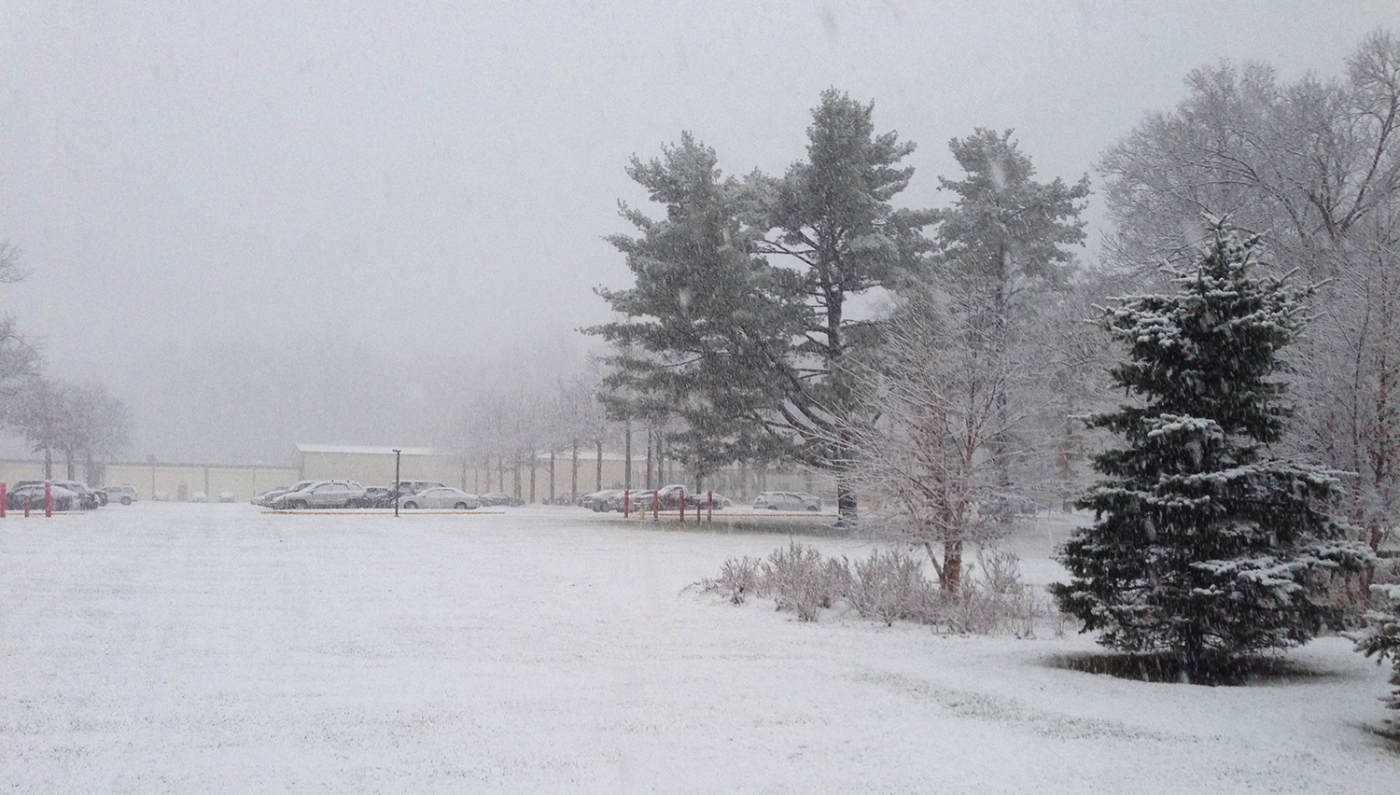
This Week @ PPPL
January 13-18, 2014
From the PPPL Office of Communications

Slide 2

PPPL Alternative Commuting Incentives
Vanpool
Princeton University will provide a van to groups of at least 5 whom live more than 10 miles from the laboratory.
The group is responsible for gas and the university is responsible for all other costs and maintenance.

Slide 3
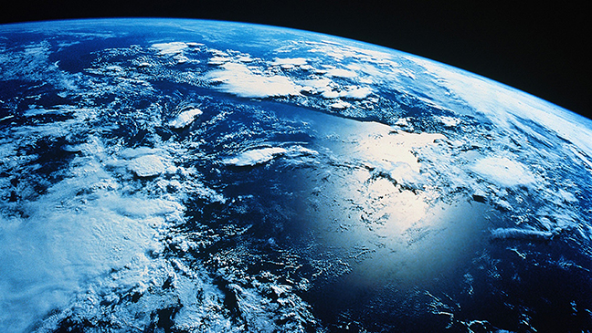

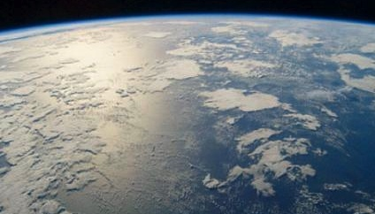
The Global Carbon Cycle and Earth's Climate
David Archer
University of Chicago
WEDNESDAY, JAN. 15
4:15 p.m. (Coffee/Tea at 4 p.m.) • M.B.G. Auditorium

Slide 4


UPCOMING EVENTS
Wednesday, January 15
  PPPL Colloquium • 4:15 p.m. – MBG Auditorium – “The Global Carbon Cycle”
Saturday, January 18
  Science on Saturday – 9:30 a.m. – MBG Auditorium – “Physics of Cancer”
Wednesday, January 22
  PPPL Colloquium • 4:15 p.m. – MBG Auditorium – “Addressing Big Data Challenges in Simulation-based Science”
Saturday, January 25
  Science on Saturday – 9:30 a.m. – MBG Auditorium – “The atmosphere as a laboratory: aerosols, air quality, and climate”
Wednesday, January 29
  PPPL Colloquium • 4:15 p.m. – MBG Auditorium – “The Usefulness of Useless Knowledge: The History of the Institute for Advanced Study”
Saturday, Febuary 1
  Science on Saturday – 9:30 a.m. – MBG Auditorium – “The invisible world of marine microbes: how Earth’s smallest living things have the biggest impact on how our ocean works”

Slide 5
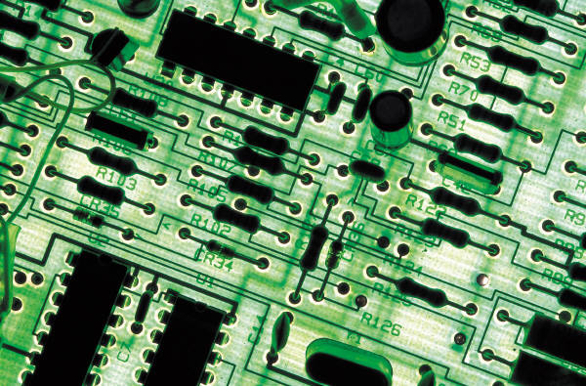
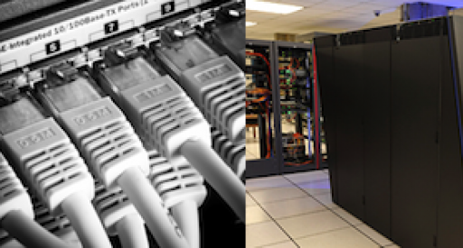
Addressing Big Data Challenges in Simulation-based Science
Manish Prashar
Rutgers University
Next Week - WEDNESDAY, JAN. 22
4:15 p.m. (Coffee/Tea at 4 p.m.) • M.B.G. Auditorium

Slide 6

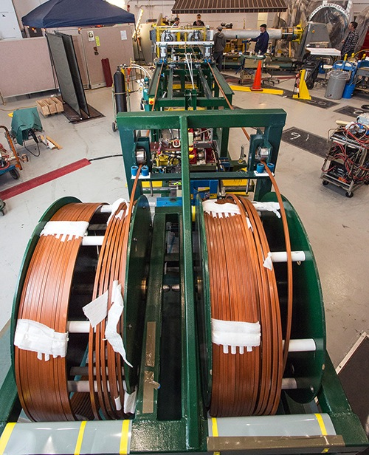
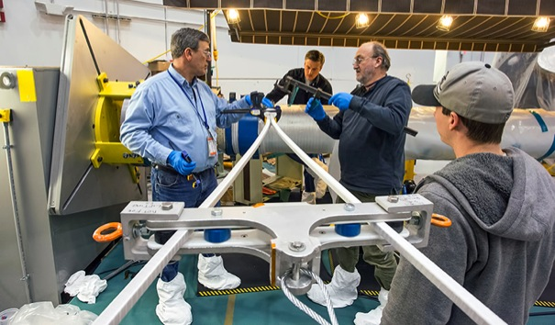

Winding up the NSTX-U center stack

Slide 7

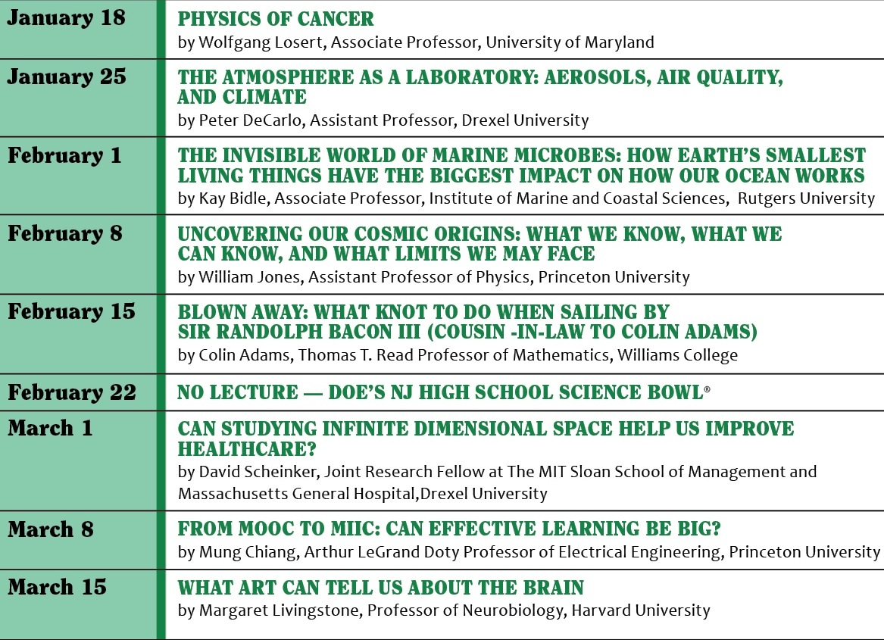

Slide 8


Slide 9
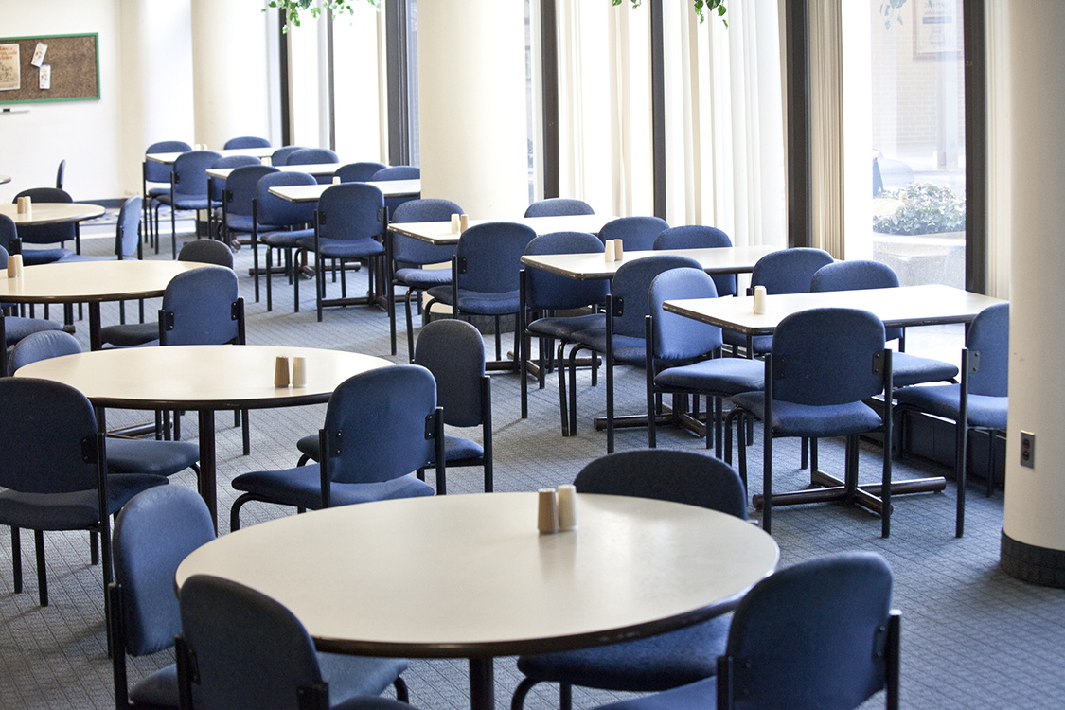
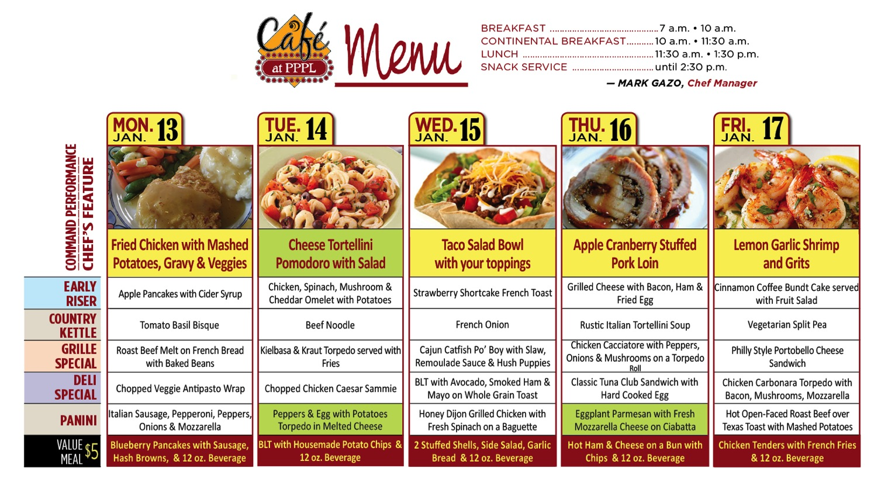
Menu subject to change without notice.

