Slide 1
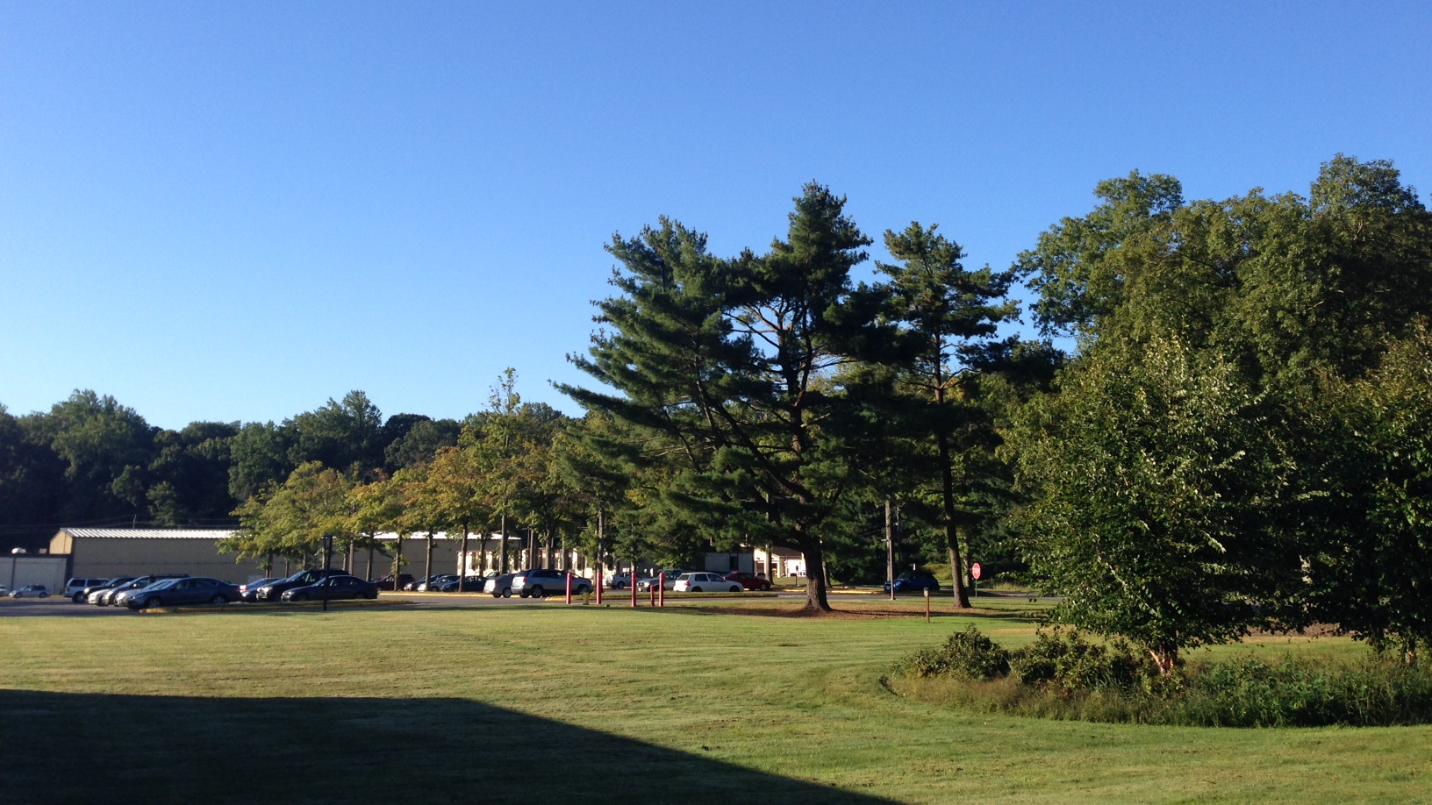
This Week @ PPPL
October 7, 2013
From the PPPL Office of Communications

Slide 2
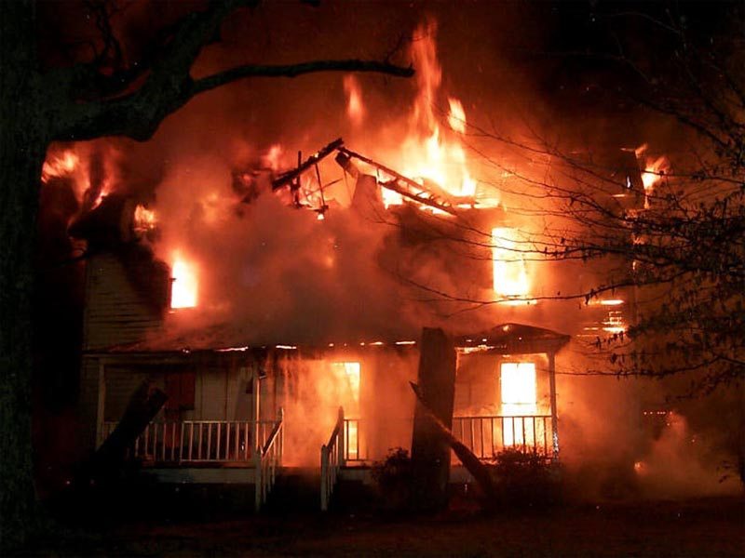

Please join the Site Protection Division on Friday, October 11 from 11 a.m. to 2 p.m. in the
LSB Loop to learn about fire safety. There will be a fire hose demonstration with a hose house, PPPL Fire Engine 66 and a fire extinguisher demonstration.

Slide 3
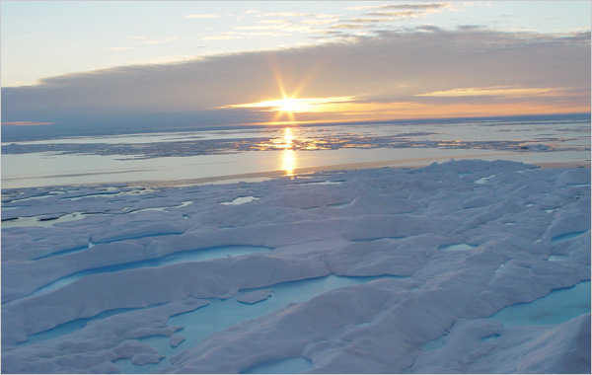

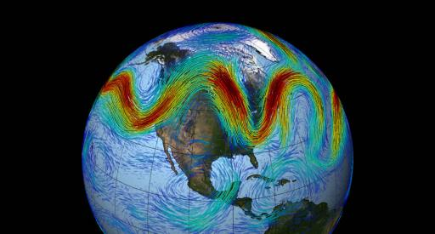
Effects of a Rapidly Warming Arctic on Weather Patterns in Mid-Latitudes
Jennifer Francis
Rutgers University
WEDNESDAY, OCTOBER 9
NOTE>>>> 3:00 p.m. (Coffee/Tea at 2:45 p.m.) • M.B.G. Auditorium

Slide 4
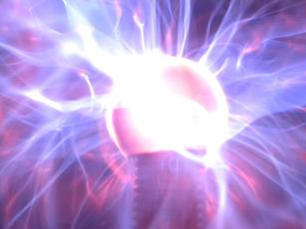
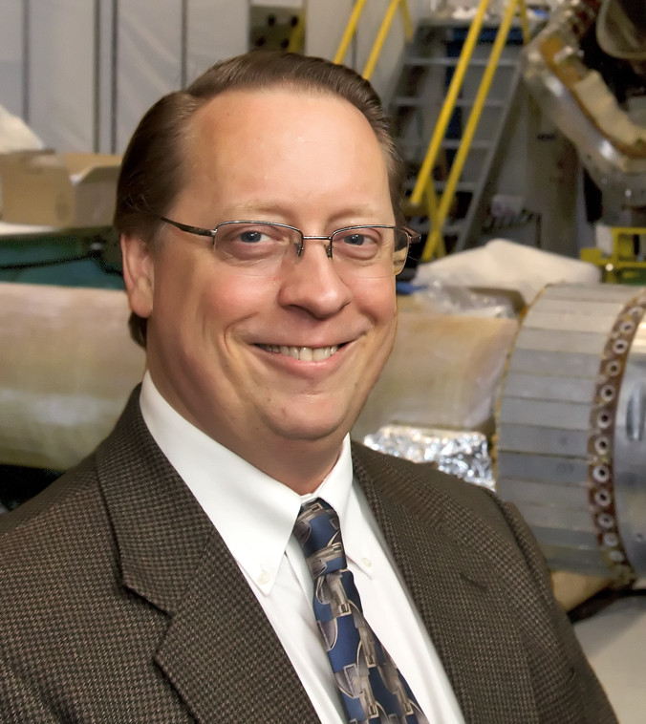
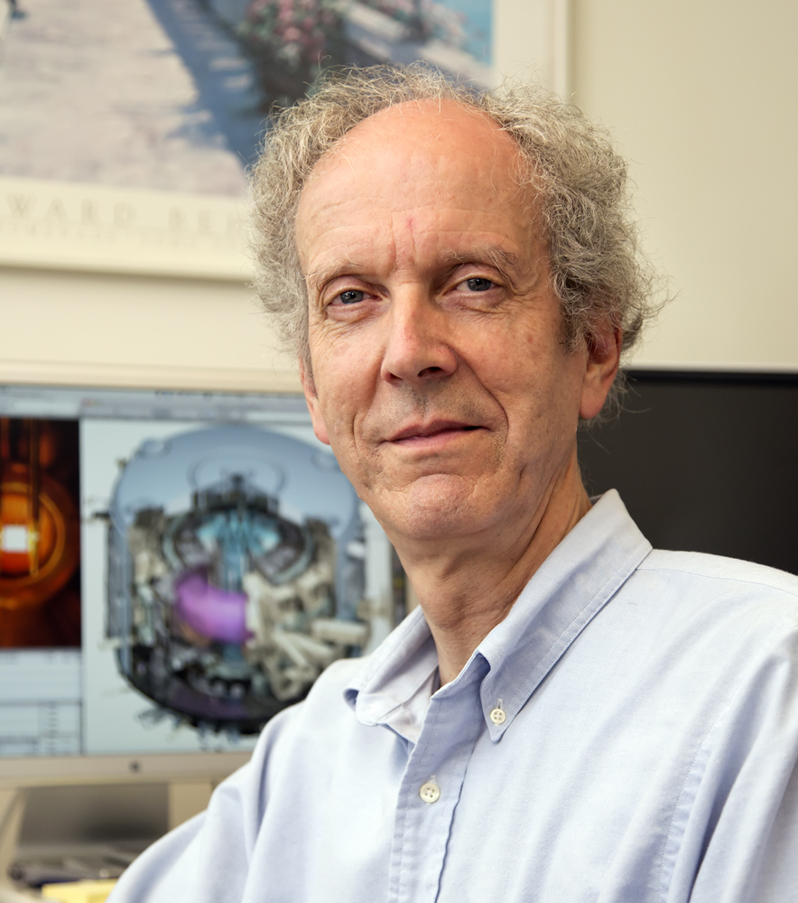
-
David Gates and Charles Skinner were elected as APS fellows for their pioneering work in plasma physics.

Slide 5


Influenza is a contagious disease caused by a virus that can be spread by coughing, sneezing
or nasal secretions.
The best single way to prevent seasonal flu
is to get an annual influenza vaccination.
By getting vaccinated you can protect yourself from influenza and may also avoid spreading
this illness to others.
Flu vaccine appointments are available NOW.
Contact the OMO at 3200 for an appointment.

Slide 6
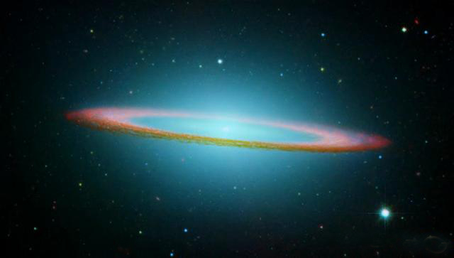

Big Bang Neutrinos
Christopher Tully
Princeton University
Next week WEDNESDAY, OCTOBER 16
4:15 p.m. (Coffee/Tea at 4 p.m.) • M.B.G. Auditorium

Slide 7

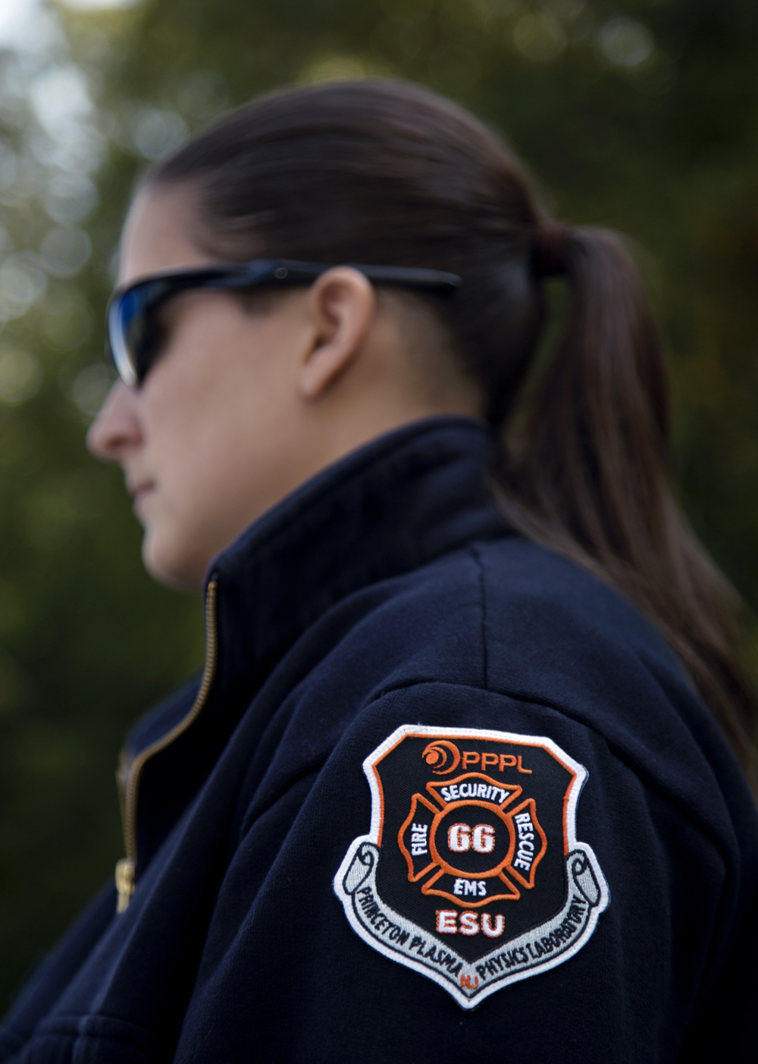

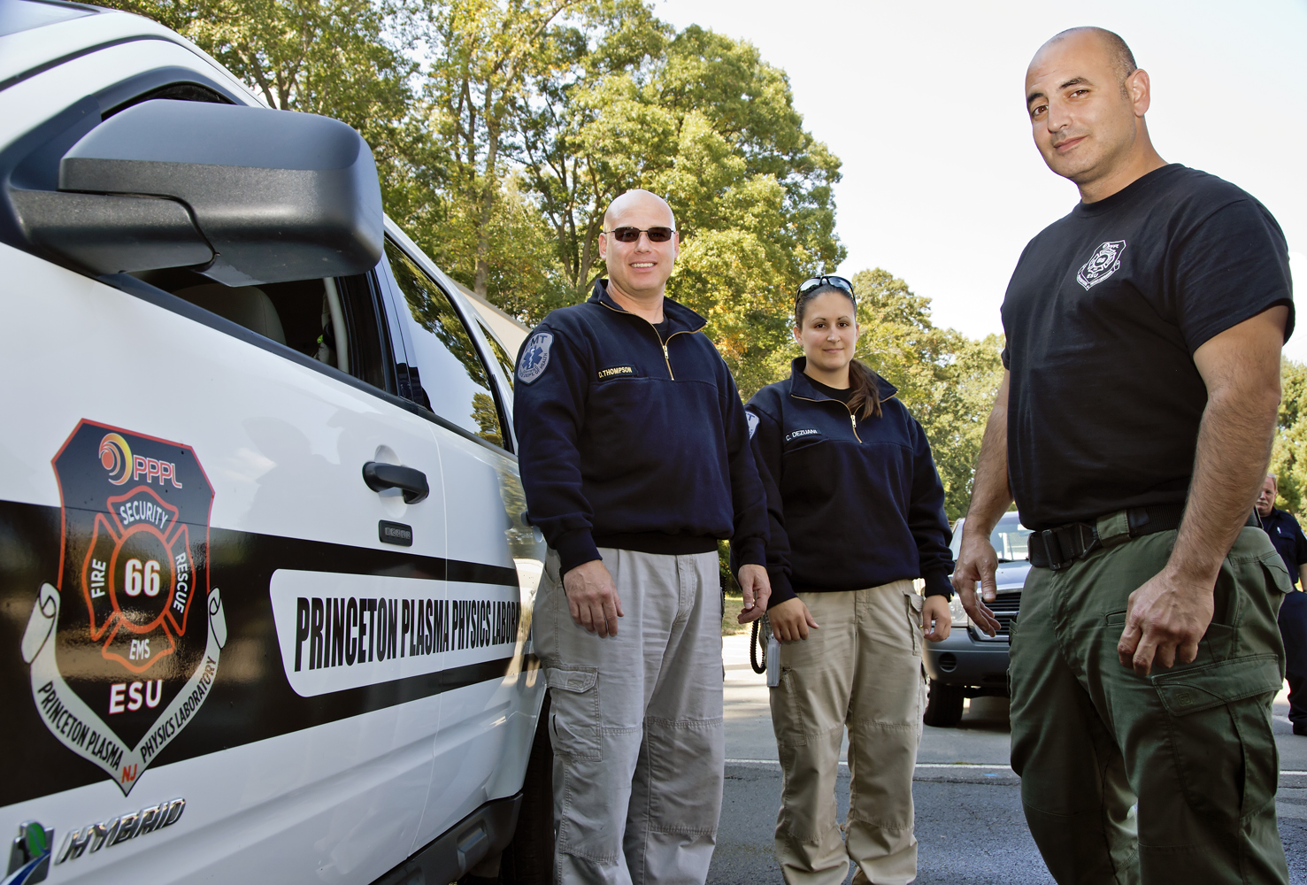
ESU debuts new Patch

Slide 8
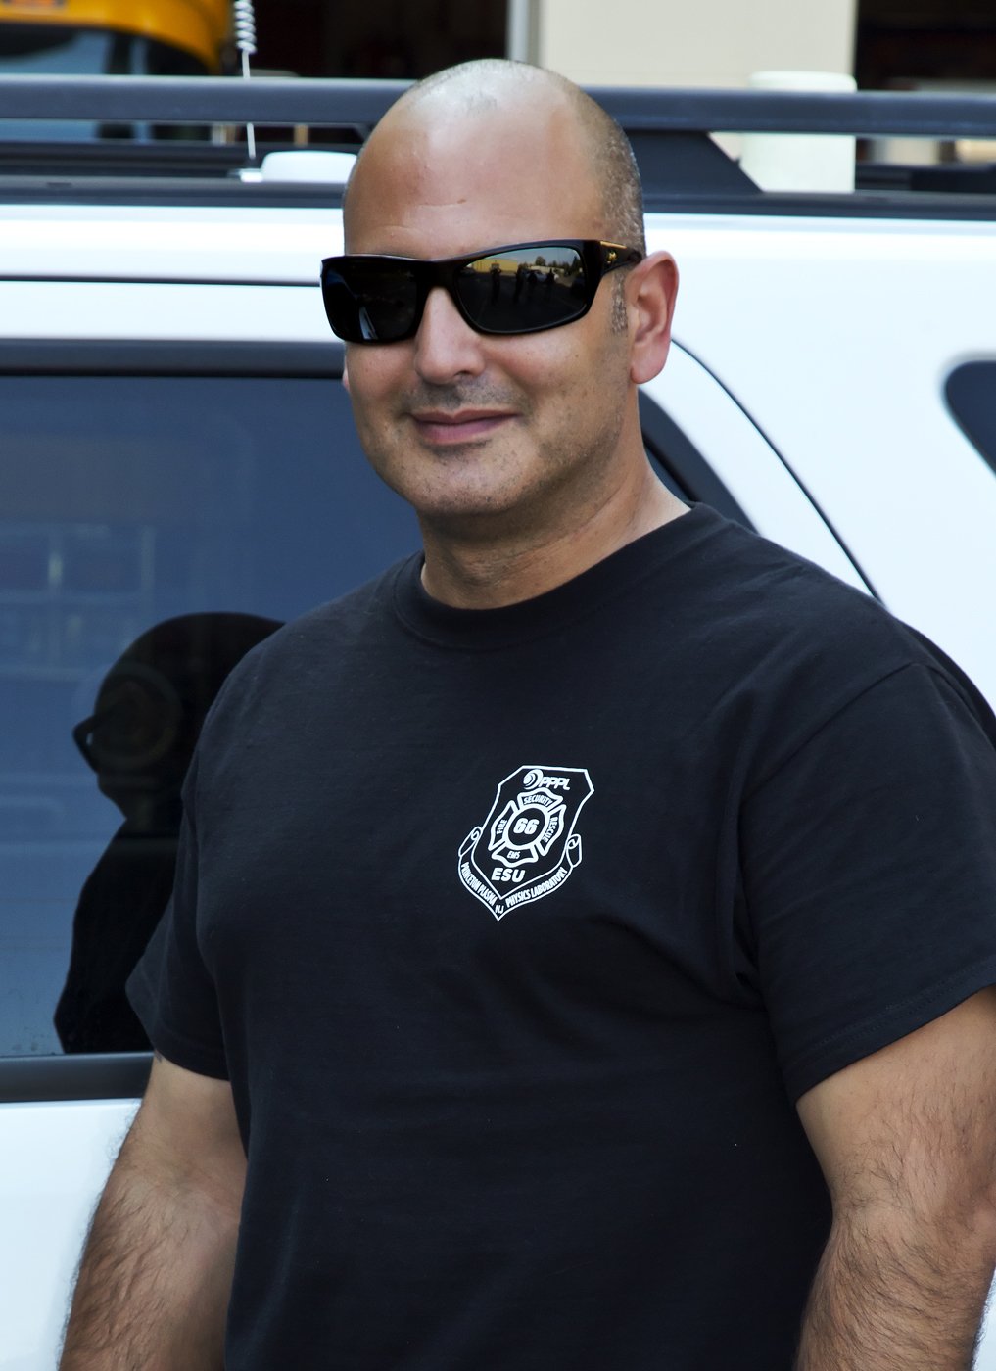
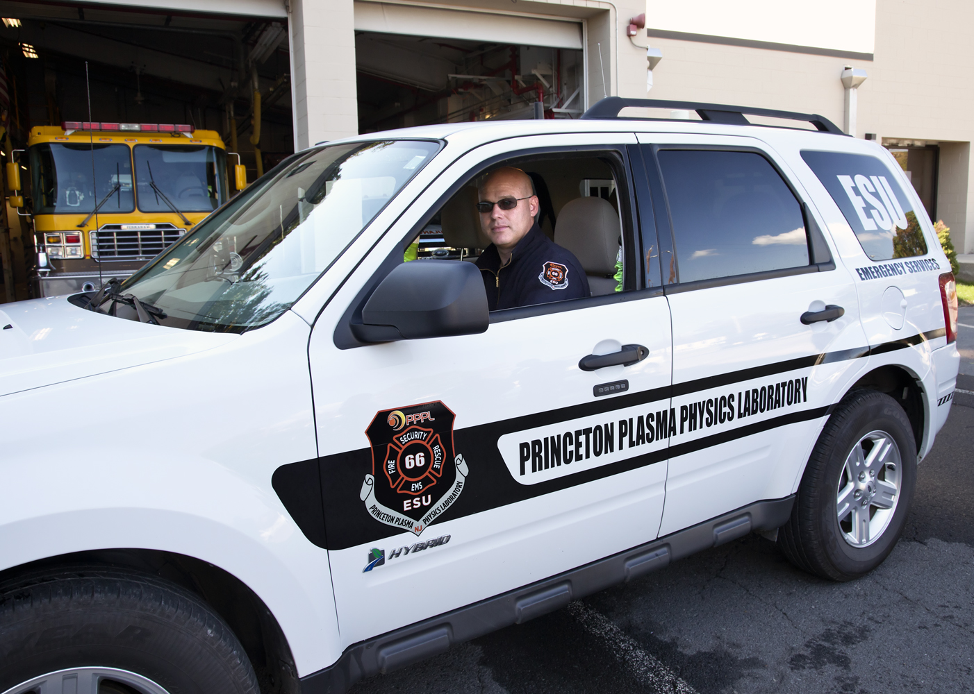
ESU debuts new Patch

Slide 9

Welcome PPPL New Hires…

Slide 10

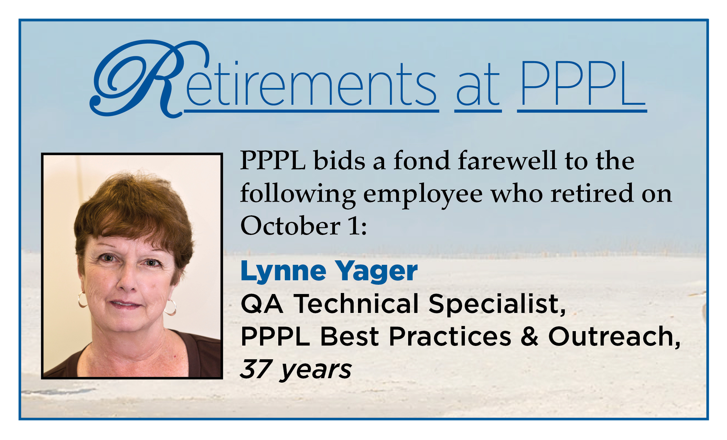

Slide 11

Convenience
is one of the most reported reasons behind unsafe behavior, per STOP Program data.
Don’t accept shortcuts for yourself or from others.
Consider the potential outcome of your actions - for yourself, your family, and your coworkers.
Analyze hazards and have protective measures in place before you begin to work.
Take the time to do it right!

Slide 12

UPCOMING EVENTS
Wednesday, October 9
PPPL Colloquium • 3:00 p.m. - MBG Auditorium – Jennifer Francis, Rutgers University
Saturday, October 12
Princeton University Community & Staff Day • 10 a.m. - Jadwin Gym, Princeton Stadium
Saturday, October 12
Princeton University Freshman Parents Tour at PPPL • 2 p.m. and 3 p.m.
Wednesday, October 16
PPPL Colloquium • 4:15 p.m. - MBG Auditorium – Christopher Tully, Princeton University
Sat.- Sun., October 19-20
Lyman Spitzer Conference • Dept. of Astrophysical Sciences Peyton Hall, Princeton University
Monday, October 21
Open Enrollment Begins for Princeton University Healthcare Plans
Saturday, October 26
Boy Scout Merit Badge Fair at PPPL
Wednesday, November 6
Open Enrollment Health Fair at PPPL
Mon.-Fri., November 11–15
55th Annual Meeting of the APS Division of Plasma Physics, Denver, Colo.

Slide 13
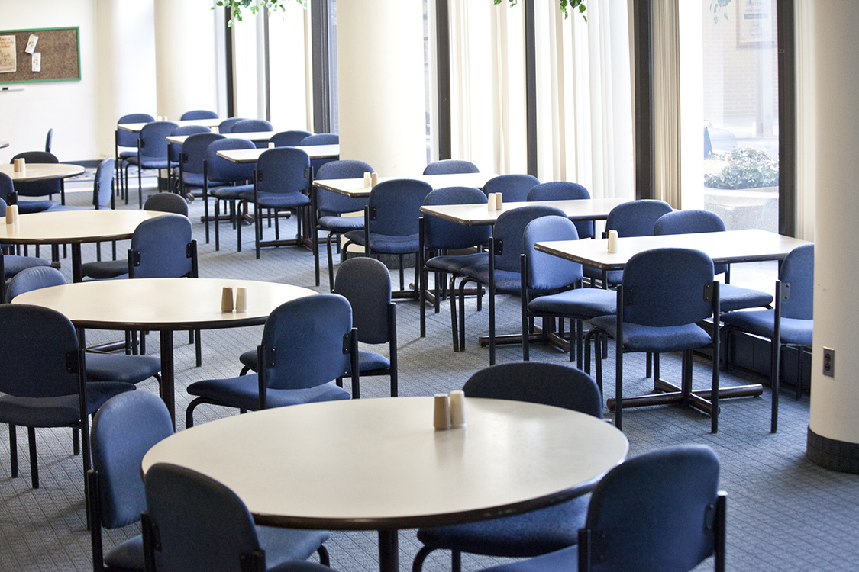

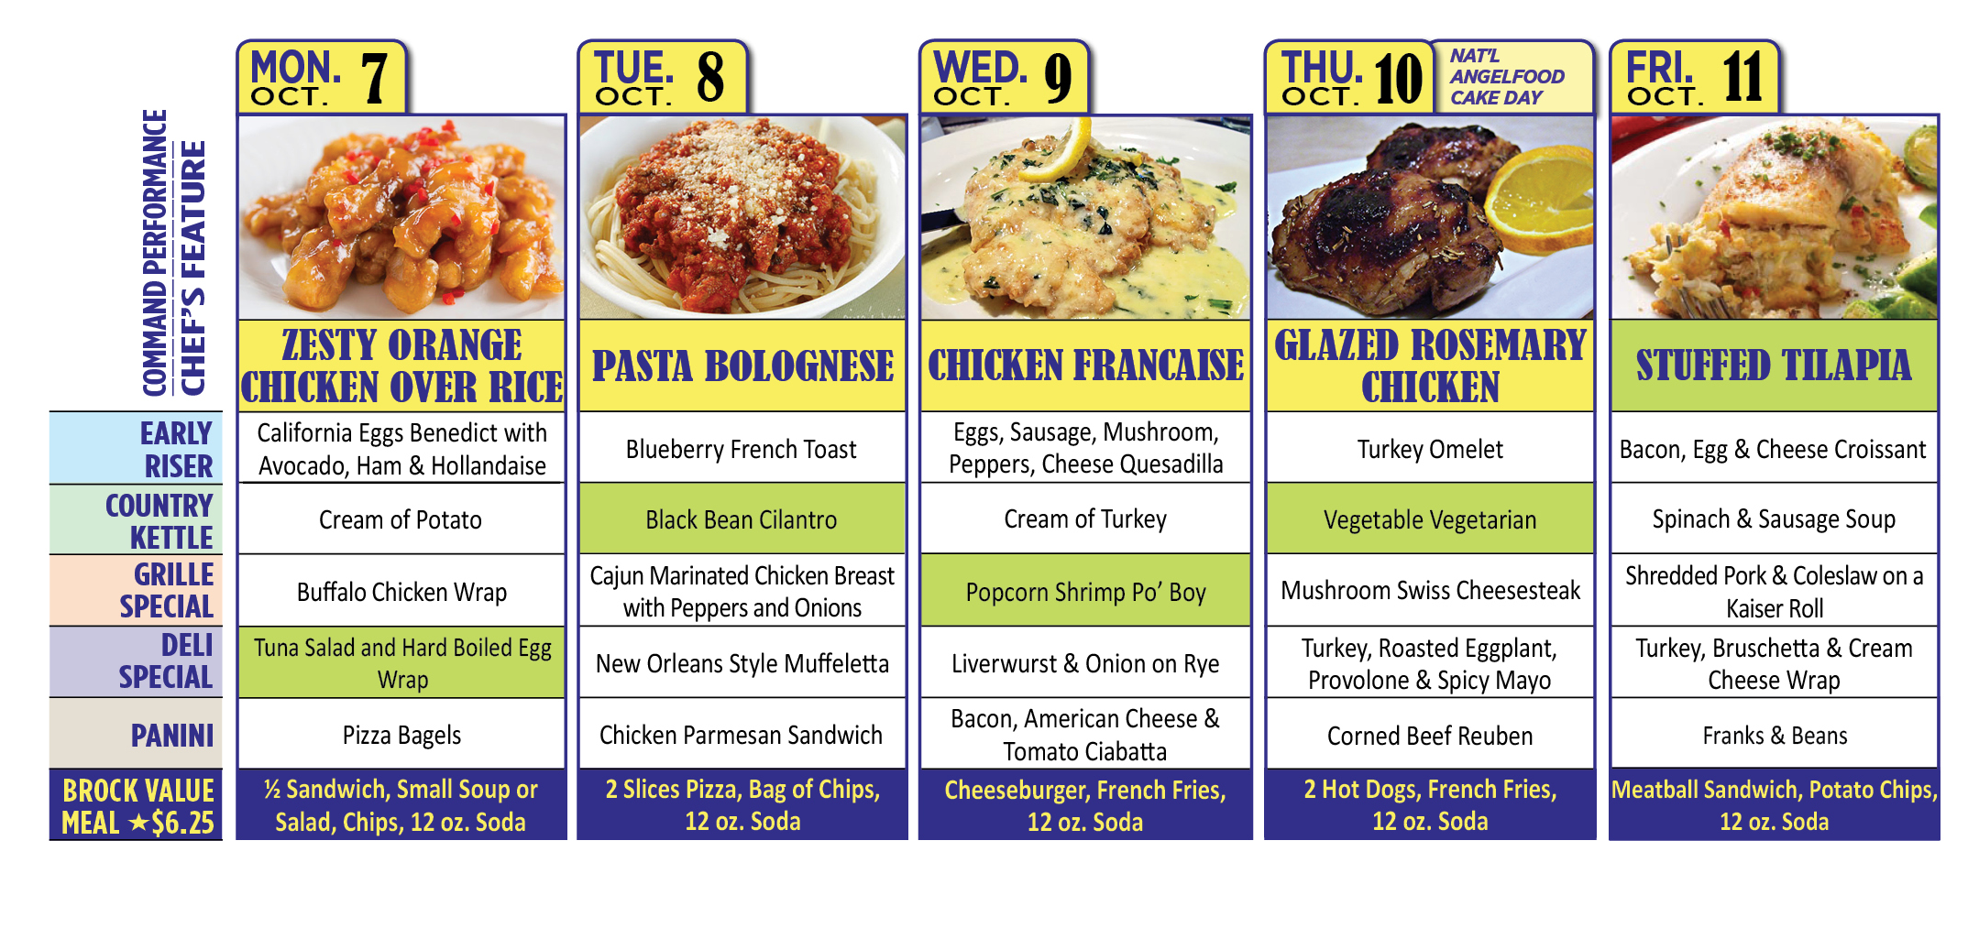
Menu subject to change without notice.

