Slide 1
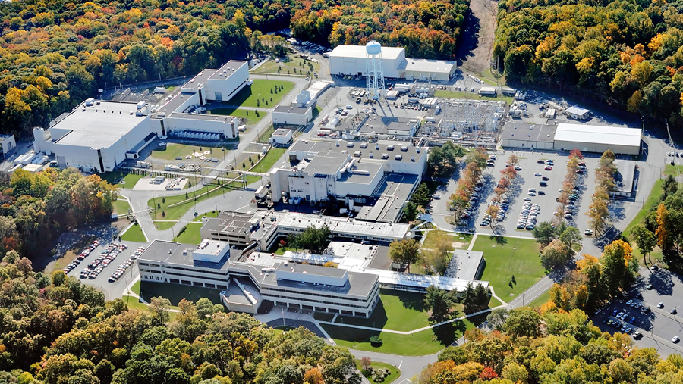
This Week @ PPPL
December 3 – 7, 2012
From the PPPL Office of Communications

Slide 2
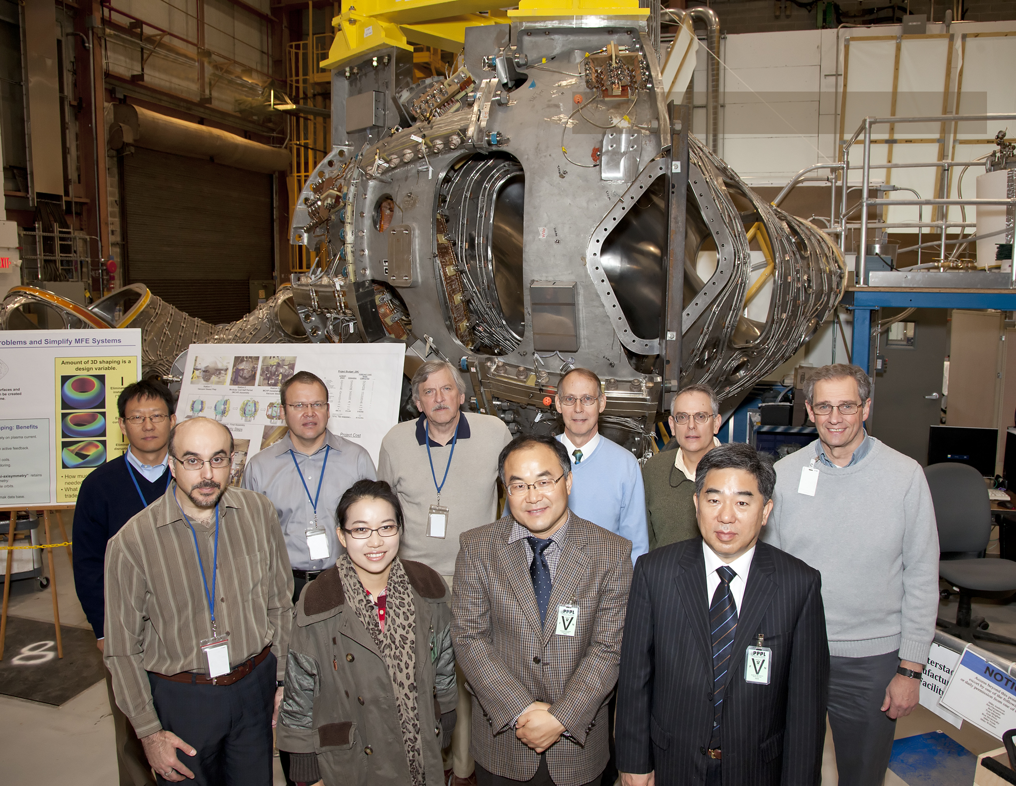
Planning for
K-DEMO
Three members of the National Fusion Research Institute of Korea visit PPPL to discuss
plans for K-DEMO, Korea’s next-step fusion facility.

Slide 3
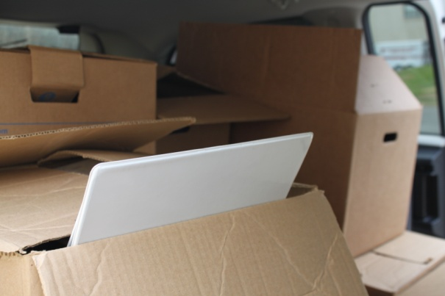
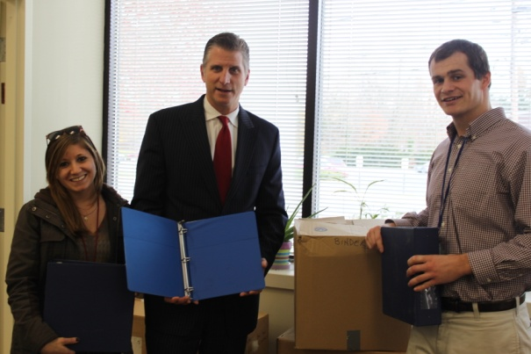

Binder Collection for Ewing Township School District
460 lbs
Of Binders
Nelson Neal Spencer Holcombe Jim Conover Kyron Jones Margaret King Zoe Shaheen
Thank you to the individuals above, who
devoted extra time and effort for this project

Slide 4
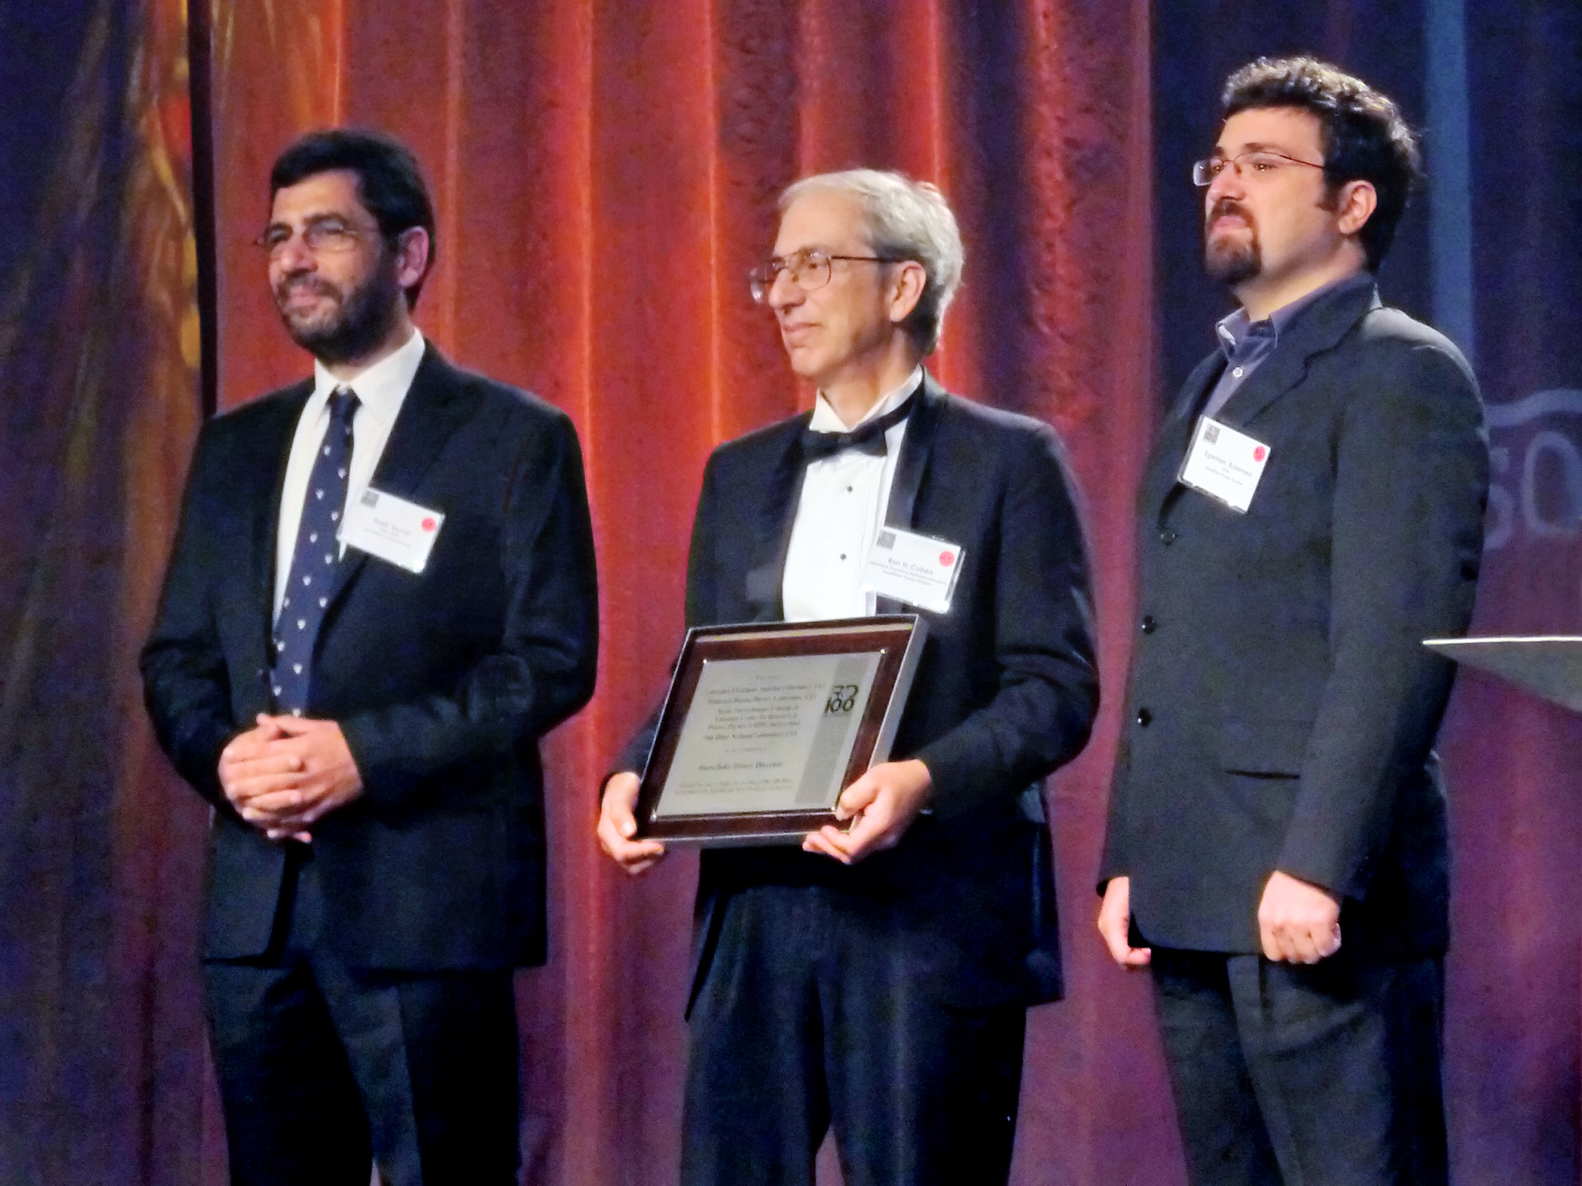
The 2012
R&D 100 Award ceremony
on Nov. 1 in
Orlando, Florida
Congratulations to Egemen Kolemen and two others from a team of scientists working on the “snowflake” power divertor.

Slide 5
Latest Developments in Quantum Computing
Dr. Robert Lucas
University of Southern California
This Week - Wednesday, December 5
4:15 p.m. (Coffee/Tea at 4 p.m.) • M.B.G. Auditorium, Lyman Spitzer Building

Slide 6

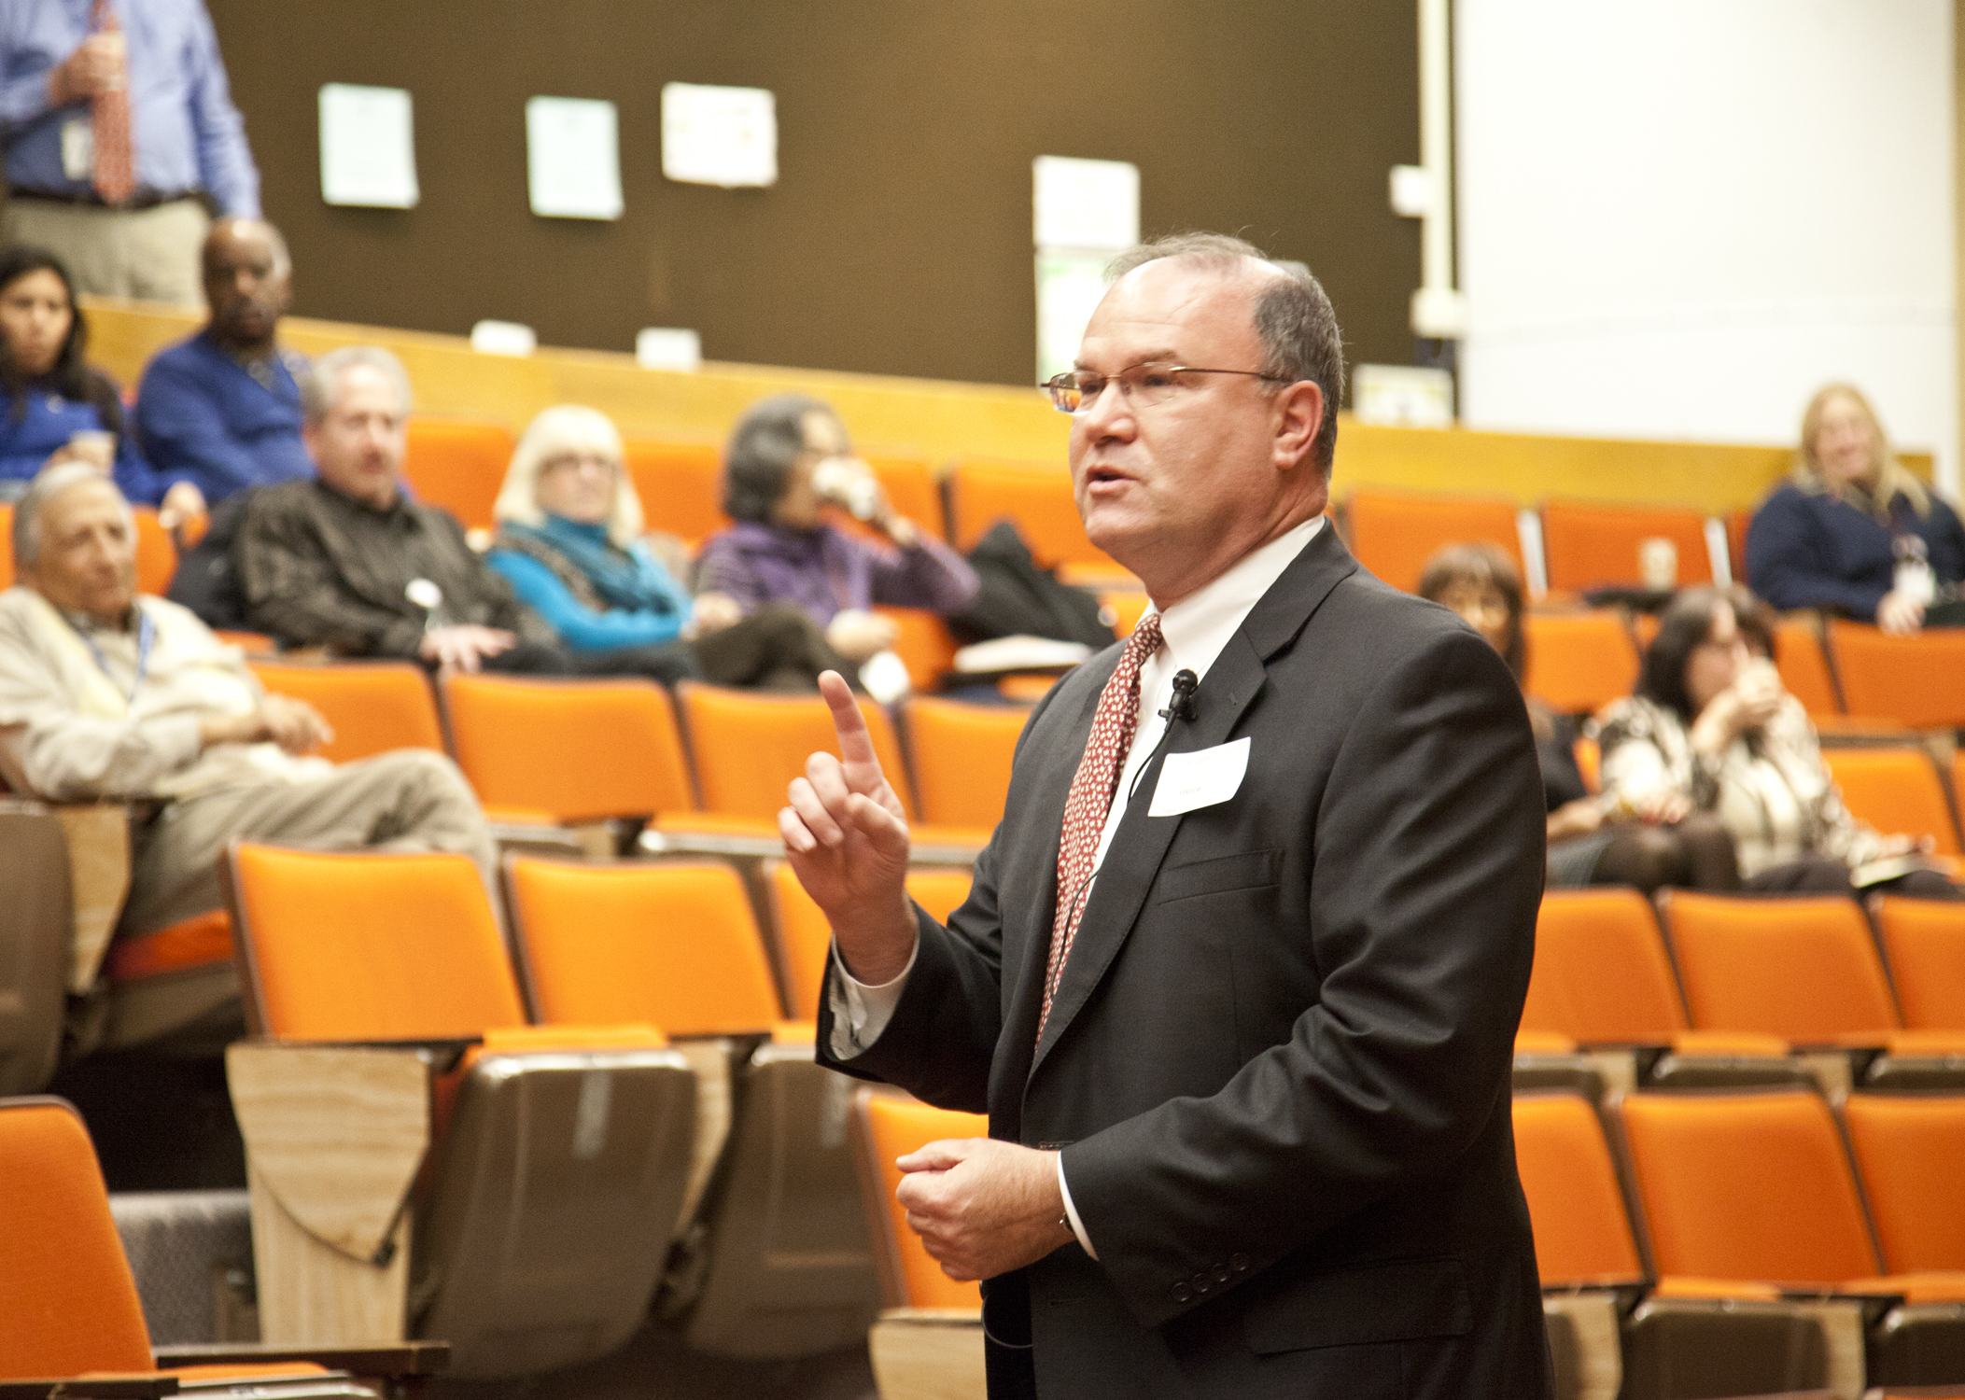
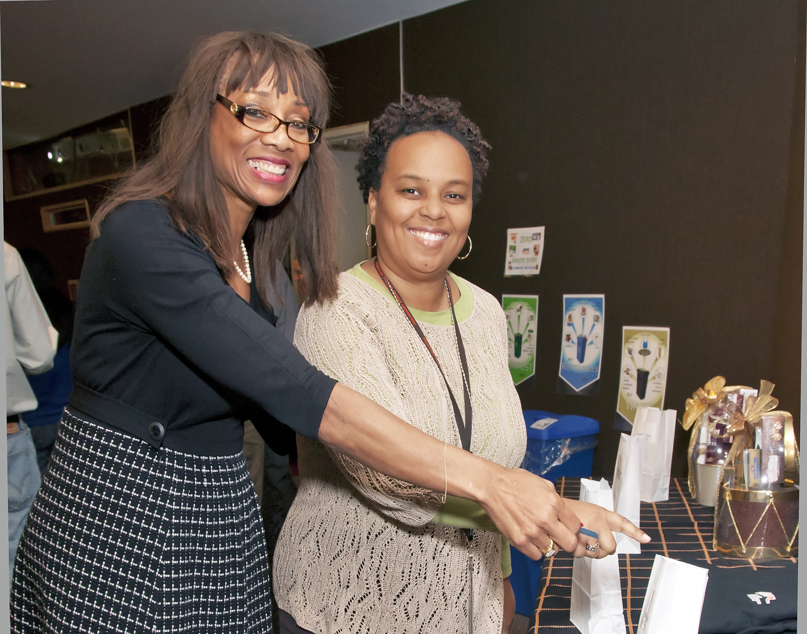
The PPPL and Princeton University United Way Campaign kicked off Nov. 29. Please make your contributions through Dec. 14.

Slide 7
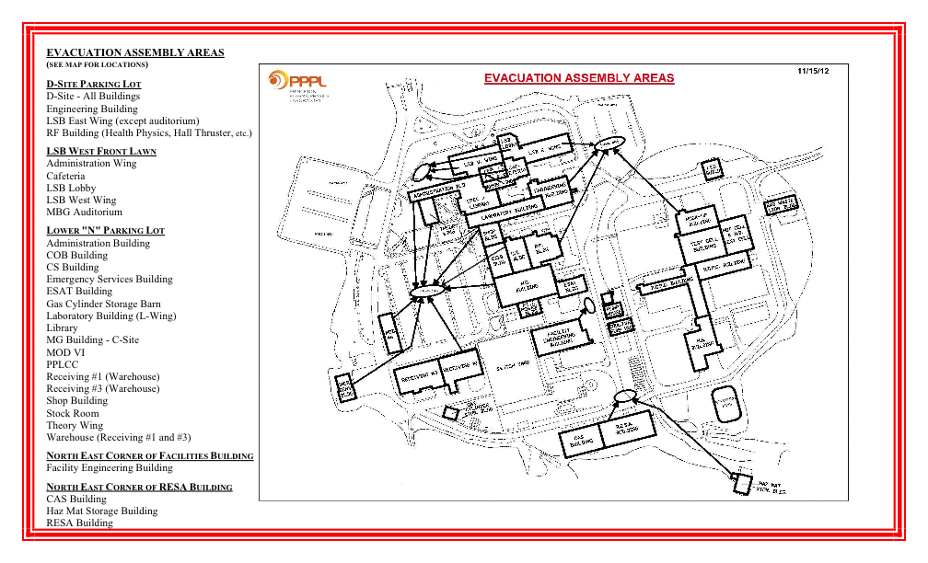

Slide 8




Menu subject to change without notice.

