Slide 1



The State of the Lab
Progress and opportunities in turbulent times
Stewart Prager
May, 2013

Slide 2
The lab fundamentals are solid
Our mission is of national importance
The opportunities in fusion and plasma science are large
Fusion is entering the “ITER era,” and PPPL plans to have a major role in research and operations
Our progress is outstanding
The commitment by DOE to PPPL is strong
We are optimistic about the future of PPPL

Slide 3
But, PPPL is immersed in a turbulent national setting
Long-term planning in the US is challenging
The increasing funding needs for ITER are stressing the current fusion research program

Slide 4
The budget challenge for fusion
 | FY 12 | FY14 | change
ITER | 105 | 225 | 120
Research | $296M | 233 | -63 (21%)
Total | 401 | 458 | 57
The plan is to maintain ITER at $225M for many years
The cut to the research program is severe everywhere, (singularly so for MIT)

Slide 5
The approximate effect on PPPL in FY14
NSTX-Upgrade project and program are fully funded
Roughly a 10% reduction for PPPL ($6M - $7M) from FES
Reduction of funding for
collaborations (C-MOD at GA,DIII-D at MIT),
theory,
general plasma science experiments
high energy density physics
Broad negative scientific impact

Slide 6
Actions to manage the budget reductions
Voluntary staff reduction program will be initiated in the Theory Department and ITER & Tokamak Department
Further adjustments may be necessary, but no lab-wide staff actions expected in FY13, and likely not in FY14
We are expecting, and will fight for, normal salary increases for FY 14

Slide 7
The national fusion program: managing and growing beyond the crisis
PPPL, with the larger fusion community, is working to
Convey technical information to Congress
2. Advance strategic planning
3. Communicate fusion to the public

Slide 8
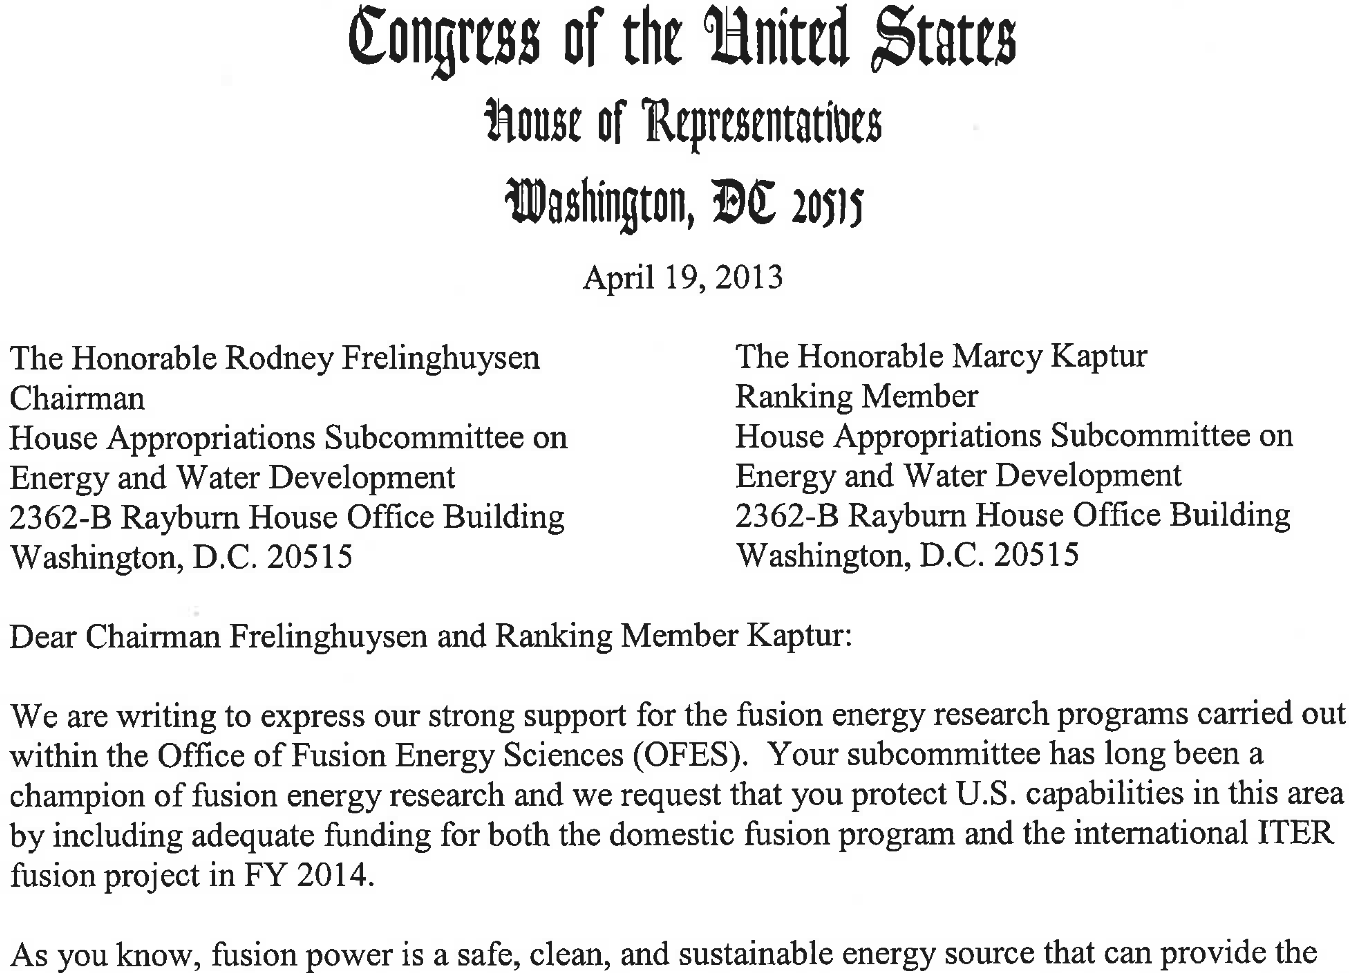
There is significant support for fusion in Congress
Letter of support for fusion signed by 50 congresspersons

Slide 9
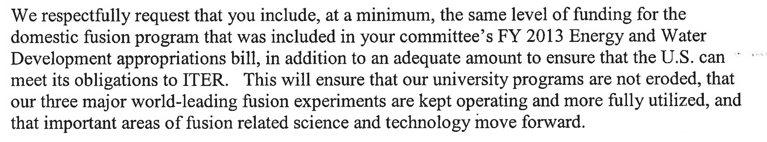
The letter was initiated by Rush Holt

Slide 10

Community strategic discussions
Several community discussions underway
e.g., Group of fusion program leaders articulated simple ten year goal for an aggressive program, informing the actions of the American Security Project (and Forbes article)
American Security Project white paper
A Challenge to America: Develop Fusion Power Within a Decade
by
Norman Augustine and Gary Hart

Slide 11
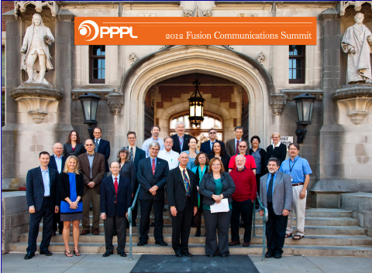
Fusion communications
Fusion Communications summit, Sept 2012
National gathering of communications professionals, fusion scientists, journalists…….

Slide 12
Fusion communications
Fusion Communications summit, Sept 2012
National Fusion Communications Group formed
National Strategic Plan formulated

Slide 13
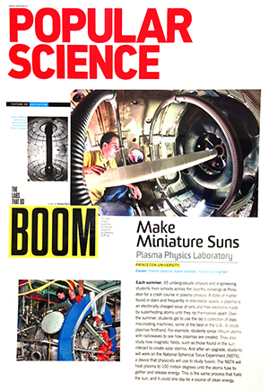
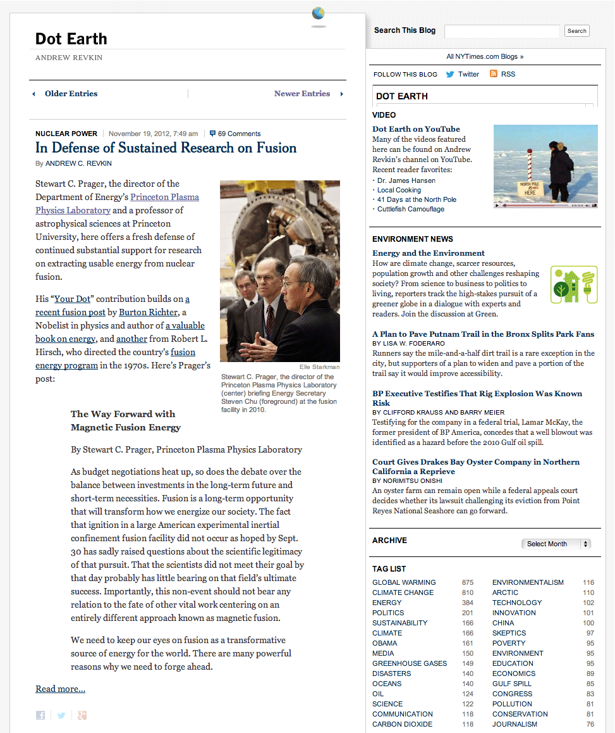
Meanwhile, PPPL featured in major news outlets
Wash Post
NY Times Blog

Slide 14
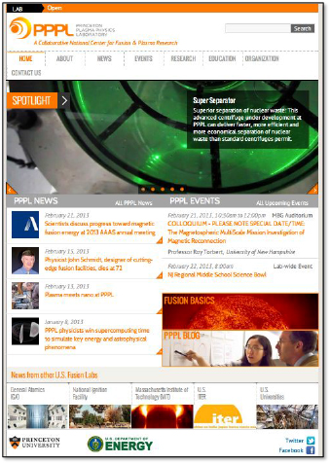
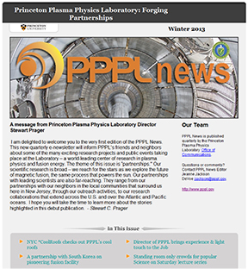
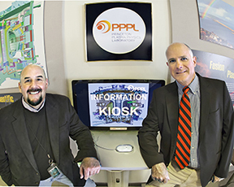
New website
New e-newsletter for external audience
New information kiosk in lobby

Slide 15
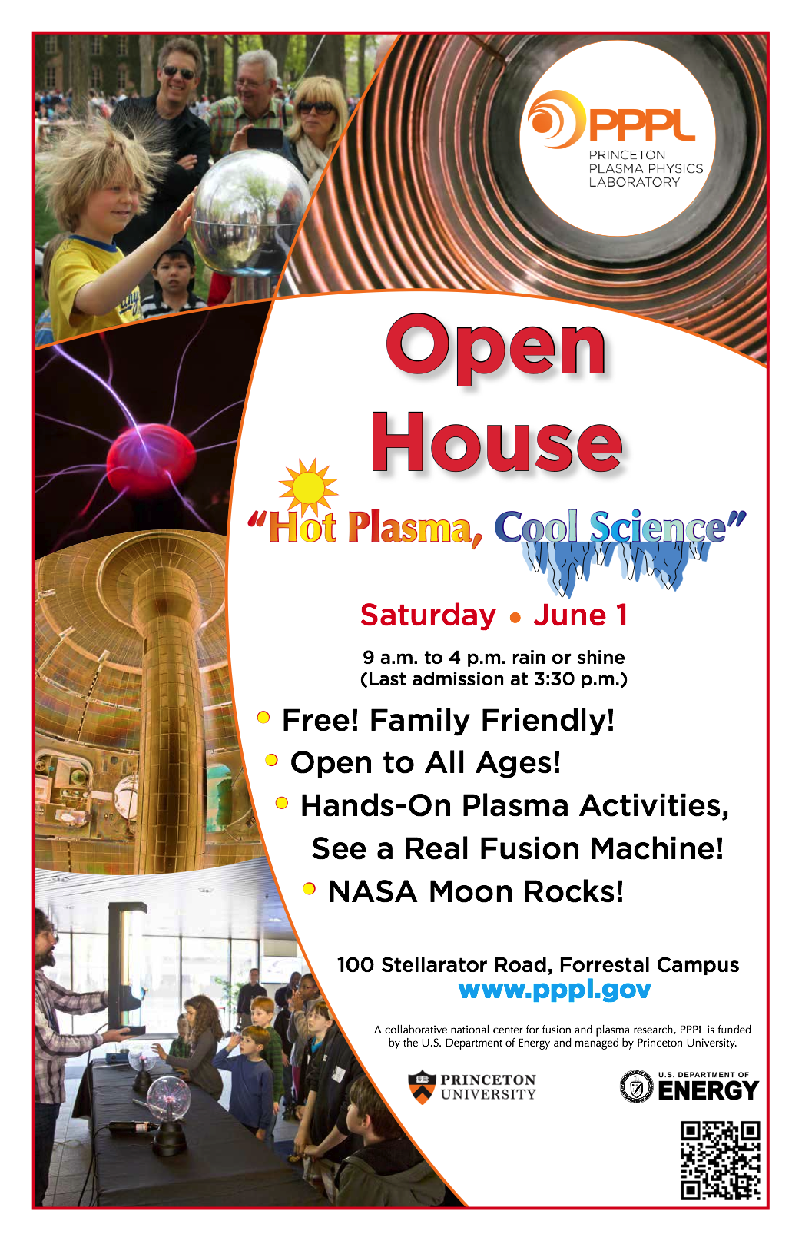
Open House on Saturday
Still need volunteers!
(especially to discuss the science)
Contact:
John Delooper or Andrea Moten

Slide 16
PPPL has a well-formulated strategy
Two mission elements
Develop magnetic fusion energy
Advance basic plasma science and its applications
Flexible to fit the uncertain times
Explore many avenues and opportunities

Slide 17
Lab strategic elements for magnetic fusion
Advance the spherical tokamak for multiple fusion applications
Explore the physics and engineering science of plasmas producing fusion power (ITER plus)
Use 3D magnetic fields for steady-state, disruption-free plasma confinement
Supporting program elements:
Integrated fusion simulation
Plasma-material interface program

Slide 18
NSTX-U Program
In February, FESAC rated the importance of NSTX-U
as
“A” for “absolutely central”
in its review of facilities
The missions of NSTX-U:
Advance spherical tokamak for a fusion nuclear science facility
Develop novel solutions for the plasma-material interface
Advance predictive capability for ITER and beyond

Slide 19
DOE review of NSTX-U five year plan
(last week)
“NSTX-U will be a leading facility in the world fusion program, exploring the unique physics of a low aspect ratio spherical tokamak, accessing high beta, large non-inductive current fractions and compact magnetic geometry, and pushing to parameters not accessible to conventional tokamaks.”
“The quality of the proposed research is excellent, employing state-of-the-art diagnostics to obtain data that will be compared to theory using a wide variety of numerical models”
Congratulations to the NSTX-U team

Slide 20
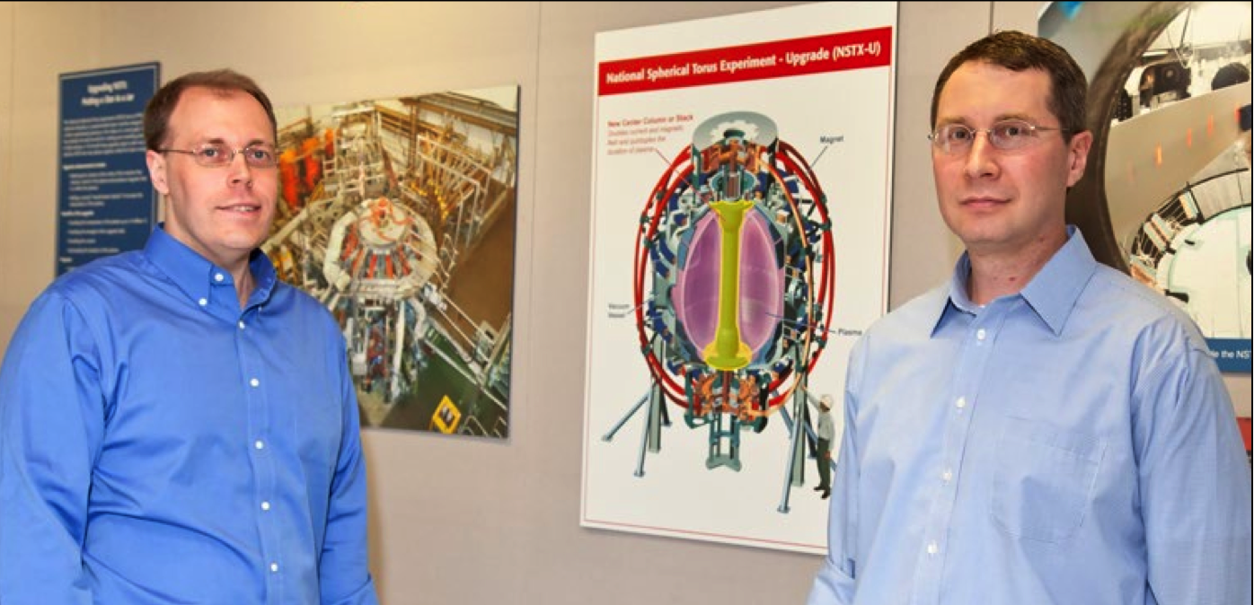
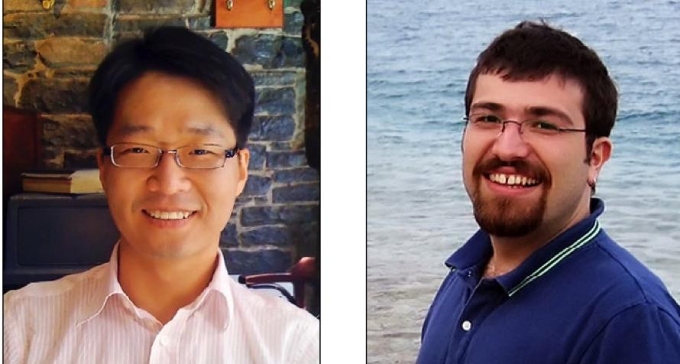
NSTX researchers win R&D 100 Award
For development of the snowflake divertor
Vlad Soukhanovskii
(LLNL)
Jon Menard
Egemen Kolemen
Joon-Wook Ahn
(ORNL)
Shared with scientists from LLNL and Lausanne

Slide 21
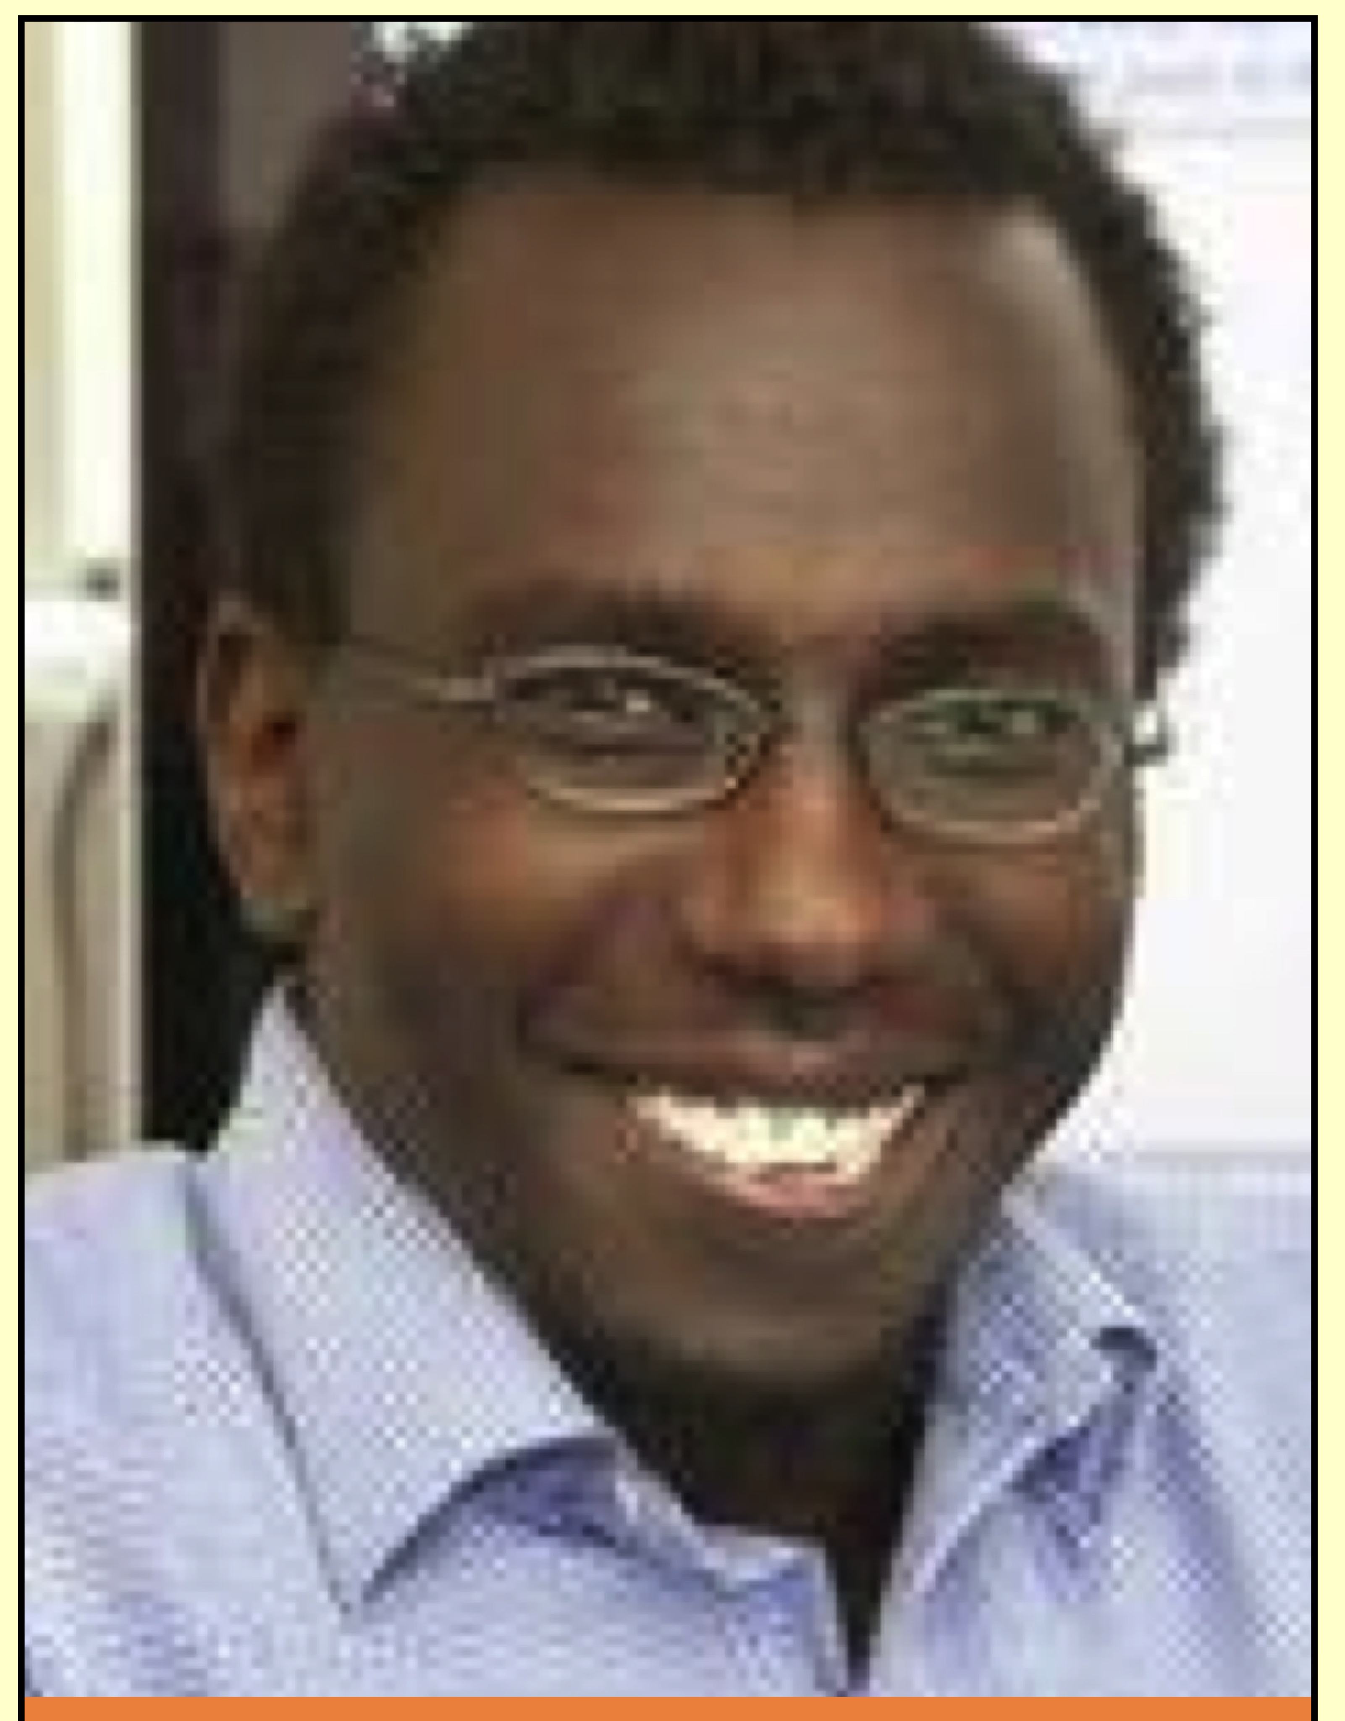
Ahmed Diallo wins
Early Career Research Program award from DOE
“Edge Pedestal Structure Control for Maximum Core Fusion Performance”
in NSTX
(five-year award)

Slide 22
During outage,
NSTX researchers active in collaborations on physics relevant to NSTX-U, ITER and beyond, on
DIII-D (GA): advanced tokamak
C-MOD (MIT): advanced tokamak
MAST (UK): spherical tokamak
EAST (China): long-pulse tokamak
KSTART (Korea): long-pulse tokamak
LHD (Japan): long-pulse stellarator
The collaborations have been very productive

Slide 23
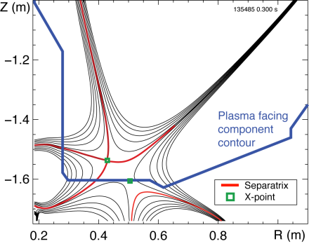
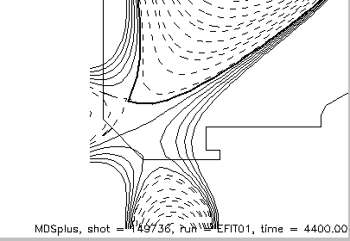
Reducing heat flux via the snowflake divertor
NSTX DIII-D
core plasma
Transferred results and operating experience from NSTX to DIII-D

Slide 24
Fully automatic, real-time control of plasma instability
(neoclassical tearing mode)
Instability location detected inside plasma,
RF wave steered to location,
mode stabilized
DIII-D

Slide 25
PPPL physics results highlighted by
Division of Plasma Physics, APS press releases
(11 out of 15 involved PPPL contributions)
NSTX Lithium impurity penetration (with LLNL)
Stability at high beta (Columbia)
Halo currents during disruptions
Pedestal measurements in DIII-D, C-Mod, NSTX
Edge turbulence (Wisconsin, U. Colorado…)
Theory Plasmoids, reconnections, solar flares (UNH)
Alpha particle losses
Energetic particles in DIII-D (modeled using PPPL code)
Reconnection theory in 3D (Columbia)
MRX Effect of guide field on reconnection
Off-site Suppression of NTM on DIII-D
Collab
Product of excellent science and communications

Slide 26
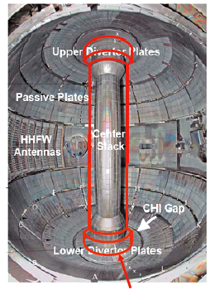

NSTX-Upgrade
new center stack second neutral beam
Double the current, double the heating power, quintuple the plasma duration
big boost to all NSTX science missions

Slide 27
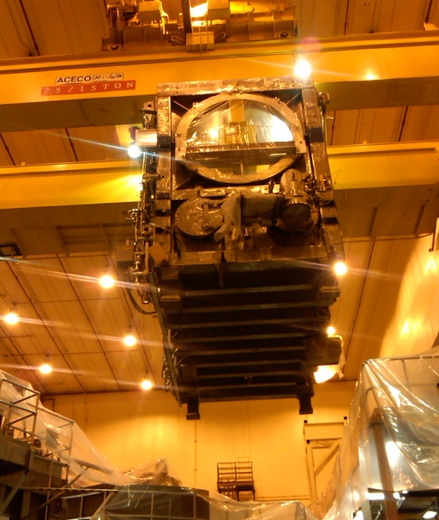
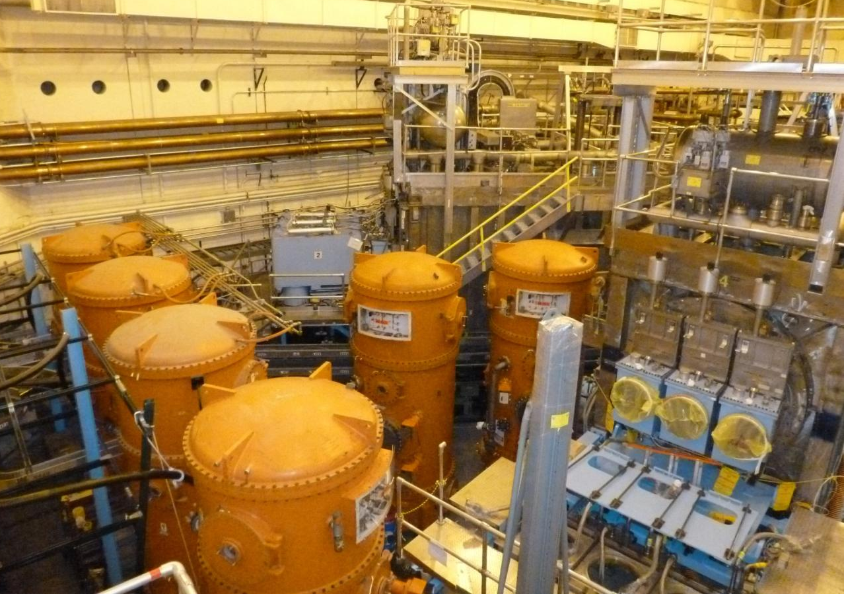
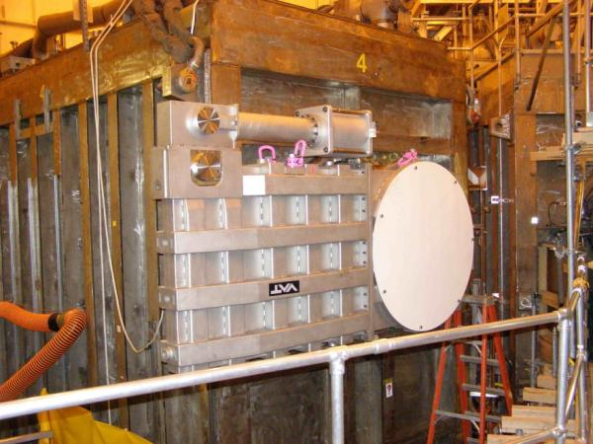
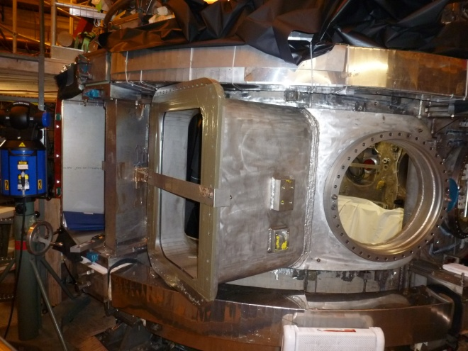
Neutral beam installation ahead of schedule
40 ton lift
Neutral Beam and HVE’s in final position
Ready for connecting duct
Valve installed on the front of the Neutral Beam
New vacuum vessel port installed onto NSTX

Slide 28
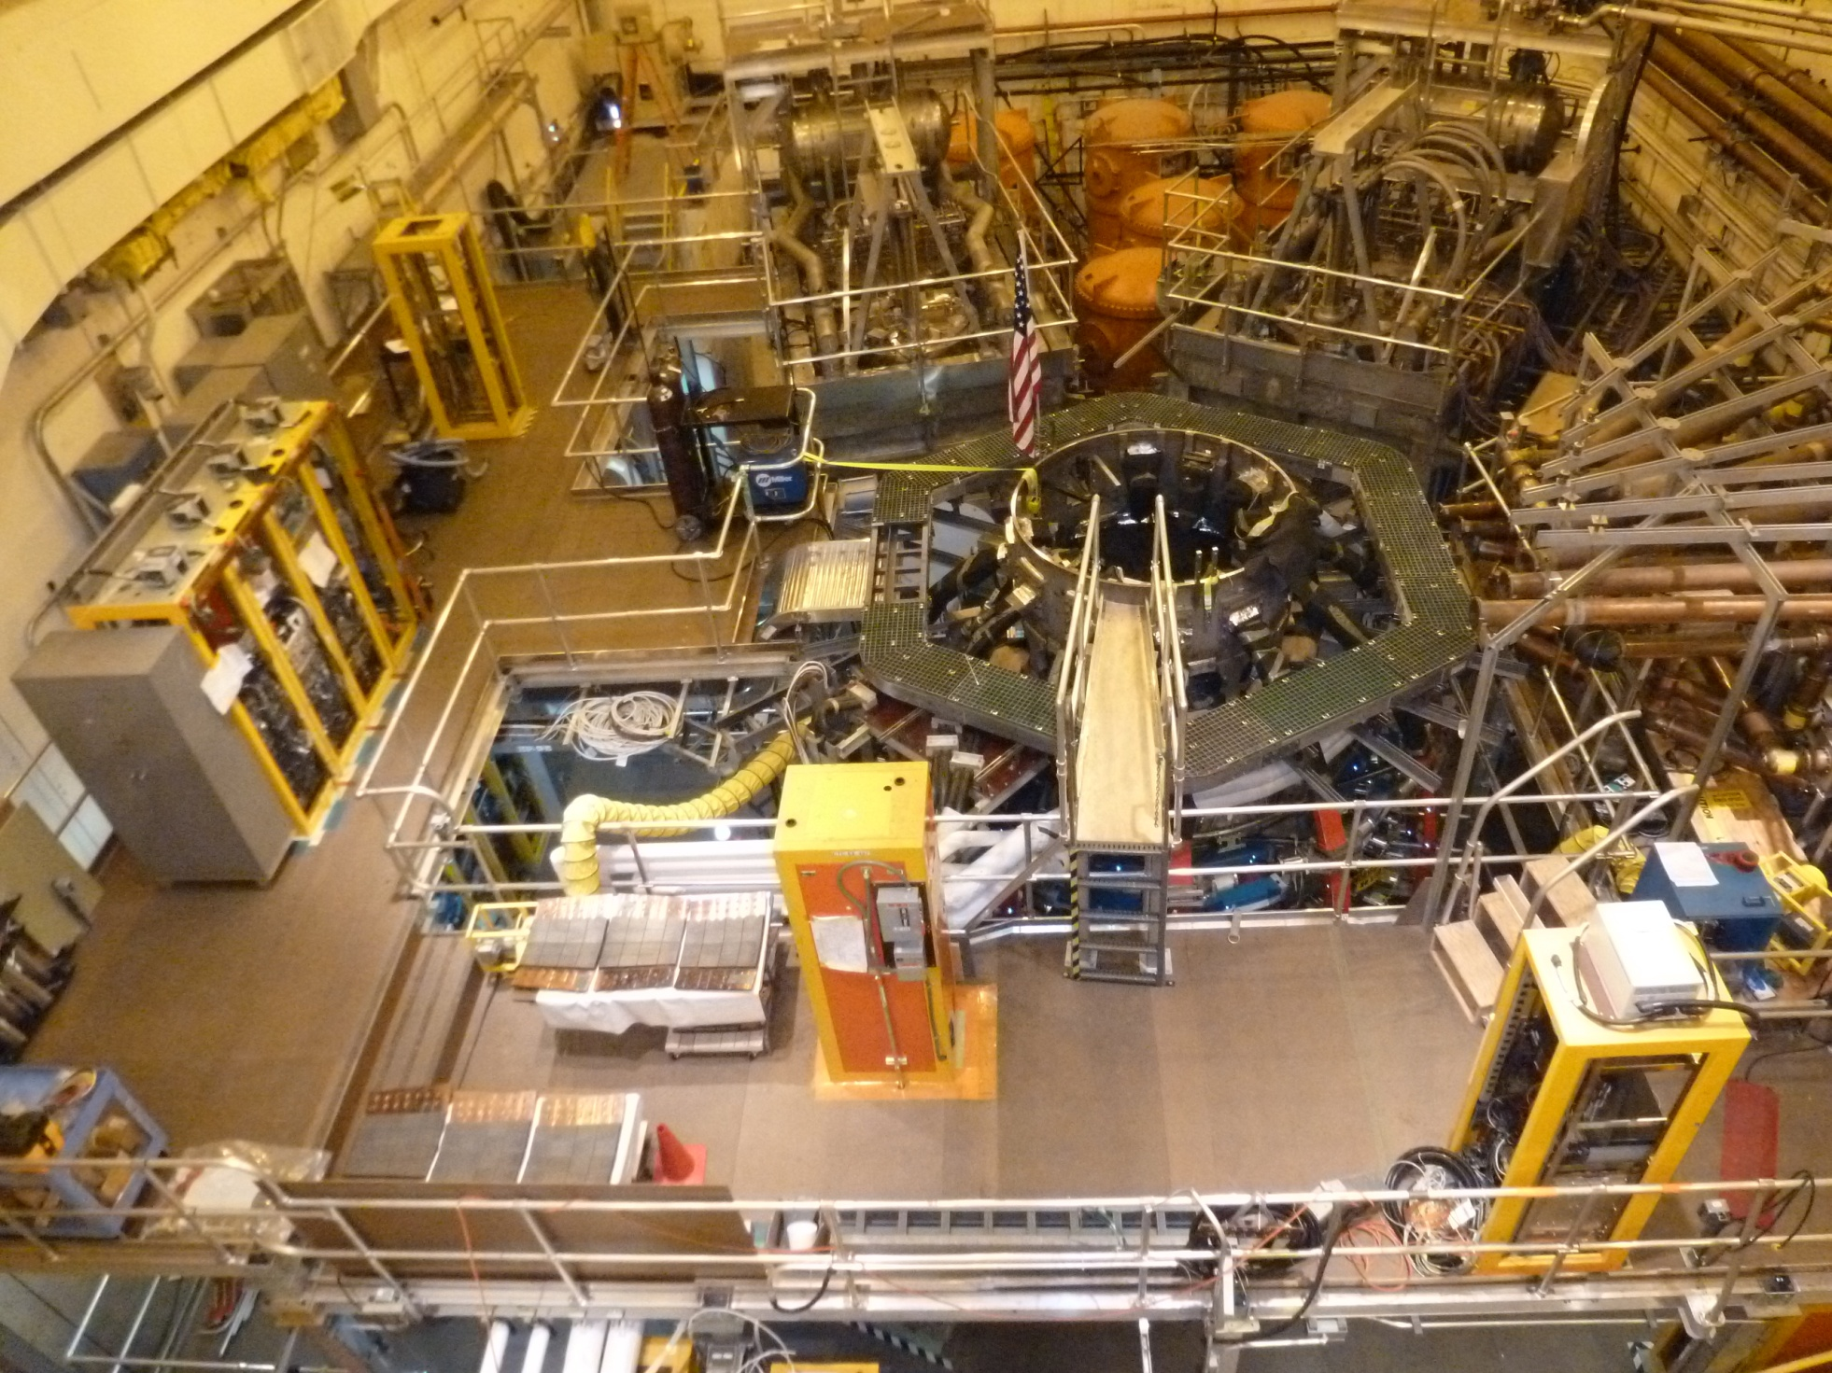

Slide 29
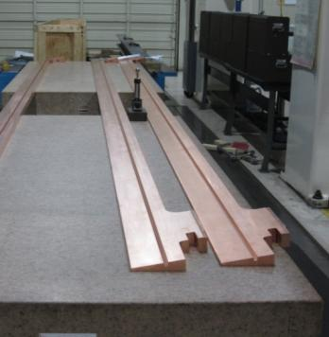
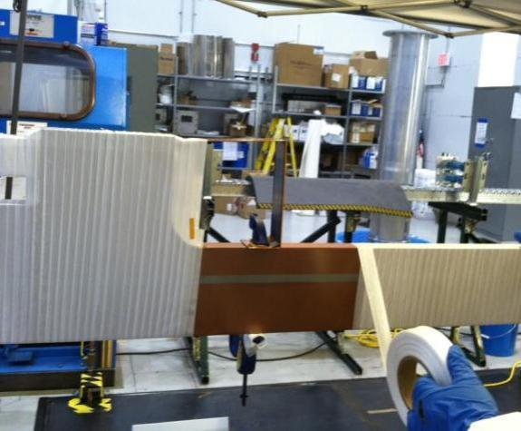
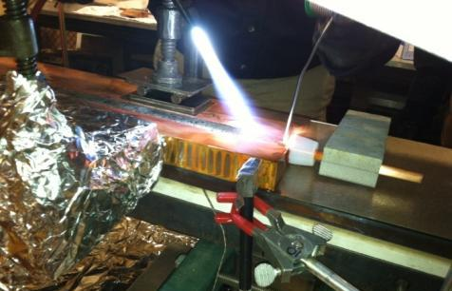
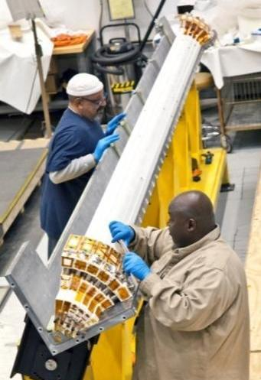
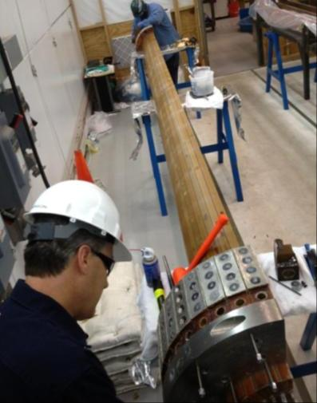
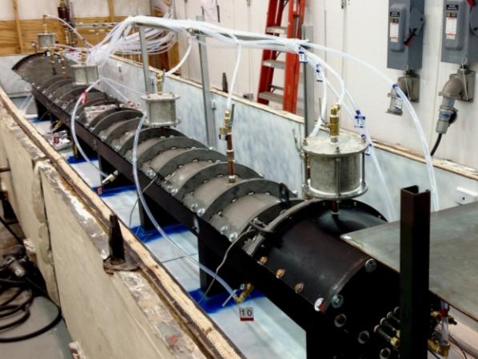
Center stack fabrication proceeding very well
Machined conductor received
Cooling tube soldered into inner TF conductor (completed )
Conductor being wrapped with fiberglass insulation
100% COMPLETE
100% COMPLETE
86% + COMPLETE
Insulated conductor placed into mold
Cleaning mold for 4th quadrant
Next VPI planned first week June
Assembled TF mold ready for Vacuum Pressure Impregnation (VPI)
First 3 Quadrants successfully VPI’d !

Slide 30
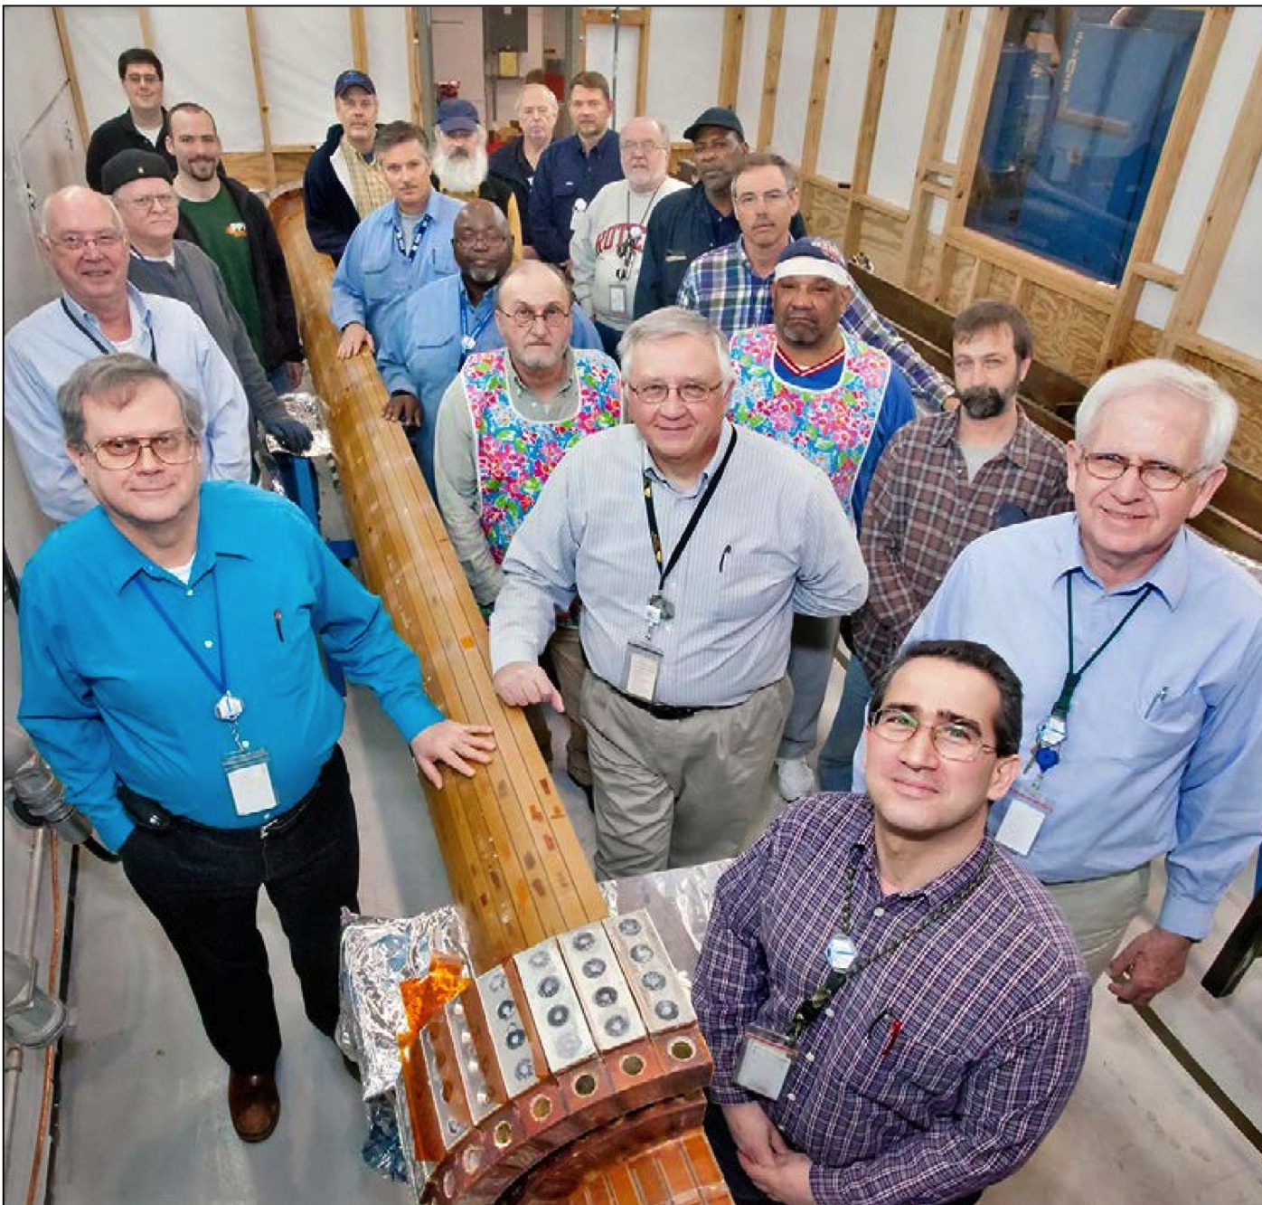
The completed first quadrant

Slide 31
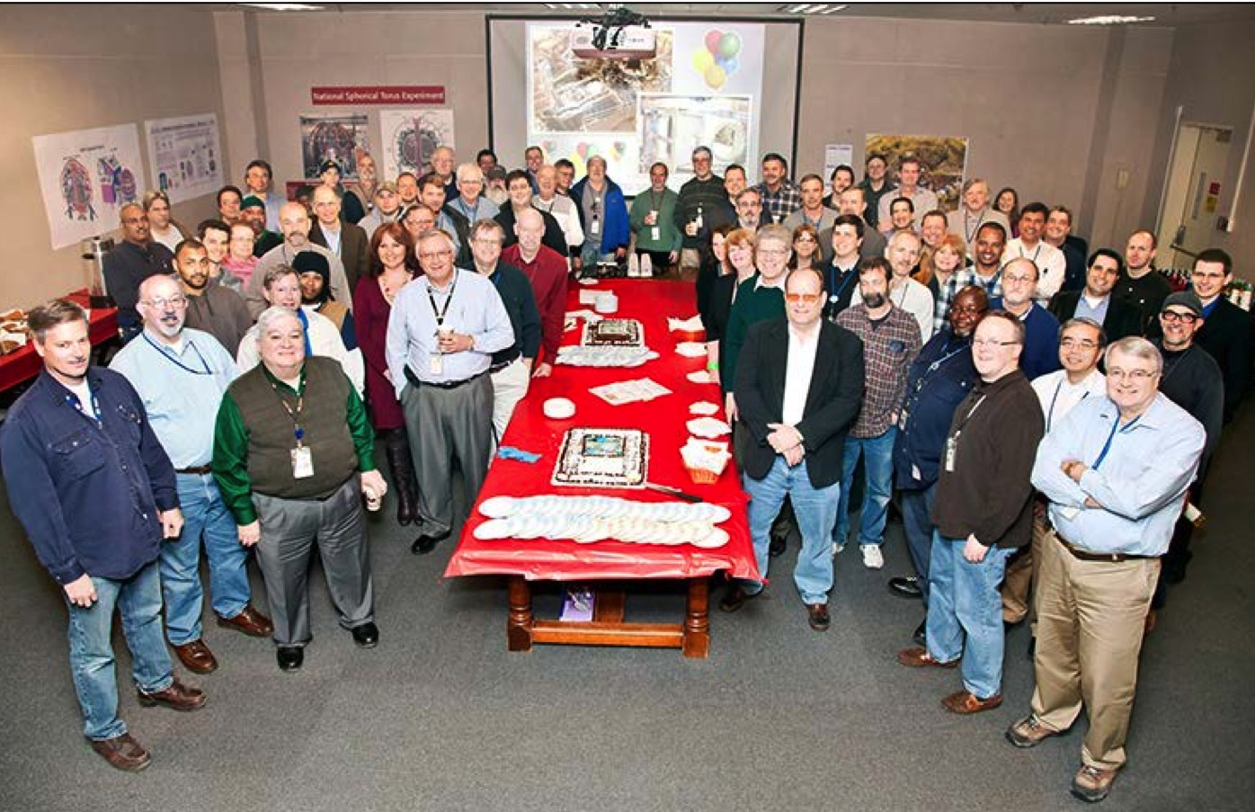
Celebrating the neutral beam cap and first TF quadrant
NSTX-U will provide a scientific anchor to PPPL for the next decade
To date, all technical challenges met successfully
~ on cost and schedule, ~ 60% complete,
Successful Lehman review in December
First plasma about October, 2014

Slide 32
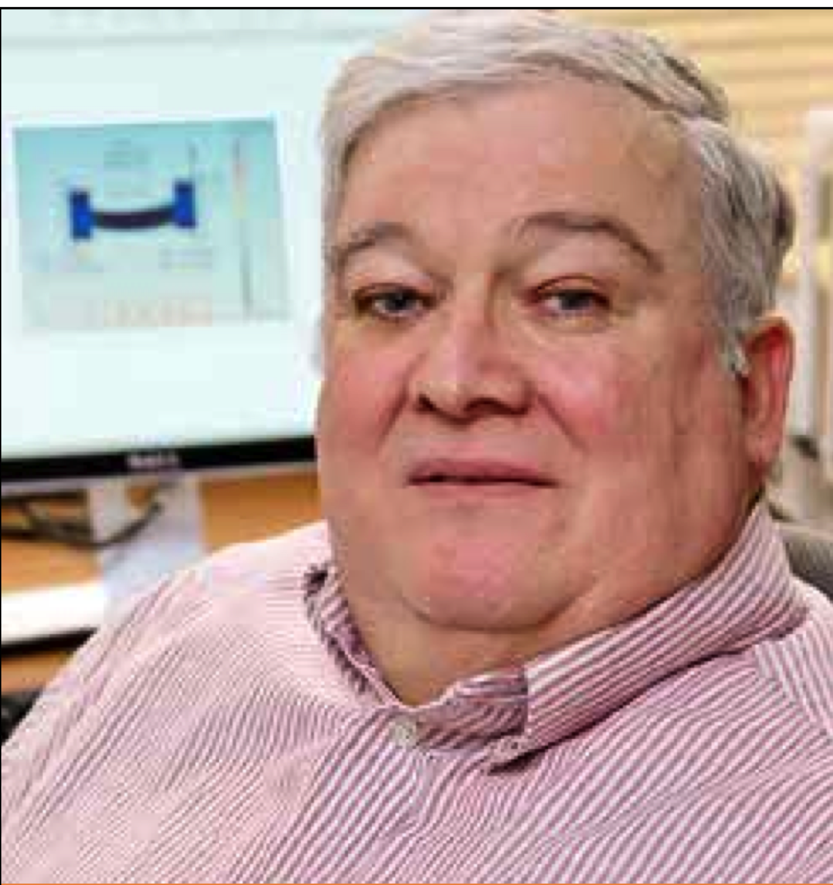
Phil Heitzenroeder wins
2013 Fusion Technology Award
Nuclear and Plasma Sciences Society, IEEE
To recognize outstanding contributions to research and development in the field of Fusion Technology

Slide 33
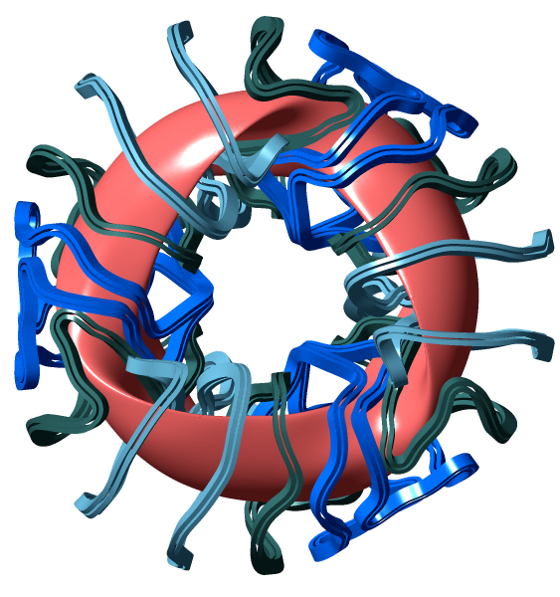
Advancing the stellarator path to fusion
  Stellarators are highly optimized designs for fusion,
NCSX:
half-built at PPPL
Steady-state, highly stable, high-gain plasma confinement,
Complementary to the tokamak

Slide 34
Advancing the stellarator path to fusion
International Collaboration
Prospects for a new US experiment
W7-X (Germany)
LHD (Japan)

Slide 35
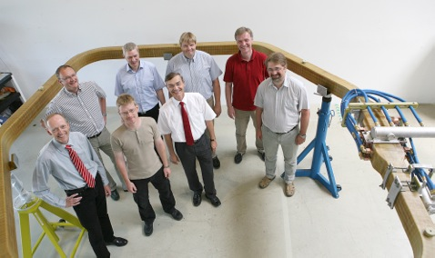
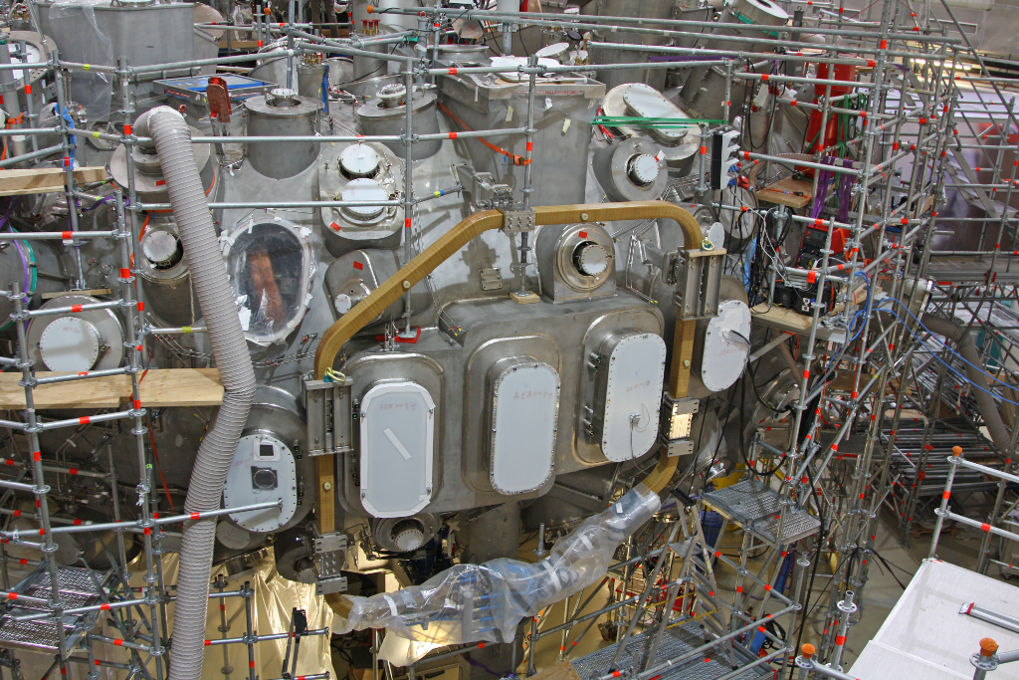
Wendelstein 7-X Trim Coils
Five coils designed and manufactured by a PPPL-industry team.
Power supplies will be shipped in August
U.S. team will use coils for plasma control research
DOE asked PPPL to lead US Team on W7-X
Trim Coil and W7-X Team
Installed on W7-X

Slide 36
Making the case for QUASAR – a new US experiment
(QUASI-Axisymmetric Research experiment)
OFES submitted to FESAC the NCSX facility (renamed QUASAR) as a candidate facility
FESAC rated a stellarator experiment as “absolutely central;” did not choose between QUASAR and a U. Wisconsin design
Strong international support (including an extraordinary offer of partnership by China – ASIPP)
We are continuing to make the case for a stellarator experiment (would be at world forefront in a critical area)

Slide 37
Theory and integrated simulation
New theory head (Amitava Bhattacharjee)
appointed in September
Department strategy evolving
Computationally, focus on three flagship codes
Activating new interactions within the department
Restructuring, augmenting theory applied to NSTX

Slide 38
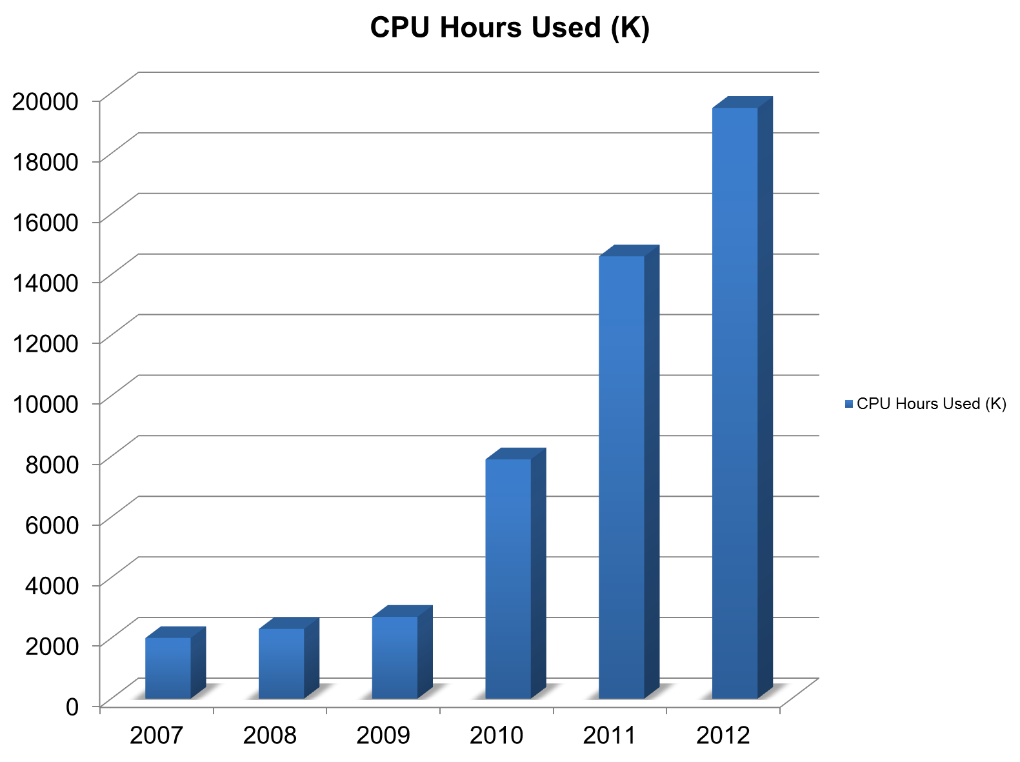
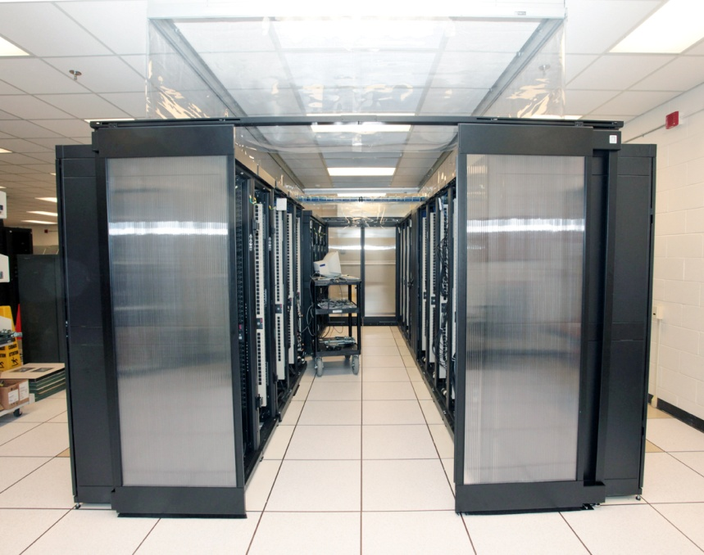
Expanding use of the PPPL computing cluster
CPU hours used (k)
40% More CPU’s
35% Reduced Power Consumption
Enables theoretical and engineering simulations,
using codes such as TRANSP and M3D-C1

Slide 39
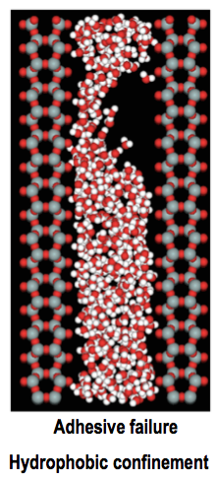
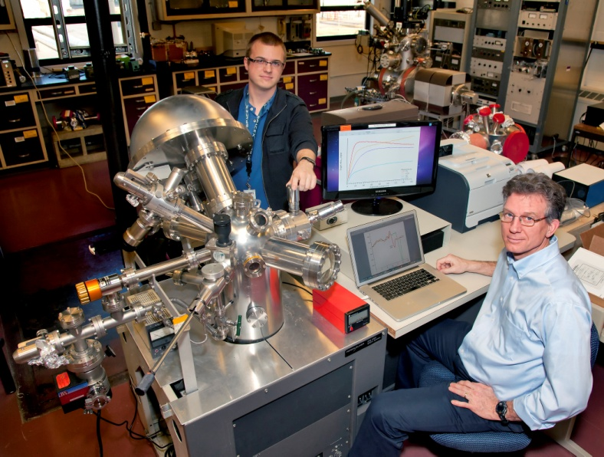
Liquid Metals as Plasma-Facing Materials for Fusion
From atoms to tokamaks
Princeton University team of materials scientists received OFES funding
Theoretical materials science of liquids
Instrumentation for surface characterization
Fluid dynamics of thin film flow
LDRD support for flow experiments on
HT-7 (China) and Magnum (Netherlands)
Experiments in tokamaks (LTX, NSTX-U)
Aiming toward the world’s most comprehensive program in this area

Slide 40
PPPL contributing to ITER
ITER provides the access to burning plasma science, and will be the centerpiece of the world fusion program
ITER physics pervades the PPPL physics program: NSTX, theory, and off-site tokamak collaborations
PPPL is a partner in the US ITER construction activities

Slide 41
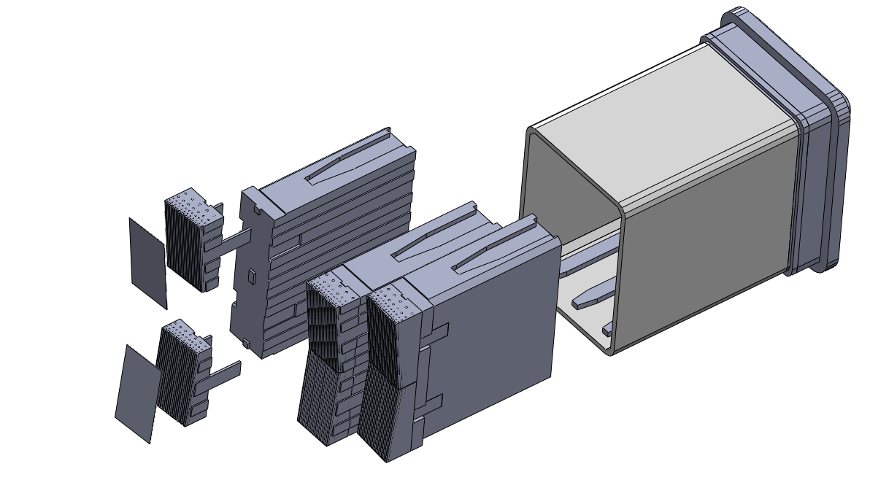
PPPL is contributing to ITER design and construction
Designing
in-vessel coils
PPPL manages US diagnostic contributions
Designing diagnostic port plugs
Diagnostic First
Wall Panel
Diagnostic Shield Module

Slide 42
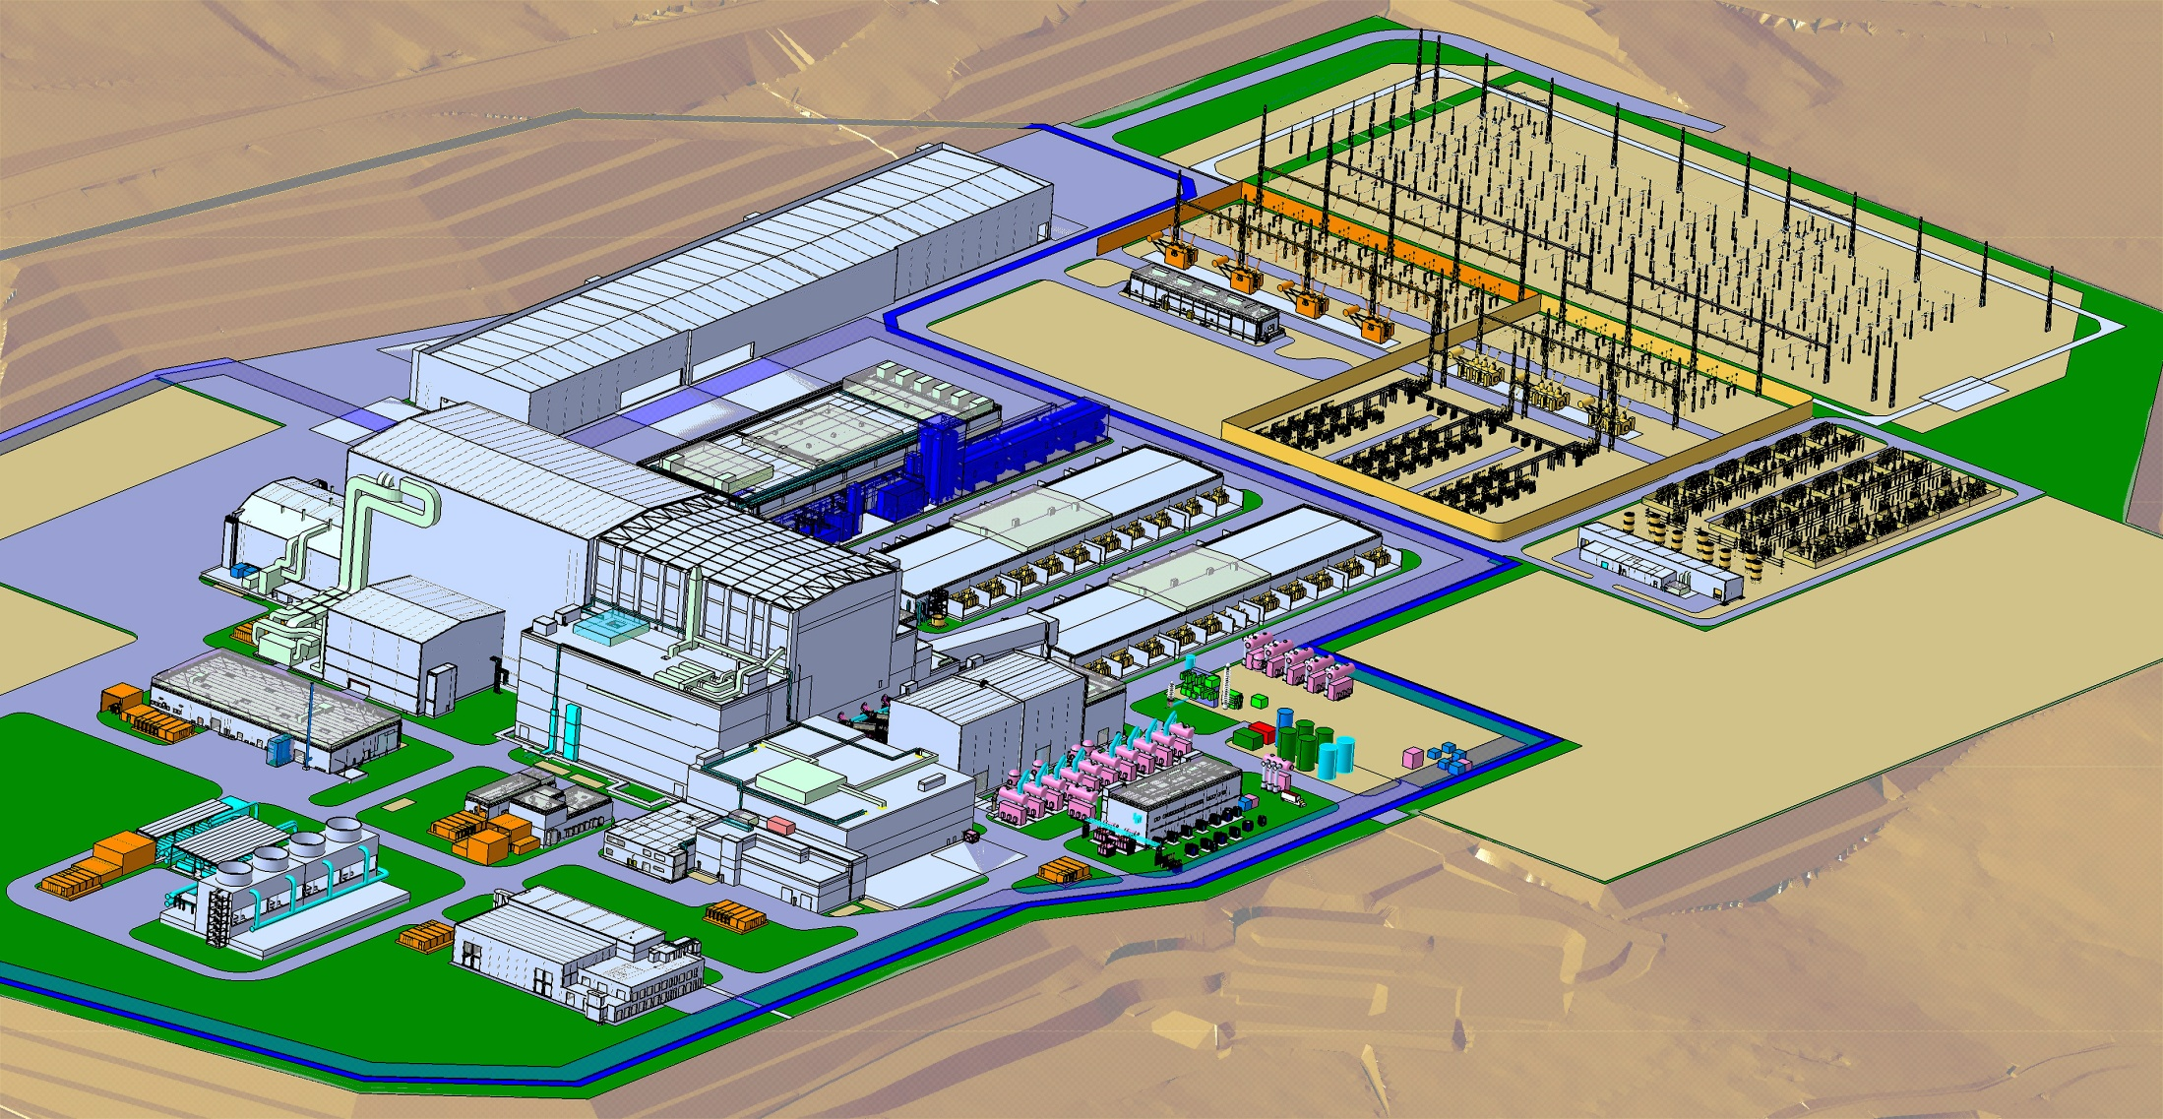
Providing Steady State Electrical Network
22kV Switchgear
400kV SSEN Substation
6.6kV Power Centers
(typ. 6 locations)
Invesment Protection Distribution, UPS, DC systems
150MW to conventional ITER systems (cooling water, cryoplant, etc.)
75% of Equipment Provided by US (PPPL)

Slide 43
Planning for ITER operation
PPPL will aspire to play a lead role in the US operations team
Large-scale simulation is essential to interpret and guide ITER physics

Slide 44
Advancing general plasma science and applications

Slide 45
Growing plasma astrophysics
Proposal submitted to NSF for next-generation reconnection experiment
MRX design,
At larger size
Increases the dimensionless size 10x,
Increases the dimensionless electrical conductivity 100x,
More astrophysically relevant

Slide 46
Growing plasma astrophysics
Proposal submitted to NSF for next-generation reconnection experiment
Max-Planck/Princeton Center for Plasma Physics ramping up
Princeton: PPPL, Dept. of Astrophysical Science
Max-Planck Society: Institute of Plasma Physics
Institute of Solar System Research
Institute of Astrophysics
Inaugurated March, 2012
New US/German links
New astrophysics/fusion links
Center meeting in Princeton, week of Oct 28

Slide 47
Growing plasma astrophysics
Proposal submitted to NSF for next-generation reconnection experiment
Max-Planck/Princeton Center for Plasma Physics ramping up
New effort in reconnection in high energy density plasmas (NNSA)
Expanded effort in heliophysics
Expanded collaborations with Astrophysics Department

Slide 48
Advancing new applications
Plasma-based nanotechnology
New mass separation techniques
PTOLEMY experiment

Slide 49
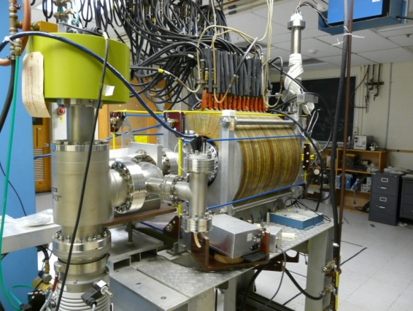
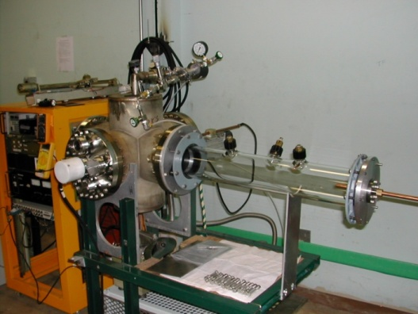
Plasma-based nanotechnology
Proposal submitted to Basic Energy Sciences/DOE
“ Fundamental Studies of Synthesis of Nanomaterials: A joint
challenge for plasma and materials sciences”
Collaborators from
Princeton University (material and laser scientists in the engineering school and Chemistry Department),
George Washington University (low temperature plasma science),
Case Western Reserve (plasma synthesis of nanoparticles)
Exploits plasma nano-lab set up via LDRD funds

Slide 50
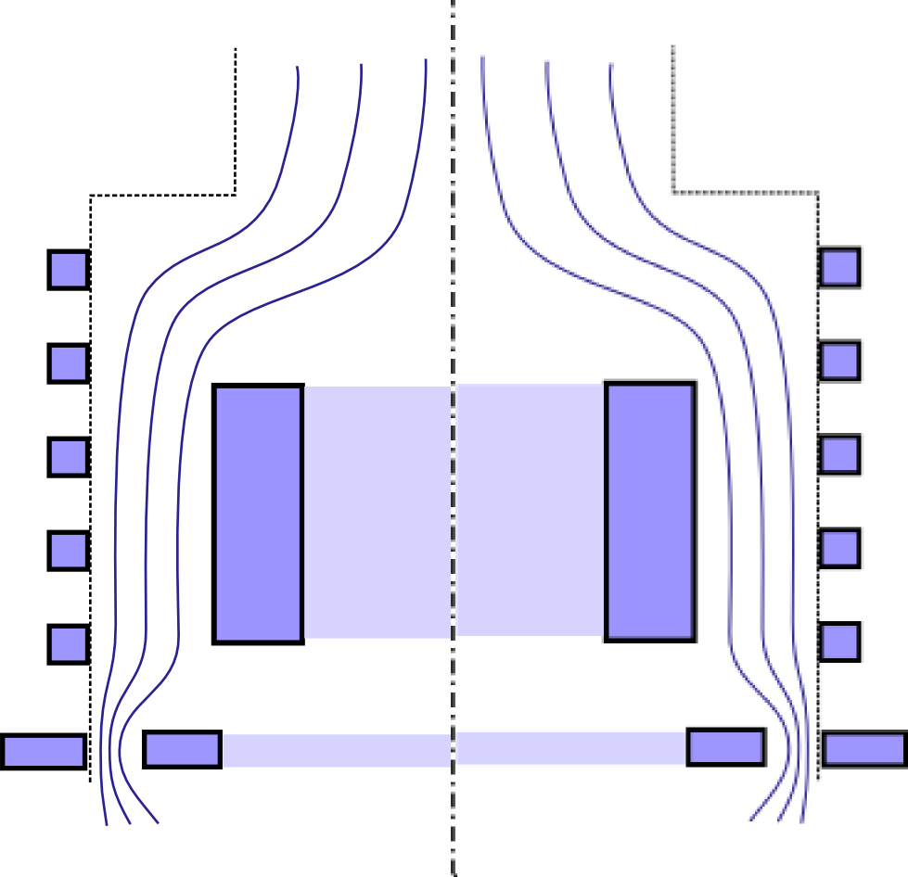
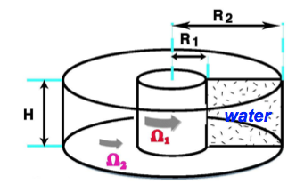
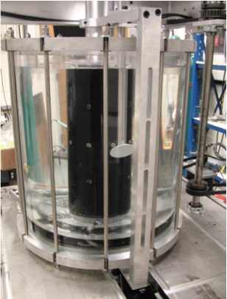
New mass separation techniques
Plasma mass filter
Advanced liquid centrifuge
Heavy ions
Light ions
Centrifugal force
Magnetic force
Continuing discussions with Savannah River National Lab,
DOE/Environmental Management, and DOE/Nuclear Energy

Slide 51
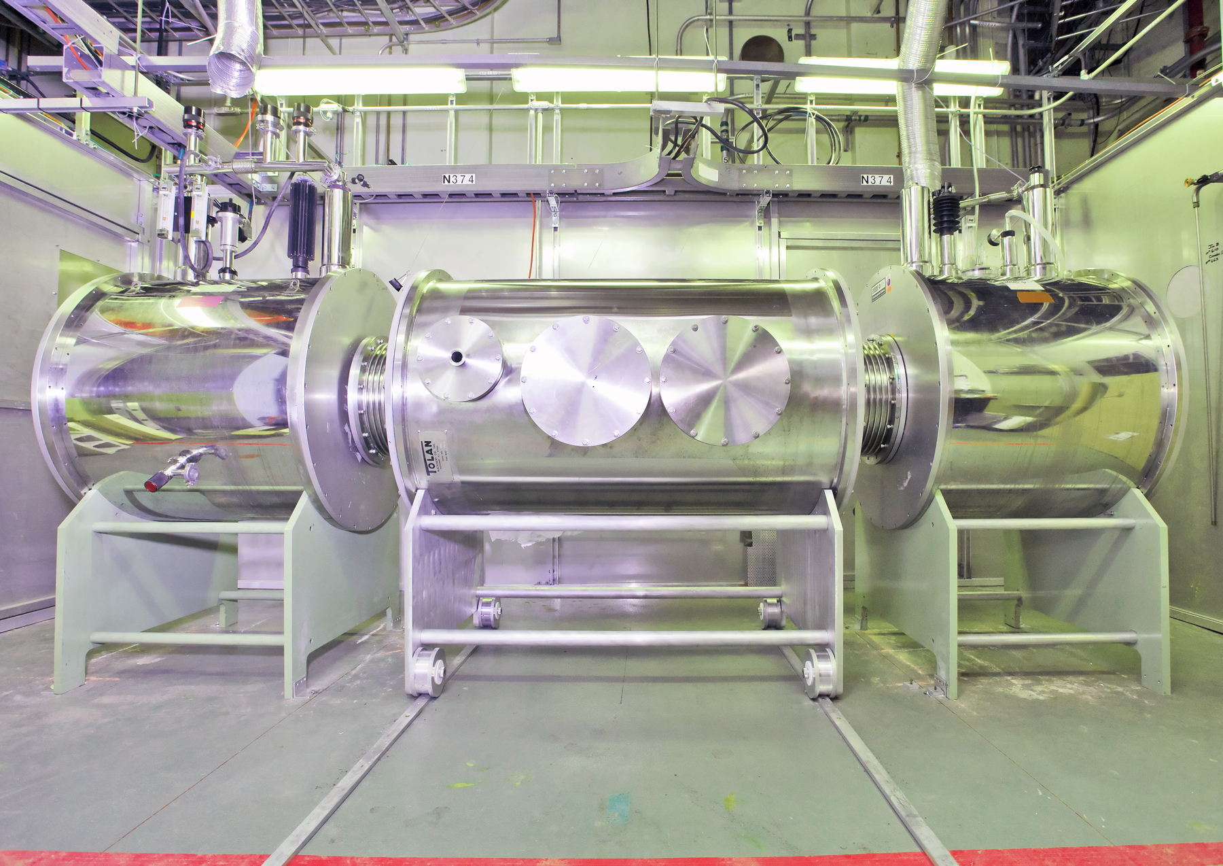
The PTOLEMY Experiment
(Princeton Tritium Observatory for Light, Early university, Massive neutrino Yield)
Initiated and led by Prof. Chris Tully, Physics Department
To detect neutrinos created 1 second after the big bang
Neutrinos captured by tritium; electrons emitted via beta decay
Exploits PPPL’s special facility and engineering capabilities
Prototype experiment set up at D-site

Slide 52
PPPL works to be ever more safe, green and secure

Slide 53
Keeping a strong emphasis on safety in the past year
Ongoing surveys (quarterly to 1/4th of staff each time)
Human Factors Committee completed assessments of all units of the lab with heightened hazards
Large list of corrective actions implemented
External reviews
Safety Champions committee committee stablished

Slide 54
Over the past year,
PPPL’s safety performance has been excellent
Thanks to efforts of the entire staff
Challenge:
keep up safety awareness, avoid complacency,
keep ideas coming in

Slide 55
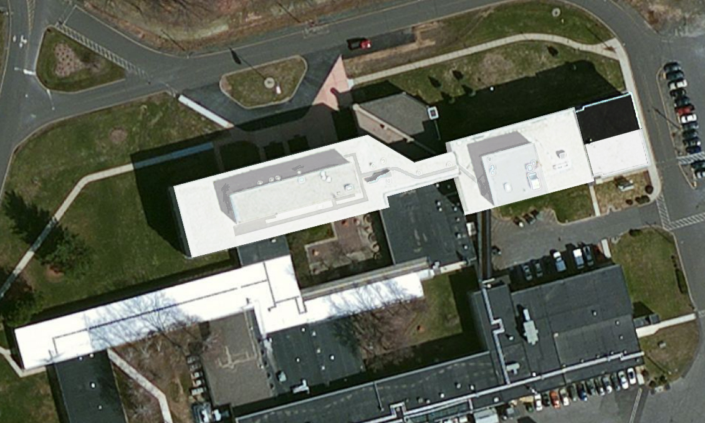
Making PPPL greener
Recycling metal (4 million pounds)
composting
“Cool roof” – energy savings and research
Reducing paper

Slide 56
PPPL recognized as “top environmental steward” in New Jersey
Award from NJ Department of Environmental Protection
PPPL is #1 out of 760 organizations evaluated!
Only organization to satisfy 20 out of 21 criteria
(green buildings, hazardous materials reduction, environmental management, recycling, reducing paper………)
A result of the efforts of the entire staff

Slide 57
Maintaining cyber-security
  Malicious attempts blocked at PPPL in 2012:
    3.7 million malicious web sites
    7,400 email viruses
    48,000 ‘phishing’ attempts
    7.5 million email spams
  Lab-wide cyber incident response exercise
  DOE graded PPPL’s cyber-security program
  highest among all Office of Science Laboratories

Slide 58
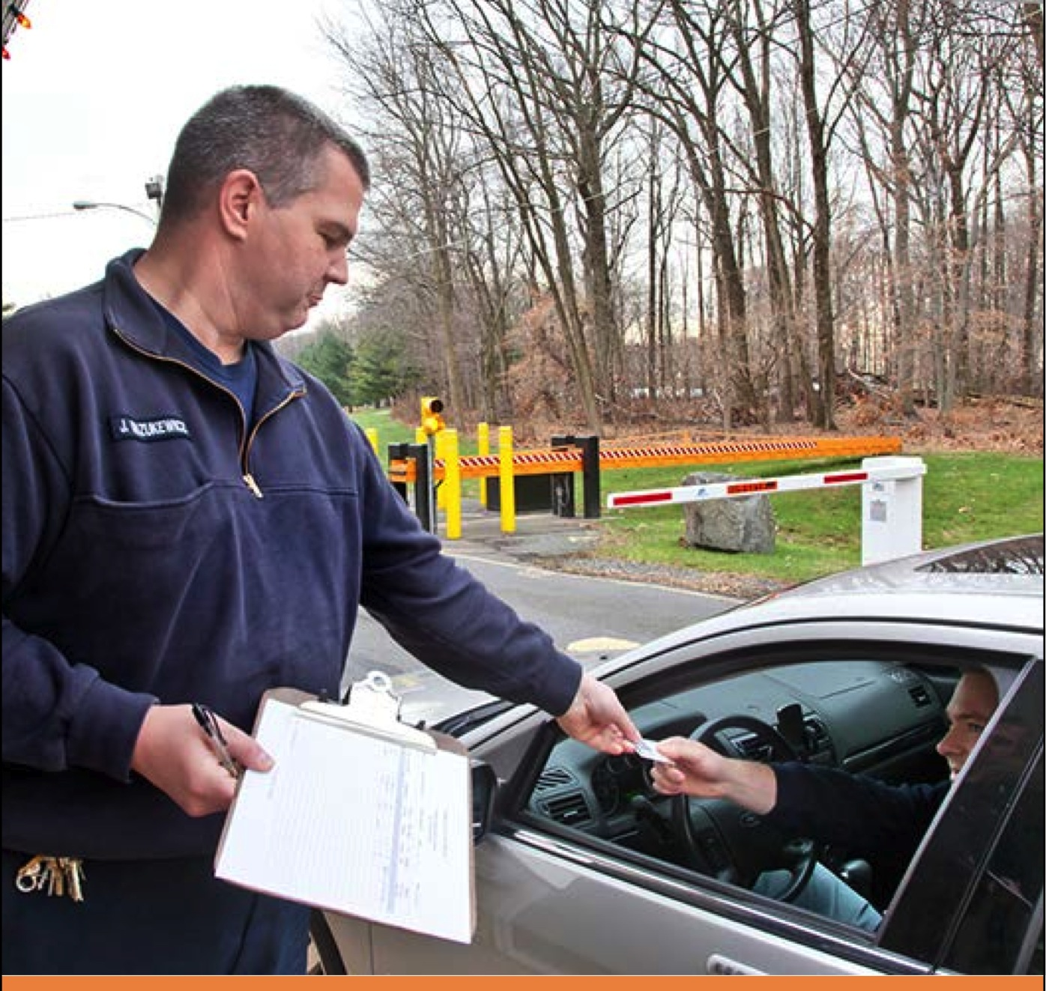
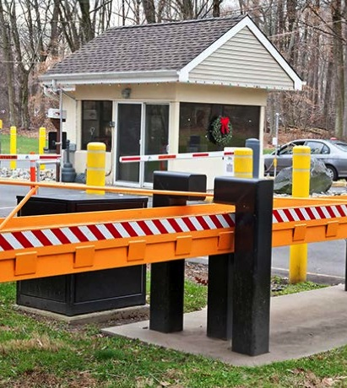
PPPL’s physical security is outstanding
This past year:
Drill for physical security
DOE assessment cited
best practices (for multi-tasked responders, booth ops), best in class (for mutual aid)

Slide 59
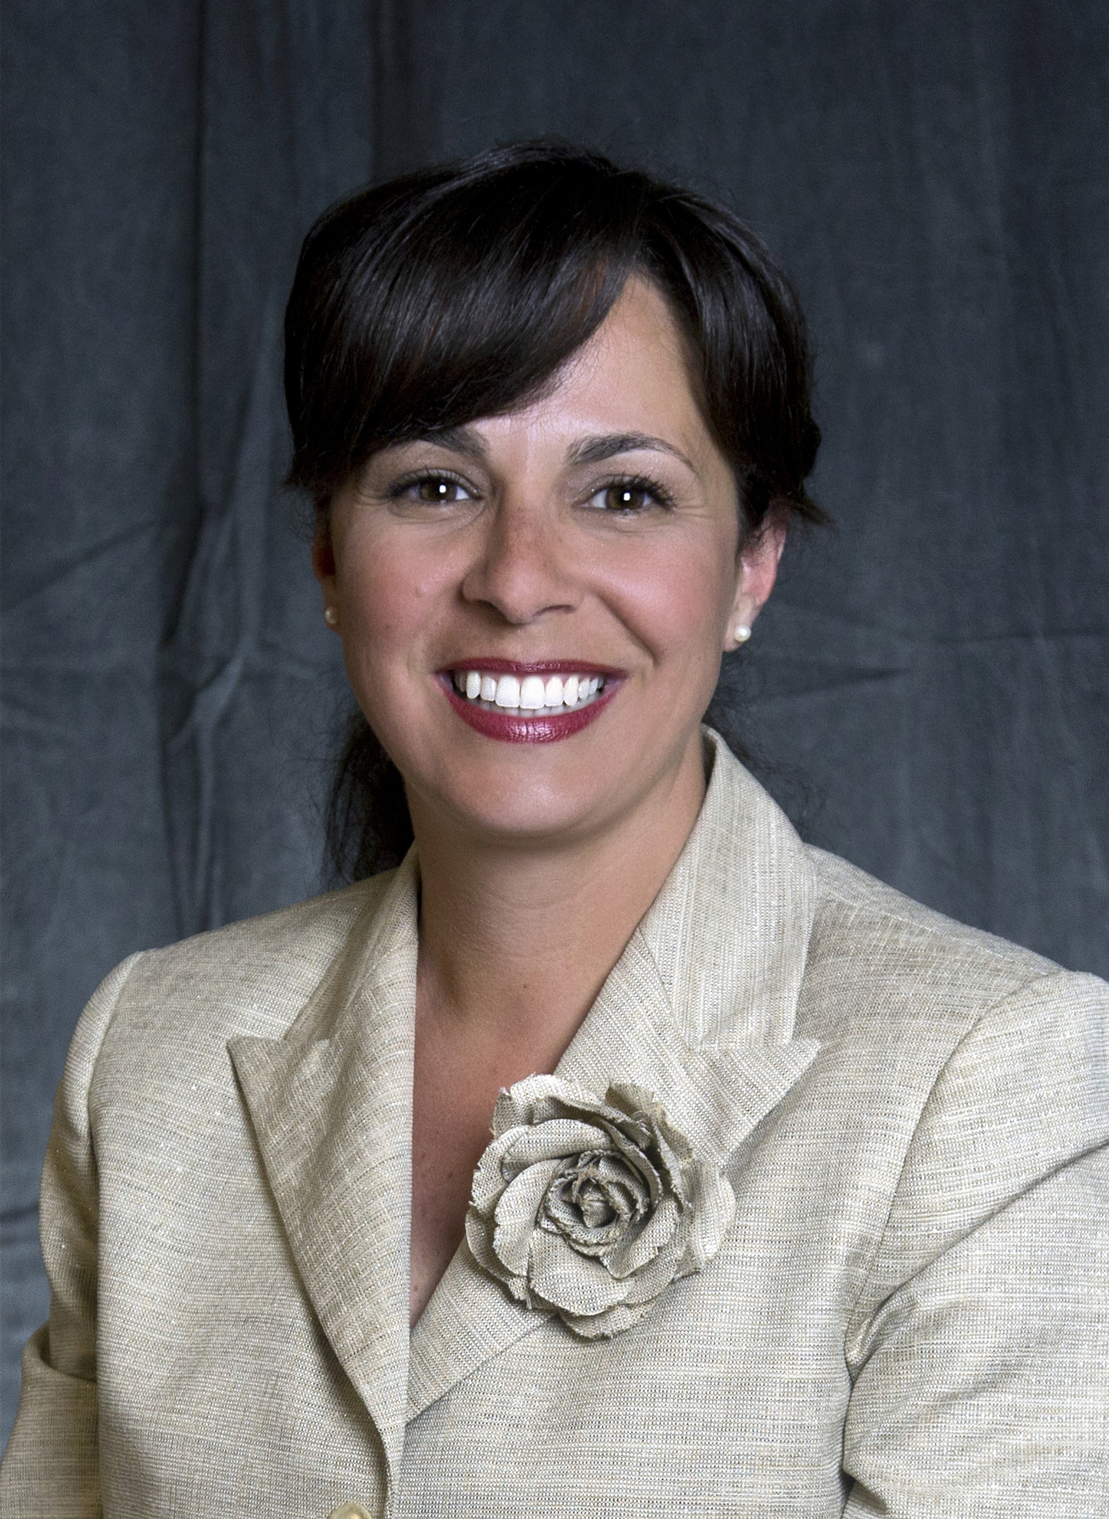
HR and business operations outstanding performance during stressful times
Increasing compliance, training, regulatory requirements
Business operations processed 50% more proposals than last year
Welcome to our new
Chief Financial Officer,
Kristen Fischer

Slide 60
Summary
In very challenging times,
PPPL progress is outstanding
The PPPL future is bright
Thanks to the ingenuity and hard work of our staff

Slide 61
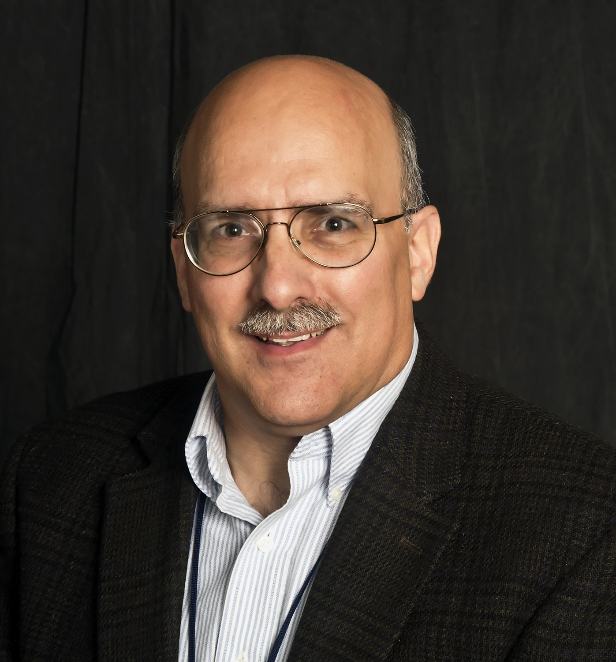
Kaul Foundation Prize for excellence in plasma physics research and technology develpment
Steve Sabbagh
For his leadership in advancing the physics understanding of resistive wall mode stability and feedback stabilization which resulted in sustainment of record normalized beta plasmas in NSTX

Slide 62
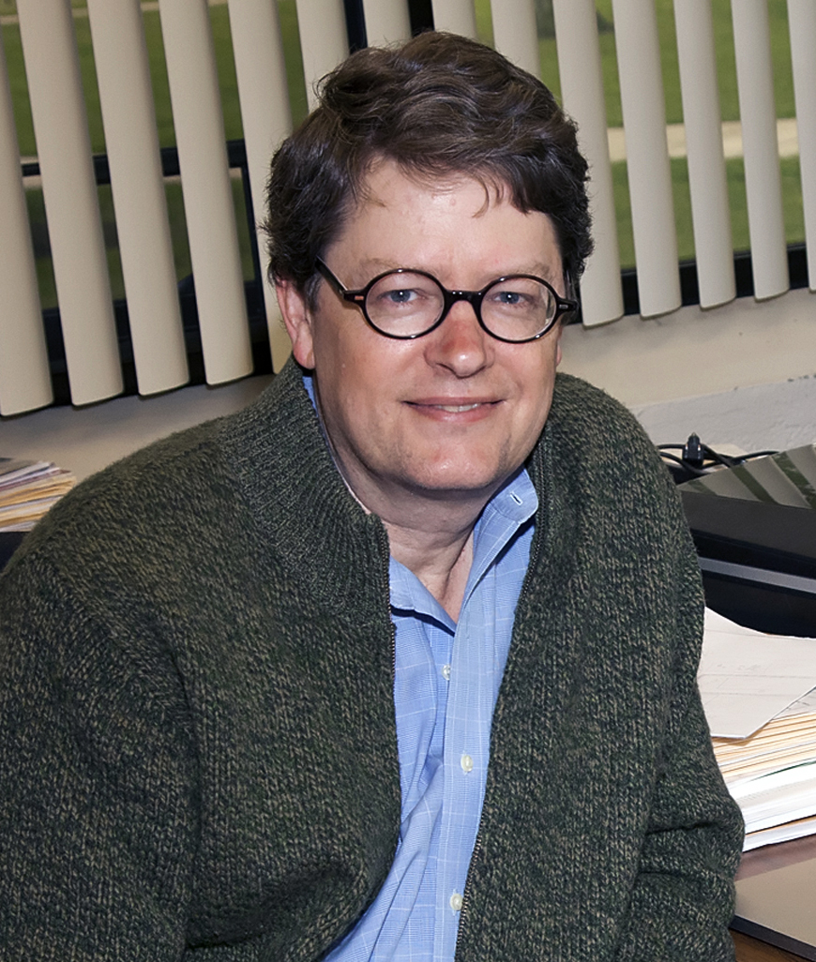
Distinguished Research Fellow
Greg Hammett
For pioneering contributions to the numerical simulation and analytical theory of fusion plasmas including the development of successful gyrofluid models and simulations of plasma turbulence, analysis of sampling noise in particle-in-cell simulations, and novel research on the statistical mechanics of magnetized plasmas; and for influential mentoring of the next generation of plasma physicists.

Slide 63


Greg’s equations featured on TV
Sheldon
Greg (“The Big Bang Theory,” CBS)

Slide 64
See you all at the open house!

