Slide 1
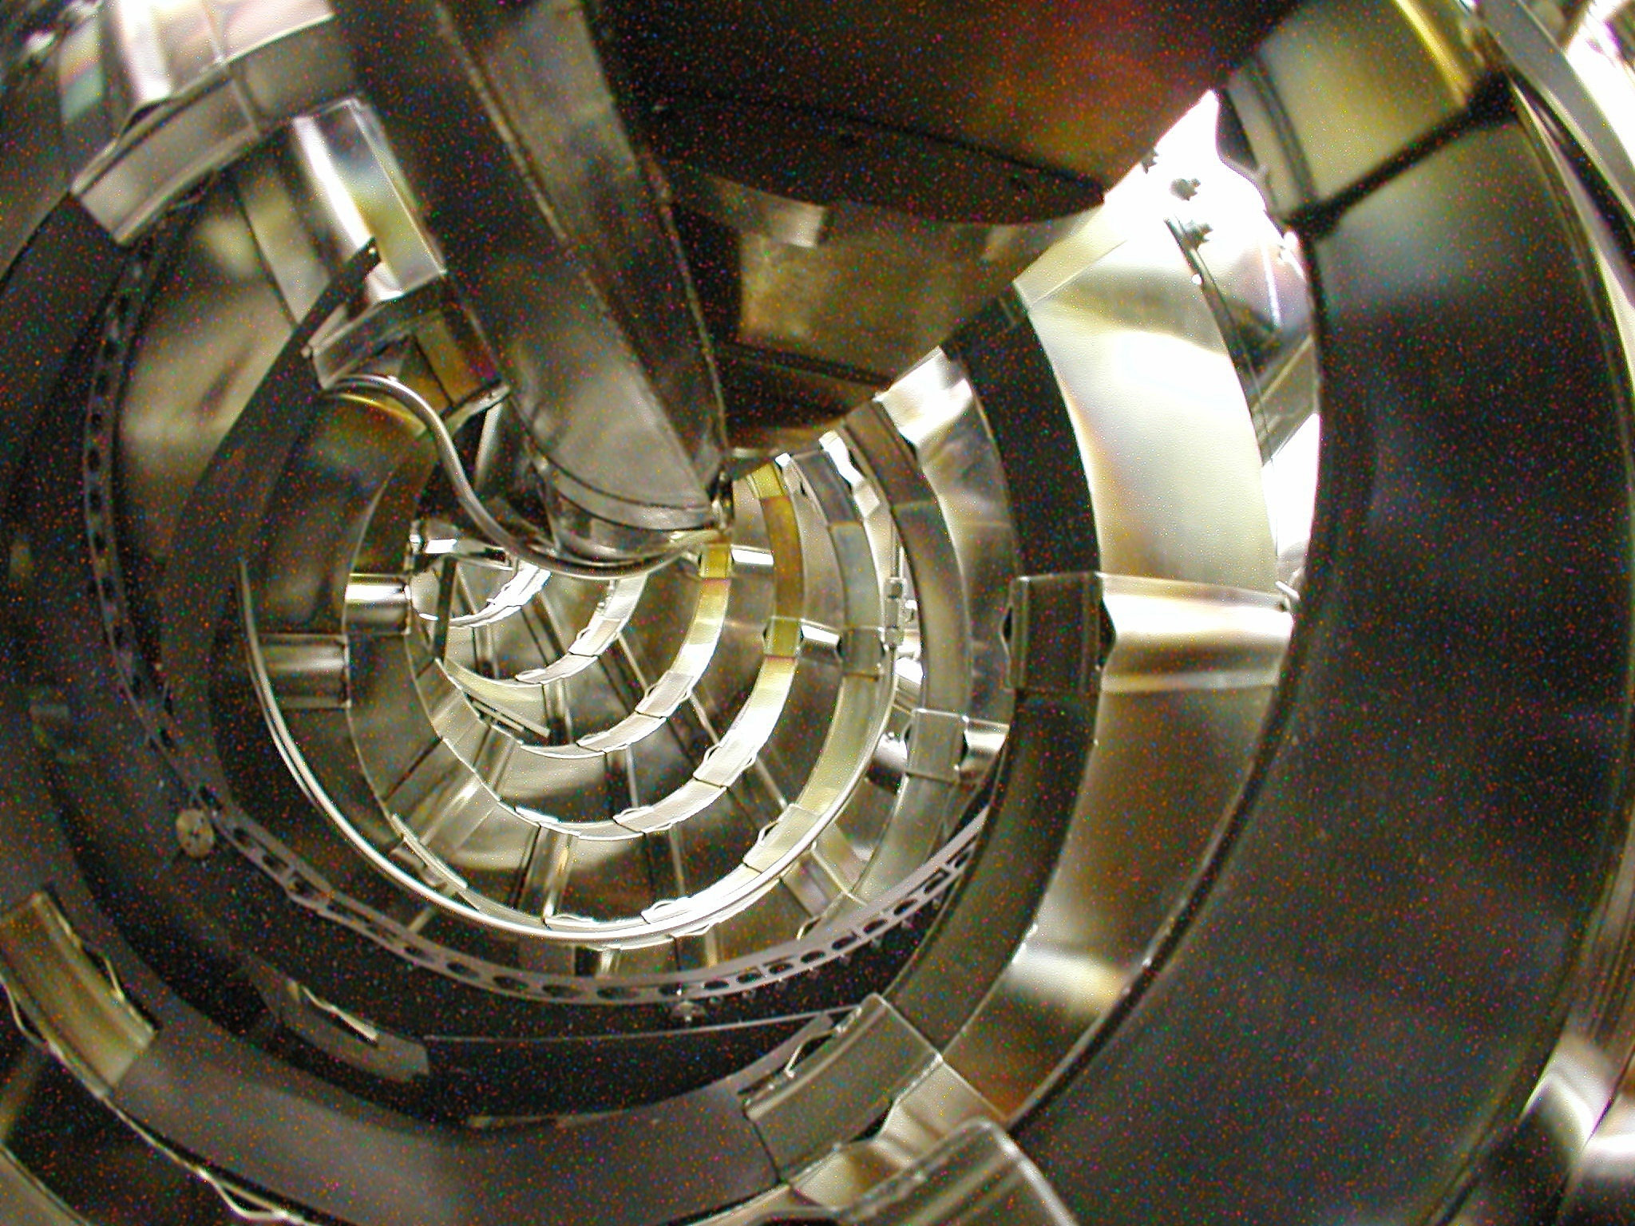
The Australian National Plasma Fusion Research Facility: Results and Upgrade Plans
J. Howard, D.G. Pretty, J.W. Read, H. Punzmann, S.T.A. Kumar, M.J. Hole, F. Detering, C.A. Nuhrenberg, M. McGann, R.L. Dewar, J. Bertram Australian National University, *Max Planck IPP Greifswald, and **Oak Ridge National Laboratory

Slide 2
The Australian National Plasma Fusion Facility: Results and Upgrade Plans
H-1 Plasma and Facility
Plasma configurations, parameters
MHD Modes
Data mining
Alfvénic Scaling
Scaling discrepancies
Optical Measurements
Radial Structure
Confinement Effects
Effect of Magnetic Islands
Facility Upgrade
Aims Key areas
New diagnostics for Upgrade
Conclusions/Future

Slide 3
H-1NF: National Plasma Fusion Research Facility
A Major National Research Facility established in 1997 by the Commonwealth of Australia and the Australian National University
Mission:
Detailed understanding of the basic physics of magnetically confined hot plasma in the HELIAC configuration
Development of advanced plasma measurement systems
Fundamental studies including turbulence and transport in plasma
Contribute to global research effort, maintain Australian presence in the field of plasma fusion power
The facility is available to Australian researchers through the AINSE¹ and internationally through collaboration with Plasma Research Laboratory, ANU.
¹⁾ Australian Institute of Nuclear Science and Engineering
limited collaborative funding expires June 2010 – please come!
International collaboration played an important role in the success of H-1 in obtaining facility funding

Slide 4
H-1 CAD
Notes:
Important:
– toroidal connection, relation to boundary conditions
– twisted field lines.

Slide 5
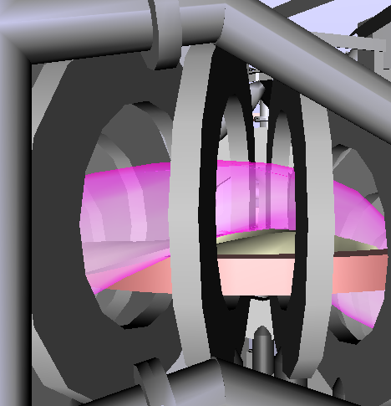
H-1 Heliac: Parameters
3 period heliac: 1992
Major radius 1m
Minor radius 0.1-0.2m
Vacuum chamber 33m² excellent access
Aspect ratio 5+ toroidal
Magnetic Field ≤1 Tesla (0.2 DC)
Heating Power 0.2MW 28 GHz ECH 0.3MW 6-25MHz ICH
Parameters: achieved to date::expected
n 3e18 :: 1e19
T <200eV(T_{e})::500eV(T_{e})
β 0.1 :: 0.5%
Notes:
Parameters 10¹⁸, 0.5T, Hydrogen / Helium

Slide 6
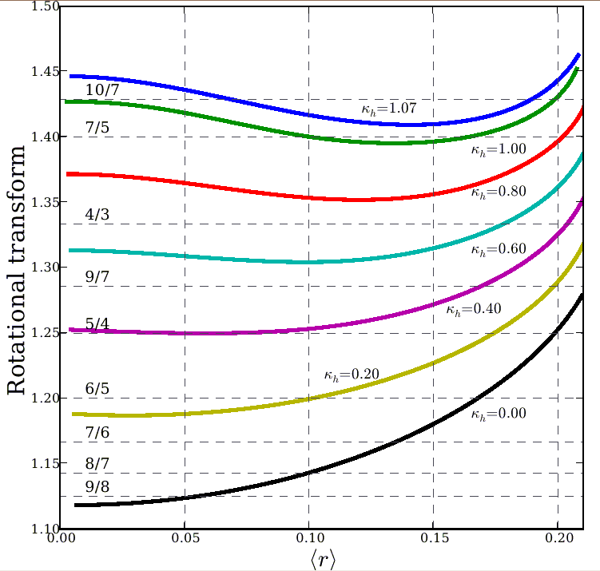
H-1 configuration (shape) is very flexible
“flexible heliac” : helical winding, with helicity matching the plasma, ⇒ 2:1 range of twist/turn
H-1NF can control 2 out of 3 of transform (ι) magnetic well and shear Δι (spatial rate of change)
Reversed Shear → Advanced Tokamak mode of operation
low shear
ι = 4/3
ι = 5/4
medium shear
Centre
Edge
Notes:
Flexible heliac:
I will concentrate today on the effect of twist per turn.
This graph also illustrates magnetic shear, the rate of change of twist with position.
H1 is a medium to low shear device.

Slide 7
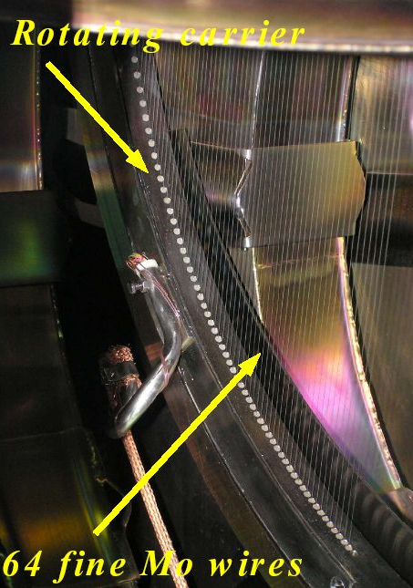
Experimental confirmation of configurations
Santhosh Kumar
Rotating wire array
64 Mo wires (200um)
90 - 1440 angles
High accuracy (0.5mm)
Moderate image quality
Always available
Excellent agreement with computation
T.A. Santhosh Kumar B.D.Blackwell, J.Howard
Iota ~ 1.4 (7/5)

Slide 8
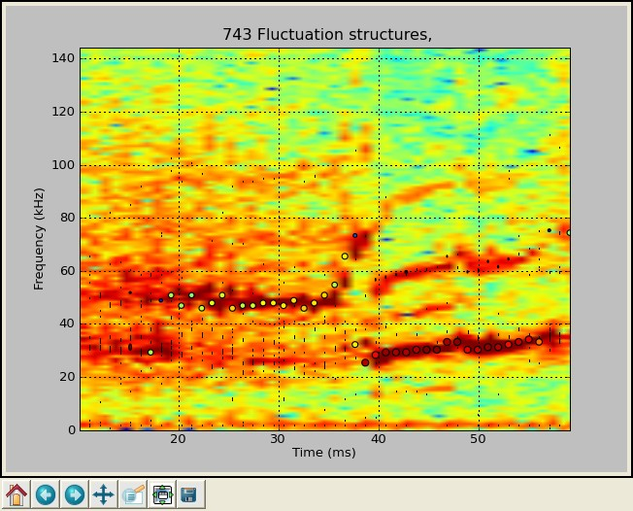
MHD/Mirnov fluctuations in H-1

Slide 9
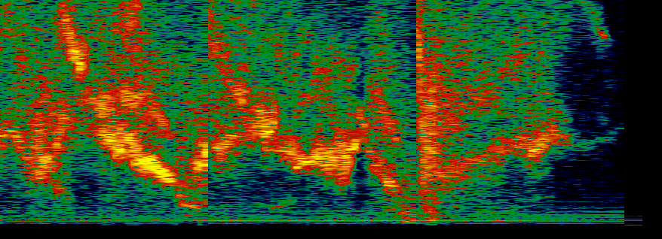
Mode Decomposition by SVD and Clustering
D. Pretty, Tues am
Initial decomposition by SVD → ~10-20 eigenvalues
Remove low coherence and low amplitude
Then group eigenvalues by spectral similarity into fluctuation structures
Reconstruct structures to obtain phase difference at spectral maximum
Cluster structures according to phase differences (m numbers)
→ reduces to 7-9 clusters for an iota scan
Grouping by SVD+clustering potentially more powerful than by mode number
Recognises mixtures of mode numbers caused by toroidal effects etc
Does not depend critically on knowledge of the correct magnetic theta coordinate
4 Gigasamples of data
128 times
128 frequencies
²C₂₀ coil combinations
100 shots
Data mining
increasing twist →
Notes:
Scan of 100 configurations – also rich in detail.

Slide 10
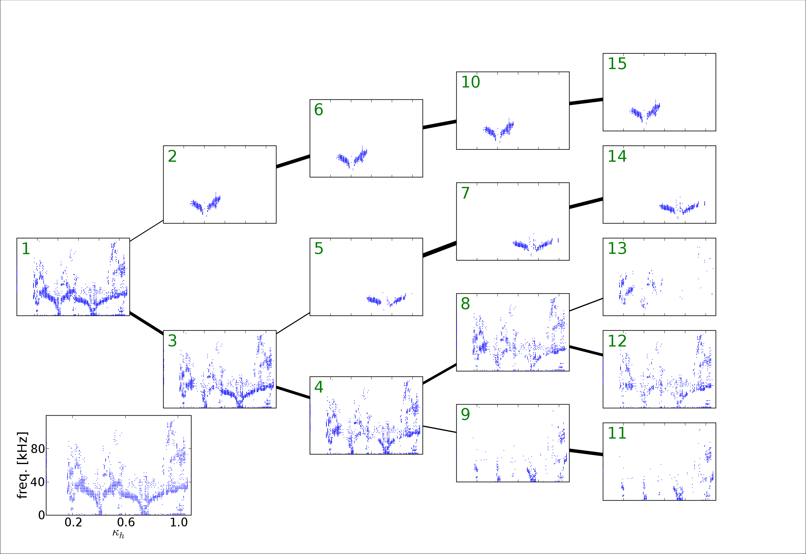
Data Mining Classification by Clustering
D. Pretty, Tues am
Full dataset

Slide 11
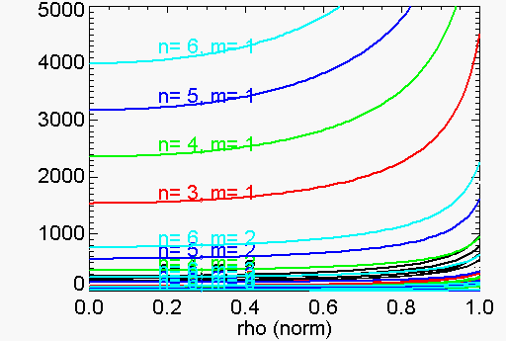
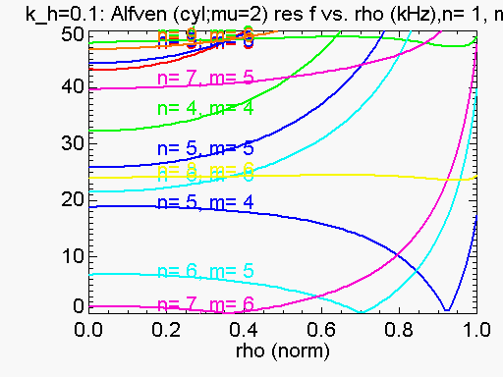
Identification with Alfvén eigenmodes: k||, twist
Why is f so low? V_{Alfven}~ 5x10⁶ m/s
ω_{res =} k|| V_{Alfvén} = k|| ^{B}/_{√(μoρ)}
k|| varies as the angle between magnetic field lines and the wave vector
for a periodic geometry the wave vector is determined by mode numbers n,m
Component of k parallel to B is ∝ ι - n/m
k|| = (m/R₀)(ι - n/m)
ω_{res} = (m/R₀)(ι - n/m) ^{B}/_{√(μoρ)}
Low shear means relatively simple dispersion relations – advantage of H-1
Small near resonance
Alfvén dispersion (0-5MHz)
Alfvén dispersion (0-50kHz)
Near rationals, resonant freq. is low
}
Notes:
Need a wider range iota

Slide 12
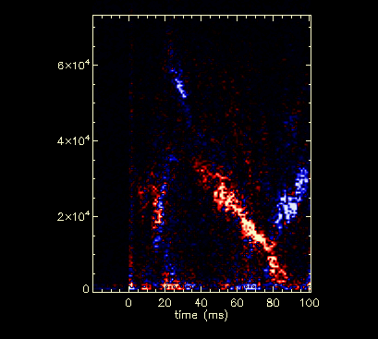
Two modes coexisting at different radii
Cross-power between n_{e} and Mirnov coils shows two modes coexisting (0,180º)
Probably at different radii as frequency is different, mode numbers the same
Notes:
We can also detect these fluctuations on the electron density.
The cross-power between ne and Mirnov shows that two sides of the V curve do not intersect at 0 frequency – an explanation is that there are two modes at different radii (and hence slightly different twist)

Slide 13
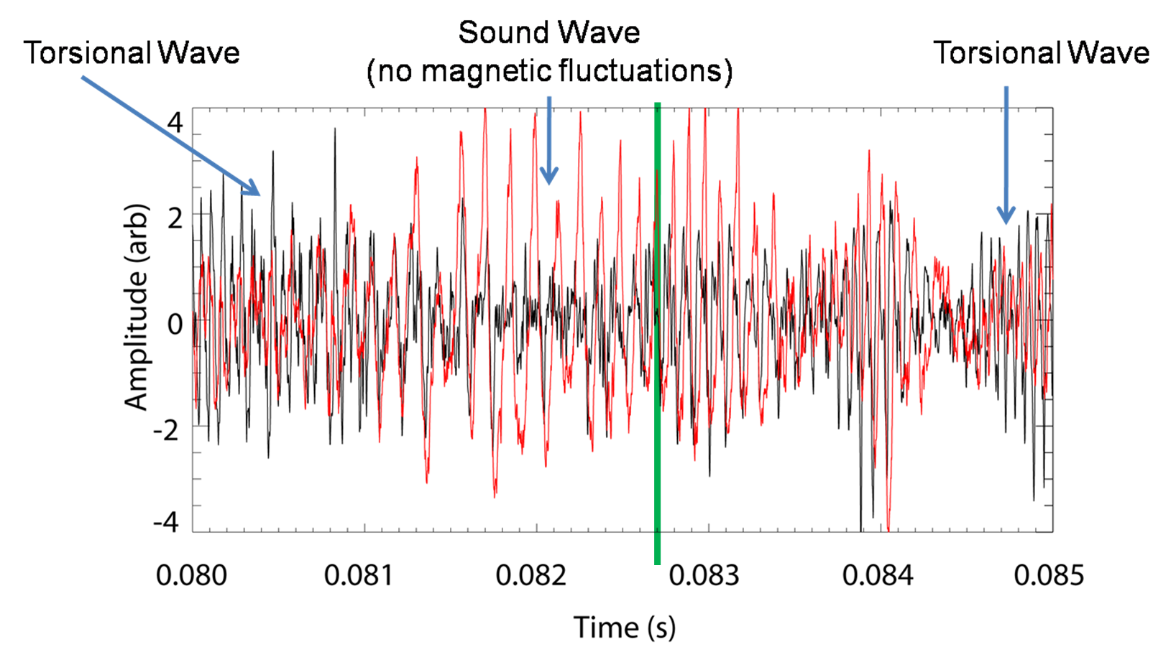
Phase flips, character changes near rational
The sense of the phase between the magnetic and light fluctuations changes about the resonance
More “sound-mode” like. (red is optical emission ∝ n_{e}).
Iota scanning in time ➔

Slide 14
CAS3D: 3D and finite beta effects
Carolin Nuhrenberg
Gap forms to allow helical Alfven eigenmode, and beta induced gap appears at low f
Beta induced gap ~5-10kHz
Coupling to “sound mode”

Slide 15
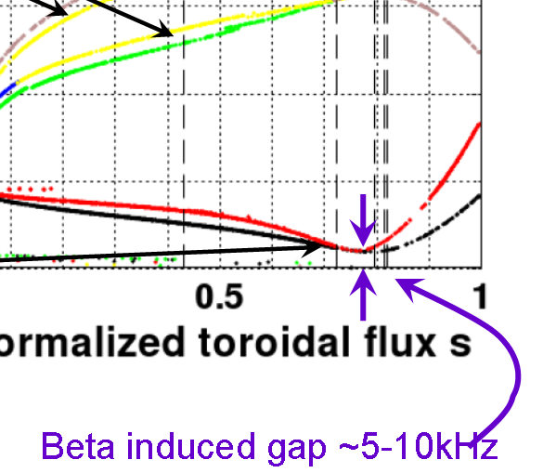
Beta-induced Alfvén eigenmodes?
At low beta in H-1 (10⁻⁴), the beta-induced gap is in the range 5-10kHz.
This is within the range of the modes near resonance, when iota-n/m is small
Beta induced gap scales with temperature rather than magnetic field
→ interactions between the beta induced gap and Alfvén continuum could help explain the ambiguous B dependence.
Scaling of f ~n/m (not ι- n/m) does not explain observed dependence of frequency on ι.
10kHz

Slide 16
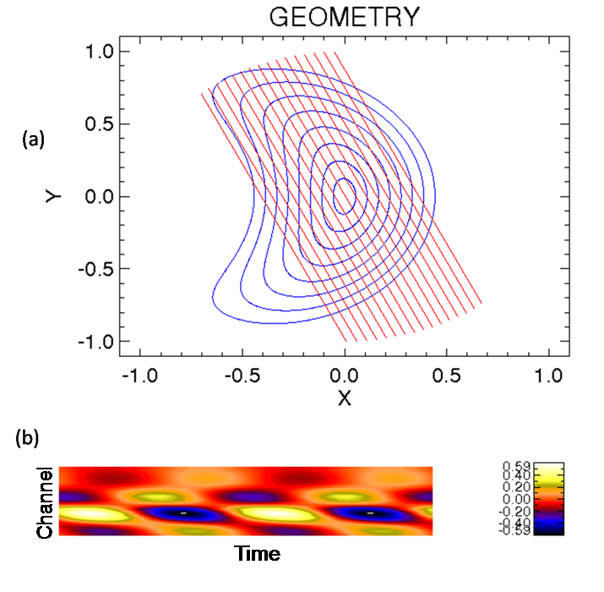
New PMT array →mode rotation information
16 channel PMT for broadband light emission measurements.
Views plasma at an angle → breaks the symmetry
Forward modelling shows shear in the projections (which depends on poloidal rotation direction)
Data shows this effect → ion diamag rotation direction
radius
Intensity (arbitrary units)
radius

Slide 17
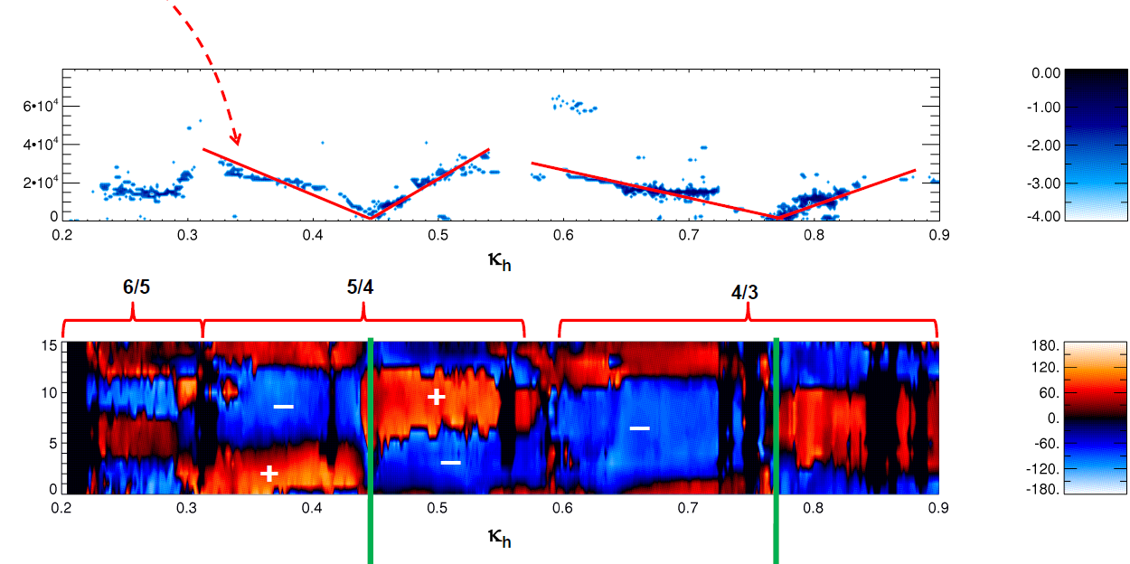
Radial Mode Structure
Jesse Read
Cross-power between light emission and Mirnov coils shows phase flips in radius and on either side of “V” resonance
Configuration (increasing twist →)
phase
Radius
number of radial nodes increases with the poloidal wavenumber.
Notes:
We can also detect these fluctuations on the electron density. The number of radial nodes reflects the poloidal wavenumber.
The cross-power between ne and Mirnov shows that two sides of the V curve do not intersect at 0 frequency – an explanation is that there are two modes at different radii (and hence slightly different twist)

Slide 18
Mode structure via synchronous 2D imaging
Intensified Princeton Instruments camera synchronised with mode using the intensifier pulse as a high speed gate. (256x256)
Total light or Carbon ion line imaged for delays of 0....1 cycle
Averaging is performed in the camera image plane, background removed by subtracting an unsynchronised shot.
Intensity (arbitrary units)

Slide 19
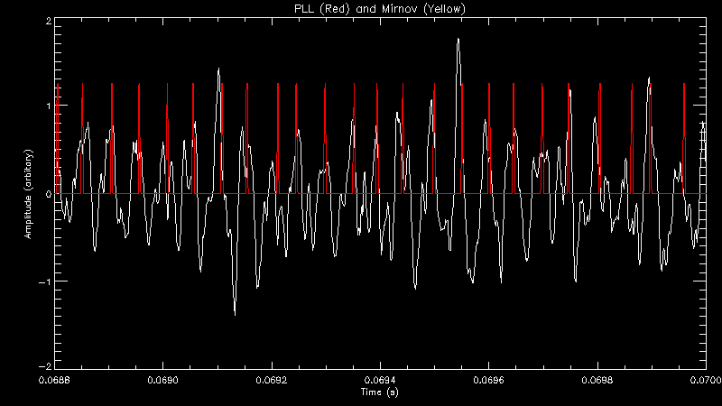
MHD: synchronous 2D imaging
Mirnov coil used as a reference signal.
PLL then matches the phase of its clock to the reference.
PLL output pulses drive the ICCD camera.
Delay output to explore MHD phase
Performance
Amplitude
Time (s)

Slide 20
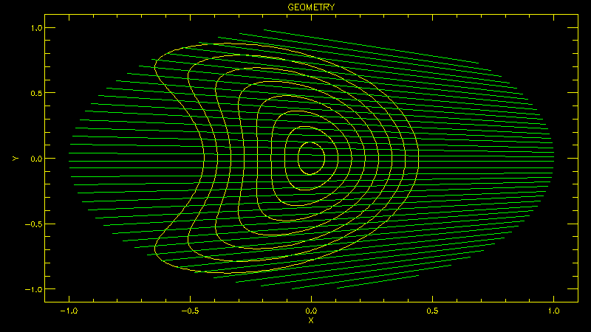
Modelling the Mode
For comparison the camera view was modelled. Allowing us to calculate expected line-integrated profiles.
Asymmetric views cause tilt in profiles which indicate the poloidal rotation direction of the mode.

Slide 21
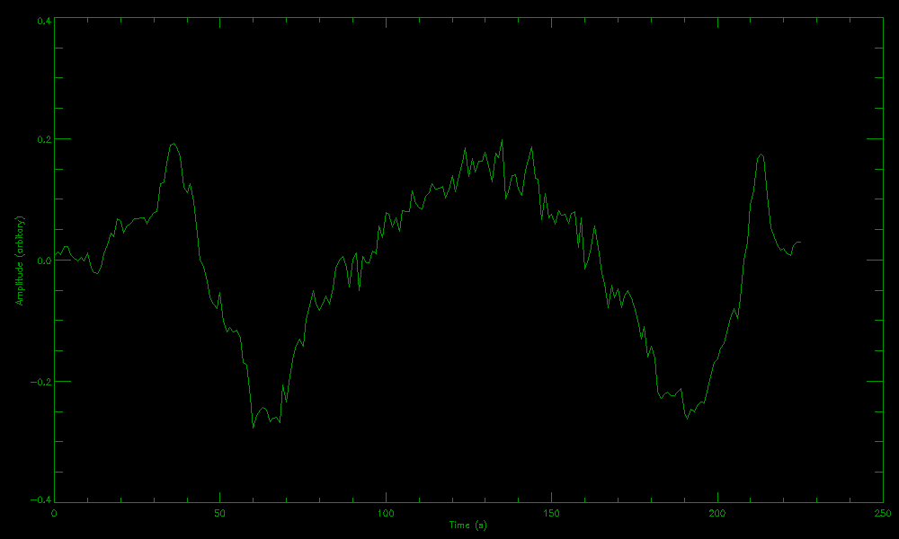
Comparison with Model
Intensity Profile
Amplitude (arbitrary units)
Vertical Position
Profile segment line
Images clearly show the mode’s helical structure.
Even parity, four zero crossings ➔ m ≥ 4.
Images at different time delays (between PLL pulse and camera gate) shows mode rotation.
Mode structure and rotation direction determined by comparing to model.

Slide 22
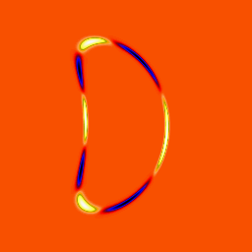
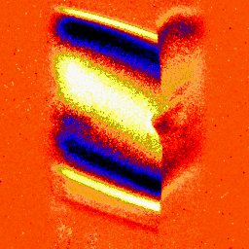
Comparison with Model (ii)
Model
Mode
Comparing with model of m=4 mode revealed an edge-localised mode.
Asymmetry ➔ rotation direction.
Pixel Position
Pixel Position
Time
Time
Result of asymmetry (plasma not central in camera view)
Model (poloidal cross-section)
Image (DC removed)

Slide 23
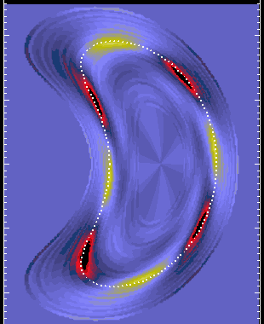
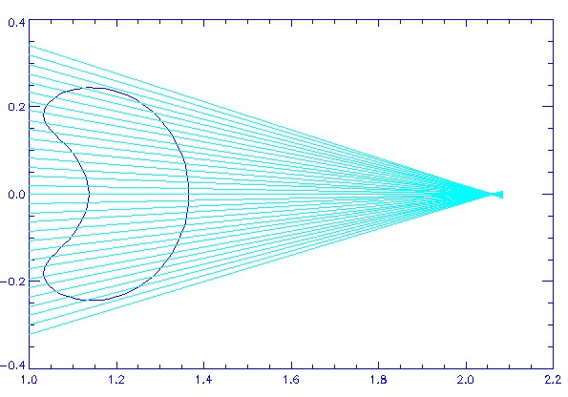
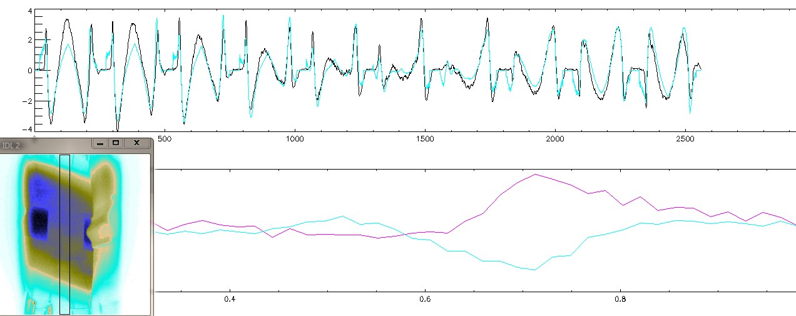
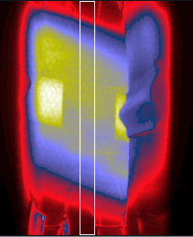
Mode Tomography
arbitrary radial profile, m=4, n=5
Match sightline integrals with data
Use data from 18 different phases
Mode appears narrow in radius
Model
Mode
Data and reconstruction
Result of asymmetry (plasma not central in camera view)
Sin/cos cpts
Peaked at r/a ~0.7
Model (poloidal cross-section)
Image (DC removed)
0.4 0.6 _{(r/a)} 0.8 1.0

Slide 24
Scaling discrepancies
ω_{res =} k|| V_{Alfvén} = k|| ^{B}/_{√(μoρ)}
Numerical factor of ~ 1/3 required for quantitative agreement near resonance
Impurities (increased effective mass) may account for 15-20%
3D MHD effects ~ 10-30% (CAS3D), still a factor of 1/1.5-2x required
Magnetic field scaling is unclear
Unknown drive physics
V_{Alvfen} ~5e6 m/s – in principle, H+ ions are accelerated by ICRH, but poor confinement of H+ at V_{A} (~40keV) makes this unlikely.
More complete analysis of orbits with H-1 paramaters (Nazikian PoP 2008) reduces required ion energy considerably
H+ bounce frequency of mirror trapped H+ is correct order?
Electron energies are a better match, but the coupling is weaker. (mechanism?)

Slide 25
Island Effects

Slide 26
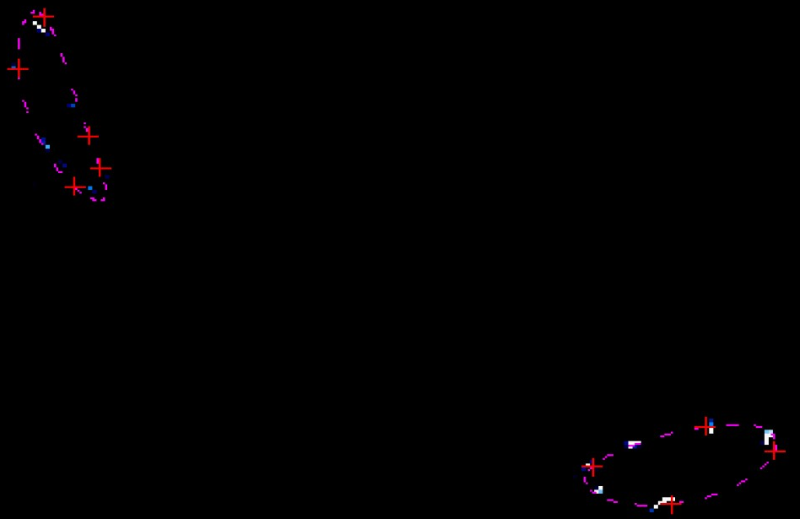
Good match confirms island size, location
computed +
e-beam mapping (blue/white)
Iota ~ 3/2
Iota ~ 1.4 (7/5)
Good match between computed and measured surfaces
Accurate model developed to account for all iota (NF 2008)
Minimal plasma current in H-1 ensures islands are near vacuum position
Sensitive to shear ✓ identify sequence number ✗ high shear surfaces “smear”
Notes:
We have developed a fast code for vacuum surface modelling with very detailed magnetic models. (BLINE)

Slide 27
Effect of Islands on Plasma
Santhosh Kumar
LHD, JT60U results show
T_{e} profile flattened – radial transport high (inside side to outside side)
But this doesn’t mean that internal transport is high
(from the inside to the outside of the island.)
Internal rotational transform is quite low and can complicate experiments
10 to 100 toroidal transits to circumnavigate island?
Conditions:
Argon plasma ~10eV
T_{e} ~ 10 eV, T_{i} ~ 10 eV ∼30-80 eV
electron density ∼ 1 × 10¹⁸/m³
n_{n} < neutral fill density ∼ 0.81 × 10¹⁸/m³
ρ_{e} ∼ 0.075 mm, ρ_{i} ∼35-55 mm
ν_{ei} ∼ 9×10⁵/sec ν_{en} ∼ 1.6×10⁵/sec
Collision mean free path λ_{ei} ∼2.5 m, λ_{en} ∼8 m

Slide 28
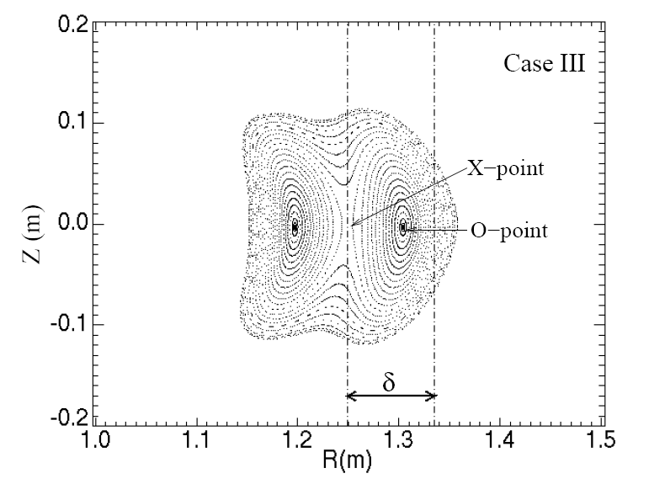
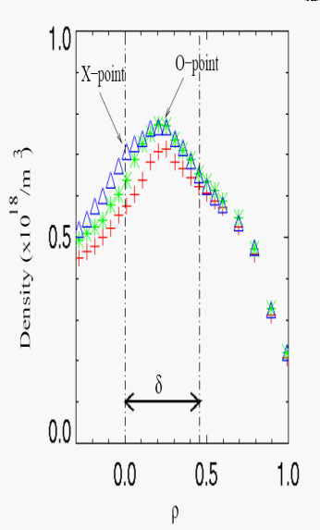
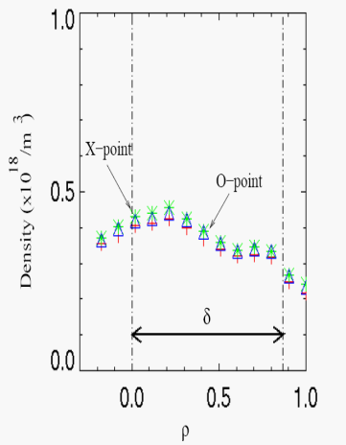
Effect of Magnetic Islands
Santhosh Kumar
Giant island →“flattish” density profile
Possibly connected to core electron root enhanced confinement
Central island – tends to peak

Slide 29
Spontaneous Appearance of Islands
Santhosh Kumar
Iota just below 3/2
– sudden transition to bifurcated state
Plasma is more symmetric than in quiescent case.
Uncertainty as to current distribution (and therefore iota), but plausible that islands are generated at the axis.
If we assume nested magnetic surfaces, →then we have a clear positive Er at the core – similar to core electron root configuration?
Many unanswered questions…… Symmetry? How to define Er with two axes?
Notes:
Electric field twice the magnitude of the highest observed in island case

Slide 30
Unanswered Questions
Issues Remaining:
What is the correct analysis for Er?
When does the plasma “see/not see” islands”
collisionality, ρ_{i}, ρ_{e} internal transform are important
What is the most robust indicator of surface number?
(φ_{p}? – varies with n_{e} by a fraction of T_{e} (Boltzmann relation))
Alternatives for “Correct” analysis for Er?
If we take the axis at the core → core electron root
If we assume two axes, then → ion root, but field is still large (characteristic of e-root)
[Conditions for usual e-root picture (1/ν, trapped e) not met]

Slide 31
Facility Upgrade
(New) Rudd Government “Super Science Package”
boosted National Collaborative Infrastructure Program using the “Educational Infrastructure Fund”
→ Restrictions on this fund limit use to infrastructure
→ ~US$5M over 4 years for infrastructure upgrades
2009 Australian Budget Papers
Funding agreement to be signed this year
Quarterly Milestones

Slide 32
Aims of Facility Upgrade
Consolidate the facility infrastructure required to implement the ITER forum strategy plan
Try to involve the full spectrum of the ITER forum activities
More specifically:
Improve plasma production/reliability/cleanliness
RF production/heating, ECH heating, baking, gettering, discharge cleaning
Improve diagnostics
Dedicated density interferometers and selected spectral monitors permanently in operation
Increasing opportunities for collaboration
Ideas?
Increasing suitability as a testbed for ITER diagnostics
Access to Divertor – like geometry, island divertor geometry

Slide 33
RF Upgrade
RF (7MHz) will be the “workhorse”
Low temperature, density limited by power
Required to initiate electron cyclotron plasma
New system doubles power: 2x100kW systems.
New movable shielded antenna to complement “bare” antenna
(water and gas cooled).
Advantages:
Very wide range of magnetic fields in Argon
New system allows magnetic field scan while keeping the resonant layer position constant. e.g. to test Alfven scaling MHD
Additional ECH source (10/30kW14/28GHz) for higher Te

Slide 34
Improved Impurity Control
Impurities limit plasma temperature (C, O, Fe, Cu)
High temperature (>~100eV) desirable to excite spectral lines relevant to edge plasma and divertors in larger devices.
Strategy - Combine:
Glow discharge cleaning for bulk of tank
Pulsed RF discharge cleaning for plasma facing components.
antenna (cooled) and source (2.4GHz)
Low temperature (90C) baking
Gettering

Slide 35
Small Linear Satellite Device – PWI Diagnostics
Purpose:
Testing various plasma wall interaction diagnostic concepts
spectroscopy, laser interferometry, coherence imaging
Features:
Much higher power density than H-1
Clean conditions of H-1 not compromised by material erosion diagnostic tests
Simple geometry, good for shorter-term students, simpler projects
Shares heating and magnet supplies from H-1
Circular coils ex Univ Syd. machines
Magnetic Mirror/Helicon chamber?

Slide 36
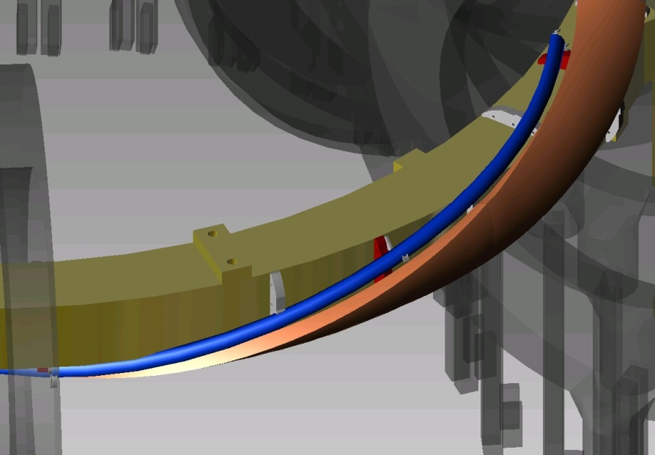
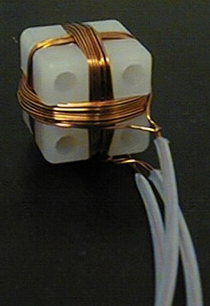
New Toroidal Mirnov Array
View of plasma region through port opening
Mounted next to Helical
Coils inside a SS thin-wall bellows (LP, E-static shield)
Access to otherwise inaccessible region with
largest signals and
with significant variation in toroidal curvature.

Slide 37
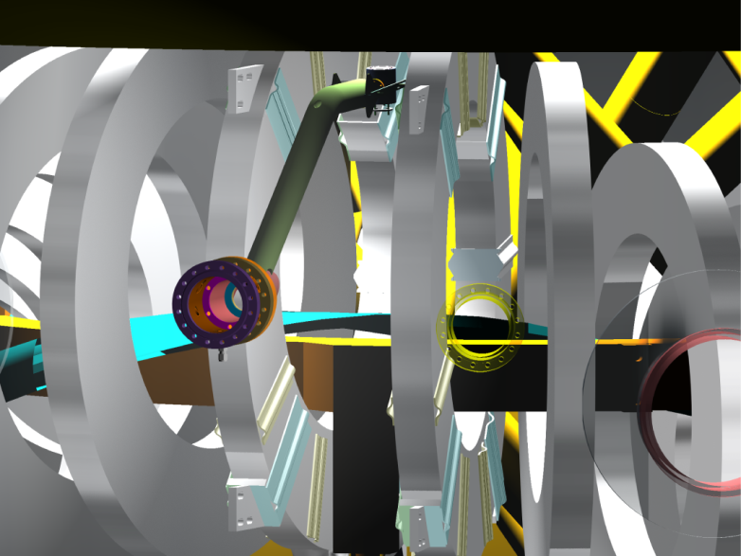
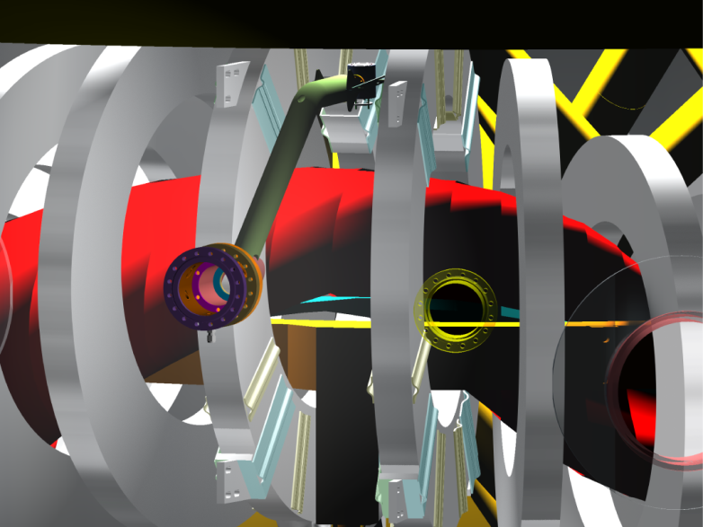
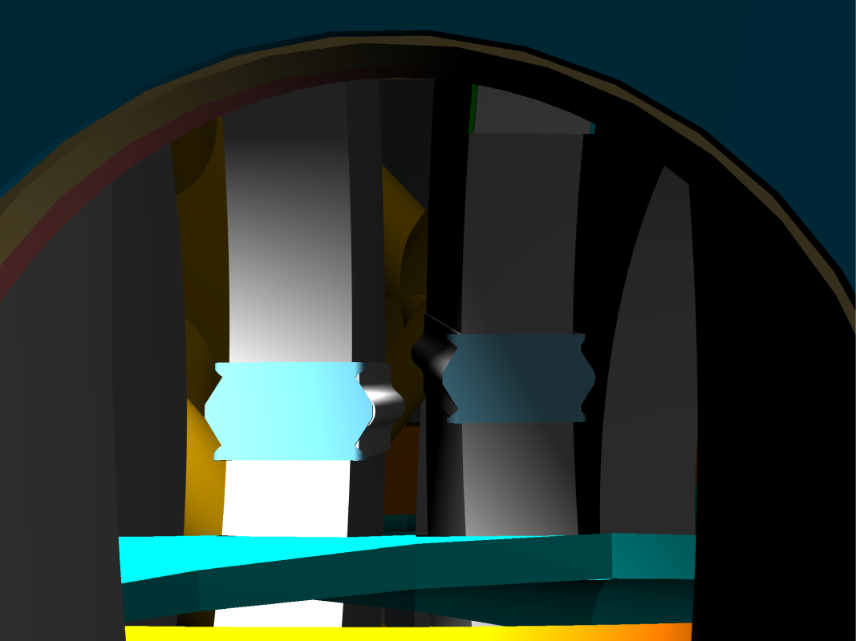
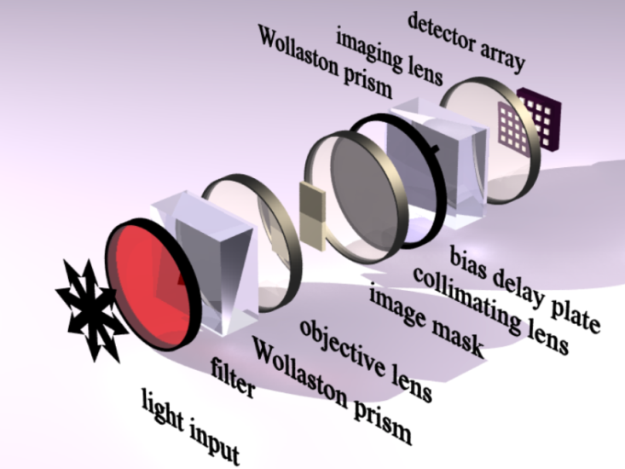
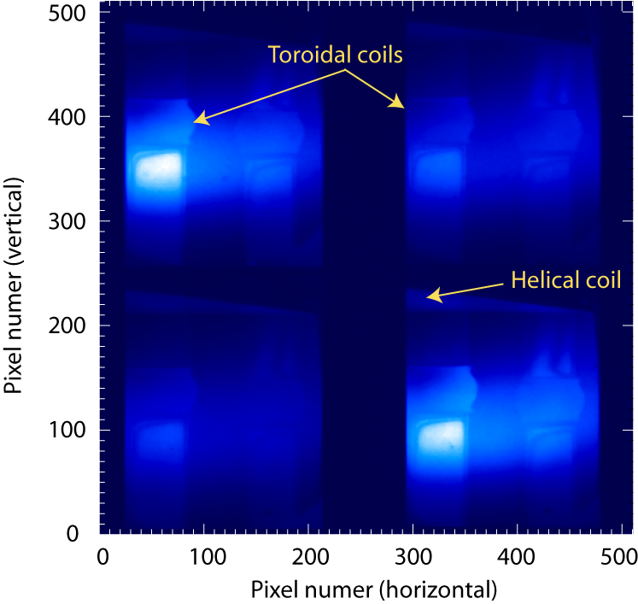
Quadrature Doppler imaging on H-1 (Angular multiplex)
Angle multiplexing through a polarization interferometer produces quadrature images of the interferogram at the 4 corners of a CCD camera
CAD view of coil set and view port
View of plasma region through port opening
CAD view of coil set and view port, including plasma
Brightness Ion temperature Flow profile
2-D, quadrature Doppler imaging

Slide 38
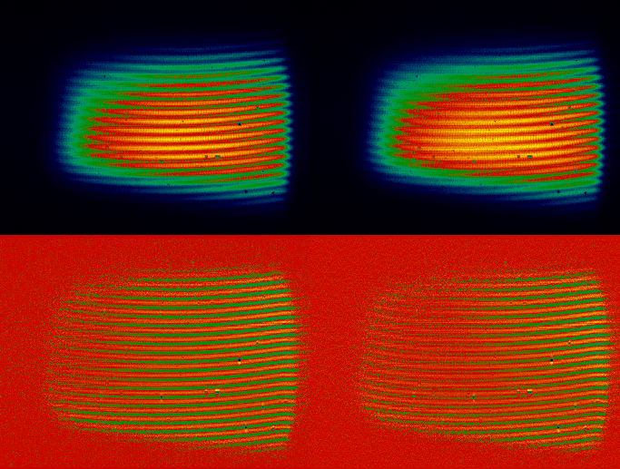
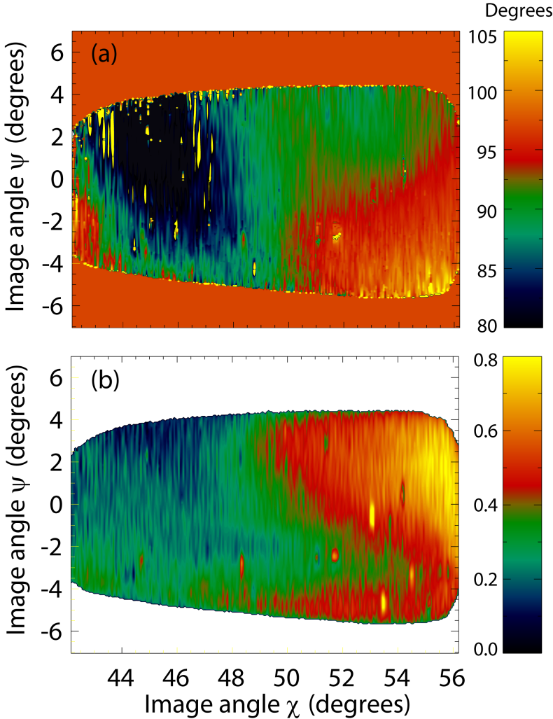
Hybrid Spatial-temporal multiplex
Raw image time 1
Raw image time 2
MSE polarization
Fringe visibility
Normalized interferogram 1
Normalized interferogram 2
Produced first full image of magnetic field in TEXTOR! (using MSE)

Slide 39
Conclusions
We show strong evidence for Alfvénic scaling of magnetic fluctuations in H-1, in n_{e}, iota and ω.
Scaling in B is unclear however, and an unexplained factor of ~3 in the frequency of near-resonant modes.
The driving mechanism is not understood
Interferometer CCD camera and PMT array → valuable mode structure Information
First indication is that mode is quite narrow radially
Island experiments well suited to H-1 (Argon is not so good!)
Is plasma potential is the best (“most constant”) surface label in this case?
Spontaneous bifurcation is similar to core electron root improved phenomenon, but how to interpret this if the flux surfaces are bifurcated?

Slide 40
Future
New Toroidal Mirnov Array
Bayesian MHD Mode Analysis
Toroidal visible light imaging (CII 525nm)
Correlation of multiple visible light, Mirnov and n~ _{e} data
Spatial and Hybrid Spatial/Temporal Coherence Imaging
Facility upgrade!
Develop divertor and edge diagnostics
Develop PWI diagnostics (materials connection)
Study stellarator divertors, baffles e.g. 6/5 island divertor

Slide 41
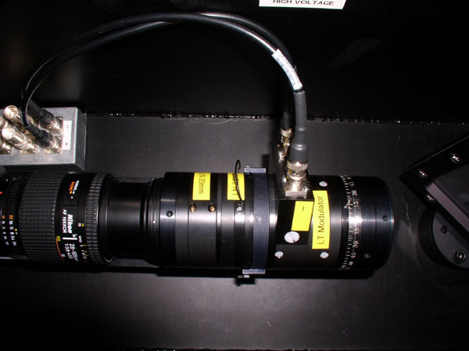
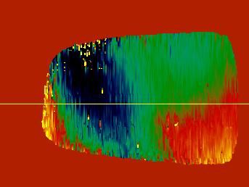
Advanced imaging systems
John Howard
International Science Linkages funding $700K (US, Korea, Europe, 2004-)
Systems developed under external research contracts for Japan, Korea, Germany, Italy ($480K)
View of plasma region through port opening
World’s first 2D image of internal plasma magnetic field on TEXTOR
(Howard 2008)
Signal processing, probabilistic data analysis, inverse methods (ANU)
International Science Linkages funding $430K (UKAEA 2008- )
Laser-based probing (USyd, ANU)
Atomic and molecular physics modeling (Curtin, ANU, Flinders)
Complex and dusty plasmas (USyd)
Notes:
41

Slide 42
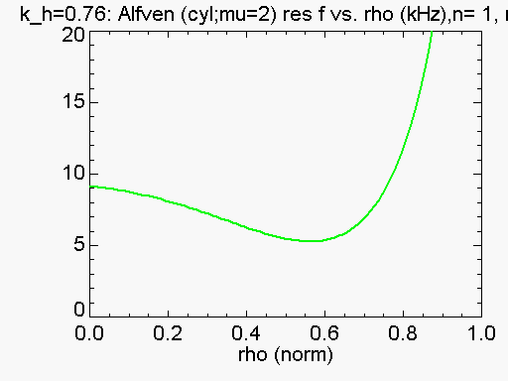
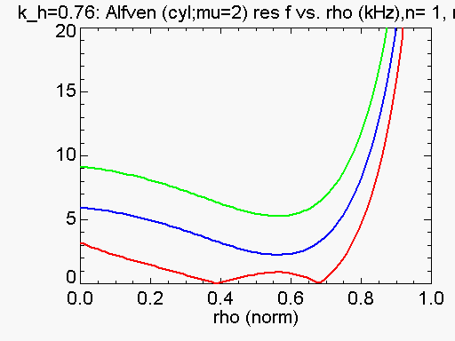
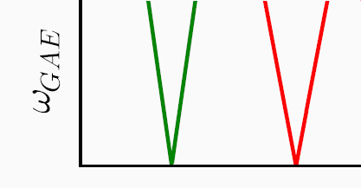
Identification with Alfvén eigenmodes: k|| → 0 as twist→ n/m
David Pretty
ω_{res} = k|| V_{A =} (m/R₀)(ι - n/m) ^{B}/_{√(μoρ)}
k|| varies as the angle between magnetic field lines and the wave vector
k|| ∝ ι - n/m
iota resonant means k||, ω → 0
Expect F_{res} to scale with δ iota
Resonant ι
Twist →
ι = 4/3
ιota →
Notes:
We can also see that k|| and freq will go to zero at resonance i=n/m. Freq will increase with δ iota as we move away from res.
However iota is not quite constant with radius – so we must consider the change in the radial profile.

