Slide 1
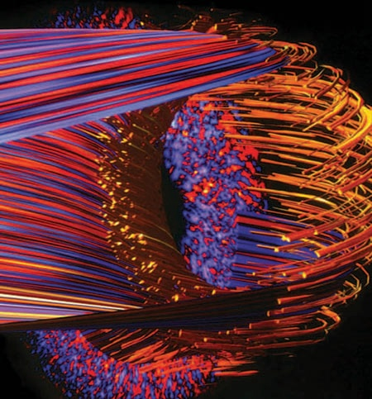
FSP Science Drivers
Presented by Martin Greenwald on behalf of FSP Team
Fusion Simulation Project PAC
September 23, 2010

Slide 2
Outline
Introduction and Motivation
Process and progress developing plans based on Science Drivers
Integrated Planning Teams
Charge to teams
Description and status of Science Applications
How does proposed approach help answer science questions?
Response to questions and recommendations from last PAC

Slide 3
Science Drivers – Motivation
The Science Drivers are a set of compelling scientific problems chosen to focus FSP’s design and initial implementation
(These could also be described as a set of evolving use cases)
Criteria for the drivers
Clear need for multi-scale, multi-physics integration
Importance and urgency for the fusion program
Readiness and tractability
Opportunities to open up new lines of research
The FSP will build Integrated Science Applications targeted to these problems
The Applications will
Help address these critical problems
Define and exercise the required range of capabilities
Provide useful tools for the broader fusion community

Slide 4
We Are In The Midst Of A Multi-step Process For Developing Program Plans For Each Science Driver
For each Science Driver ⇒ Develop plans for the Integrated Applications
Teams have developed “science development roadmaps”, a step by step plan for adding scientific capabilities (see March workshop summary).
These plans are being elaborated to include requirements for components, frameworks, verification and validation. (more details to come) Schedule and resource requirements will be estimated.
Result will be detailed program plans for each driver. (Reports due 9/30)
Program will be rationalized and refactored across all drivers
Scope, schedule and priorities adjusted to mesh development elements and to match anticipated funding profiles.
Major deliverables and milestones defined.
Result will be an overall FSP program plan

Slide 5
A Broad Community Is Engaged in This Planning
Work rests on previous community efforts and ongoing outreach activities
Approximately 35 people contributed to development of science drivers, with additional input during the March FSP Workshop.
Report available at http://www.pppl.gov/fsp/documents/Briefings/FSP PLANNING WORKSHOP SUMMARY REPORT_2010.pdf
Interdisciplinary teams were formed at the end of April to further define the programs. These teams include a cross section of prominent fusion computationalists,theorists, experimentalists along with experts in computer science and applied math.
The teams are addressing scope covering scientific issues, component needs, framework requirements, validation plans, etc.

Slide 6
Integrated Planning Group Membership (1)
Boundary Physics
Tom Rognlien (LLNL) Team Leader
Dennis Whyte (MIT) co-Leader
Darren Stotler (PPPL)
Jeff Brooks (Purdue)
John Canik (ORNL)
Tim Tautges (ANL)
Brian Wirth (U. Tenn)
Martin Greenwald (MIT)
Xianzhu Tang (LANL)
Pedestal
Phil Snyder (GA) Team Leader
Rajesh Maingi (ORNL) co-Leader
X. Xu (LLNL)
C.S. Chang (NYU)
Tom Osborne (GA)
Jeff Hittinger (LLNL)
Martin Greenwald (MIT)
Arnold Kritz (Lehigh)

Slide 7
Integrated Planning Group Membership (2)
Core profiles
Bill Nevins (LLNL) Team Leader
Stan Kaye (PPPL) co-Leader
Pat Diamond (UCSD)
Jeff Candy (GA)
Chris Holland (GA/UCSD)
Scott Parker (U. Colorado)
Scott Klasky (ORNL)
Weixing Wang (PPPL)
Xianzhu Tang (LANL)
Vincent Chan (GA)
Wave-Particle
R. Nazikian (PPPL) Team Leader
P. Bonoli (MIT) co-Leader
Herb Berk (IFS)
Ed D'Azevedo (ORNL)
Nikolai Gorelenkov (PPPL)
Bill Heidbrink (UC-Irvine)
Z. Lin (U.C. Irvine)
Cynthia Phillips (PPPL)
Randy Wilson (PPPL)
Don Spong (ORNL)
Steve Wukitch (MIT)
John Cary (TechX)

Slide 8
Integrated Planning Group Membership (3)
Disruptions
S. Kruger (TechX) Team Leader
J. Menard (PPPL) co-Leader
Allan Reiman (PPPL)
Dave Humphreys (GA)
Vincent Chan (GA)
Bill Tang (PPPL)
Other contributions from Chacon (ORNL), Izzo, Hollmann, Pigarov (UCSD), Strauss (NYU), Breslau, Jardin, Stotler (PPPL), Whyte (MIT), Harvey, Petrov (CompX), Hassanein, Sizyuk, Sizyuk (Purdue), Putvinski (ITER)
Whole device modeling
A. Pankin (Lehigh) Team Leader
Ron Prater (GA) co-Leader
Glenn Bateman (Lehigh)
C.S. Chang (NYU)
Julian Cummings (CalTech)
Chuck Kessel (PPPL)
Doug McCune (PPPL)
Lang Lao (GA)
Lynda LoDestro (LLNL)
Arie Shoshani (LBNL)
John Cary – (Tech-X)
Arnold Kritz (Lehigh)

Slide 9
Charge To Planning Groups
Goal: The integrated planning teams are charged with preparing the overall logic, approach and requirements for each of the FSP science drivers. The plans developed by the teams are expected to have a 10-15 year scope
Approach: The process of developing these plans begins with the descriptions and roadmaps of the FSP science drivers as summarized in the March workshop report.
The level of detail in the technical plans developed by the integrated planning teams should be sufficient to lay out a schedule for work to be accomplished, to estimate resource requirements and to define milestones.
It is expected that each team will plan a staged assessment process and establish a schedule for carrying out the tasks required in developing the plans for the work to be carried out in the 10-15 time period.
Deliverables and schedule: Interim reports were submitted July 30, 2010
Final reports due September 30, 2010

Slide 10
Detailed Expectations Have Been Defined for Component, Framework and Validation
Components
physical models (equations)
component factorization and functionality
Frameworks
Overall description of physics and models that require coupling
Computational details
Data exchange details
Validation
Critical scientific issues and measurement requirements
Further details on each will be provided in subsequent talks

Slide 11
Agreed Outline of Final Reports (1)
Background and motivation
Goals for the science driver: with clear explanation of the problems being addressed, physics challenges and the modeling capabilities required.
Components: 1) Functional requirements for physics codes components) that need to be integrated in order to achieve the goals associated with the science driver. 2) Plans for adapting older components and as well as plans for developing new components.
Framework requirements 1) Analysis of the requirements for composition of the physics components (including data exchanges and algorithms) 2) Analysis of the requirements for the full workflow (task composition)

Slide 12
Agreed Outline of Final Reports (2)
Validation requirements: 1) Measurement requirements and notable gaps 2) Plans for validation of critical physics associated with the science driver
Connections to other work 1) Needs for collaboration with other efforts within the FSP 2) Requirements for work to be accomplished outside the FSP (foundational theory, etc.)
Schedule and resources 1) A projected schedule of the work to be carried over a 15 year time period including notes on dependences with other Science Driver (or other FSP) activities and deliverables. 2) Realistic estimate of resources required
Milestones: Suggested high-level goals and milestones (perhaps at roughly the 2, 5, 10 and 15 year marks.)

Slide 13
Outline
Introduction and Motivation
Process and progress developing plans based on Science Drivers
Integrated Planning Teams
Charge to teams
Description and status of Science Applications
How does proposed approach help answer science questions?
Response to questions and recommendations from last PAC

Slide 14
Plasma Boundary Layer
Crucial unresolved scientific issues for fusion.
Heat and particle loads
Erosion of first wall & impurity generation & screening
Tritium fuel cycle – retention in first wall
Key Challenges
Self-consistent solution of coupled plasma turbulence, macro-stability, neutral transport, atomic physics
Complexity of plasma-wall interactions, materials chemistry and morphology, large range of timescales
Lack of spatial scale separation (gradients, gyro-radius, neutral mfp, photon, mfp), scrape-off layer (SOL) coupling to pedestal
Magnetic topology: open and closed field lines, 3D geometry

Slide 15
Plasma Boundary Layer Program Plans
Years 1-2 (Begin addressing heat and particle loads, impurity sources)
Coupled fluid turbulence and cross-field transport and …
Atomic and neutral physics, classical parallel transport
Initial dynamic wall model, recycling and sputtering coefficients
Years 2-5 (More complete model of heat and particle loads, impurity sources, begin addressing retention issues)
Preliminary kinetic models for turbulent transport, neutral transport
Time dependent models for hydrogen retention and recycling
Fluid impurity transport
Years 5-15 (Models for retention, first wall erosion)
Kinetic models for turbulent transport, neutral transport , impurities
More complete PMI models including time dependent surface evolution and 2D transport within the materials, extended molecular dynamics

Slide 16
Pedestal
Key Physics Questions
L-H transition, particularly in terms of input power
Structure of pedestal, pressure, density and temperature profiles
Heat and particle loads from Type I ELMs
Prediction of large scale radial electric field (Er) and plasma rotation
Pedestal gradient relaxation: Understanding the wide variety of ELM types and non-ELM H-modes
Staged Approach
Linear models for pedestal structure
Dynamic evolution of pedestal with quasi-linear transport models
ELM dynamics with fluid or hybrid fluid-kinetic models
Direct multi-scale simulation

Slide 17
Pedestal Plans (1)
Implement existing time averaged pedestal models based on linear constraints (stability) and experimental validation (Predictions of pedestal pressure profiles)
Directly calculate linear constraints (e.g. peeling-ballooning, KBM), including realistic geometry, initially with extended MHD, later full gyrokinetic (GK) calculations for KBM. Incorporate ExB shear stabilization. (Improved predictions of pressure profiles, onset and type of ELM or other relaxation mechanism.)
Develop dynamical "quasi-linear" models using accurate representation of linear onset of various modes (ETG, TEM, ITG, KBM...). Include accurate calculations of neoclassical transport (Predictions of temperature and density profiles.)
Implement fluid and/or kinetic models of neutral recycling, fueling and density evolution (Prediction of dynamical evolution of profiles.)

Slide 18
Pedestal Plans (2)
Direct nonlinear electromagnetic gyrokinetic simulation of turbulent transport coupled to neoclassical and sources (Prediction of L-H threshold, improved model for density and temperature profiles)
Model ELM crash dynamics (Heat and particle loads from ELMs )
Include 3D effects – extended MHD + parallel transport. (Improved models for pedestal relaxation mechanisms and ELM dynamics)
Direct multi-scale simulation, formulation for finite n needs new theory (Improved models for L-H transition and pedestal structure.)

Slide 19
Elements Required in Pedestal Models
Realistic geometry (near edge, separatrix) including realistic boundary conditions, & regional coupling [to core, to scrape-off-layer (SOL), divertor plate, wall]
Reduced pedestal structure models
Linear MHD
Linear electromagnetic gyrokinetics (EM GK)
Neoclassical (including 3D magnetic perturbations, δB)
Fluid turbulence (separatrix, L-mode, δB)
Nonlinear EM GK (near edge, electron and ion scales, δB)
Nonlinear EM GK (cross separatrix, electron and ion scales, δB)
Sources and Sinks including neutrals, NBI, RF pellets (*kinetic treatment with large perturbations), radiation
Nonlinear extended MHD (across separatrix, δB)
*Full Fokker-Planck nonlinear collision operator
*Multi-scale, high-fidelity kinetic code (6D or extended 5D or kinetic-fluid)
*requires substantial new algorithmic and/or theoretical development

Slide 20
Core Profiles Nonlinear Turbulence & MHD
Scientific Questions
To what extent can local gyrokinetic models predict core profiles in MHD quiescent discharges? (What is the role of mesoscale phenomena?)
What is the influence of 3D geometry, originating in MHD instabilities, on turbulent driven transport and overall profiles?
Three parallel paths to modeling plasma transport:
1.5D transport models in which fluxes of particles, momentum and energy are approximated using model transport coefficients (mainly responsibility of Whole Device Modeling group)
Local transport models, in which fluxes of particles, momentum and energy are obtained from a radial array of gyrokinetic flux-tube codes
Meso-scale transport models, which obtain fluxes of particles, momentum, and energy from global codes and are capable of including the effect of meso-scale phenomena (e.g., neoclassical tearing modes) on plasma transport

Slide 21
Core Profiles, Nonlinear Turbulence & MHD
Local Transport Models
Mesoscale Transport Models
GK/Maxwell equations integrated on a representative set of flux surfaces on the gyrokinetic time scale
Resulting fluxes used to advance core profiles on transport time-scale
Proven algorithm
TGYRO (GYRO)
TRINITY (GS2)
Widely used for GK code validation
Can expect near-term results
2 to 5 yr. milestone to implement local transport model within FSP
5 to 10 yr. milestone addressing validation of the local transport model
Obtain fluxes from global GK code to model mesoscale phenomena
Key goal is modeling effect of tearing modes, sawteeth, etc on core transport
Requires 3D MHD equilibrium
Requires more development:
new formalism to describe the coupling between the plasma turbulence and the evolving 3-D MHD equilibrium
develop global GK code - model plasma turbulence in perturbed 3-D fields
Develop new components to describe the evolution of the 3-D magnetic equilibrium
Longer-term
5-year milestone to develop required formalism
10 year milestone addressing validation of this mesoscale transport model

Slide 22
Wave Particle Interactions
Scientific Questions:
Will Alfvenic instabilities in the presence of alphas, RF heating and neutral beam injection, lead to unacceptable loss of energetic ions in reactor regimes?
Can RF waves couple effectively to the plasma core and be used to control plasma profiles and MHD instabilities in the presence of multiple particle species (including energetic fusion products)?
Outstanding Issues:
Transport predictions for Alfvenic instabilities requires multimode simulation with self consistent description of mode dynamics using realistic sources and sinks of fast ions.
Predictive understanding of RF plasma control requires high fidelity simulation of edge dissipation mechanisms and self consistent description of RF fields in the presence of multiple particle species and MHD instabilities.

Slide 23
Wave Particle Interactions - Goals
1-2 yrs:
“Quasilinear” Alfven multimode model for transport simulation with particle sources/sinks and linear eigenfunctions (Prediction of energy losses from fast particle instabilities)
Linear model of RF edge coupling including 3-D field reconstructions (First predictions of RF heating and current profiles in presence of realistic plasma edge)
3-5 yrs:
“Quasilinear” Alfven multimode model for transport simulation including RF sources (More complete prediction of energy losses from fast particle instabilities)
Nonlinear description of RF edge coupling including slow wave/sheath effects (More complete prediction of RF heating and current profiles in presence of realistic plasma edge)
5-10 yrs:
a. Self consistent Alfven eigenmode description with multiple particle sources and nonlinear RF interactions. (Prediction of coupled interactions between RF fields, fast ion distributions and MHD instabilities.)

Slide 24
Disruption Avoidance and Mitigation
Scientific Issues
Can we predict stability boundaries with sufficient reliability and robustness to avoid virtually all disruptions?
If disruptions can’t be avoided, can they be predicted early enough for mitigation strategies?
What are the effects of mitigated and unmitigated disruptions (heat loads, mechanical forces, runaway electrons)?
Key Scientific Challenges
Stiffness of ideal MHD operator leads to difficulties in stability boundary assessments
Strongly nonlinear MHD, with large Lundquist number
Coupling to plasma pressure & current, atomic physics, neutral and impurity transport, radiation transport, relativistic electron transport
Coupling to electromagnetic model of machine (complex wall geometry, power supplies coils, control systems, etc., diagnostics)

Slide 25
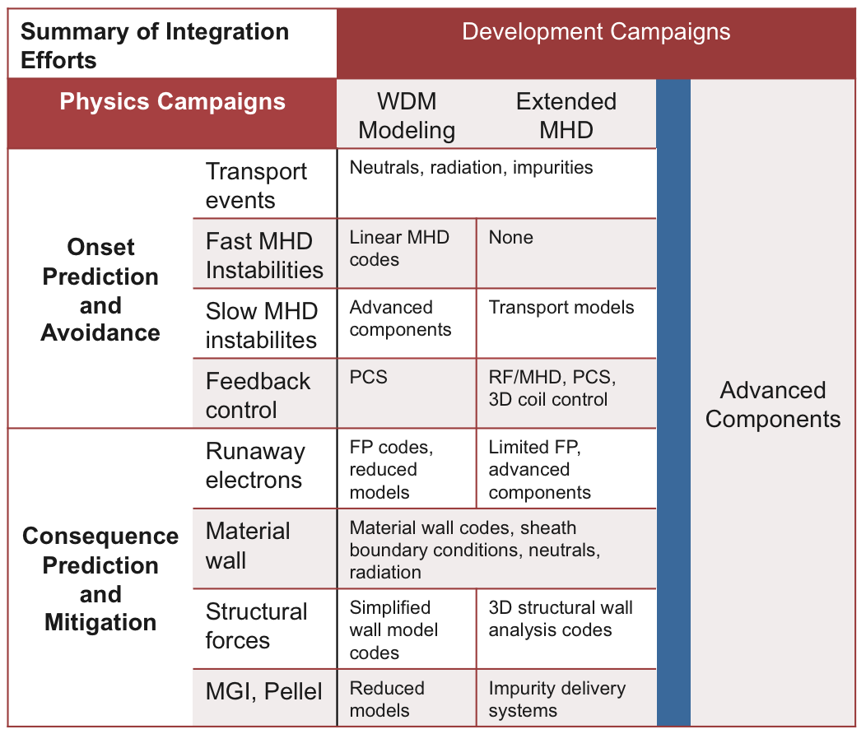
Disruption Avoidance and Mitigation
New physics campaign
New developmentcampaign

Slide 26
Disruption Avoidance and Mitigation Staged Development
WDM campaign
Use linear codes to help predict stability boundaries including UQ
Develop better whole-device techniques for studying disruption onsets and effects, including integration with 3D modeling
Extended MHD campaign (note: Many elements are done in parallel. Milestones will clarify)
Start with existing extended MHD codes, free-boundary disruption models
Couple three-dimensional MHD fields with Fokker-Plank modeling of runaway electron generation and transport in stochastic, time-varying fields.
Couple three-dimensional MHD fields with external codes to study effects on material wall and detailed force analyses.
Use reduced models for plasma-material boundary interactions including sheath model, impurities and radiation losses and couple to MHD calculations.
Use improved models for plasma-material boundary interactions including reduced wall models, dust, and radiation transport
Use improved modeling of gas jet and pellets for disruption mitigation.
Include improved models for electron and ion (thermal and super-thermal) transport in stochastic field
Implement self-consistent coupling of extended MHD models with codes that model PMI and structural forces.
Develop Kinetic-MHD hybrid models

Slide 27
Further Integration
To support experimental operation and design of new experiments, Whole Device Models will be required
Over time, science driver paths will begin to merge
Pedestal integrated with Boundary Physics
Pedestal integrated with Core
Wave-particles models including effects of micro-turbulence
Etc., etc.
However, even from the start, we envision full integration (whole device modeling) at various, but increasing levels of physics fidelity.
To begin, reduced models will be required for many phenomena.
Over time better models will need to be made available.
Each science area will need to develop reduced models based on and benchmarked against high-fidelity models

Slide 28
Whole Device Modeling – Challenges and Requirements
WDM Challenges
Dynamical modeling of all discharge phases from startup to shutdown
Integration of physics components that operates on different spatial and time scales such as
Scrape-off layer physics
Plasma wall interactions
Core transport
Heating and current drive
Fast particles
Pedestal physics including ELMs and their impact on the divertor
3D MHD modes
Non-linear interaction of multi-scale physics
Verification and validation of WDM tools
WDM needs
Robust and stable solvers for 1D, 2D, and 3D models and stiff transport equations
Stable for >10⁵ timesteps
Alternate solvers/models for the cases when solution convergence fails
Selection of physics models that provide different level of fidelity and cover different plasma parameter regimes
Each component should have a module structure and well documented
Dynamic parallelism as a part of FSP framework requirement
Implicit coupling of WDM components
Each WDM component needs to be verified as standalone component and as a part of the FSP suite of codes

Slide 29
Whole Device Modeling – Critical Elements
Several FSP thrusts can shape the WDM successes:
High fidelity science components
Reliable and flexible framework that set standards for coupling of science components in the WDM code. The framework should be flexible enough to allow the coupling with 1d, 2d, or 3d components, explicit and implicit coupling, dynamic parallelism, flexible data exchange and storage
Verification and validation of individual physics components and WDM tool in general. The V&V activity will include the establishing of V&V metrics, set of synthetic diagnostic tools, development of interfaces to experimental data, and legacy transport codes
Data visualization, analysis, transport, and storage
Four high priority research areas are identified:
1) 2.5D equilibrium and transport solver
2) Self-consistent fast particle treatment for neutral beam, ion cyclotron, and alpha heating and current drive sources
3) Incorporation of turbulence simulation into transport time-scale simulation
4) Modeling of ELM with pedestal/SOL/divertor/first wall interaction

Slide 30
Whole Device Modeling - Roadmap
Integration Physics | Relies on | Integration/common needs | Yr
Turbulence on transport time scales | Gyro-kinetic and integrated modeling codes | Evolution of plasma profiles, including turbulence | 3
Interaction of boundary with plasma core | 1-1/2-D core and 2-D edge codes | Plasma and neutrals transport, atomic physics | 6
3-D free-boundary plasma evolution | 3-D equilibrium with magnetic islands and stochastic fields | 3-D equilibrium, sources, sinks, transport | 9
Prediction, control and mitigation of instabilities | Macroscopic instability codes | Nonlinear macroscopic instability together with integrated modeling | 12

Slide 31
Whole Device Modeling - Roadmap
Implement reduced plasma models for all relevant phenomena in quiescent, axisymmetric equilibrium, including off-line verification and validation of reduced models against experiments and high-fidelity codes.
Establish mechanisms for coupling to high-fidelity models running on parallel architectures during time-dependent simulations. Start with turbulence models.
Implement tight-coupling between core and edge plasmas including pedestal, scrape-off layer and plasma-wall interactions.
Include high-fidelity models for interactions between fast and thermal particles, waves, instabilities and turbulence.
Implement 3D free boundary equilibrium that can handle magnetic islands, stochastic regions, RF, nuclear and atomic physics modules.
Include nonlinear extended MHD models for disruptions, sawteeth, ELMs, etc.

Slide 32
Continuing Activities
Interdisciplinary groups will complete their work on the six Science Application areas shortly (9/30).
FSP management team will meld these into a single scientific program plan.
Schedules and resource allocation will be adjusted to mesh with overall priorities, interdependencies and projected funding.
Outreach and engagement with broader community will continue – including winter workshop.

Slide 33
Outline
Introduction and Motivation
Process and progress developing plans based on Science Drivers
Integrated Planning Teams
Charge to teams
Description and status of Science Applications
How does proposed approach help answer science questions?
Response to questions and recommendations from last PAC

Slide 34
Response to PAC Recommendations (1)
“The PAC recommends that the FSP continue to develop a strategy and prioritized plans for realizing the capabilities for each science driver through a transparent and documented process. This process should involve the fusion experimental and theoretical communities and the DOE computational science communities with participation from other communities.”
“The PAC would like to see the science driver outreach continue with a stronger effort to engage the experimental community in the selection and prioritization process.”
Done
“The adequacy and feasibility of the roadmap for covering the needs of the magnetic fusion program should be assessed by a focused review by these communities as part of the FSP PP deliverables.”
Agreed - Part of FSP Plan

Slide 35
Response to PAC Recommendations (2)
“The requirements and opportunities for verification and experimental validation should be key elements in the selection of science drivers and roadmaps, including outreach to US and international partners for long duration discharge data.”
Agreed – Part of ongoing efforts
“The PAC endorses a staged software delivery model, with early and periodic releases, each with greater capability. This will be important for community support and feedback.”
Agreed - Part of current plans
“the PAC recommends careful consideration of the early deployment of three-dimensional simulation capabilities. “
The role of 3D physics is under consideration by the integrated teams. A number of important areas have already been identified.

Slide 36
Response to PAC Recommendations (3)
Boundary
Restriction to the "first few microns" of the wall should be relaxed. Diffusion farther into the wall can play an important role in retention. Melting leads to much larger distortions.
Rotation and momentum transport should be explicitly included.
Non-ideal wall topologies (gaps, misalignment) should be explicitly incorporated.
ELM avoidance and/or control should be highlighted. We note that this topic will have strong overlap with the Pedestal science driver.
1-3 are already part of planning activity, though relation to possible computational “materials” initiative awaits on decisions by OFES
ELM physics is the primary responsibility of the pedestal group, but the boundary team is considering effects of ELMs on boundary plasma and first wall.

Slide 37
Response to PAC Recommendations (4)
Pedestal
“ELM control techniques, like pellet pacing, should be included as part of the FSP plan.”
“Development of nonlinear electromagnetic gyrokinetic simulations of turbulent transport for the pedestal and edge will require a large amount of work, but the scale of that challenge is not adequately reflected in the emphasis in the roadmap.”
Agreed – Both are part of ongoing planning efforts (but will require substantial time and resources and resolution is not likely in the early years of the program)
Wave-Particles Interactions:
“We recommend that RF be given a higher priority than indicated in the list of scientific issues, key challenges, and payoffs for wave-particle interactions.”
These areas are meant to be balanced, we will try to reflect this in the final report

Slide 38
Response to PAC Recommendations (5)
Disruptions
“Why is disruption avoidance not listed in the roadmap elements for the disruption science driver?”
This element has been explicitly added
“From experimental results, we know that the critical phase is during the current quench. Capabilities and gaps for modeling runaway electrons during the current quench phase need assessment. If development is required, it should receive relatively high priority.”
These issues are currently being considered
“Gas jet and pellets for disruption mitigation… This programmatic priority deserves early attention, possibly in parallel with other development, within the science driver.”
Some adjustment of priorities could push this forward, but a great deal of basic work is required in parallel.

Slide 39
Response to PAC Recommendations (6)
Disruptions
“While the structural response is important, the plasma’s response to 3D interactions with external components needs to be emphasized. Perturbations from imposed fields and asymmetric responses to non-uniform wall conductivity and shaping influence plasma rotation and locking.”
These issues are part of current planning (but quite challenging.)

Slide 40
Response to PAC Recommendations (7)
Whole Device Modeling
“An issue that needs additional focus is development of reduced fidelity models that capture the major important effects of a set of phenomena in an algorithm that is fast and compact and suitable for inclusion in a multi-physics whole device code. It is a major missing aspect with respect to priorities.”
Development of reduced models is indeed essential. We will try to articulate plans for this as we move forward.

Slide 41
Summary
We believe that the current science drivers address a critical set of physics issues that are appropriate for the FSP - Scientific roadmaps for each were previously outlined.
Interdisciplinary teams are currently producing more detailed plans for each including proposed schedules and resource requirements
When these teams have completed their work, the FSP management team will assess, prioritize and refactor as necessary, defining the initial set of integrated applications – suitable for the execution plan.
Once the program is underway, the science drivers will be addressed by integrated application development teams
We would expect the set of science drivers to continue to evolve over the life of the FSP.

