Slide 1
Introduction to Gyrokinetic Theory & Simulations
Greg Hammett (Princeton University, PPPL)
ITER Summer School, Aix-en-Provence, Aug. 26, 2014
(these slides & handwritten notes @ http://w3.pppl.gov/~hammett/talks/2014/gk_intro)
Students, introduce yourselves: where from, what year, main interests.
Motivation: Reducing microturbulence could help fusion
Physical picture of turbulent processes in tokamaks
Brief intro to gyrokinetics concept: average over fast gyromotion.
  Two main kinds of gyokinetics
    Iterative/asymptotic, local, δf gyrokinetics
    Lagrangian/Hamiltonian, global, full-F gyrokinetics
  Annotated references for suggested reading
  Handwritten derivation of iterative local gyrokinetics (electrostatic slab)
  Handwritten gyrokinetic derivation of toroidal ITG instability
A few slides about algorithms: PIC/continuum, Discontinuous Galerkin.
(Some slides were skipped in presentation. Revised 2014.09.08)

Slide 2
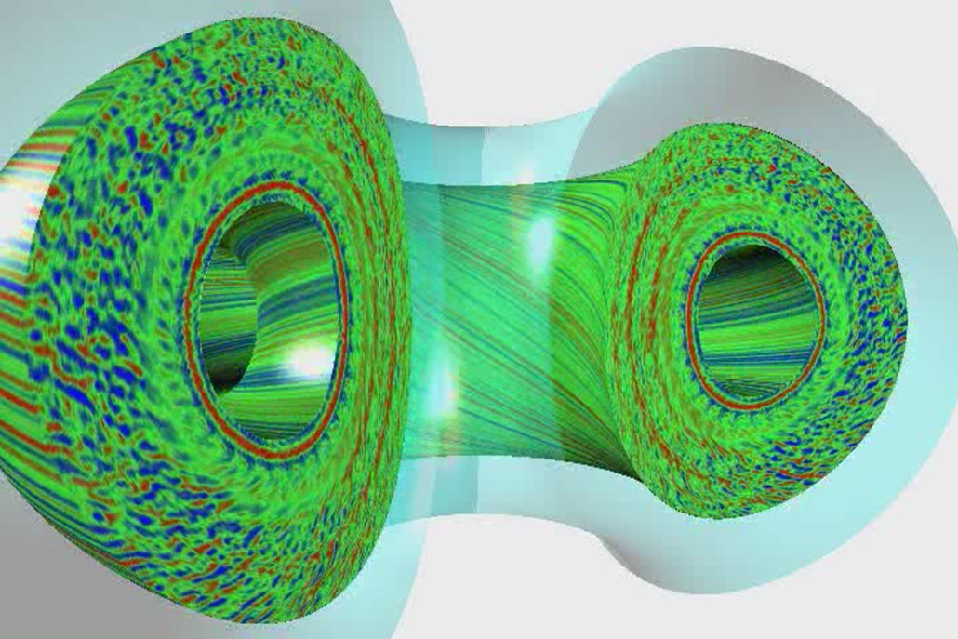
Gyrokinetic Simulation of Tokamak Microturbulence
Candy, Waltz (General Atomics)

Slide 3
Improving Confinement Can Significantly
↓ Size & Construction Cost of Fusion Reactor
Well known that improving confinement & β can lower Cost of Electricity / kWh, at fixed power output.
Even stronger effect if consider smaller power: better confinement allows significantly smaller
size/cost at same fusion gain Q (nTτ_{E}).
Standard H-mode empirical scaling:
τ_{E} ~ H I_{p}^{0.93} P^{-0.69} B^{0.15} R^{1.97} …
(P = 3VnT/τ_{E} & assume fixed nTτ_{E,} q₉₅, β_{N}, n/nGreenwald):
R ~ 1 / ( H^{2.4} B^{1.7} )
ITER std H=1, steady-state H~1.5
ARIES-AT H~1.5
MIT ARC (fire.pppl.gov FESAC) H₈₉/2 ~ 1.4
(new HTS ~Bx2, P_{fus} ~ B⁴ at fixed )
Relative Construction Cost
n ~ const.
n ∝ nGreenwald
(Plots assumes a/R=0.25, cost ∝ R² roughly. Plot accounts for constraint on B @ magnet with 1.16 m blanket/shield, i.e. B = B_{mag} (R-a-a_{BS})/R)
3

Slide 4
Interesting Ideas To Improve Fusion
* Liquid metal (lithium, tin) films or flows on walls: (1) protects solid wall (2) absorbs incident hydrogen ions, reduces recycling of cold neutrals back to plasma, raises edge temperature & improves global performance. TFTR found: ~2 keV edge temperature. NSTX, LTX: more lithium is better, where is the limit?
* Spherical Tokamaks (STs) appear to be able to suppress much of the ion turbulence: PPPL & Culham upgrading 1 --> 2 MA to test scaling
* Advanced tokamaks, alternative operating regimes (reverse magnetic shear or “hybrid”), methods to control Edge Localized Modes, higher plasma shaping. Will beam-driven or spontaneous rotation be more important than previously thought?
* Tokamaks spontaneously spin: can reduce turbulence and improve MHD stability. Can we enhance this with up-down-asymmetric tokamaks or non-stellarator-symmetric stellarators with quasi-axisymmetry?
* Many possible stellarator designs, room for further optimization: Quasi-symmetry / quasi-isodynamic improvements discovered relatively recently, after 40 years of fusion research. Stellarators fix disruptions, steady-state, density limit.
* Robotic manufacturing advances: reduce cost of complex, precision, specialty items

Slide 5
Intuitive picture of tokamak instabilities
-- based on analogy with Inverted Pendulum / Rayleigh-Taylor instability:
-- curved magnetic field lines → effective gravity

Slide 6
Stable Pendulum
Unstable Inverted Pendulum
(rigid rod)
L
g
L
M
F=Mg
ω=(g/L)^{1/2}
ω= (-g/|L|)^{1/2} = i(g/|L|)^{1/2} = iγ
Instability
Density-stratified Fluid
Inverted-density fluid
⇒Rayleigh-Taylor Instability
ρ=exp(-y/L)
ρ=exp(y/L)
stable ω=(g/L)^{1/2}
Max growth rate γ=(g/L)^{1/2}

Slide 7
“Bad Curvature” instability in plasmas
≈ Inverted Pendulum / Rayleigh-Taylor Instability
Top view of toroidal plasma:
Growth rate:
Similar instability mechanism
in MHD & drift/microinstabilities
1/L = |∇p|/p in MHD,
∝ combination of ∇n & ∇T
in microinstabilities.
R
plasma = heavy fluid
B = “light fluid”
g_{eff} = centrifugal force

Slide 8
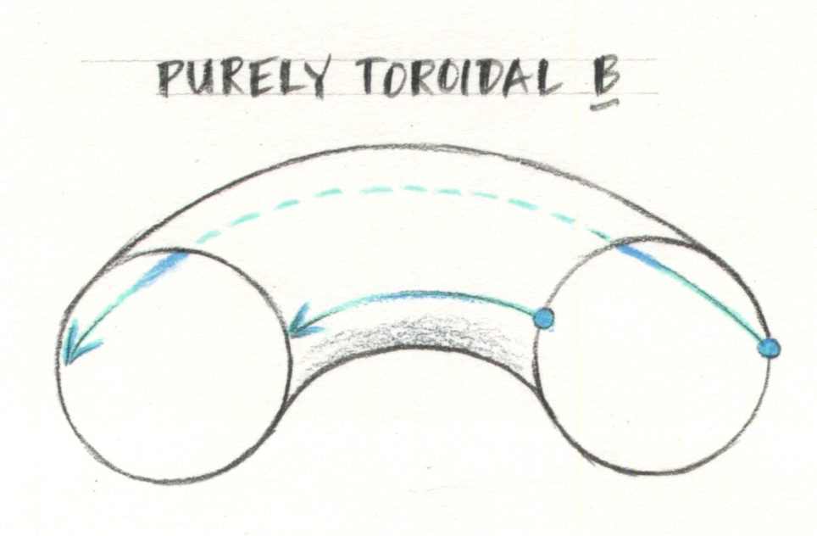
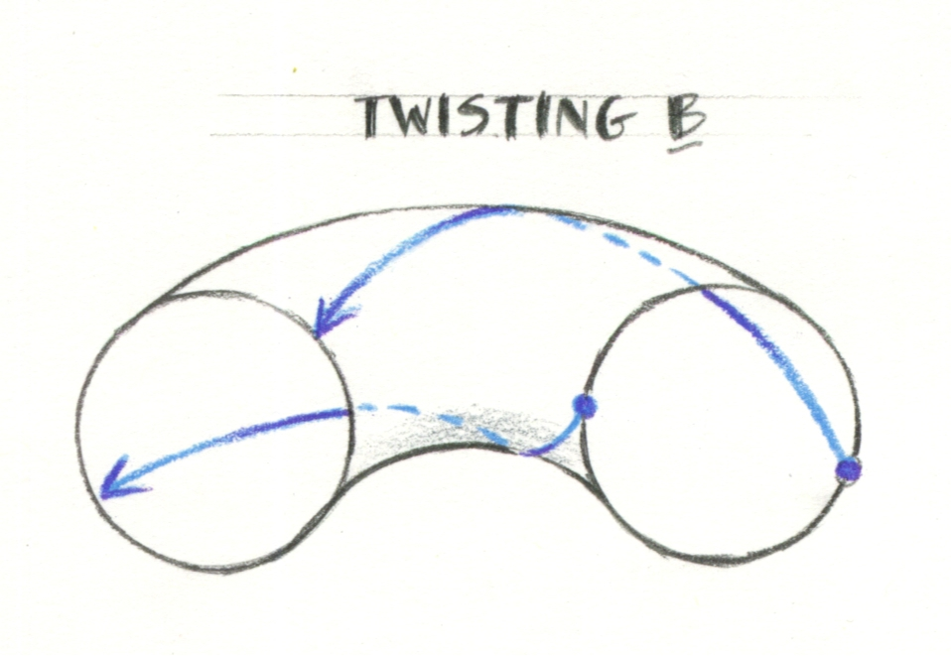
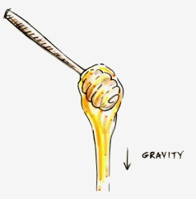
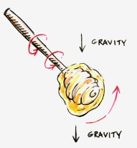
The Secret for Stabilizing Bad-Curvature Instabilities
Twist in B carries plasma from bad curvature region
to good curvature region:
Unstable
Stable
Similar to how twirling a honey dipper can prevent honey from dripping.

Slide 10
An aside to define some tokamak terminology (𝜄 used in stellarator literature):
q ≈1.6 in the upper right figure 2 slides back.

Slide 12
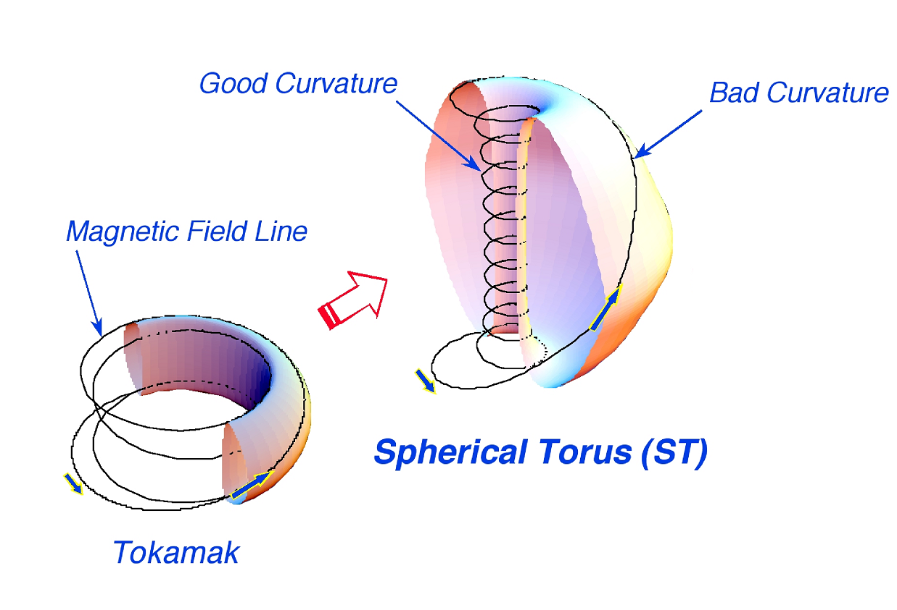
Spherical Torus has improved confinement and pressure limits (but less room in center for coils)
ST max beta ~ 100% (locally,
smaller relative to field at coil)
Tokamak max beta ~ 10%

Slide 13
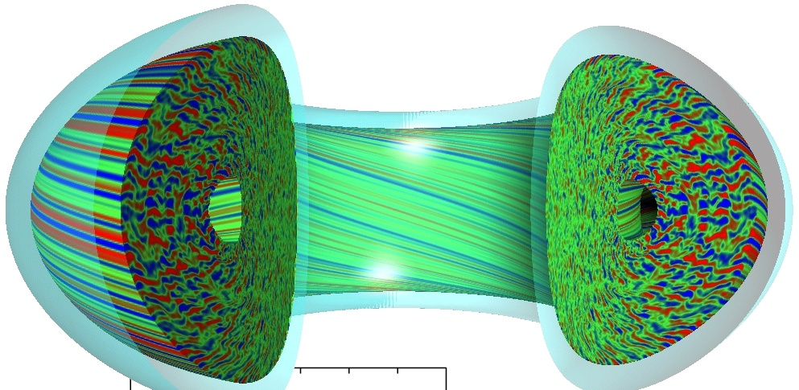
These physical mechanisms can be seen
in gyrokinetic simulations and movies
Unstable bad-curvature
side, eddies point out, direction of effective gravity
Stable
side, smaller eddies
particles quickly move along field lines, so density perturbations are very extended along field lines, which twist to connect unstable to stable side

Slide 15
Note: previous and other figures show color contours of density fluctuations, not of the total density, because if one plotted contours of total density, the tiny fluctuations would not be visible:
For low-frequency fluctuations, ω << k|| v_{te}, electrons have a Boltzmann response to lowest order along a field line:
So contours of density fluctuations are also contours of constant potential, and so represent stream lines for the ExB drift. (Like stream lines in 2D fluid flow.) Can illustrate this with a sketch…

Slide 16
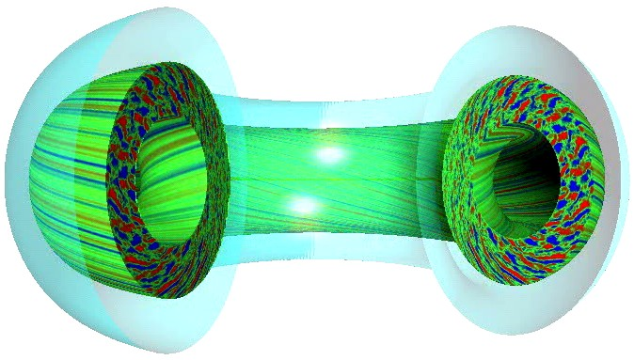
Movie https://fusion.gat.com/theory-wiki/images/3/35/D3d.n16.2x_0.6_fly.mpg from http://fusion.gat.com/theory/Gyromovies shows contour plots of density fluctuations in a cut-away view of a GYRO simulation (Candy & Waltz, GA). This movie illustrates the physical mechanisms described in the last few slides. It also illustrates the important effect of sheared flows in breaking up and limiting the turbulent eddies. Long-wavelength equilibrium sheared flows in this case are driven primarily by external toroidal beam injection. (The movie is made in the frame of reference rotating with the plasma in the middle of the simulation. Barber pole effect makes the dominantly-toroidal rotation appear poloidal..) Short-wavelength, turbulent-driven flows also play important role in nonlinear saturation.
Sheared
flows
More on sheared-flow suppression of turbulence later

Slide 17
Sheared flows can suppress or reduce turbulence
Most Dangerous Eddies:
Transport long distances
In bad curvature direction
Sheared Eddies
Less effective
Eventually break up
=
+
Sheared Flows
Biglari, Diamond, Terry (Phys. Fluids1990),
Carreras, Waltz, Hahm, Kolmogorov, et al.

Slide 18
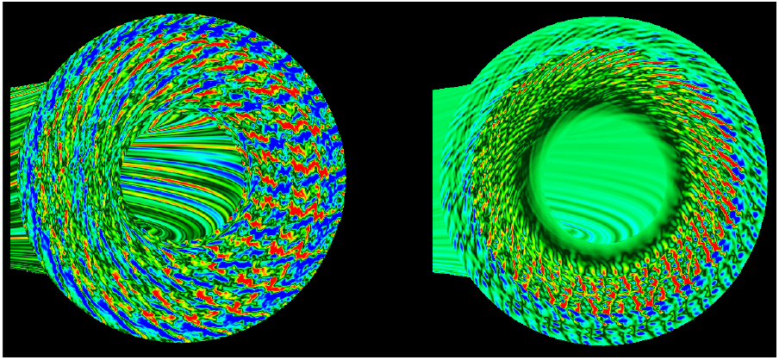
Sheared ExB Flows can regulate or completely suppress turbulence (analogous to twisting honey on a fork)
Dominant nonlinear interaction between turbulent eddies and
±θ-directed zonal flows.
Additional large scale sheared zonal
flow (driven by beams, neoclassical)
can completely suppress turbulence
Waltz, Kerbel, Phys. Plasmas 1994 w/ Hammett, Beer, Dorland, Waltz Gyrofluid Eqs., Numerical Tokamak Project, DoE Computational Grand Challenge

Slide 19
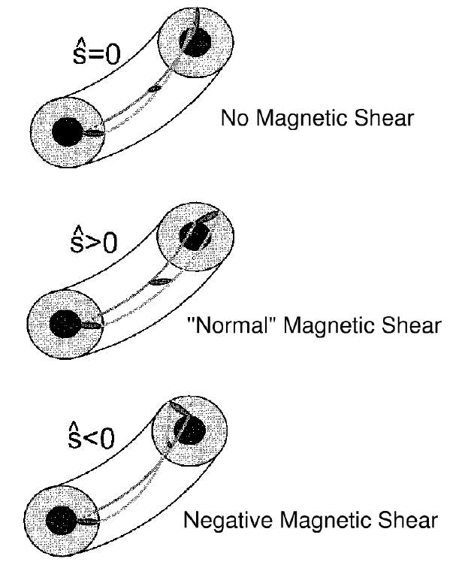
Simple picture of reducing turbulence by negative magnetic shear
Particles that produce an eddy tend to follow field lines.
Reversed magnetic shear twists eddy in a short distance to point in the ``good curvature direction''.
Locally reversed magnetic shear naturally produced by squeezing magnetic fields at high plasma pressure: ``Second stability'' Advanced Tokamak or Spherical Torus.
Shaping the plasma (elongation and triangularity) can also change local shear
(in std tokamaks)
Advanced Tokamaks
Fig. from Antonsen, Drake, Guzdar et al. Phys. Plasmas 96
Kessel, Manickam, Rewoldt, Tang Phys. Rev. Lett. 94
“Normal” in stellarators

Slide 20
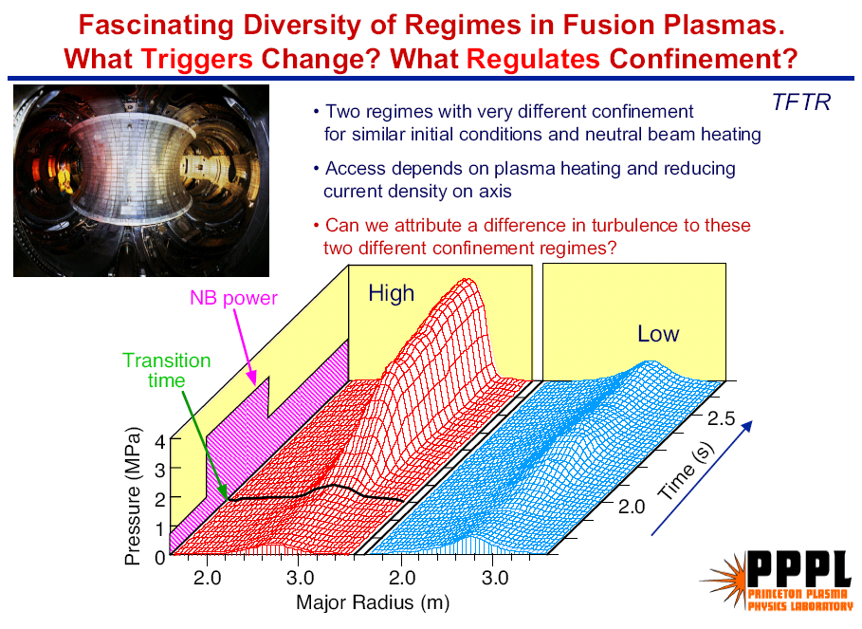
R. Nazikian et al.

Slide 21
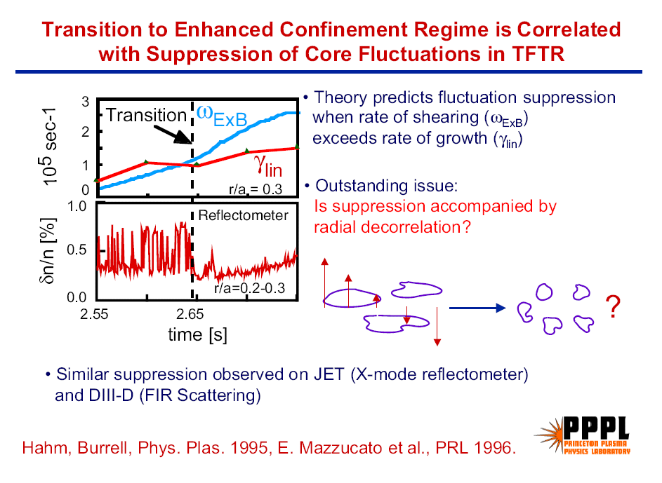
R. Nazikian et al.

Slide 23
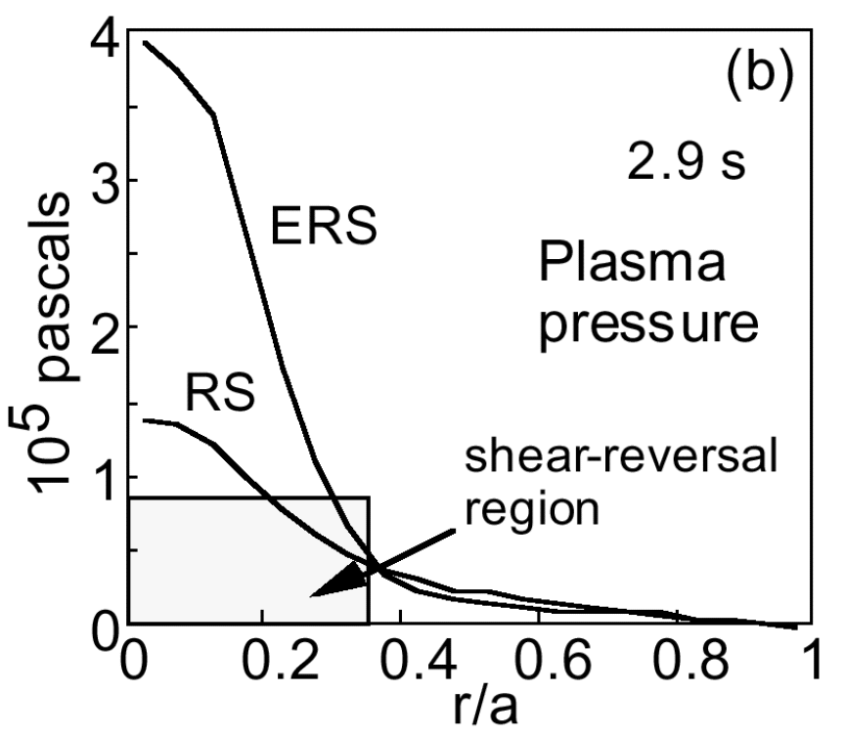
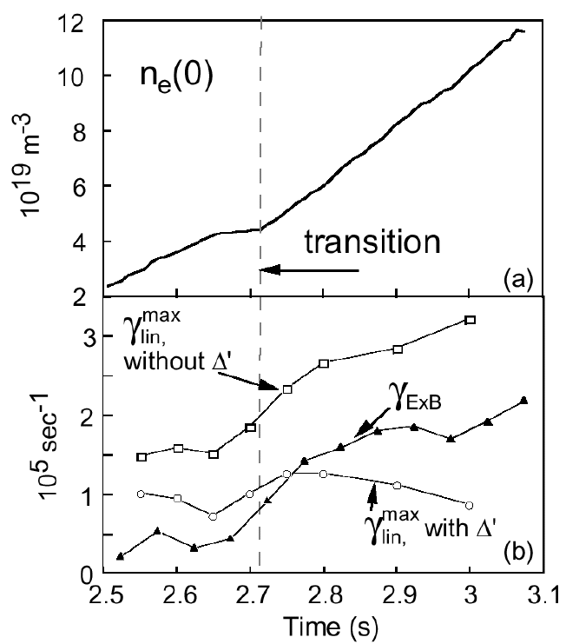
All major tokamaks show turbulence can be suppressed w/ sheared flows & negative magnetic shear / Shafranov shift
Synakowski, Batha, Beer, et.al. Phys. Plasmas 1997
Internal transport barrier forms when the flow shearing rate dv_{θ} /dr > ~ the max linear growth rate γ_{lin}^{max} of the instabilities that usually drive the turbulence.
Shafranov shift Δ’ effects (self-induced negative magnetic shear at high plasma pressure) also help reduce the linear growth rate.
Advanced Tokamak goal: Plasma pressure ~ x 2, P_{fusion} ∝ pressure² ~ x 4

Slide 24
Turbulence suppression mechanisms really work:
Ion Transport level can be reduced to minimal collisional level in some cases.

Slide 27
Rosenbluth-Longmire picture

Slide 28
Can repeat this analysis on the good
curvature side & find it is stable.
(Leave as exercise.)
Rosenbluth-Longmire picture

Slide 29
Rigorous derivation of ITG growth rate & threshold (in a simple limit) starting from the Gyrokinetic Eq.
(see handwritten notes…)

Slide 30
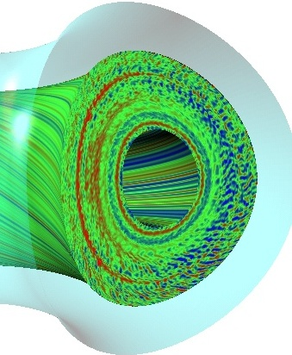
Fairly Comprehensive 5-D Gyrokinetic Turbulence Codes
Have Been Developed
small scale, small amplitude density fluctuations (<1%) suppressed by reversed magnetic shear
Solve for the particle distribution function
f(r,θ,α,E,μ,t) (avg. over gyration: 6D → 5D)
500 radii x 32 complex toroidal modes (96 binormal grid points)
x 10 parallel points along half-orbits
x 8 energies x 16 v||/v
12 hours on ORNL Cray X1E w/ 256 MSPs
Realistic toroidal geometry, kinetic ions & electrons, finite-β electro-magnetic fluctuations, full linearized collisions.
Sophisticated spectral/high-order upwind algorithms. This plot from continuum/Eulieran code GYRO (SciDAC project), GENE (Garching) similar. These and other codes being widely compared with experiments.
(Candy, Waltz, General Atomics)

Slide 31
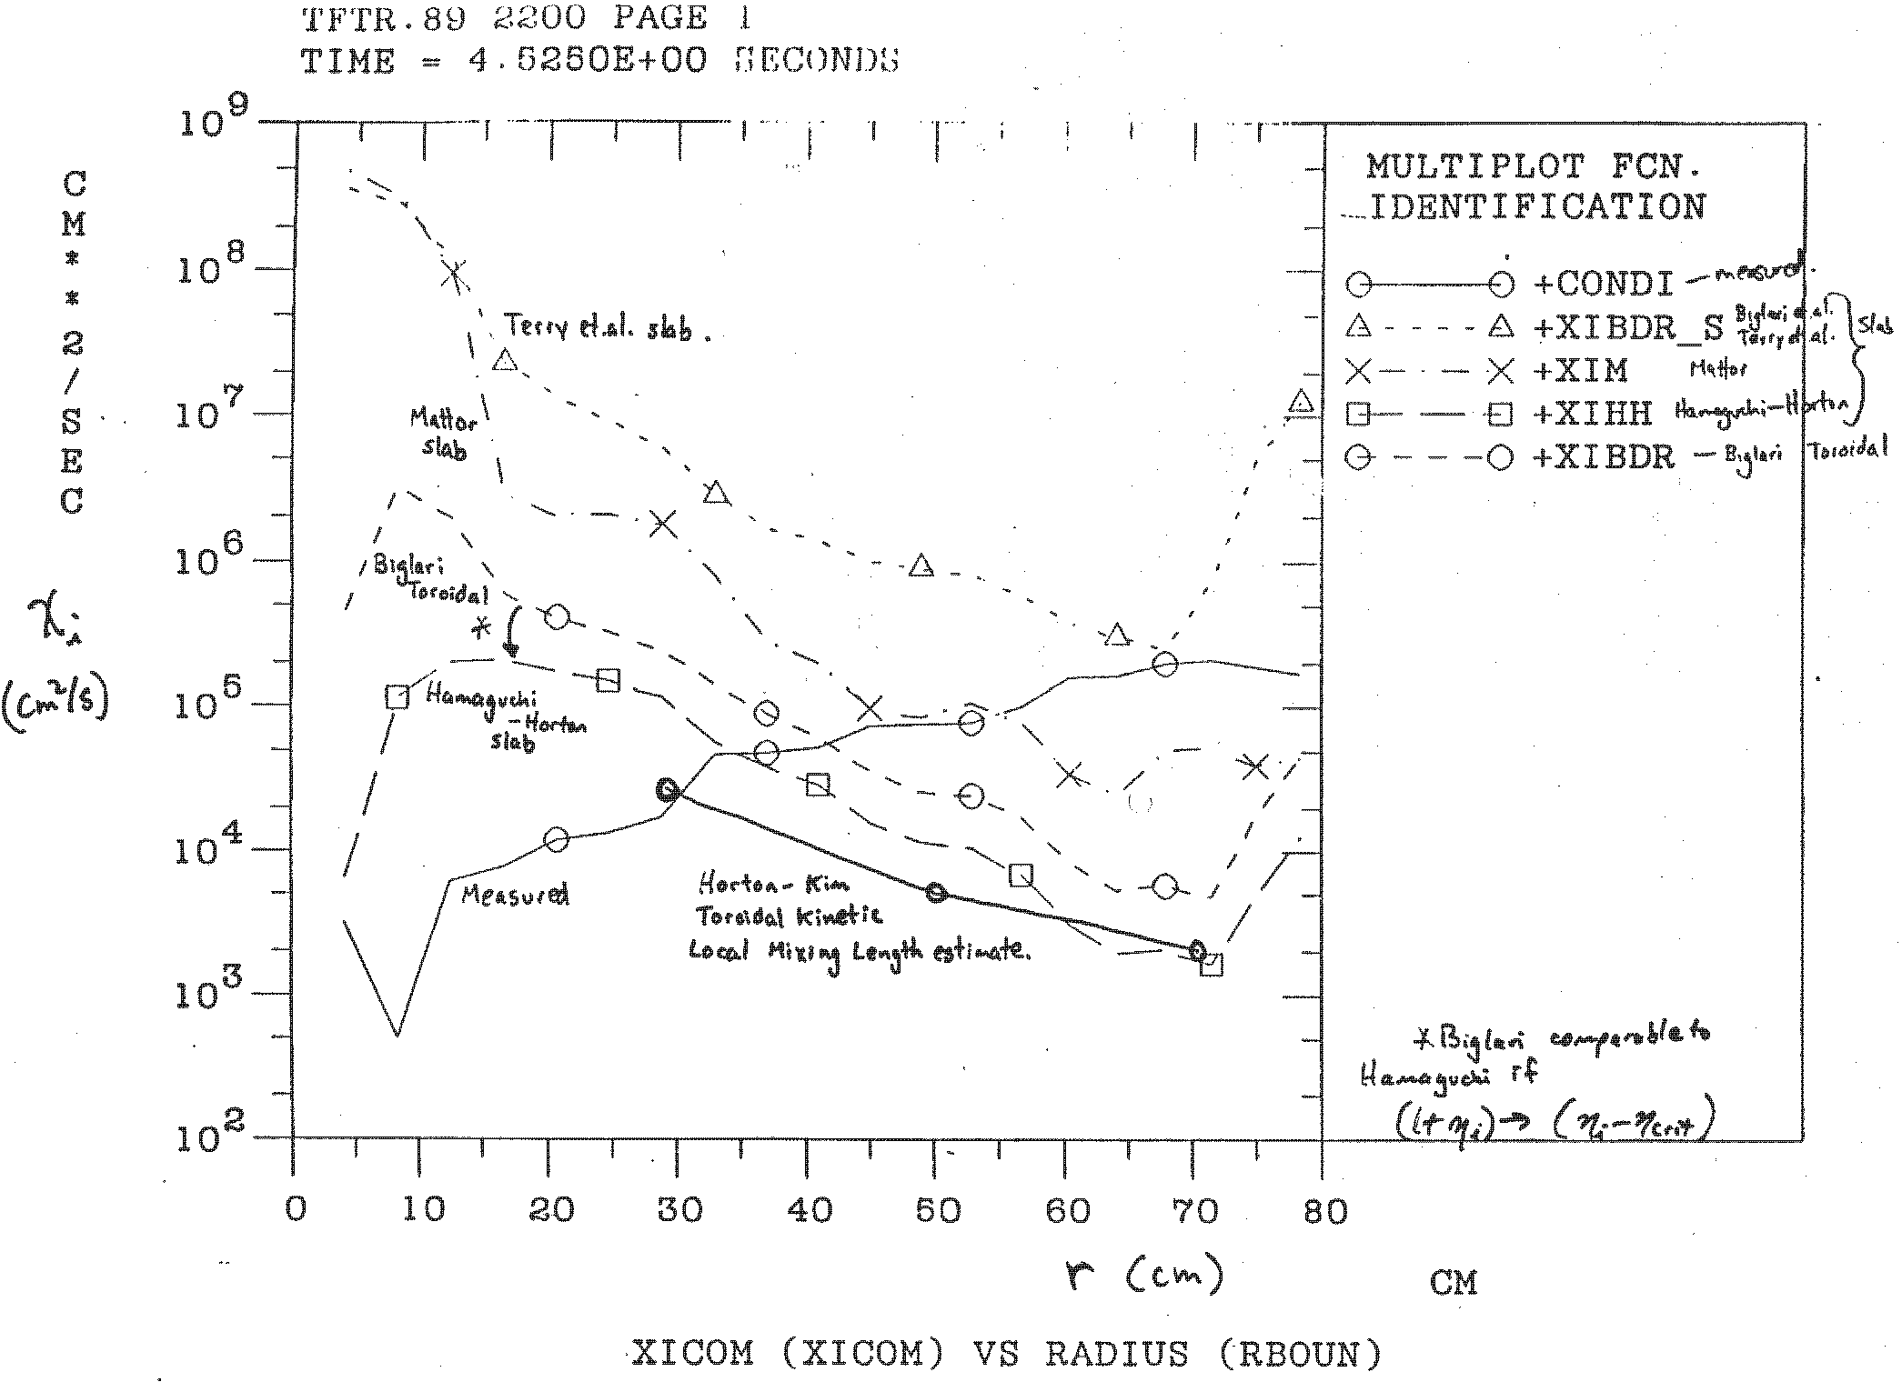
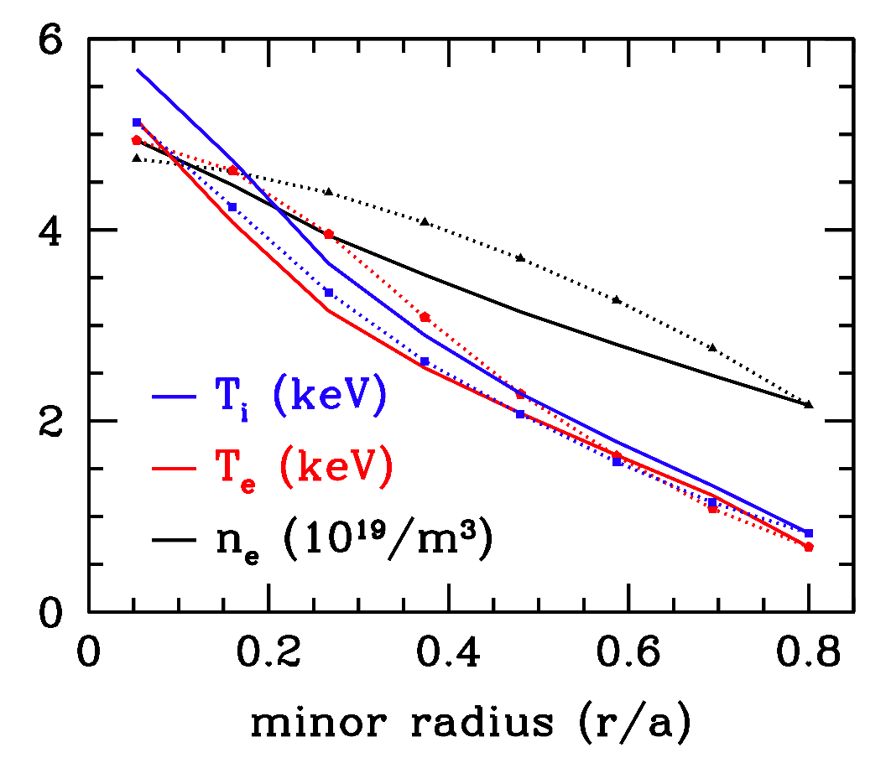
Major breakthrough: Gyrokinetic predictions now much better than 1990 analytic turbulence theories
JET L-mode 19649
meas.
sim.
χ_{i} (cm²/s)
Measured
r (cm)
Gyrokinetic simulations agree fairly well with most experiments. Demonstrates feasibility of directly coupling gyrokinetic turbulence codes to long-time-scale transport codes.
Plot made in 1990. Analytic theories disagreed with measured diffusion coefficients by factors of 100-1000. The importance of thresholds for marginal stability not appreciated then. Explains why the edge effects the core so much.
(see also S.D. Scott et al., Phys. Fluids B 1990)
Barnes, Dorland, et al., PoP 2010

Slide 32
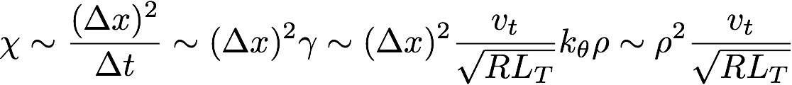
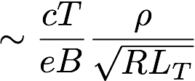

Gyro-Bohm Mixing-length estimate of diffusion caused by microturbulence eddies:
Peaks at r ~ 0 where T is high.
Contradicts expts.
More generally, there is usually a threshold for the instability:
(IFS-PPPL transport model, Kotschenreuther, Dorland, Beer, Hammett, Phys. Plasmas 1995, also GLF23, TGLF, and other models)
Small where T is high, explains χ(r) decreasing near axis in expts.

Slide 33
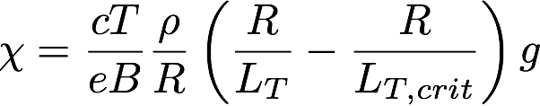
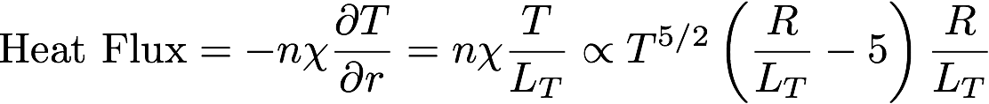

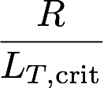
Heat
Flux
Hot Core
Cool Edge

Slide 34
Heat
Flux
Hot Core
Cool Edge
In cool edge, adding more heating power causes the temperature gradient to increase significantly.

Slide 35
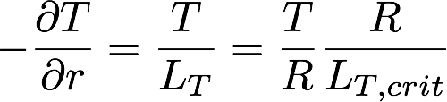
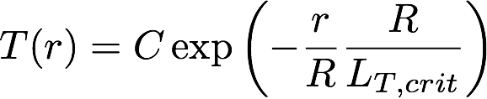
Heat
Flux
Hot Core
Cool Edge
In hot core, no matter how much heating power , you just get (approx.) marginal stability:
⇒
C set by boundary conditions near edge where marginal stability breaks down.

Slide 36
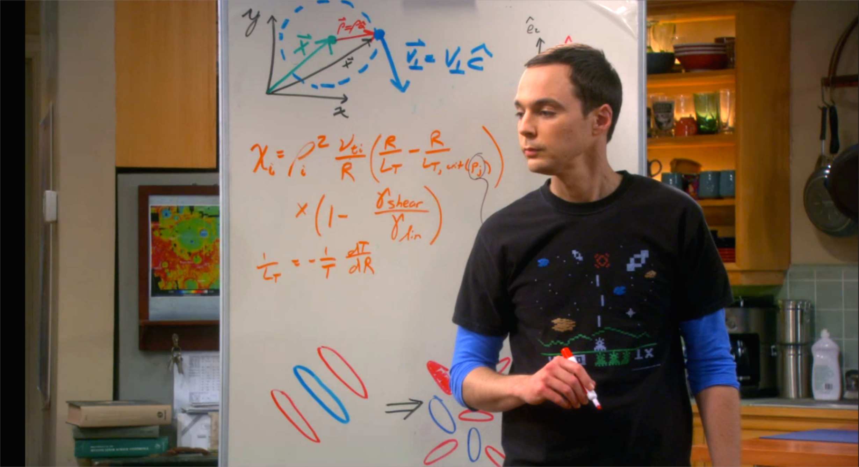
Sheldon uses gyrokinetic theory to design a fusion reactor
TV sitcom “The Big Bang Theory”, Jan. 31, 2013 "The Cooper/Kripke Inversion”. Equation for critical-gradient plasma turbulence from gyrokinetic/gyrofluid simulations based on work by Dorland, Kotschenreuther, Hammett, Beer, Waltz, Biglari et al., see slide #34 of http://w3.pppl.gov/~hammett/talks/2005/kitp-fusion-status.pdf Gyro orbit picture from Krommes 2012, http://dx.doi.org/10.1146/annurev-fluid-120710-101223.

Slide 37
Gyrokinetic-based TGLF transport model compares well with core of many experiments
Biggest gap: doesn’t predict edge region (r/a>0.8).
Kinsey et al. Nucl. Fus. 2011 http://stacks.iop.org/NF/51/083001

Slide 38
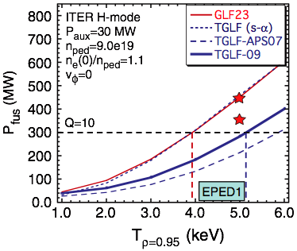
Motivation: Need comprehensive simulations of edge, because pedestal temperature has big effect on fusion gain Q
Because of marginal stability effects, the edge boundary condition strongly affects the core: the edge is the tail that wags the dog.
Need an edge code to answer many important questions:
height of the pedestal, conditions for H-mode transport barrier formation, effect of RMP coils to suppress ELMs, divertor power handling, improvements with lithium walls...
Kinsey et al. Nucl. Fus. 2011 http://stacks.iop.org/NF/51/083001

Slide 39
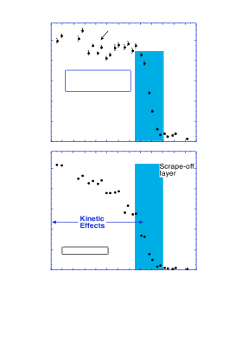
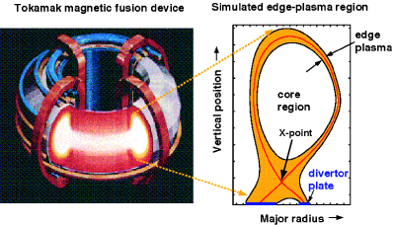
Edge region very difficult
1000
Temp. (eV)
500
0
R (cm)
Edge pedestal temperature profile near the edge of an H-mode discharge in the DIII-D tokamak. [Porter2000]. Pedestal is shaded region.
Present core gyrokinetic codes are highly optimized for core, need new codes to handle additional complications of edge region of tokamaks (& stellarators):
open & closed field lines, plasma-wall-interactions, large amplitude fluctuations, positivity constraints, atomic physics, non-axisymmetric RMP / stellarator coils, magnetic fluctuations near beta limit…
Hard problem: but success of core gyrokinetic codes makes me believe this is tractable, with a major initiative

Slide 40
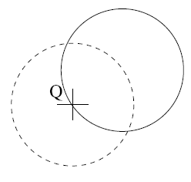

Development of & physics in gyrokinetic equations
if low frequencies ω << cyclotron frequency (Ω_{c}), → average over particle gyration, treat particles as rings of charge in spatially varying fields
When calculating charge at point Q,
have to sum over all particles whose
guiding centers are on the dashed line,
& have to include small variation of particle density around gyro-orbit (→ polarization shielding)
potential averaged
around particle orbit,
even if k⊥ρ_{i} large
Development of nonlinear gyrokinetics
was a major breakthrough
Based on B.D. Scott

Slide 41
Development of & physics in Gyrokinetic Eqs.
Development of gyrokinetic equations one of the triumphs of high-power theoretical plasma physics and applied math (asymptotic analysis)
Interesting pre-history and history of gyrokinetics…
Key advance: Frieman & Chen (79-82) show nonlinear gyrokinetics possible, used an iterative local approach
Another version of gyrokinetics: Hamiltonian / Lagrangian Field-Theory derivations (Hahm, Brizard, Qin, Sugama, …), insures conservation properties for global codes, easier to go to higher order

Slide 42
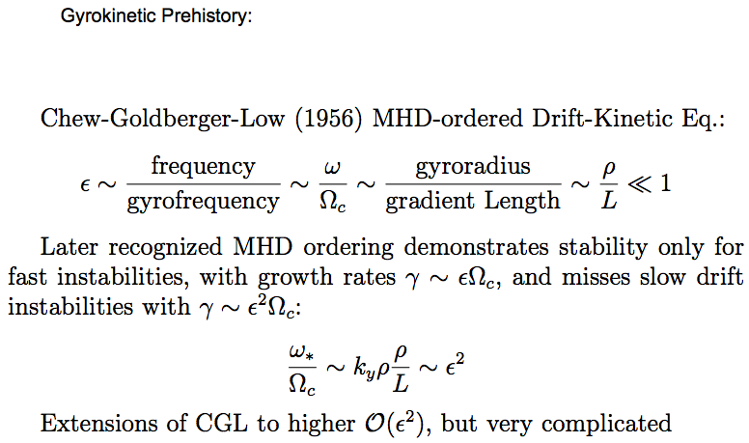
Deriviation of MHD-Drift-Kinetic Eq.:
* R. M. Kulsrud, in Proc. International School of Physics Enrico Fermi, Course XXV, Advanced Plasma Theory, edited by M. N. Rosenbluth, Varenna, Italy, 1962.
* R. M. Kulsrud, in Handbook of Plasma Physics, edited by M. N. Rosenbluth & R. Z. Sagdeev, 1983.

Slide 43
Big Breakthrough: Nonlinear Gyrokinetics
Long, interesting history of linear gyrokinetics, 1960’s, 1970’s.
E. A. Frieman & L. Chen 79-82, showed it is possible to gyro-average nonlinear terms and keep full FLR-effects for arbitrary k⊥ρ, & get rigorous solution w/o closure problem. Very impressive. Triumph of asymptotic analysis and theoretical insight.
(usually, averaging nonlinear terms → closure problems, such as fluid equation closures, statistical turbulence theories,...
Perhaps some understood, or in retrospect: J.B. Taylor ’67 showed adiabatic invariant still exists at arbitrary k⊥ρ, for small amplitude perturbations…)
GK ordering allows capture of drift/micro-instabilities & much of MHD at just order ε & not ε²
Guided by expts., μwave scattering, physics insights

Slide 45
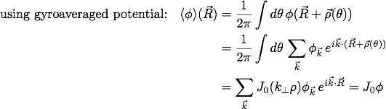

(written in slightly different way in Lagrangian
forms of gyrokinetics to get exact energy and
phase-space conservation for global codes.)

Slide 47
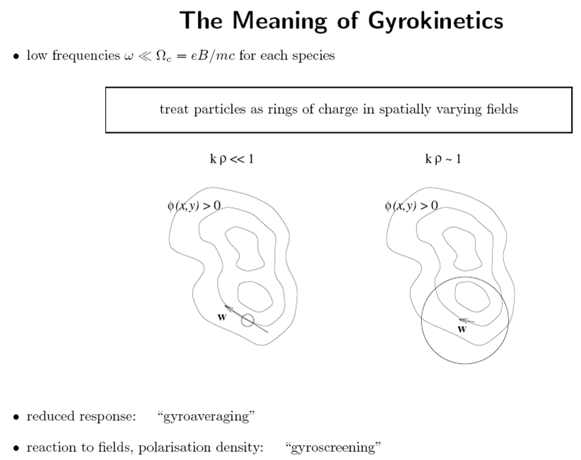
(borrowed from B. D. Scott)

Slide 48


Polarization Density Plays Key Role in
Gyrokinetic Poisson / Quasineutrality Eq.
At long wavelengths (neglecting higher-order FLR corrections to polarization density):
-(Polarization charge density) = guiding center charge density (including
gyroaveraging)
Looks like a Poisson equation, but actually is a statement of quasineutrality:
Because the polarization density depends on the potential, this is how the potential gets determined. The polarization density can be shown to be related to the higher-order polarization drift:

Slide 49
Polarization Density Plays Key Role in
Gyrokinetic Poisson / Quasineutrality Eq.
At long wavelengths (neglecting higher-order FLR corrections to polarization density):
In order for a non-local/global gyrokinetic code to have a conserved energy-like quantity using just the lowest order drifts (ExB, grad(B) and curvature) from the first order Hamiltonian H₁ ~ (ρ/L) T, the density on the LHS must be replaced by a time-independent n_{s0}. Okay for short time scales.
In order to allow a time varying n_{s}, and conserve the energy properly, one must include drifts from the second order Hamiltonian H₂ ~ (ρ/L)² T.
Natural consequence of Lagrangian field theory approach.
(Local gyrokinetics also satisfies energy conservation, H₂ effects incorporated in the higher-order transport equations.)

Slide 50
alternative derivation: next order correction to adiabatic invariant mu

Slide 51
First Gyrokinetic PIC code
Frieman & Chen had first derivation, but very complicated. (Nonlinearities in ballooning/field-aligned coordinates clarified in Beer, Cowley, Hammett, ’95.)
W.W. Lee ’83 & ’87 derivations somewhat clearer, used Catto transformation to guiding center coordinates, & then asymptotic expansion. Made clearer the role of the polarization density (higher order polarization drift dropped from gyrokinetic equation, but resulting polarization density contributes to the gyrokinetic Poisson equation (because even small charge densities lead to large forces in plasmas)).
Lee made clearer that GK polarization density eliminates small Debye scale and high frequency plasma oscillations, making simulations much more tractable. Demonstrates first GK PIC simulations (slab, electrostatic, 2-D on early 1980’s computers).

Slide 52
Two main types of gyrokinetics
Original local “δf” iterative/asymptotic gyrokinetics, directly expands Vlasov Eq. and F = F₀ + ε F₁ (Frieman and Chen). Rigorous for small ρ* = ρ/L gyroBohm limit, important limit to study. Eddy size Leddy ~ ρ << L. Simulate small-scale turbulence in a local region where radial variation of parameters (ω*(r),ν(r), etc.) can be neglected. (I.e., both n₀ and dn₀/dr are treated as constant, as in Hasegawa-Mima eq.) The most complete derivations, including both gyrokinetic turbulence equation & next order transport equations:
  Ian Abel, Rep. Prog. Phys. 76 (2013) 116201 (69 pp)
  Sugama and Horton, Phys. Plasmas 5 (1998) 2560 (14 pp)
Global “full F” Lagrangian/Hamiltonian gyrokinetics. Does not break up F = F0 + δf. Does not assume eddy sizes Leddy << L, and so includes effect of radial variation of parameters and possible non-gyroBohm regimes. (Probably important near plasma edge and near transport barriers.) Maybe consistent only in some case:
    ρ ~ Leddy << L, (gyroBohm regime) or
    ρ << Leddy ~ L, (i.e., k⊥ ρ << 1, Bohm regime) but not
    ρ ~ Leddy ~ L (but perhaps generalizations exist for SOL, ...)
  First derivation in Lagrangian field theory approach that gave particle+field energy conservation consistently is Sugama (2000), followed quickly by Brizard (2000) and others.

Slide 53
Two main types of gyrokinetics (part 2)
Note: both the local delta-f approach and the global full-F approaches are “multiscale”: ω << Ω.
There is also some mixture of techniques. Parra and Catto 2008 (PPCF 50, 065014) shows how to derive a set of global full-F gyrokinetic equations using an iterative technique directly on the Vlasov equation.
There are many gyrokinetic papers, with some variation in assumed orderings (for example, with strong equilibrium ExB flows or not), the physical effects included (for example, simple vs. general geometry, electrostatic, δA||, δB||, …), order of accuracy, the degree of energy and momentum conservation or accuracy.
Some derivations are more general than their apparent stated assumptions. The frequency ordering (in the plasmas frame) is more fundamental than spatial orderings.

Slide 54



Outline of Iterative local gyrokinetics
Original “2-scale” local “delta f” gyrokinetics with direct iterative/asymptotic expansion of Vlasov eq. and F = F₀ + ε F₁ (or δf)
Involves 4 orders of expansion to go through transport time scale (Sugama 98, Barnes 08, Plunk09, Abel 13):
ε⁻¹: F₀ independent of gyro-angle:
ε⁰: parallel force balance and
polarization from gyro-phase dependence:
ε¹: standard GK equation on ω* turbulence time scale
ε²: transport equations for slow variation of F₀
on transport time scale.

Slide 55
Suggested Refs for iterative local gyrokinetics
Original “2-scale” local “δf ” gyrokinetics (Frieman and Chen, ’83). However, very complicated. (Nonlinearity in ballooning/field-line coordinates clarified in Beer, Cowley Hammett, ’95.)
Lee ’83 (Phys. Fluids 26, 556), used Catto coordinate transformation. (Lee ‘83 is iterative, but writes things in full-F global form. Keeps higher-order terms in Poisson eq. that aren’t necessary… Energy & momentum conservation subtleties.)
Linear papers by Catto ‘78, and by Antonsen & Lane ‘80 are instructive.
My 20-page handwritten notes on a complete derivation of gyrokinetics in δf slab electrostatic limit. Tried to show all steps. (Based on (and fixes some typos in) Dorland Thesis (1993), Appendix C tutorial, which summarizes Lee ’83.)
(handwritten notes at http://w3.pppl.gov/~hammett/talks/2014/gk_intro)
Cowley Vienna notes, 2008
Howes 2006, Gyrokinetics for Astrophysics tutorial paper. Complete, systematic derivation in slab limit. (Dorland thesis and Howes ‘06 available at http://w3.pppl.gov/~hammett/papers )
The most complete, systematic derivations in general geometry, including next order transport equations:
  Ian Abel, Rep. Prog. Phys. 76 (2013) 116201 (69 pp)
  Sugama and Horton, Phys. Plasmas 5 (1998) 2560 (14 pp).
Derivation of a global gyrokinetics, but w/ traditional iterative asymptotic approach:
  Parra and Catto 2008

Slide 56
Lagrangian/Hamiltonian
Lie-Perturbation methods
Advantage: ∂f/∂t = {H,f}, make approximations to Hamiltonian/Lagrangian, but preserve important Hamiltonian properties: exact conservation for a global code of an energy H, phase-space, symplectic etc., easier to extend to full f instead of breaking up f=f₀+f₁, easier to extend to higher-order terms that may be important in some regimes (perhaps in edge turbulence where f₁ << f₀ assumption weak), etc.
(Energy conservation in local iterative gyrokinetics is also correct, handled in higher order transport equations. See Abel ‘13)
Dubin, Krommes, Oberman, & Lee ’83 built on Littlejohn, Hamiltonian, slab, electrostatic
Hahm ‘88: Lagrangian approach advantages, extended to toroidal geometry & δB⊥
Brizard: Lagrangian, extended to full δB⊥ and δB|| , nonlinear properties
Dimits & Lodestro generalization of ordering
Qin: Various extensions and tests. Linear benchmarks with PEST MHD code, including kink mode. Higher-order extensions that may be useful near edge. Extensions to general frequency for RF resonant heating, etc.
Sugama (2000), Brizard (2000) Lagrangian field theory for particles and fields together. Second order drifts from H2 ~ ε² T required to get exact energy conservation with polarization density that is linear in phi.
Brizard-Hahm RMP 2007

Slide 57
Suggested References for Learning
Lagrangian Field-Theory Approaches to Gyrokinetics
I (and many others) find this topic very difficult (but I appreciate it’s usefulness and importance).
Start with Krommes’ 2012 Annual Rev. of Fluid Mechanics, “The Gyrokinetic Description of Microturbulence in Magnetized Plamsas”, http://dx.doi.org/10.1146/annurev-fluid-120710-101223. Nice review article that surveys the big picture without trying to do the gory derivation.
Next do background textbook reading reminding yourself of the basics of Lagrangian/Hamiltonian mechanics. (Concise summaries: Miyamoto’s textbook, Steven’s “The Six Core Theories of Modern Physics”, errata at http://w3.pppl.gov/~hammett/courses/physics-summaries/core-theories-errata.pdf).)
Helander & Sigmar’s book has a nice review of Lagrangian mechanics, and a nice Lagrangian variational derivation of single particle drifts.
Parra & Calvo PPCF 2011, a Lagrangian Field-Theory derivation of gyrokinetics but without relying on the language of differential geometry. Don’t need to know what “differential form”, “one form”, “two form”, “wedge product”, “Lie transform” mean. Would start with the slab limit. (Recent 2014 paper on arxiv.org with Burby showing equivalence with differential geometric approaches.)
Sugama 2000, PoP 7, 466, *key paper*, first paper on Lagrangian field theory for gyrokinetics, to get field equations on an equal footing with particle drifts, particle-field energy conservation. Some use of Lie transforms but not differential forms.

Slide 58
Suggested References for Learning
Lagrangian Field-Theory Approaches to Gyrokinetics
With More Differential Geometry
Littlejohn, J. Plasma Physics 29 (1983), 111 “Variational principles of guiding center motion”. Introduced Lagrangian variational methods to particle drift calculations. (I think there is an error in the ordering of a certain term that requires him to go to higher order than necessary, but this pioneering paper is still important for the concepts.)
Cary and Littlejohn, Annals of Physics 151, 1 (1983), “Noncanonical Hamiltonian Mechanics and Its Application to Magnetic Field Line Flow”. Has a nice tutorial on differential forms and Lie transforms used in some GK. See also Littlejohn, J. Math. Phys. 23, 742 (1982).
Kikuchi’s textbook , “Frontiers in Fusion Research” (2011). Interesting textbook, with highlights of interesting physics and current research in various parts of fusion. First textbook I think that tries to present gyrokinetics using Lie transforms (though he glosses over the gyrokinetic field equation). Fairly readable, but there are some typos to watch for.
Krommes & Hammett 2013 (http://bp.pppl.gov/pub_report//2014/PPPL-4945-abs.html) on momentum transport ordering difficulties pointed out by Parra & Catto. Krommes included an extensive tutorial on Lagrangian differential geometry approaches to gyrokinetics.
Series of geometrical Lagrangian papers: Brizard, Qin, B.Scott, J. Squire, J. Burby, Brizard-Hahm Rev. Mod. Phys. 2007, Cary-Brizard Rev. Mod. Phys. 2009, Idomura, Miyato & Scott, Brizard & Tronko, …
Good gyrokinetics & turbulence tutorials by Jenko, by Bottino, and others:http://www2.ipp.mpg.de/~fsj/tutorial.html

Slide 59
Parra & Catto pointed out challenges of momentum transport
In a series of papers, Parra & Catto pointed out challenges of momentum transport in a standard regime (gyroBohm ordering, axisymmetric, up-down symmetric, slow flows of order the diamagnetic velocity v* ~ ε v_{t} ). In particular, they showed that the standard Lagrangian gyrokinetic approach would require the third order Hamiltonian H3 to deal with momentum transport accurately in this low flow ordering. They advocate supplementing with a separate equation for directly solving for toroidal momentum evolution, then need only H2. (See Krommes & Hammett, PPPL report 4945, 2013. http://bp.pppl.gov/pub_report//2014/PPPL-4945-abs.html)
Our report gives some straightforward ordering arguments (originally due to P&C) demonstrating their point. One should understand the implications in a balanced way. Slow flows in this regime are so slow that usually they would not significantly affect the turbulence, though they might still be important for MHD stability. Flows are usually more important in regimes that break some of these assumptions (like non-gyroBohm scaling near the edge or near transport barriers), but then still need a second order Hamiltonian. P&C deserve credit for pointing out these subtle issues and helping people realize the importance of even H2 for a complete treatment in other regimes. (Many codes at present neglect H2.)

Slide 60
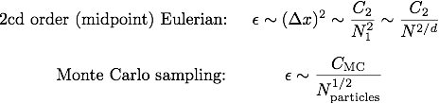
PIC & Continuum algorithm comparisons
Both PIC & continuum codes need comparable spatial resolution to represent electromagnetic/gravitational fields. But use different methods to do velocity integrals to calculate charge/current densities needed to find fields.
N
1
N
1
Continuum methods appear competitive/better for d <= 4.
Caveats:
(1) coefficients highly problem-dependent
(2) Don’t need same resolution in all directions,
(3) Modern continuum codes use higher-order/spectral methods.
(4) Focused here on velocity integration methods, but algorithms also differ in how they solve particle motion or solve for distribution function. PIC particles ~move to where needed…
Notes:
Animate these steps! ??

Slide 61
PIC & Continuum algorithm comparisons
Very different algorithms with different numerical properties.
  PIC: Lagrangian / Monte-Carlo random sampling
  Continuum: Eulerian (or semi-Lagrangian) / optimized integration
Essential to have independent algorithms to cross check each other, particularly for the types of difficult problems we study.
Modern Continuum codes use range of advanced CFD algorithms (pseudo-spectral, high-order upwind, discontinuous Galerkin, Arakawa,...) not just simple grid.
Error vs. N (# particles/cell or velocity grid points):
PIC may be better for problems with large “signal” where larger noise can be tolerated. Continuum may be better for problems where low noise is needed (e.g. near marginal stability).
Continuum appears asymptotically more efficient for gyrokinetics and even full Vlasov (d=2 and d=3 velocity space)
Error
PIC err ~ 1/N^{1/2}
Continuum ~ 1/N^{2/d} ~ 1/N for d=2 GK
N

Slide 62
PIC & Continuum algorithm comparisons: details
Some PIC simulations of reconnection or tokamak edge plasmas now use 1000 particles/cell --> 5000 quantities/cell (3x & 2v for each particle).
“finite-size-particles” smooth fields over ~3 adjacent cells in each direction (similarly, “force-softening” in N-body tree codes)
Equivalent continuum code would have ~ 520x260 in (v||, v⊥) (or ~ 55³ in 3V) per resolved region. (GYRO, GENE, & GS2 often converge very well with just 8 μ and 16 v||).
Because collisions enter as ~ ν v_{t}² ∂² /∂v², continuum codes don’t need much velocity resolution at moderate collisionality to be fully resolved.

Slide 63
With Ammar Hakim & grad student Eric Shi, working on new continuum gyrokinetic code for the challenging edge region, using Discontinuous Galerkin & other advanced algorithms
Several advanced algorithms to significantly improve efficiency:
  Discontinuous Galerkin (DG) algorithms, improved conservation properties for Hamiltonian systems, optimized (Maxwellian-weighted) basis functions, sub-grid turbulence models in phase space, efficient use of massively parallel computers.
A version of DG (based on C.-W. Shu & Liu, 2000) can exactly conserve energy for general Hamiltonian problems, ∂f/∂t = {H,f}. Interestingly, does so even with upwind fluxes for f --> limiters (helpful to minimize artificial oscillations & preserve positivity).
Efficient Gaussian integration --> ~ twice the accuracy / interpolation point:
  Standard interpolation: p uniformly-spaced points to get p order accuracy
  DG interpolates p optimally-located points to get 2p-1 order accuracy
Kinetic turbulence very challenging, benefits from all tricks we can find. Potentially big win: Factor of 2 reduction in resolution --> 64x speedup in 5D gyrokinetics
  Goal: a robust code capable of relatively fast simulations at low velocity resolution, but with qualitatively-good gyro-fluid-like results, or fully converged kinetic results at high velocity resolution w/ massive computing.

Slide 64
Discontinuous Galerkin (DG) Combines Attractive Features of Finite-Volume & Finite Element Methods
Standard finite-volume (FV) methods evolve just average value in each cell (piecewise constant), combined with interpolations
DG evolves higher-order moments in each cell. I.e. uses higher-order basis functions, like finite-element methods, but, allows discontinuities at boundary like shock-capturing finite-volume methods --> (1) easier flux limiters like shock-capturing finite-volume methods (preserve positivity, important for large amplitude fluctuations in edge) (2) calculations local so easier to parallelize.
Hot topic in CFD & Applied Math: >1000 citations to Cockburn & Shu JCP/SIAM 1998.

Slide 65
Discontinuous Galerkin (DG) Combines Attractive Features of Finite-Volume & Finite Element Methods
Don’t get hung up on the word “discontinuous”. Simplest DG is piecewise constant: equivalent to standard finite volume methods that evolve just cell averaged quantities. Can reconstruct smooth interpolations between adjacent cells when needed.
Going to at least piecewise linear allows energy conservation (even with upwinding).
DG has ~twice the accuracy per point of FV, by optimal spacing of points within cell.

Slide 66
Introduction to Gyrokinetic Theory & Simulations
Greg Hammett (Princeton University, PPPL)
ITER Summer School, Aix-en-Provence, Aug. 26, 2014
(these slides & handwritten notes @ http://w3.pppl.gov/~hammett/talks/2014/gk_intro)
Students, introduce yourselves: where from, what year, main interests.
Motivation: Reducing microturbulence could help fusion
Physical picture of turbulent processes in tokamaks
Brief intro to gyrokinetics concept: average over fast gyromotion.
  Two main kinds of gyokinetics
    Iterative/asymptotic, local, δf gyrokinetics
    Lagrangian/Hamiltonian, global, full-F gyrokinetics
  Annotated references for suggested reading
  Handwritten derivation of iterative local gyrokinetics (electrostatic slab)
  Handwritten gyrokinetic derivation of toroidal ITG instability
A few slides about algorithms: PIC/continuum, Discontinuous Galerkin.
(Some slides were skipped in presentation. 2014.08.27 version slightly updated from presentation.)

