Slide 1
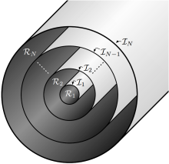
The Multi-region, relaxed MHD energy principle combines ideal MHD and Taylor relaxation
The plasma is partitioned into N “relaxed volumes”, separated by N “ideal interfaces”.
Minimize the total energy, subject to the constraints of conserved fluxes and helicity in each region
In the “relaxed volumes”, ∇×B=μB, and islands, chaotic fields are allowed.
Across the “ideal interfaces”, [[p+B²/2]]=0, and pressure gradients are allowed.
If N = 1 , obtain a globally relaxed Taylor state.
If N→∞, recover ∇p=j×B.
Equilibrium solutions computed using the Stepped Pressure Equilibrium Code (SPEC),
Hudson, Dewar, et al. PHYSICS OF PLASMAS 19, 112502 (2012).
Notes:
1

