Slide 1
From Chirikov's island overlap criterion, to cantori, and ghost-surfaces.
S.R.Hudson
Abstract
A brief review of the KAM theorem, Chirikov's island overlap criterion and Greene's residue criterion will show how these widely-quoted ideas can be simply understood by considering how far a given irrational number is from nearby low-order rationals.
Flux surfaces are broken by islands and chaos, but in a very meaningful sense they do not completely disappear, at least not immediately. Graphical evidence showing the importance of cantori in restricting both fieldline transport and heat transport in partially chaotic magnetic fields will be given.
Two classes of almost-invariant surfaces, namely quadratic-flux minimizing surfaces and ghost surfaces, which serve as “replacement” flux surfaces after the destruction of invariant surfaces, can be derived quite simply from classical action principles and are shown to be equivalent.

Slide 2
In the beginning, there was Hamiltonian mechanics
Hamilton, Lagrange, et al. identified integrals of motion,
Boltzmann’s postulated the ergodic hypothesis,
Poincaré described the “chaotic tangle”.
Quotations from [“Regular and Chaotic Dynamics”, by Lichtenberg & Lieberman]
“These deep contradictions between the existence of integrability and the existence of ergodicity were symptomatic of a fundamental unsolved problem of classical mechanics.”
“Poincaré contributed to the understanding of these dilemmas by demonstrating the extremely intricate nature of the motion in the vicinity of the unstable fixed points, a first hint that regular applied forces may generate stochastic motion in nonlinear oscillator systems.”
“Birkhoff showed that both stable and unstable fixed points must exist whenever there is a rational frequency ratio (resonance) between two degrees of freedom.”
“..the question of the ergodic hypothesis, whether a trajectory explores the entire region of the phase space that is energetically available to it, or whether it is constrained by the existence of constants of the motion, was not definitively answered until quite recently. The KAM theorem, originally postulated by Kolomogorov (1954), and proved under different restrictions by Arnold (1963) and Moser (1962) . .

Slide 3
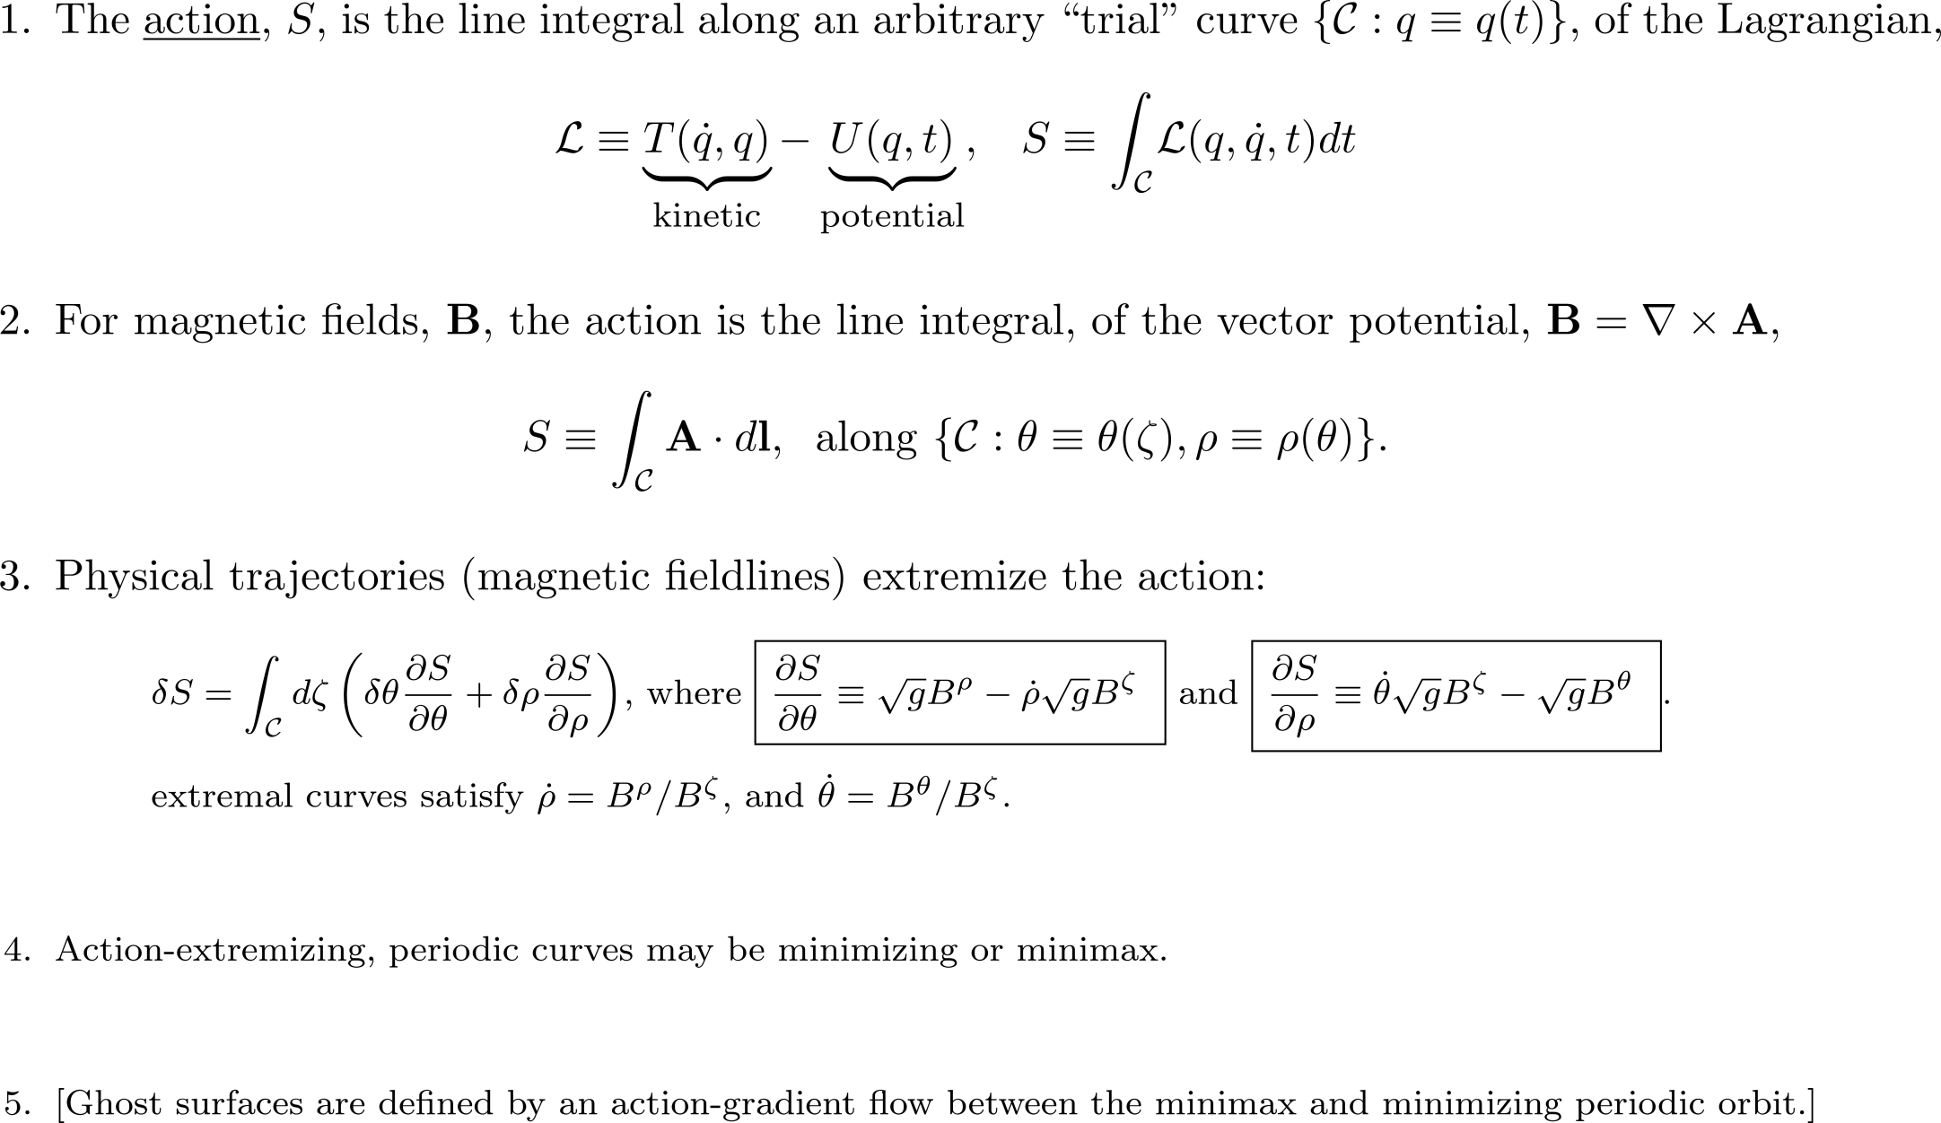
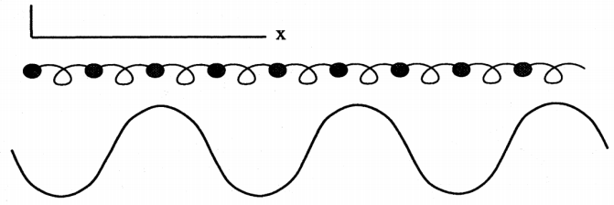
Classical Mechanics 101:
The action integral is a functional of a curve in phase space.

Slide 4
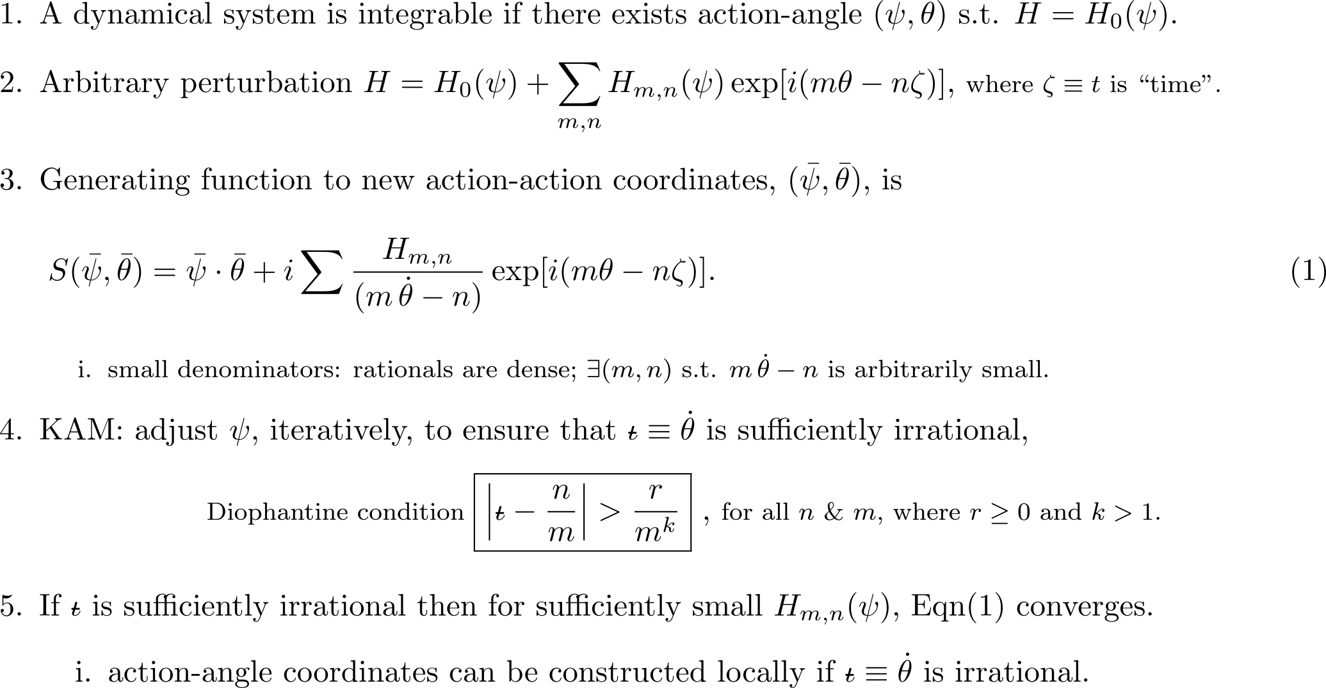
1954 : Kolmogorov, Dokl. Akad. Nauk SSSR 98, 469 ,1954
1963 : Arnold, Russ. Math. Surveys 18, 9,1963
1962 : Moser, Nachr. Akad. Wiss. Goett. II, Math.-Phys. Kl. 1, 1,1962
“one of the most important concepts is labelling orbits by their frequency” [ J. D. Meiss, Reviews of Modern Physics, 64(3):795 (1992)]

Slide 5
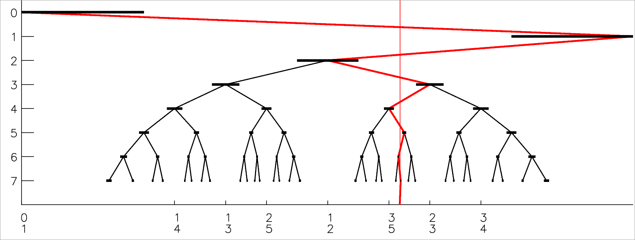
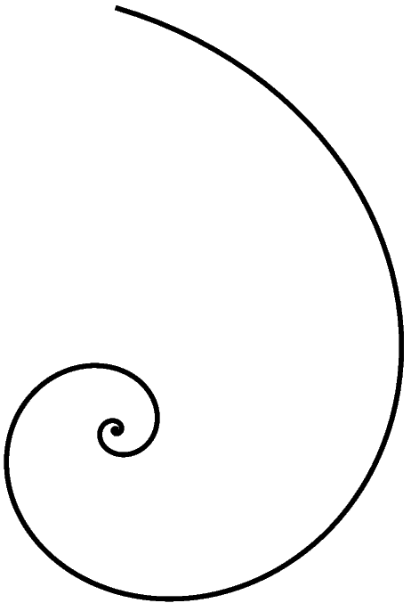
The structure of phase space is related to the structure of rationals and irrationals.
THE FAREY TREE;
or, according to Wikipedia,
THE STERN–BROCOT TREE.
alternating path→
(excluded region)
←alternating path
→
←
→

Slide 6
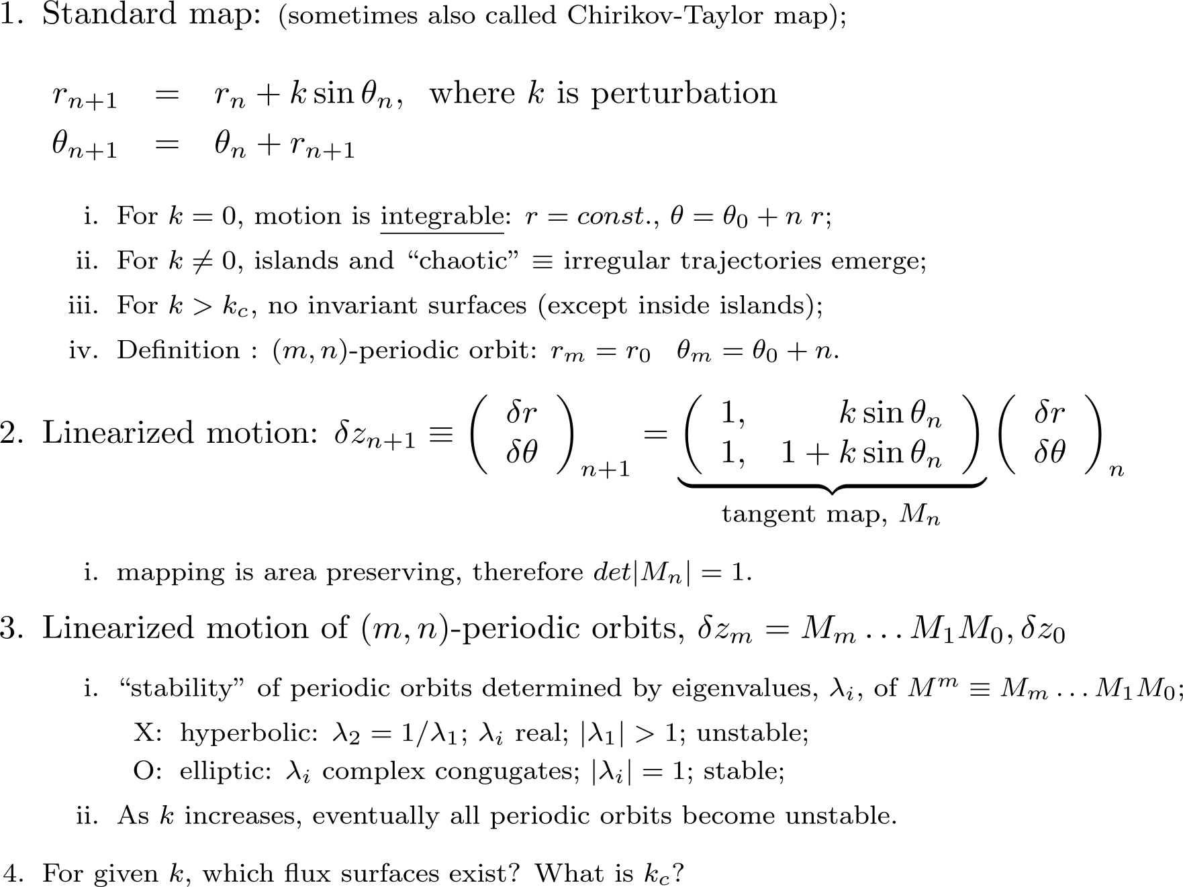
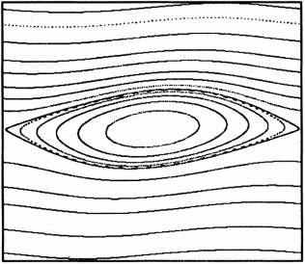
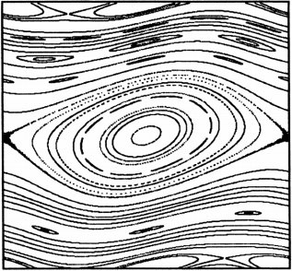
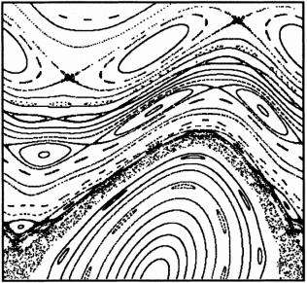
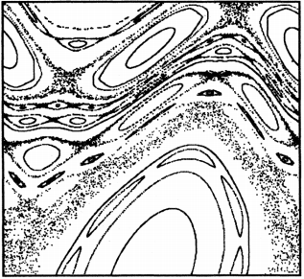
The standard map is a simple and widely-used model of chaotic dynamics . . .

Slide 7
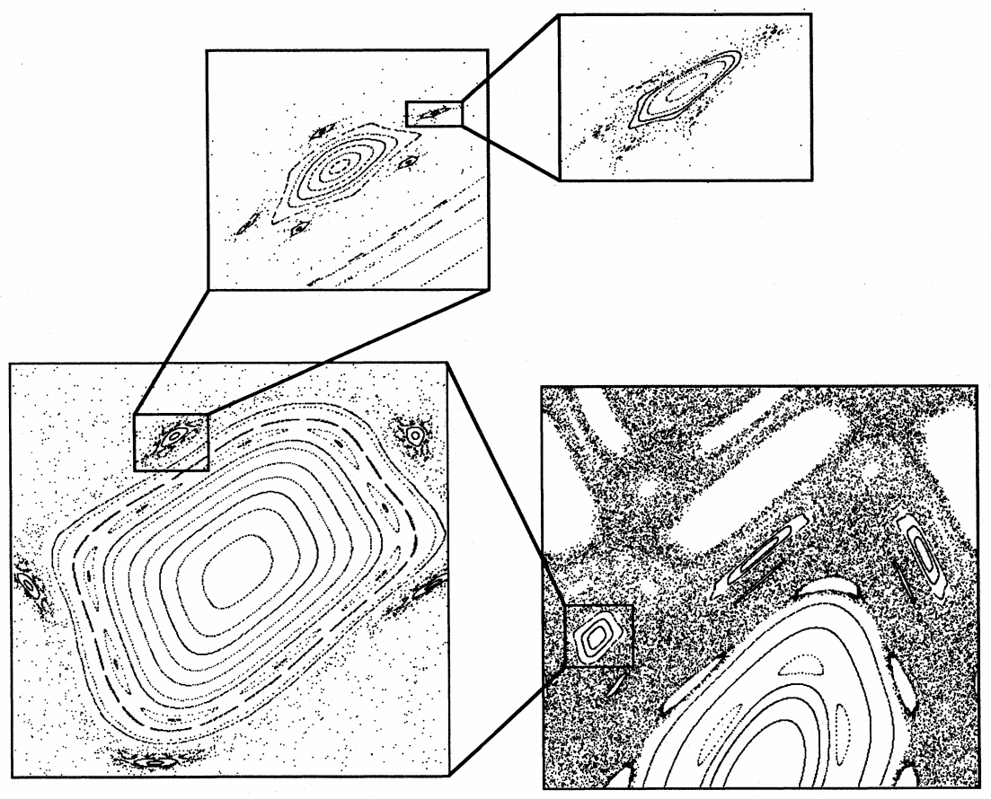
The standard map is very simple, but the trajectories are very complicated.
There are islands around islands around islands . . .
Birkhoff (1935) “It is clear that not only do general elliptic periodic solutions possess neighboring elliptic and hyperbolic periodic solutions, but also, beginning again with the neighboring elliptic solutions, who are, as it were, satellites of these solutions, one can obtain other elliptic and hyperbolic solutions which are secondary satellites.”
[“Symplectic maps, variational principles, and transport”, J. D. Meiss, Reviews of Modern Physics, 64(3):795 (1992)]

Slide 8
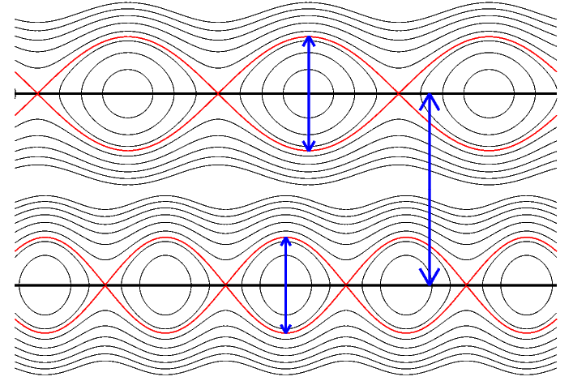
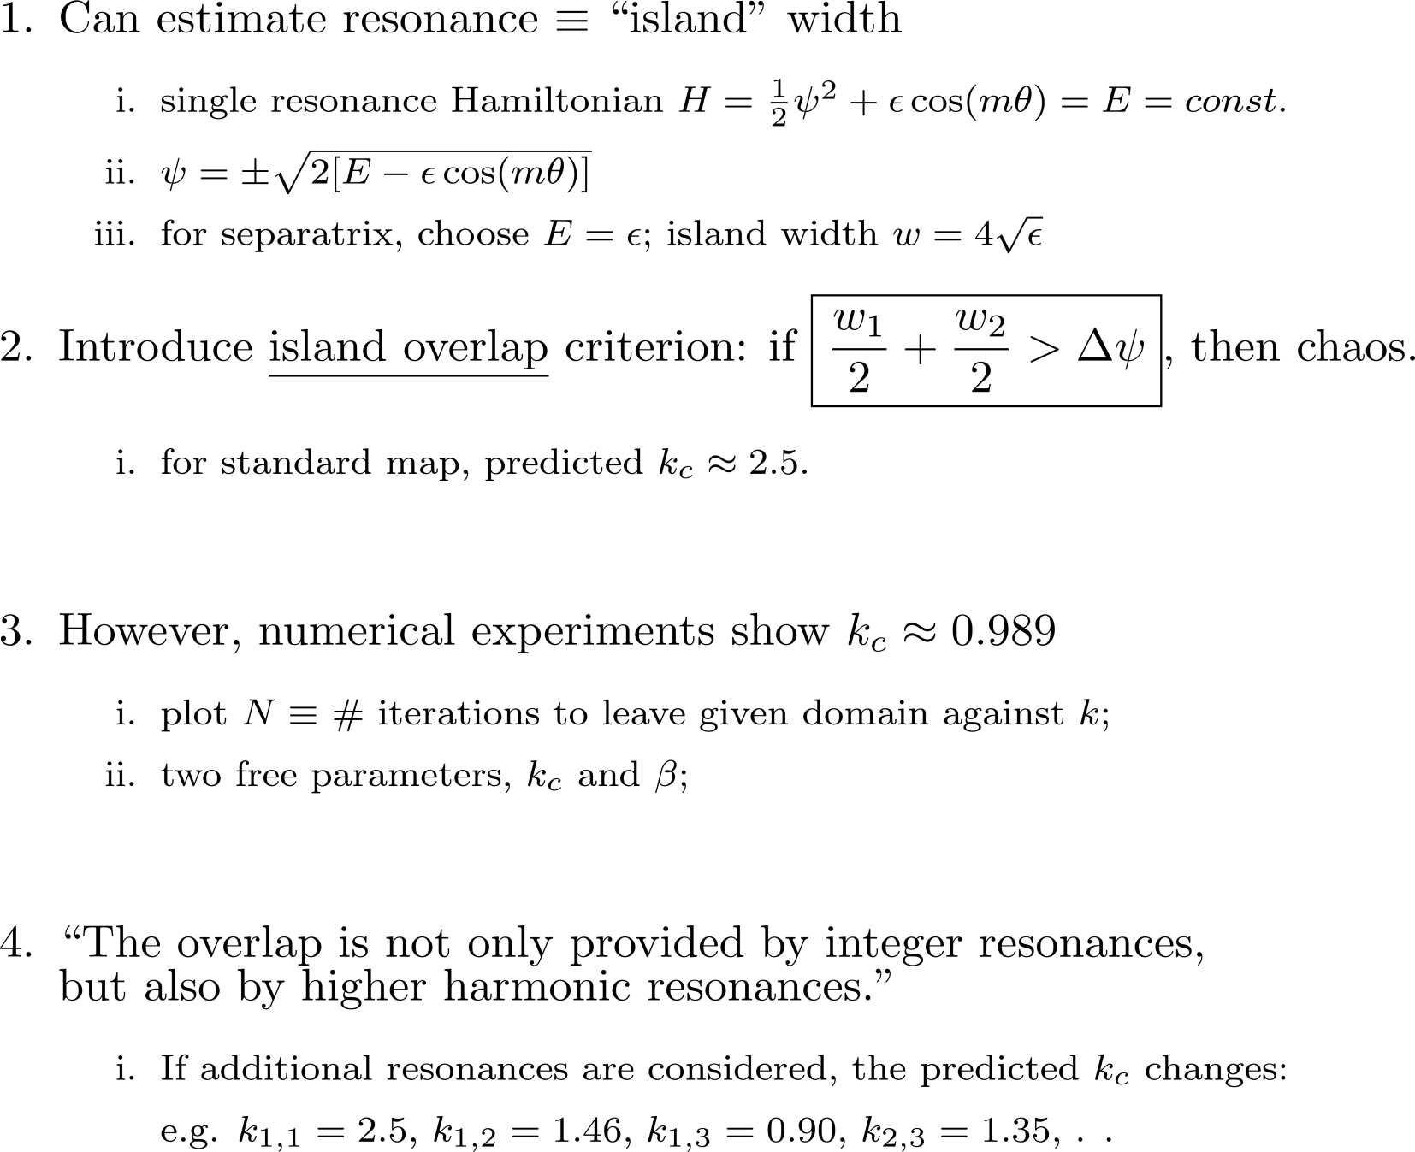
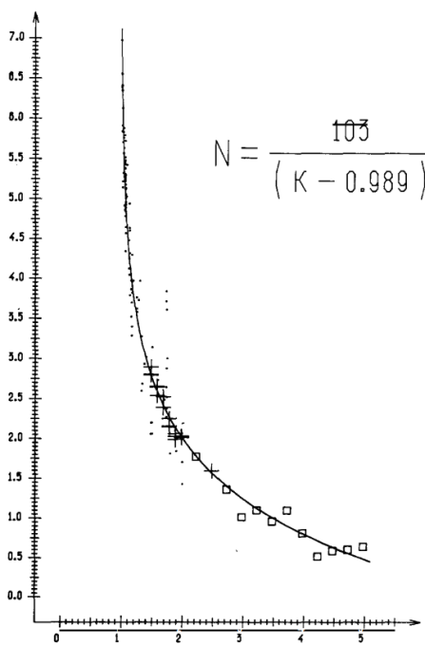
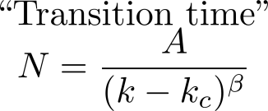
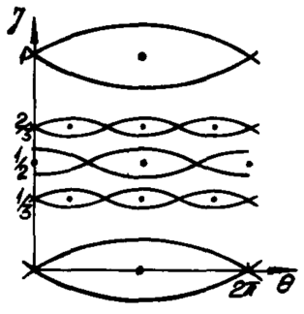
1979 : Chirikov’s Island-Overlap Criterion
PHYSICS REPORTS 52, 5(1979)263-37

Slide 9
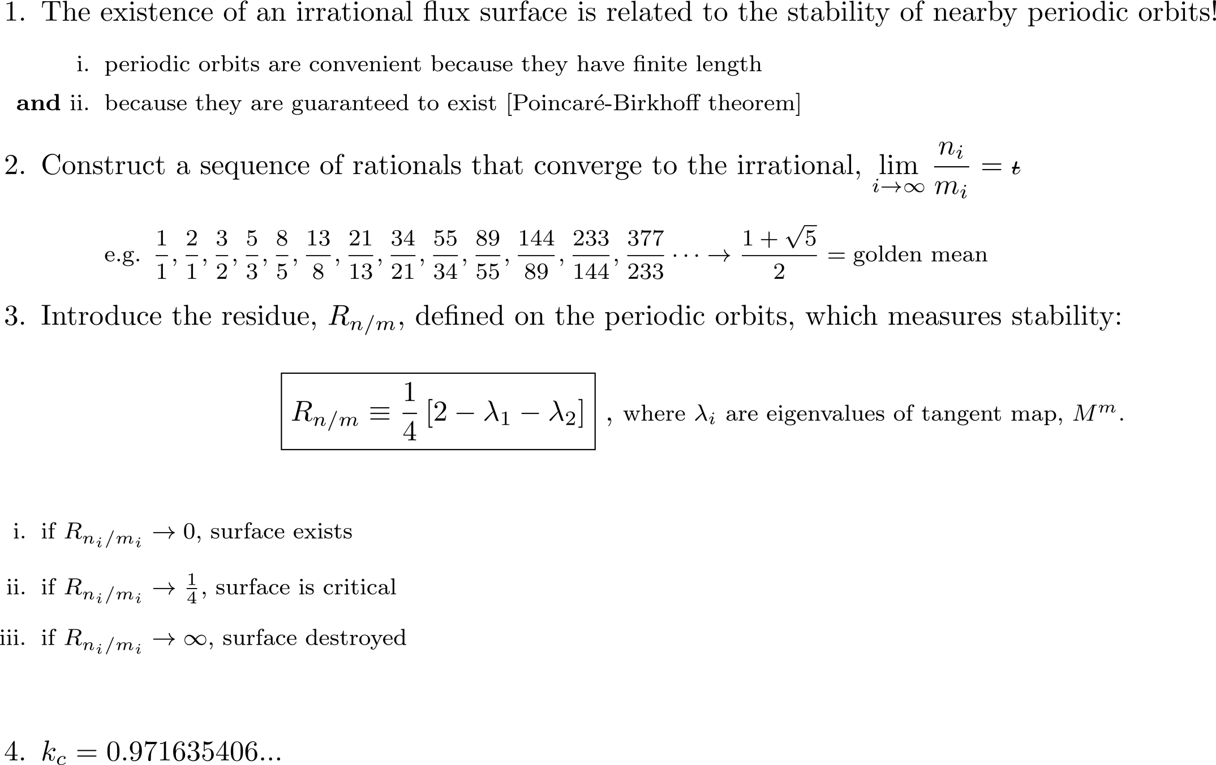
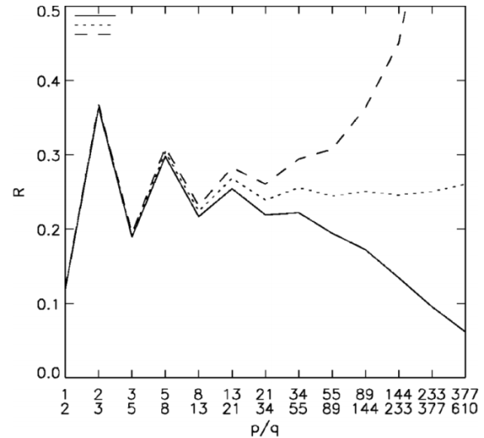
1979 : Greene’s Residue Criterion
J. Math. Phys. 20(6), 1979, 1183 (1979)
super-critical
near-critical
sub-critical

Slide 10
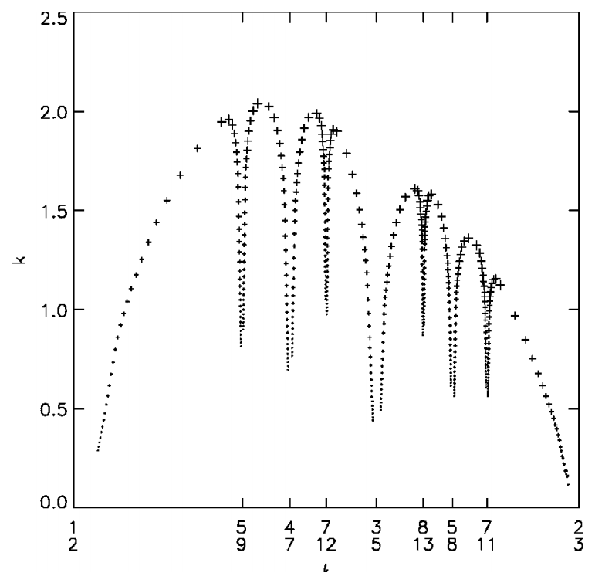
Standard Map critical function is similar to the Bruno function

Slide 11
Cantori

Slide 12
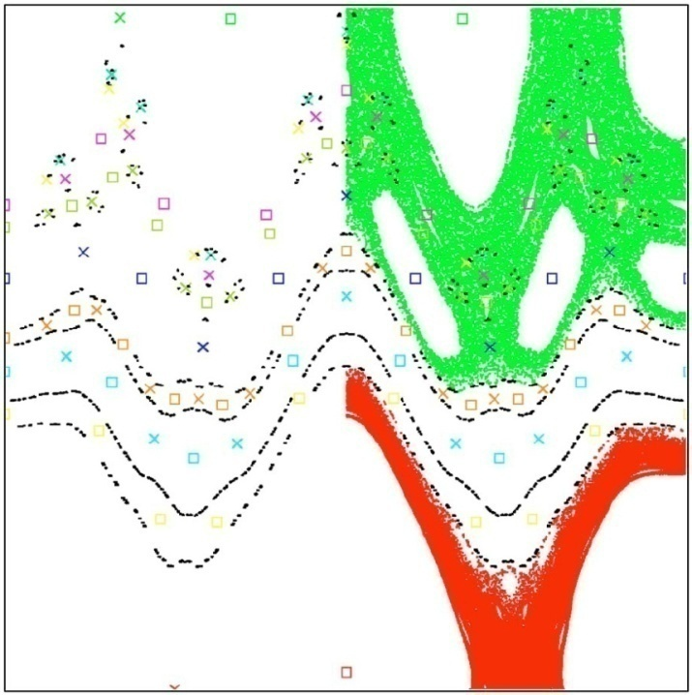
Irrational KAM surfaces break into cantori when perturbation exceeds critical value. Both KAM surfaces and cantori restrict transport.
KAM surface
delete middle third
complete barrier
→∞
Cantor set
→ gap ←
partial barrier
KAM surfaces are closed, toroidal surfaces
that stop radial field line transport
Cantori have “gaps” that fieldlines can pass through;
however, cantori can severely restrict radial transport
Example: all flux surfaces destroyed by chaos,
but even after 100 000 transits around torus
the fieldlines don’t get past cantori !
Regions of chaotic fields can provide some
confinement because of the cantori partial barriers.
“noble”
cantori
(black dots)
← radial coordinate →

Slide 13
Simple physical picture of cantori
[Percival, 1979]
[Schellnhuber, Urbschat & Block, Physical Review A, 33(4):2856 (1986) ]

Slide 14
Fractal dimension of cantori
W.Li & P. Bak, Physical Review Letters 57(6):655, 1986
“Chirikov's standard map' describes the behavior of a Hamiltonian dynamical system which is subjected to a periodic force..”
“The orbits of the standard map are also of importance to an entirely different physical problem, namely the static Frenkel-Kontorowa (FK) model of modulated structures. The FK model may describe, for instance a monolayer of rare-gas molecules adsorbed on a periodic substrate.”
“ The KAM trajectories correspond to free-sliding incommensurate states and the cantori describe pinned incommensurate states, where the particles occupy only a subset of positions relative to a periodic potential.”
“In order to study the scaling properties of the cantori we first estimate the measure m(r) "left over" when gaps larger than a certain scale r are removed from the set . . .”
“In conclusion, we have found by means of numerical and analytical considerations the rather counterintuitive result that the KAM trajectory immediately dissolves into a thin Cantor set of dimension D = 0 at the critical point.”

Slide 15
Ghost surfaces, quadratic-flux minimizing surfaces

Slide 16
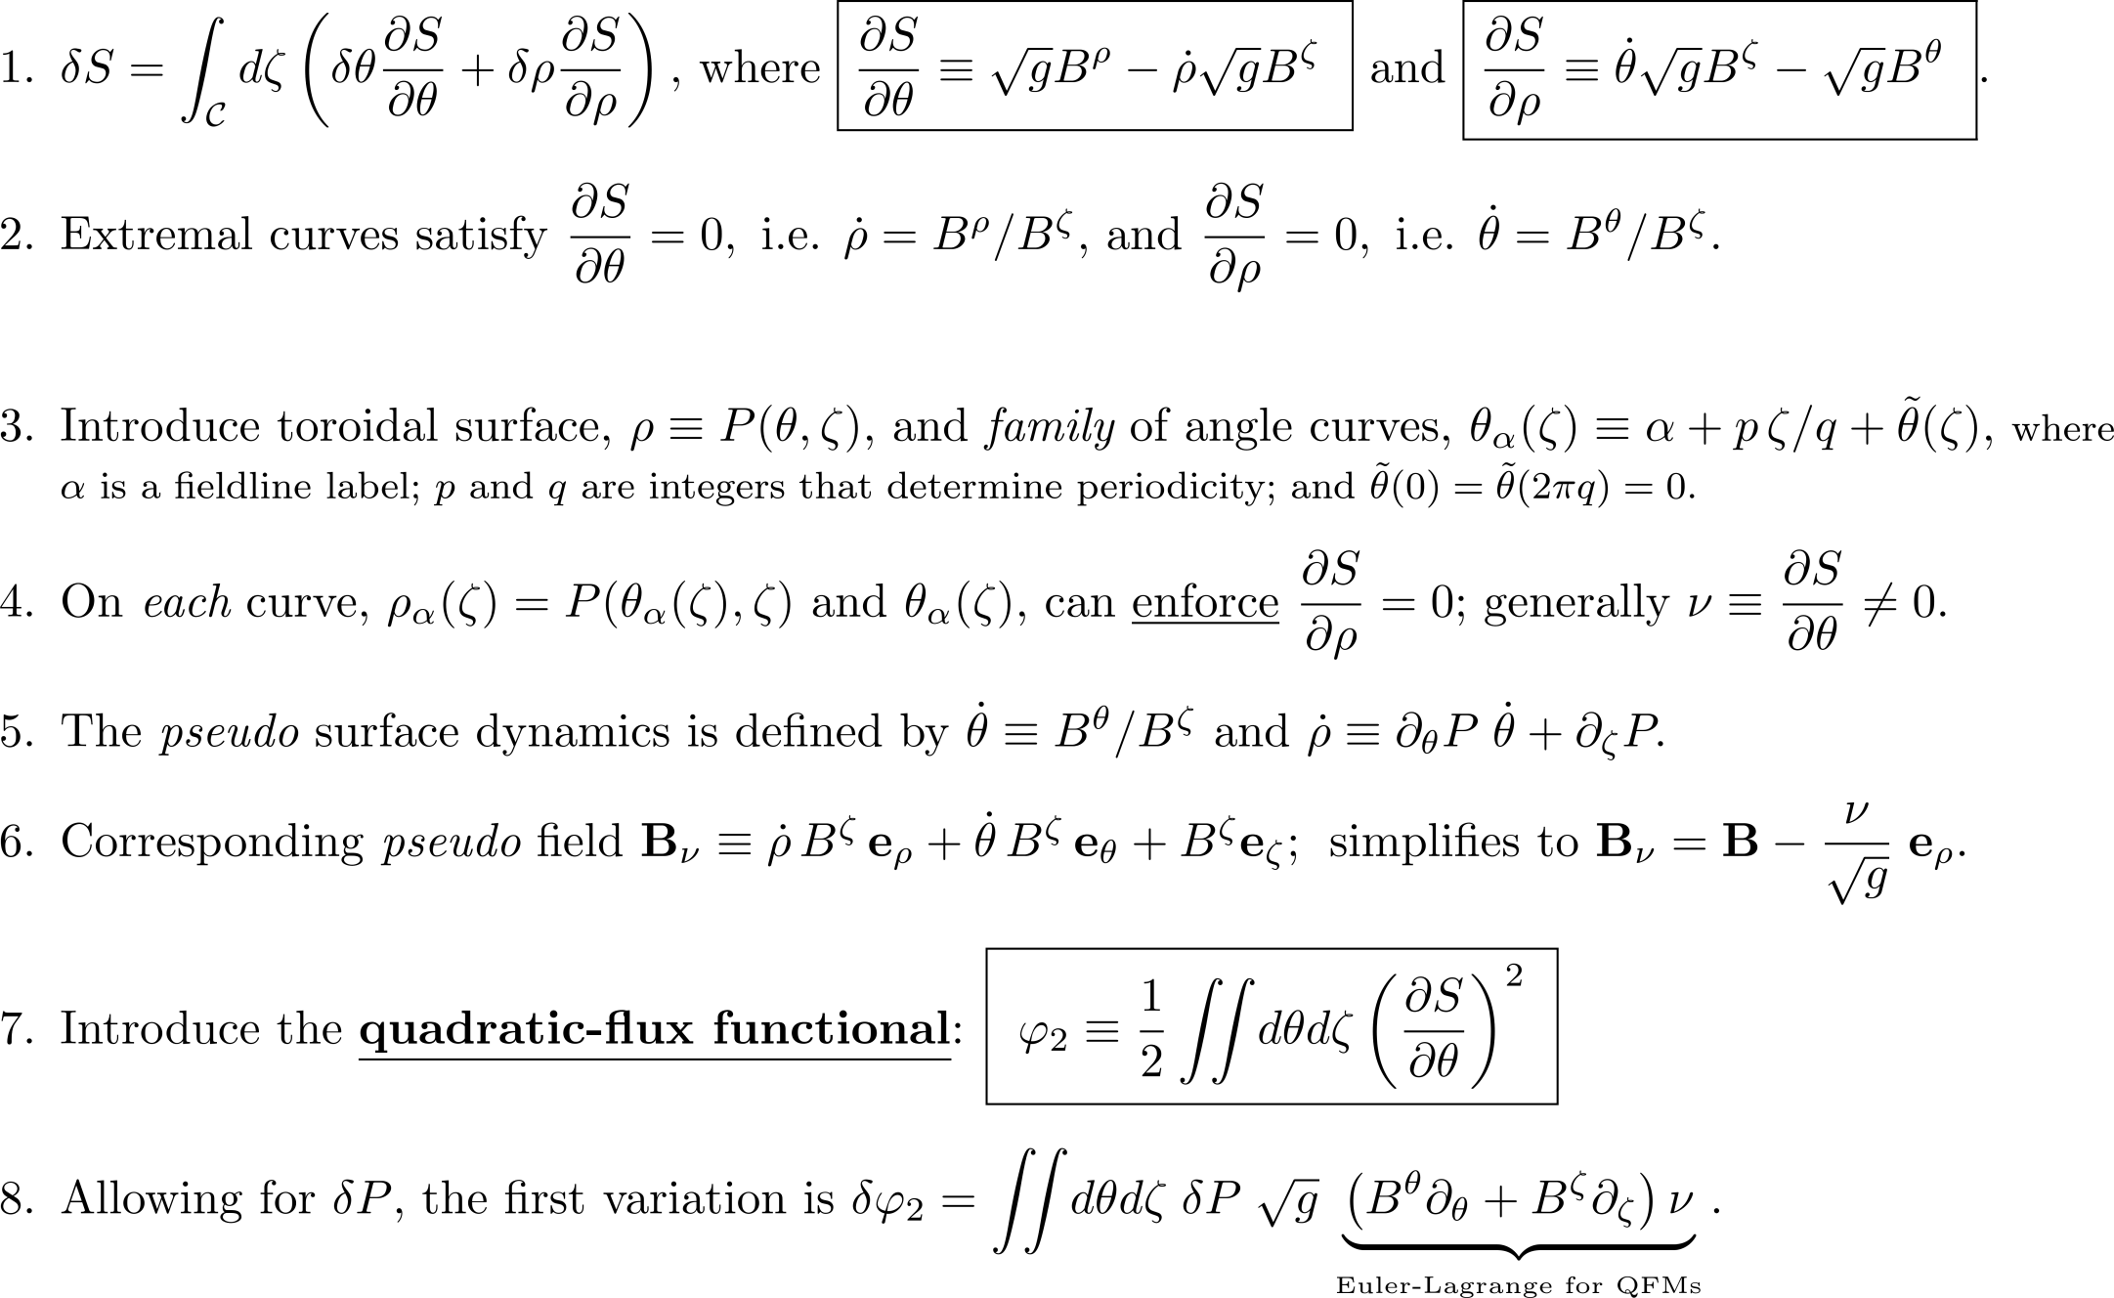
The construction of extremizing curves of the action
generalized extremizing surfaces of the quadratic-flux

Slide 17
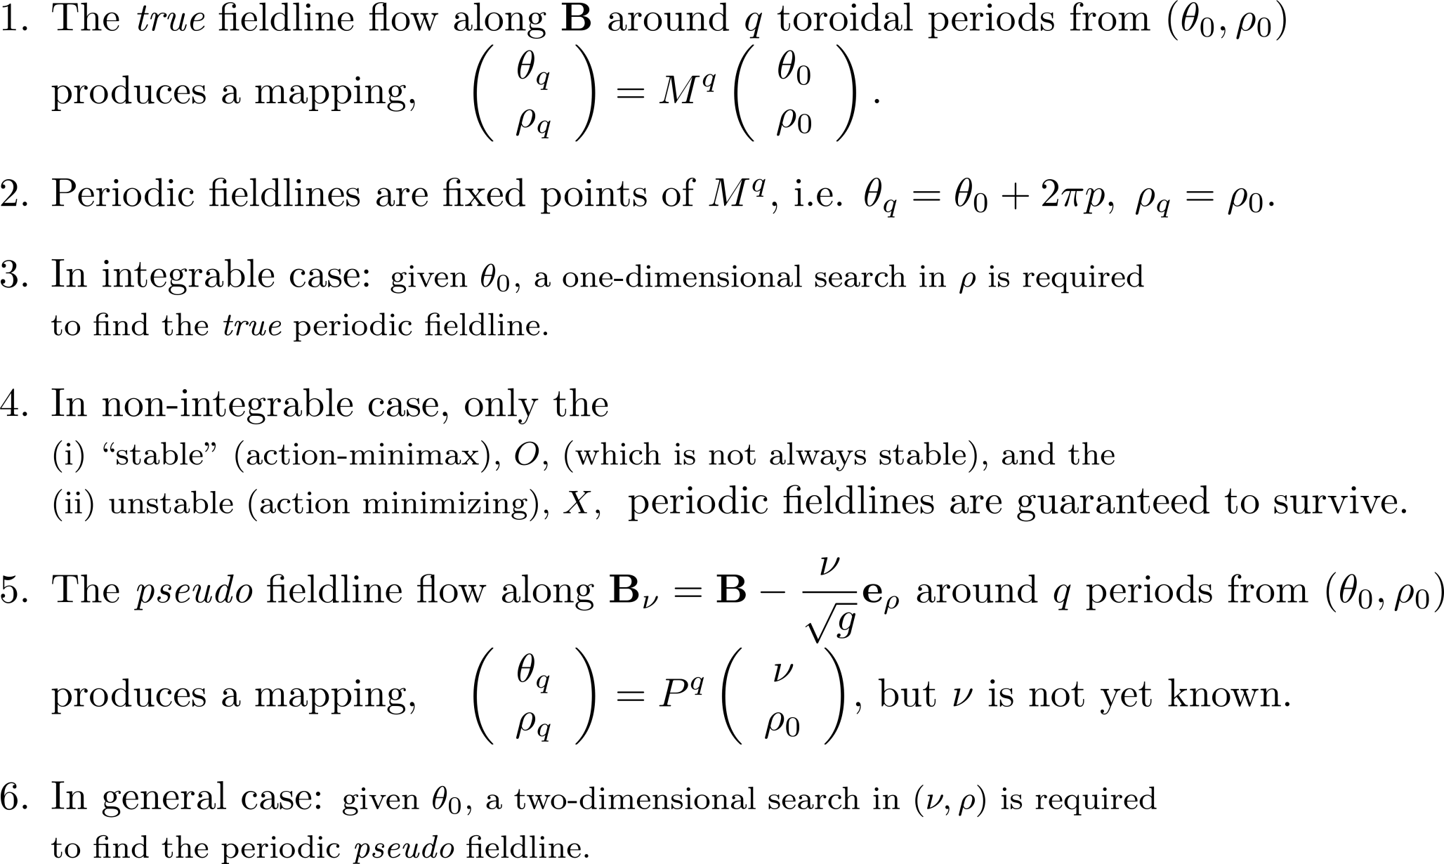
The action gradient, ν, is constant along the pseudo fieldlines; construct Quadratic Flux Minimzing (QFM) surfaces by pseudo fieldline (local) integration.

Slide 18
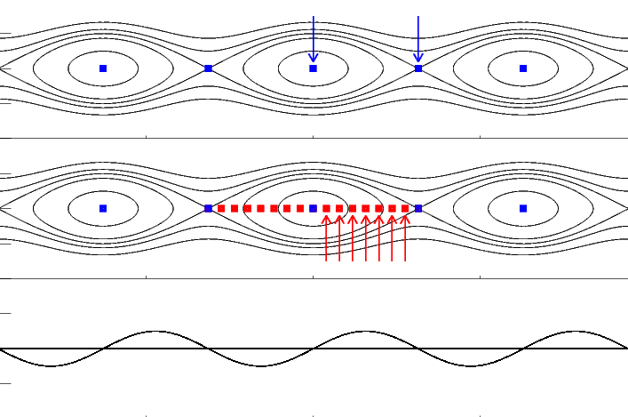
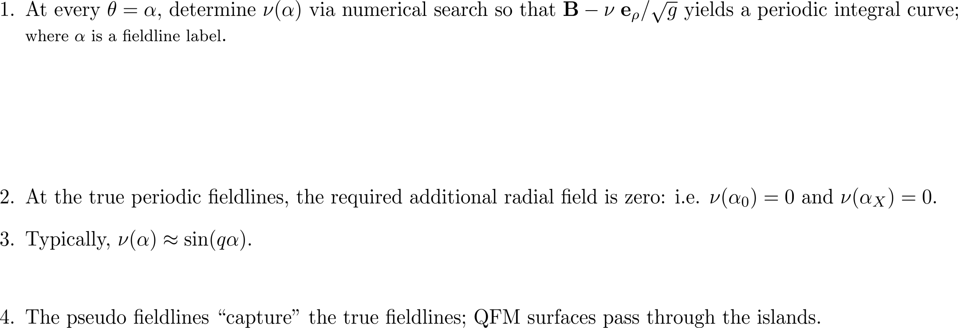
At each poloidal angle, compute radial “error” field that must be subtracted from B to create a periodic curve, and so create a rational, pseudo flux surface.
0. Usually, there are only the “stable” periodic fieldline and the unstable periodic fieldline,
true fieldlines
ρ
poloidal angle, θ
pseudo fieldlines

Slide 19
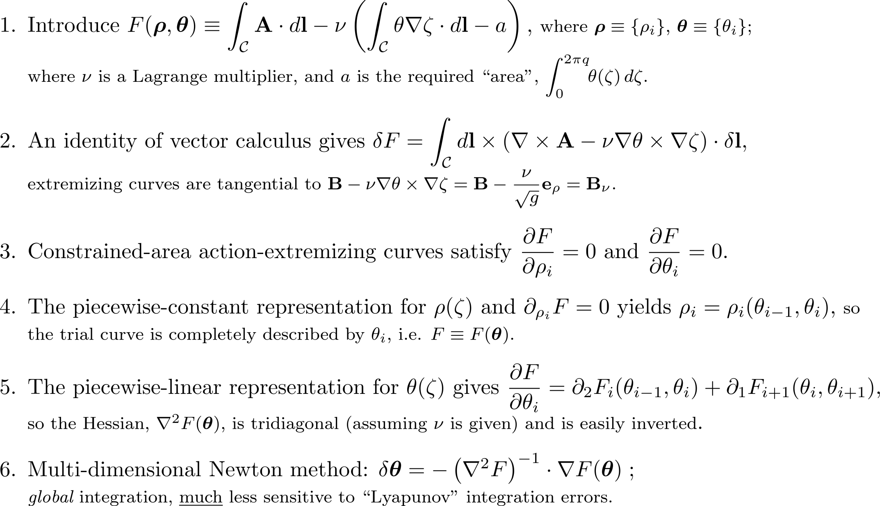
Alternative Lagrangian integration construction:
QFM surfaces are families of extremal curves of the
constrained-area action integral.

Slide 20
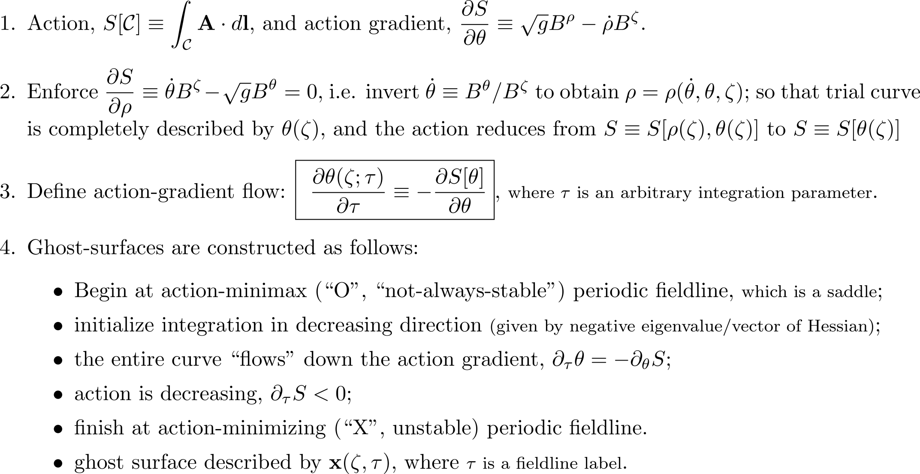
Ghost surfaces, another class of almost-invariant surface, are defined by an action-gradient flow between the action minimax and minimizing fieldline.

Slide 21
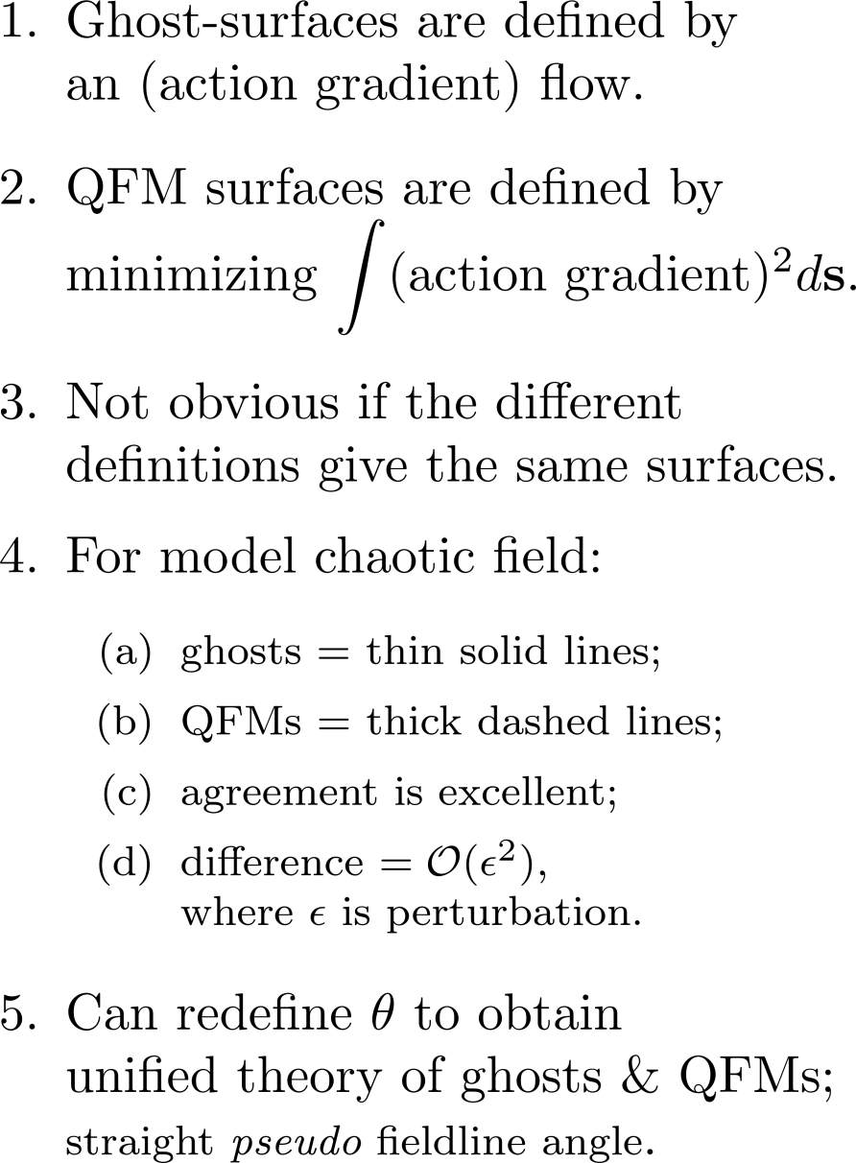
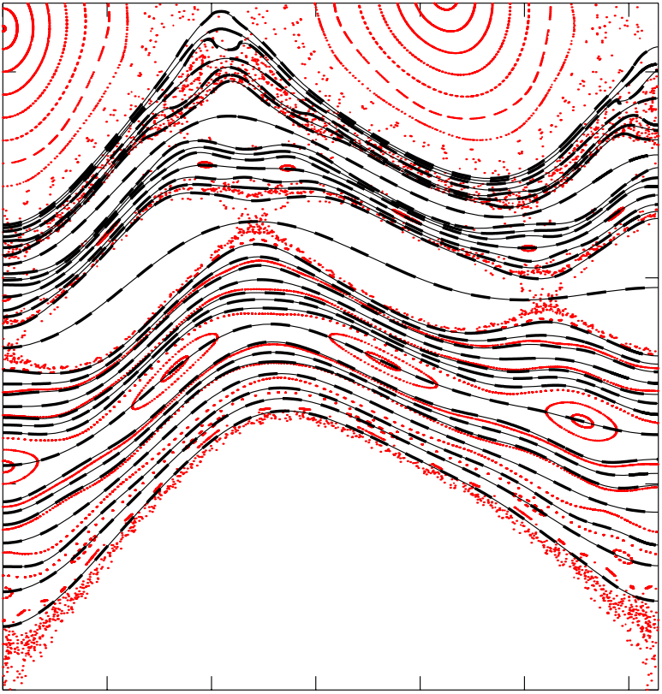
Ghost surfaces are (almost) indistinguishable from QFM surfaces
can redefine poloidal angle to unify ghost surfaces with QFMs.

Slide 22
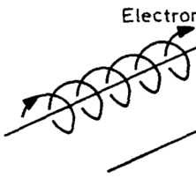
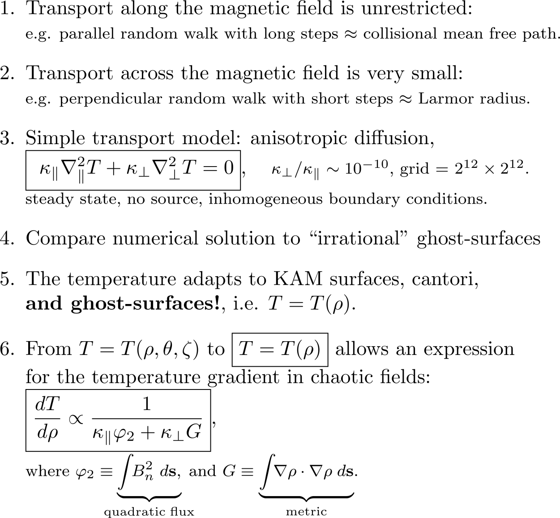
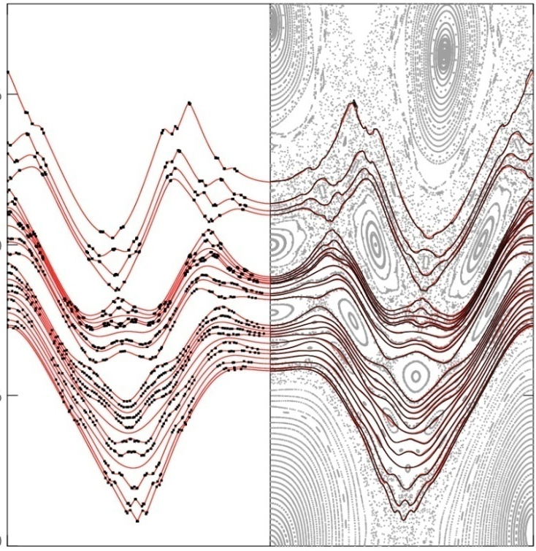
Isotherms of the steady state solution to the anisotropic diffusion coincide with ghost surfaces;
analytic, 1-D solution is possible.
free-streaming along field line
particle “knocked”
onto nearby field line
ghost-surface
cold
ghost-surface
isotherm
[Hudson & Breslau, 2008]
hot

Slide 23
Summary: Timeline of topics addressed in talk
(not a comprehensive history of Hamiltonian chaos!)
Poincaré unstable manifold (i.e. chaos)
1954 Kolmogorov KAM theorem
1962 Moser
1963 Arnold
1979 Chirikov island overlap criterion
1979 Greene residue criterion [see also 1991 MacKay]
1979 Percival can(tor + tor)us = cantorus
1982 Mather Aubry-Mather theorem (showing existence of cantori)
1983 Aubry
1991 Angenent & Golé ghost-circles
1991 Meiss & Dewar quadratic-flux minimizing curves
2008 Hudson & Breslau isotherms = ghost-surfaces
2009 Hudson & Dewar ghost-surfaces = quadratic-flux minimizing surfaces
and texts:
1983 Lichtenberg & Lieberman [Regular and Stochastic Motion]
1992 Meiss [Reviews of Modern Physics]

