Slide 1
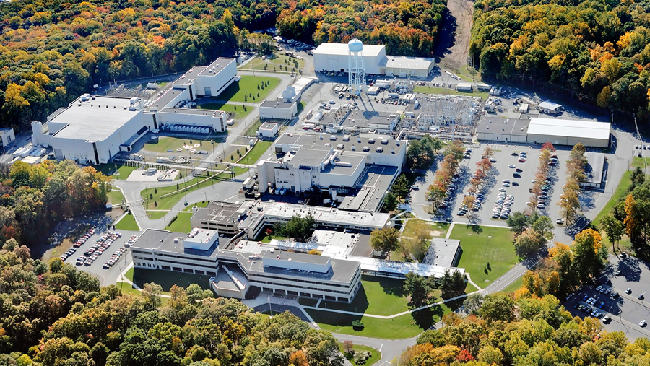
This Week @ PPPL
January 1-5, 2013
From the PPPL Office of Communications

Slide 2
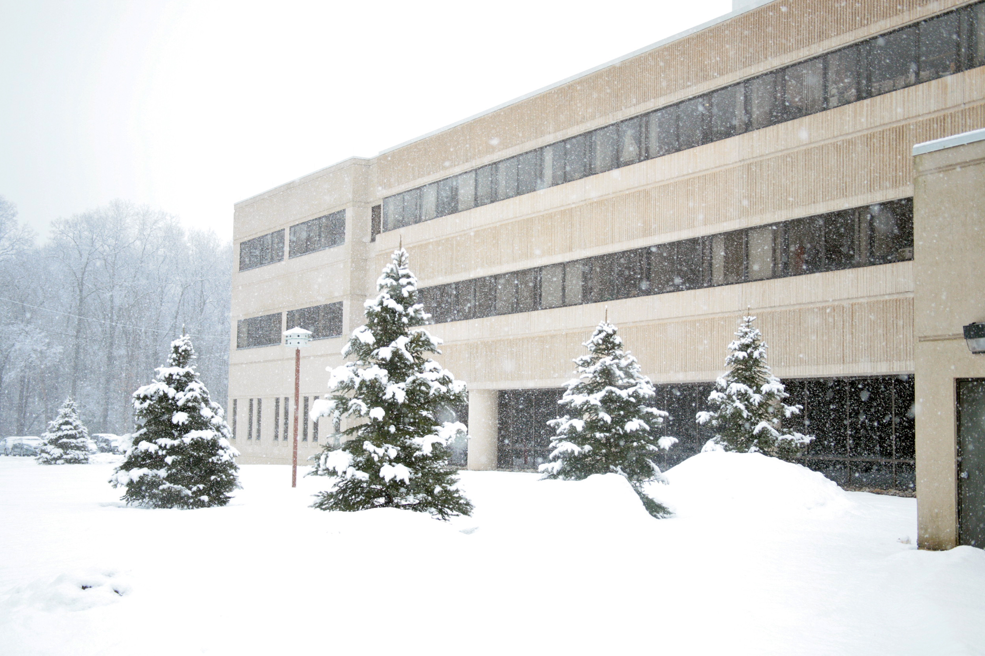
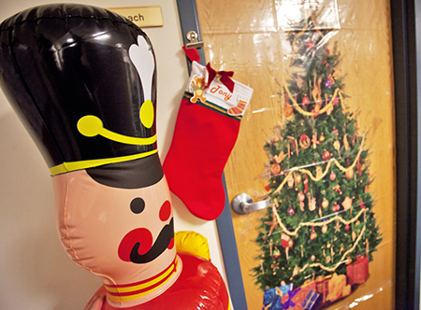
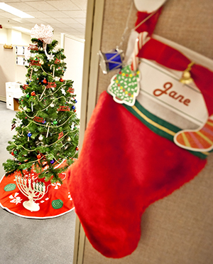
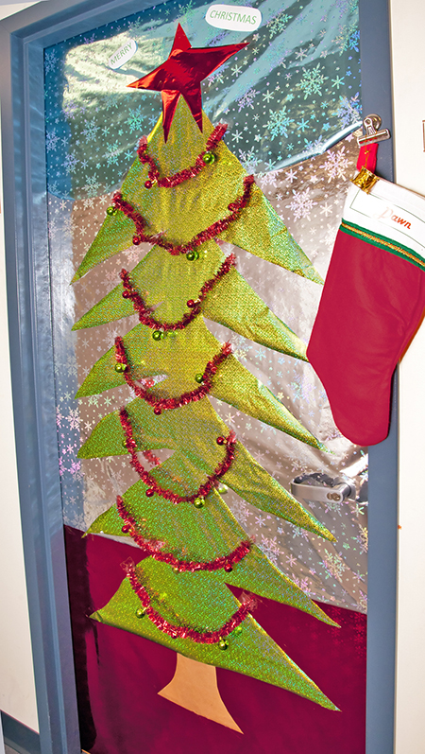
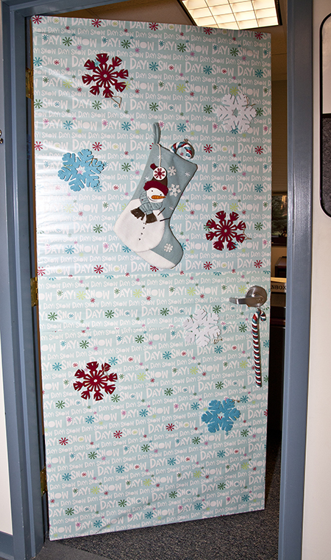
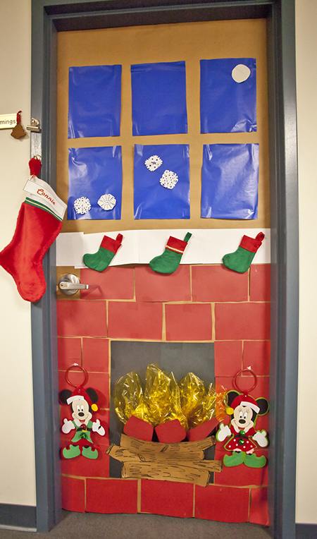
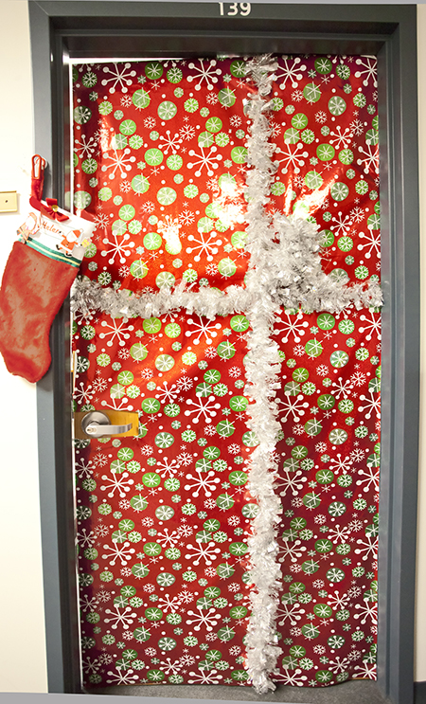
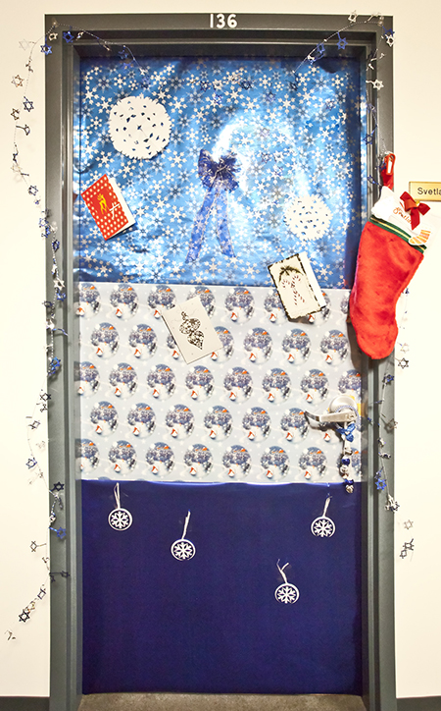
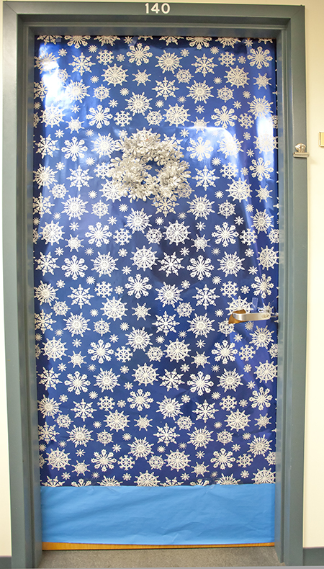
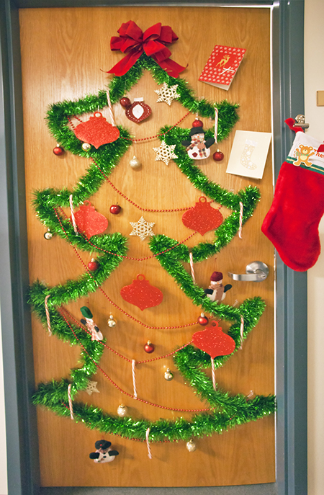
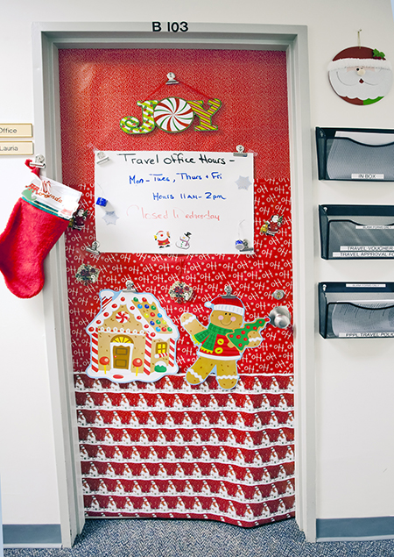
Holiday “Door” Spirit at PPPL

Slide 3



Slide 4
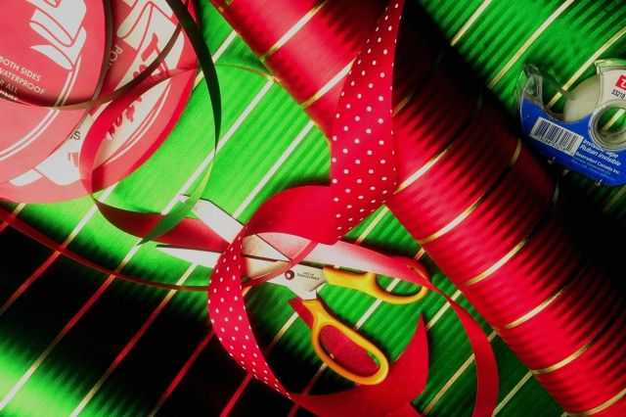
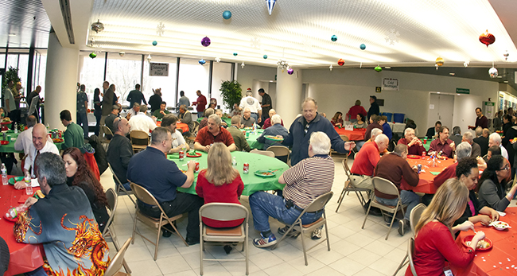
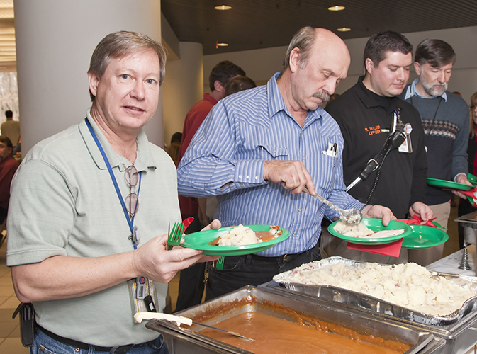
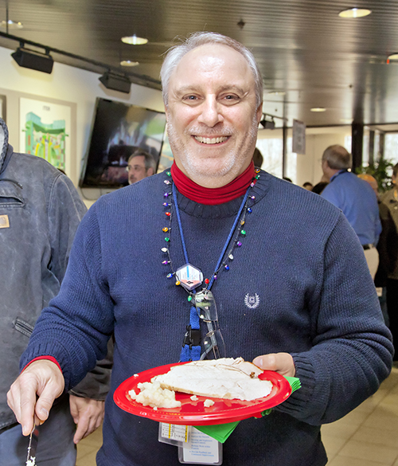
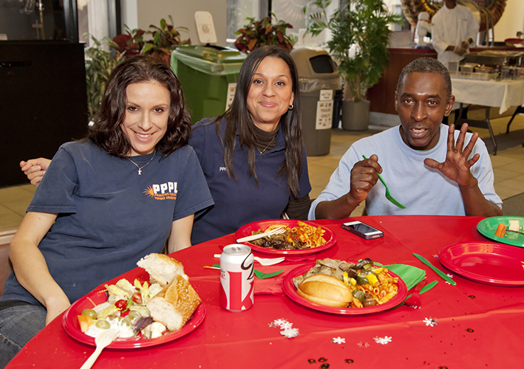
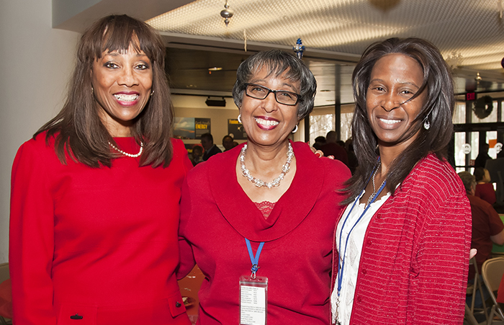
PPPL Holiday Party Luncheon

Slide 5
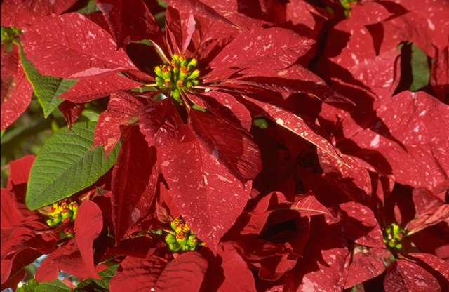
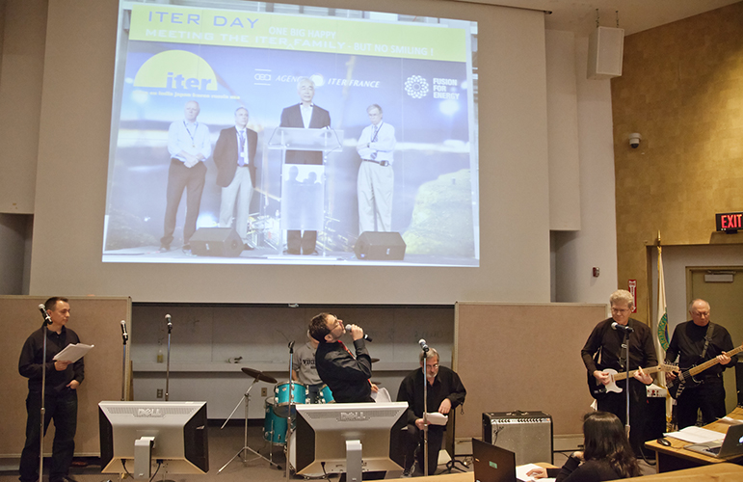
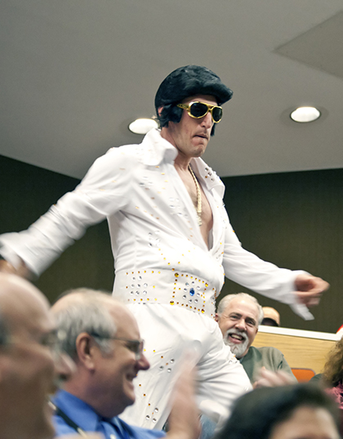
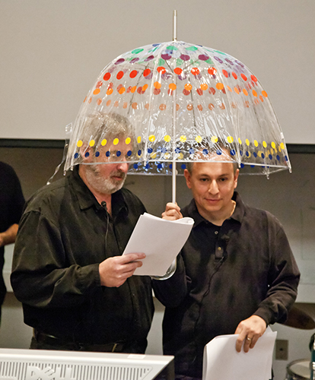
World Famous Holiday Party Skit

Slide 6
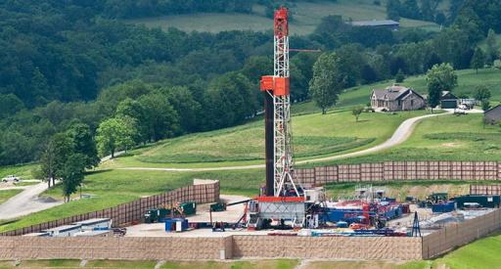
The Environmental Footprint of Shale Gas Extraction and Hydraulic Fracturing
Robert Jackson
Duke University
Next WeDNESDAY, JANUARY 9
4:15 p.m. (Coffee/Tea at 4 p.m.) • M.B.G. Auditorium, Lyman Spitzer Building

Slide 7


Thank you to all the PPPL’ers who contributed $19,132 to the PPPL and Princeton University United Way as of Dec. 14. Your contributions will help numerous organizations in Mercer county, including groups that mentor at-risk high school students in Trenton, provide housing for homeless people and help seniors and a group that helps people with disabilities stay in their homes. Although the drive is over, you can still send in your contributions, so keep those donations coming!

Slide 8



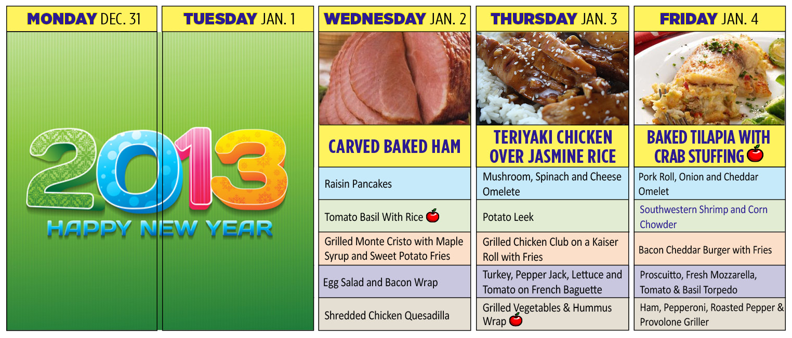
Menu subject to change without notice.

