Slide 1
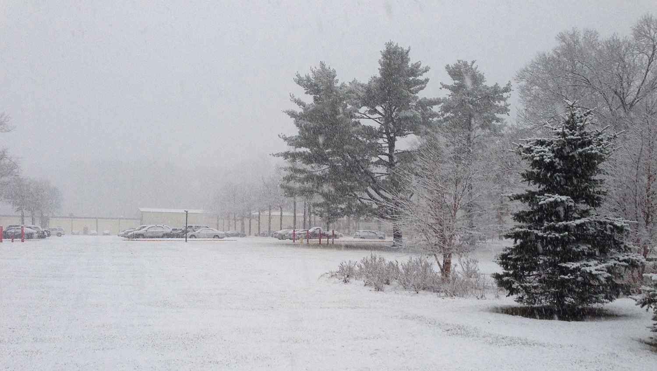
This Week @ PPPL
January 5 - 10, 2015
Brought to you by the PPPL Office of Communications

Slide 2


Slide 3



Slide 4

UPCOMING EVENTS
  Wednesday, Jan. 7
  PPPL COLLOQUIUM – NIF An Unexpectant Journey or Lessons Learned to Secure Projects of Scale
  Saturday, Jan. 10
  RONALD E. HATCHER SCIENCE ON SATURDAY LECTURE SERIES – Consciousness and the Social Brain – Michael Graziano, Princeton University
  Wednesday, Jan. 14
  PPPL’S RECORDS PAPER SHREDDING EVENT - Warehouse, Receiving #3
  Wednesday, Jan. 14
  PPPL COLLOQUIUM – Starlight Detectives: How Astronomers, Inventors, and Eccentrics Discovered the Modern Universe
  Saturday, Jan. 17
  RONALD E. HATCHER SCIENCE ON SATURDAY LECTURE SERIES – Shedding New Light on an Old Idea – Samuel Lazerson, PPPL

Slide 5
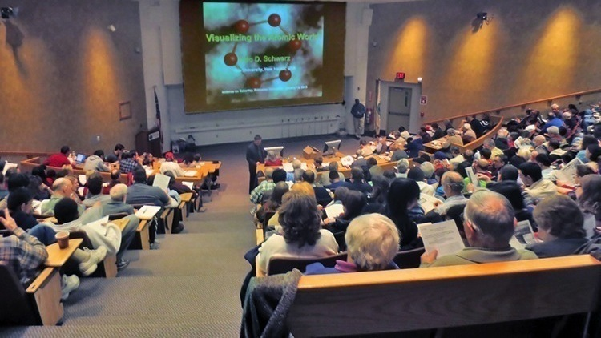

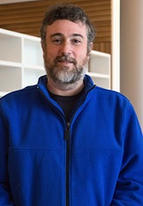
Consciousness and the Social Brain
Michael Graziano
Associate Professor of Psychology
Princeton University
Saturday, January 10, 2015
9:30 a.m. – MBG Auditorium

Slide 6
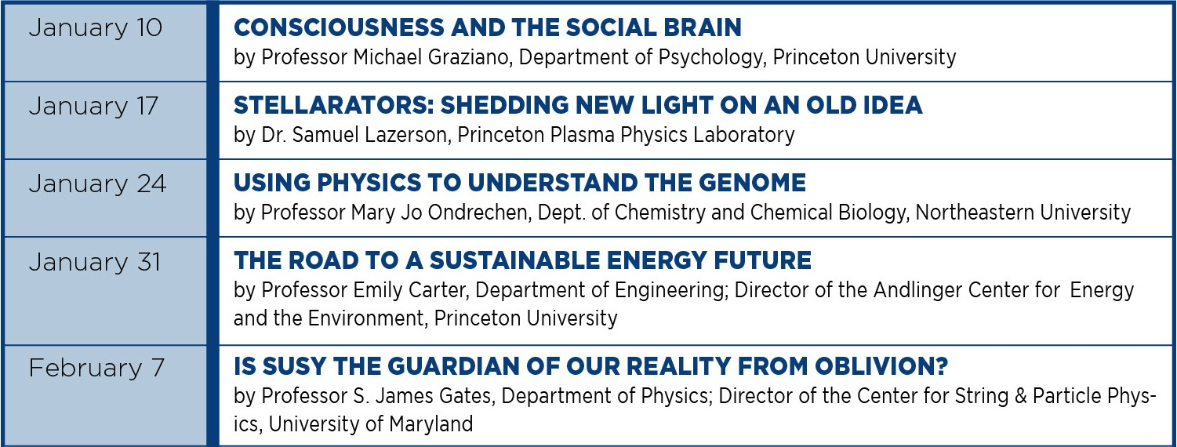

Slide 7

SAVE THE DATE
RECORDS/PAPER SHREDDING EVENT
When:
January 14, 2015 (9 a.m. – 4 p.m.)
Where:
Warehouse, PPPL Receiving Area #3
Restrictions:
Only PPPL departmental business-related records and documents will be shredded!

Slide 8
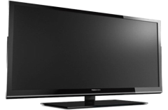

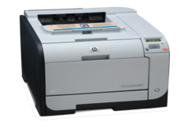
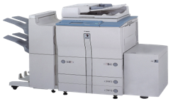

Buying a Tablet or Touch Screen?
Ensure required EPEAT purchases for Tablets, Slates & 2 in 1 Notebooks
The following items must be EPEAT certified:
• Tablets/Slates
• 2 in 1 Notebooks
• TV’s
• Printers
• Faxes
• Copiers
• Multi-Function Devices
• Desktops/Laptops
• Monitors
• Thin Clients & Workstations
Search the EPEAT Registry before purchasing or contact Leanna Meyer x2599 lmeyer@pppl.gov

Slide 9
