Slide 1
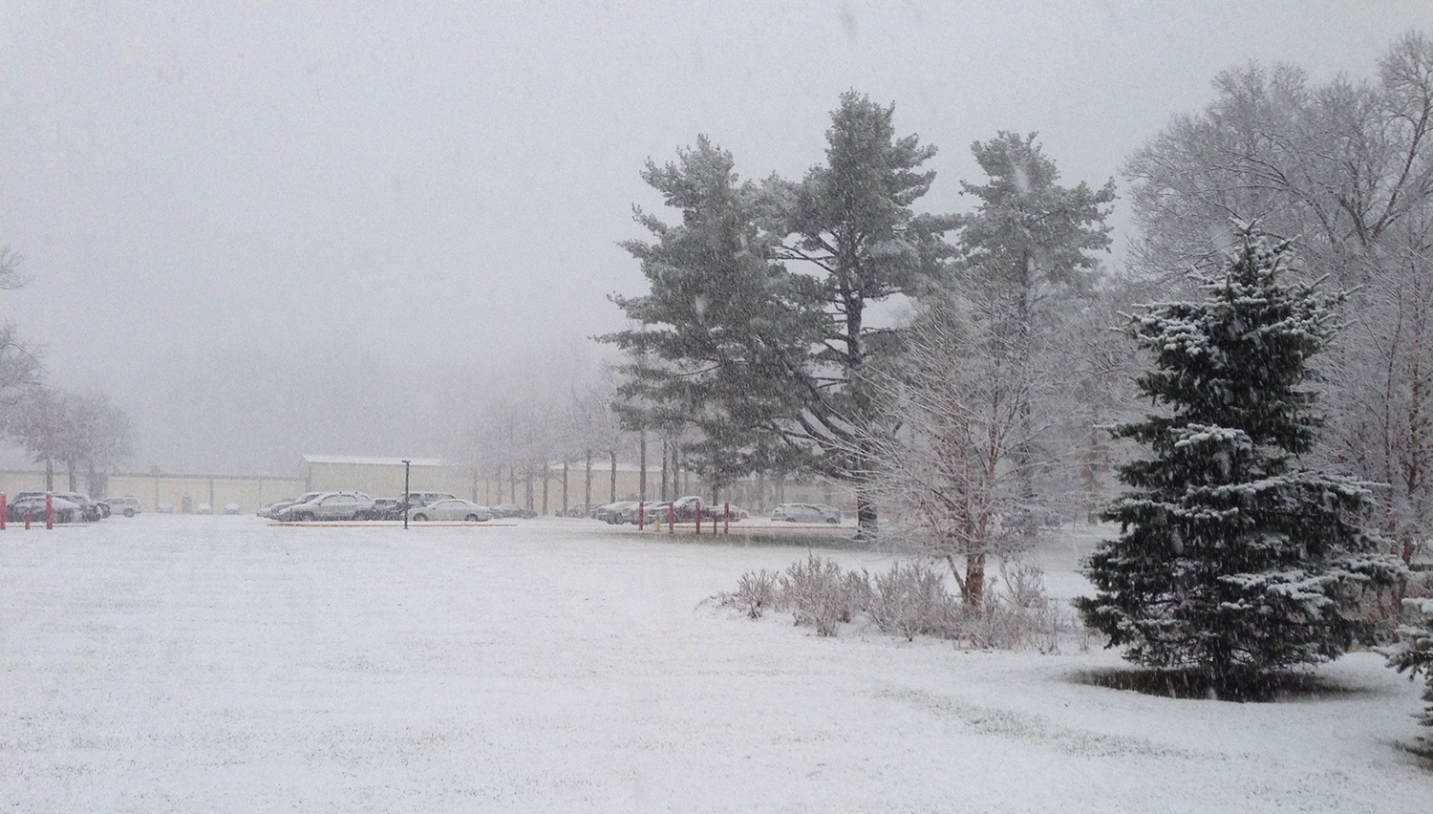
This Week @ PPPL
January 6-11, 2014
From the PPPL Office of Communications

Slide 2


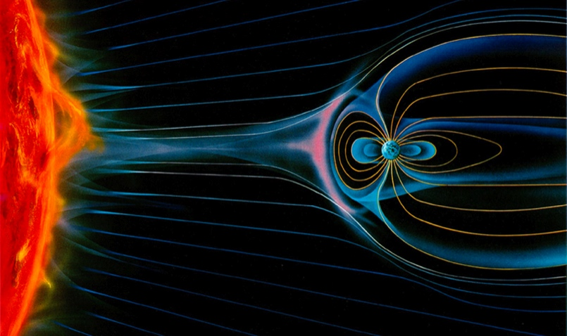
On the Origins of the
Solar Wind
Sarah MacGregor
Boston University
WEDNESDAY, JAN. 8
4:15 p.m. (Coffee/Tea at 4 p.m.) • M.B.G. Auditorium

Slide 3
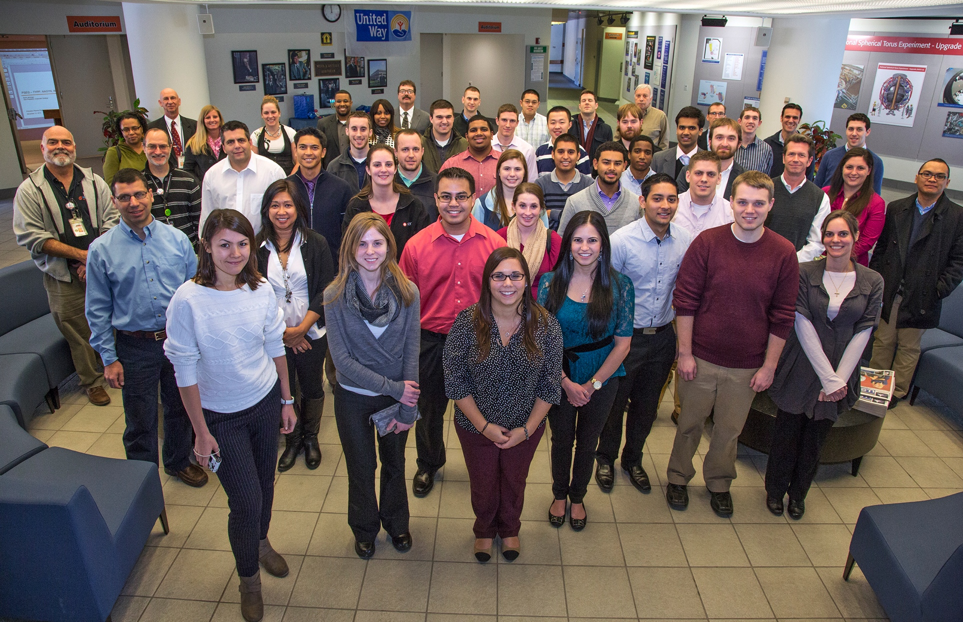

YOUNG PSE&G EXECUTIVES & ENGINEERS VISIT PPPL

Slide 4

PPPL Alternative Commuting Incentives
Mass Transit
University staff are eligible to receive a 50% monthly subsidy for taking mass transit.
There is a shuttle that runs between main campus and PPPL. Additionally, the lab is local to many bus/train stops.

Slide 5
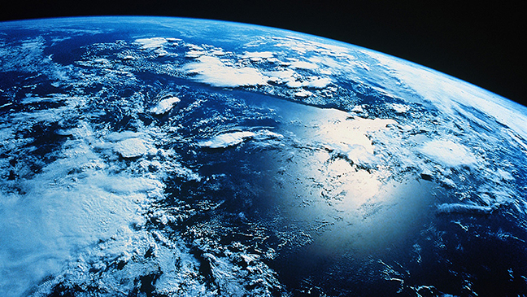
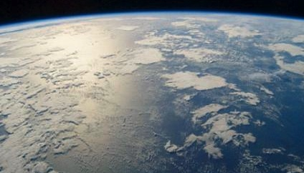
The Global Carbon Cycle and Earth's Climate
David Archer
University of Chicago
Next week - WEDNESDAY, JAN. 15
4:15 p.m. (Coffee/Tea at 4 p.m.) • M.B.G. Auditorium

Slide 6


Welcome New PPPL Employees…

Slide 7


UPCOMING EVENTS
Wednesday, January 8
  PPPL Colloquium • 4:15 p.m. – MBG Auditorium – “Origins of the Solar Wind”
Saturday, January 11
  Science on Saturday Lecture Series – 9:30 a.m. – MBG Auditorium – “Containing a Star on Earth: Understanding Turbulence at 100 Million Degrees”
Wednesday, January 15
  PPPL Colloquium • 4:15 p.m. – MBG Auditorium – “The Global Carbon Cycle”
Saturday, January 18
  Science on Saturday Lecture Series – 9:30 a.m. – MBG Auditorium – “Physics of Cancer”
Wednesday, January 22
  PPPL Colloquium • 4:15 p.m. – MBG Auditorium – “Addressing Big Data Challenges in Simulation-based Science”
Saturday, January 25
  Science on Saturday Lecture Series – 9:30 a.m. – MBG Auditorium – “The atmosphere as a laboratory: aerosols, air quality, and climate”

Slide 8


Thank you to all PPPL’ers who have contributed $33,279 to the
United Way as of January 2.

Slide 9
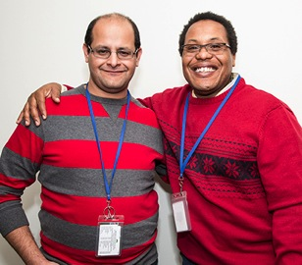
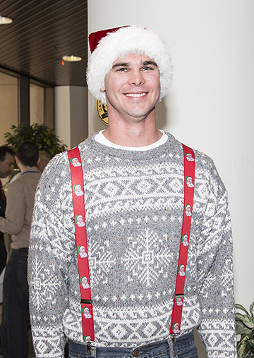
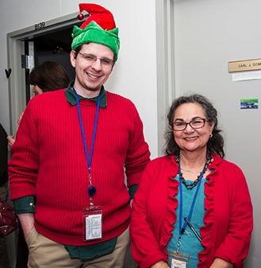
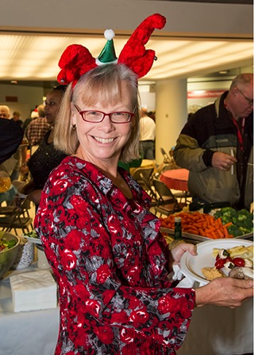
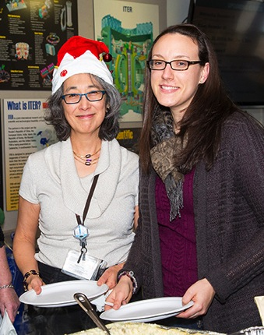
PPPL Holiday Party

Slide 10
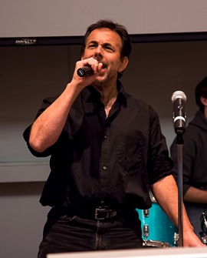
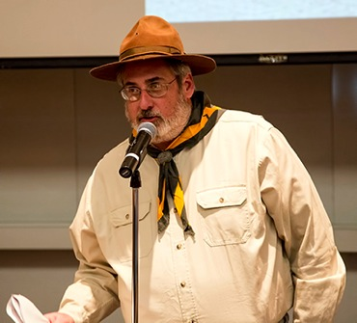
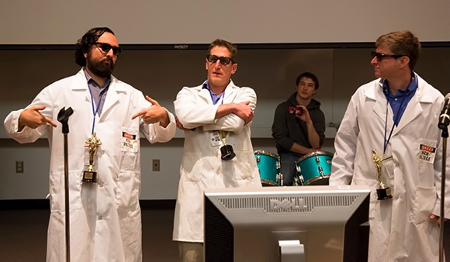
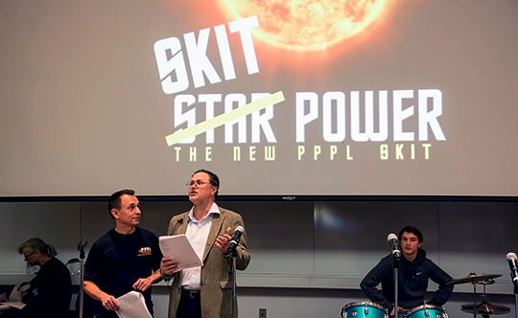
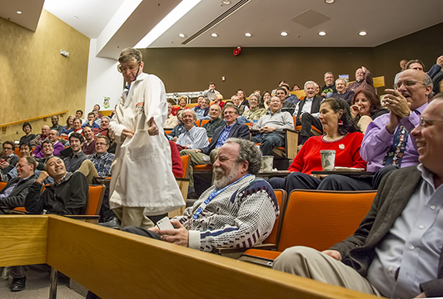
World Famous PPPL Holiday Party Skit

Slide 11
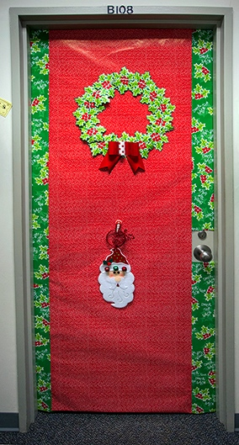
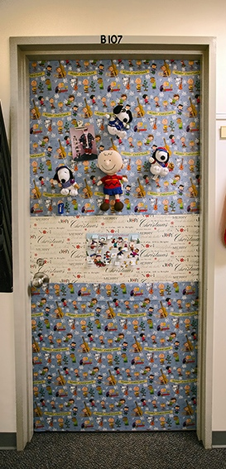
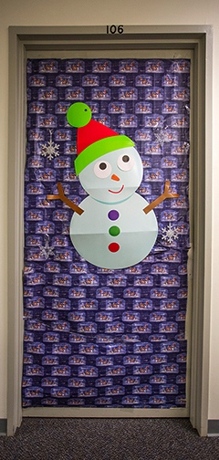
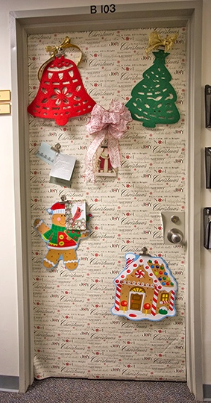
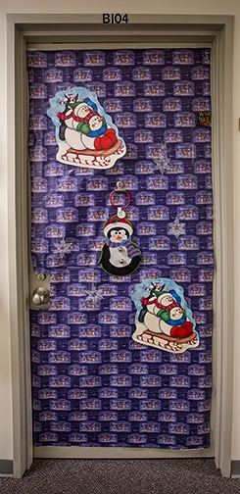
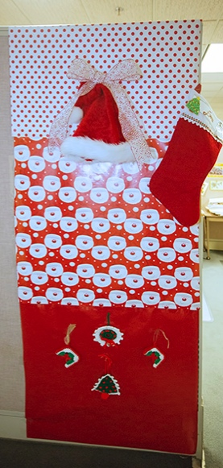
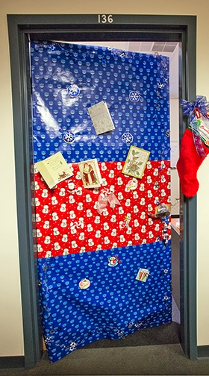
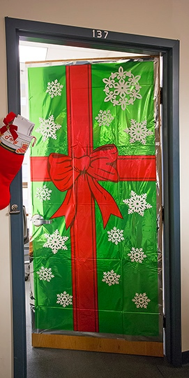
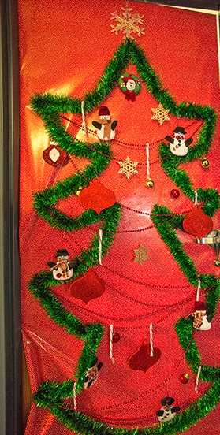
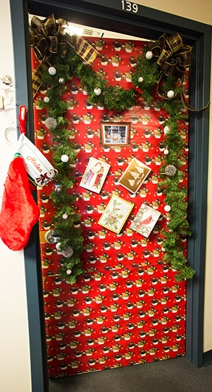
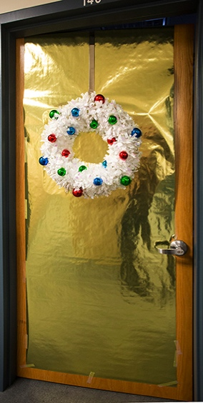
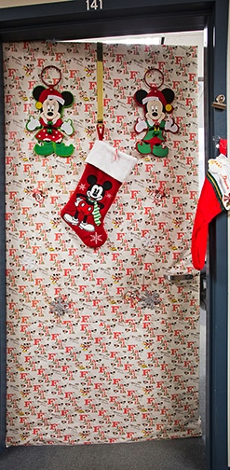
PPPL Holiday Doors

Slide 12

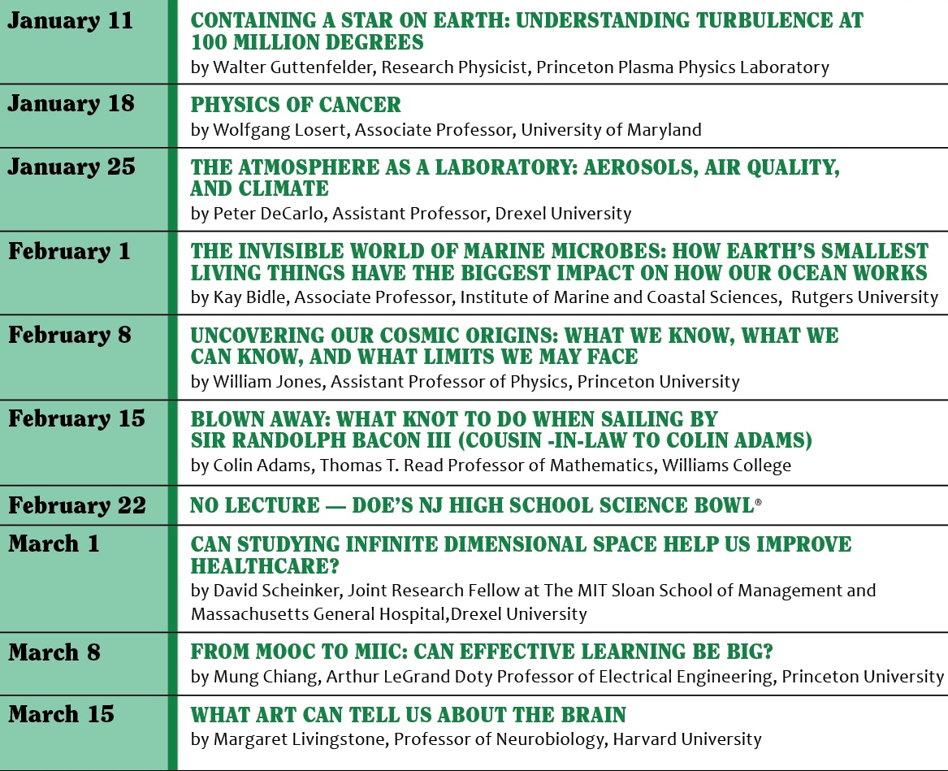

Slide 13
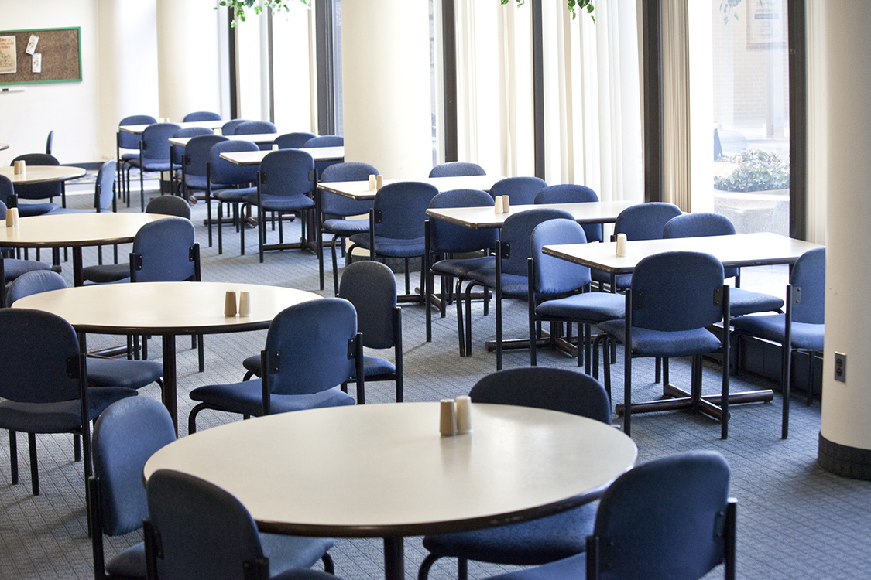
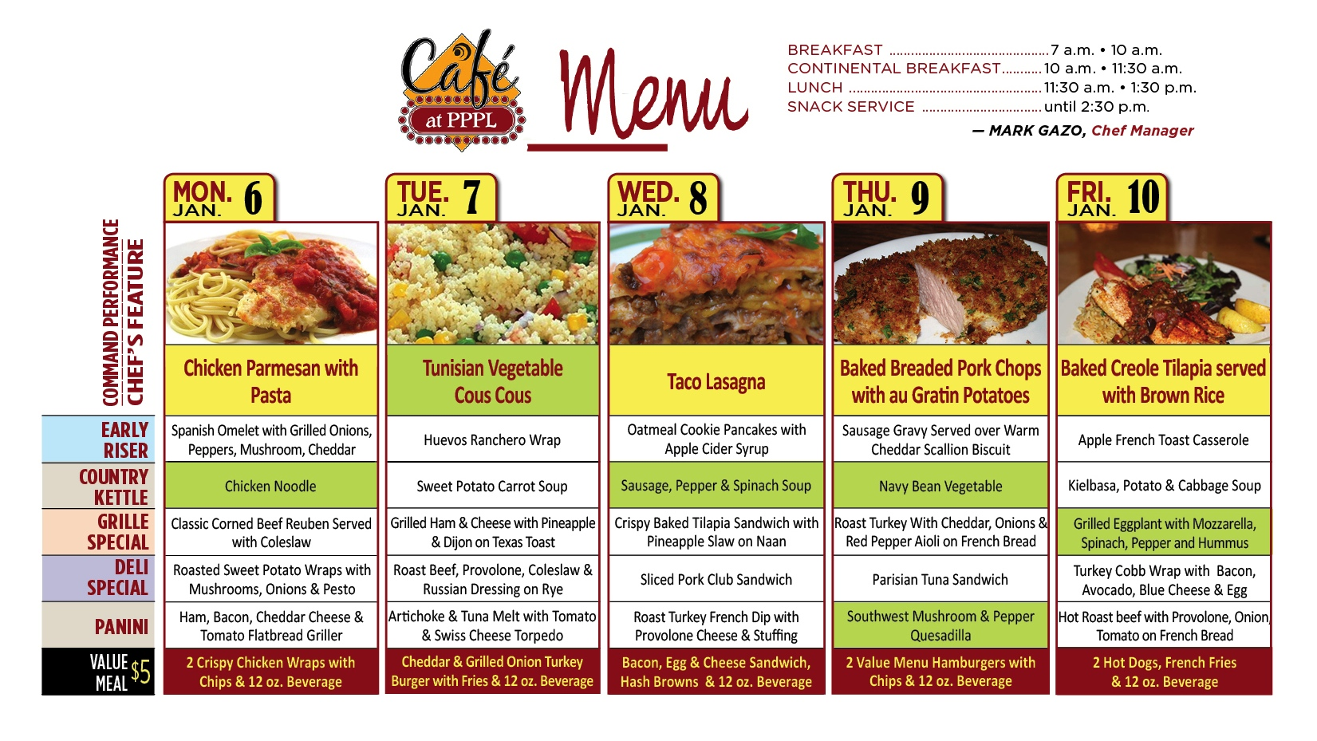
Menu subject to change without notice.

