Slide 1
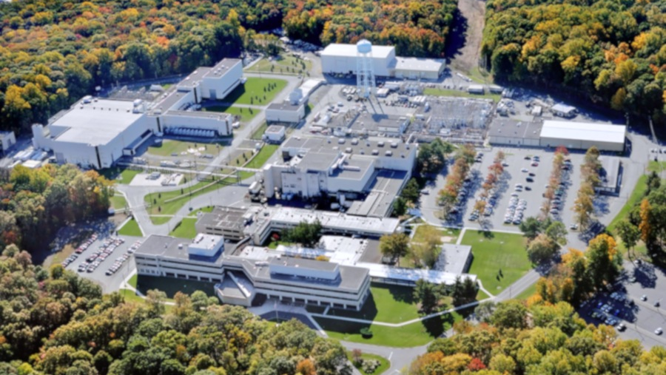
This Week @ PPPL
January 14-19, 2013
From the PPPL Office of Communications

Slide 2
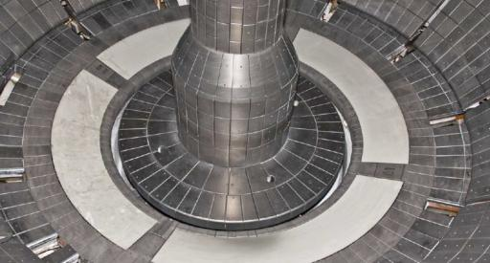
Excitement at the Plasma Boundary
Rob Goldston
Princeton University
WeDNESDAY, JANUARY 16
4:15 p.m. (Coffee/Tea at 4 p.m.) • M.B.G. Auditorium, Lyman Spitzer Building

Slide 3
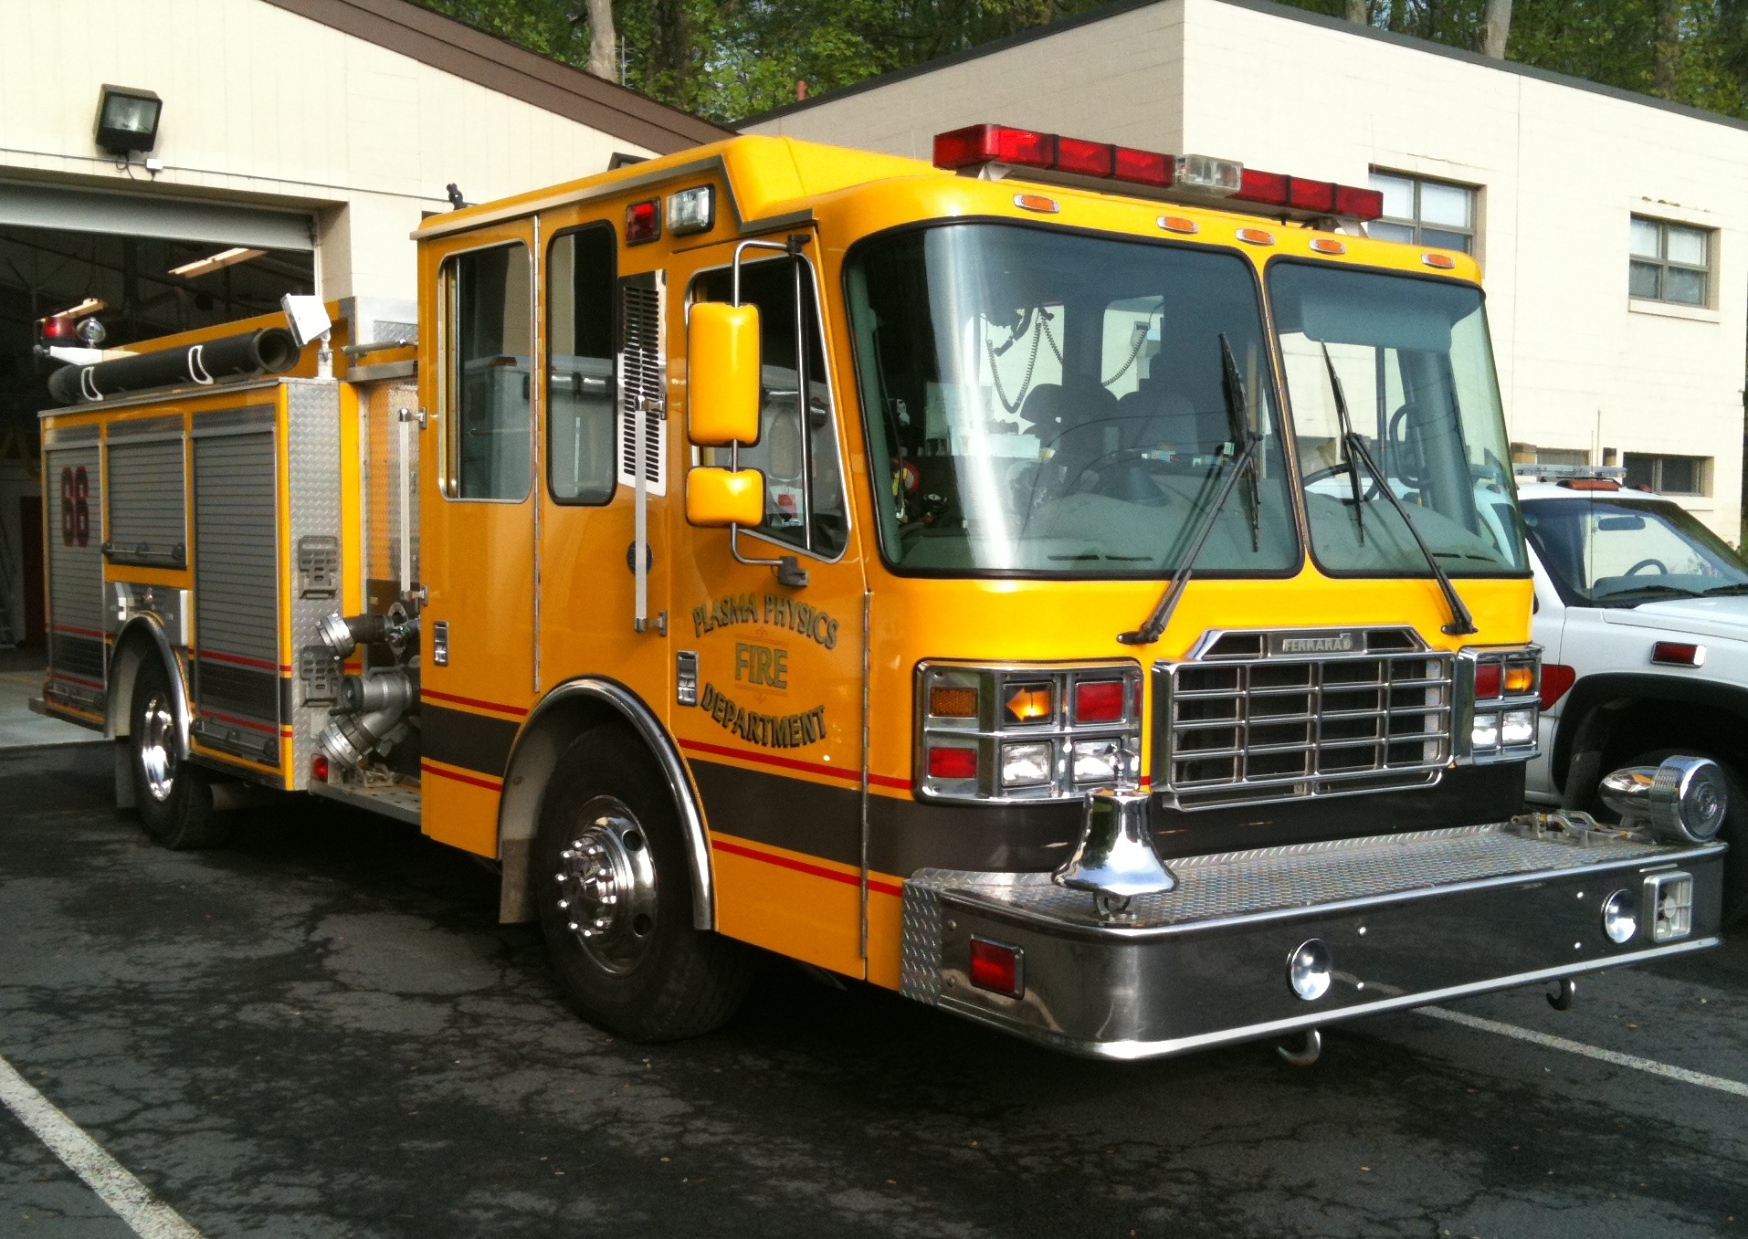
Fire Protection Systems Audit at PPPL
this week

Slide 4

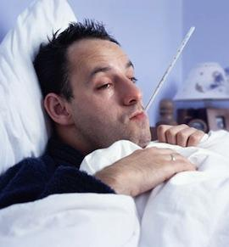

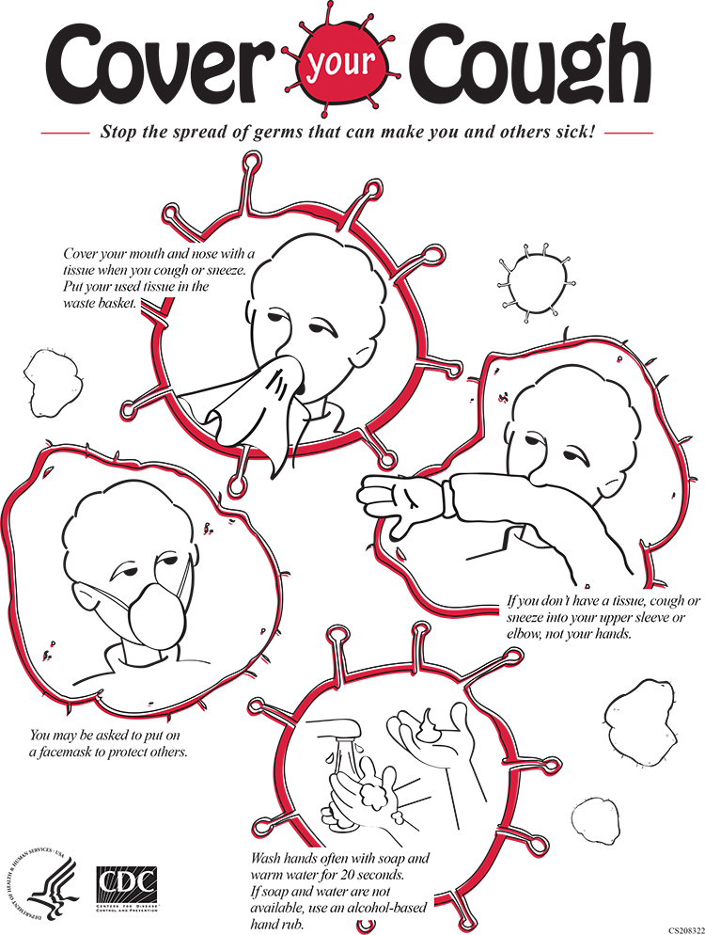

Slide 5
Look for the Safety Culture Survey in your email box soon!
Look for the Safety Culture Survey in your email box soon!

Slide 6
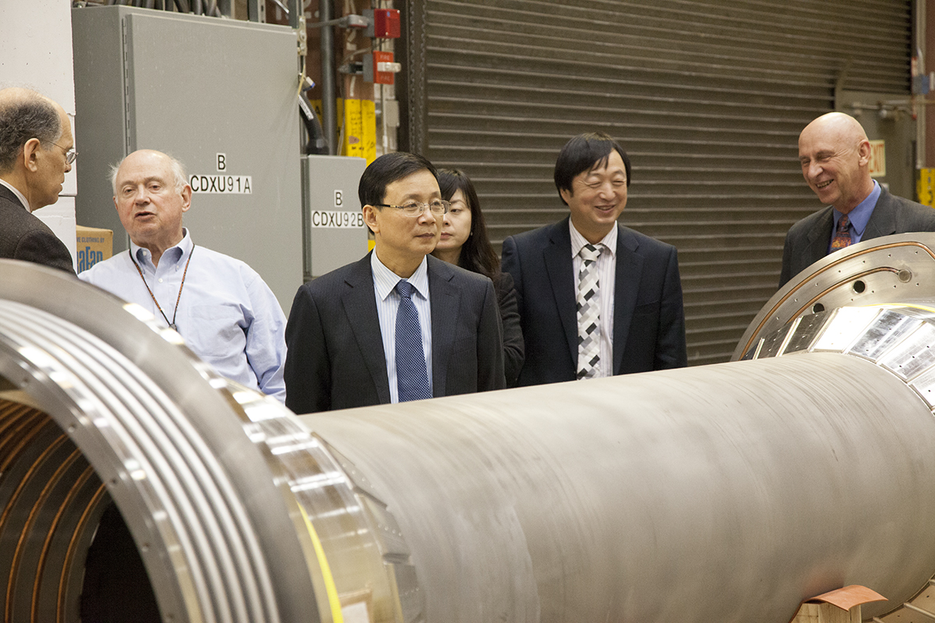
A delegation from the University of Science and Technology of China (USTC) took a tour of PPPL.

Slide 7
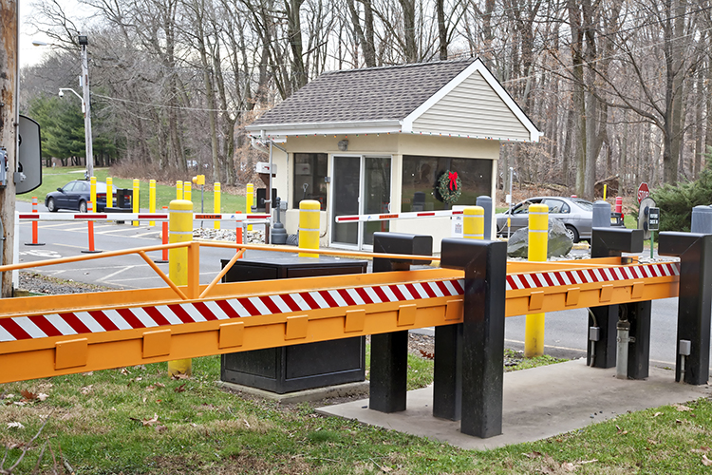
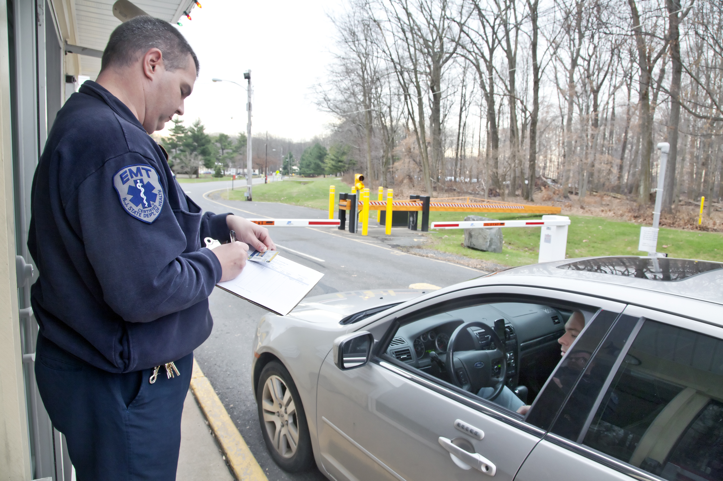

PPPL’s security booth and officers won high praise in a DOE evaluation.

Slide 8

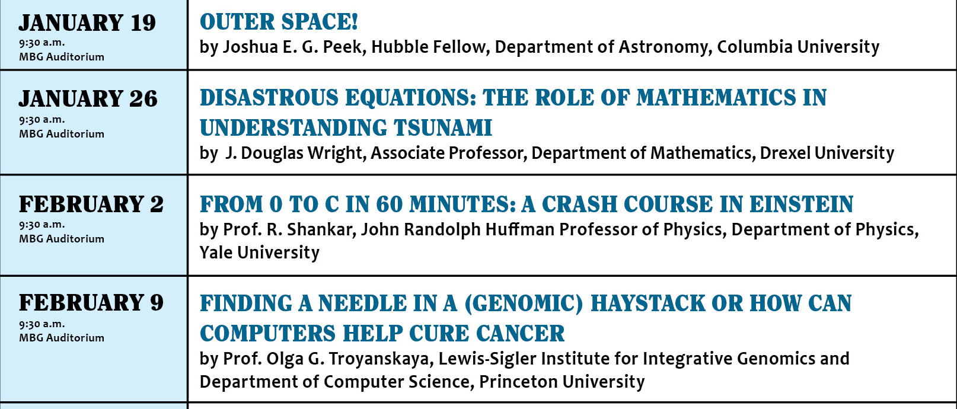

Slide 9



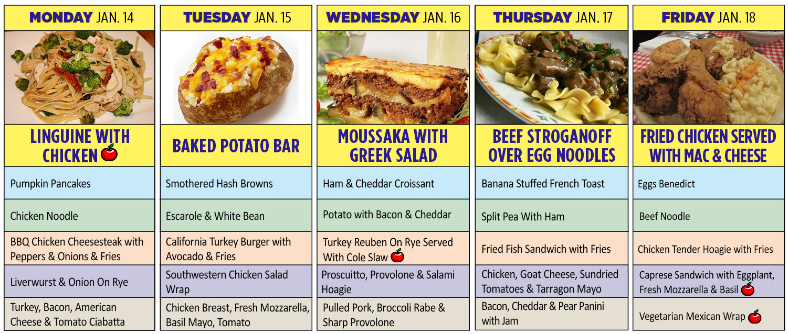
Menu subject to change without notice.

