Slide 1
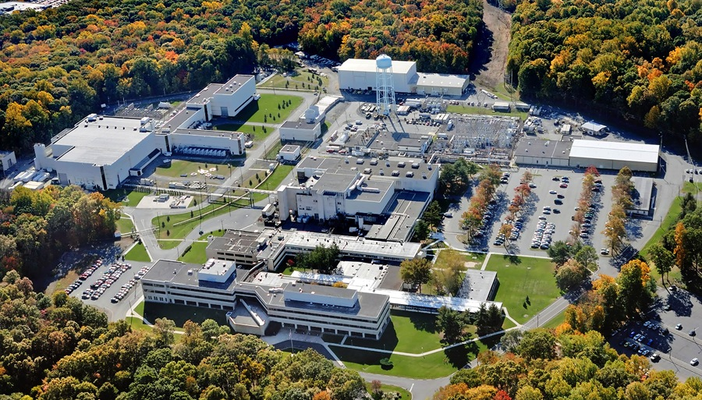
This Week @ PPPL
January 20-25, 2014
From the PPPL Office of Communications

Slide 2

PPPL Alternative Commuting Incentives
Carpool
Princeton University offers car pool matching for staff.
If you participate in a carpool, you can be eligible for a $50 gas card.

Slide 3


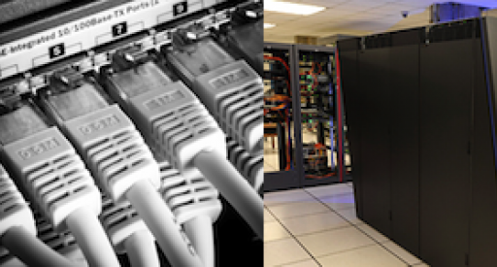
Addressing Big Data Challenges in Simulation-based Science
Manish Prashar
Rutgers University
WEDNESDAY, JAN. 22
4:15 p.m. (Coffee/Tea at 4 p.m.) • M.B.G. Auditorium

Slide 4


UPCOMING EVENTS
Wednesday, January 22
  PPPL Colloquium • 4:15 p.m. – MBG Auditorium – “Addressing Big Data Challenges in Simulation-based Science”
Saturday, January 25
  Science on Saturday – 9:30 a.m. – MBG Auditorium – “The atmosphere as a laboratory: aerosols, air quality, and climate”
Wednesday, January 29
  PPPL Colloquium • 4:15 p.m. – MBG Auditorium – “The Usefulness of Useless Knowledge: The History of the Institute for Advanced Study”
Saturday, Febuary 1
  Science on Saturday – 9:30 a.m. – MBG Auditorium – “The invisible world of marine microbes: how Earth’s smallest living things have the biggest impact on how our ocean works”
Saturday, Febuary 8
  Science on Saturday – 9:30 a.m. – MBG Auditorium – “Uncovering our Cosmic Origins: what we know, what we can know, and what limits we may face”

Slide 5
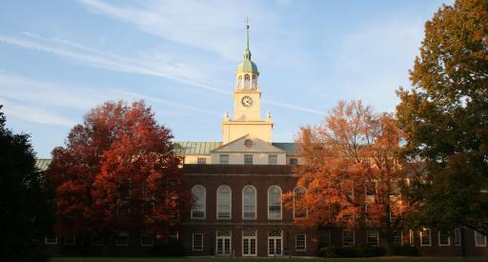
The Usefulness of Useless Knowledge: The History of the Institute for Advanced Study
Christine DeBella
Institute for Advanced Study
Next Week - WEDNESDAY, JAN. 29
4:15 p.m. (Coffee/Tea at 4 p.m.) • M.B.G. Auditorium

Slide 6

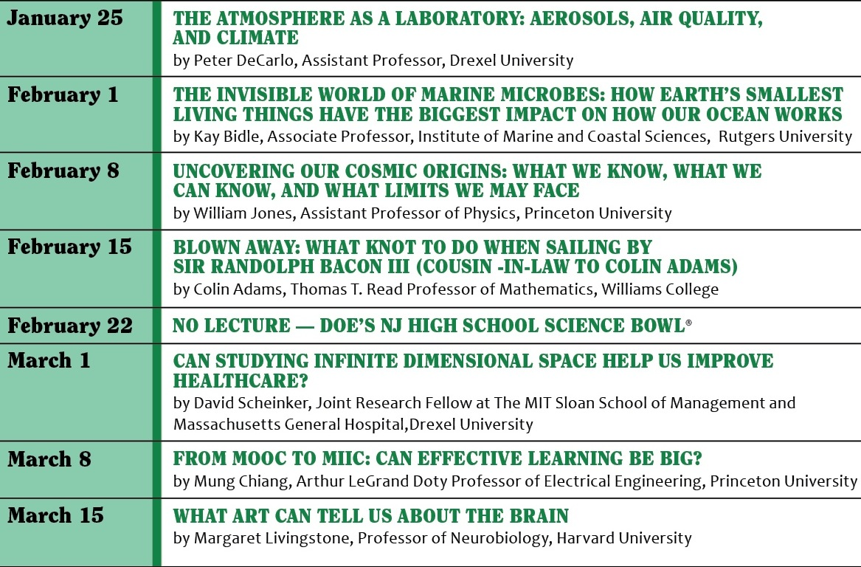

Slide 7
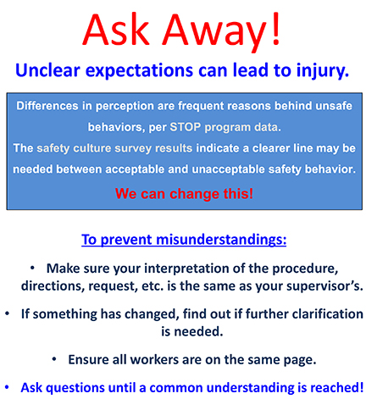

Slide 8
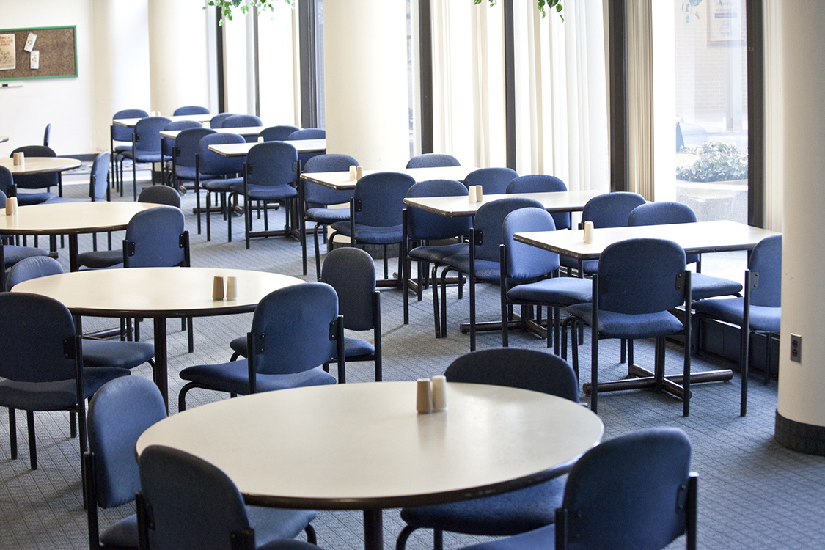
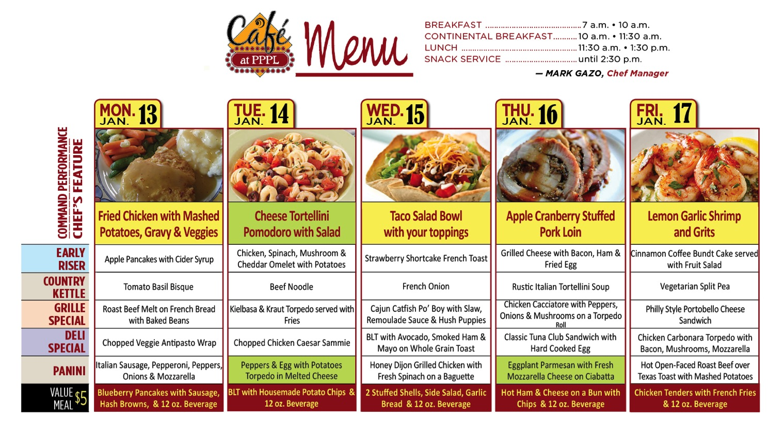
Menu subject to change without notice.

