Slide 1
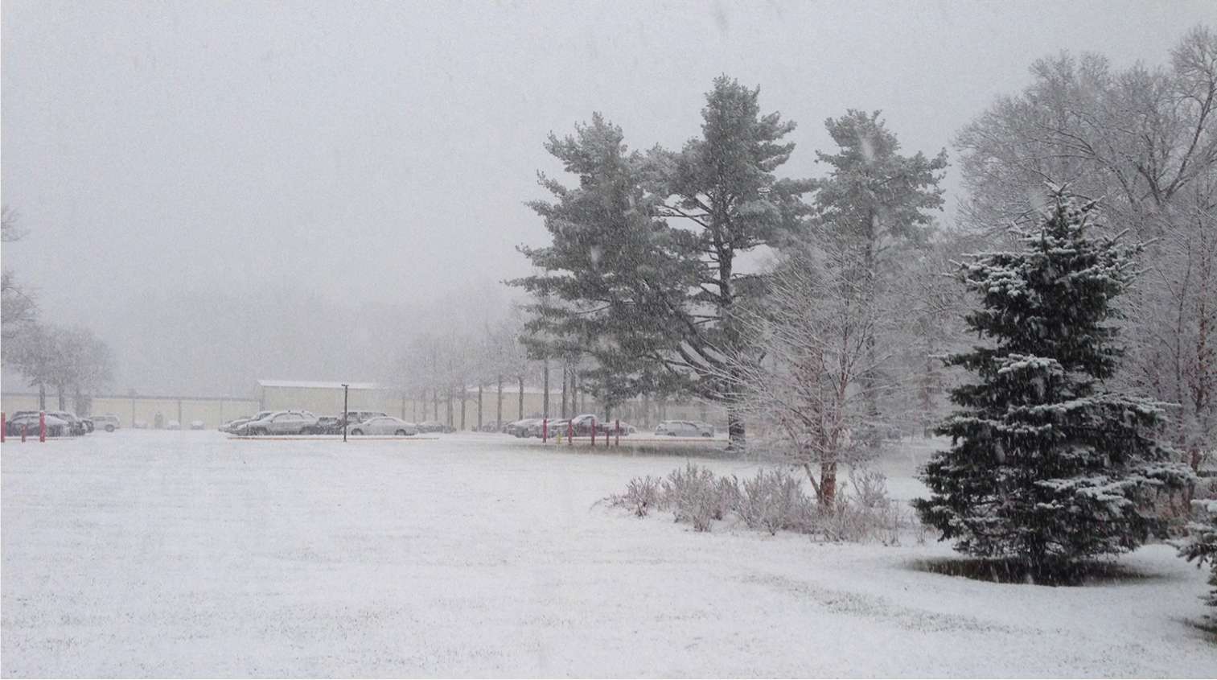
This Week @ PPPL
January 20-24, 2014
From the PPPL Office of Communications

Slide 2
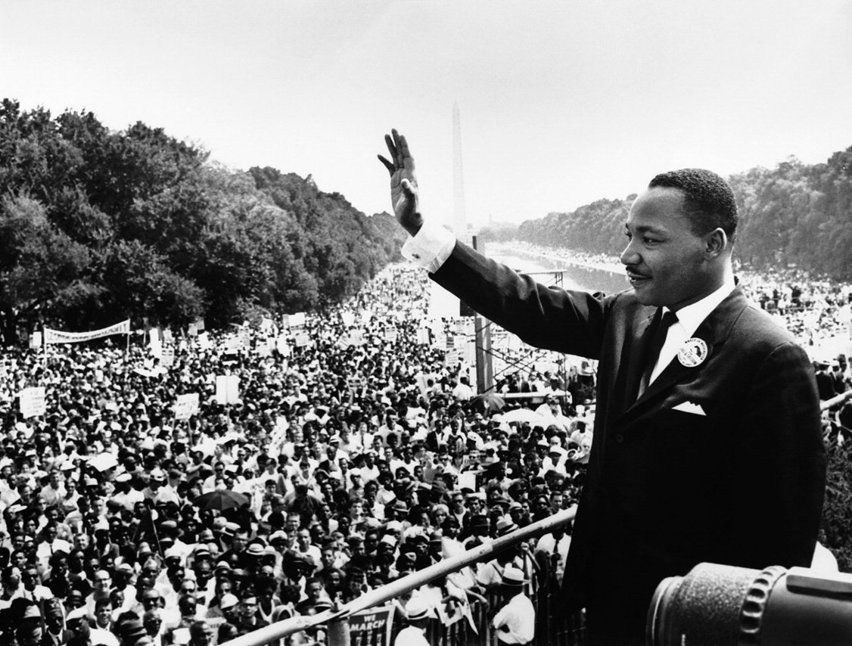
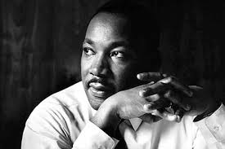
Martin Luther King Jr. Day of Service
January 20, 2014
“Life’s most persistent and urgent question is: What are you doing for others?”

Slide 3
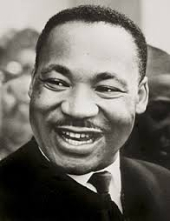
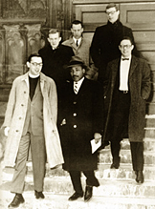

Princeton University’s King Day Celebration
Monday, Jan. 20 at 1:15
Alexander Hall, Richardson Auditorium, Princeton University
Omar Wasow, assistant professor of politics at Princeton University, keynote speaker.

Slide 4


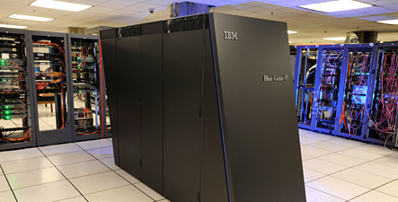
Addressing Big Data
Challenges in Simulation-based Science
Manish Prashar
Rutgers University
WEDNESDAY, JAN. 22
4:15 p.m. (Coffee/Tea at 4 p.m.) • M.B.G. Auditorium

Slide 5

PPPL Alternative Commuting Incentives
Mass Transit
University staff are eligible to receive a 50% monthly subsidy for taking mass transit.
There is a shuttle that runs between main campus and PPPL. Additionally, the lab is local to many bus/train stops.

Slide 6
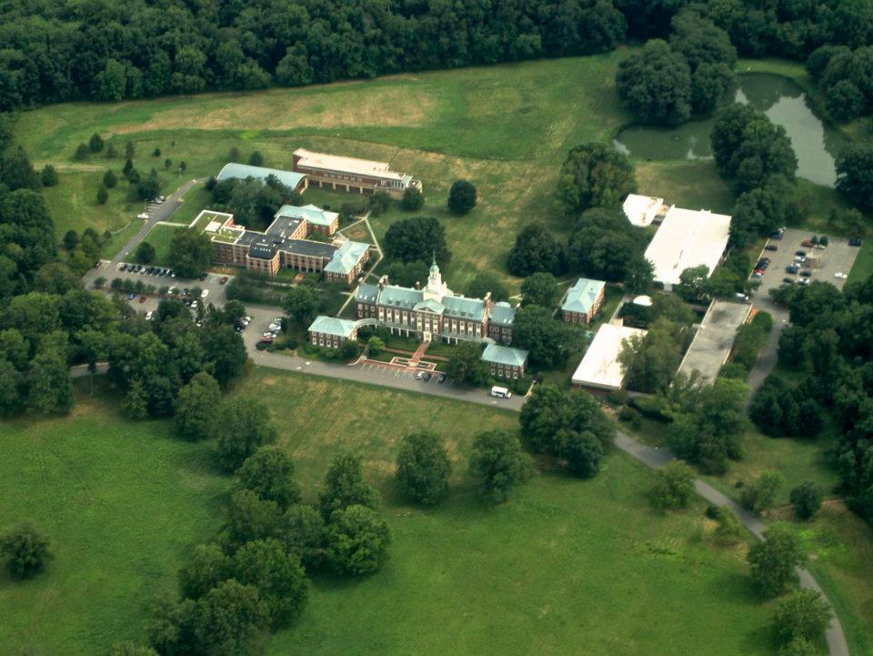
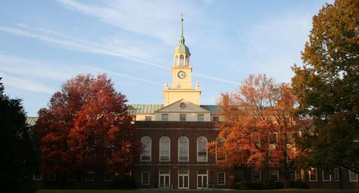
“The Usefulness of Useless Knowledge”: The History of the Institute for Advanced Study
Christine Di Bella
Institute For Advanced Study
Next week - WEDNESDAY, JAN. 29
4:15 p.m. (Coffee/Tea at 4 p.m.) • M.B.G. Auditorium

Slide 7

UPCOMING EVENTS
Monday, January 20
  Martin Luther King Day Celebration • 1:15 p.m. – Princeton University – Alexander Hall – Richardson Auditorium – Omar Wasow, assistant professor of politics, keynote speaker
Wednesday, January 22
  PPPL Colloquium • 4:15 p.m. – MBG Auditorium – “Addressing Big Data Challenges in Simulation-based Science”
Saturday, January 25
  Science on Saturday Lecture Series – 9:30 a.m. – MBG Auditorium – “The atmosphere as a laboratory: aerosols, air quality, and climate”
Sunday, January 26
  TEDx Conference - 10:30 a.m. – 2 p.m. – Princeton Charter School, 110 Bun Drive, Princeton - Andrew Zwicker on “Global Change: Clean Energy by Creating a Star on Earth”
Wednesday, January 29
  PPPL Colloquium • 4:15 p.m. – MBG Auditorium – “The Usefulness of Useless Knowledge”: The History of the Institute for Advanced Study

Slide 8

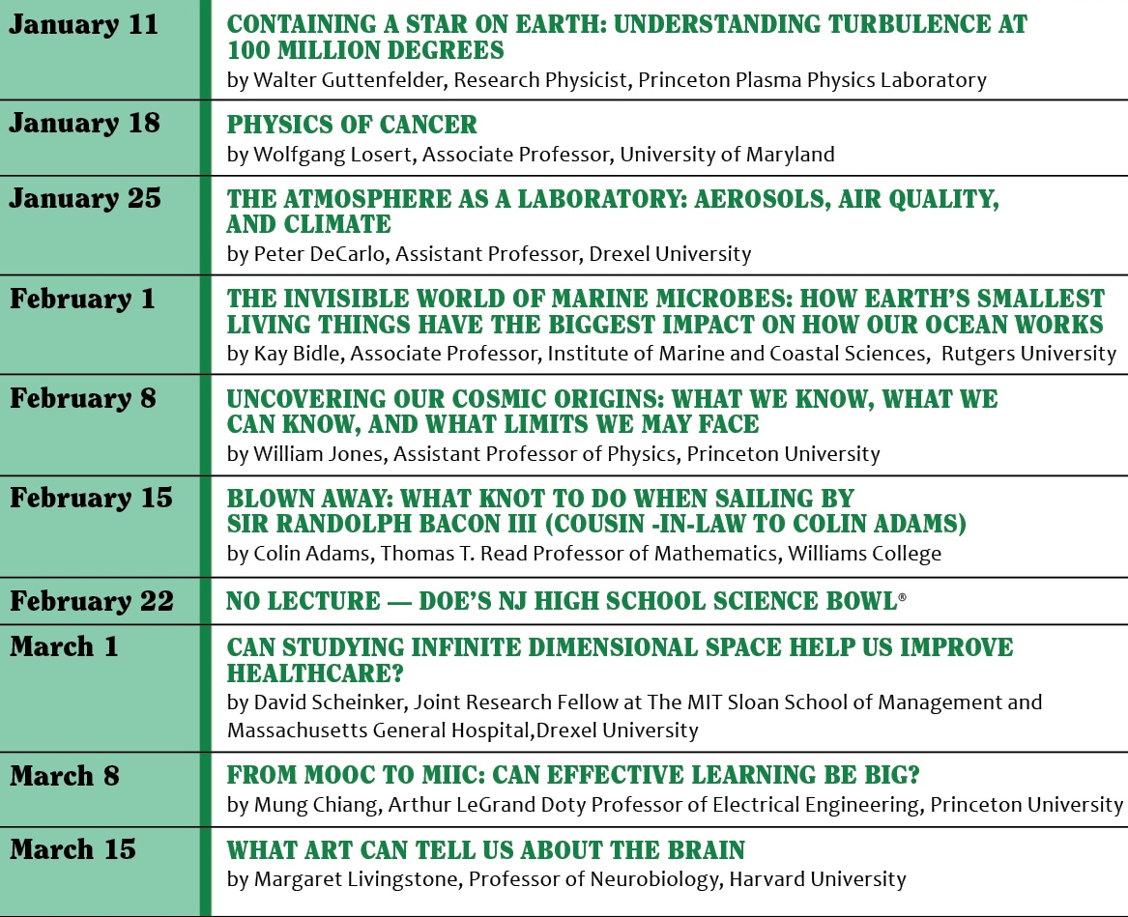

Slide 9
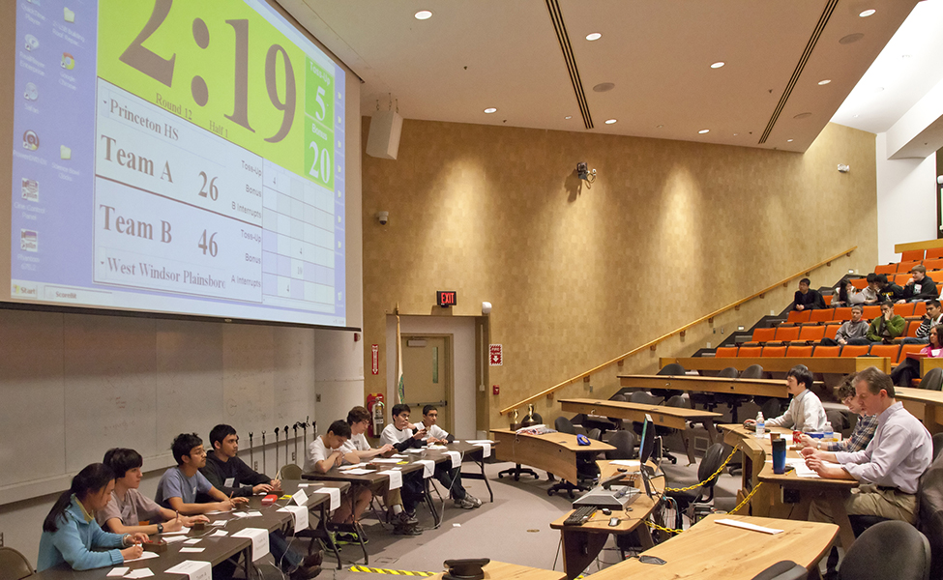
Science Bowl Volunteers Needed!
We need your help! Please volunteer to help out as moderators, science/rules judges, time/score keepers, lunch attendants, etc. Lunch is provided for competition day volunteers. Contact Deedee Ortiz at dortiz@pppl.gov or ext.2758 to sign up or for more information.

Slide 10

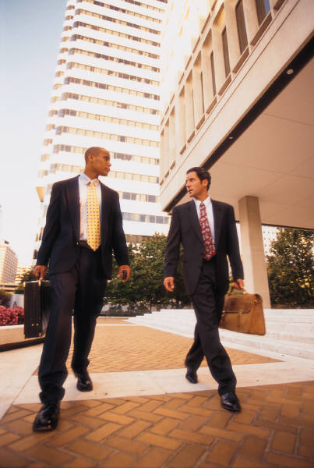
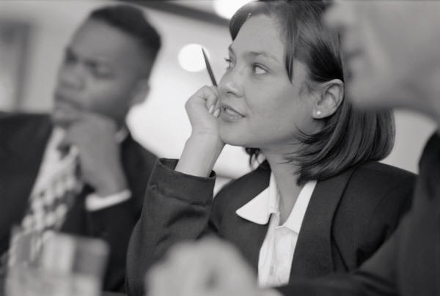
Princeton University and PPPL’s Annual
Business Clothing Drive
Please donate gently used business attire for men and women. The clothes will be distributed by several Mercer County organizations. PPPL is also collecting used eyeglasses, as well as unwanted stuffed toys to create dog toys. The drop off location is Room A116 between 8 a.m. and 9 a.m. and 12:30 p.m. and 1:30 p.m. from Jan. 22 – Jan. 29.

Slide 11
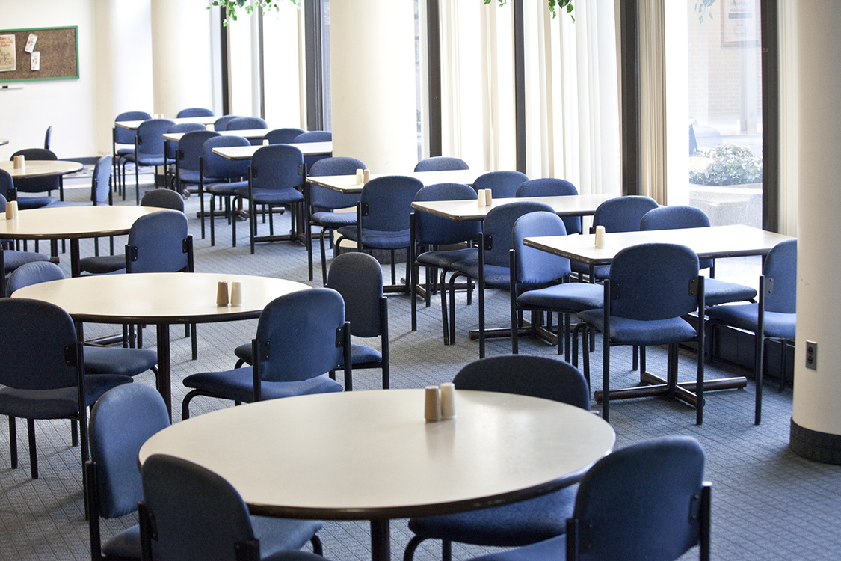
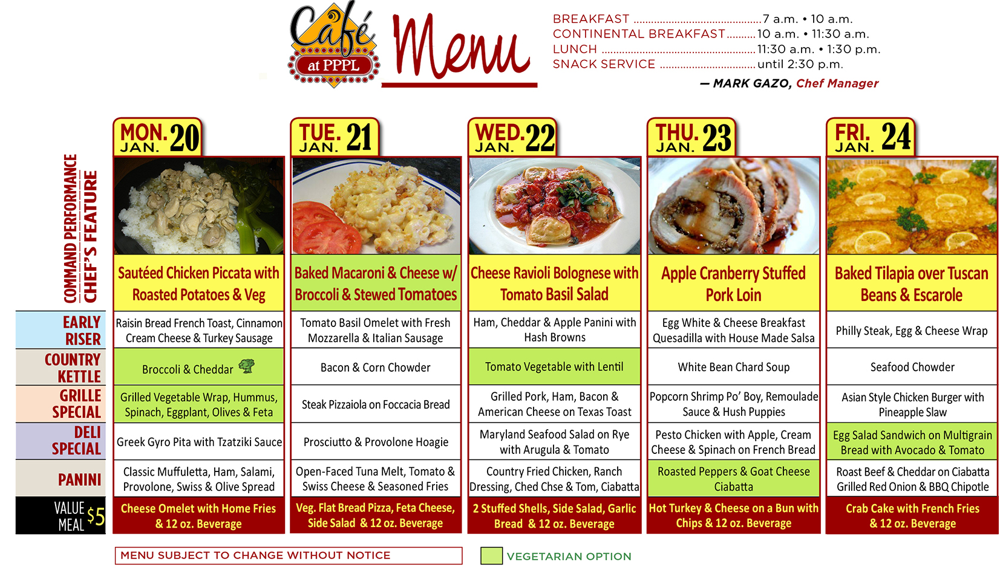
Menu subject to change without notice.

