Slide 1
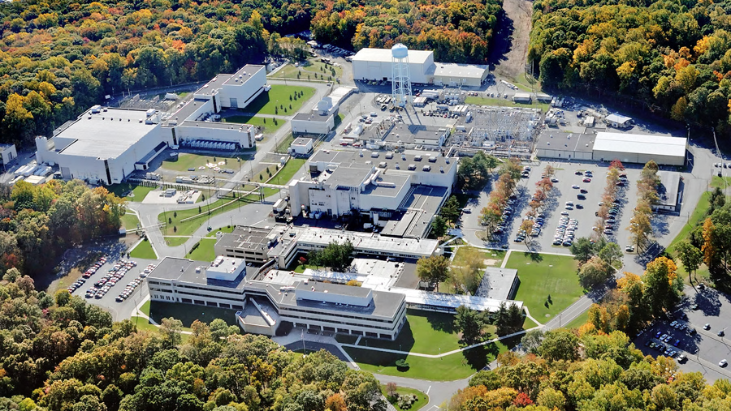
This Week @ PPPL
January 21-26, 2013
From the PPPL Office of Communications

Slide 2

Martin Luther King Jr. Day
Jan. 21

Slide 3
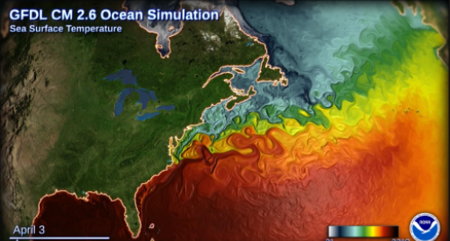
Ensemble modeling of climate-carbon cycle interactions
John Krasting
Geophysical Fluid Dynamics Laboratory
WeDNESDAY, JANUARY 23
4:15 p.m. (Coffee/Tea at 4 p.m.) • M.B.G. Auditorium, Lyman Spitzer Building

Slide 4
^{Look for the}
Safety Culture Survey in your email box
^{THIS WEEK.}
^{Look for the}
Safety Culture Survey in your email box
^{THIS WEEK.}

Slide 5
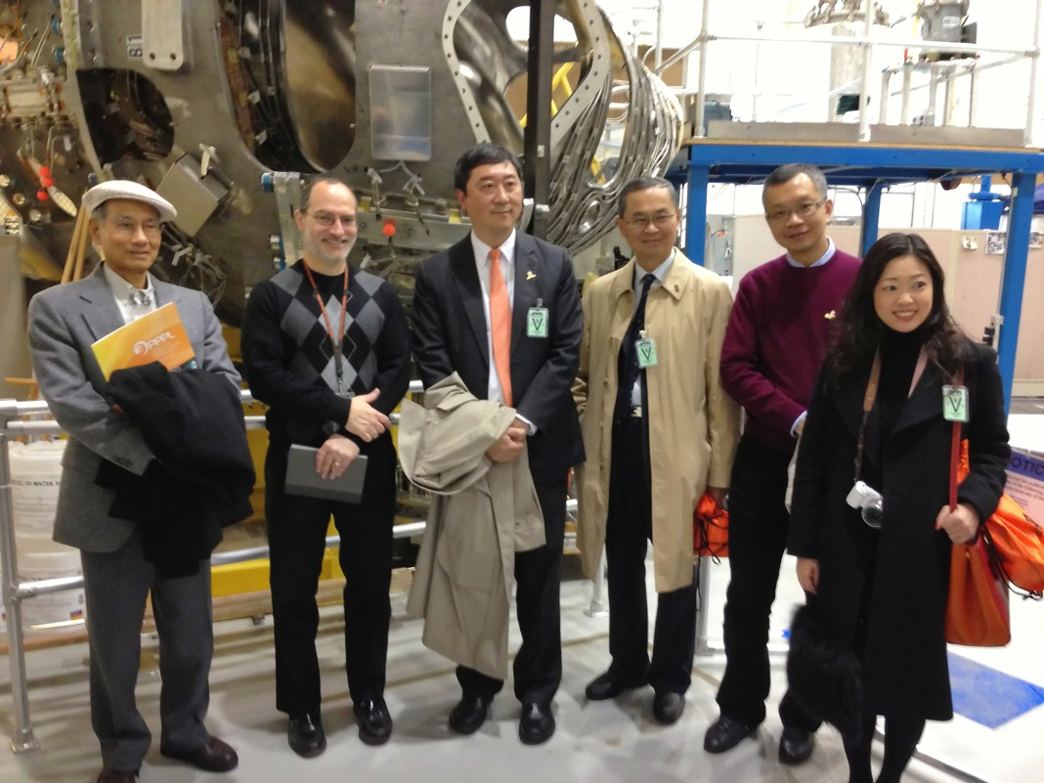

A delegation from the Chinese University of Hong Kong visited PPPL.

Slide 6


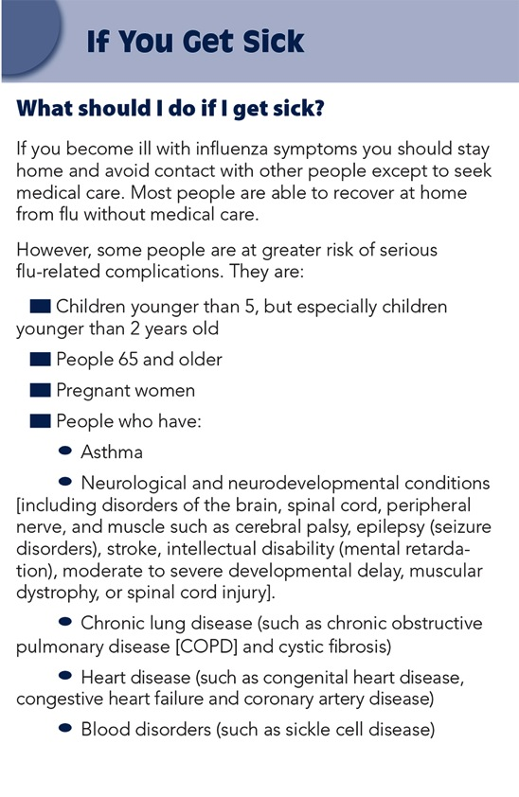

Slide 7

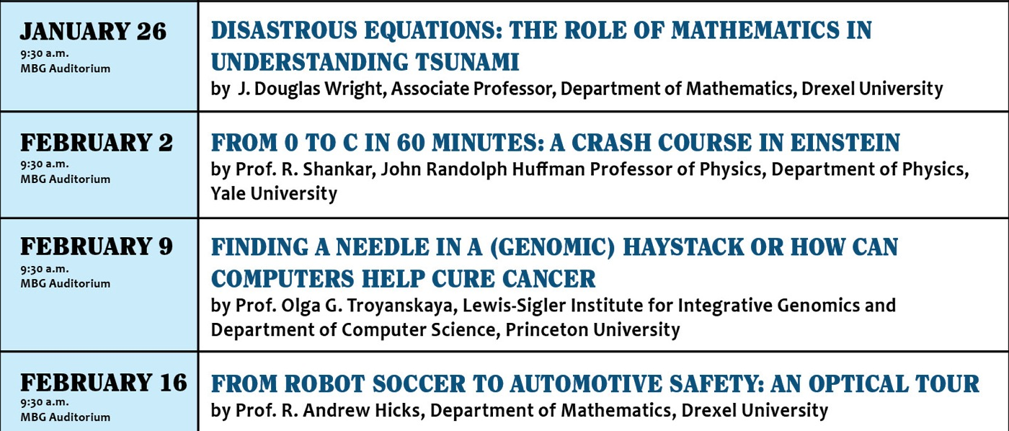

Slide 8



Slide 9


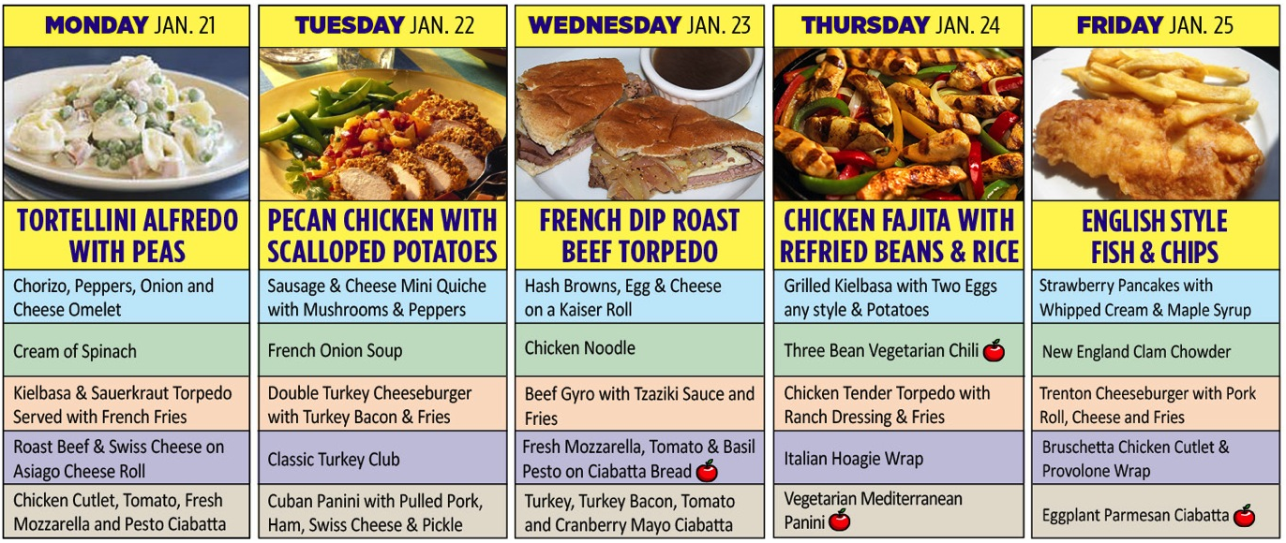
Menu subject to change without notice.

