Slide 1
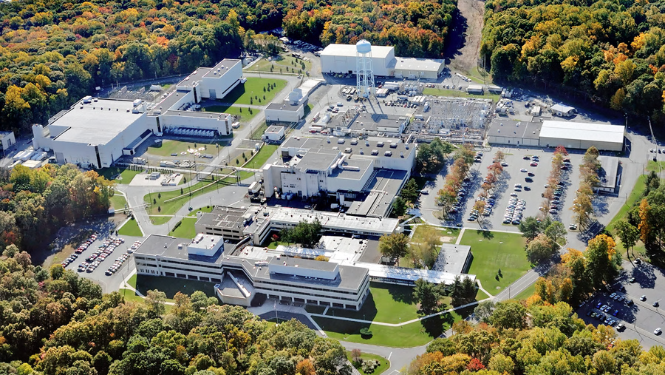
This Week @ PPPL
February 4 - 9, 2013
From the PPPL Office of Communications

Slide 2
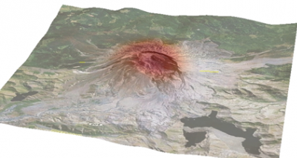
Seismic Imaging and Inversion Based on Spectral-Element AND
Adjoint Methods
Jeroen Tromp
Princeton University
WeDNESDAY, FEB. 6
4:15 p.m. (Coffee/Tea at 4 p.m.) • M.B.G. Auditorium, Lyman Spitzer Building

Slide 3
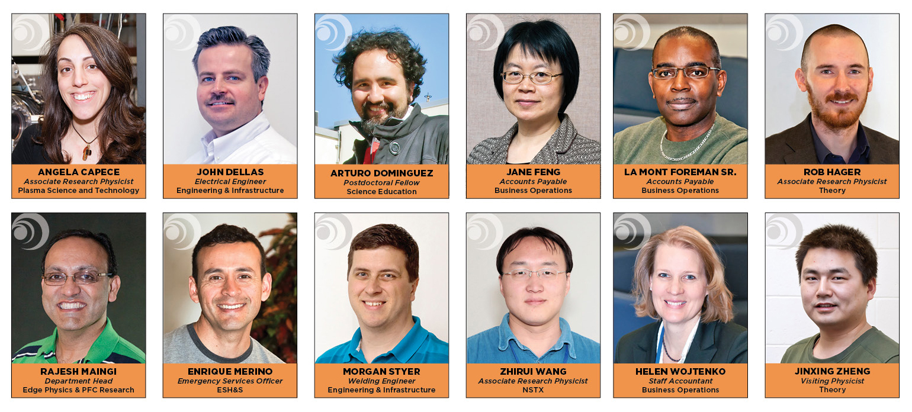

Welcome PPPL New Hires

Slide 4


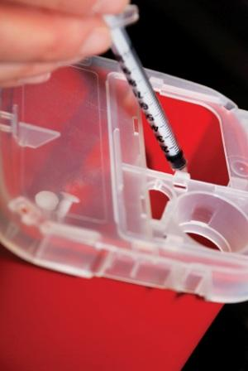
Did you know?
Lancets and needles
are SHARPS.
Sharps do not belong
in a waste receptacle.
Call 3200 if you have a question about disposal.

Slide 5


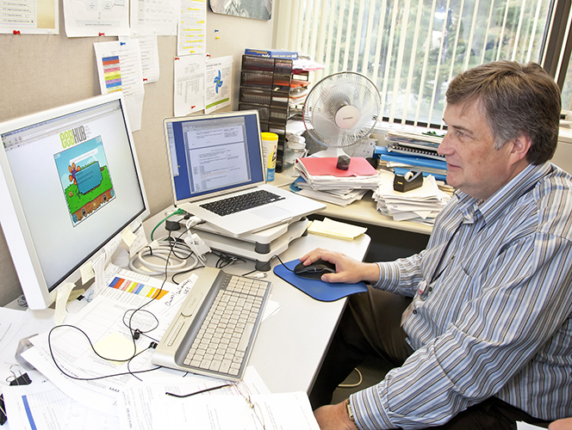
Energy Chickens game makes saving energy fun at PPPL

Slide 6
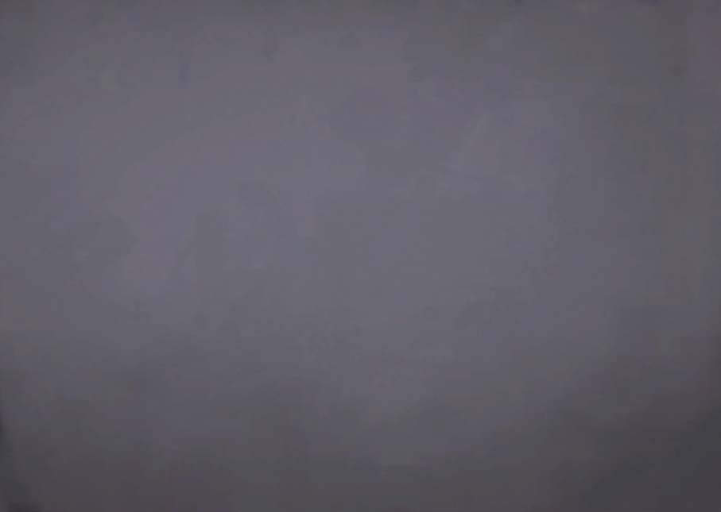


Slide 7



Slide 8



Menu subject to change without notice.

