Slide 1
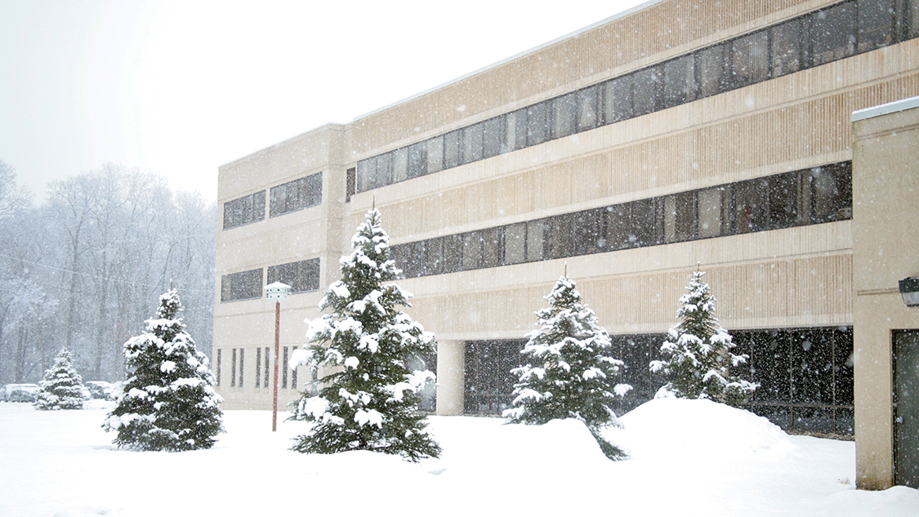
This Week @ PPPL
February 11-16, 2013
From the PPPL Office of Communications

Slide 2
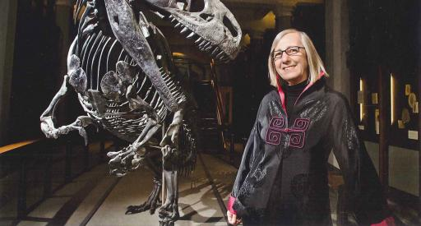
Volcanism, Impacts and Mass Extinctions:
Causes and Effects
Gerta Keller
Princeton University
WeDNESDAY, FEB. 13
4:15 p.m. (Coffee/Tea at 4 p.m.) • M.B.G. Auditorium, Lyman Spitzer Building

Slide 3


Slide 5
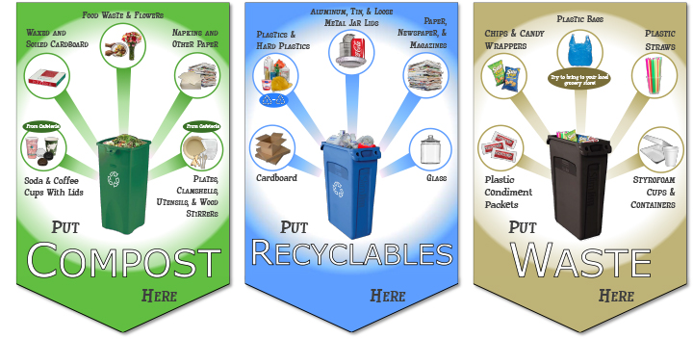
PLEASE REMEMBER TO:
Notes:
WEEK #1

Slide 6
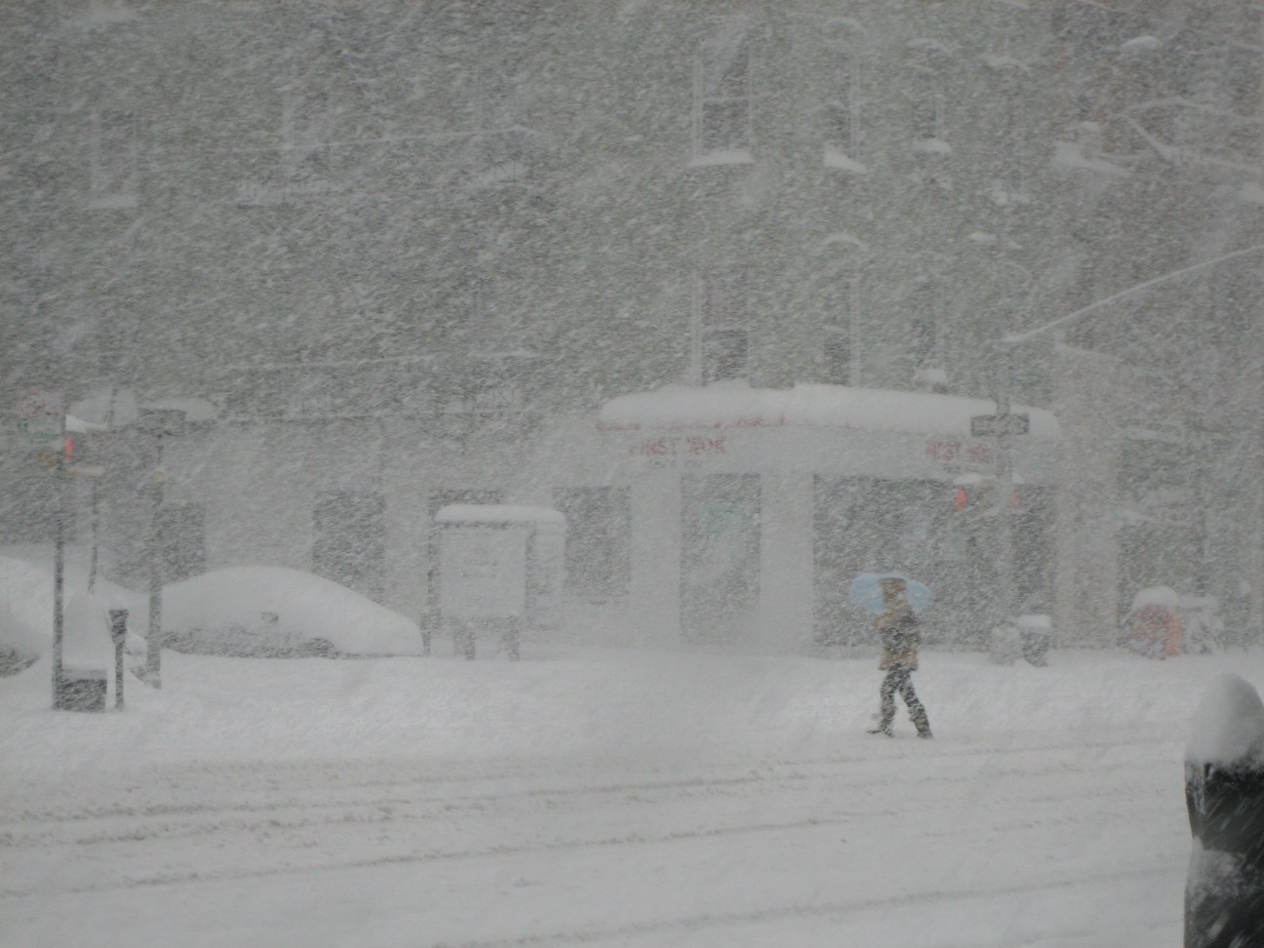
Weather Emergency Notifications
For weather emergencies, the status of PPPL may differ from that of Princeton University. Employees should not conclude that the Princeton University PTENS announcement is applicable to the Lab. The Laboratory will make the appropriate determination, considering our circumstances, as soon as possible.
Employees should always check and follow the PPPL PTENS notifications, the Lab Telephone Hotline (609-243-2034) or the Lab Status Web Page (emergency.pppl.gov). For an evolving weather situation that might impact the Lab opening, we try to update the Laboratory status by 5:45 AM.
In all cases when there are weather emergencies, employees must use their best judgment to determine their own safety when traveling to and from work. Notify your supervisor as soon as possible if you cannot or choose not to report to work. Employees should be sure to get their supervisor's contact information.
All staff are reminded to keep PTENS information up to date. You may review your contact information on the University Human Resources Self-Service web-site: www.princeton.edu/selfservice. If you do not have a University Net ID and wish to be included in PTENS announcements, please provide your contact information to Dolores Stevenson (dstevens@pppl.gov).

Slide 7

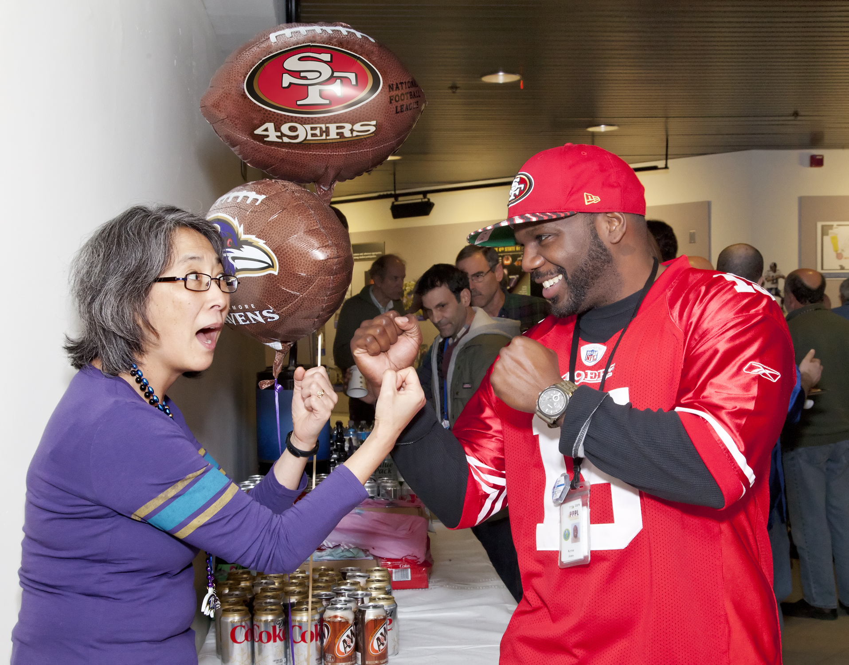
Super Bowl Party at PPPL

Slide 8
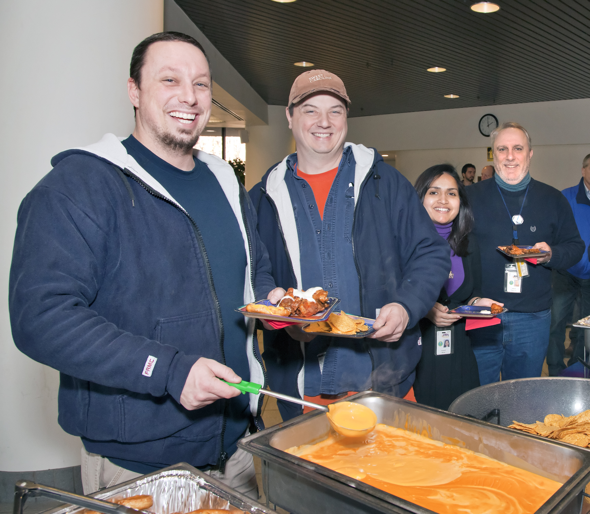
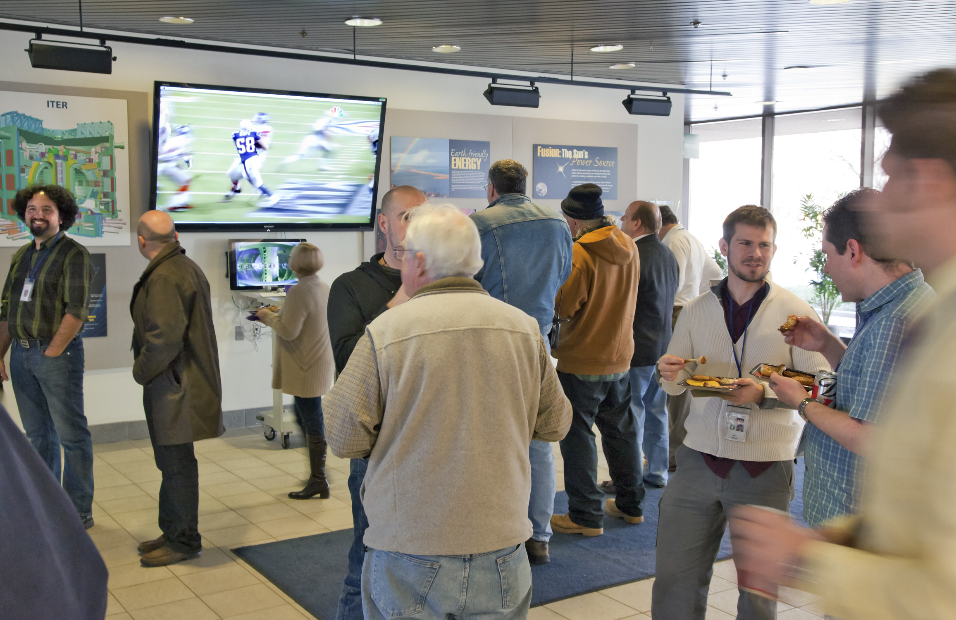

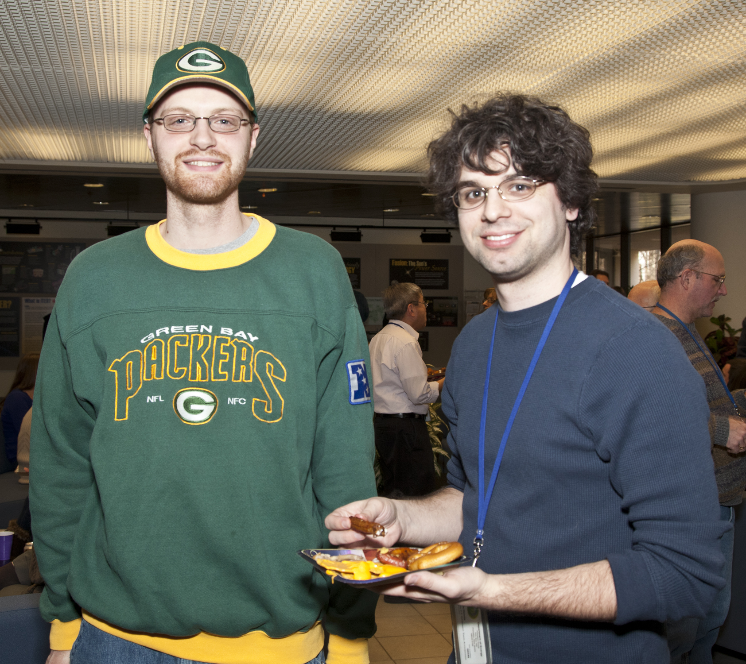
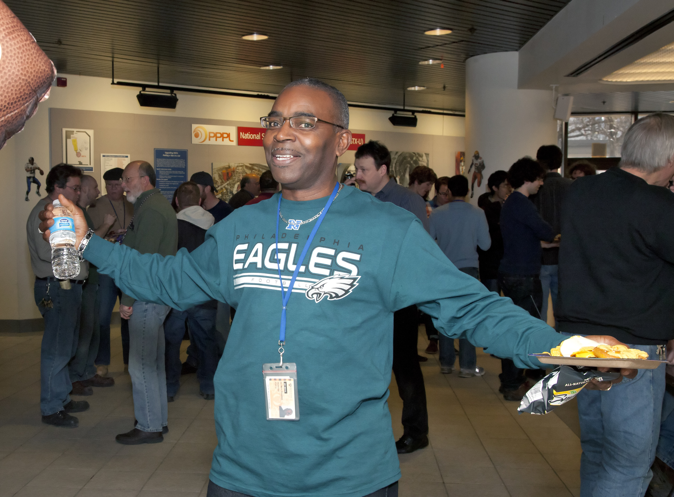
Super Bowl Party at PPPL

Slide 9
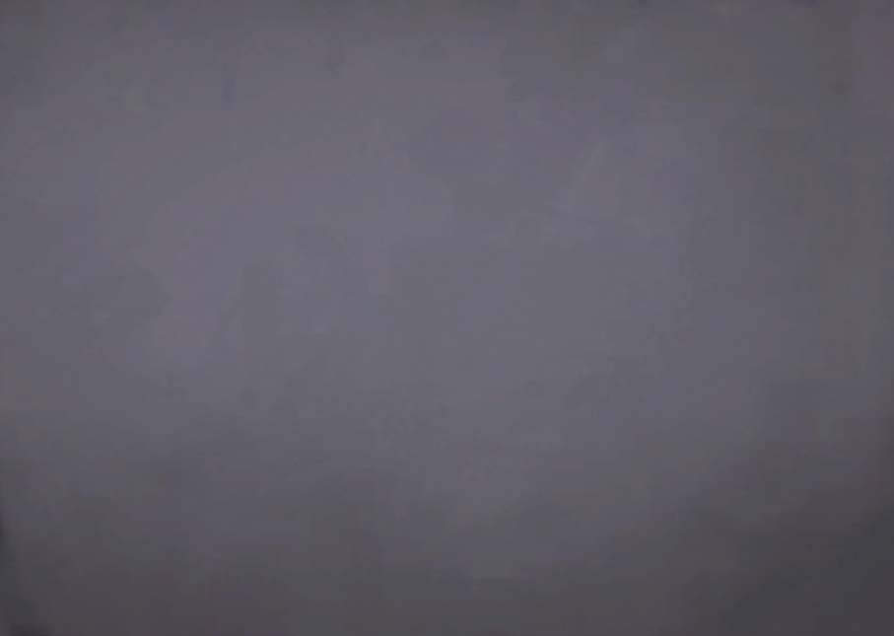
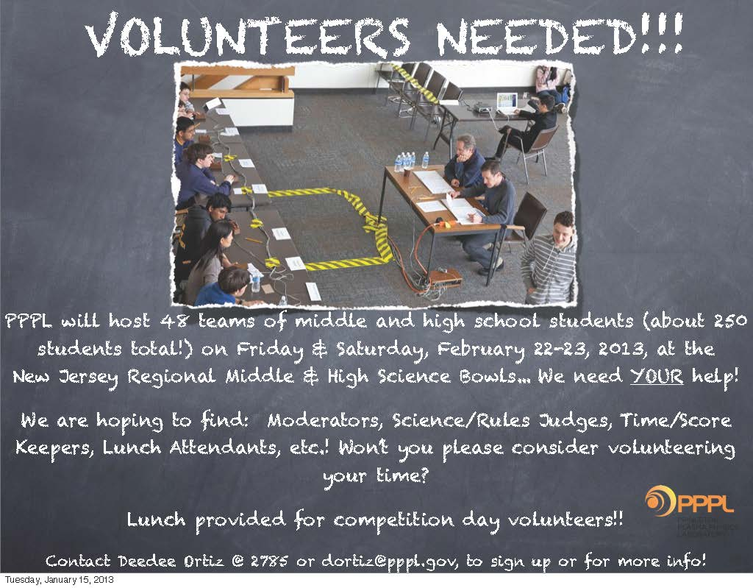

Slide 10



Slide 11
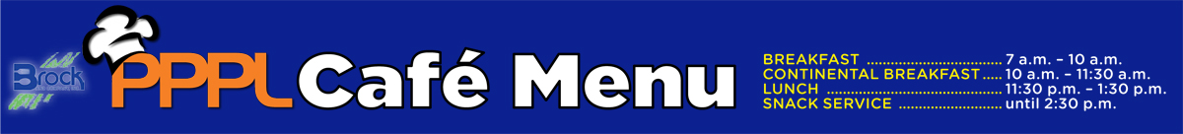

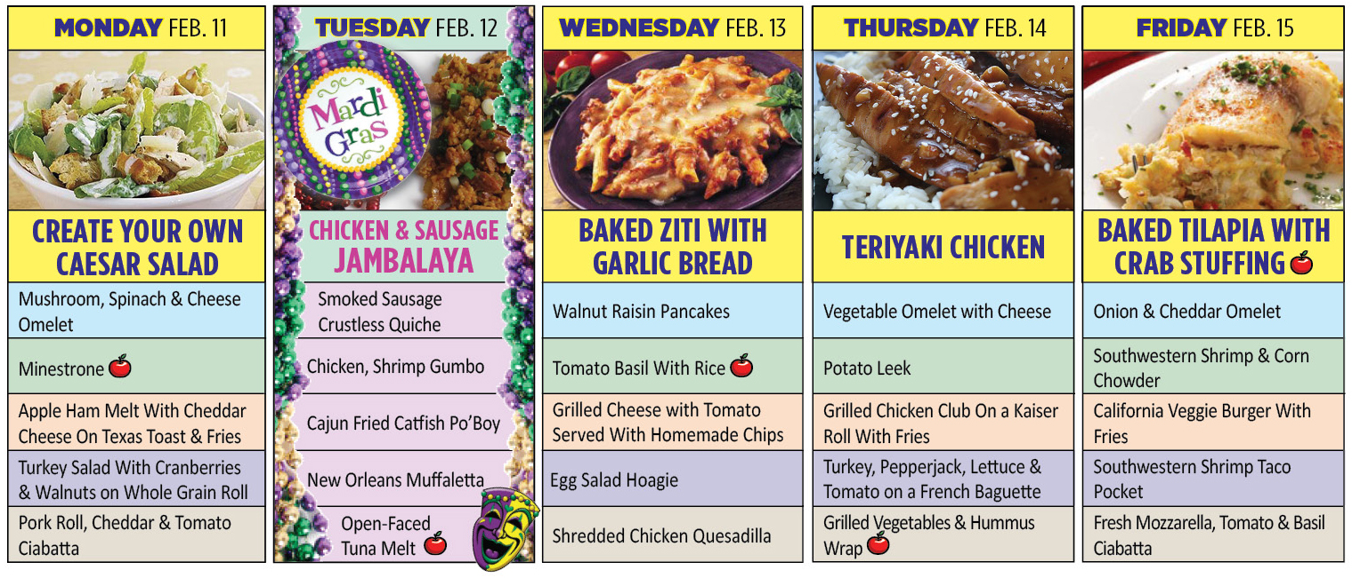
Menu subject to change without notice.

