Slide 1
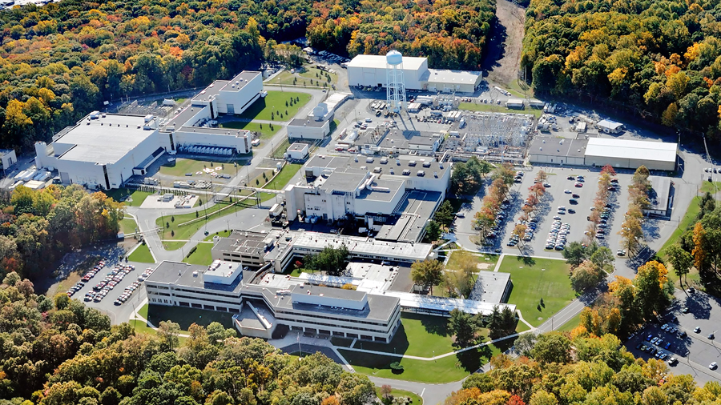
This Week @ PPPL
Feb. 25 - Mar. 2, 2013
From the PPPL Office of Communications

Slide 2
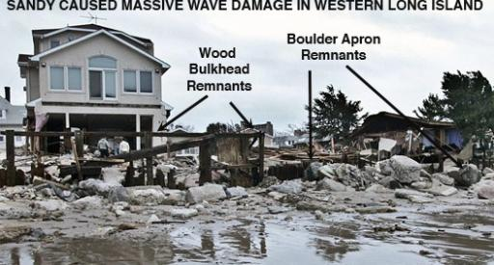
Unique Vulnerability of the NY/NJ Metro Region to Hurricane Destruction - A New Perspective Based on Recent Research on Irene 2011 and Sandy 2012
Nicholas K. Coch
University of New Hampshire
THURSDAY, FEB. 28*Note Special Date
4:15 p.m. (Coffee/Tea at 4 p.m.) • M.B.G. Auditorium, Lyman Spitzer Building

Slide 3




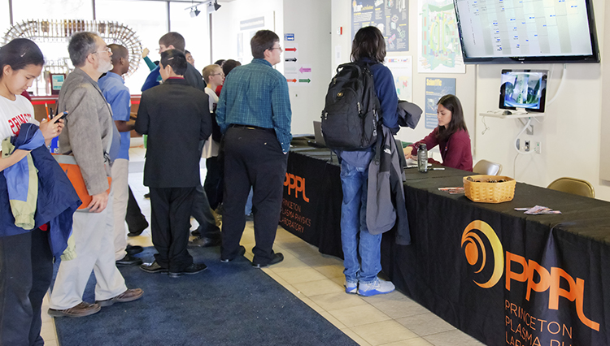
DOE’s NJ Middle School Science Bowl® at PPPL

Slide 4
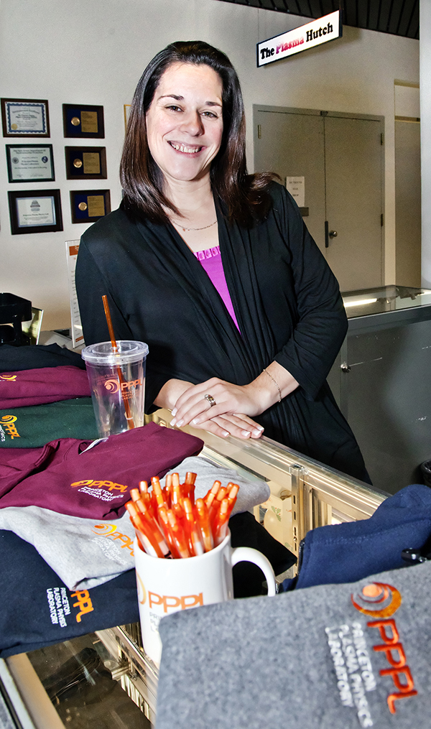
The Plasma Hutch is open on Fridays from 11:30 a.m. to noon.
You can also pick up an order form or download one from the HR website at hr.pppl.gov and send it via email to Kim at kmastrom@pppl.gov.

Slide 5
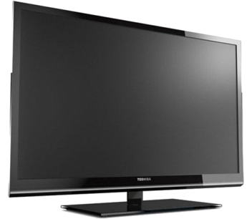
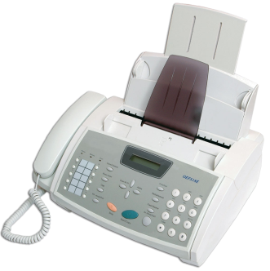
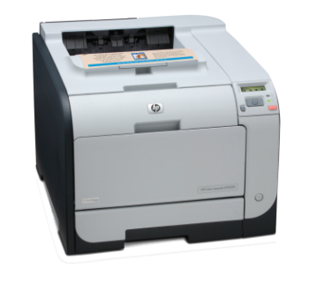
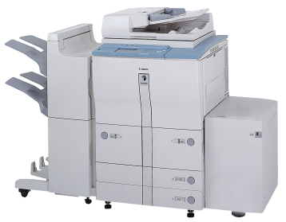

Buying any of these?
Make sure to purchase EPEAT rated Televisions and Imaging Equipment
The following items must be EPEAT certified:
TVs
Printers
Faxes
Copiers
Multi-Function Devices
New regulations appended to Executive Orders 13514 & 1342
For further information please visit: http://www.epeat.net/ or contact Mark Hughes at x2296

Slide 6


Slide 7



Slide 8
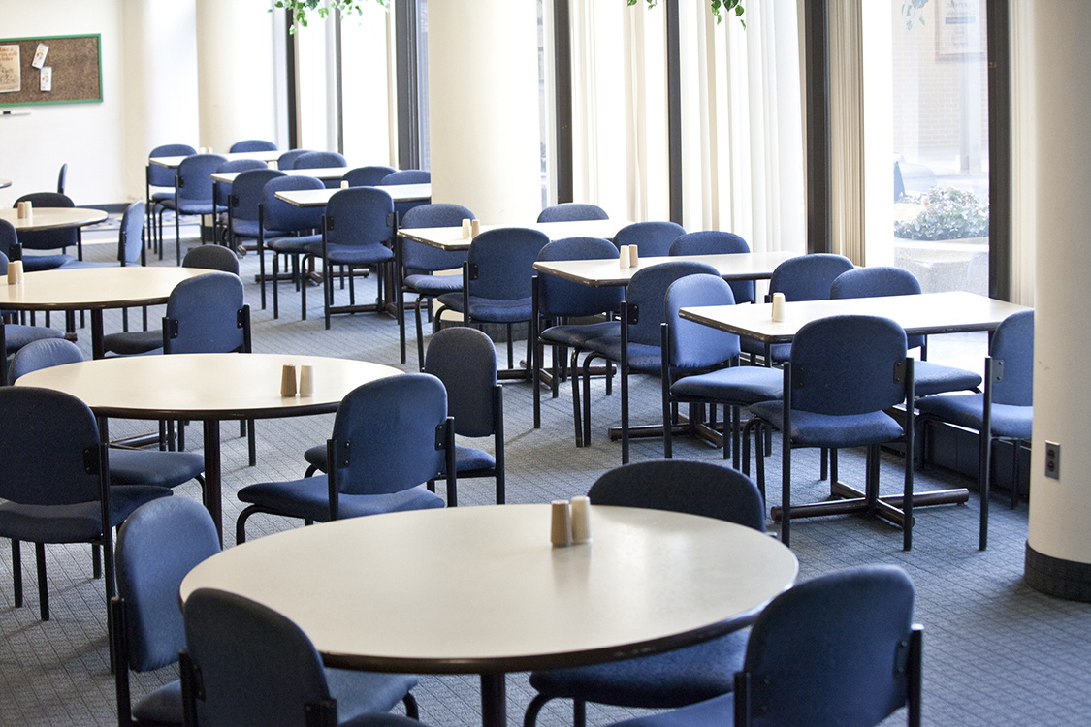

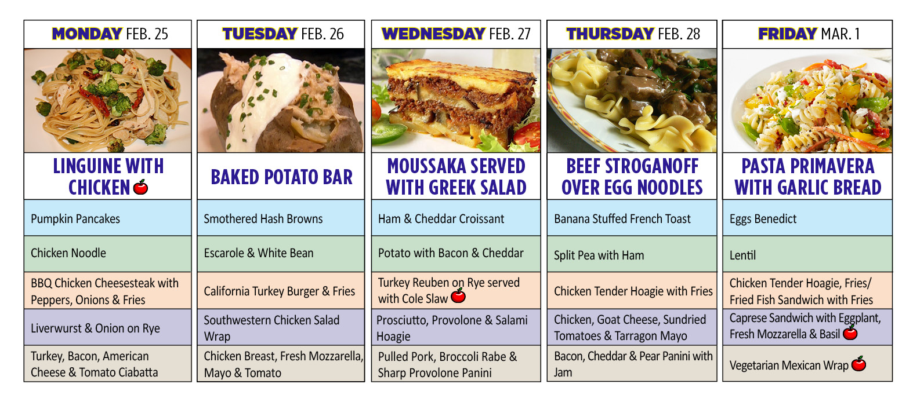

Menu subject to change without notice.

