Slide 1

This Week @ PPPL
March 3-8, 2014
From the PPPL Office of Communications

Slide 2


Risks of Nuclear Weapons Use in an Era of Proliferation, Cyber Warfare and Terrorism
Bruce Blair
PRINCETON UNIVERSITY
WEDNESDAY, MARCH 5
4:15 p.m. (Coffee/Tea at 4 p.m.) • M.B.G. Auditorium

Slide 3


UPCOMING EVENTS
Wednesday, March 5
  PPPL Colloquium • 4:15 p.m. – MBG Auditorium – Risks of Nuclear Weapons Use in an Era of Proliferation, Cyber Warfare and Terrorism
Saturday, March 8
  Science on Saturday • 9:30 a.m. – MBG Auditorium – From MOOC to MIIC: Can Effective Learning Be Big?
Wednesday, March 12
  PPPL Colloquium • 4:15 p.m. – MBG Auditorium – Fluid Dynamics
Saturday, March 15
  Science on Saturday • 9:30 a.m. – MBG Auditorium – What Art Can Tell Us About the Brain
Wednesday, March 19
  American Red Cross Blood Drive • 8 a.m. to 1 p.m. – Lower Parking Lot
Wednesday, March 21
  Young Women’s Conference – Princeton University – Volunteers needed

Slide 4


Slide 5
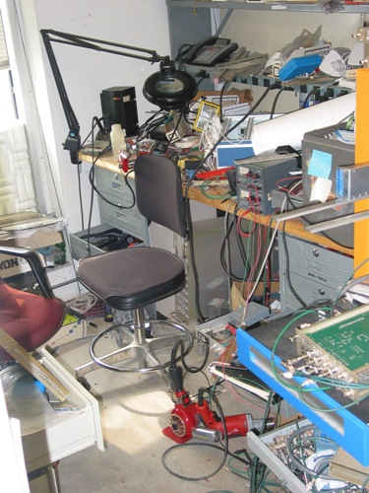

Slide 6
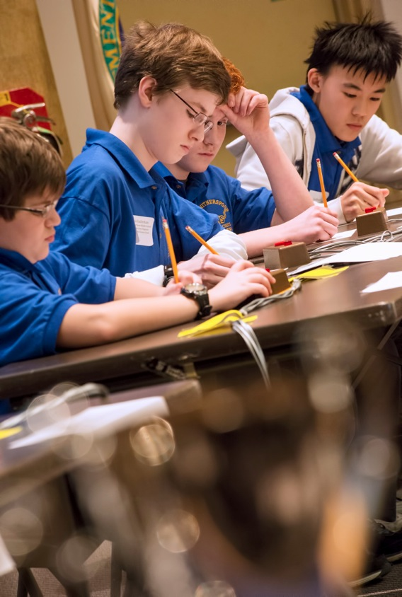
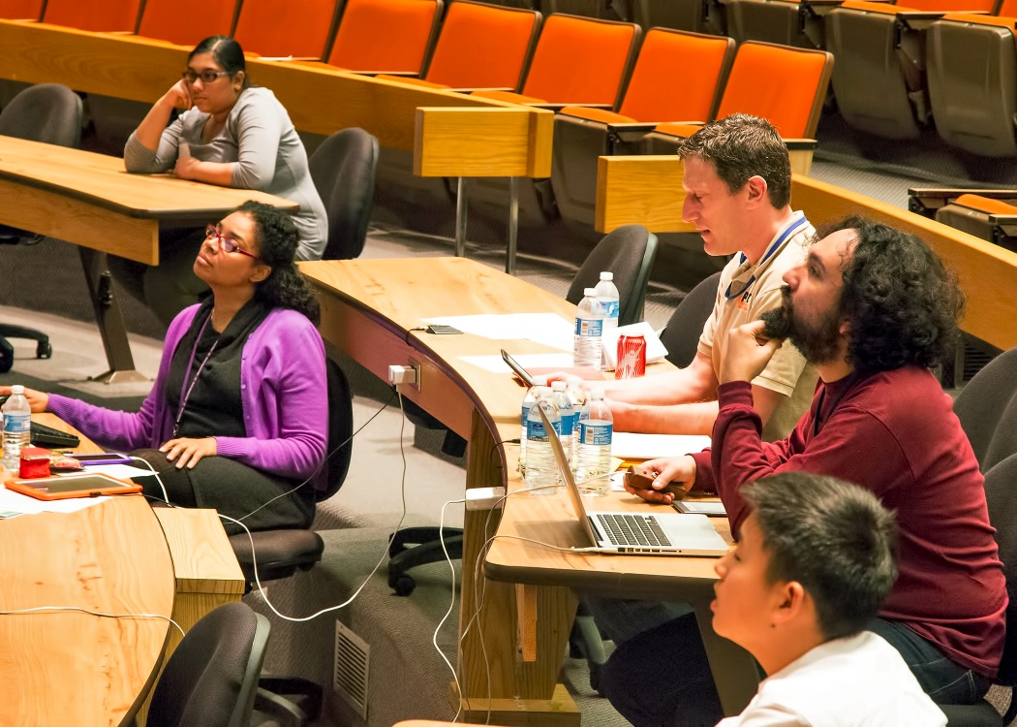
DOE N.J. Regional Science Bowl at PPPL

Slide 7
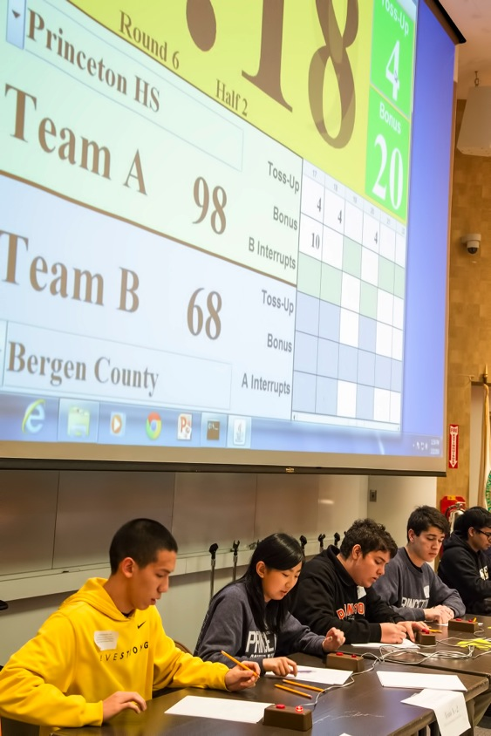
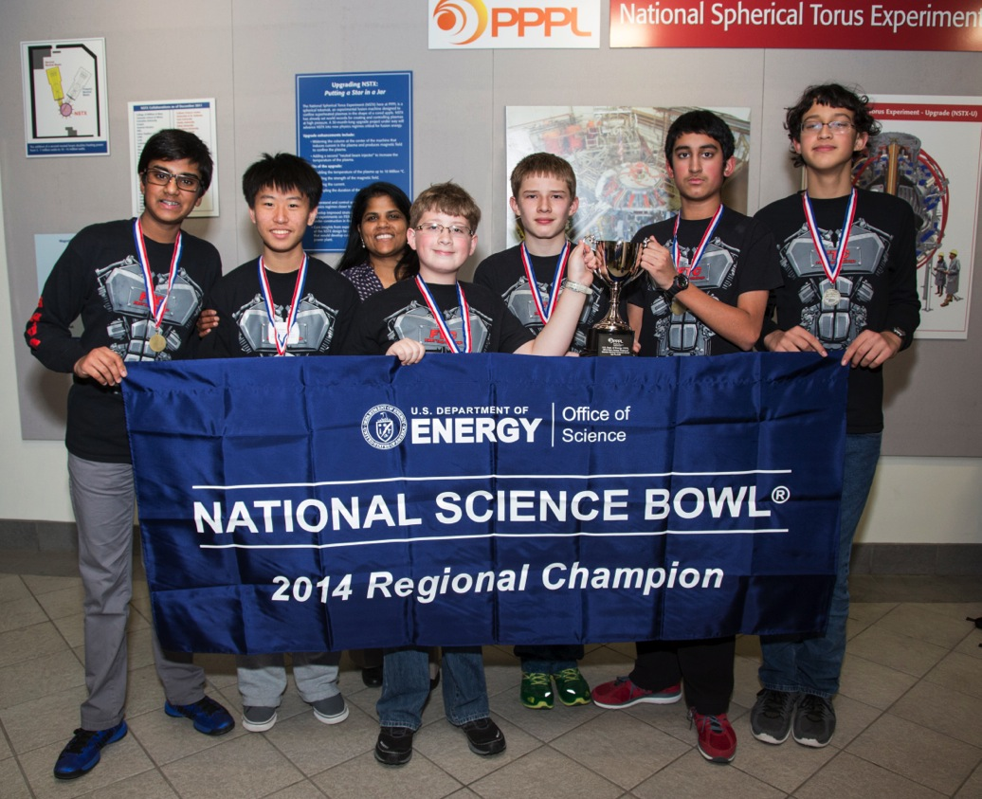
DOE N.J. Regional Science Bowl at PPPL

Slide 8
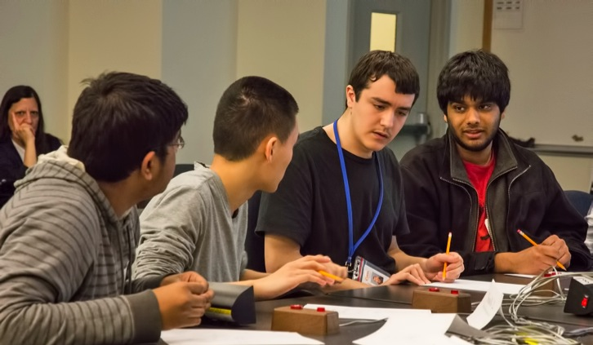
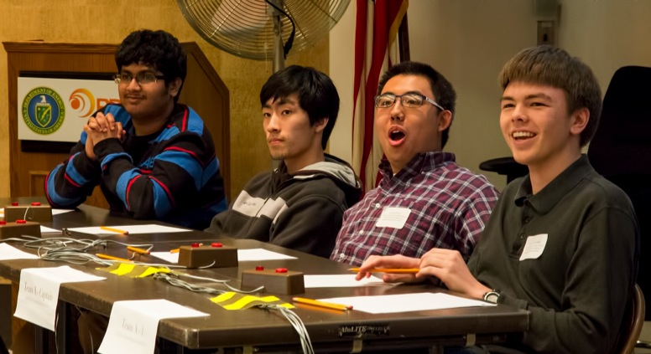
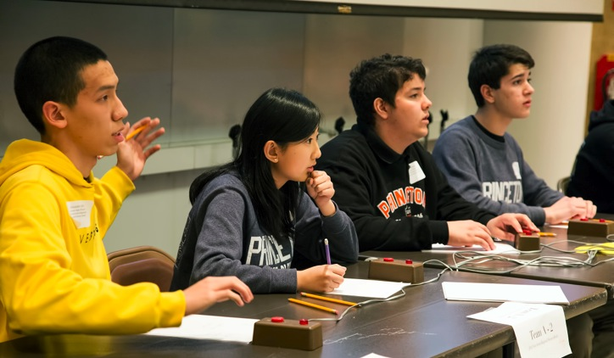
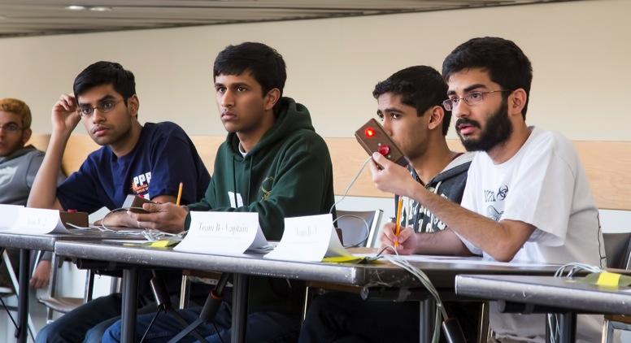
DOE N.J. Regional Science Bowl at PPPL

Slide 9



Slide 10



Slide 11

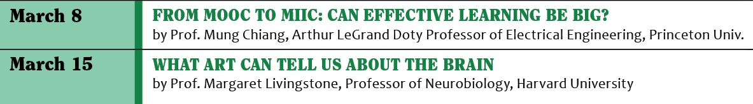

Slide 12
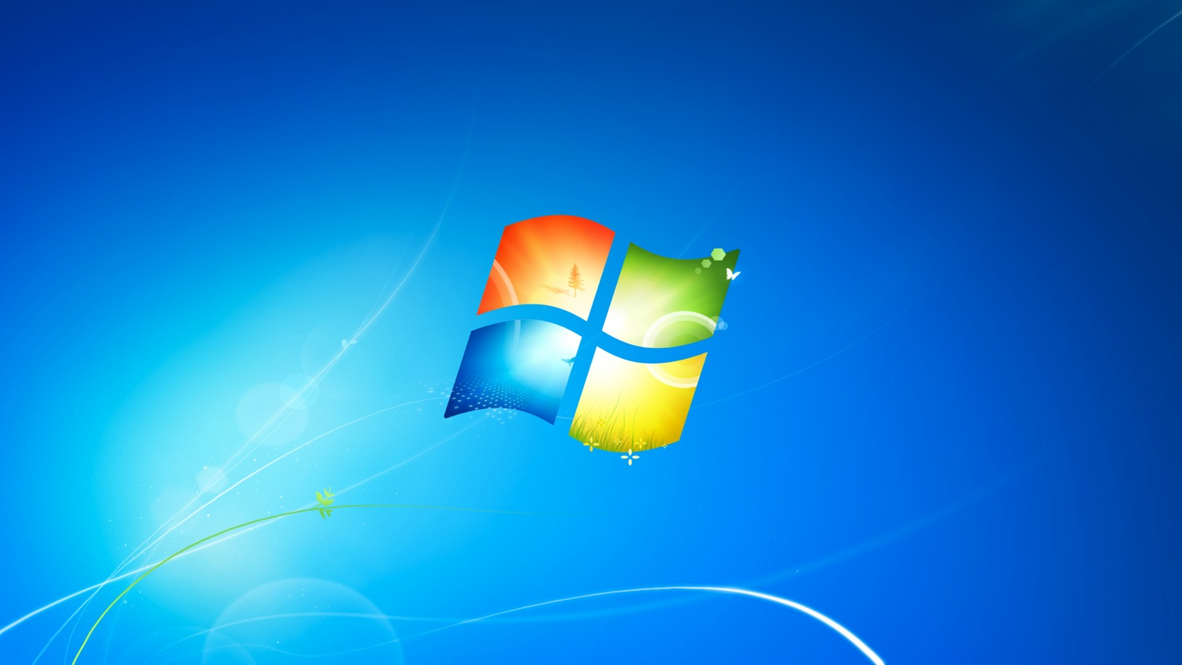
Windows® XP computers are being upgraded to Windows® 7.
After April 8, Windows XP will no longer be supported by PPPL (there will be loss of network connectivity.)
Loss of network connectivity will occur on April 8th.
To ensure there is no loss of network connectivity, users should schedule their updates no later than Friday, March 21st.
To schedule an update, please contact the helpdesk at x2275 or email helpdesk@pppl.gov.

Slide 13

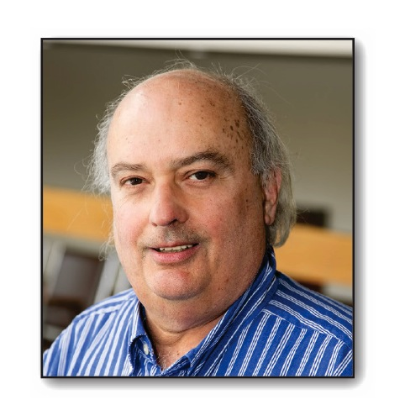
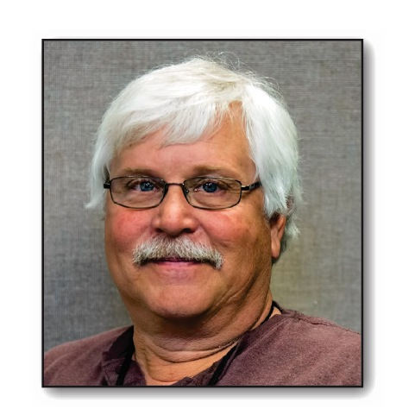

PPPL bids a fond farewell to the following employees who retired as of March 1.

Slide 14
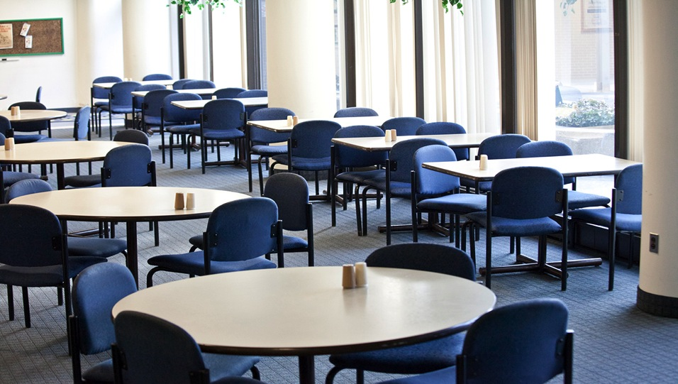

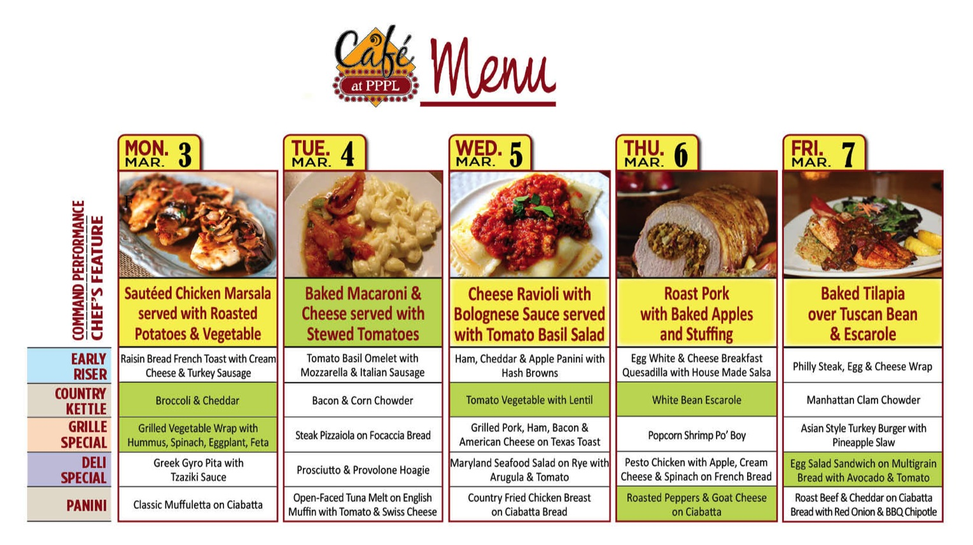
Menu subject to change without notice.

