Slide 1
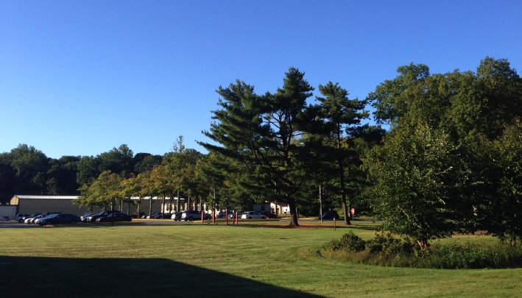
This Week @ PPPL
March 24-28, 2014
Brought to you by the PPPL Office of Communications

Slide 2
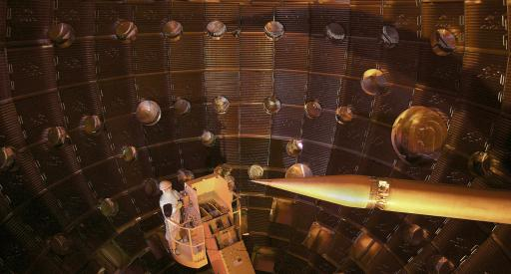

In Pursuit of Ignition on the National Ignition Facility
M. John Edwards
Lawrence Livermore National Laboratory
WEDNESDAY, MARCH 26
3:15 p.m. (Coffee/Tea at 3 p.m.) • M.B.G. Auditorium

Slide 3
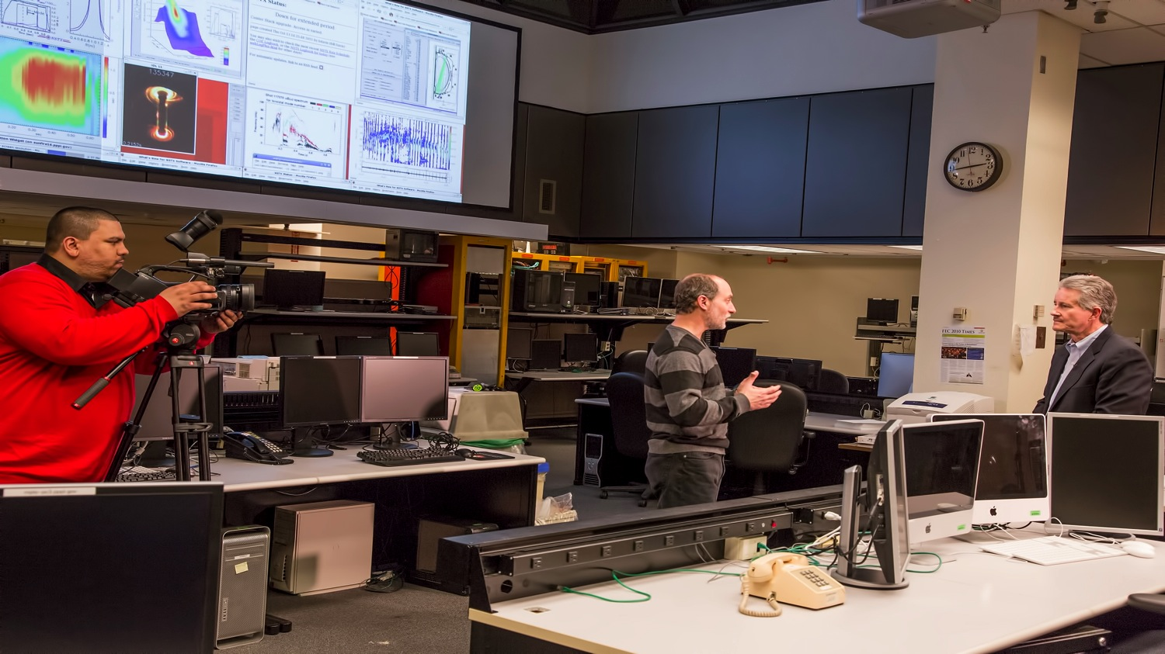
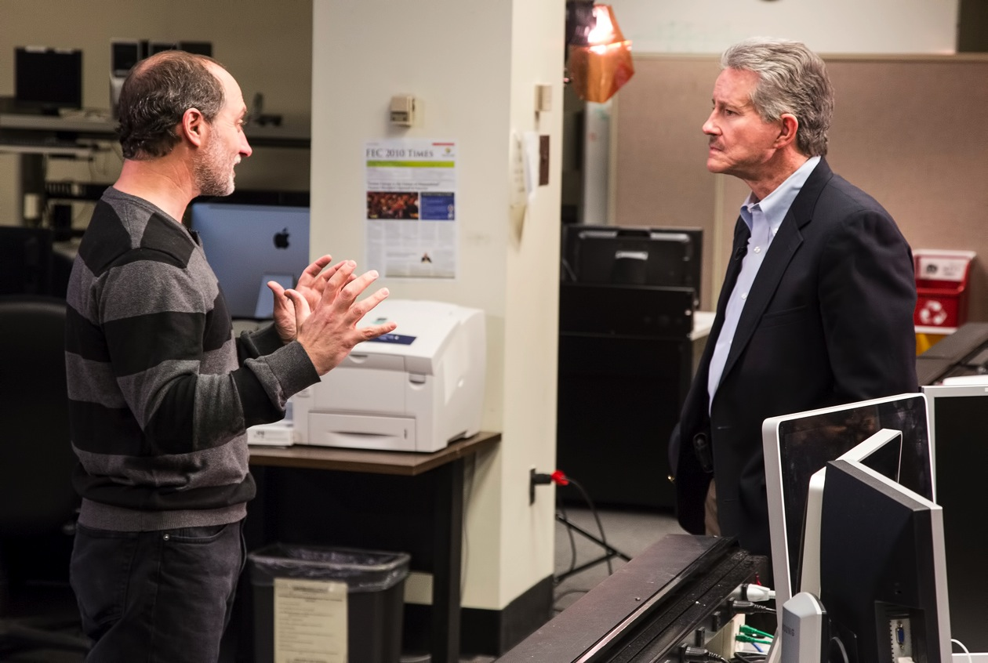
Correspondent Max Gomez, right, of CUNY-TV interviewed
Adam Cohen for a video about renewable energy that is
scheduled to air on Earth Day.

Slide 4


UPCOMING EVENTS
Tuesday, March 25
  Suspect and Counterfeit Parts Awareness Training – 1:30 p.m. – ROOM B-318
Wednesday, March 26
  Suspect and Counterfeit Parts Awareness Training – 8:30 a.m. – ROOM B-318
Wednesday, March 26
  PPPL Colloquium • 3 pm. – MBG Auditorium – In Pursuit of Ignition on the N.I.F.
Wednesday, April 2
  PPPL Colloquium • 4:15 pm. – MBG Auditorium – The Brain
Friday, April 4
  PPPL Service Awards – 9:30 a.m. – MBG Auditorium
Wednesday, April 23
  PPPL Celebrates Earth Day – Guest Speakers, Displays, Activities, Green Machine Awards
Sunday, April 27
  Annual Communiversity Festival – 1 to 6 p.m. – Downtown Princeton – Featuring PPPL Displays

Slide 5
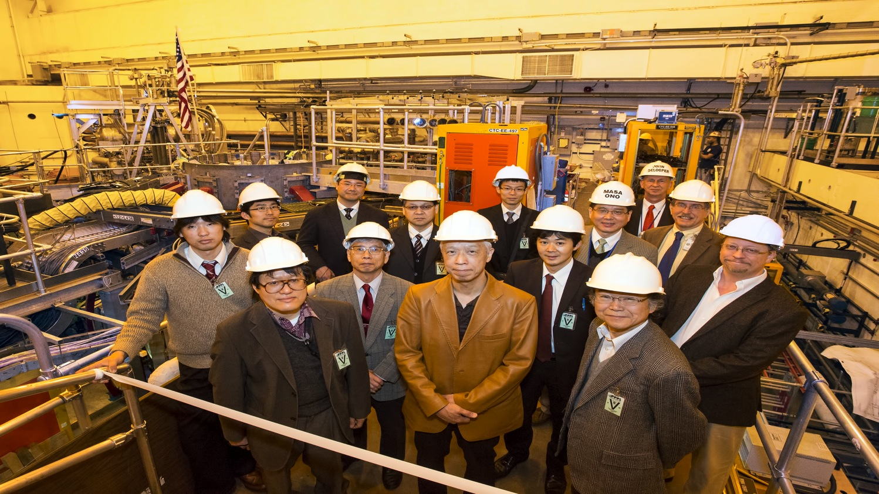
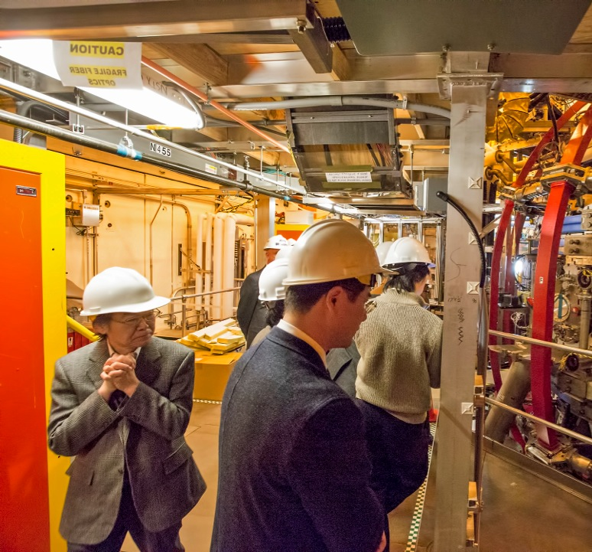
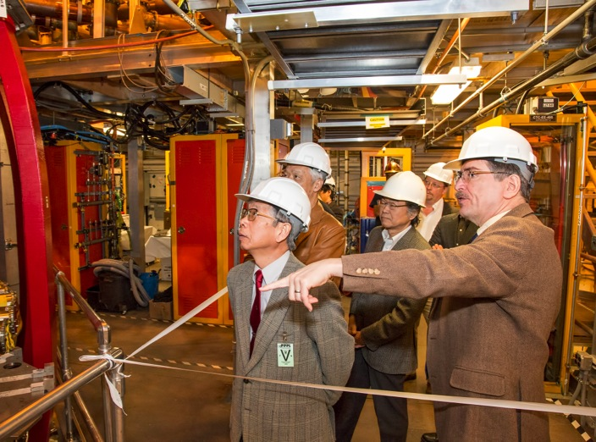
Members of the National Institute for Fusion Science in Japan visited PPPL

Slide 6

Windows® XP computers are being upgraded to Windows® 7.
After April 8, Windows XP will no longer be supported by PPPL (there will be loss of network connectivity.)
Loss of network connectivity will occur on April 8th.
To schedule an update, please contact the helpdesk at x2275 or email helpdesk@pppl.gov.

Slide 7
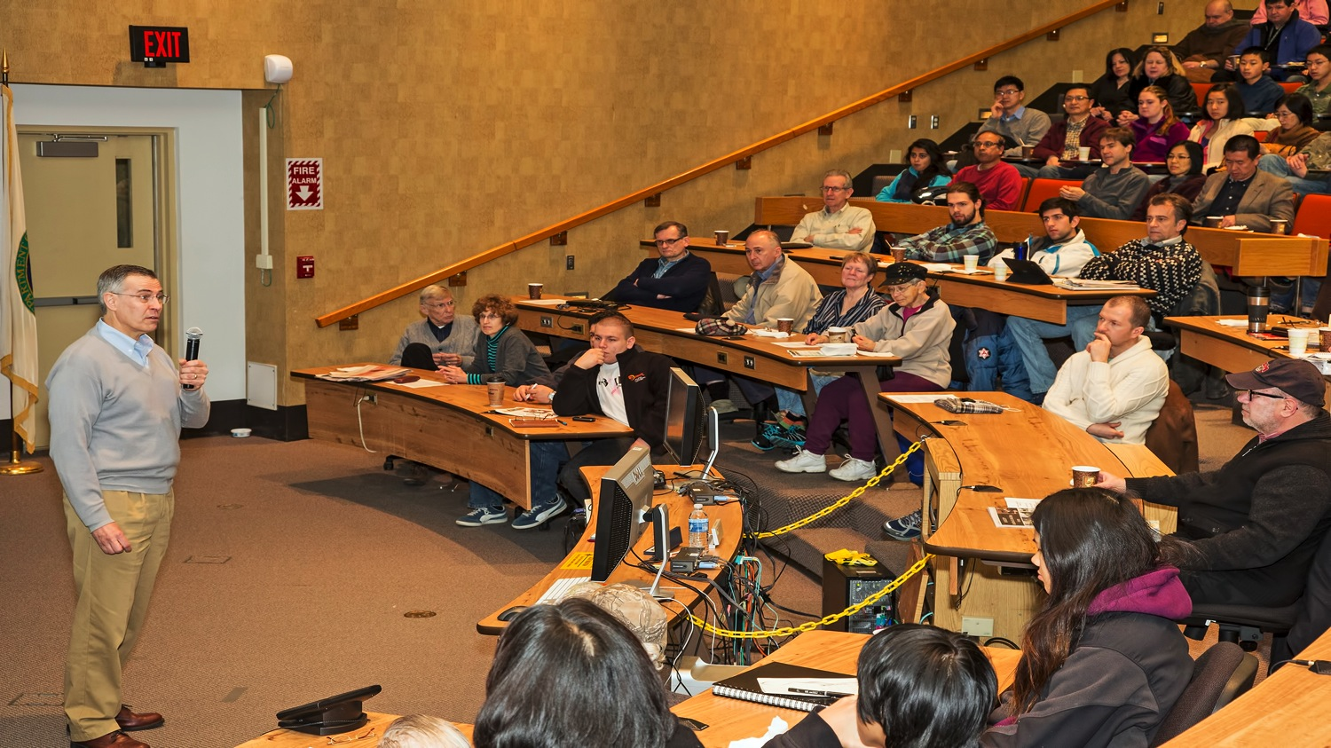
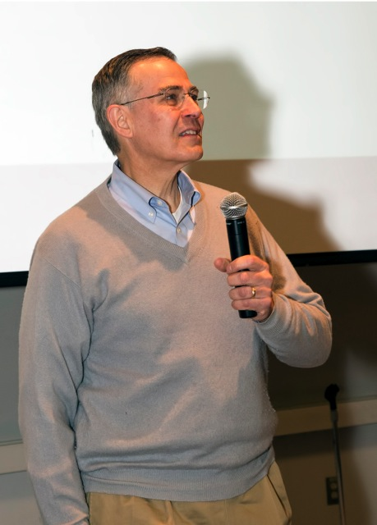
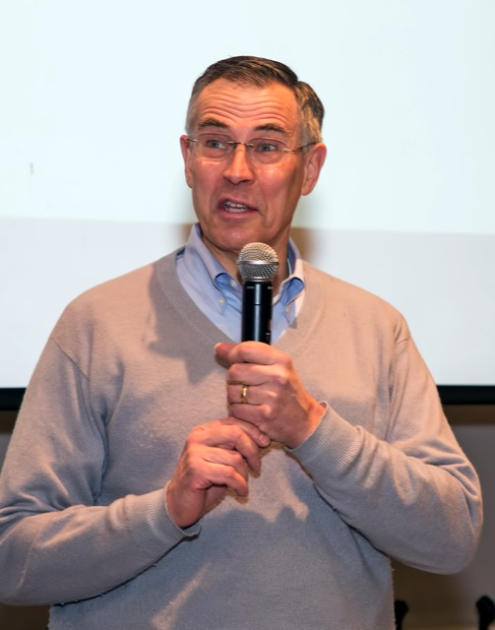
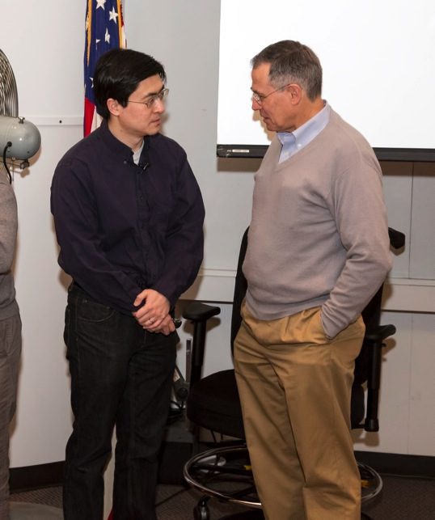
Rep. Rush Holt visits Science on Saturday at PPPL

Slide 8

Suspect & Counterfeit Parts
Awareness Training
presented by Roger Moerman and simulcast from Oak Ridge
Two sessions:
Tuesday, March 25, 1:30 p.m. – 5 p.m.
Wednesday, March 26, 8:30 a.m. – Noon
Room B-318 (note room change)
Note that this training is required every 3 years for anyone involved in
ordering, receiving, or installing hardware or electrical items.
Contact Frank Malinowski at ext. 2203 or
fmalinow@pppl.gov by March 21 to register for one of the sessions

Slide 9


Slide 10
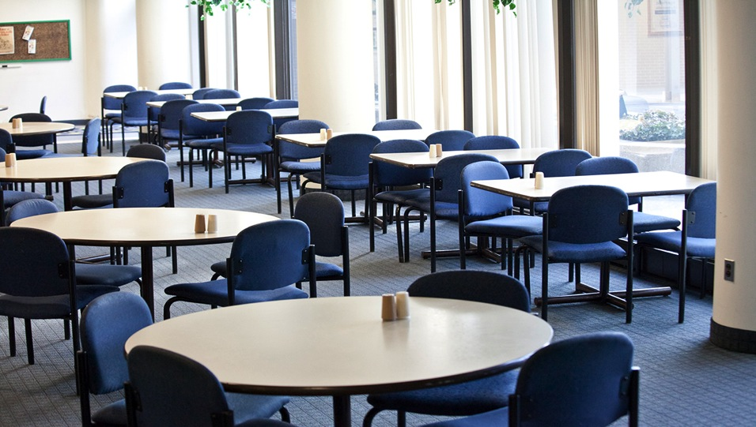
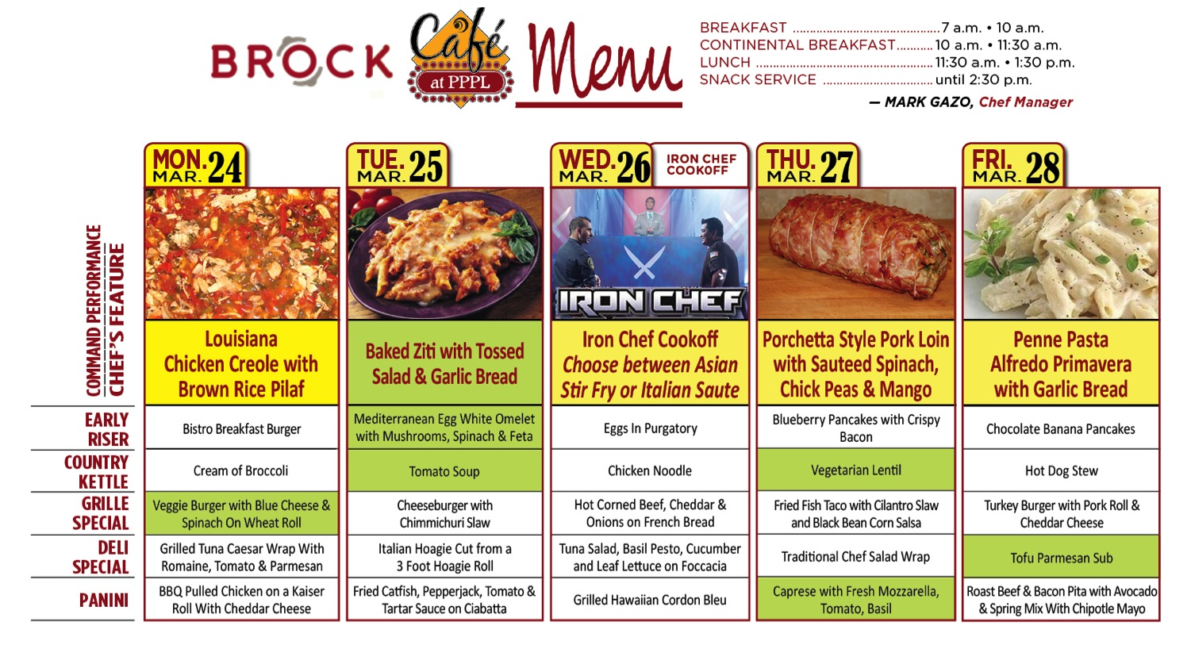
Menu subject to change without notice.

