Slide 1
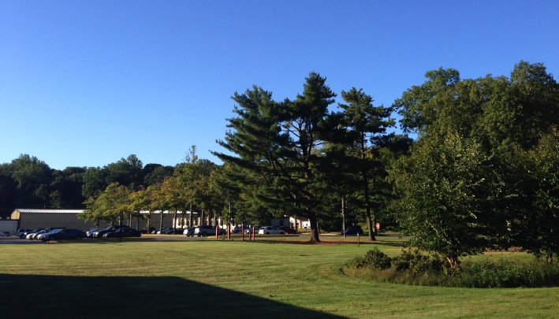
This Week @ PPPL
March 31 – April 4, 2014
Brought to you by the PPPL Office of Communications

Slide 2
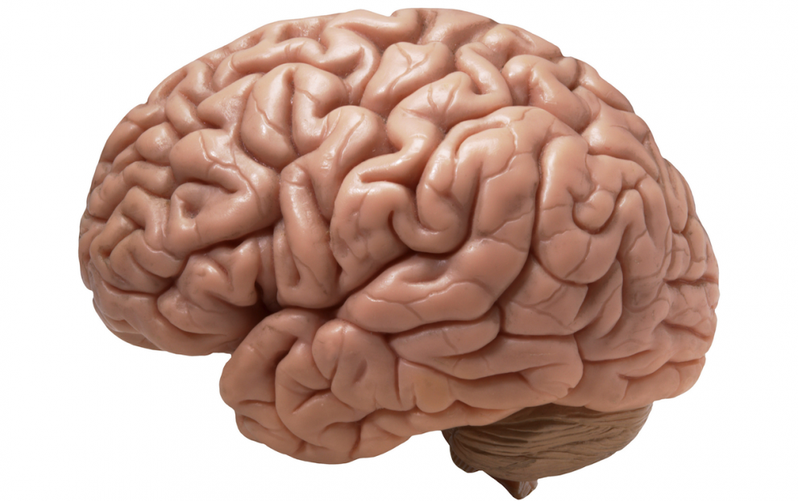

Your Restless Brain:
Changing Continually
Throughout the Day & Night
BARRY JACOBS
Princeton University
WEDNESDAY, APRIL 2
4:15 p.m. (Coffee/Tea at 4 p.m.) • M.B.G. Auditorium

Slide 3


UPCOMING EVENTS
Wednesday, April 2
  PPPL Colloquium • 4:15 pm. – MBG Auditorium – Your Restless Brain: Changing Continually throughout the Day and Night
Friday, April 4
  PPPL Service Awards – 9:30 a.m. – MBG Auditorium
Wednesday, April 9
  PPPL Colloquium • 4:15 pm. – MBG Auditorium – Trenton Iron and Steel
Wednesday, April 23
  PPPL Celebrates Earth Day – Guest Speakers, Displays, Activities, Green Machine Awards
Sunday, April 27
  Annual Communiversity Festival – 1 to 6 p.m. – Downtown Princeton – Featuring PPPL Displays

Slide 4
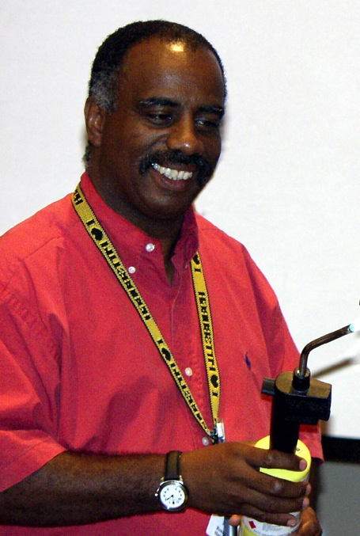
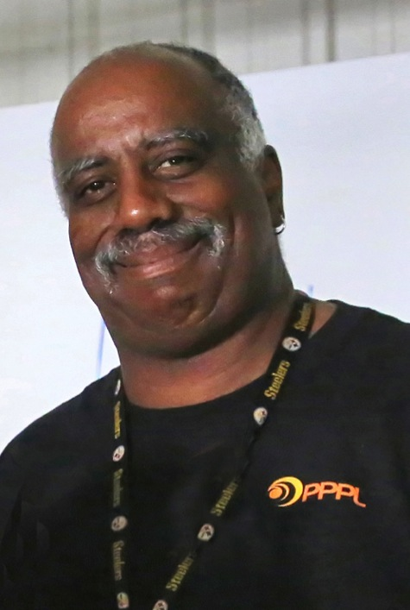
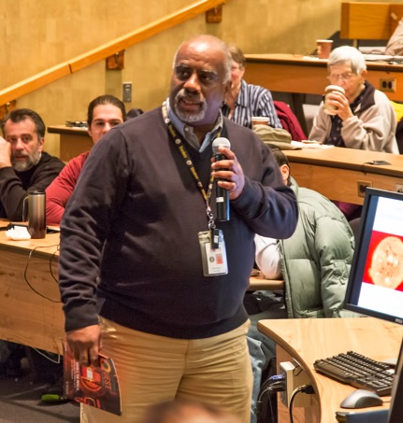
In memory of
Ronald Hatcher
1957 – 2014

Slide 5

Windows® XP computers are being upgraded to Windows® 7.
After April 8, Windows XP will no longer be supported by PPPL (there will be loss of network connectivity.)
Loss of network connectivity will occur on April 8th.
To schedule an update, please contact the helpdesk at x2275 or email helpdesk@pppl.gov.

Slide 6

Annual PPPL "Green Machine" Awards
PPPL will celebrate Earth Day on April 23rd with guest speakers, displays and activities for employees, and presentation of the annual PPPL Green Machine Awards.
Please submit award nominations for PPPL employees or employee teams that have contributed to PPPL’s environmental performance during the past year by:
Reducing greenhouse gas emissions,
Saving energy,
Saving water,
Reusing equipment or material,
Recycling materials or equipment,
Reducing the use of toxic or hazardous materials,
Sustainable acquisition (purchasing recycled content, biobased, and other "green" products),
Reducing or eliminating pollution, or
Other actions which help protect public health or the environment.
Nominations should include:
Nominee name(s), PPPL work group, description of the actions taken, and estimated cost savings or environmental benefit.
Please contact Margaret King (mking@pppl.gov) or Leanna Meyer (lmeyer@pppl.gov) if you have questions or would like information about past Green Machine awards.
Nominations are due by Monday March 31, 2014 by completing the online nomination form or by email to Virginia Finley (vfinley@pppl.gov).

Slide 7

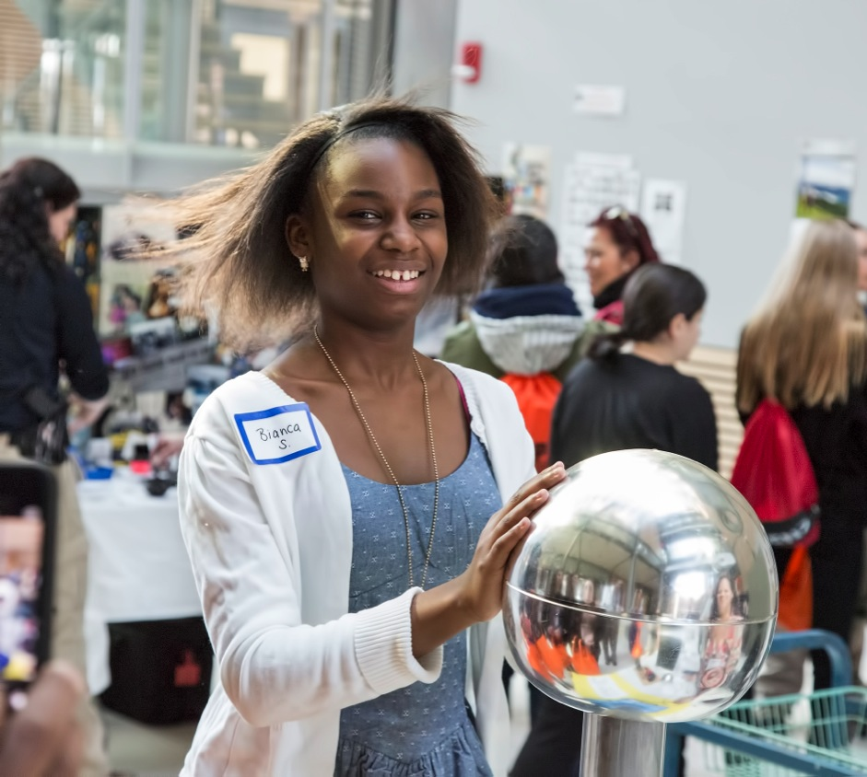
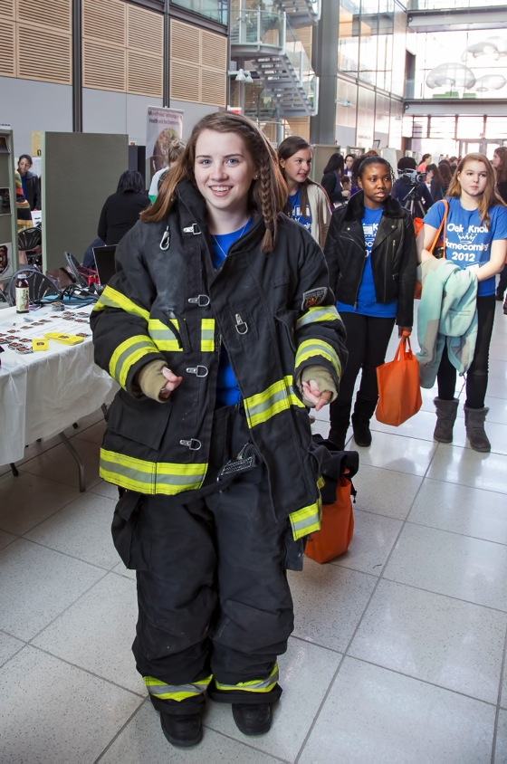
Young Women’s Conference

Slide 8
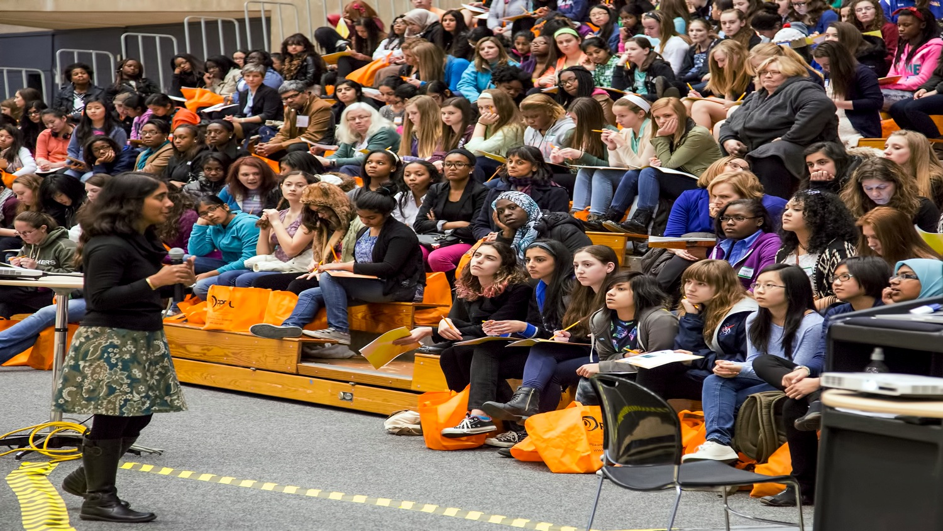
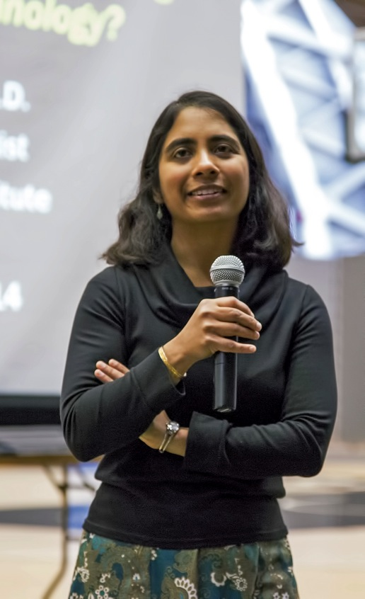
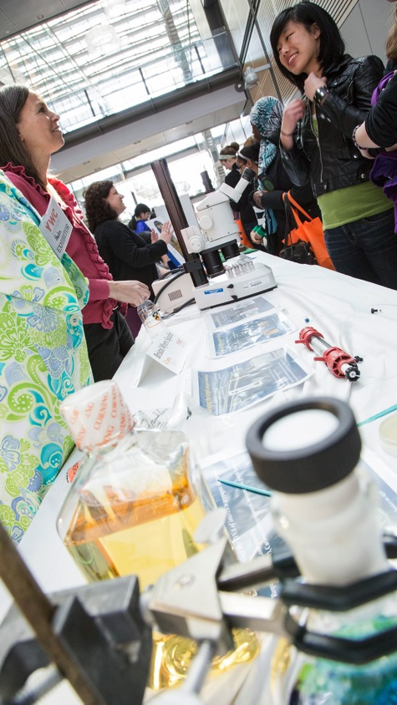
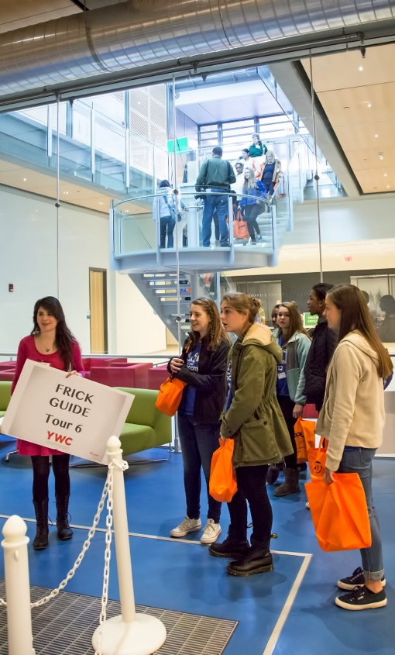
Young Women’s Conference

Slide 9
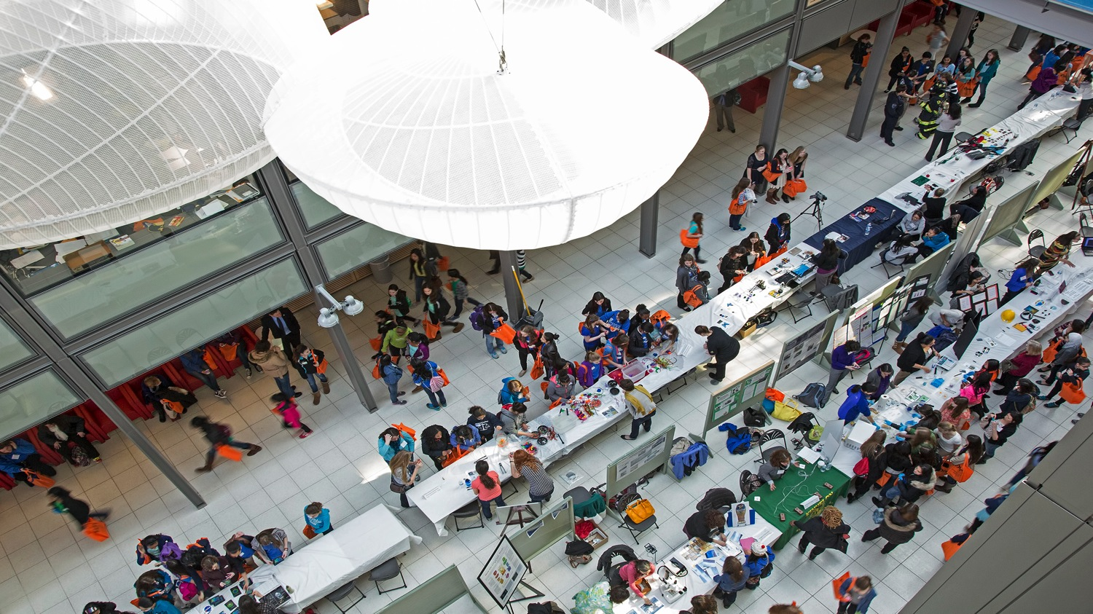
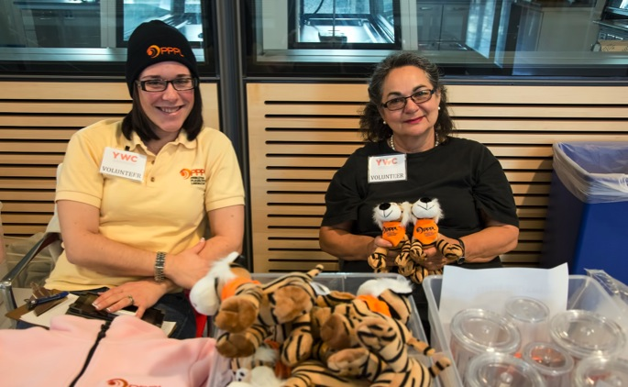
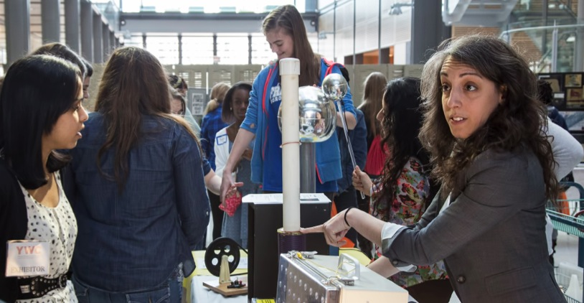
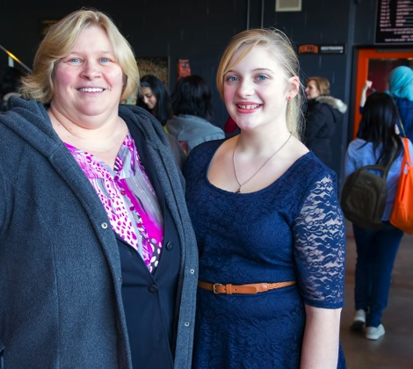
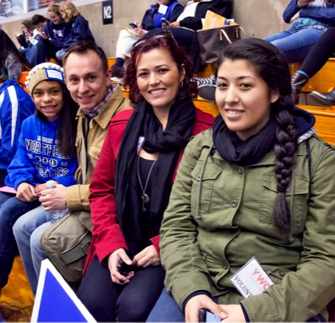
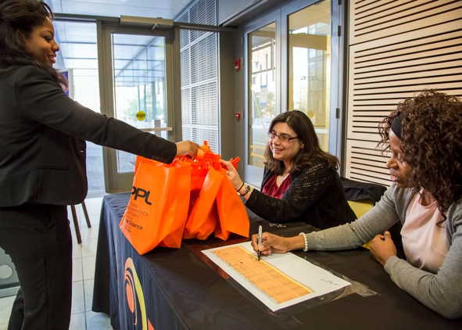
Young Women’s Conference
Thank you PPPL volunteers!

Slide 10


Slide 11
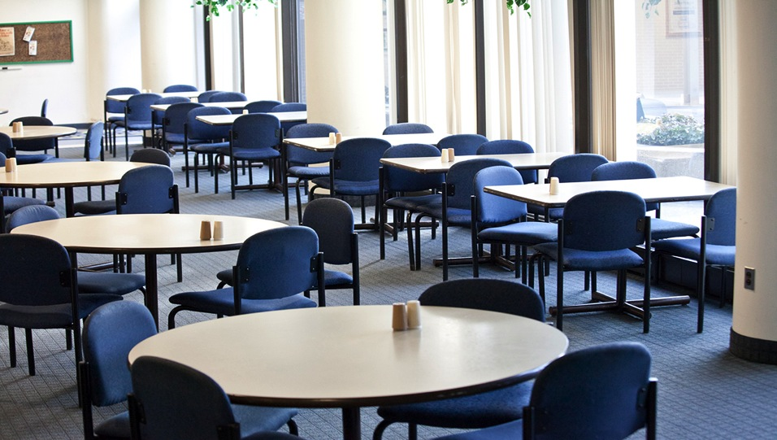

Menu subject to change without notice.

