Slide 1
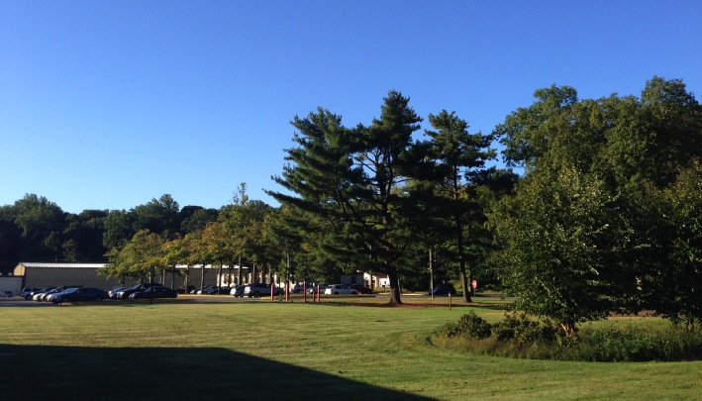
This Week @ PPPL
April 7 - 12, 2014
Brought to you by the PPPL Office of Communications

Slide 2
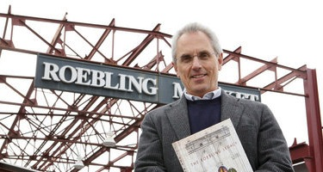

How Trenton Iron and Steel Innovations Reshaped America
Clifford Zink Independent Historian
WEDNESDAY, APRIL 9
4:15 p.m. (Coffee/Tea at 4 p.m.) • M.B.G. Auditorium

Slide 3
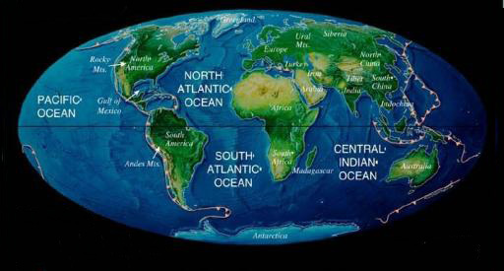
Extreme Global Warming:
Examples from the Past
Mark Pagani
Yale University
WEDNESDAY, APRIL 16
4:15 p.m. (Coffee/Tea at 4 p.m.) • M.B.G. Auditorium

Slide 4


UPCOMING EVENTS
Wednesday, April 9
  PPPL Colloquium • 4:15 pm. – MBG Auditorium – “How Trenton Iron and Steel Innovations Reshaped America”
Monday, April 14
  PPPL Colloquium • 4:15 pm. – MBG Auditorium – “Fusion through the Eyes of a Fusion Journalist”
Wednesday, April 16
  PPPL Colloquium • 4:15 pm. – MBG Auditorium – “Extreme Global Warming: Examples from the past”
Thursday, April 17
  PPPL Colloquium • 4:15 pm. – MBG Auditorium – “Toward Diversity in Flatland: Controlled Synthesis of 2D Alloys & Heterostructures”
Tuesday, April 22
  PPPL Earth Day Grounds Cleanup – Volunteers needed – Free lunch for all volunteers
Wednesday, April 23
  PPPL Celebrates Earth Day – Guest speakers, displays, activities, Green Machine Awards
Sunday, April 27
  Annual Communiversity Festival – 1 to 6 p.m. – Downtown Princeton – Featuring PPPL Displays
Tuesday, April 29
  State of the Laboratory Address – 1:30 p.m. – MBG Auditorium

Slide 5

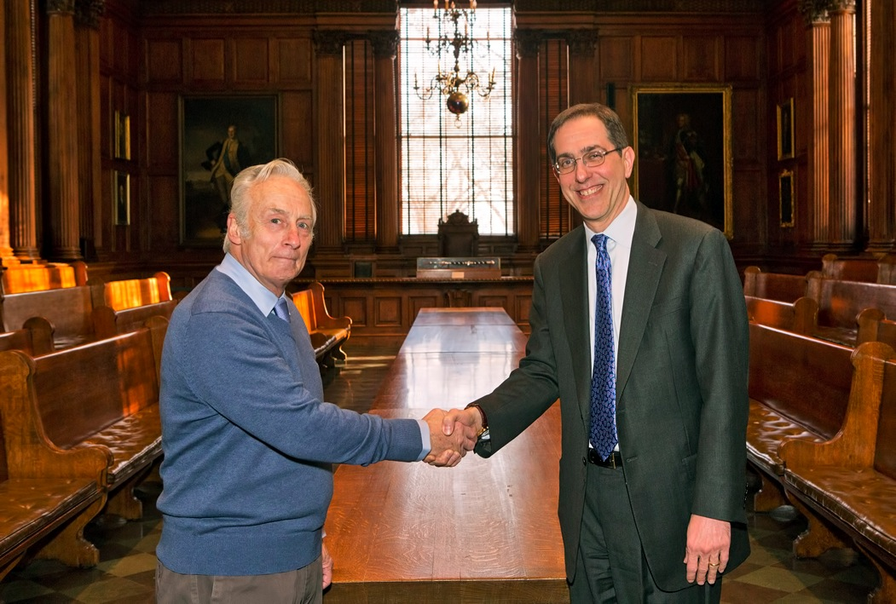
Robert Cutler Receives Presidential Achievement Award from Princeton

Slide 6
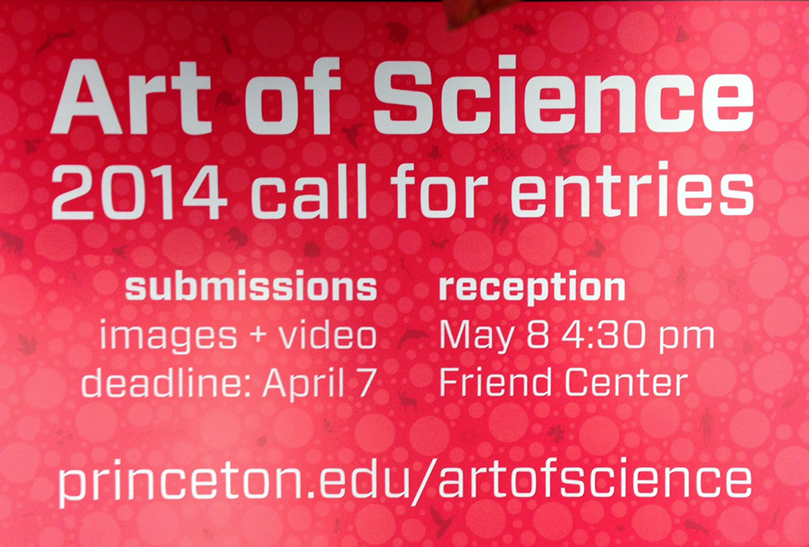

Slide 7

Welcome New PPPL Employees…

Slide 8
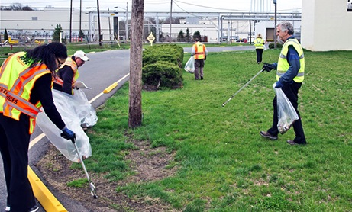
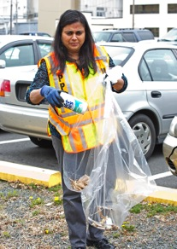
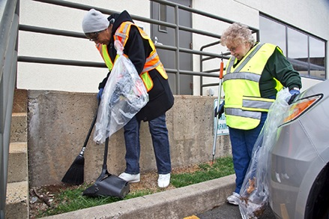
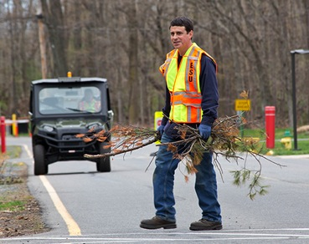
Volunteers needed for
PPPL’s Earth Day Grounds Clean-Up
on Tuesday, April 22
Free lunch for all volunteers!
To sign up call Joanne at 3380 or sign up online at
https://docs.google.com/a/pppl.gov/forms/d/1iJzmosiQFDWfJ6T5ZvBUoziy7C8wcLUwmmqDMTYx9I/viewform

Slide 9
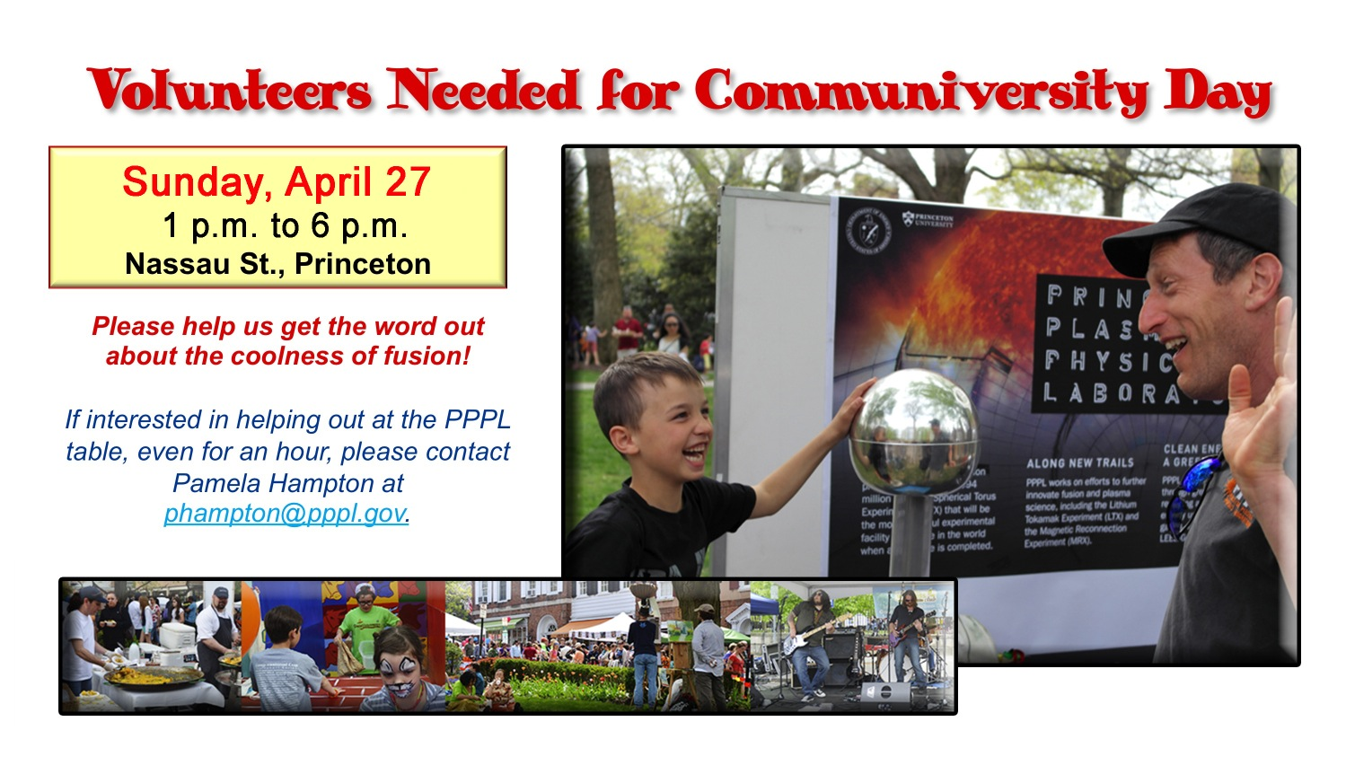

Slide 10
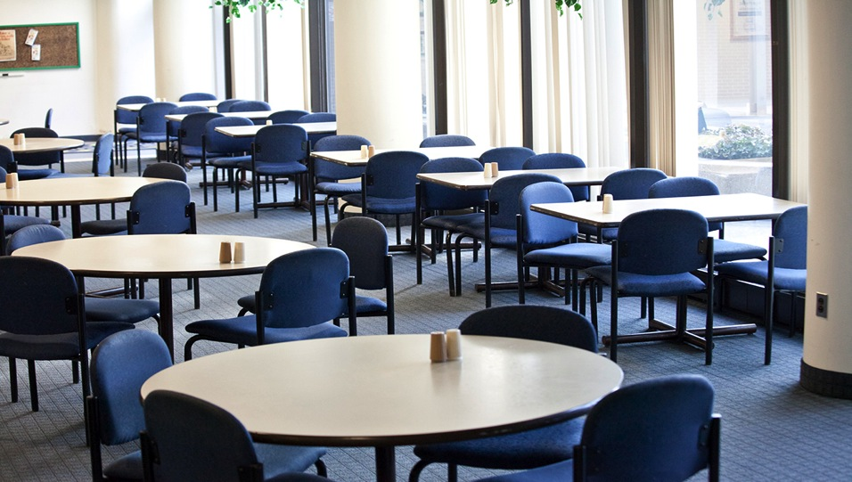
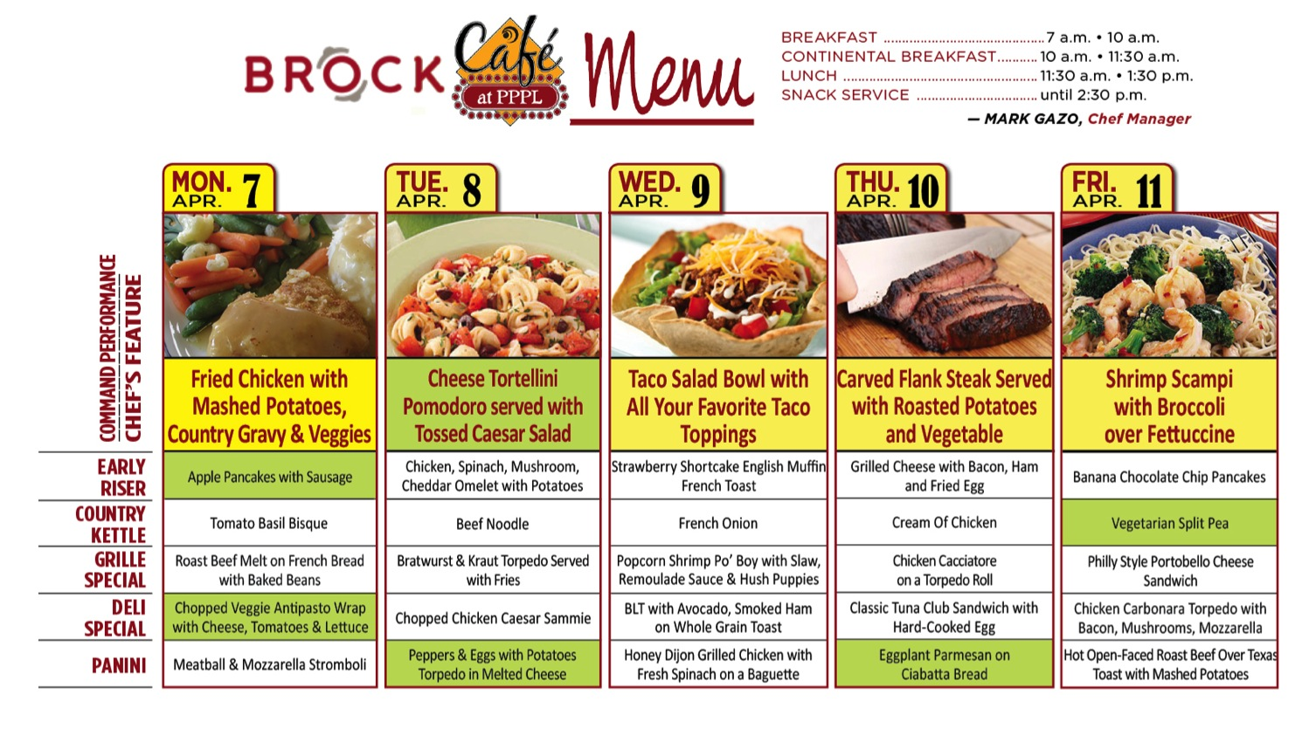
Menu subject to change without notice.

