Slide 1
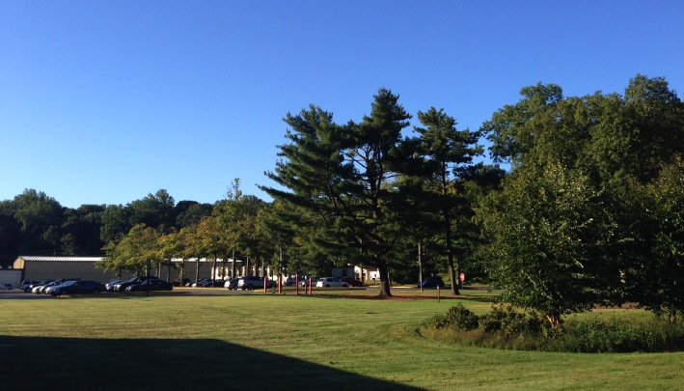
This Week @ PPPL
April 14-19, 2014
Brought to you by the PPPL Office of Communications

Slide 2
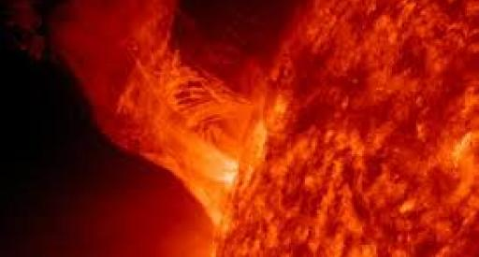

The Many Faces of Fusion
Dan Clery
SCIENCE Magazine
Note Special Day MONDAY, APRIL 14
4:15 p.m. (Coffee/Tea at 4 p.m.) • M.B.G. Auditorium

Slide 3
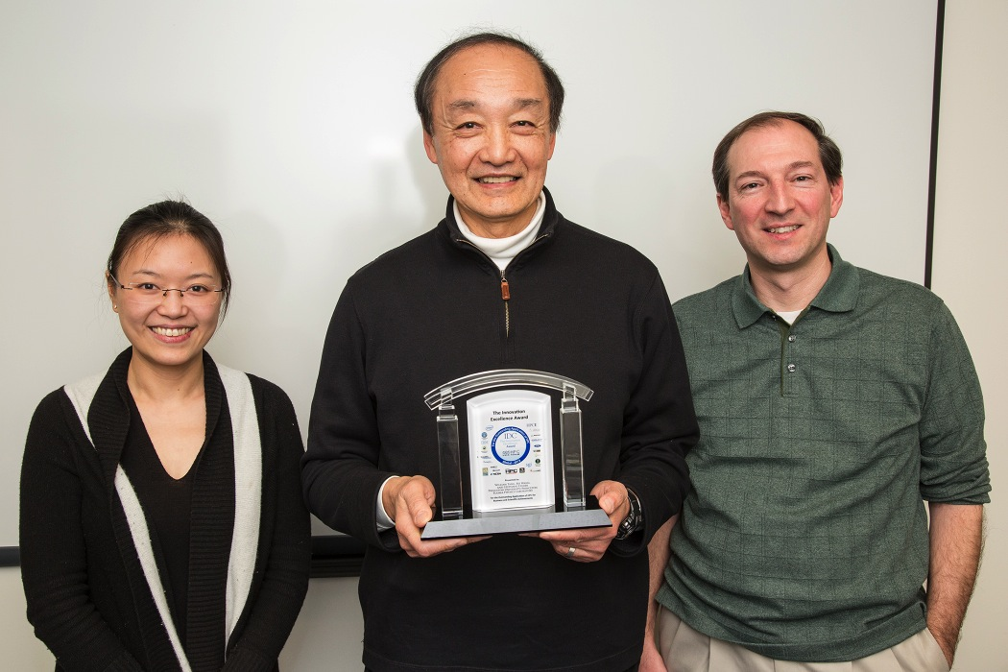
PPPL physicist William Tang (center) and his team, Bei Wang, left, and Stephane Ethier, right,
won an HPC (High-Performance Computing) Innovation in Excellence Award from the International Data Corporation.

Slide 4
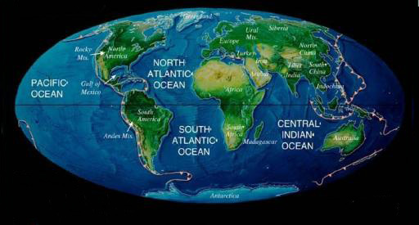
Extreme Global Warming:
Examples from the Past
Mark Pagani
Yale University
WEDNESDAY, APRIL 16
4:15 p.m. (Coffee/Tea at 4 p.m.) • M.B.G. Auditorium

Slide 5
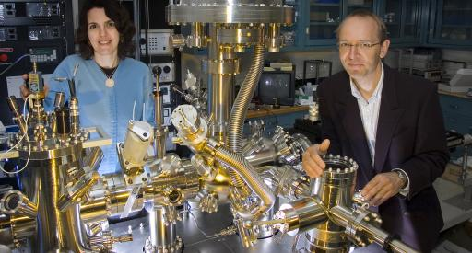
Toward Diversity in Flatland: Controlled Synthesis of 2D Alloys and Heterostructures
Peter Sutter
Brookhaven National Laboratory
Note Special Day THURSDAY, APRIL 17
4:15 p.m. (Coffee/Tea at 4 p.m.) • M.B.G. Auditorium

Slide 6
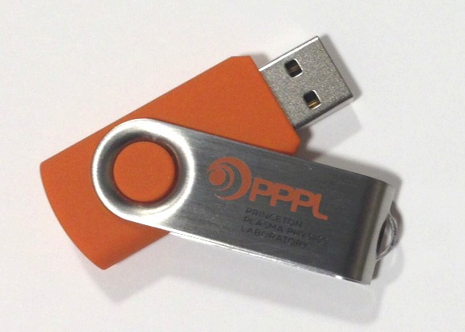
Check Out New Items in the Plasma Hutch!
4 GB Flash Drives $12.00
Umbrellas $14.50
Keychains $ 5.00
Also ceramic mugs, notebooks,
pens and all your favorite
PPPL clothing!
The Plasma Hutch is open on Fridays from 11:30 a.m. you can also pick up an order form or download one from the HR website at hr.pppl.gov
and send it via email to kim kastromarino at kmastrom@pppl.gov.

Slide 7
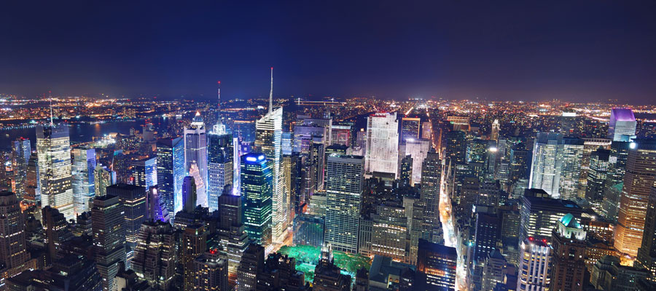
SPECIAL EARTH DAY
Sustainability Policy and Planning
in New York City
John Lee
Deputy Director for Buildings and Energy Efficiency at the New York City Mayor's Office of Long-Term Planning and Sustainability
Next week WEDNESDAY, APRIL 23
11:15 a.m. • M.B.G. Auditorium

Slide 8
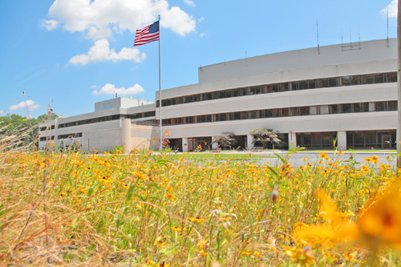


UPCOMING EVENTS
Monday, April 14
  PPPL Colloquium • 4:15 pm. – MBG Auditorium – “The Many Faces of Fusion”
Wednesday, April 16
  PPPL Colloquium • 4:15 pm. – MBG Auditorium – “Extreme Global Warming: Examples from the Past”
Thursday, April 17
  PPPL Colloquium • 4:15 pm. – MBG Auditorium – “Toward Diversity in Flatland: Controlled Synthesis of 2D Alloys & Heterostructures”
Tuesday, April 22
  PPPL Earth Day Grounds Cleanup – Volunteers needed – Free lunch for all volunteers
Wednesday, April 23
  PPPL Celebrates Earth Day – Displays, Activities, Green Machine Awards – Special Earth Day Colloquium: “Sustainability Policy and Planning in New York City”
Sunday, April 27
  Annual Communiversity Festival – 1 p.m. to 6 p.m. – Downtown Princeton – Featuring PPPL Displays

Slide 9
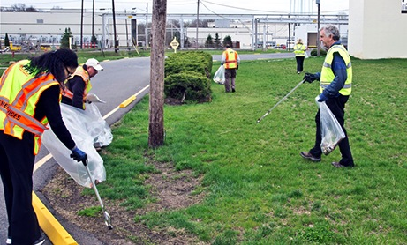
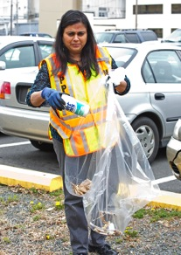
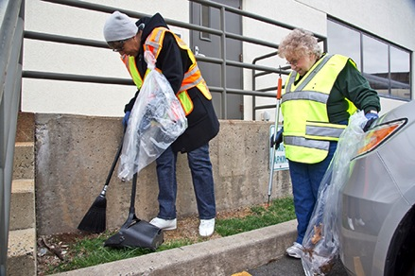
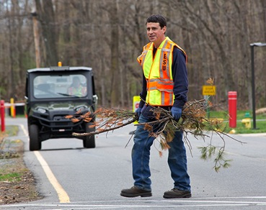
Volunteers needed for
PPPL’s Earth Day Grounds Clean-Up
on Tuesday, April 22
Free lunch for all volunteers!
To sign up call Joanne at 3380 or sign up online at
https://docs.google.com/a/pppl.gov/forms/d/1iJz-mosiQFDWfJ6T5ZvBUoziy7C8wcLUwmmqDMTYx9I/viewform

Slide 10
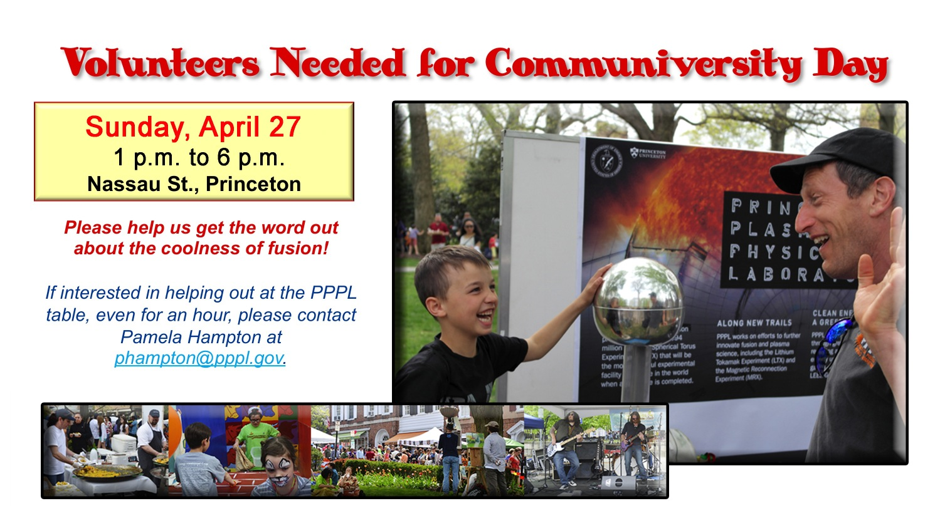

Slide 11
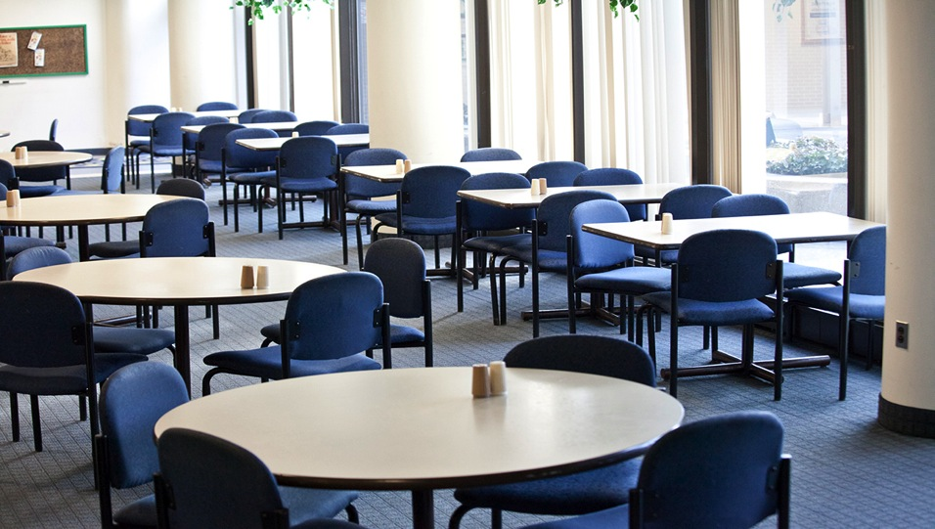

Menu subject to change without notice.

