Slide 1

This Week @ PPPL
April 15 - 19, 2013
From the PPPL Office of Communications

Slide 2

PPPL CELEBRATES
April 15 to 19
Lab-wide Clean Up Week
WEDNESDAY, APRIL 17: Grounds Clean-up 10: 30 a.m. to noon
Free lunch for volunteers. Call ext. 3380 to sign up
THURSDAY, APRIL 18: 10:30 a.m. to 1:30 p.m. Earth Day festivities at PPPL
Displays, prizes, speakers, and a Native American dance performance!
Free pizza and drinks for audience members

Slide 3
PPPL CELEBRATES
Volunteers needed for PPPL’s Grounds Clean-Up
in honor of Earth Week on April 17
from 10:30 a.m. to noon!
Free lunch for all volunteers!
Call ext. 3380 to sign up!

Slide 4
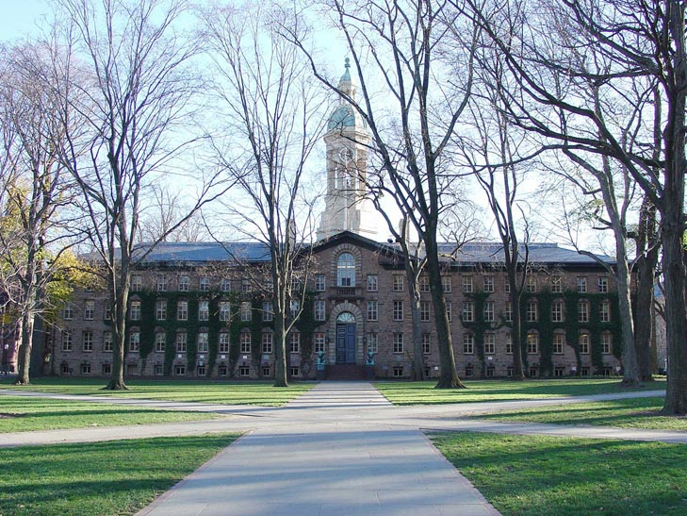
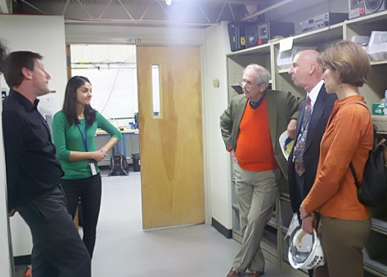
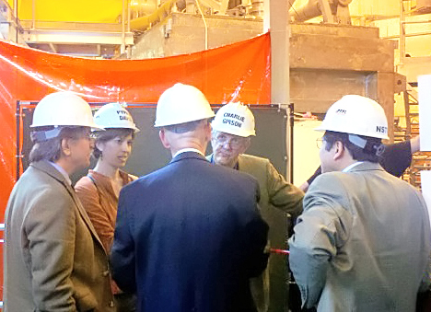

Princeton University Trustees visit PPPL

Slide 5

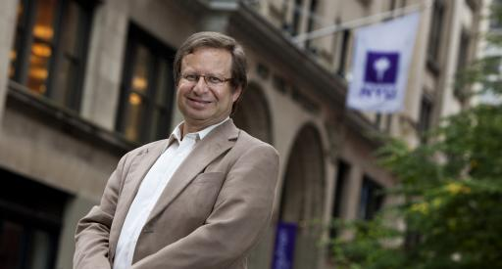
The Promise of Urban Science
Steven S. Koonin
New York University
TUESDAY, April 16
3:15 p.m. (Coffee/Tea at 4 p.m.) • M.B.G. Auditorium, Lyman Spitzer Building

Slide 6
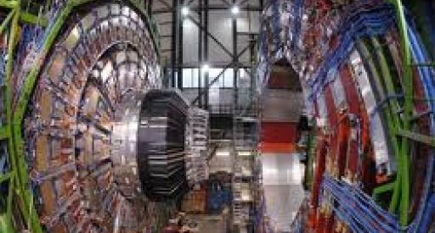
Fundamental Physics and the LHC:
A Progress Report
Nima Arkani-Hamed
The Institute for Advanced Study
WEDNESDAY, April 17
4:15 p.m. (Coffee/Tea at 4 p.m.) • M.B.G. Auditorium, Lyman Spitzer Building

Slide 7
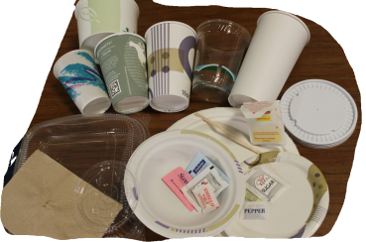



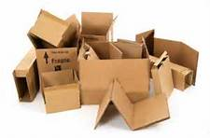
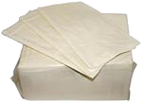
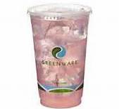
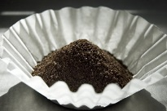

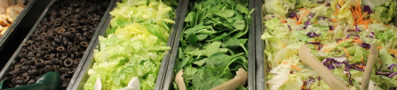
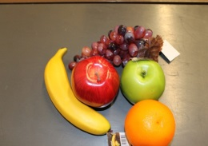
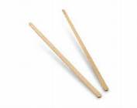

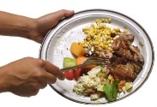


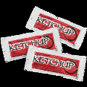

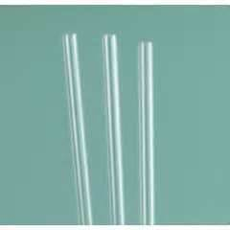
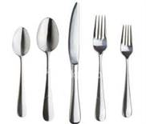
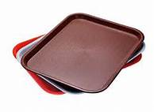
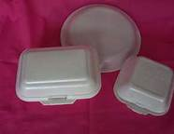
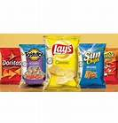
COMPOST ITEMS
SINGLE-STREAM
2013
April 15 to April 19
Lab-wide Clean Up Week; Cleanup offices and shop, call x3652 for collection bins.
Wednesday, April 17
Grounds cleanup 10:30AM to 11:30AM
Free lunch for Volunteers- Sign up: x3380 jbianco@pppl.gov
Thursday, April 18, 2013
7 a.m. – 10 a.m. Employee Electronics Drop Off: Warehouse
10:30 a.m. to 1:30 p.m. Lobby
Earth Day Vendors, Displays, Raffle
Auditorium 11:15 a.m.
Native American Tribal Dance
Green Machine Awards
FREE Pizza Lunch - First come first served with Guest Speaker
Guest Speaker: Climate Change & the Workplace
TRASH ITEMS
REUSABLE ITEMS
IN CAFETERIA
(To remain in or returned to cafe)
DID YOU KNOW: IN FY12 –
PPPL COMPOSTED
15% OF ITS WASTE STREAM
31,506 POUNDS OF FOOD
AND FOOD WASTE ITEMS?

Slide 8

YOU MAY BRING THE FOLLOWING ITEMS FROM HOME FOR RECYCLING ON APRIL 18 –– All Electronic Equipment Including:
Electronic Gadgets:
Cameras
Camcorders
MP3 Players
Gaming Systems (Handheld & TV Systems)
Calculators
Microscopes
Telescopes
PDAs
Household Equipment:
Televisions
DVRs
Cable Boxes
Copiers/Printers/Faxes
Telephone Systems
Computer Equipment:
Laptops
Desktop Towers
Modems
Keyboards
Mouses
Monitors (CRT & LCD)
Printers
Computer Wires
Hard Drives
DVDs/Tapes
Circuit Boards Drivers
*Reminder - Please delete all sensitive
material from cell phones and desktops.
All items will be collected at the C Site Lower End Parking Lot,
Warehouse Access Door Area from 7:30AM – 10AM, do not bring items to lobby.
Any Questions Please Contact Kyron Jones at X3326 or Margaret King X3652

Slide 9

Earth Day Festivities at PPPL
April 18

Slide 10
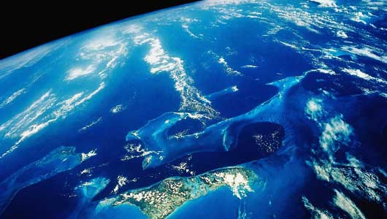
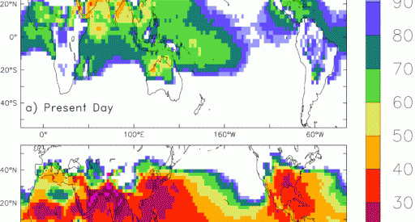
SPECIAL EARTH DAY
How Global Warming Is Heating Things Up at Work
John P. Dunne
Geophysical Fluid Dynamics Laboratory
THURSDAY, April 18
12 noon • M.B.G. Auditorium, Lyman Spitzer Building

Slide 11
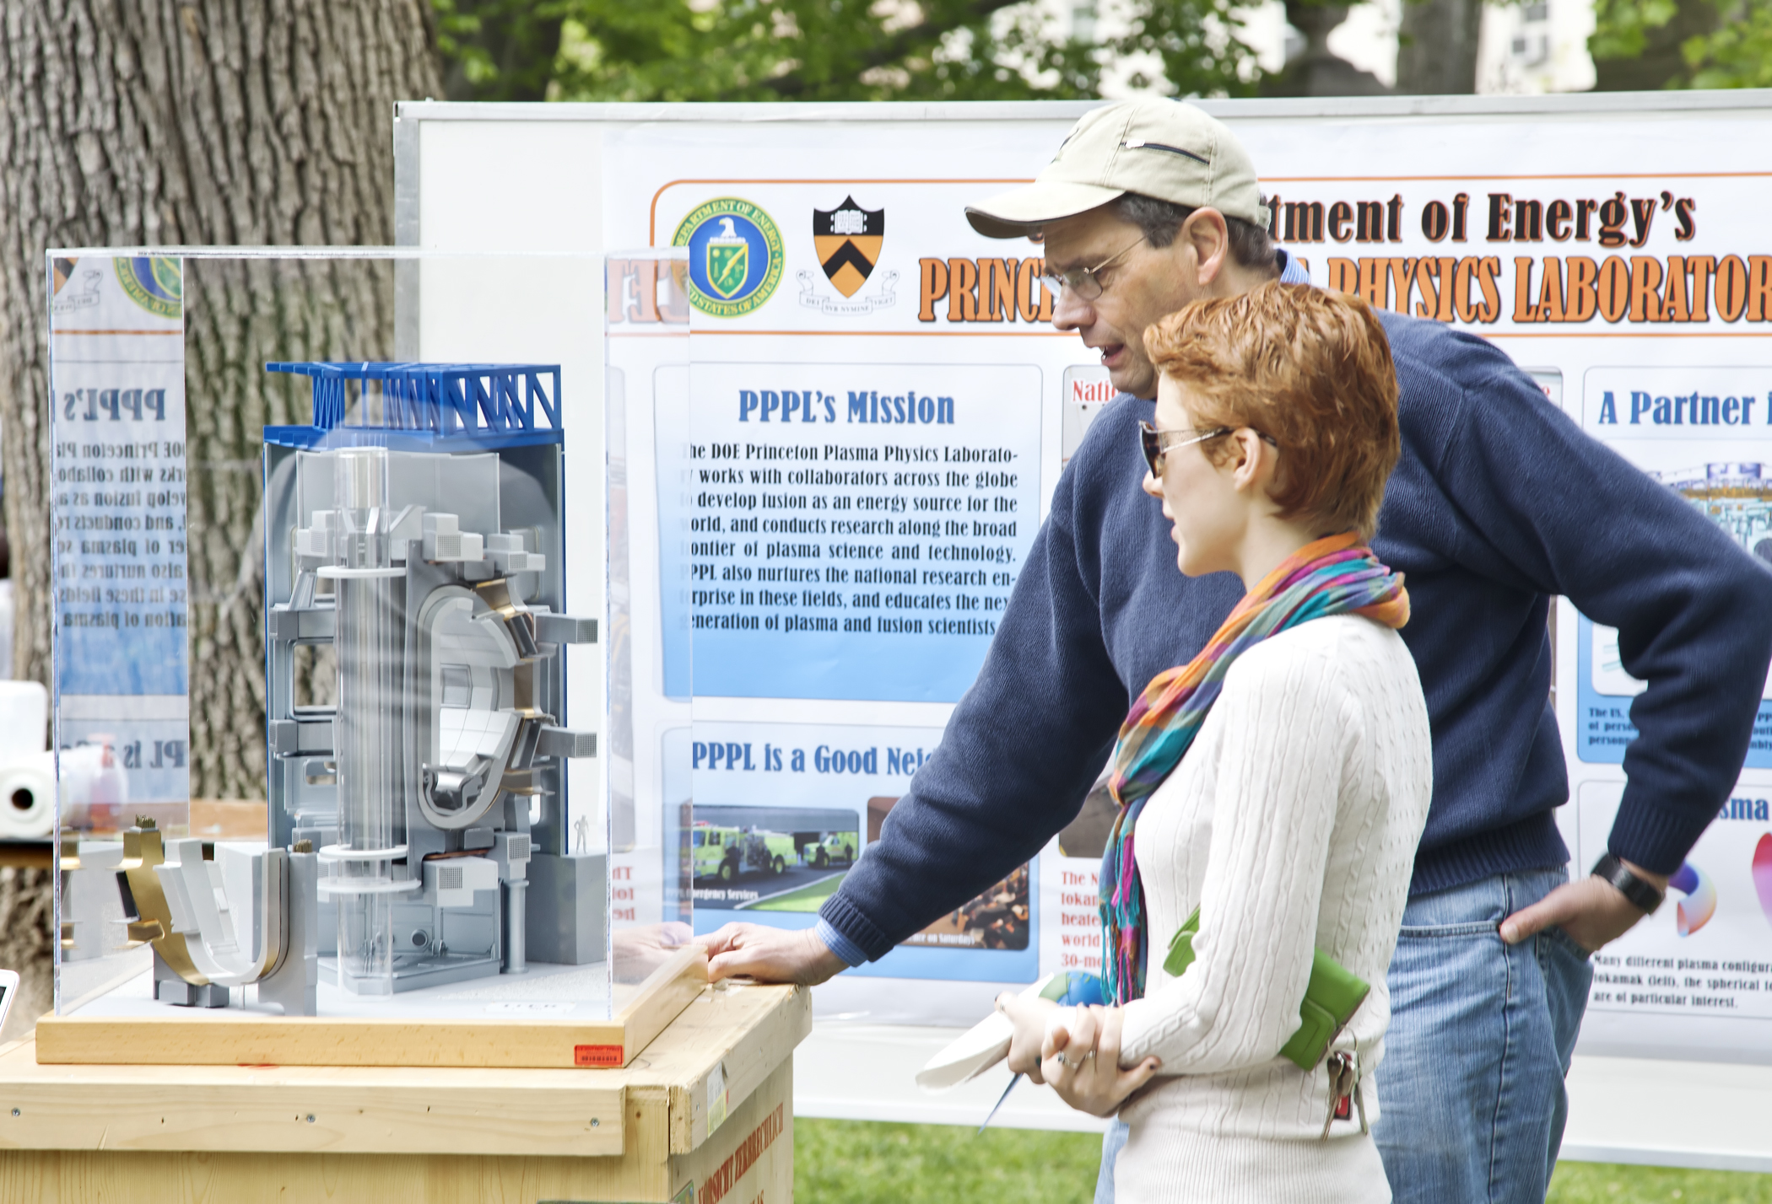
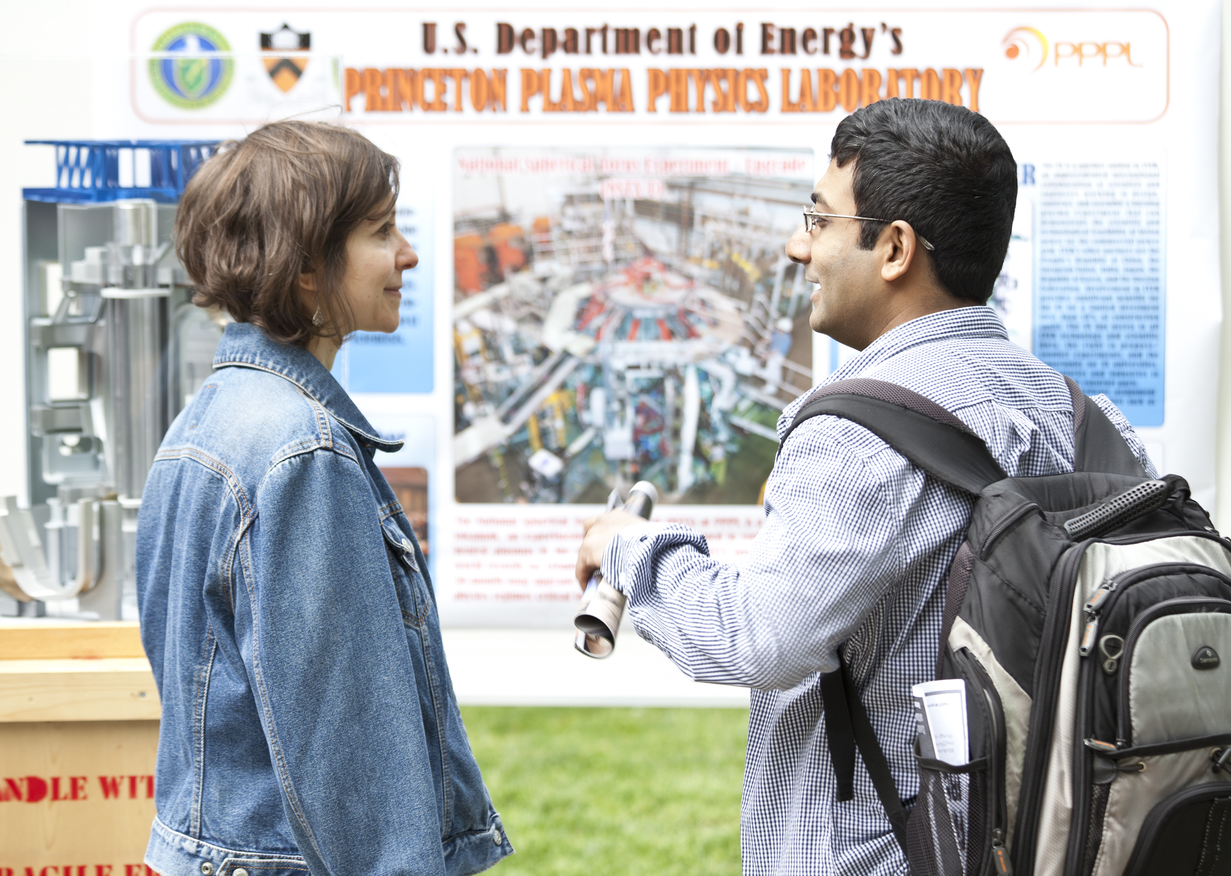
Volunteers Needed for Communiversity Day
SUNDAY, April 28
1 p.m. to 6 p.m.
Nassau St., Princeton
Please help us get the word out about the COOLNESS of FUSION!
If interested in helping out at the PPPL table, even for an hour, please contact Jeanne Jackson DeVoe jjackson@pppl.gov, ext. 2757.

Slide 12


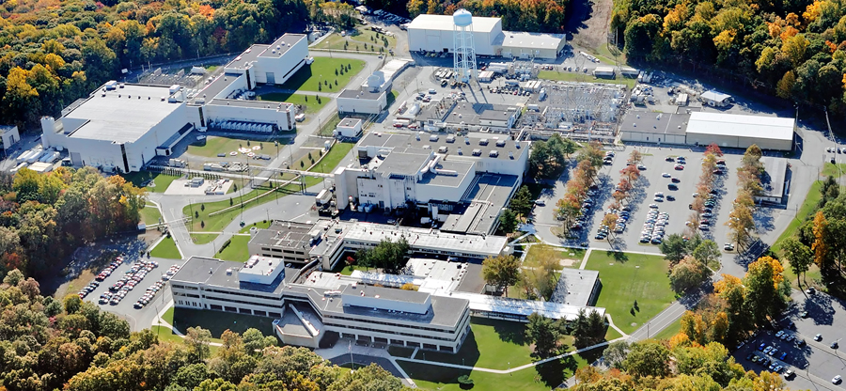
SAVE THE DATE…

Slide 13
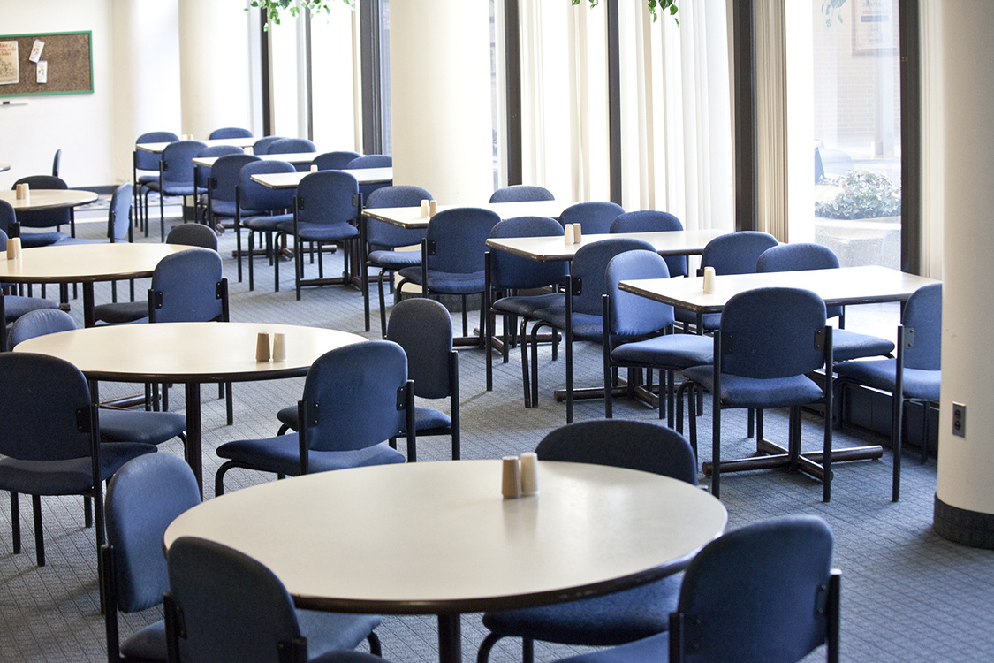
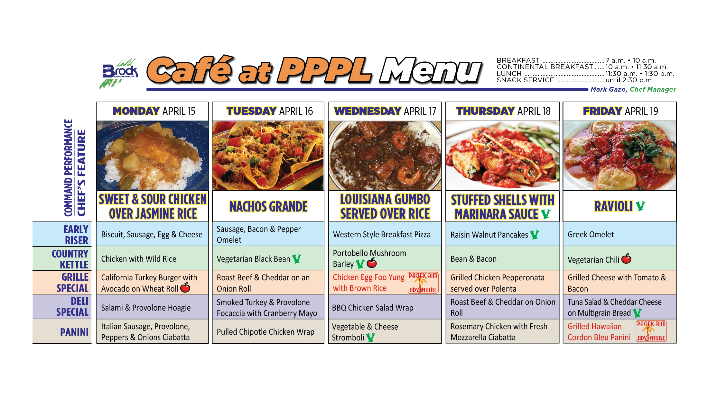
Menu subject to change without notice.

