Slide 1
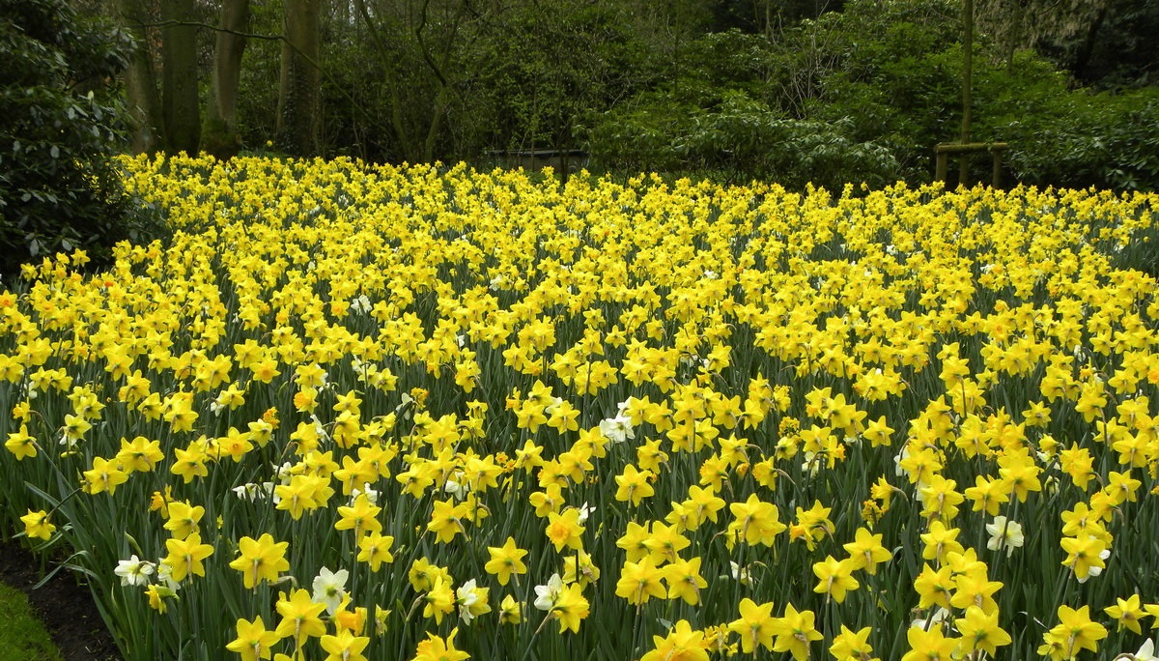
This Week @ PPPL
April 21-27, 2014
Brought to you by the PPPL Office of Communications

Slide 2
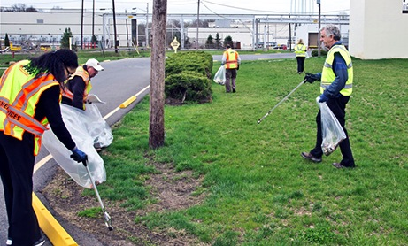
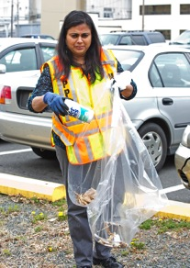
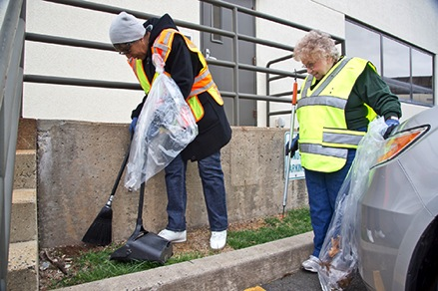
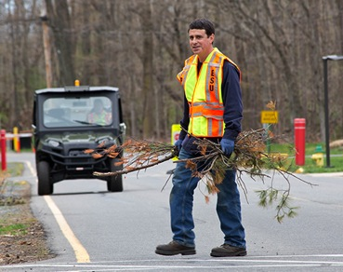
Volunteers needed for
PPPL’s Earth Day Grounds CleaNUp
on Tuesday, April 22
Free lunch for all volunteers!
To sign up call Joanne at 3380 or sign up online at
https://docs.google.com/a/pppl.gov/forms/d/1iJz-mosiQFDWfJ6T5ZvBUoziy7C8wcLUwmmqDMTYx9I/viewform

Slide 3



Earth Day Events at PPPL
Tuesday, April 22 (Rain Date April 24)
PPPL Clean-up. Volunteers Meet in LSB Lobby at 10:30 a.m. Please wear comfortable clothes and shoes! Lunch in Mod VI for volunteers at 11:45 a.m.
Wednesday, April 23
10 a.m. to 1 p.m. Earth Day Displays: LSB lobby, including raffle. Win power strips, LED light bulbs, rechargeable batteries with charger and other green goodies.
11 a.m. Green Machine Awards
11:15 a.m. Special Earth Day colloquium, “Sustainability Policy and Planning in New York City,” by John Lee, Deputy Director for Buildings and Energy Efficiency in New York’s Office of Longer Term Planning and Sustainability. There will be a pizza lunch in the auditorium for audience members after the presentation.

Slide 4
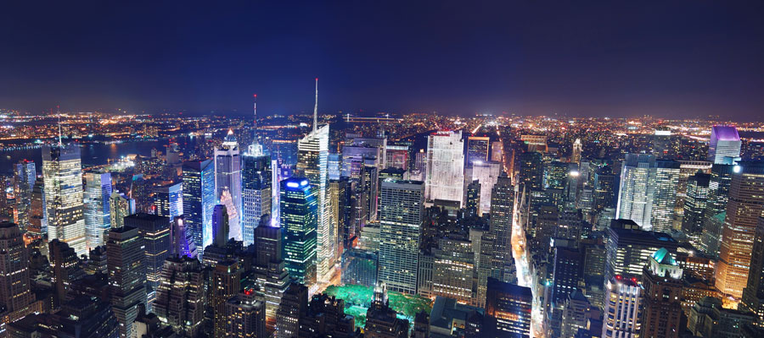

SPECIAL EARTH DAY
Sustainability Policy and Planning
in New York City
John Lee
Deputy Director for Buildings and Energy Efficiency at the New York City Mayor's Office of Long-Term Planning and Sustainability
WEDNESDAY, APRIL 23
11:15 a.m. • M.B.G. Auditorium

Slide 5
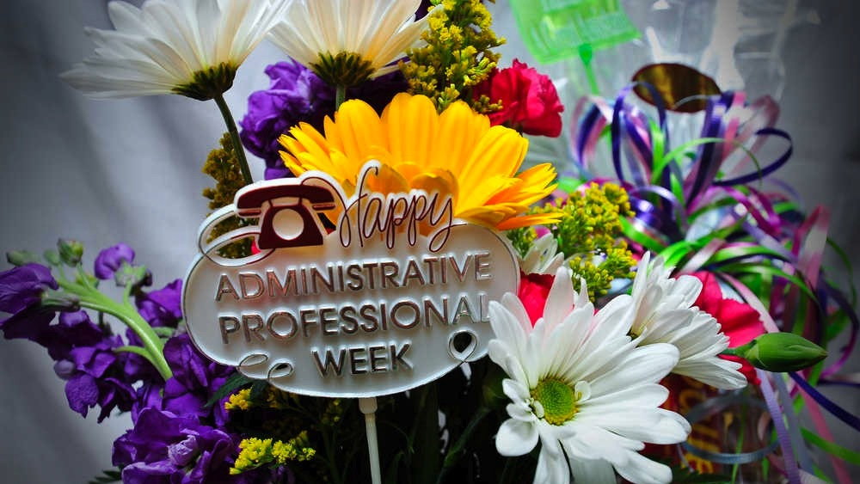

Slide 6
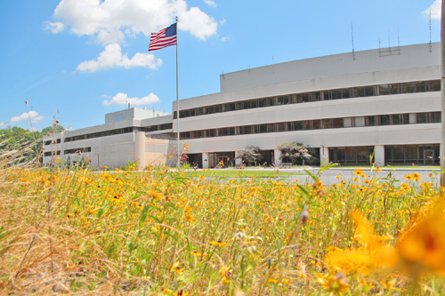


UPCOMING EVENTS
Tuesday, April 22
  PPPL Earth Day Grounds Cleanup – Volunteers needed – Free lunch for all volunteers
Wednesday, April 23
  PPPL Celebrates Earth Day – Displays, Activities, Green Machine Awards – Special Earth Day Colloquium: “Sustainability Policy and Planning in New York City”
Sunday, April 27
  Annual Communiversity Festival – 1 p.m. – Downtown Princeton – PPPL Displays
Wednesday, April 30
  PPPL Colloquium – 4:15 p.m. – MBG Auditorium – “Compressed Air Energy Storage: The Bridge to Our Renewable Energy Future”
Wednesday, May 7
  PPPL Colloquium – 4:15 p.m. – MBG Auditorium – “HEDP”
Wednesday, May 14
  PPPL Colloquium – 4:15 p.m. – MBG Auditorium – “Father of Russian Science”

Slide 7
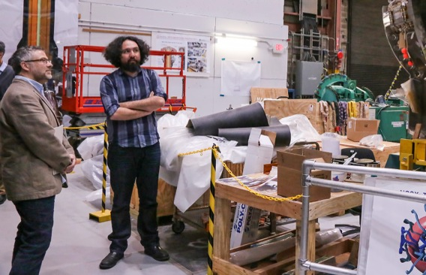
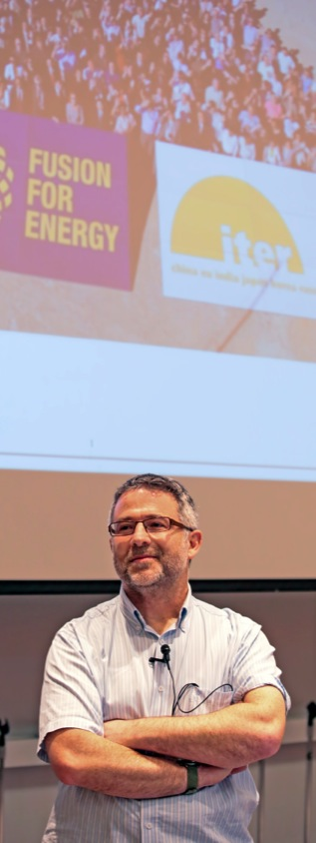
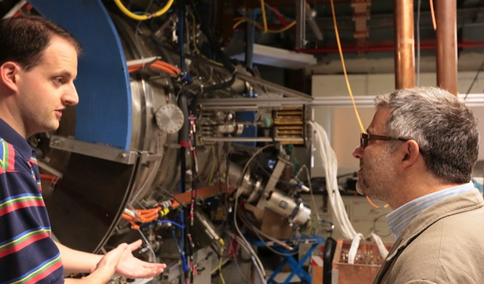
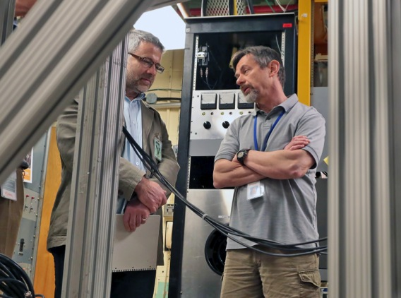
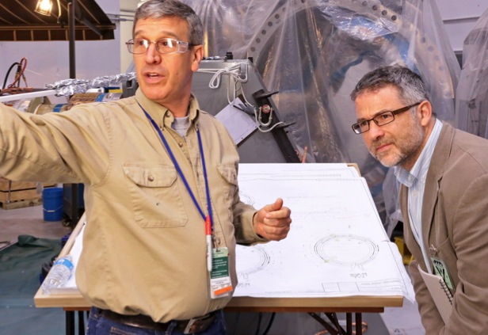
Author Daniel Clery visits PPPL and speaks at Colloquium

Slide 8


Slide 9
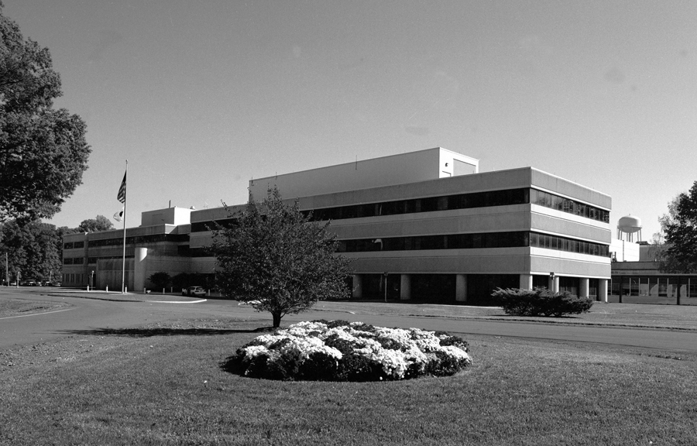
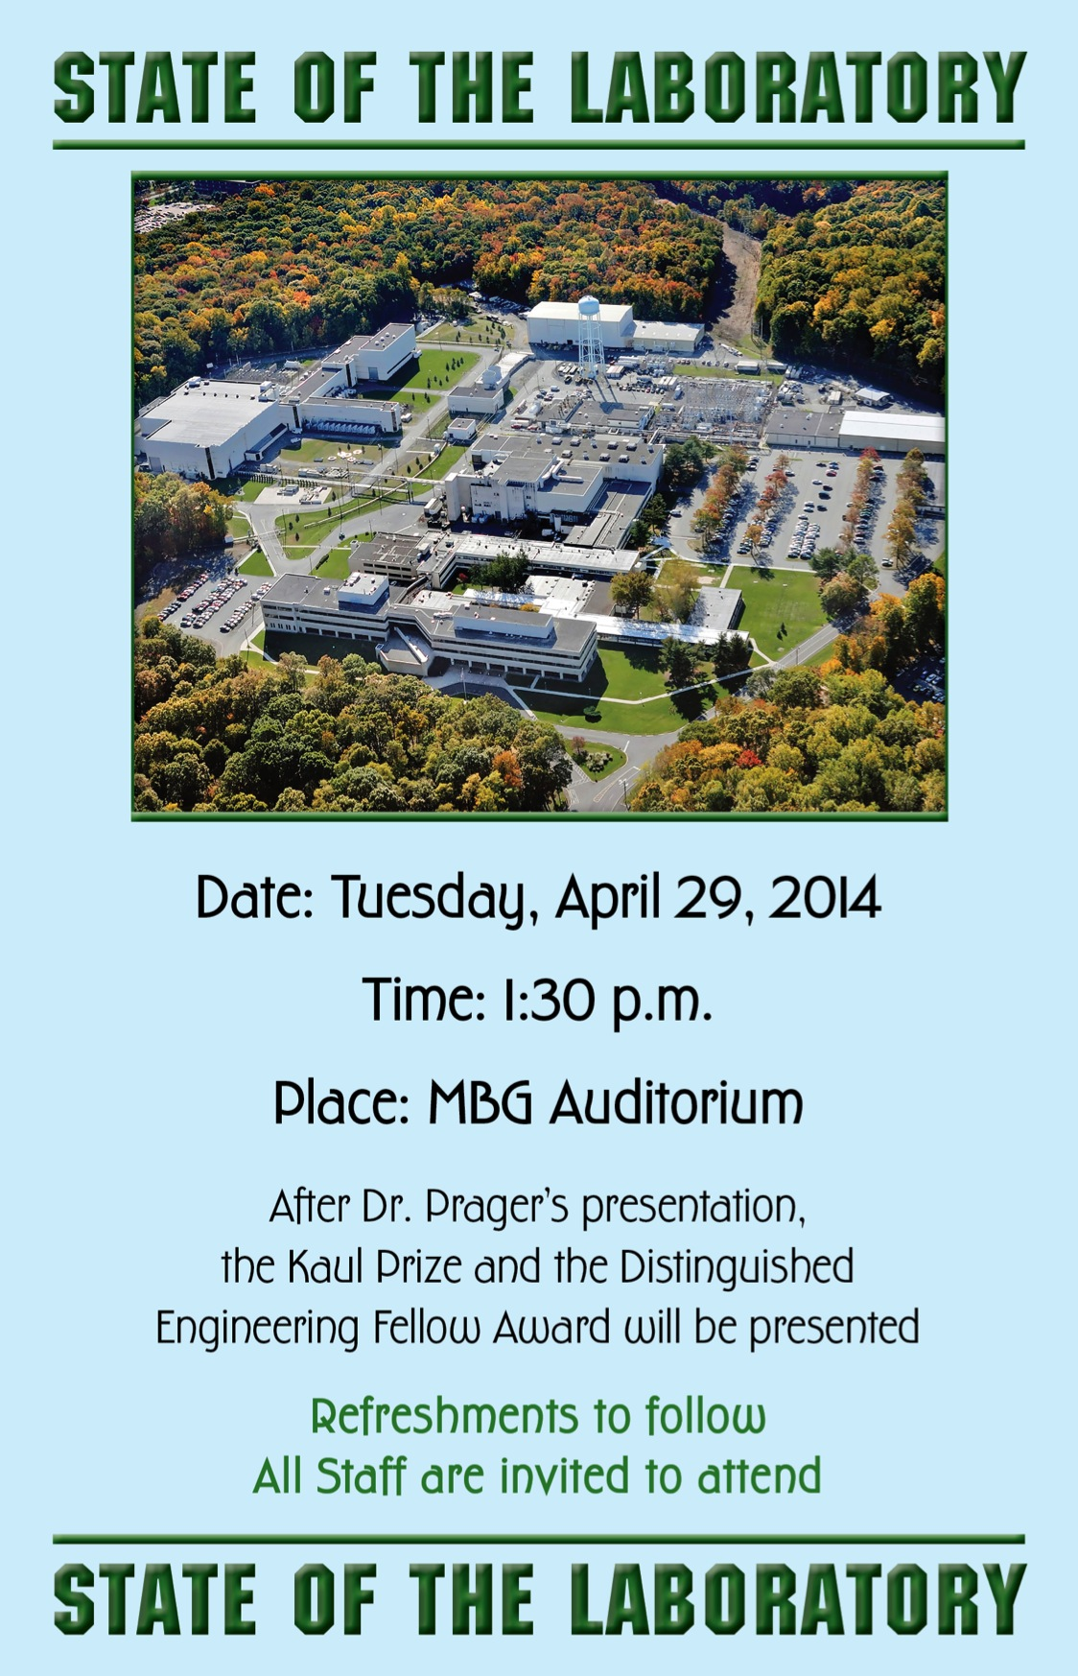

Slide 10
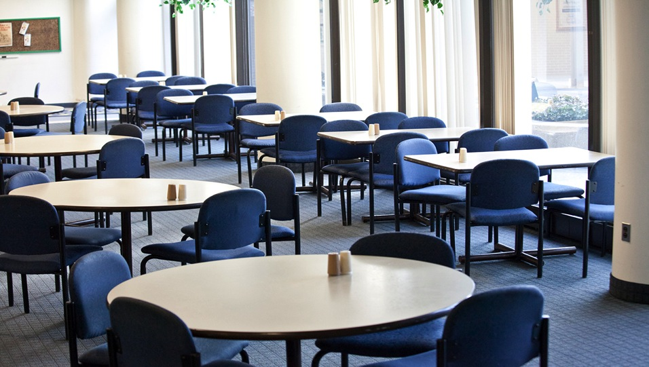
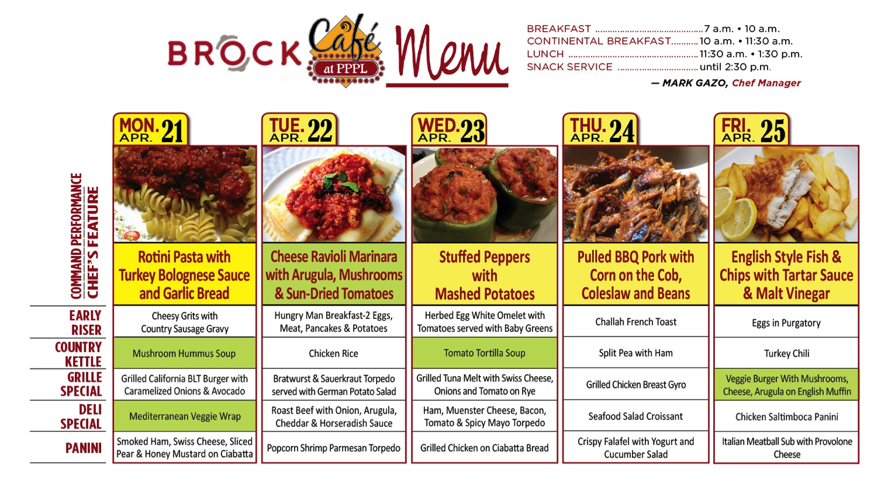
Menu subject to change without notice.

