Slide 1
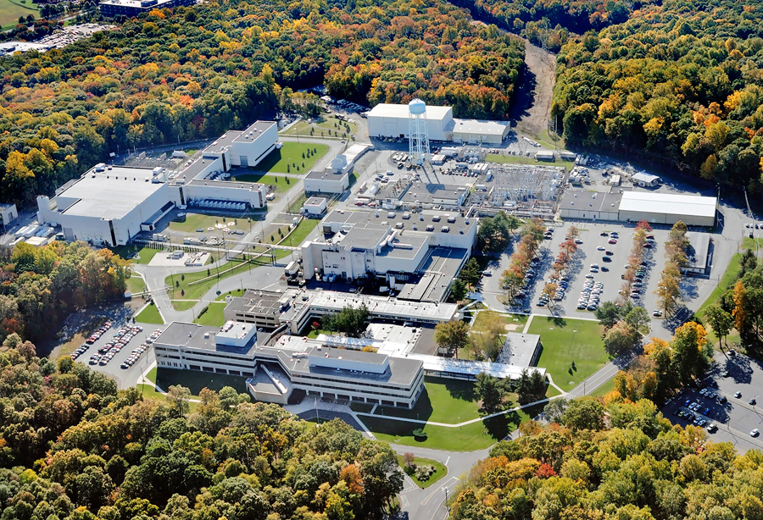
This Week @ PPPL
April 22 - 28, 2013
From the PPPL Office of Communications

Slide 2
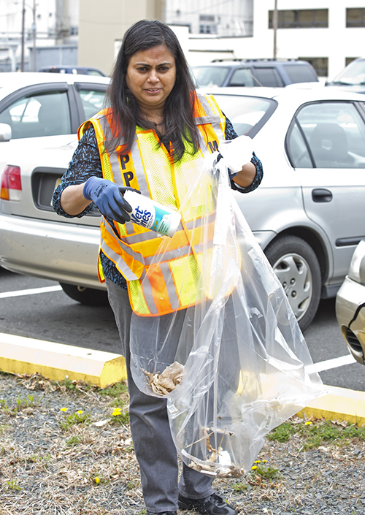
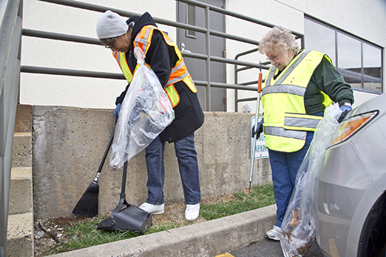
PPPL Earth Week Cleanup

Slide 3
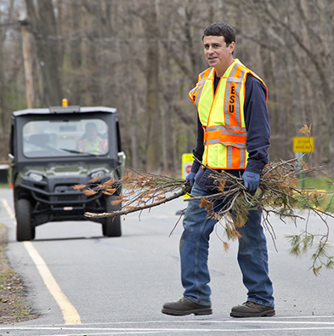
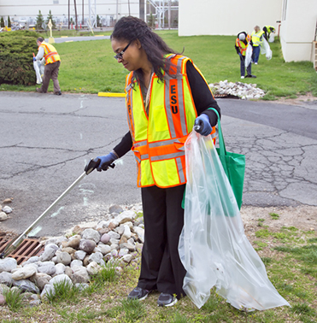
PPPL Earth Week Cleanup

Slide 4
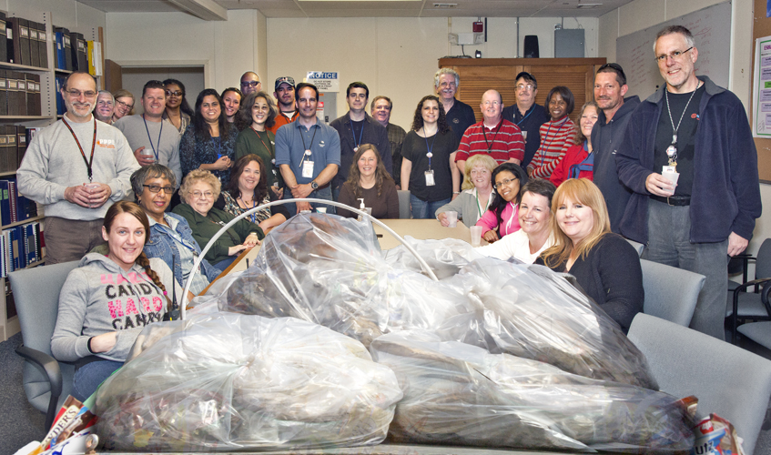
Thank You PPPL Earth Week Cleanup Volunteers

Slide 5


Slide 6

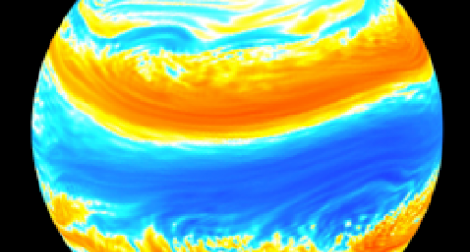
Environmental Condensed Matter Physics
Brad Marston
Brown University
WEDNESDAY, April 24
4:15 p.m. (Coffee/Tea at 4 p.m.) • M.B.G. Auditorium, Lyman Spitzer Building

Slide 7
Welcome
PPPL Advisory Committee

Slide 8

LOCAL COLLECTION SITES:
• PRINCETON POLICE DEPT.
• PLAINSBORO POLICE DEPT.
• MONTGOMERY TWP. POLICE DEPT.
• HAMILTON POLICE DEPT.
• CRANBURY POLICE DEPT.
• HOPEWELL TWP. POLICE DEPT.
• SO. BRUNSWICK POLICE DEPT.
• EWING POLICE DEPT.

Slide 9
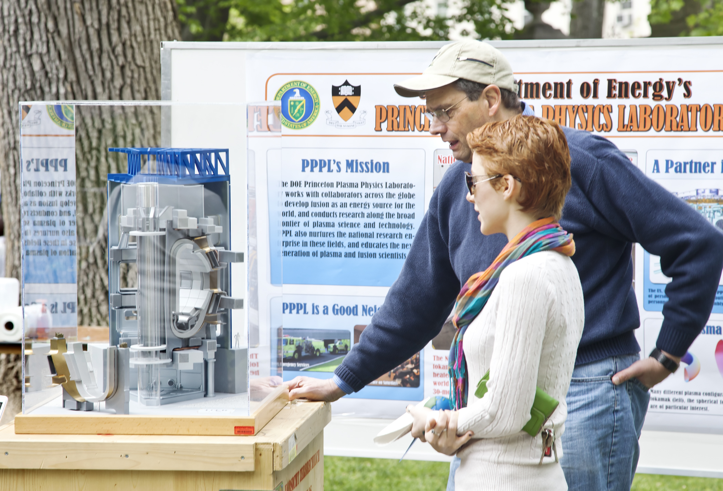
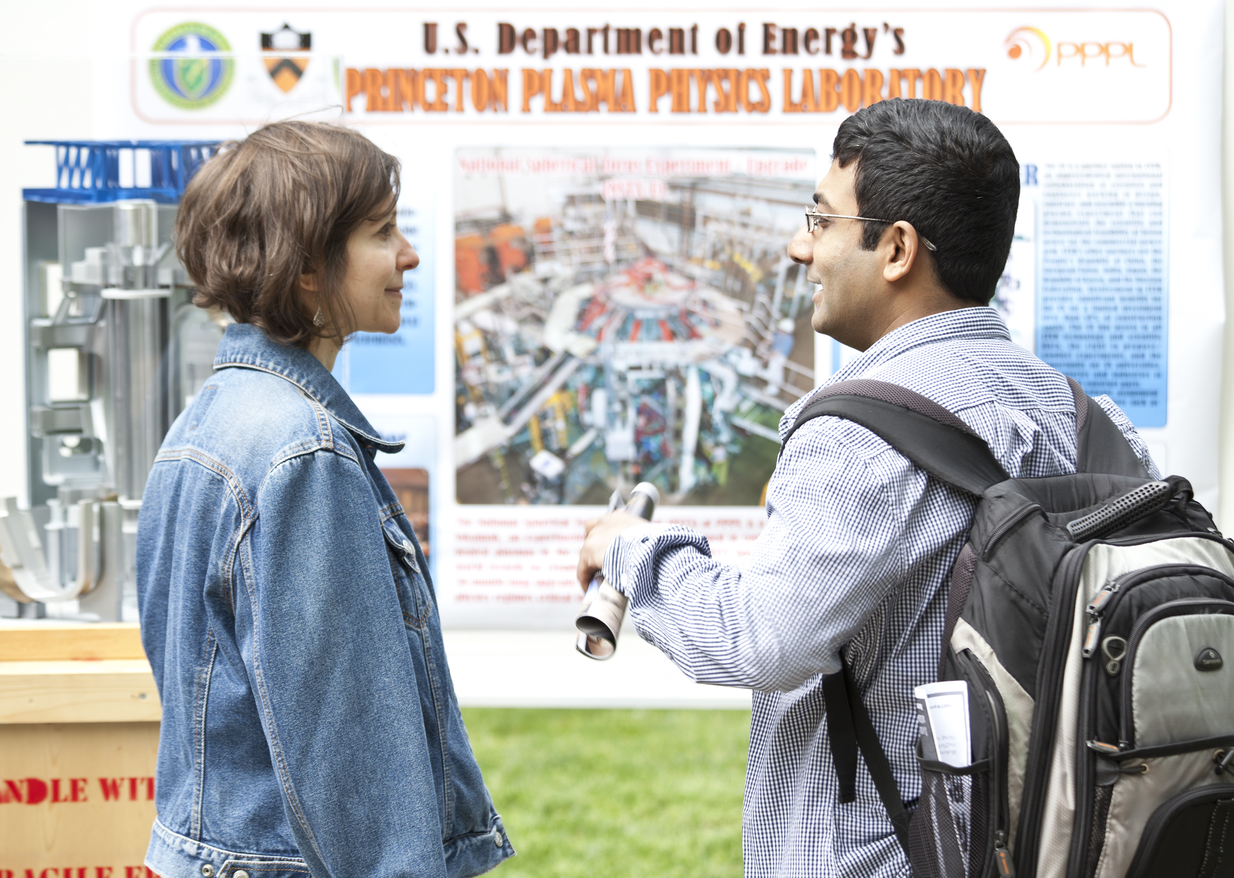
Volunteers Needed for Communiversity Day
SUNDAY, April 28
1 p.m. to 6 p.m.
Nassau St., Princeton
Please help us get the word out about the COOLNESS of FUSION!
If interested in helping out at the PPPL table, even for an hour, please contact Jeanne Jackson DeVoe jjackson@pppl.gov, ext. 2757.

Slide 10


SAVE THE DATE…

Slide 11
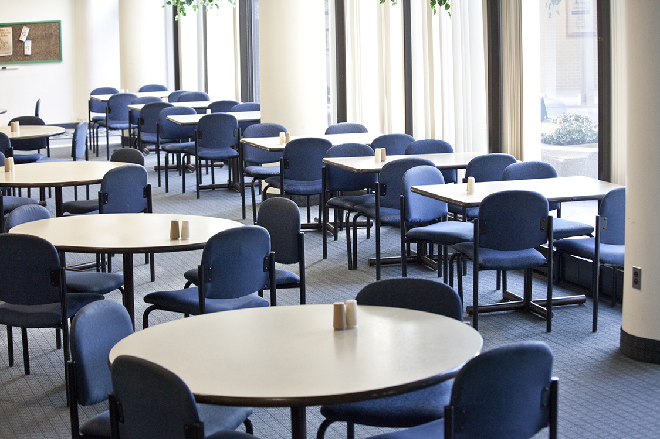
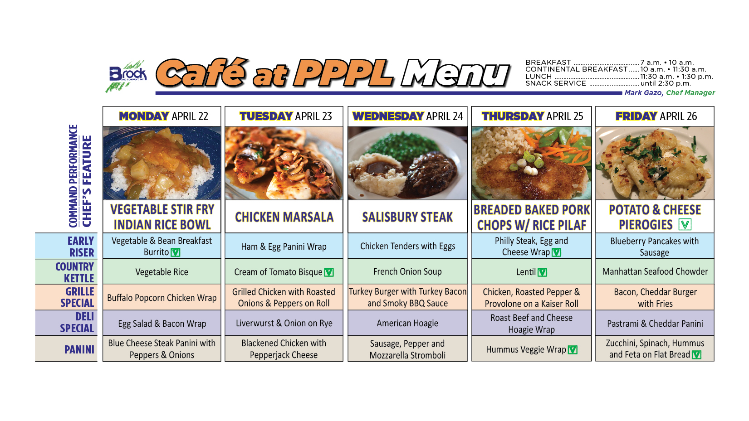
Menu subject to change without notice.

