Slide 1
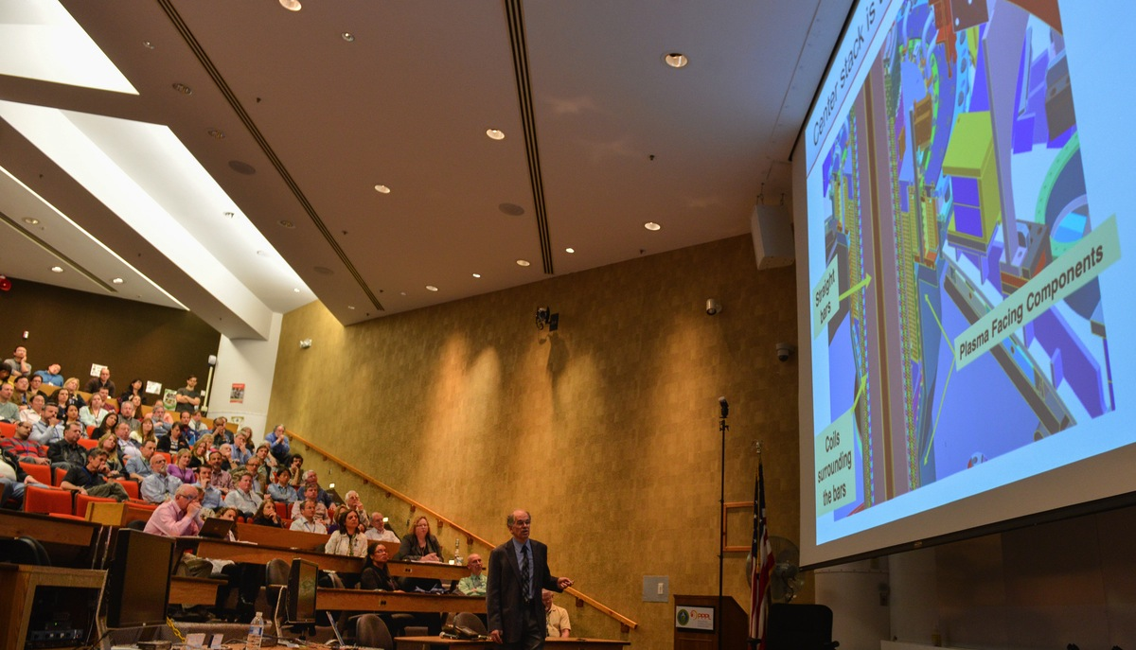
This Week @ PPPL
May 5 - 9, 2014
Brought to you by the PPPL Office of Communications

Slide 2

HAPPY
MAY 5

Slide 3
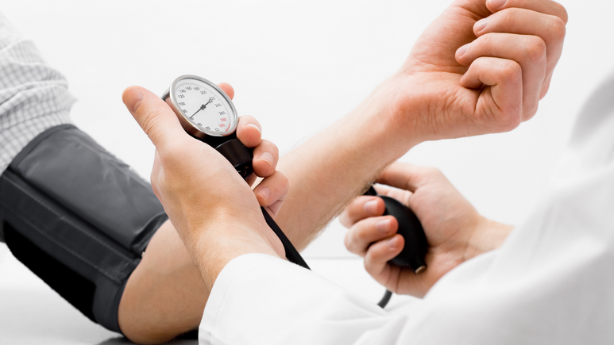
Blood Pressure Screening
Wednesday, May 7
11:15 a.m. to 1 p.m. – LSB Lobby

Slide 4
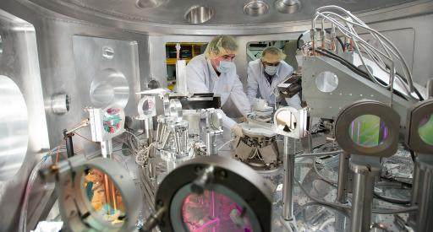

Exploring the Physical Properties of
Matter in Extreme Conditions
Siegfried Glenzer
SLAC National Accelerator Laboratory
WEDNESDAY, MAY 7
4:15 p.m. • M.B.G. Auditorium

Slide 5
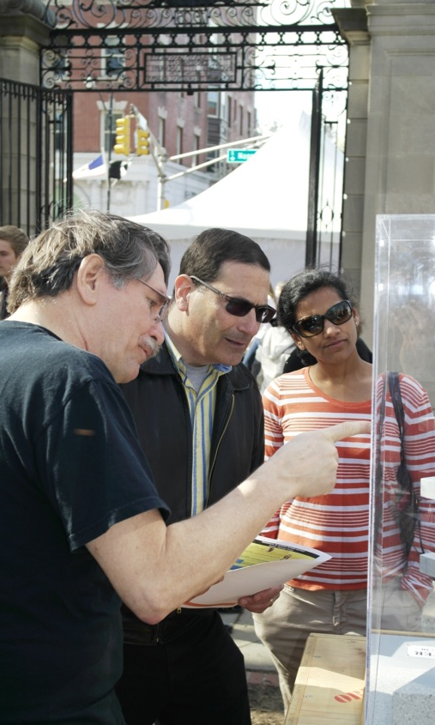


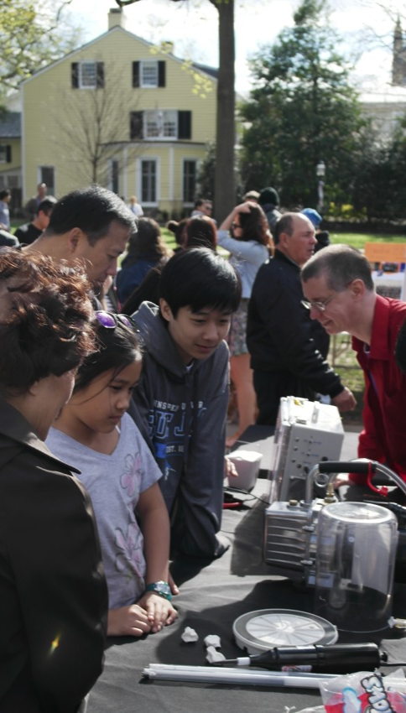

Slide 6
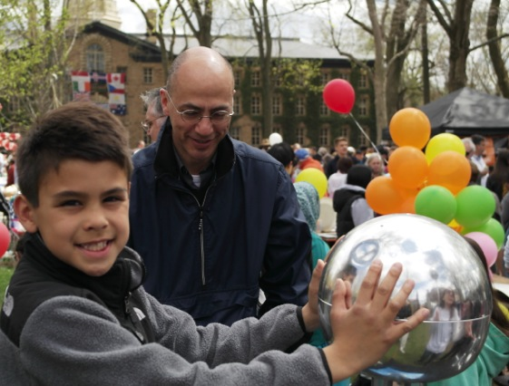
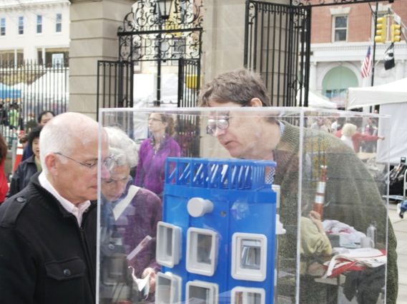
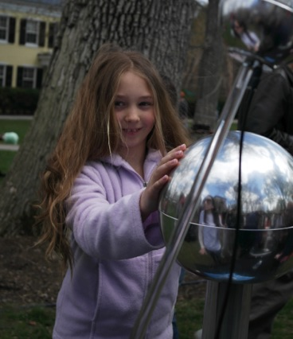
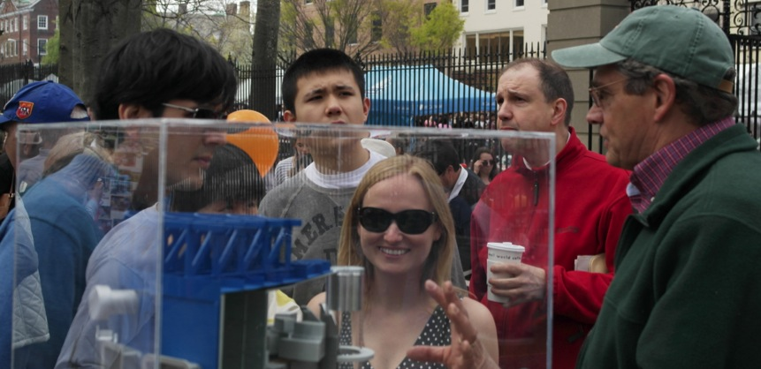
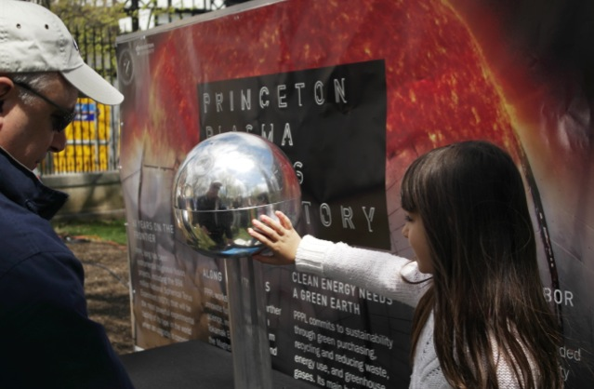

Slide 7
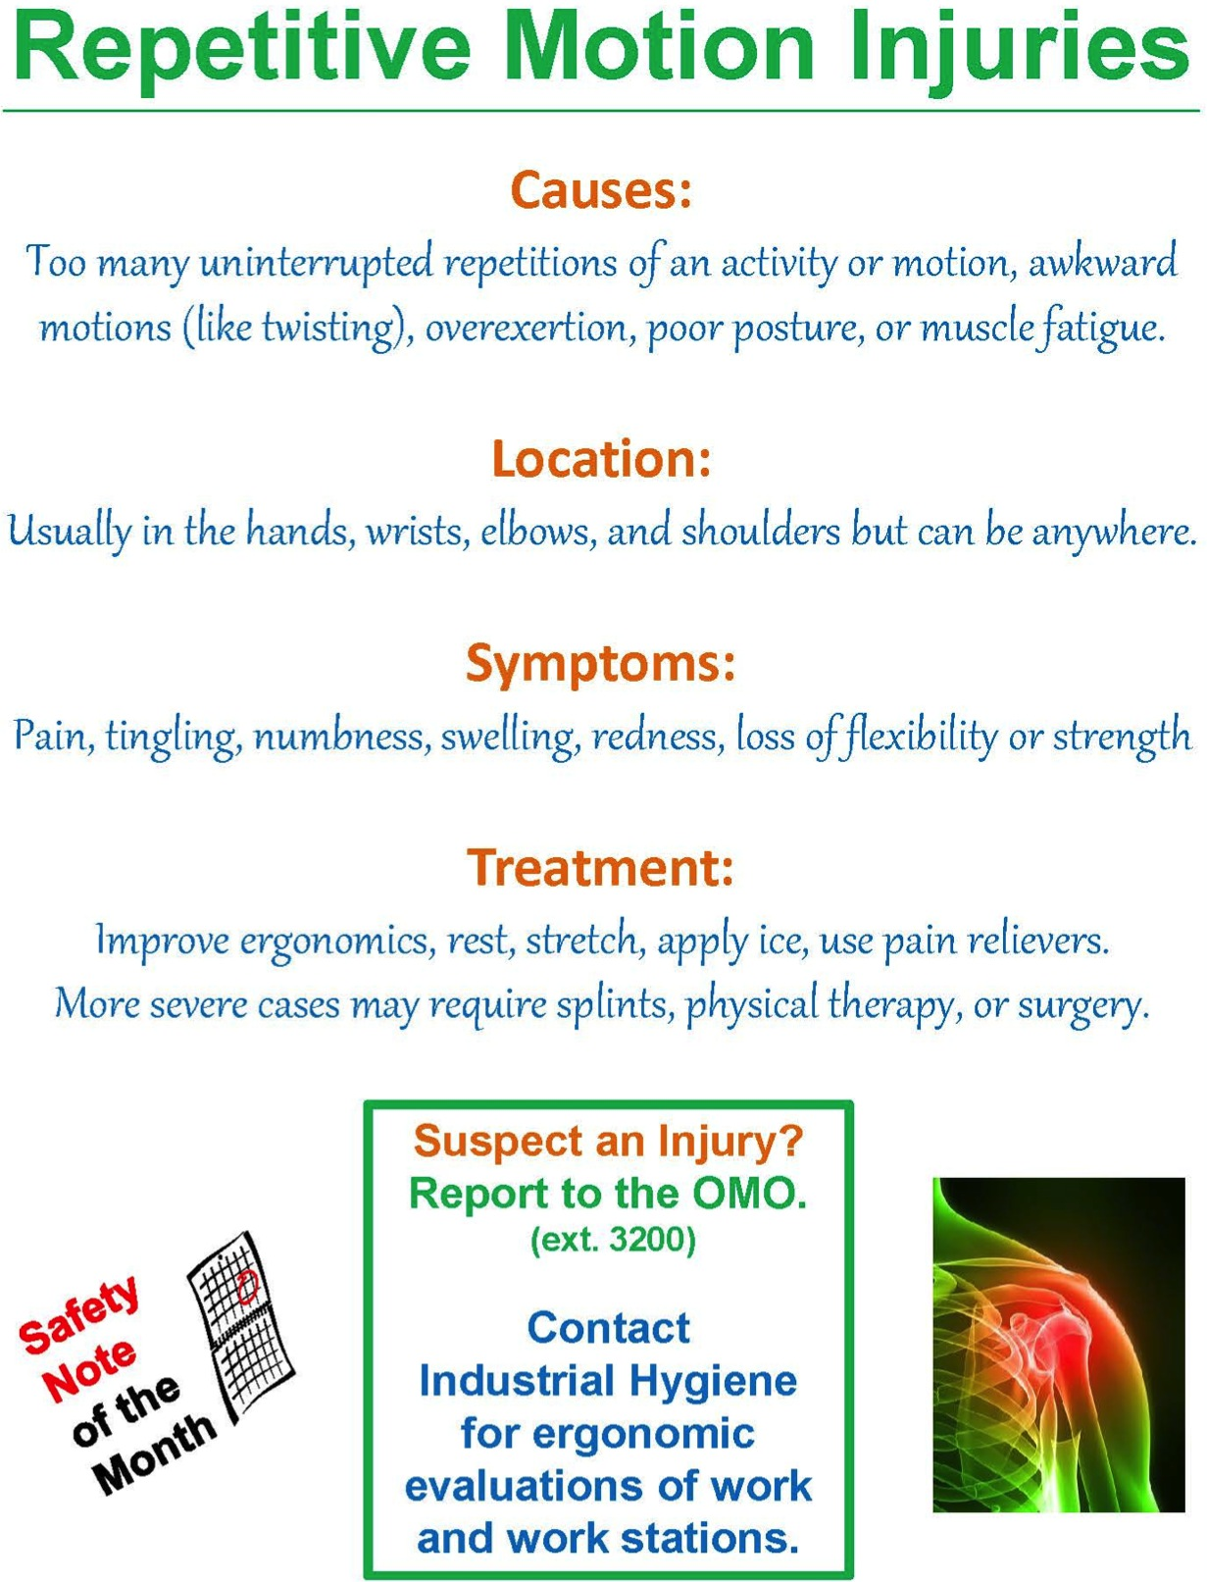
Photo by Dana Eckstein

Slide 8
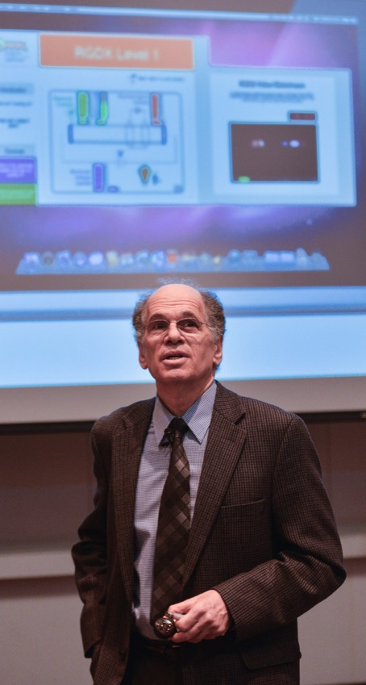
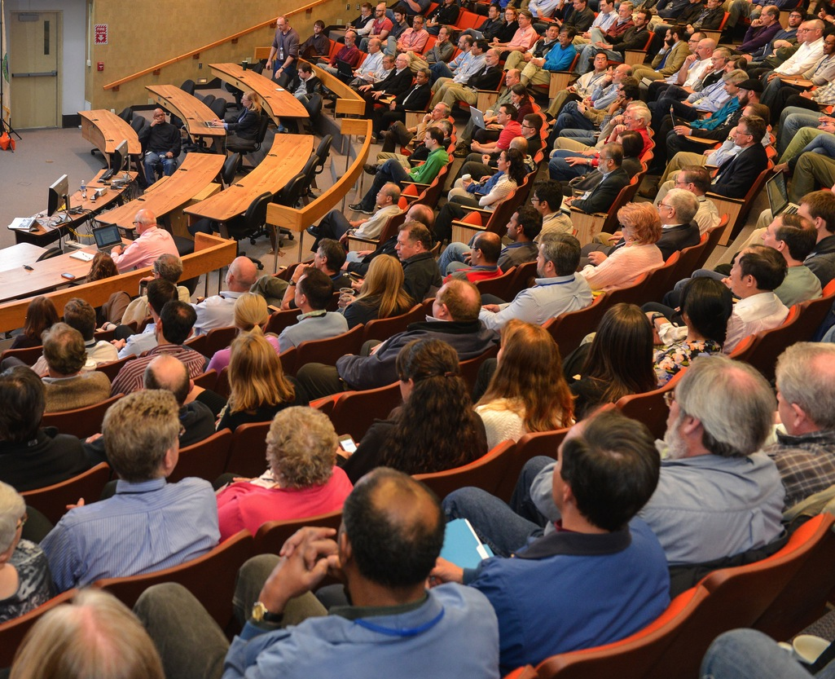

STATE OF THE LAB 2014

Slide 9
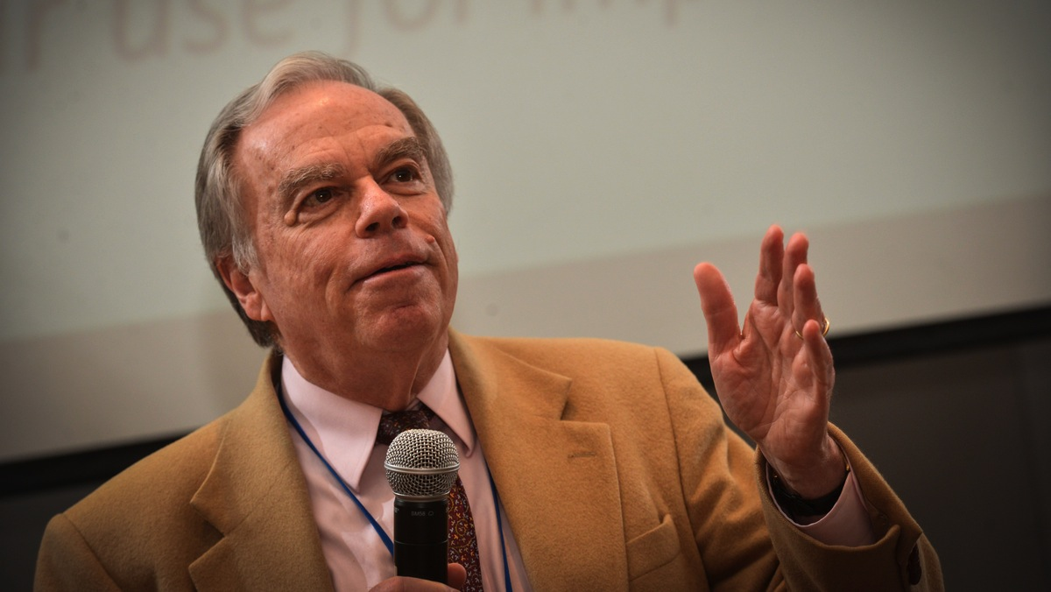
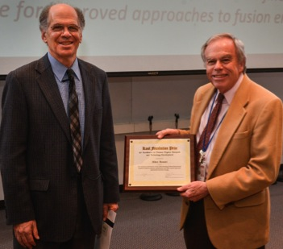
Congratulations ALLEN BOOZER
RECIPIENT OF THE Kaul Foundation Prize
for Excellence in Plasma Physics Research and Technology Development

Slide 10
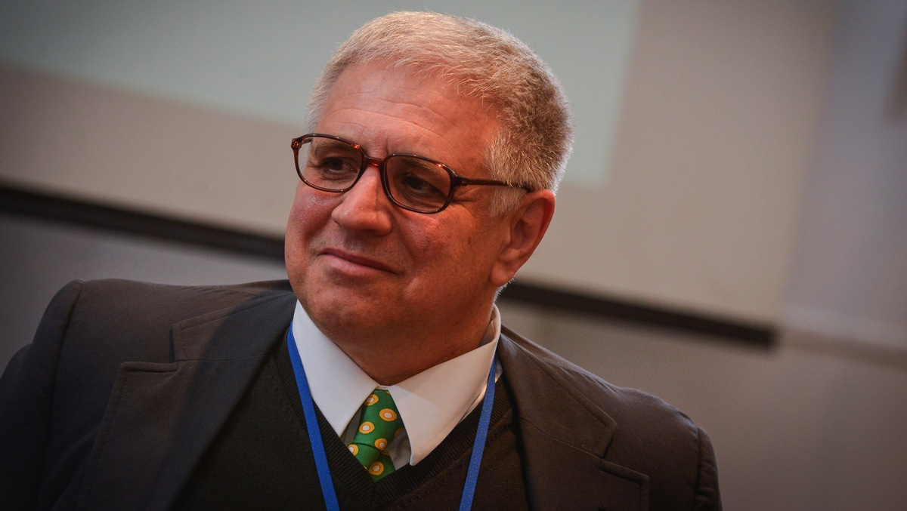
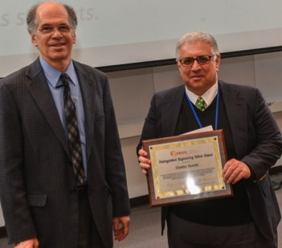
Congratulations CHARLES GENTILE
recipient of the Distinguished Engineering Fellow award

Slide 11
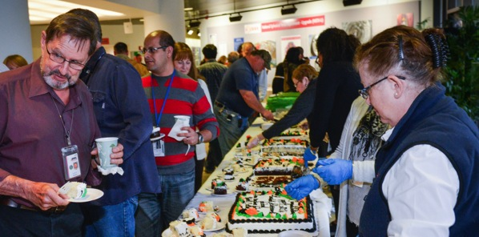
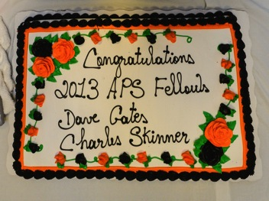
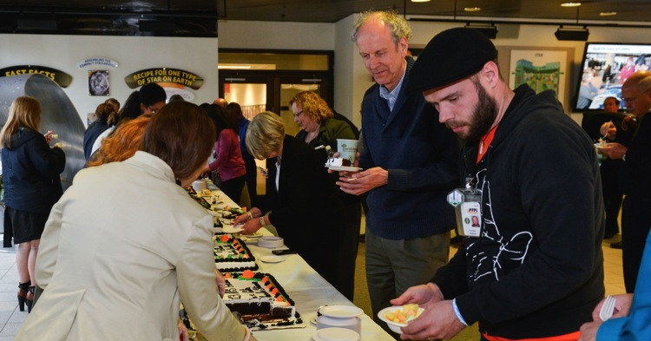
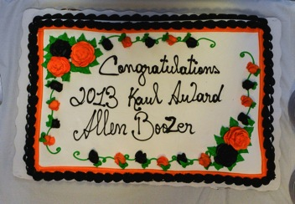
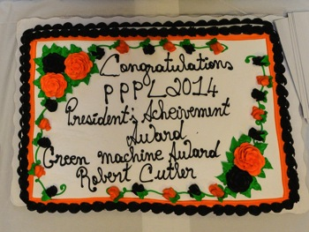
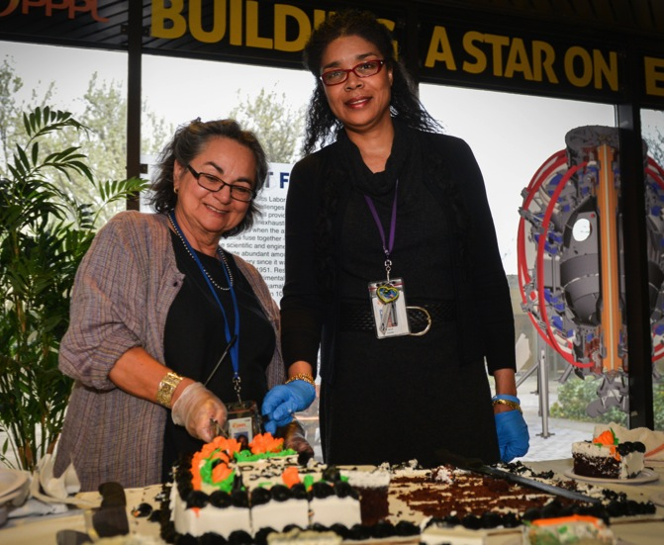
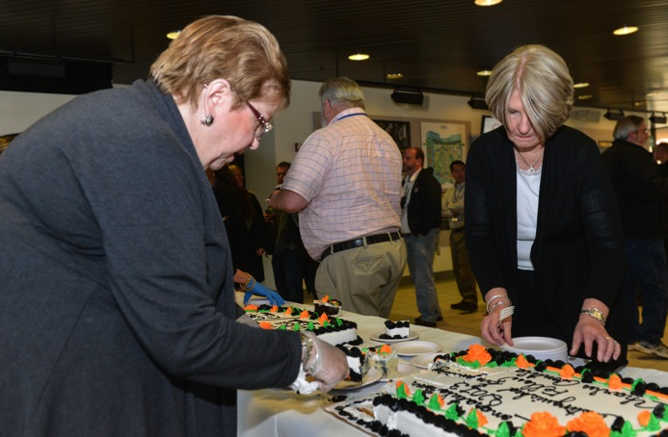
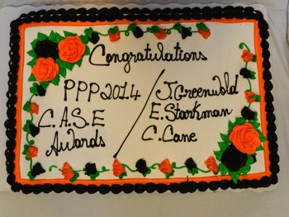
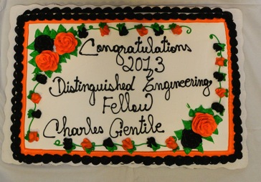
STATE OF THE LAB 2014

Slide 12
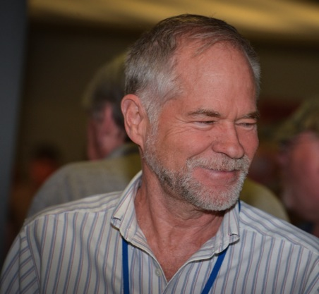
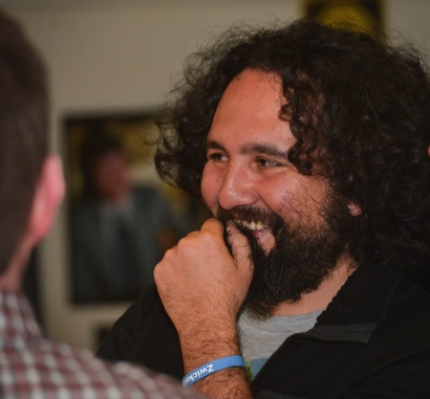
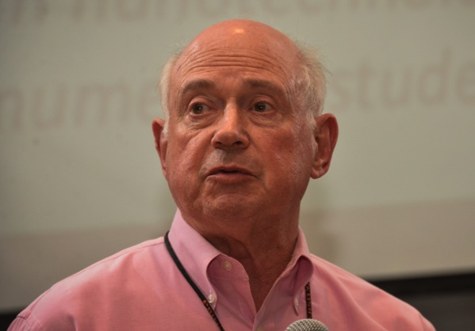
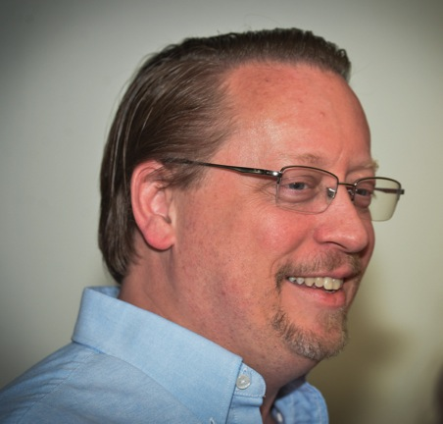
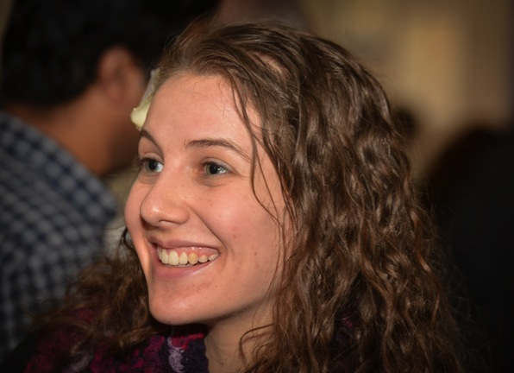
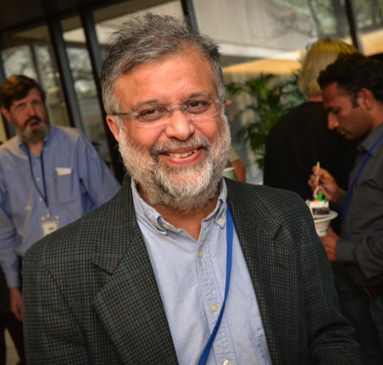
STATE OF THE LAB 2014

Slide 13
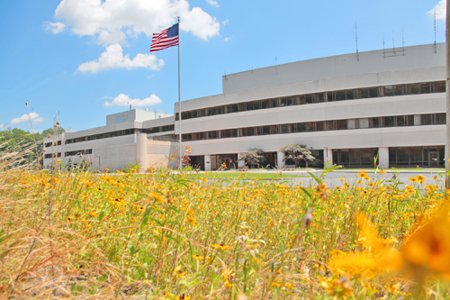

UPCOMING EVENTS
Wednesday, May 7
  Blood Pressure Screening – 11:15 a.m. – LSB Lobby
Wednesday, May 7
  PPPL Colloquium – 4:15 p.m. – MBG Auditorium – “HEDP”
Wednesday, May 14
  PPPL Colloquium – 4:15 p.m. – MBG Auditorium – “Father of Russian Science”
Saturday, May 17
  Girl Scout STEM Fair at PPPL – 8 a.m. to 4 p.m. – Lab wide
Wednesday, May 21
  PPPL Colloquium – 4:15 p.m. – MBG Auditorium – “N.J. as U.S. Electronics Center”
Monday, May 26
  Lab Closed – Memorial Day Holiday
Wednesday, May 28
  PPPL Colloquium – 4:15 p.m. – MBG Auditorium – “IPCC AR5 WG1 Report”

Slide 14
Photo by Dana Eckstein

Slide 15
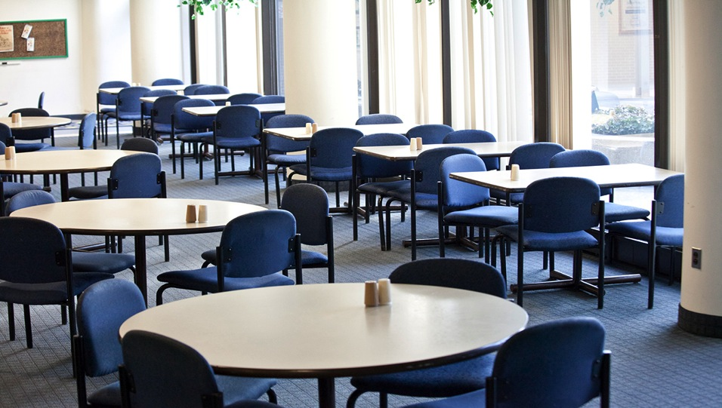

Menu subject to change without notice.

