Slide 1
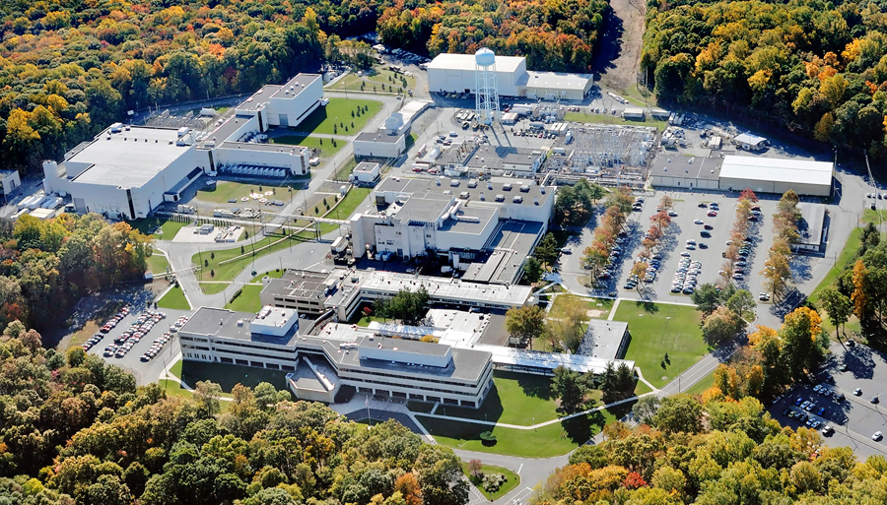
This Week @ PPPL
May 12 - 17, 2014
Brought to you by the PPPL Office of Communications

Slide 2
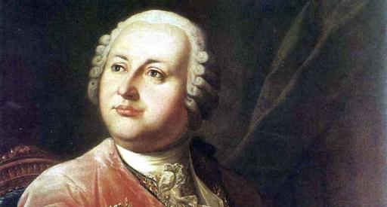

Mikhail Lomonosov – Father of Russian science
Robert Crease - Stony Brook University
Vladimir Shiltsev - Fermi National Accelerator Laboratory
WEDNESDAY, MAY 14
4:15 p.m. • M.B.G. Auditorium

Slide 3
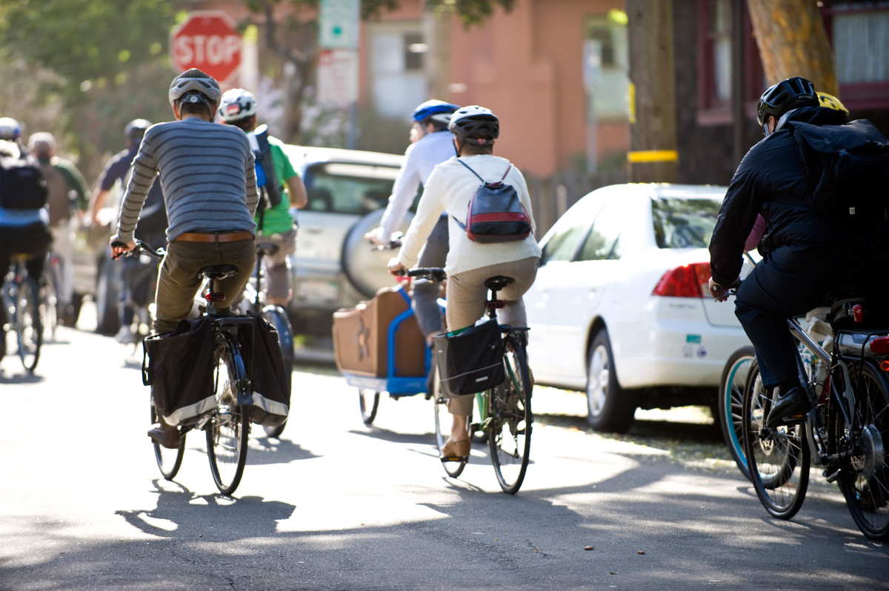

Join a PPPL Bike Team!
Celebrate National Bike Month and join the Federal Bike to Work Challenge by joining one of PPPL’s teams and competing against teams from DOE headquarters, PNNL labs and hundreds of other federal facilities.
All you have to do is agree to bike to work four times during the month of May. (People who live far away can drive to a site closer to the Lab and bike from there).
To sign up go to http://tinyurl.com/k6huwz7 or contact Rob Sheneman, rshenema@pppl.gov with any questions.

Slide 4
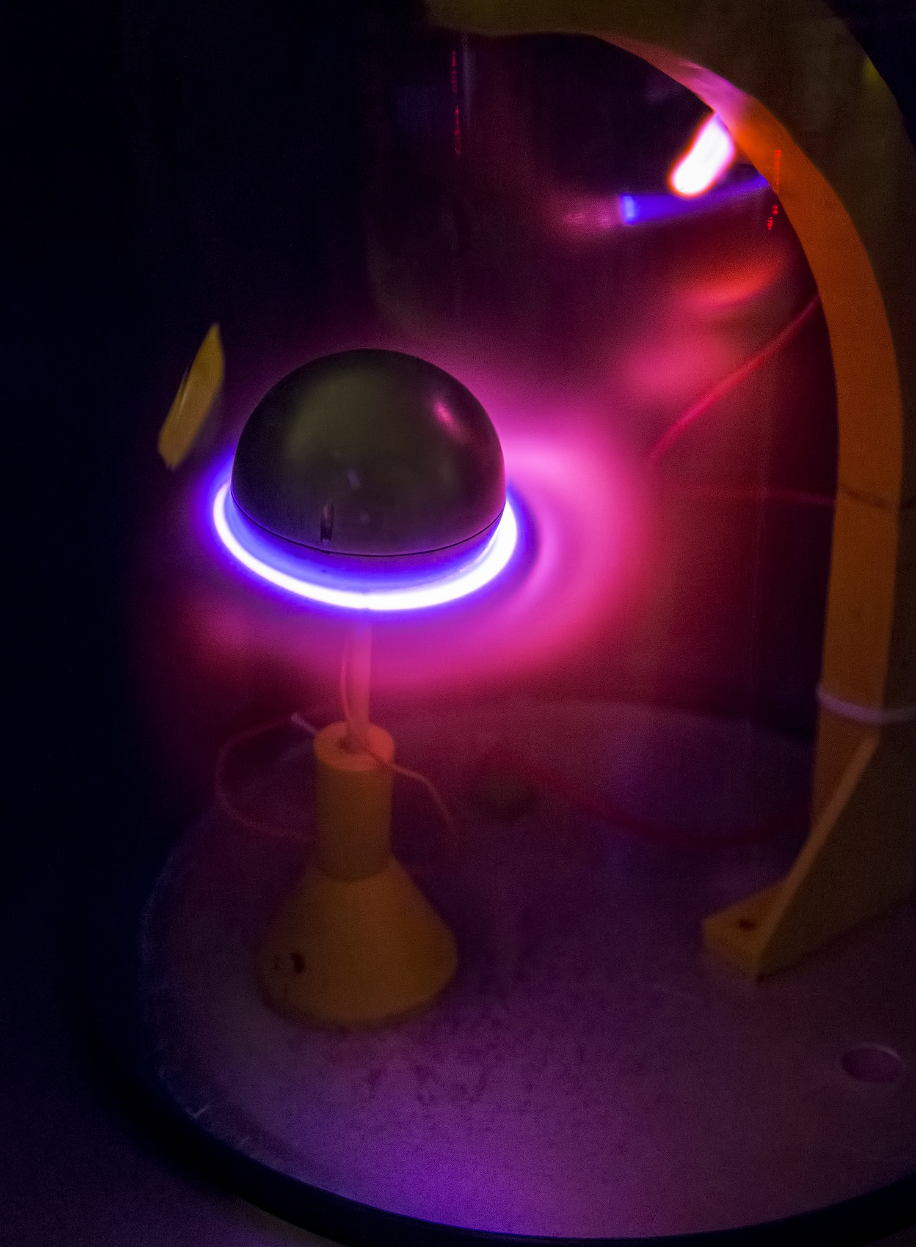
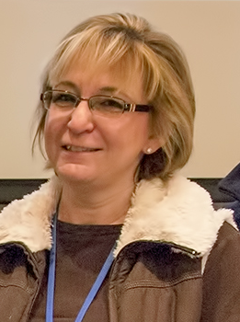

Congratulations to PPPL Photographer
Elle Starkman
Her image, “A Star is Born” has been selected as one of the 44 finalists for the 2014 Art of Science exhibition out of hundreds of submissions.
A stellar ring current is a space phenomenon involving highly magnetized stars in higher pressure atmospheres. In this laboratory simulation called a "Planeterrella," we create an environment where a magnetized stainless steel sphere has electrons over its entire surface exciting the gas in the vacuum chamber which then emits energy through light waves. The sphere becomes a "star" with the magnetic field turning the electrons down toward the equator creating the ring.

Slide 5

PPPL Welcomes New Employees…

Slide 6
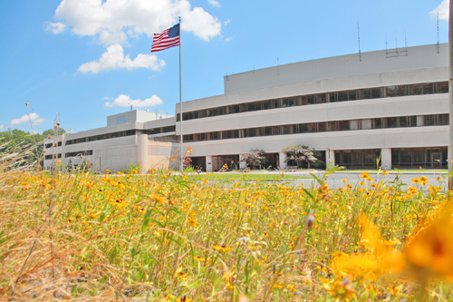


UPCOMING EVENTS
Wednesday, May 14
  PPPL Colloquium – 4:15 p.m. – MBG Auditorium – “Father of Russian Science”
Saturday, May 17
  Girl Scout STEM Fair at PPPL – 8 a.m. to 4 p.m. – Lab wide
Wednesday, May 21
  PPPL Colloquium – 4:15 p.m. – MBG Auditorium – “N.J. as U.S. Electronics Center”
Monday, May 26
  Lab Closed – Memorial Day Holiday
Wednesday, May 28
  PPPL Colloquium – 4:15 p.m. – MBG Auditorium – “Future Projections of Climate Change: An Update from IPCC AR5IPCC AR5 WG1 Report”
Friday, May 30
  Princeton University Reunions Weekend – Tours at PPPL

Slide 7
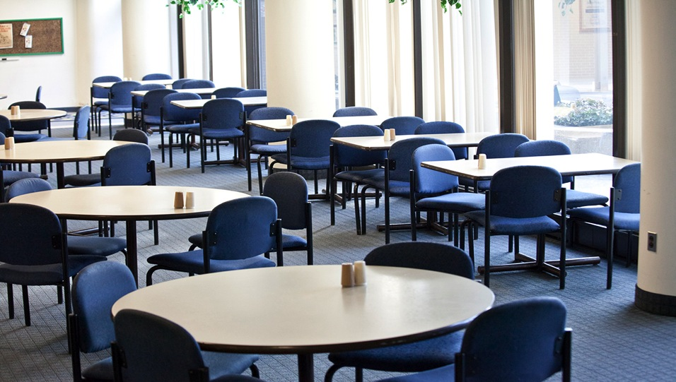
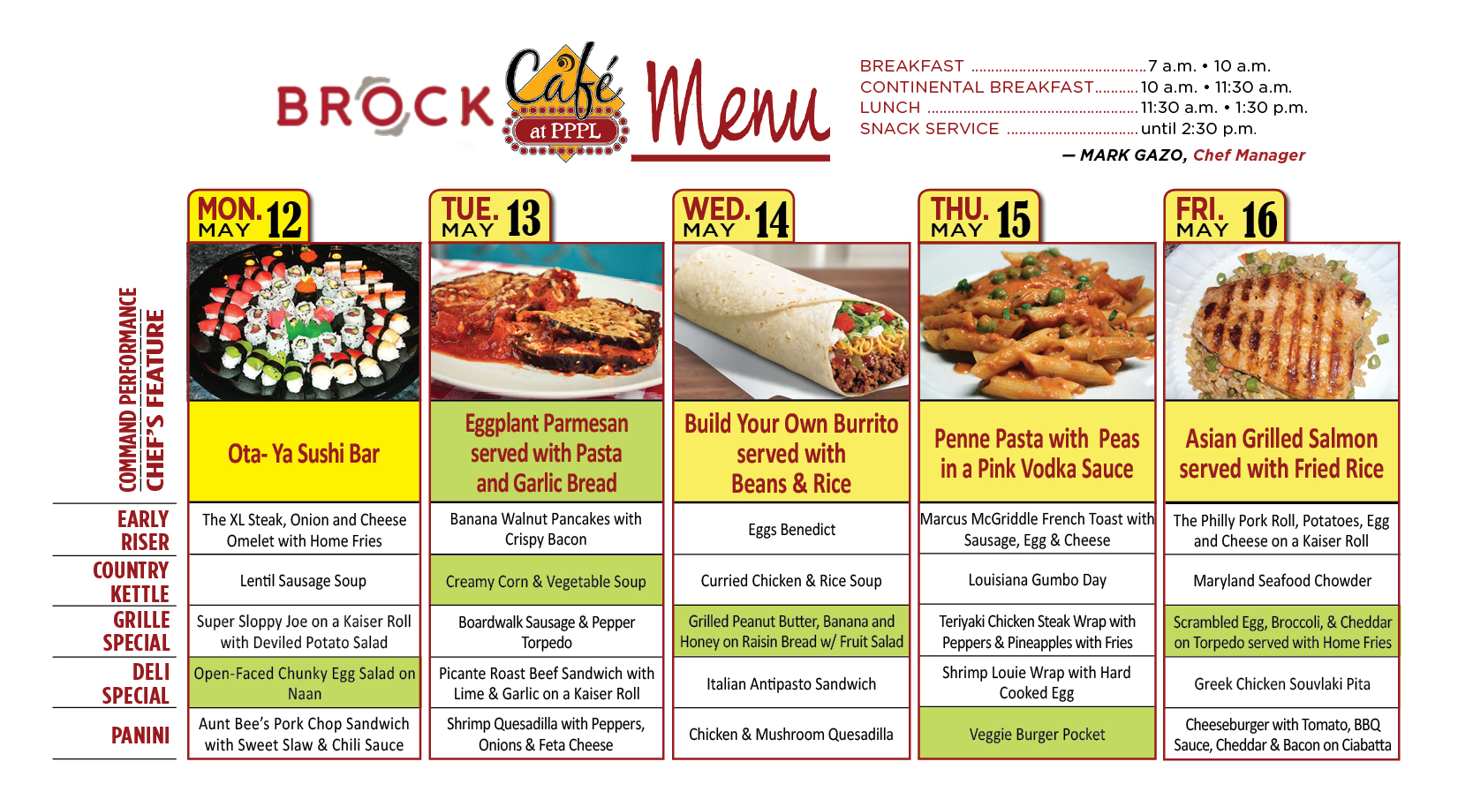
Menu subject to change without notice.

