Slide 1
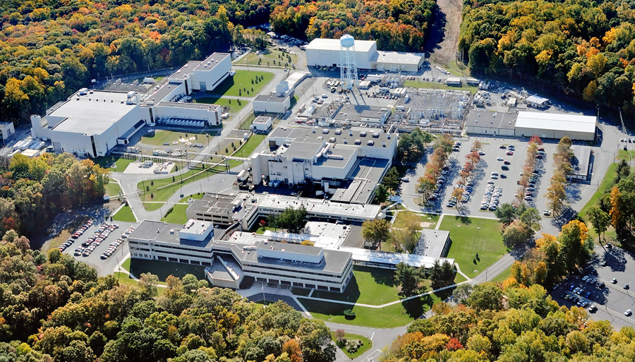
This Week @ PPPL
May 19 - 23, 2014
Brought to you by the PPPL Office of Communications

Slide 2
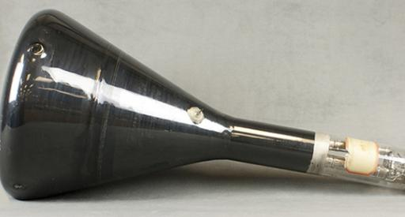

N.J. as U.S. Electronics Center
Benjamin Gross - The Sarnoff Collection
WEDNESDAY, MAY 21
4:15 p.m. • M.B.G. Auditorium

Slide 3
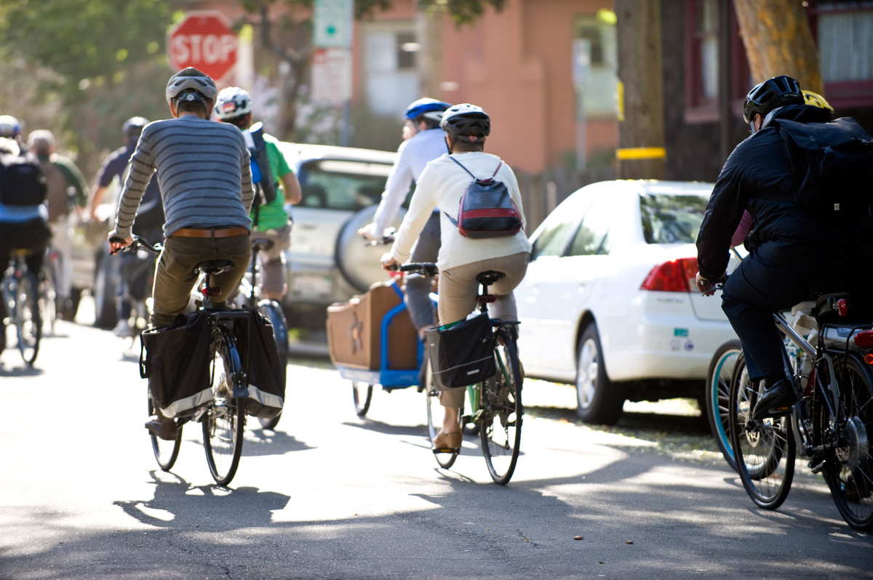

Join a PPPL Bike Team!
Celebrate National Bike Month and join the Federal Bike to Work Challenge by joining one of PPPL’s teams and competing against teams from DOE headquarters, PNNL and hundreds of other federal facilities.
All you have to do is agree to bike to work four times during the month of May. (People who live far away can drive to a site closer to the Lab and bike from there).
To sign up go to http://tinyurl.com/k6huwz7 or contact Rob Sheneman, rshenema@pppl.gov with any questions.

Slide 4

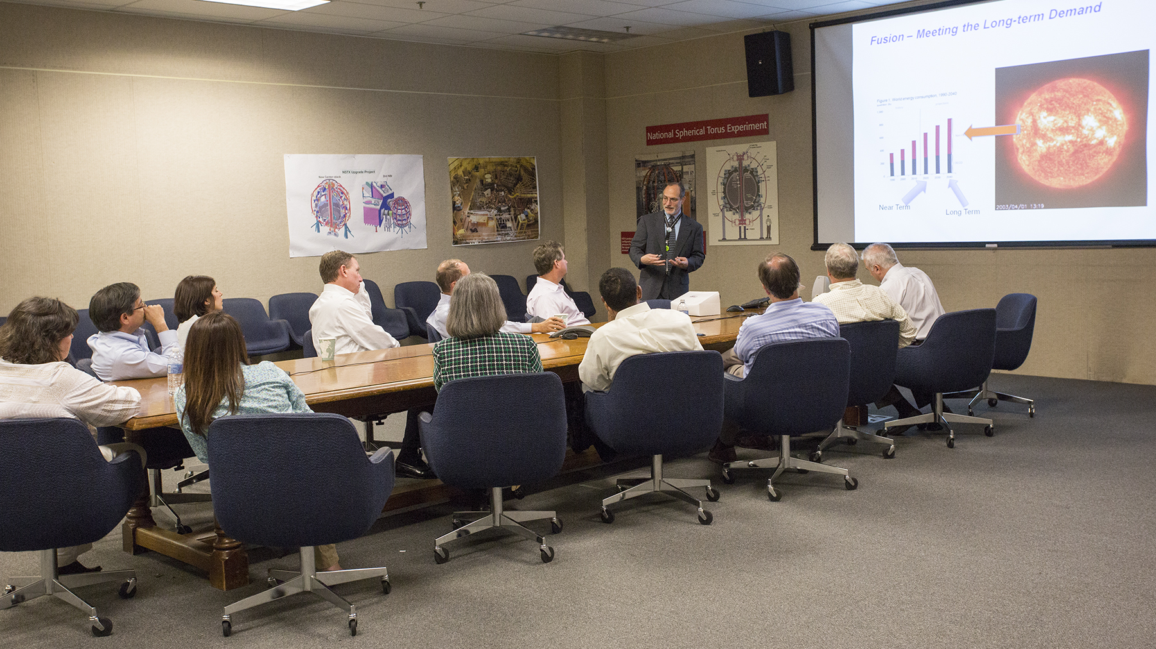
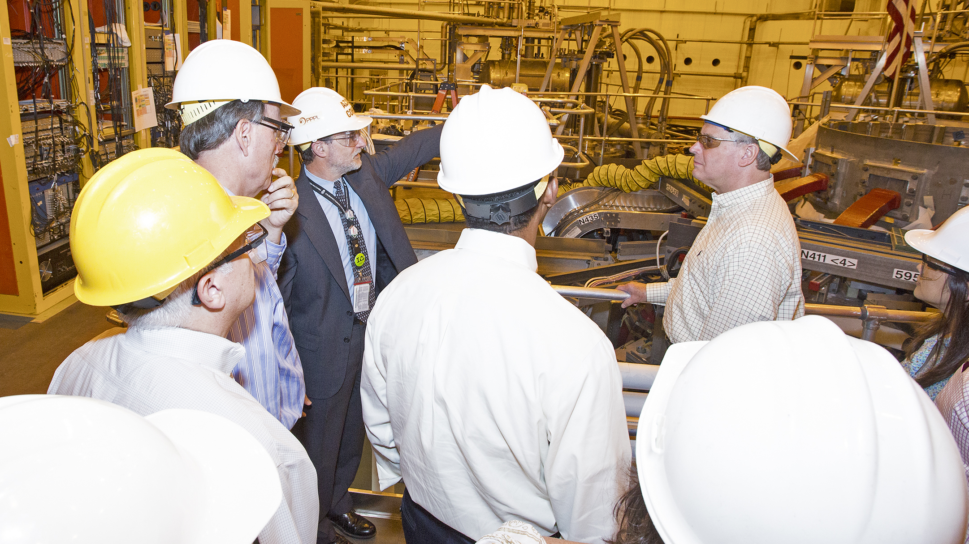
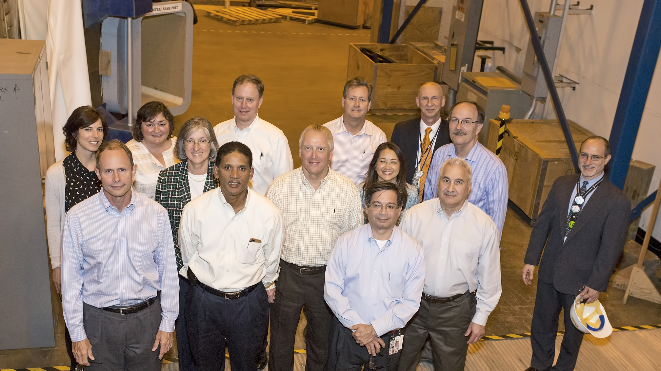
ExxonMobil executives visit PPPL

Slide 5

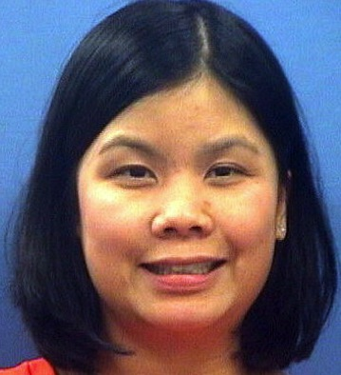
Please welcome Janice Huang,
a program assistant to
A.J. Stewart Smith,
Princeton University’s V.P. for PPPL

Slide 6
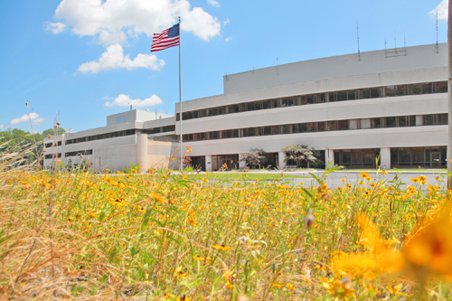


UPCOMING EVENTS
Wednesday, May 21
  PPPL Colloquium – 4:15 p.m. – MBG Auditorium – “N.J. as U.S. Electronics Center”
Monday, May 26
  Lab Closed – Memorial Day Holiday
Wednesday, May 28
  PPPL Colloquium – 4:15 p.m. – MBG Auditorium – “Future Projections of Climate Change: An Update from IPCC AR5IPCC AR5 WG1 Report”
Friday, May 30
  Princeton University Reunions Weekend – Tours at PPPL
Wednesday, June 11
  PPPL Colloquium – 4:15 p.m. – MBG Auditorium – “Magnetic Reconnection”
Wednesday, June 18
  PPPL Colloquium – 4:15 p.m. – MBG Auditorium – “Nuclear Winter”

Slide 7
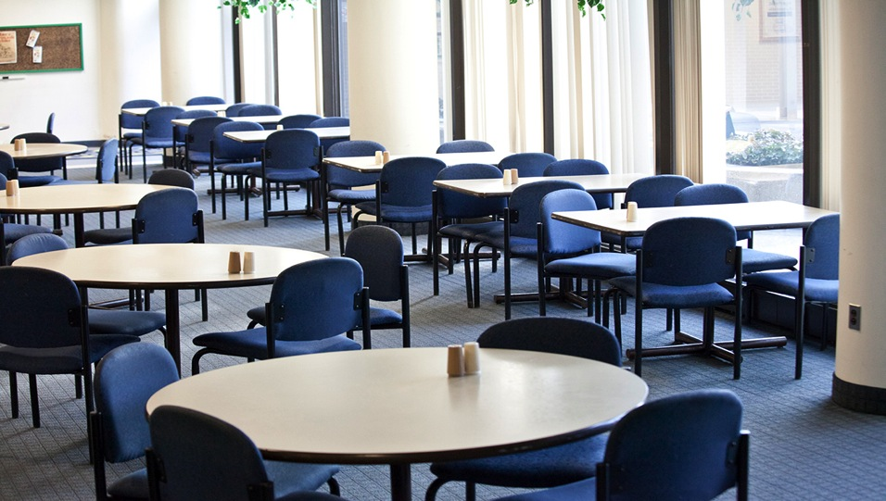

Menu subject to change without notice.

