Slide 1
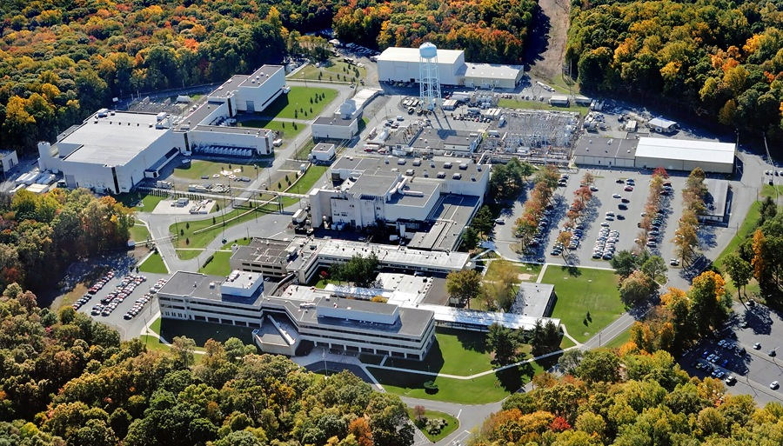

This Week @ PPPL
May 26 – May 30, 2014
Brought to you by the PPPL Office of Communications

Slide 2

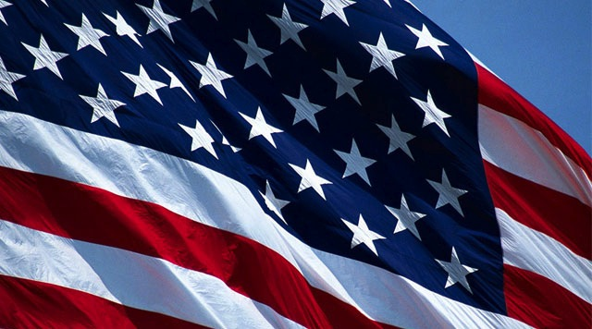

May 26

Slide 3
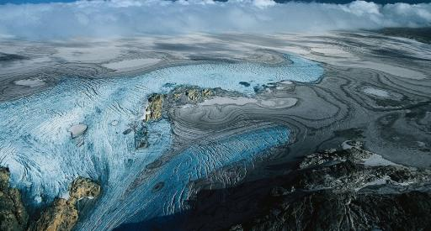

Future Projections of Climate Change:
An Update from IPCC AR5IPCC AR5 WG1 Report
Claudia Tebaldi
National Center for Atmospheric Research
WEDNESDAY, MAY 28
4:15 p.m. • M.B.G. Auditorium

Slide 4
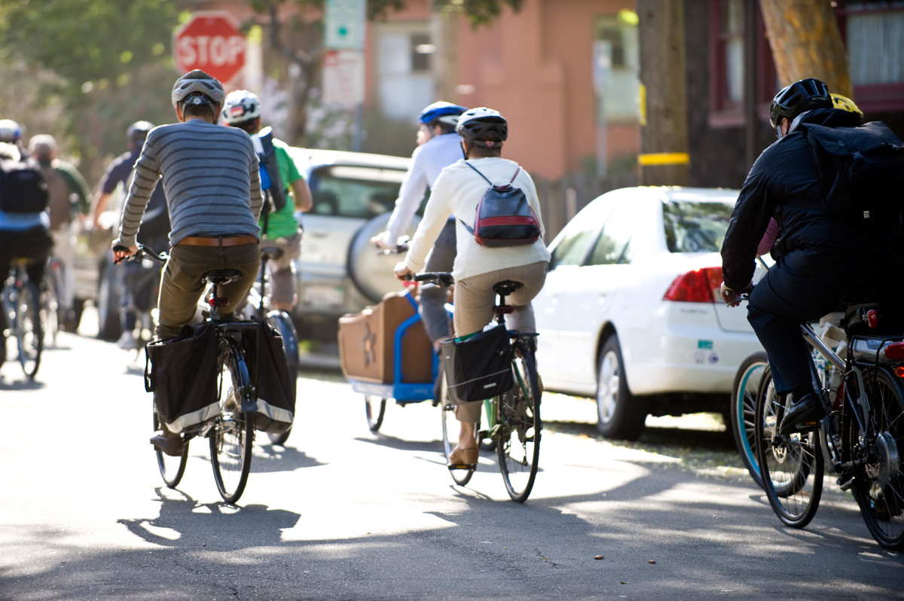

Join a PPPL Bike Team!
Celebrate National Bike Month and join the Federal Bike to Work Challenge by joining one of PPPL’s teams and competing against teams from DOE headquarters, PNNL and hundreds of other federal facilities.
All you have to do is agree to bike to work four times during the month of May. (People who live far away can drive to a site closer to the Lab and bike from there).
To sign up go to http://tinyurl.com/k6huwz7 or contact Rob Sheneman, rshenema@pppl.gov with any questions.

Slide 6

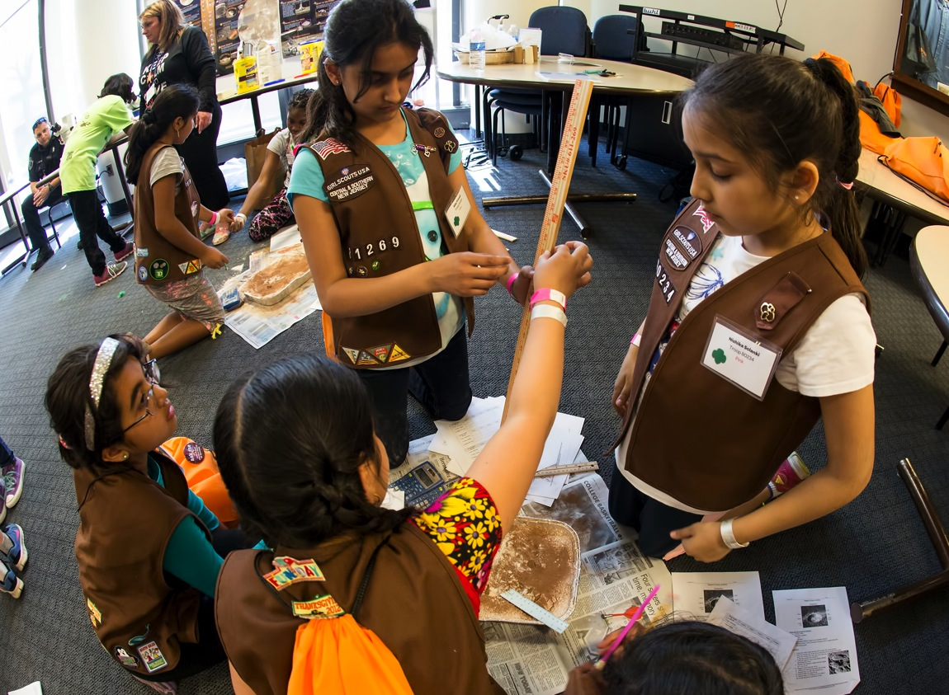
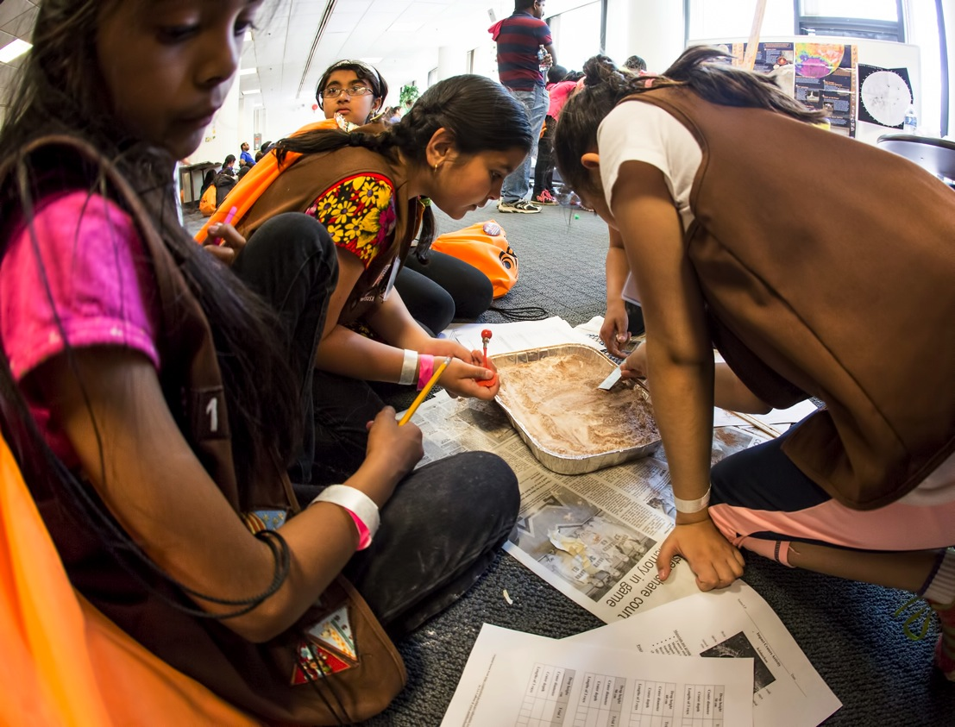
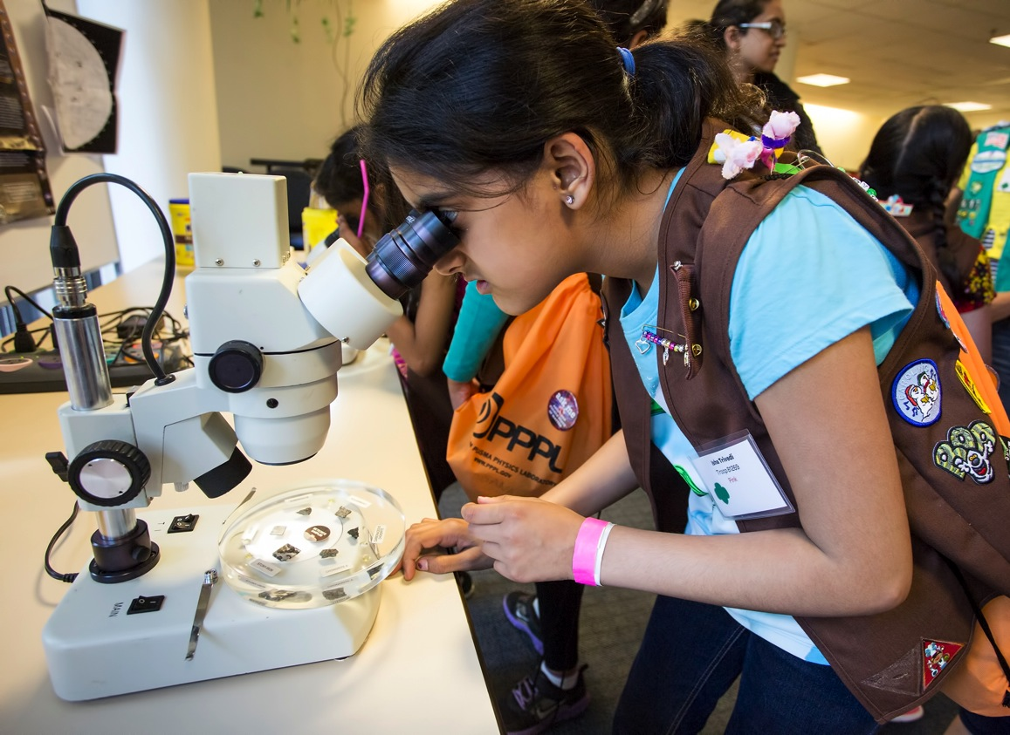
Girl Scout STEM Fair at PPPL

Slide 7
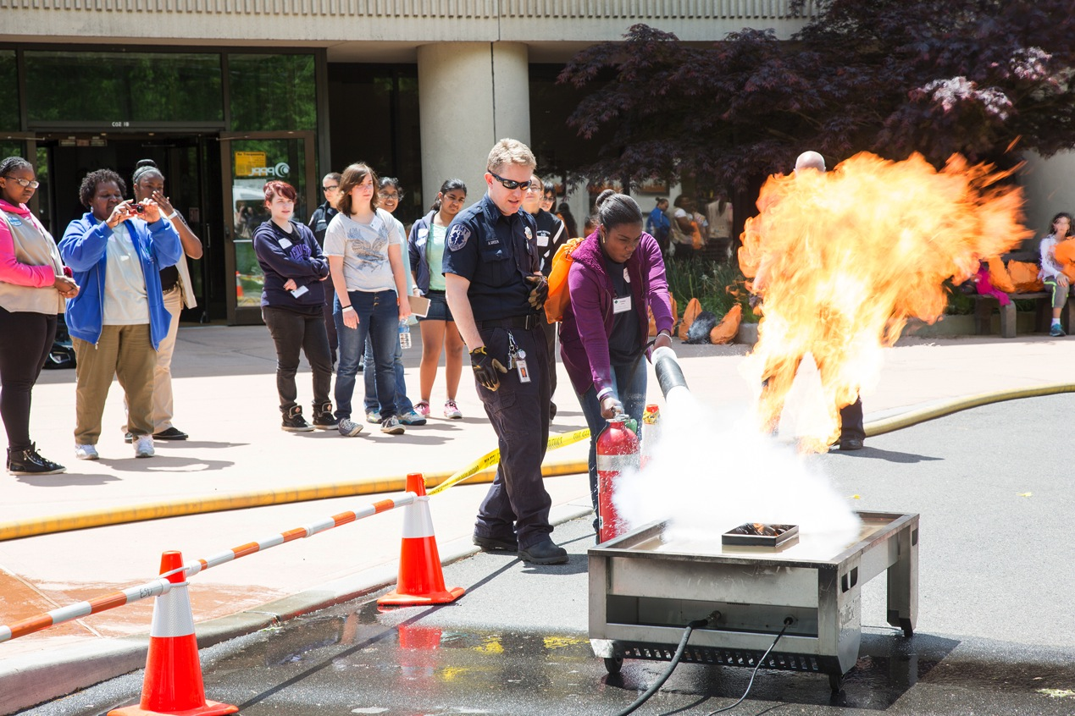
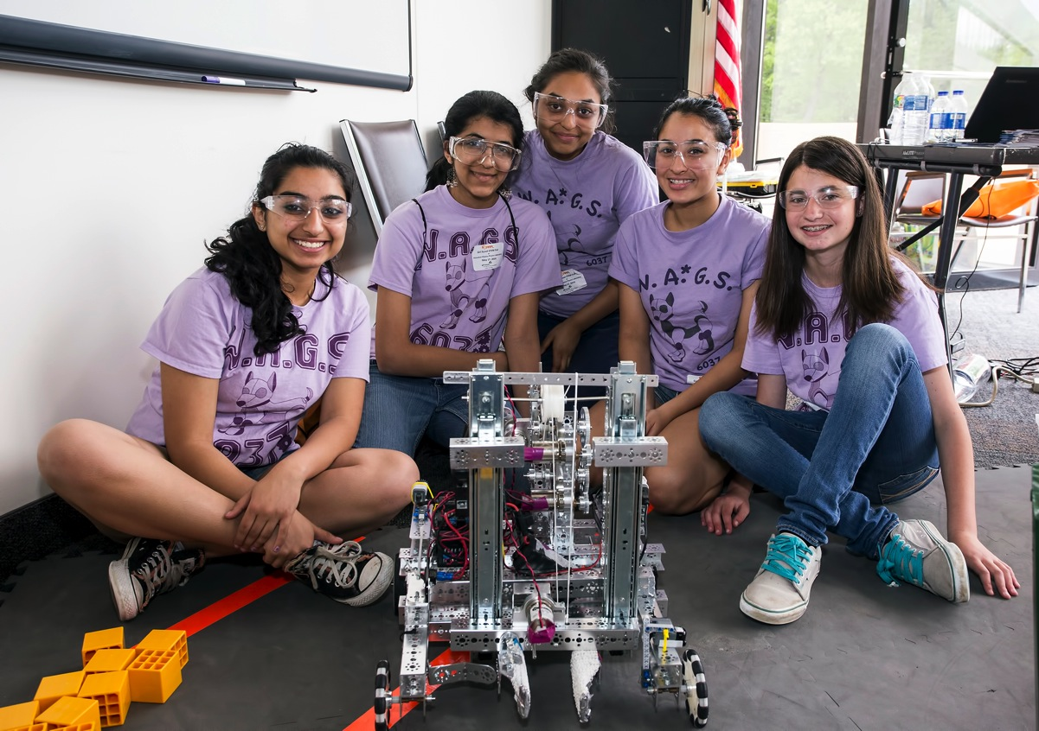
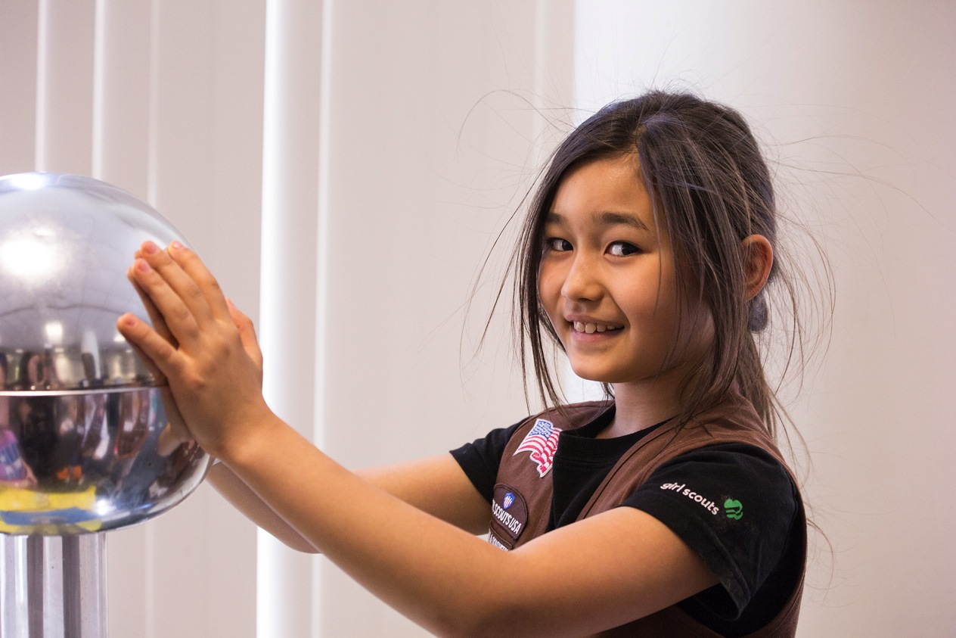
Girl Scout STEM Fair at PPPL

Slide 8
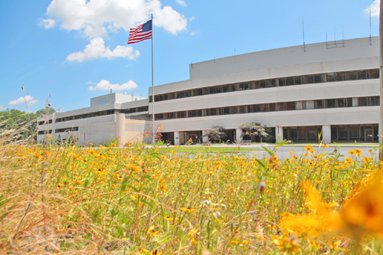


UPCOMING EVENTS
Wednesday, May 28
  PPPL Colloquium – 4:15 p.m. – MBG Auditorium – “Future Projections of Climate Change: An Update from IPCC AR5IPCC AR5 WG1 Report”
Friday, May 30
  Princeton University Reunions Weekend – Tours at PPPL
Tuesday, June 3
  Princeton University Commencement – 11 a.m. – Main Campus
Wednesday, June 11
  PPPL Colloquium – 4:15 p.m. – MBG Auditorium – “Magnetic Reconnection”
Wednesday, June 18
  PPPL Colloquium – 4:15 p.m. – MBG Auditorium – “Nuclear Winter”
Wednesday, June 25
  PPPL Colloquium – 4:15 p.m. – MBG Auditorium – “Cosmic Microwave Background”

Slide 9
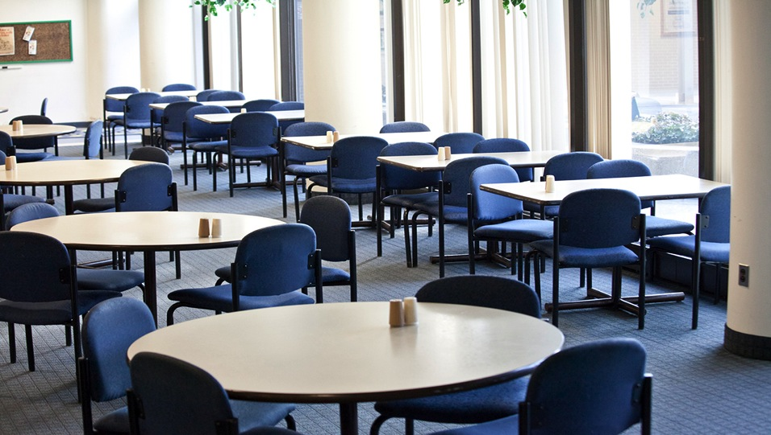

Menu subject to change without notice.

