Slide 1
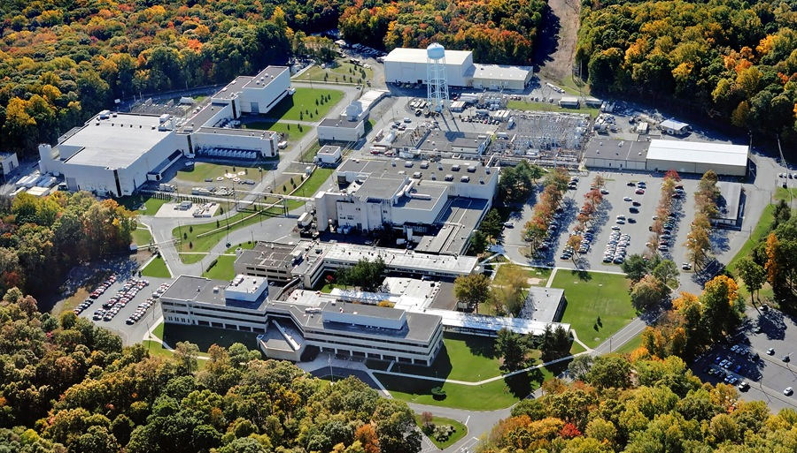
This Week @ PPPL
June 9 - 13, 2014
Brought to you by the PPPL Office of Communications

Slide 2


Alumni tour PPPL for Princeton reunions

Slide 6
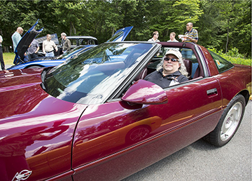
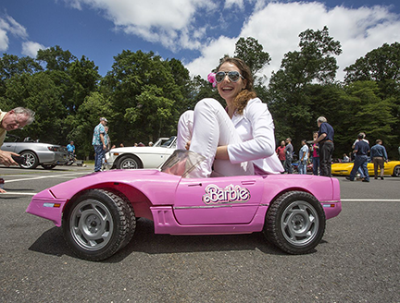
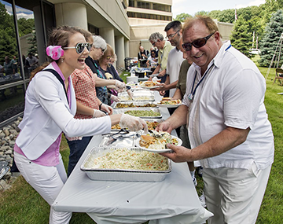
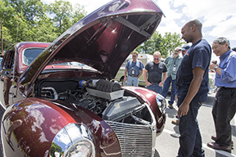
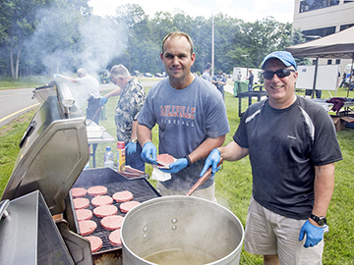
Engineering Picnic • June 6

Slide 7
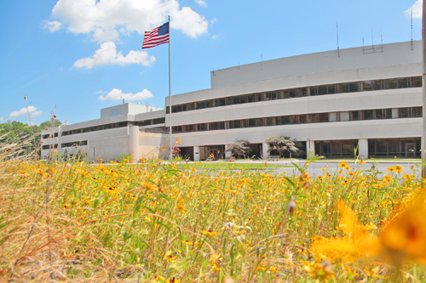

Space Physics and the Role of Magnetic
^{Reconnection in Space Weather}
^{Vassilis Angelopoulous •} ^{UCLA}
^{Wednesday, June 11}
4:15 p.m. (Coffee/Tea at 4 p.m.) • MBG Auditorium

Slide 8
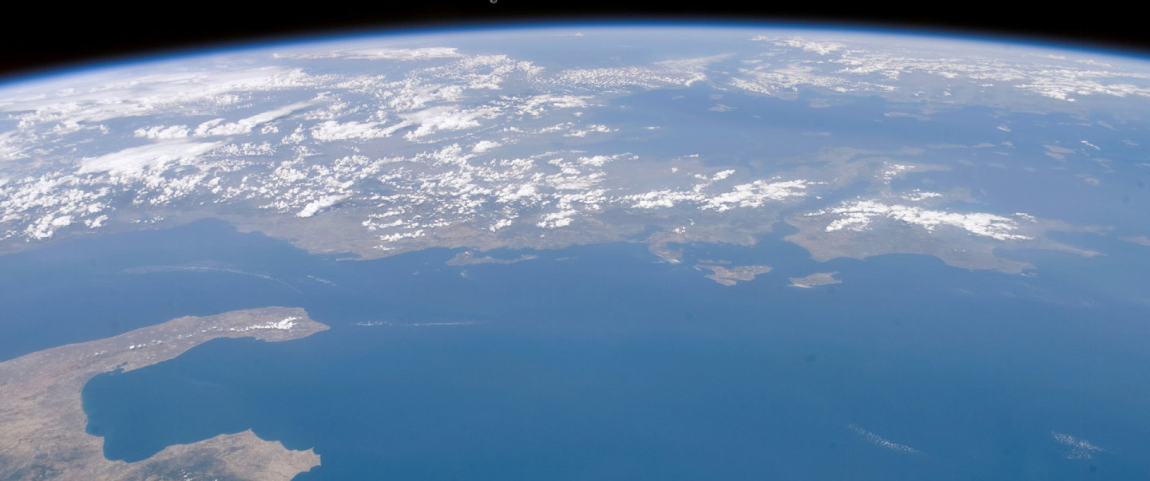
Nuclear Famine: The Threat to Humanity from Nuclear Weapons
^{Dr. Alan Robock •} ^{Rutgers University}
^{Wednesday, June 18}
4:15 p.m. (Coffee/Tea at 4 p.m.) • MBG Auditorium

Slide 9

UPCOMING EVENTS
Wednesday, June 11
  PPPL Colloquium – 4:15 p.m. – MBG Auditorium – “Magnetic Reconnection”
  Wed. – Sat., June 11-14
  NSTX-U PAC-35 (Program Advisory Committee)
Wednesday, June 18
  PPPL Colloquium – 4:15 p.m. – MBG Auditorium – “Nuclear Winter”
Thursday, June 19
  PPPL Patent Award Dinner – 6 p.m. – Prospect House, Princeton University
Wednesday, June 25
  PPPL Colloquium – 4:15 p.m. – MBG Auditorium – “Cosmic Microwave Background”
  Wed. – Fri., July 9-11
^{Disruption Theory Conference}

Slide 10
