Slide 1
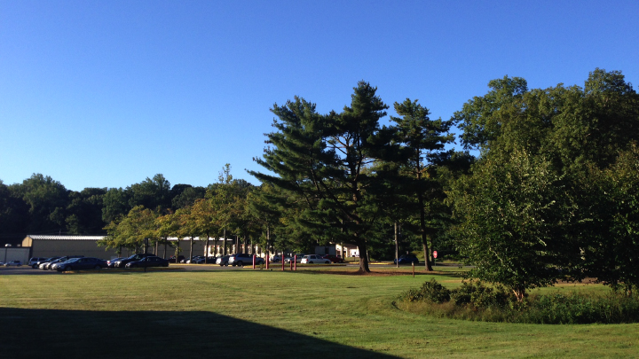
This Week @ PPPL
June 16 - 21, 2014
Brought to you by the PPPL Office of Communications

Slide 2
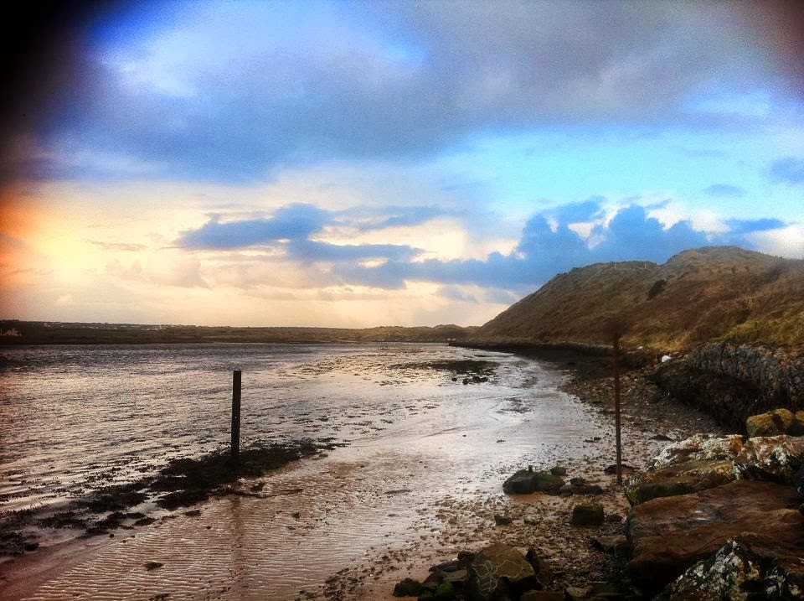

Nuclear Famine: The Threat to Humanity from Nuclear Weapons
Alan Robock
Rutgers University
Wednesday, June 18
4:15 p.m. • M.B.G. Auditorium

Slide 3
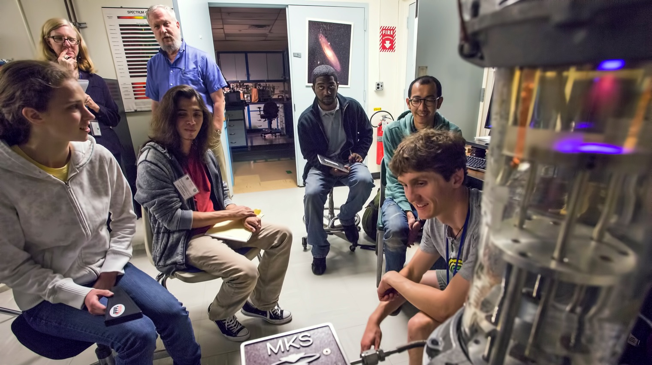
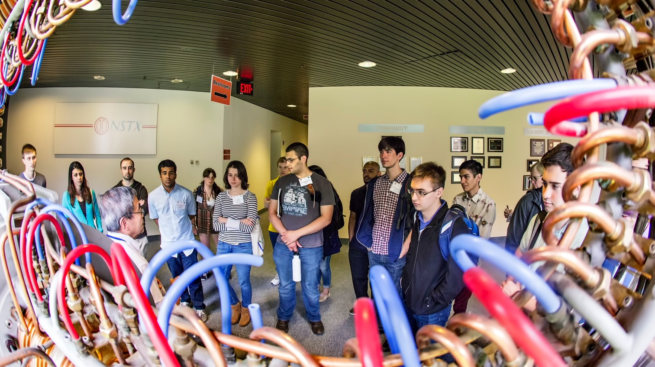
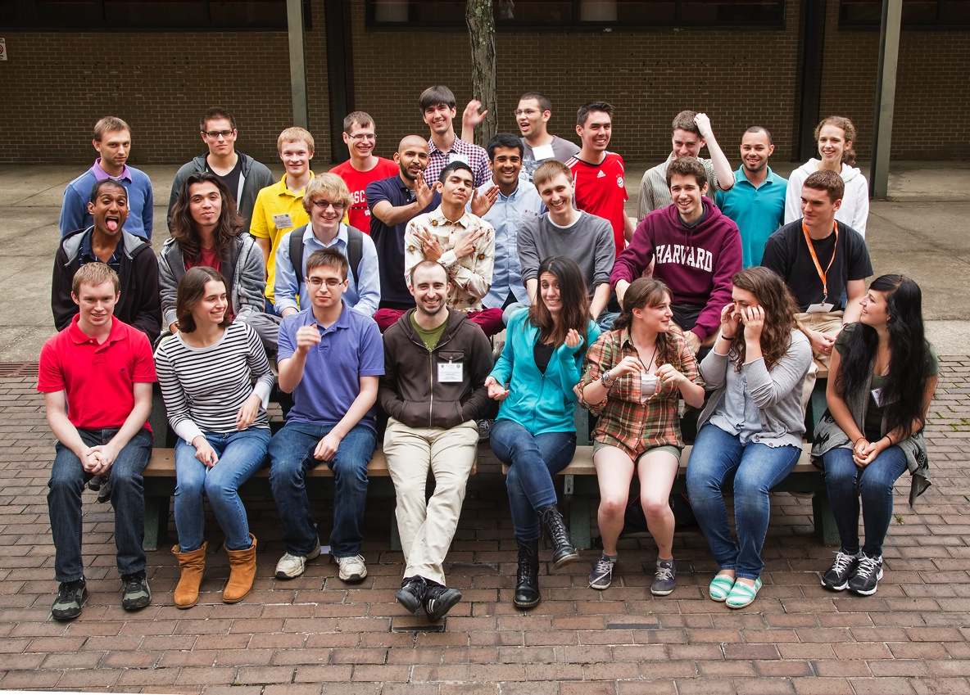
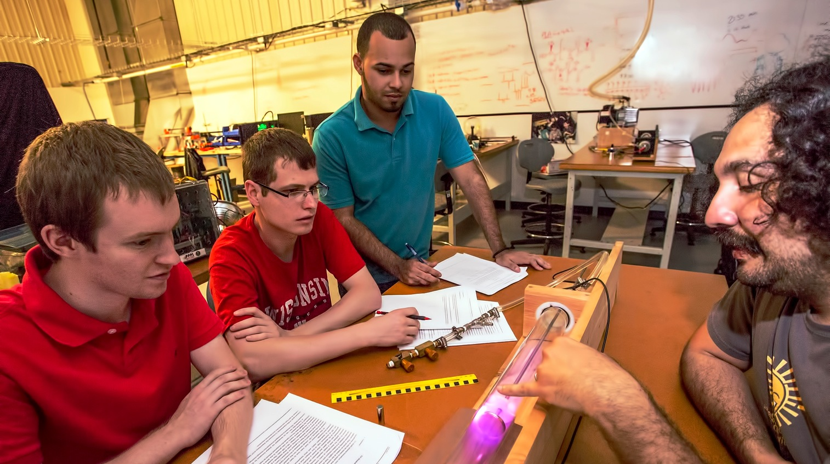
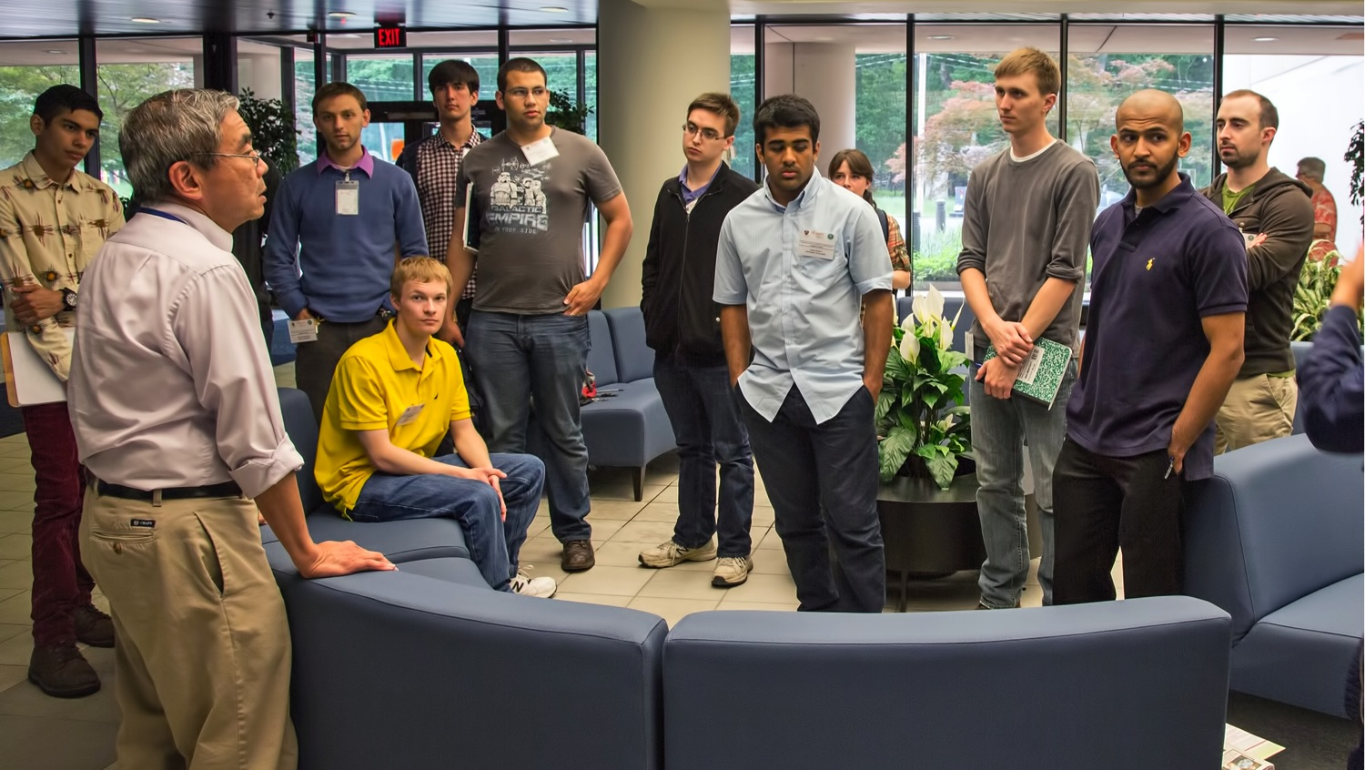
Summer Students at PPPL

Slide 4
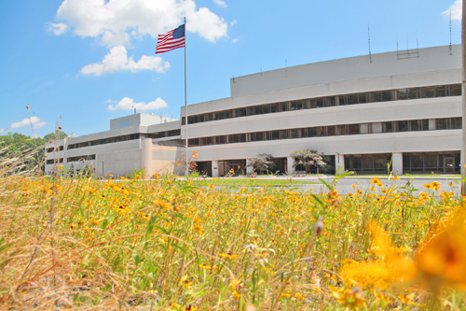


UPCOMING EVENTS
Wednesday, June 18
  PPPL Colloquium – 4:15 p.m. – MBG Auditorium – “Nuclear Famine: The Threat to Humanity from Nuclear Weapons”
Thursday, June 19
  PPPL Patent Award Dinner – 6 p.m. – Prospect House, Princeton University
Wednesday, June 25
  PPPL Colloquium – 4:15 p.m. – MBG Auditorium – “Cosmic Microwave Background”
Friday, July 4
  Lab Closed – Independence Day Holiday
  Wed. – Fri., July 9-11
^{Disruption Theory Conference}
Friday, August 8
  Annual PPPL Bluefishing Trip – 5 p.m. – Belmar Marina

Slide 5
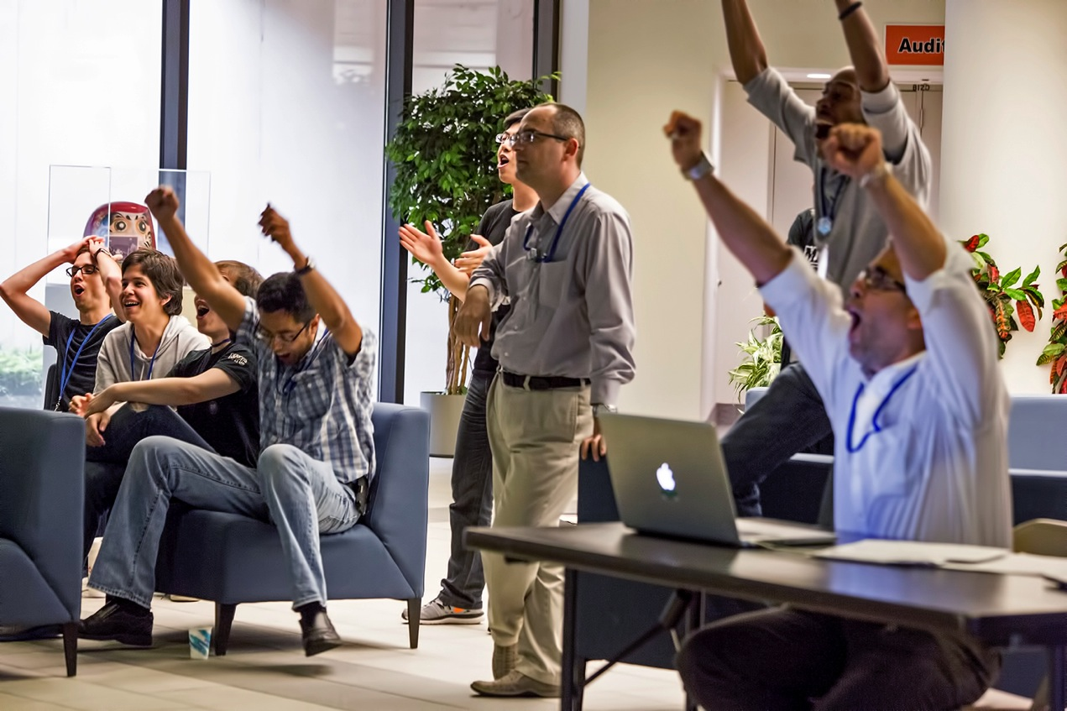
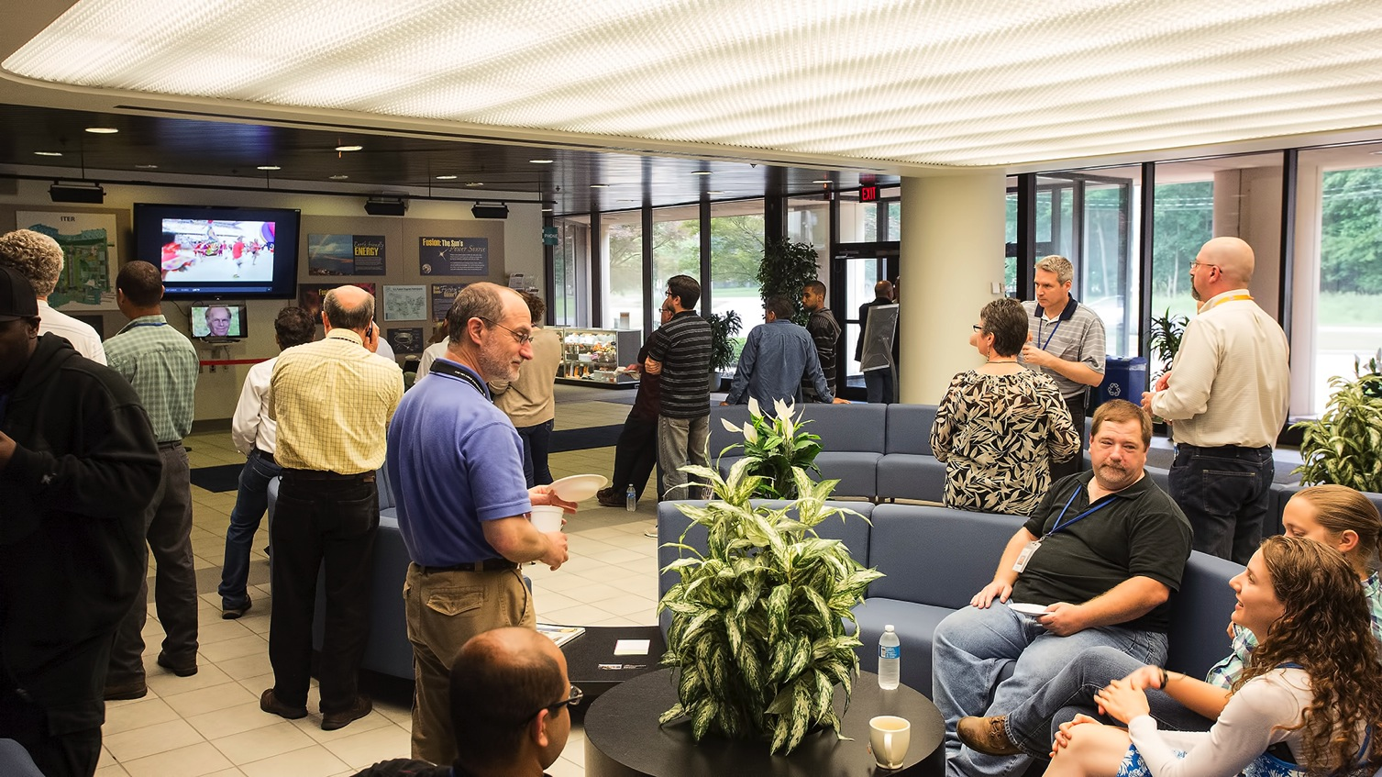
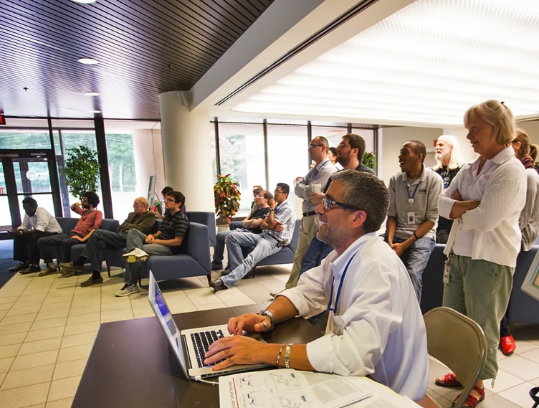

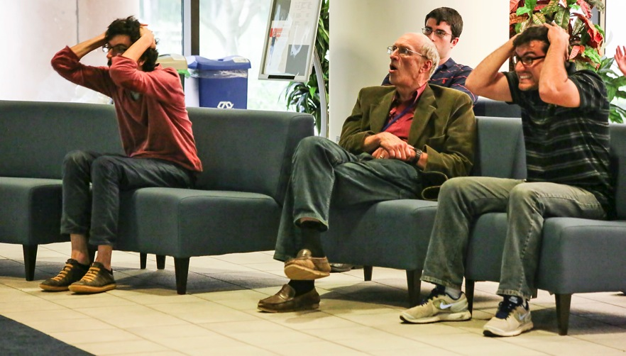


Slide 6

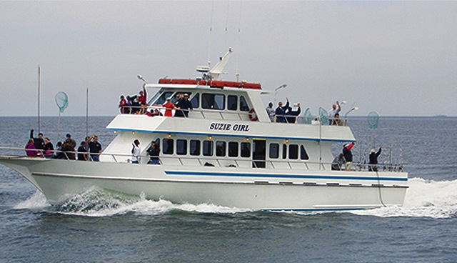
2014 PPPL Bluefishing Trip
FRIDAY, AUGUST 8
Aboard the 80’ Suzie Girl
Departure: 5 p.m. SHARP!!! Belmar Marina, Hwy. 35, Belmar, N.J.
Cost: $75 per person. All inclusive. Money due by July 25. NO REFUNDS.
Cost includes everything. Rods, bait, fish cleaning, food, beverages, prizes, etc.
All you need to do is show up!
Contact ANDY CARPE ext. 2118 acarpe@pppl.gov or BOB TUCKER JR. ext. 3190 rltucker@pppl.gov

Slide 7
