Slide 1
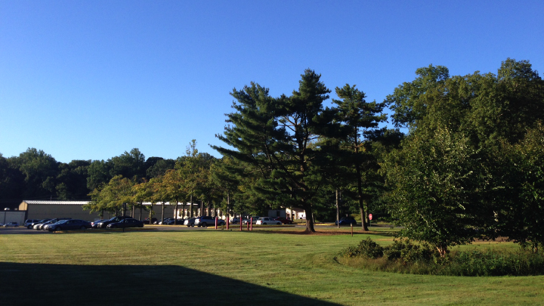
This Week @ PPPL
June 23 - 27, 2014
Brought to you by the PPPL Office of Communications

Slide 2
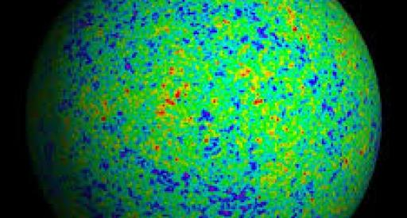

Cosmic Microwave Background (CMB)
Dr. Renee Hlozek
Princeton University
Wednesday, June 25
4:15 p.m. • M.B.G. Auditorium

Slide 3
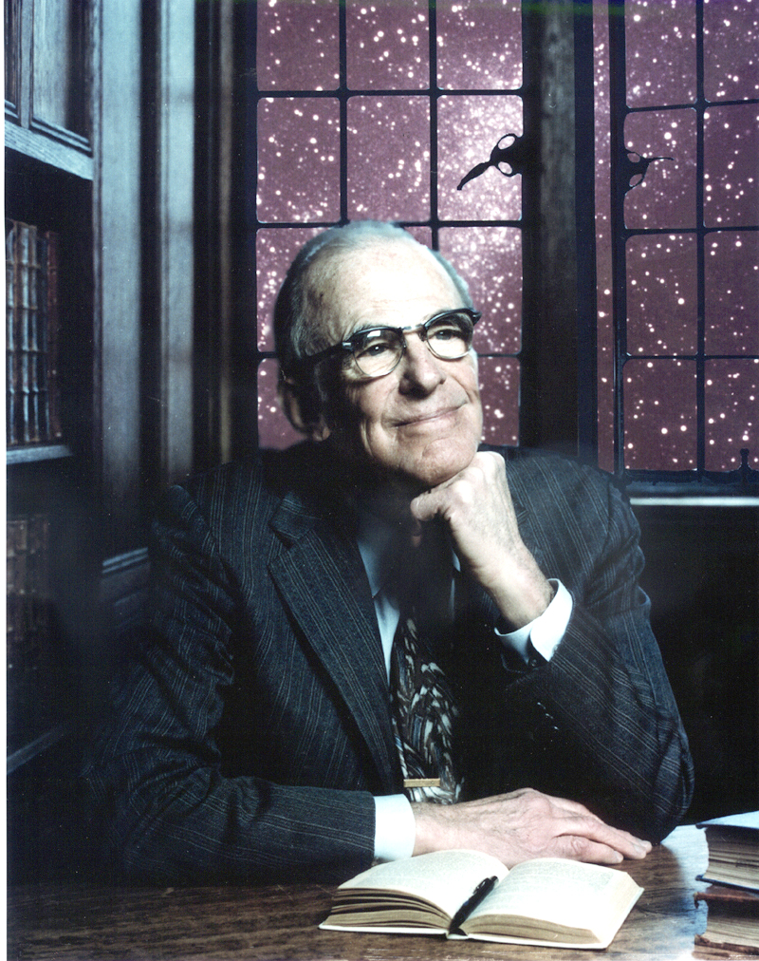
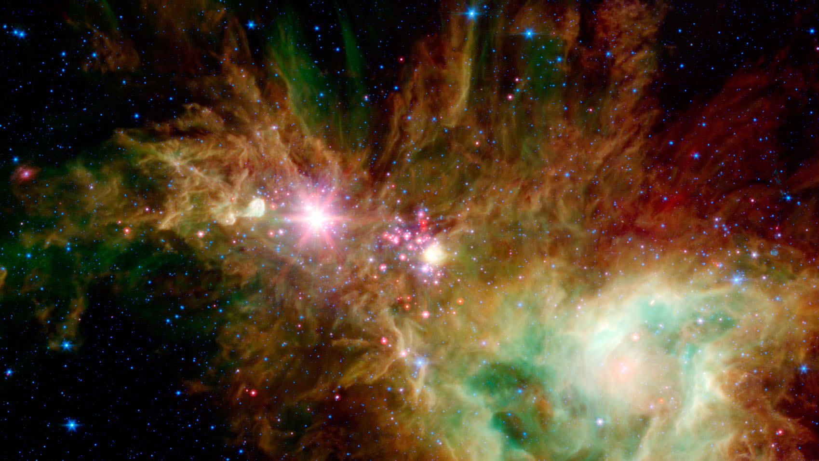
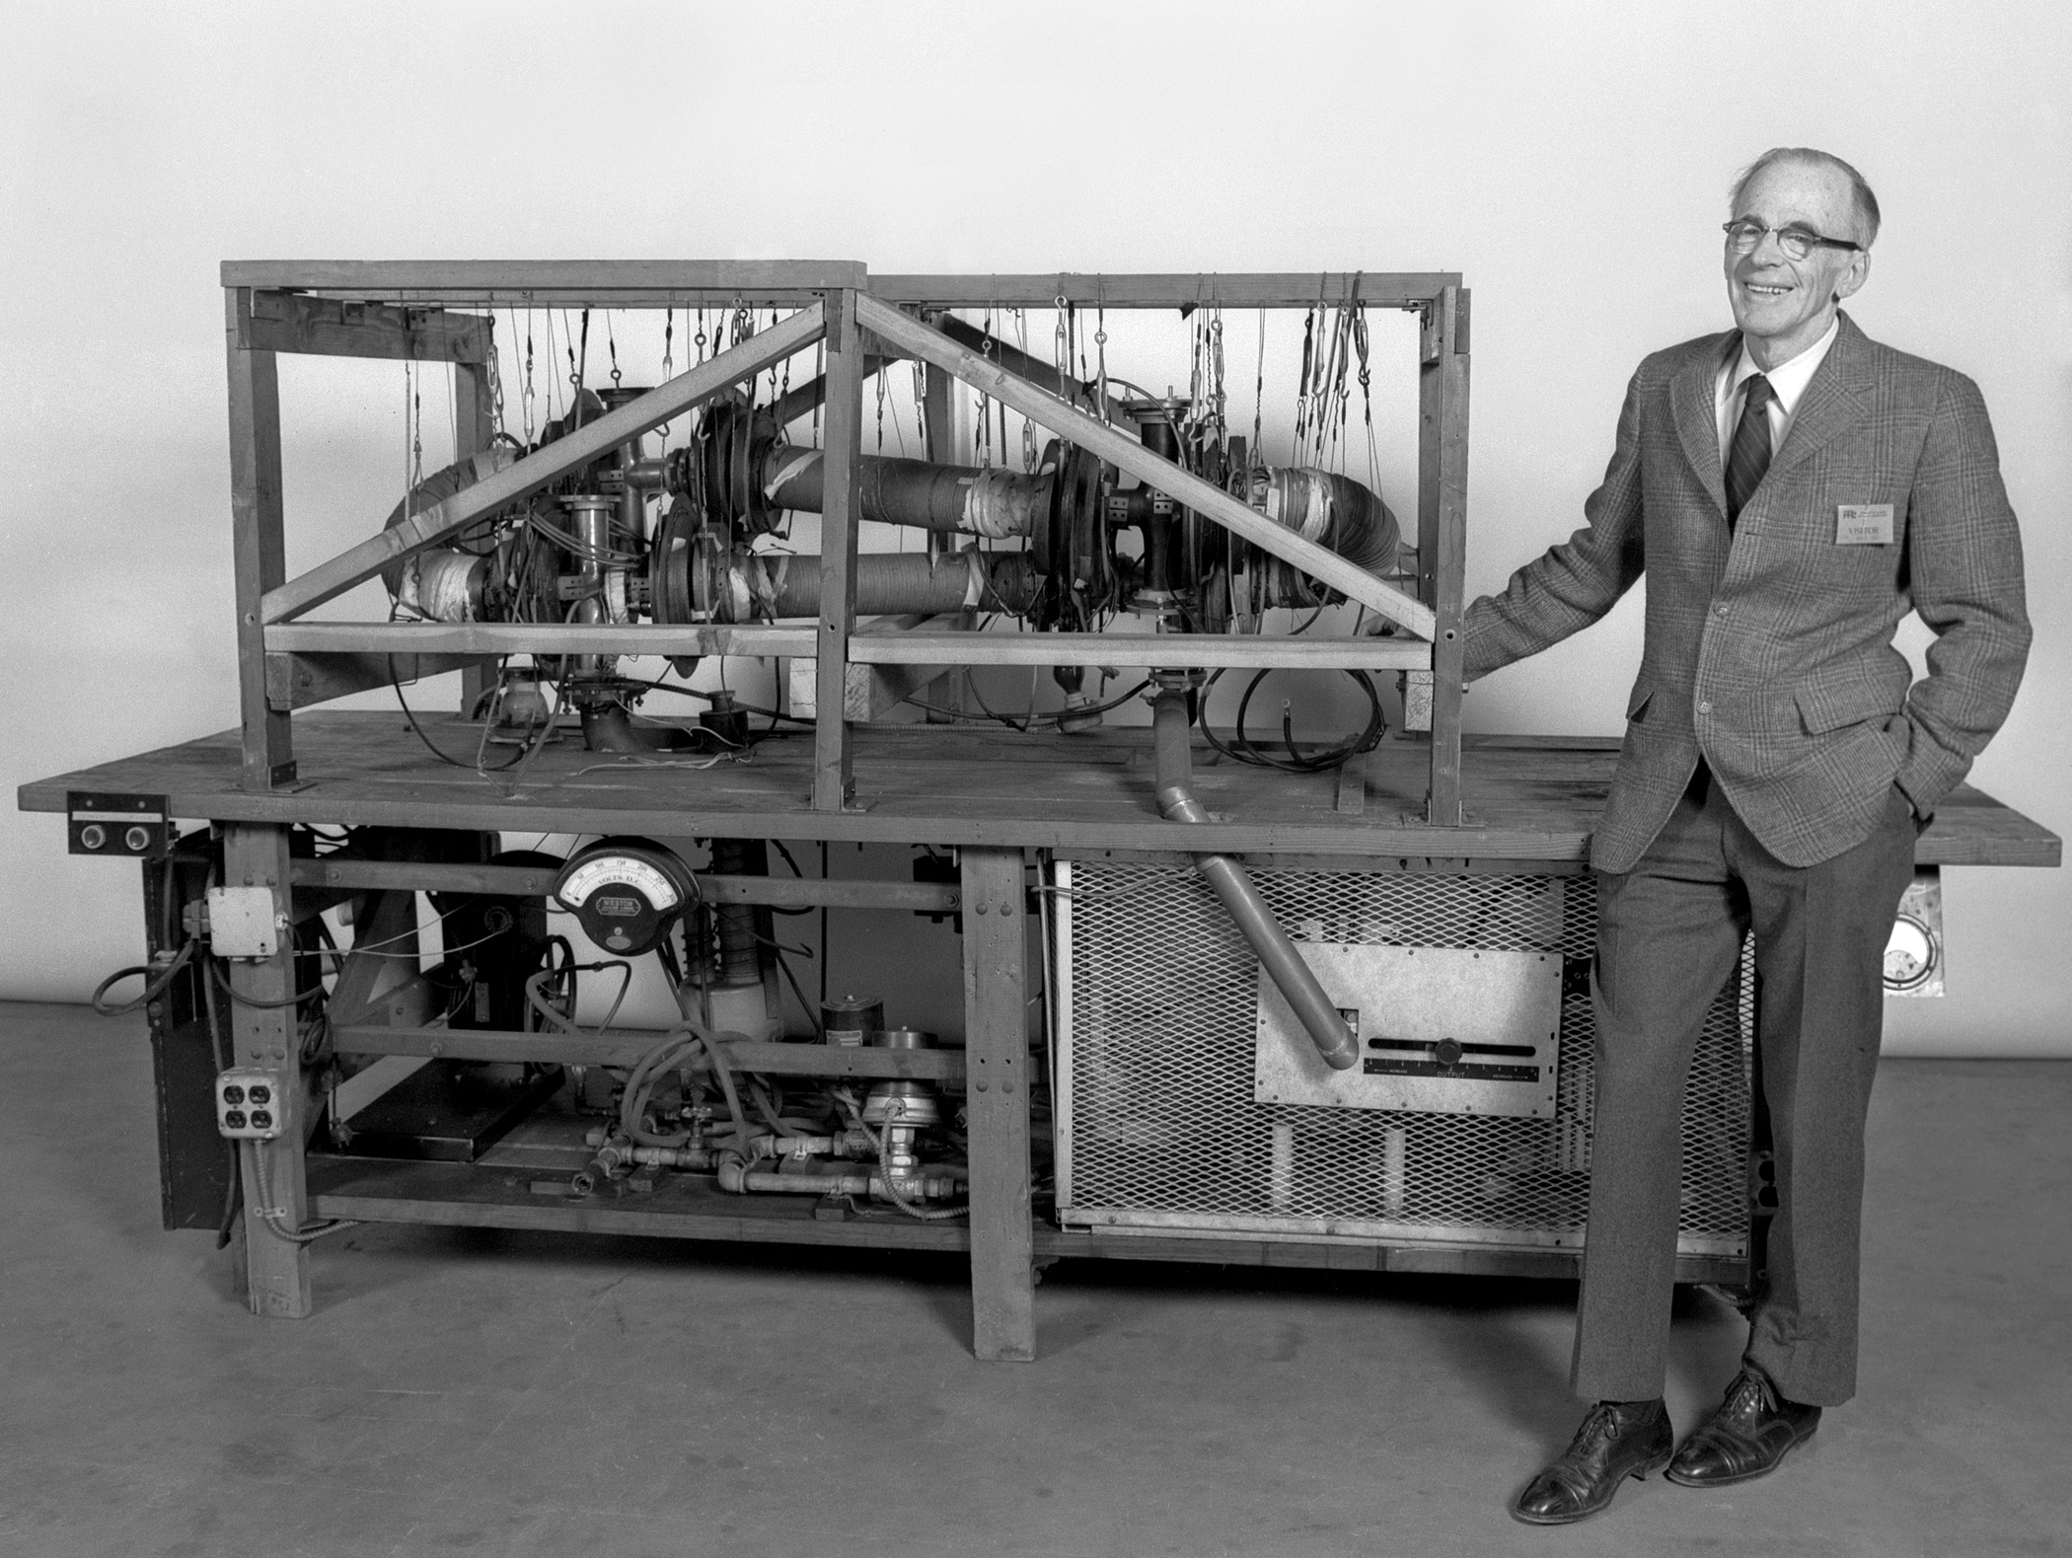
June 26, 1914 – June 26, 2014
HAPPY 100th BIRTHDAY LYMAN SPITZER, JR.

Slide 4
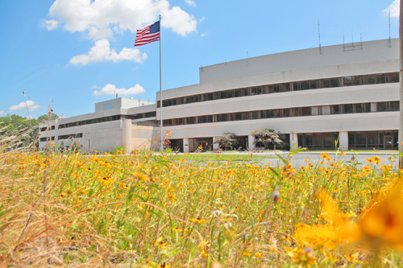


UPCOMING EVENTS
  Mon. – Fri., June 23-27
Work Planning and Control System Review Team at PPPL
Wednesday, June 25
  PPPL Colloquium – 4:15 p.m. – MBG Auditorium – “Cosmic Microwave Background”
Thursday, June 26
  Happy 100th Birthday Lyman Spitzer, Jr.
Friday, July 4
  Lab Closed – Independence Day Holiday
  Wed. – Fri., July 9-11
^{Disruption Theory Conference}
Friday, August 8
  Annual PPPL Bluefishing Trip – 5 p.m. – Belmar Marina

Slide 5
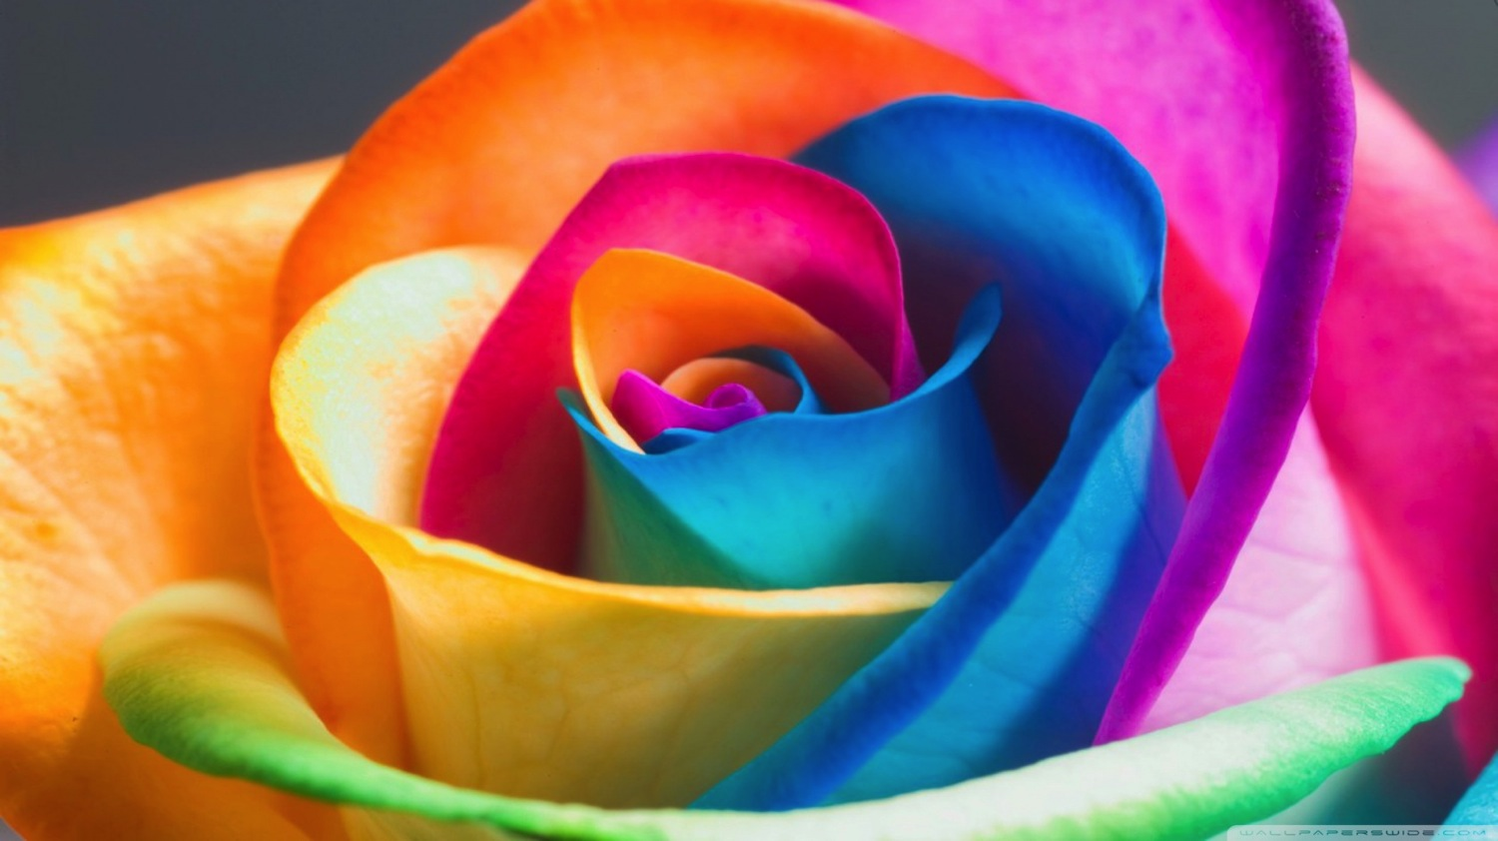
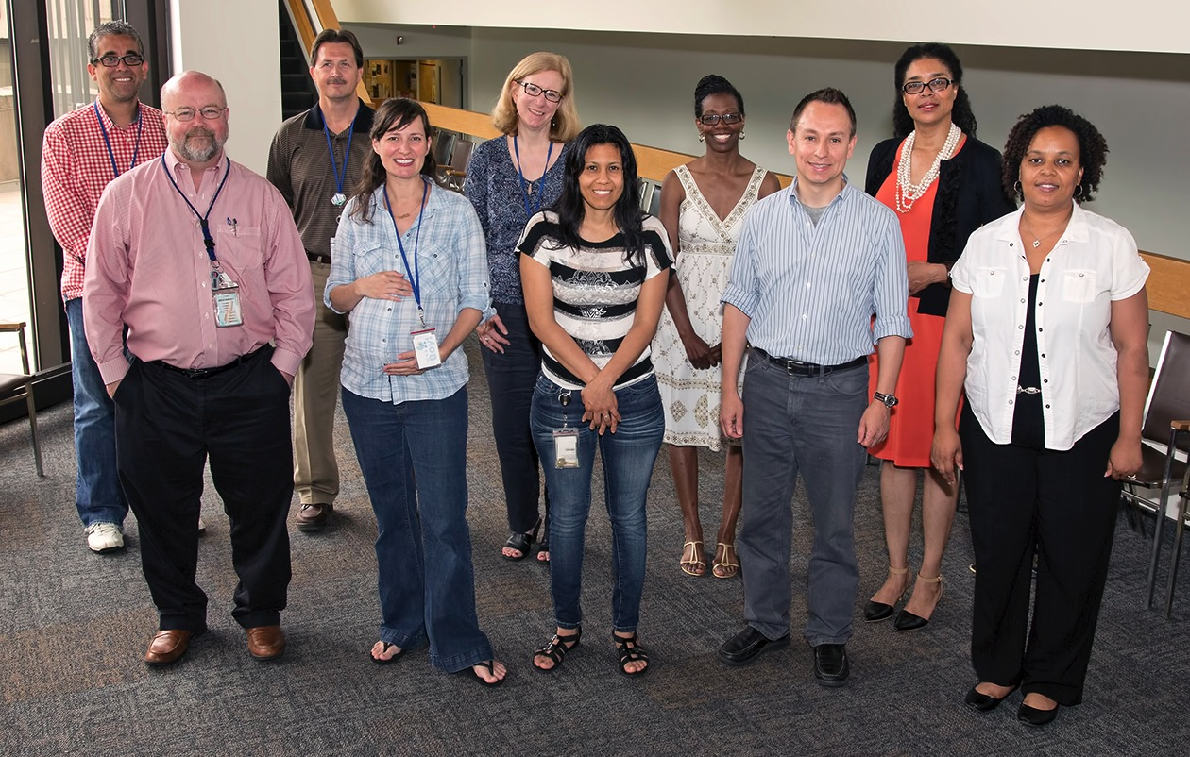
The PPPL Diversity and Inclusion Group
Front row, left: Bill Davis, Shannon Greco, Marisol Ovalles, Michael Gonzalez, and Andrea Moten, the group’s leader. Back row left to right: Luis Delgado-Aparicio, Barry Jedic, Jeanne Jackson DeVoe, Chandra Sanders, and Carol Ann Austin. Members not pictured: Neway Atnafu, Hans Schneider, Amitava Bhattacharjee, Hutch Neilson and Patricia Bruno.

Slide 7

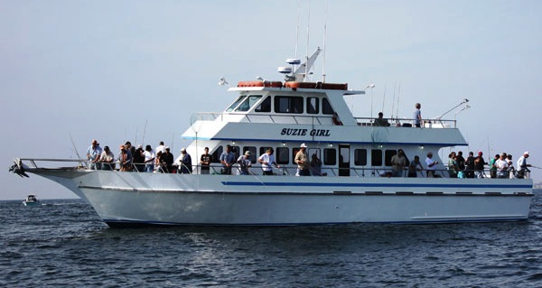
2014 PPPL Bluefishing Trip
FRIDAY, AUGUST 8
Aboard the 80’ Suzie Girl
Departure: 5 p.m. SHARP!!! Belmar Marina, Hwy. 35, Belmar, N.J.
Cost: $75 per person. All inclusive. Money due by July 25. NO REFUNDS.
Cost includes everything. Rods, bait, fish cleaning, food, beverages, prizes, etc.
All you need to do is show up!
Contact ANDY CARPE ext. 2118 acarpe@pppl.gov or BOB TUCKER JR. ext. 3190 rltucker@pppl.gov

Slide 8
