Slide 1
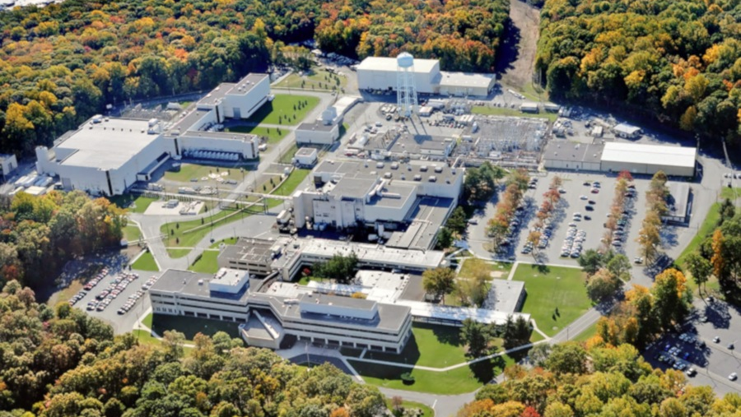

This Week @ PPPL
July 1-5, 2013
From the PPPL Office of Communications
From the PPPL Office of Communications

Slide 2


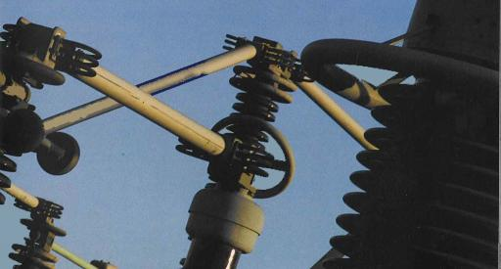
The European Roadmap for MFE
Francesco Romanelli
JET and EFDA
WEDNESDAY, JUNE 12
4:15 p.m. (Coffee/Tea at 3 p.m.) • M.B.G. Auditorium, Lyman Spitzer Building

Slide 3

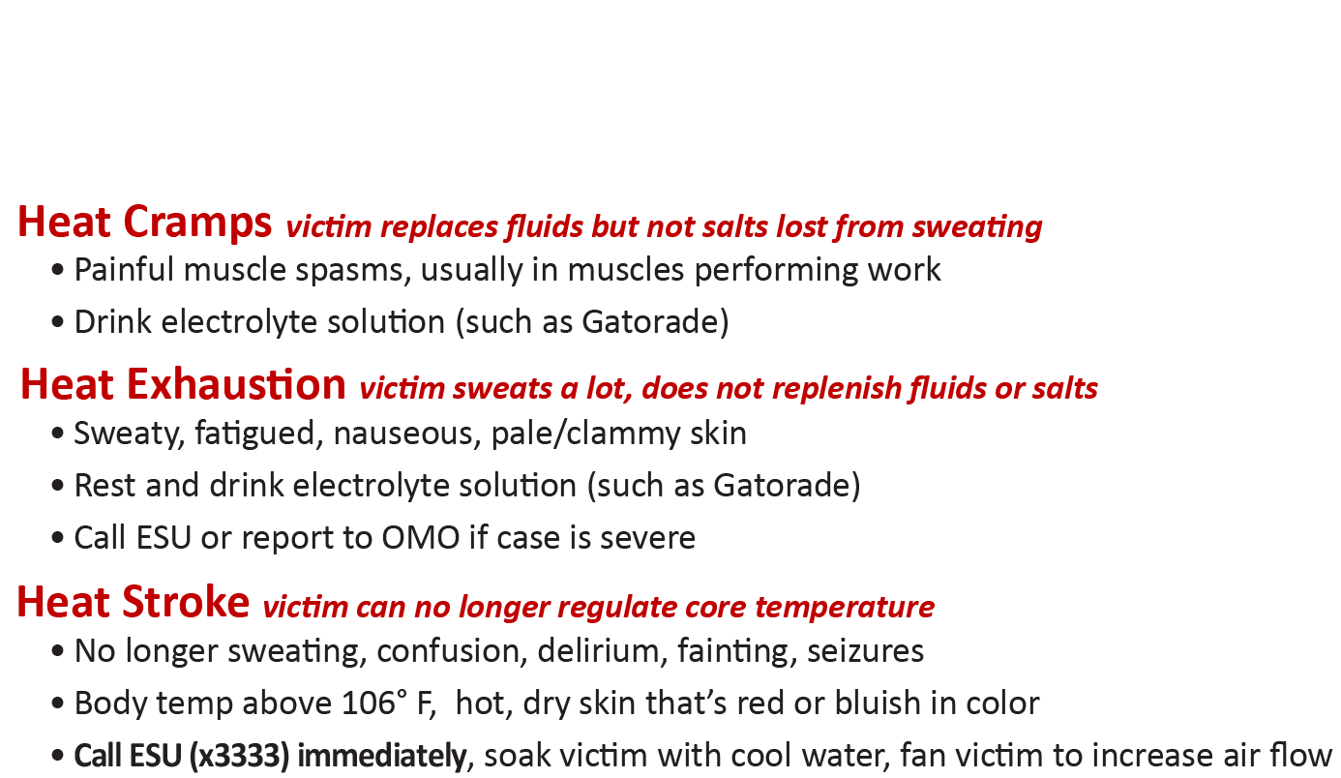
HEAT STRESS
Protect yourself from these heat-related disorders
Work when it’s cool, ventilate your workspace, take frequent breaks, remain hydrated!

Slide 4
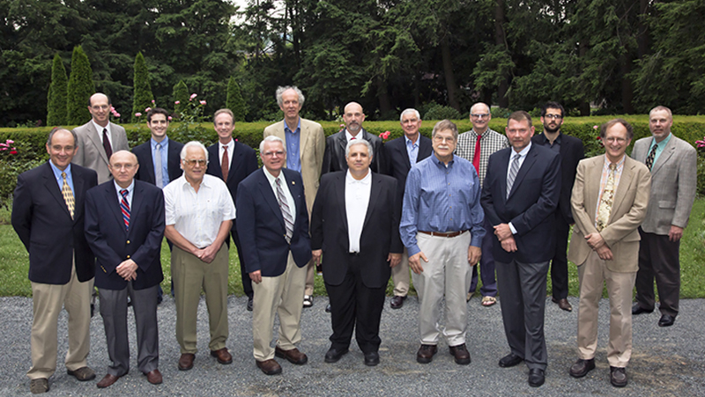
PPPL Inventors Honored at Prospect House Dinner

Slide 5

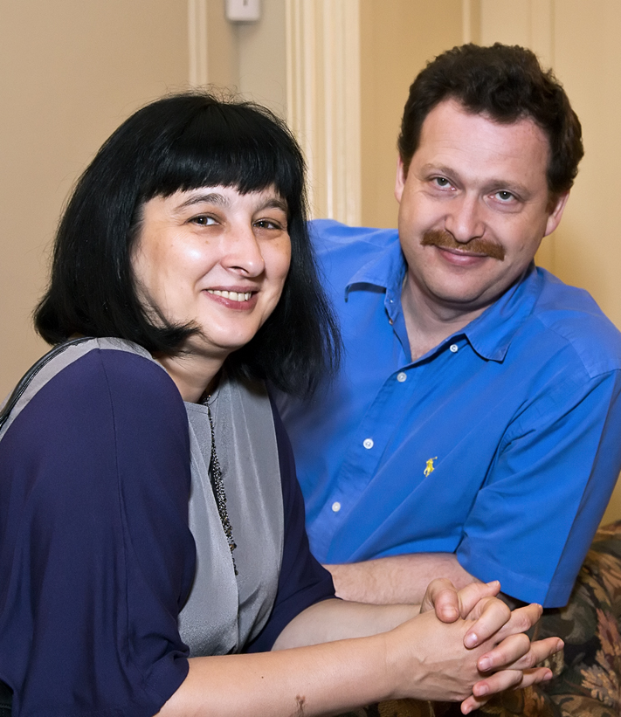
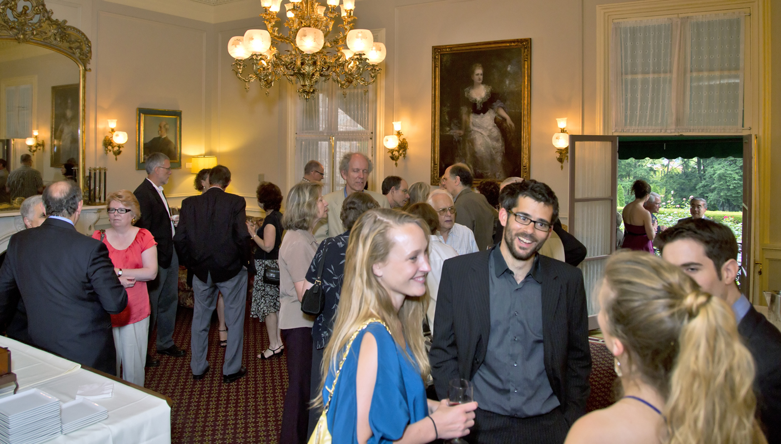
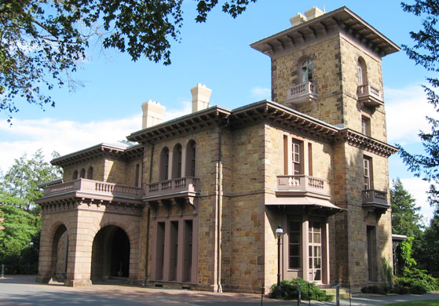
PPPL Inventors Honored at Prospect House Dinner

Slide 6
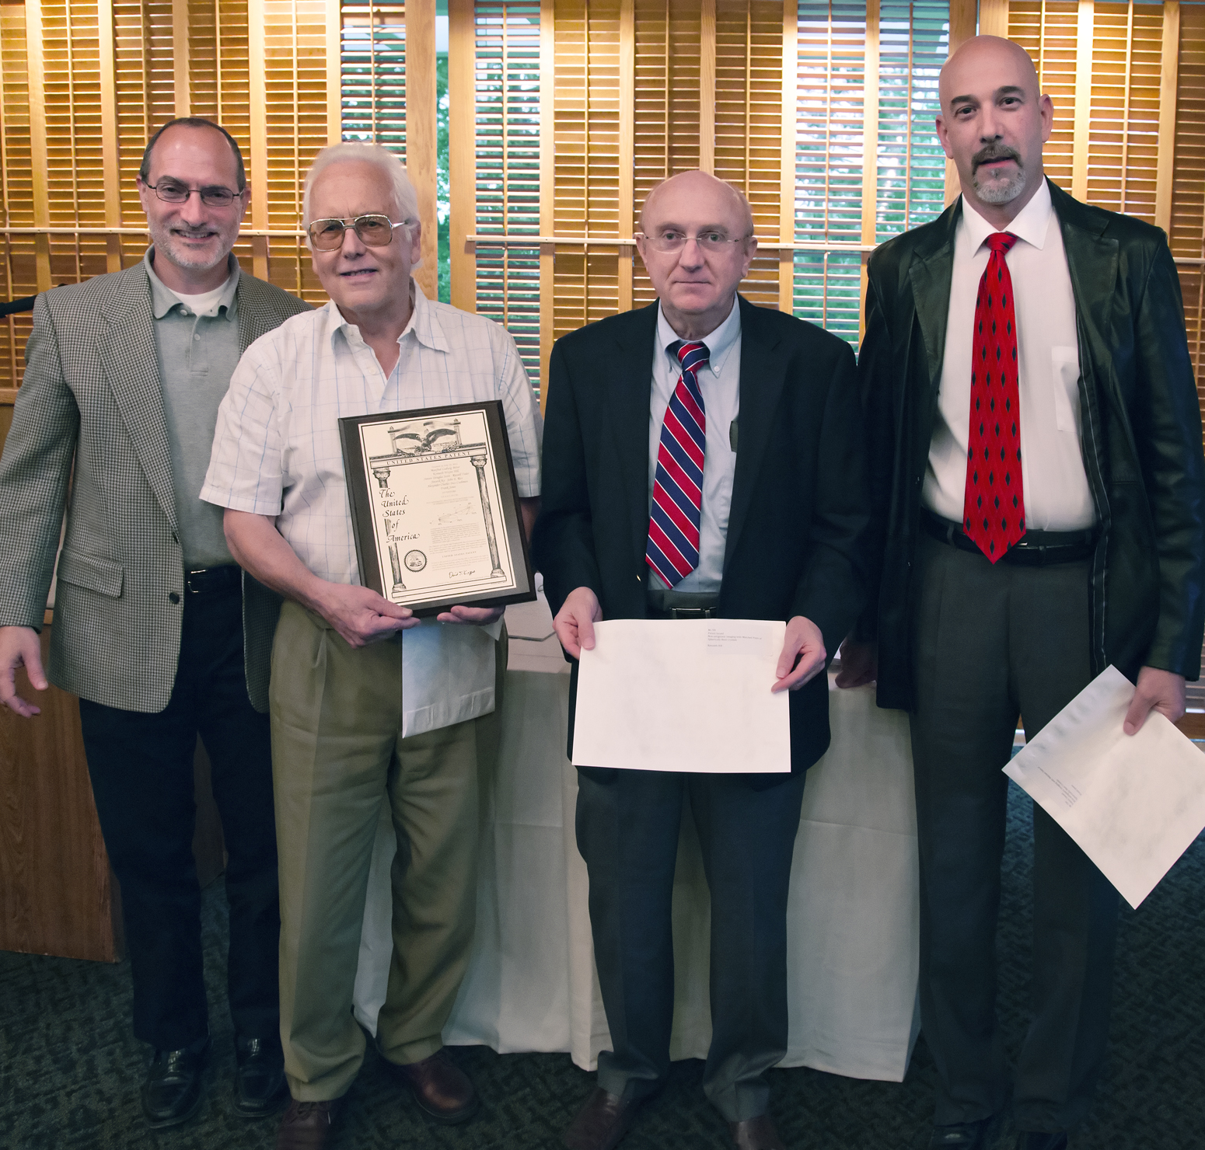
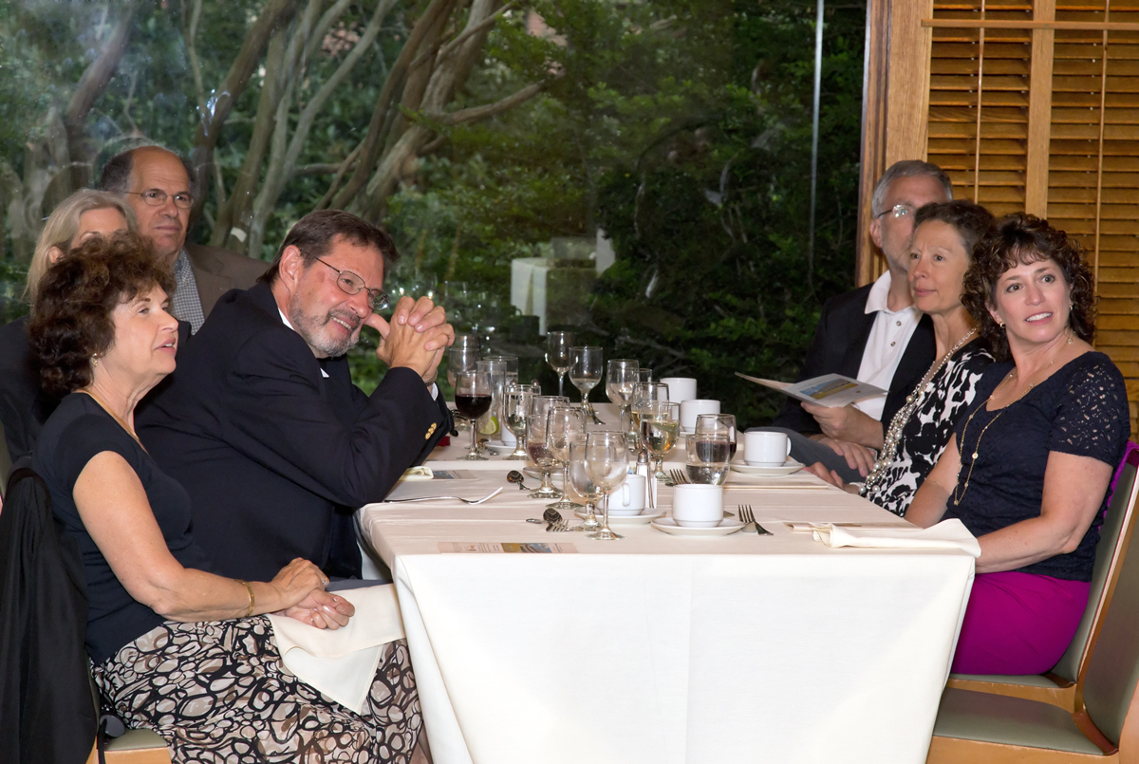
PPPL Inventors Honored at Prospect House Dinner

Slide 7
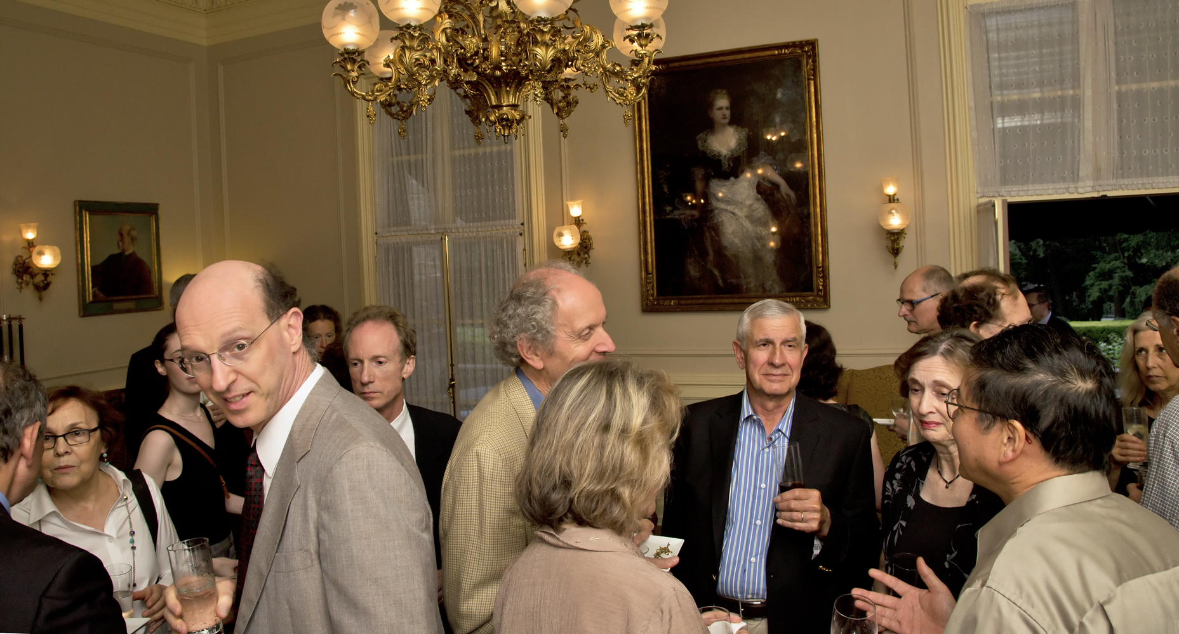
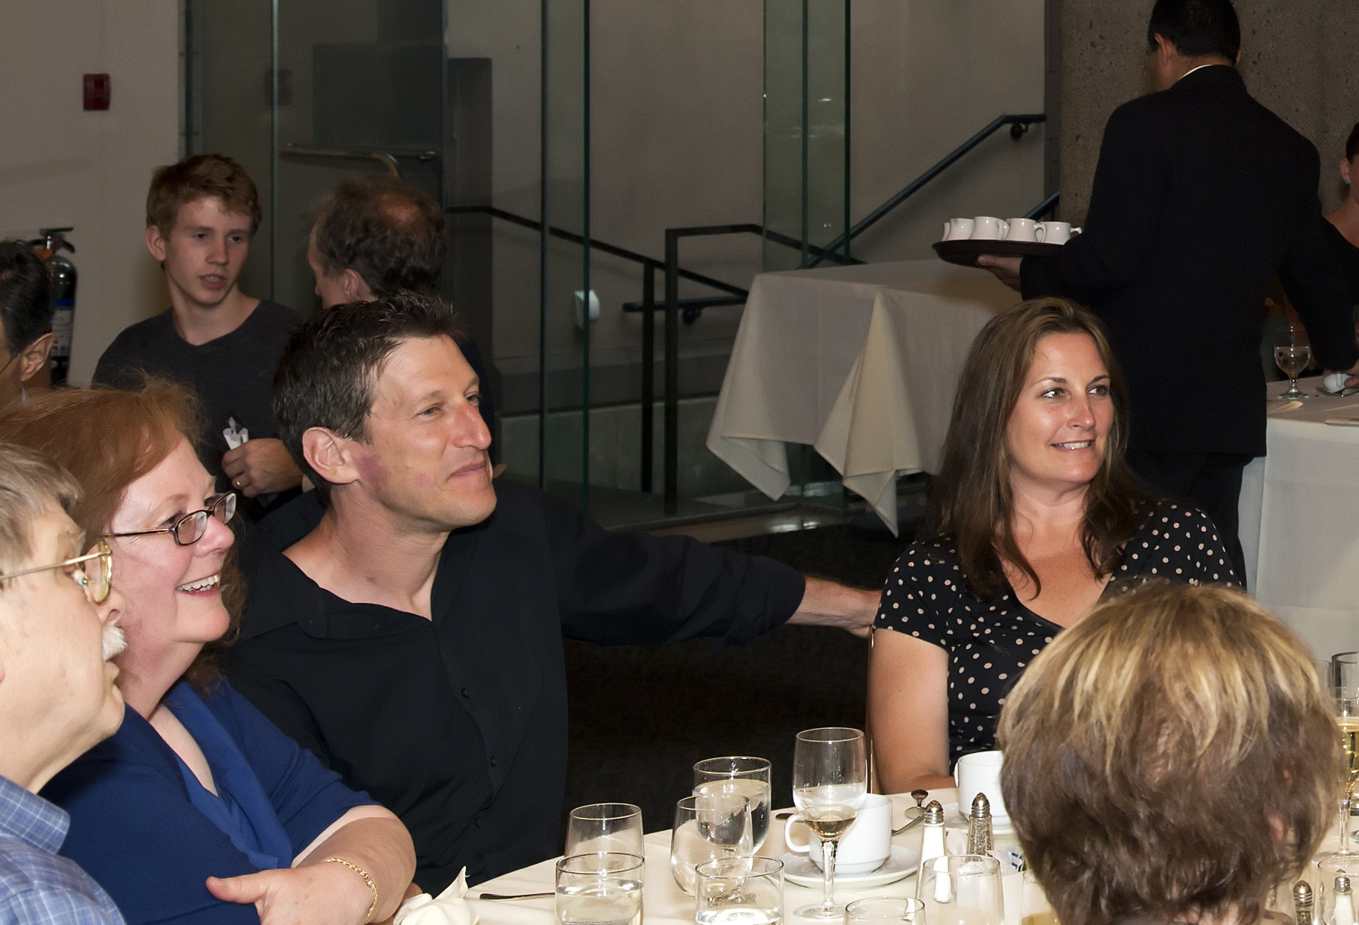
PPPL Inventors Honored at Prospect House Dinner

Slide 8
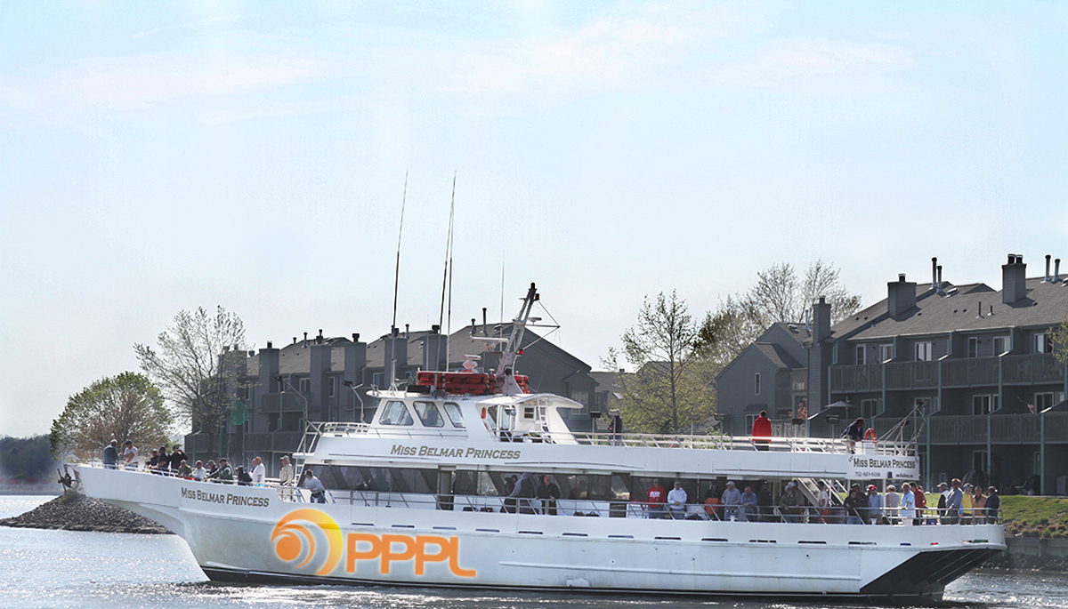

2013 PPPL Bluefishing Trip
FRIDAY, JULY 26
Aboard the 120’ Miss Belmar Princess
Departure: 5 p.m. SHARP!!! Belmar Marina, Hwy. 35, Belmar, N.J.
Cost: $75 per person. All inclusive. Money due by July 19. NO REFUNDS.
Cost includes everything. Rods, bait, fish cleaning, food, beverages, etc.
All you need to do is show up!
Contact ANDY CARPE ext. 2118 acarpe@pppl.gov or BOB TUCKER JR. ext. 3190 rltucker@pppl.gov

Slide 9


Happy 4th of July

Slide 10
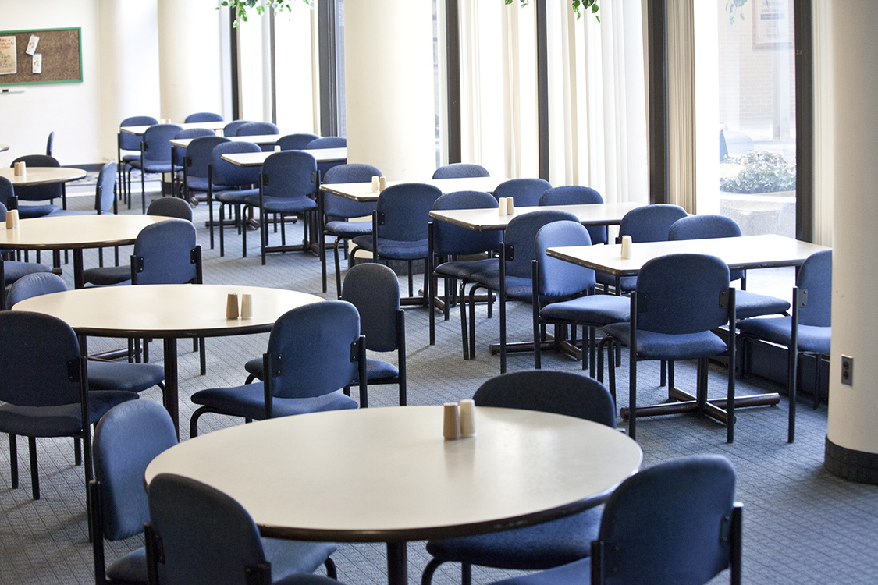

Menu subject to change without notice.

