Slide 1
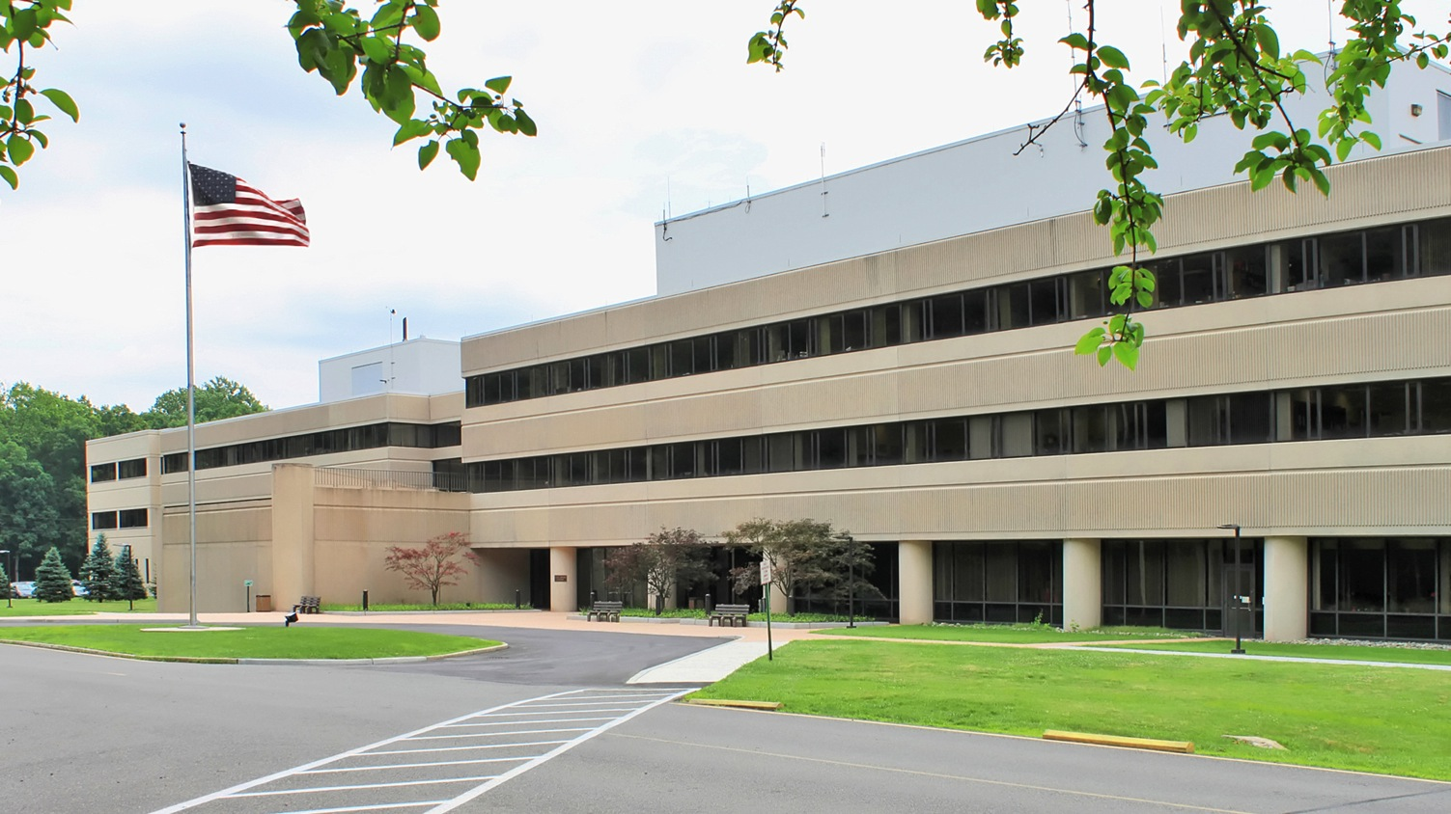
This Week @ PPPL
July 7 - 11, 2014
Brought to you by the PPPL Office of Communications

Slide 2
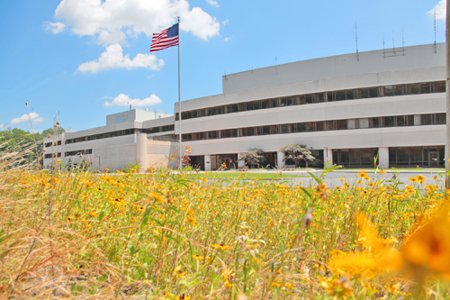


UPCOMING EVENTS
  Wed. – Fri., July 9-11
^{Disruption Theory Conference}
Friday, August 8
  Annual PPPL Bluefishing Trip – 5 p.m. – Belmar Marina
Monday, September 1
  Lab Closed – Labor Day Holiday

Slide 3

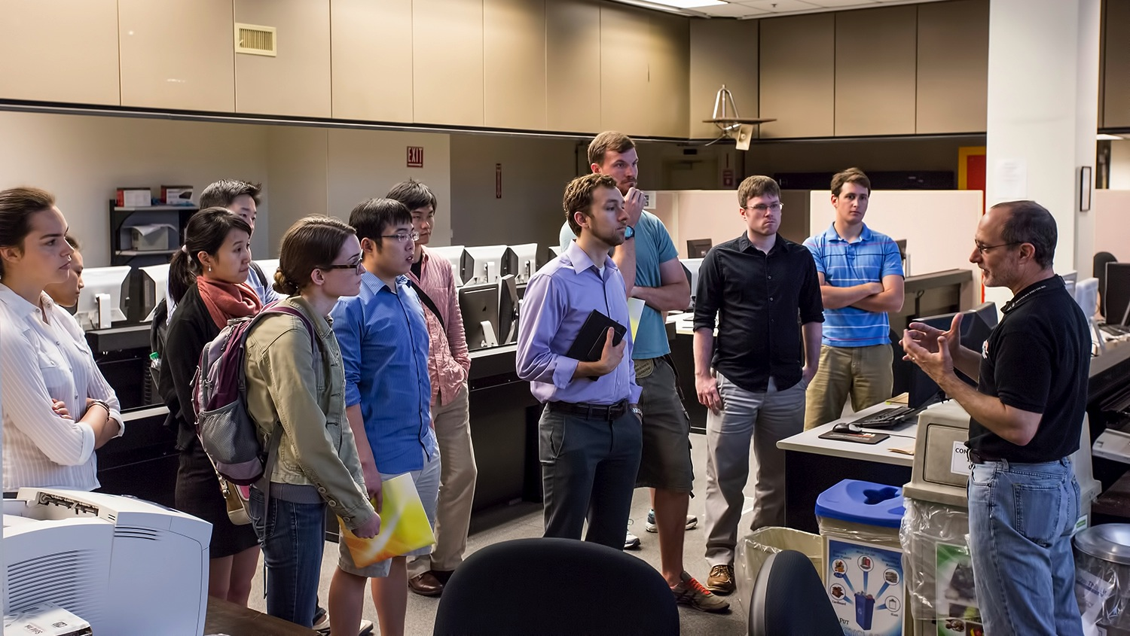
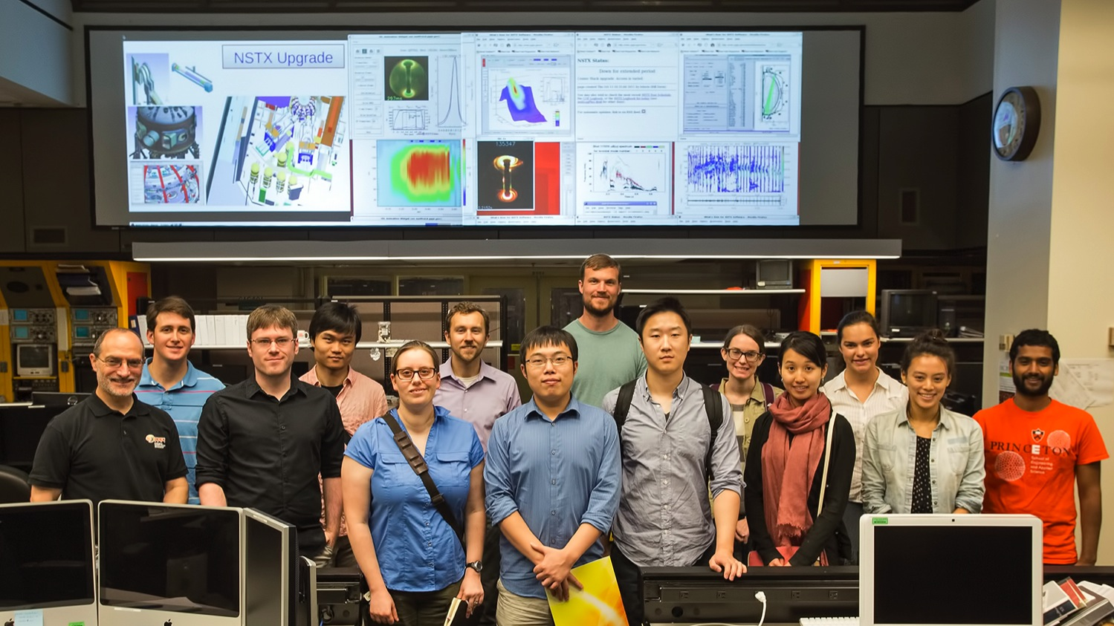
Princeton Energy Scholars visit PPPL

Slide 5


Slide 6

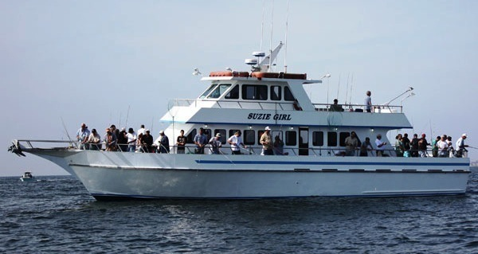
2014 PPPL Bluefishing Trip
FRIDAY, AUGUST 8
Aboard the 80’ Suzie Girl
Departure: 5 p.m. SHARP!!! Belmar Marina, Hwy. 35, Belmar, N.J.
Cost: $75 per person. All inclusive. Money due by July 25. NO REFUNDS.
Cost includes everything. Rods, bait, fish cleaning, food, beverages, prizes, etc.
All you need to do is show up!
Contact ANDY CARPE ext. 2118 acarpe@pppl.gov or BOB TUCKER JR. ext. 3190 rltucker@pppl.gov

Slide 7
