Slide 1
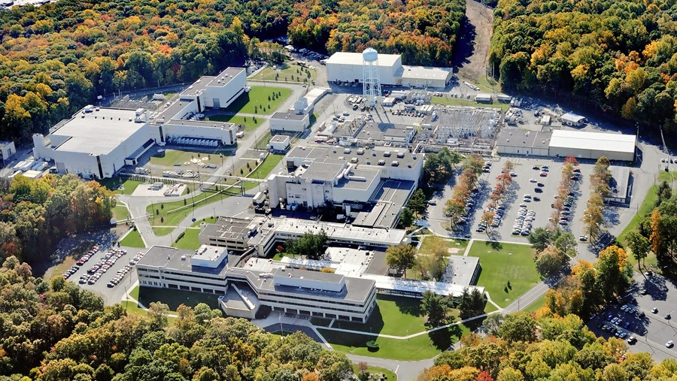
This Week @ PPPL
July 15-19, 2013
From the PPPL Office of Communications

Slide 2


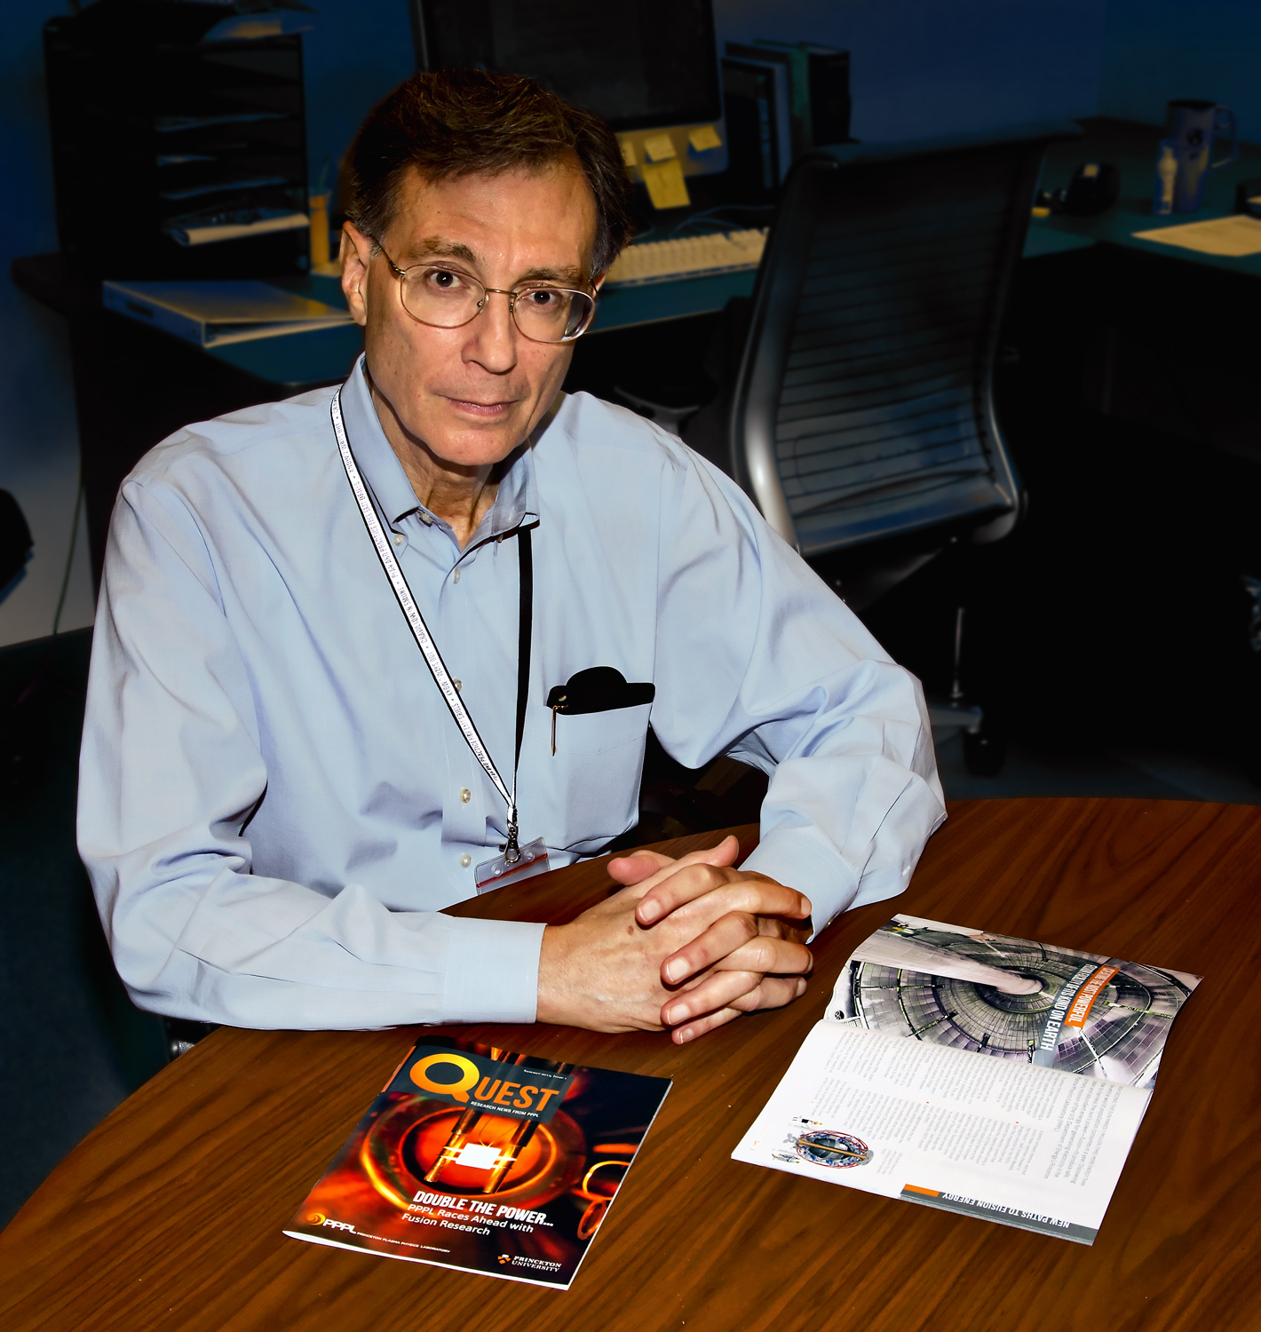
John Greenwald, Quest writer and editor
QUEST Magazine
Research news from PPPL

Slide 3

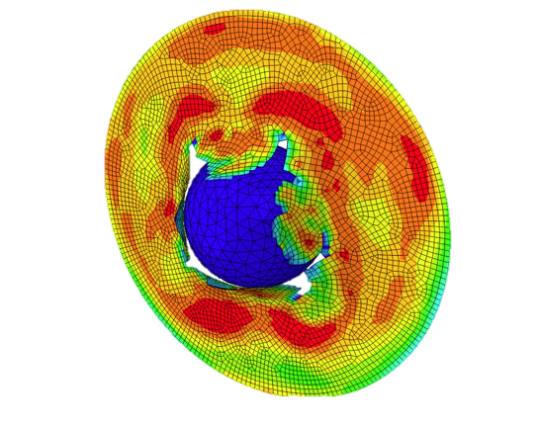
Welcome
members of the
Theory and Simulation
of Disruptions Workshop

Slide 4
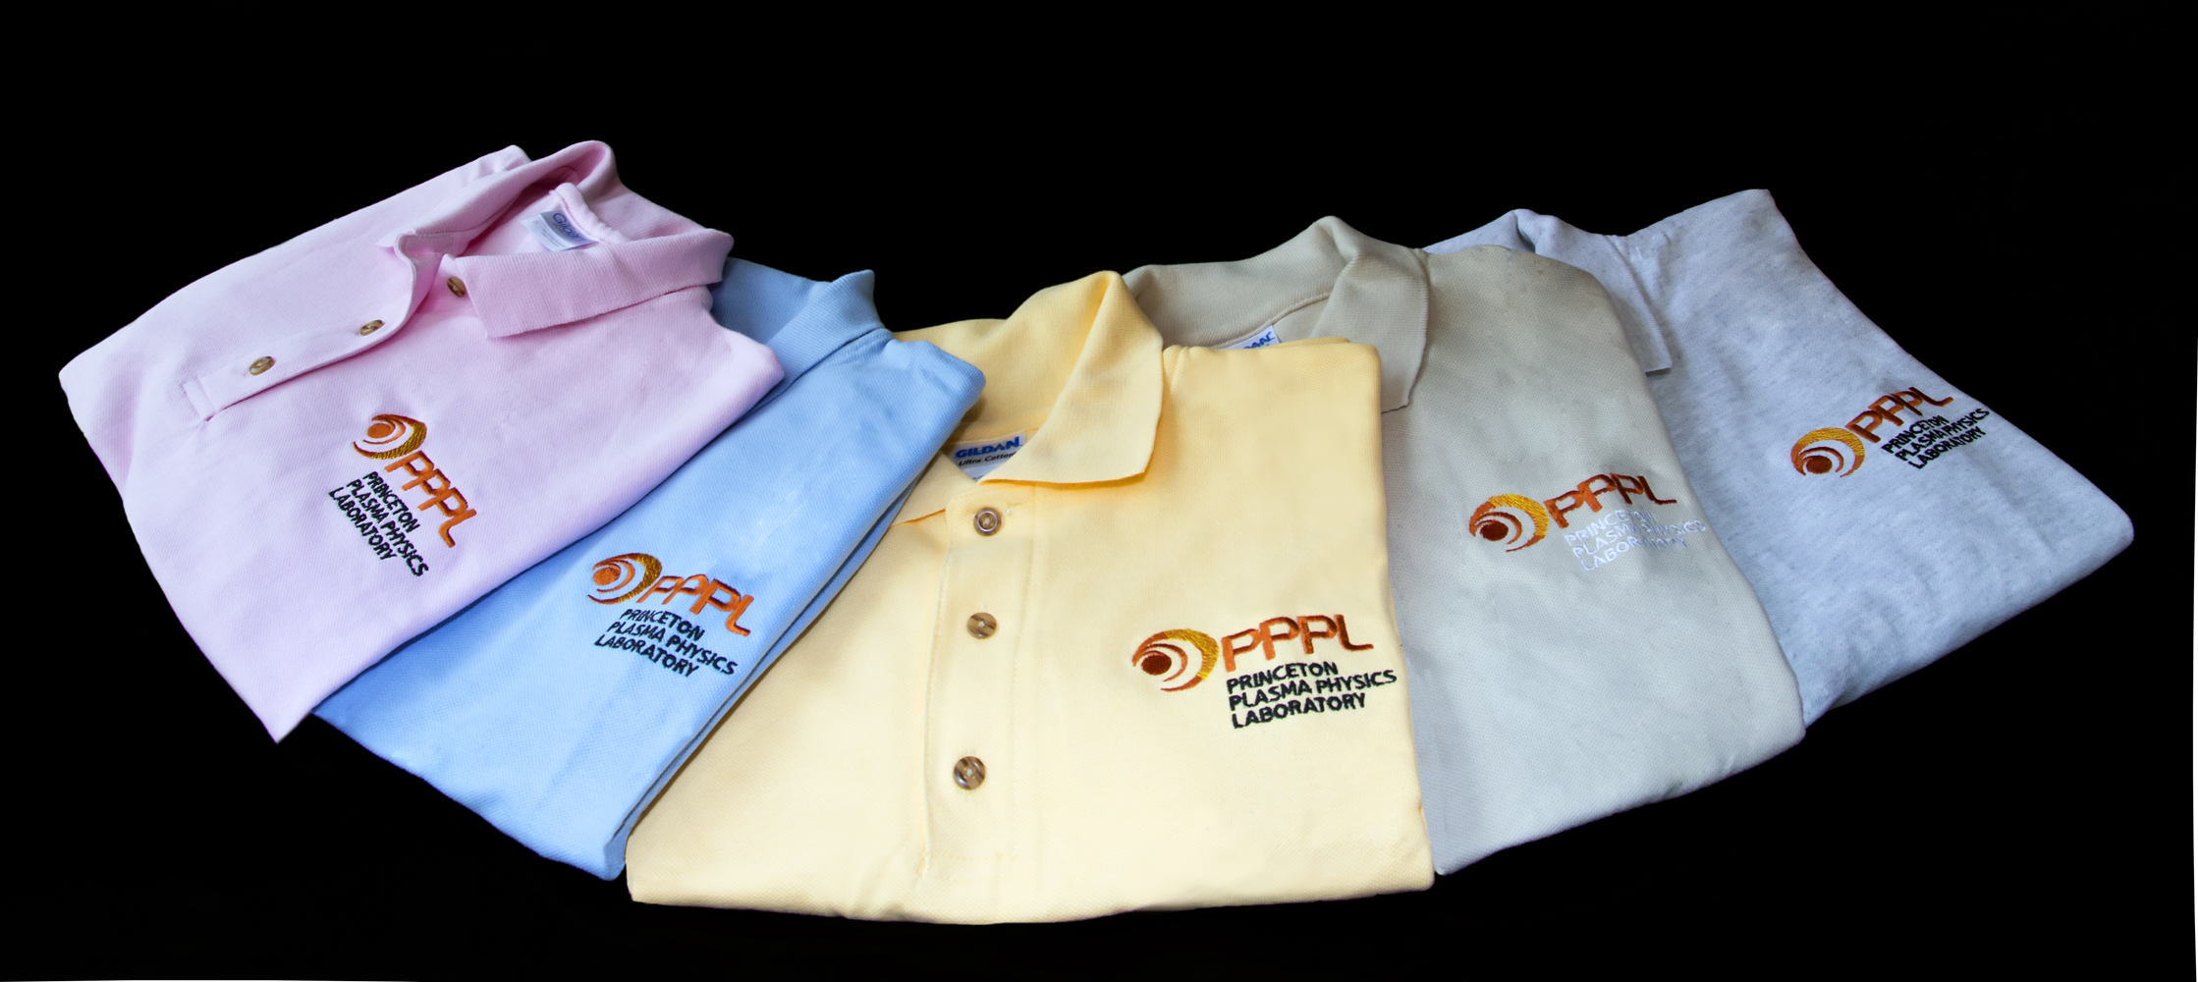
Now available at
The Plasma Hutch
100% Cotton Polos
with embroidered logo in ash grey, sand, yellow, haze, light blue & light pink
Prices: S-XL $16 • 2XL-3XL $20
THE PLASMA HUTCH is open on Fridays from 11:30 a.m. to noon.
Pick up an order form or download one from the HR website at hr.pppl.gov and send it via email to Kim at kmastrom@pppl.gov.

Slide 5

Social Security
Pre-Retirement Seminar
Tuesday, July 23
11:00 a.m.
LSB Auditorium
David Vinokurov
District Manager
Trenton Social Security Office
Carl Robinson
Public Affairs Specialist for Social Security
The discussion will include how to plan, calculate,
and apply for Social Security benefits. Please join David and Carl with your questions. It is never too early to plan!

Slide 6

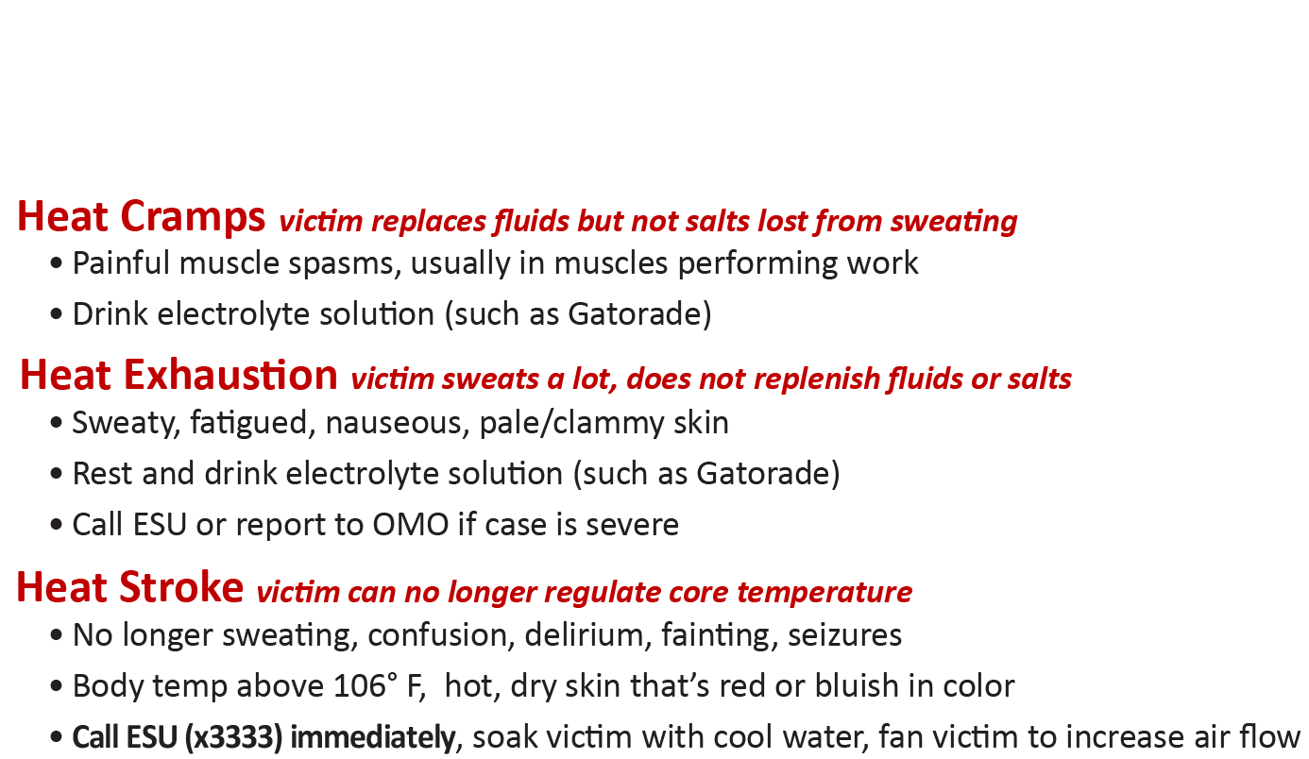
HEAT STRESS
Protect yourself from these heat-related disorders
Work when it’s cool, ventilate your workspace, take frequent breaks, remain hydrated!

Slide 7
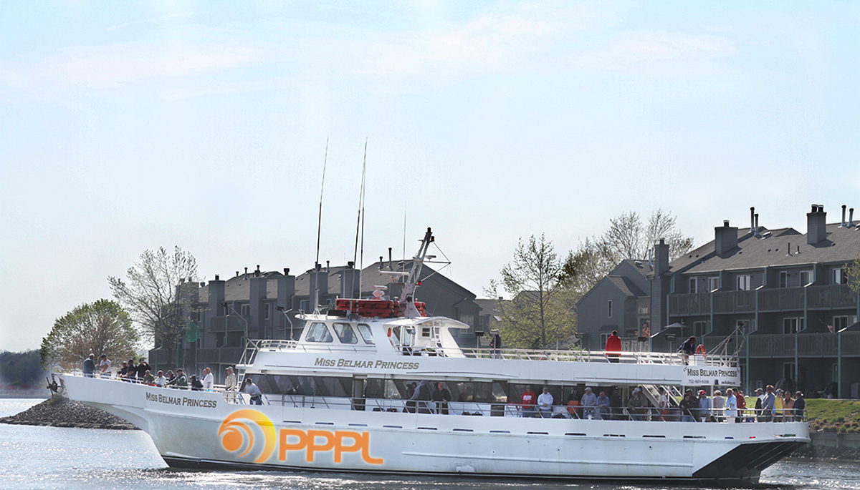

2013 PPPL Bluefishing Trip
FRIDAY, JULY 26
Aboard the 120’ Miss Belmar Princess
Departure: 5 p.m. SHARP!!! Belmar Marina, Hwy. 35, Belmar, N.J.
Cost: $75 per person. All inclusive. Money due by July 19. NO REFUNDS.
Cost includes everything. Rods, bait, fish cleaning, food, beverages, etc.
All you need to do is show up!
Contact ANDY CARPE ext. 2118 acarpe@pppl.gov or BOB TUCKER JR. ext. 3190 rltucker@pppl.gov

Slide 8
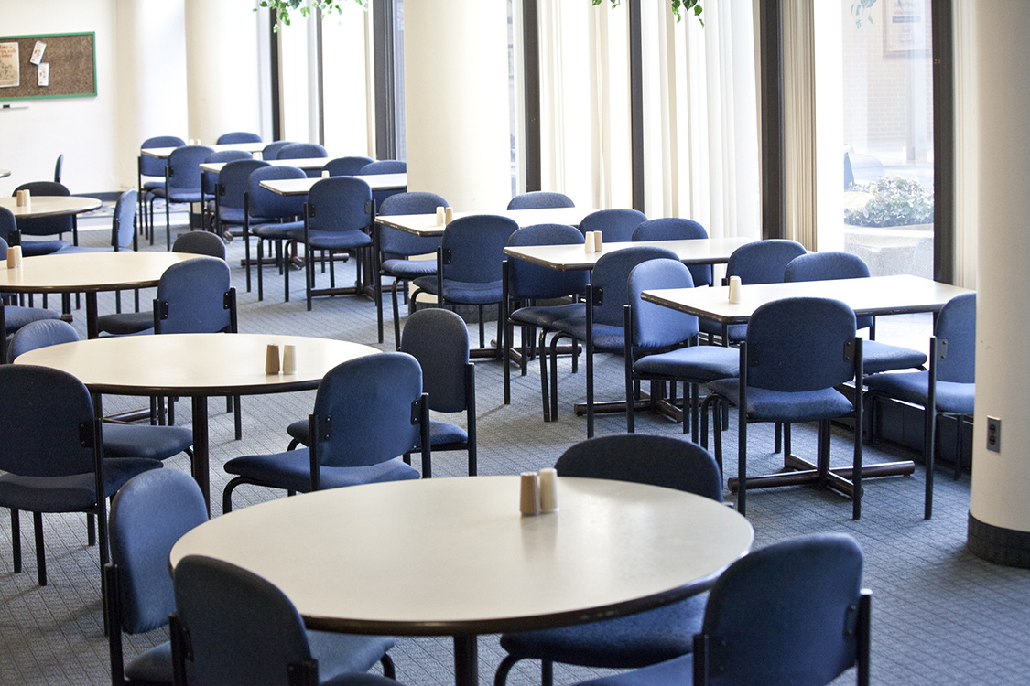

Menu subject to change without notice.

