Slide 1
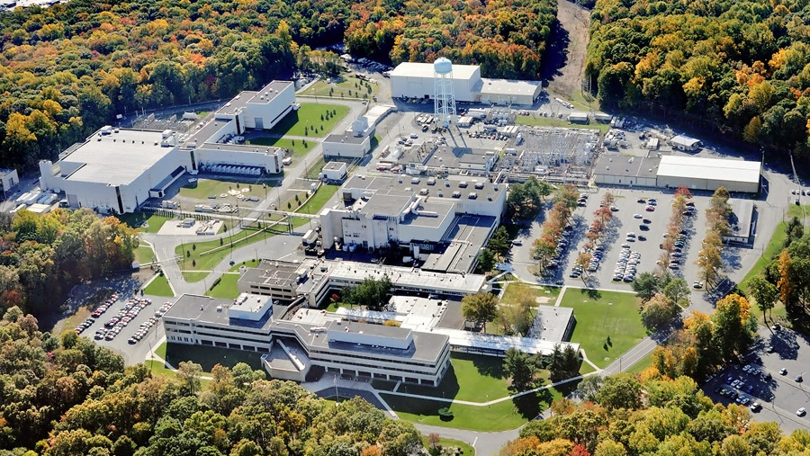
This Week @ PPPL
July 22-26, 2013
From the PPPL Office of Communications

Slide 2
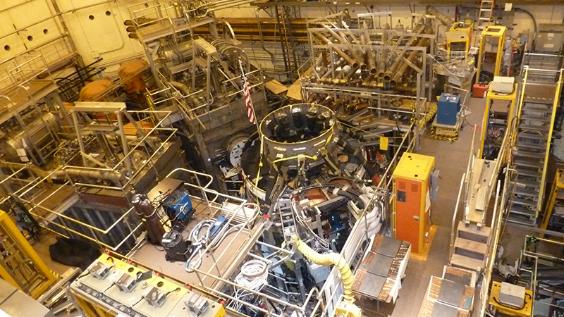
NSTX-U

Slide 3

Social Security
Pre-Retirement Seminar
Tuesday, July 23
11:00 a.m.
LSB Auditorium
David Vinokurov
District Manager
Trenton Social Security Office
Carl Robinson
Public Affairs Specialist for Social Security
The discussion will include how to plan, calculate,
and apply for Social Security benefits. Please join David and Carl with your questions. It is never too early to plan!

Slide 4

Now available at
The Plasma Hutch
100% Cotton Polos
with embroidered logo in ash grey, sand, yellow, haze, light blue & light pink
Prices: S-XL $16 • 2XL-3XL $20
THE PLASMA HUTCH is open on Fridays from 11:30 a.m. to noon.
Pick up an order form or download one from the HR website at hr.pppl.gov and send it via email to Kim at kmastrom@pppl.gov.

Slide 5
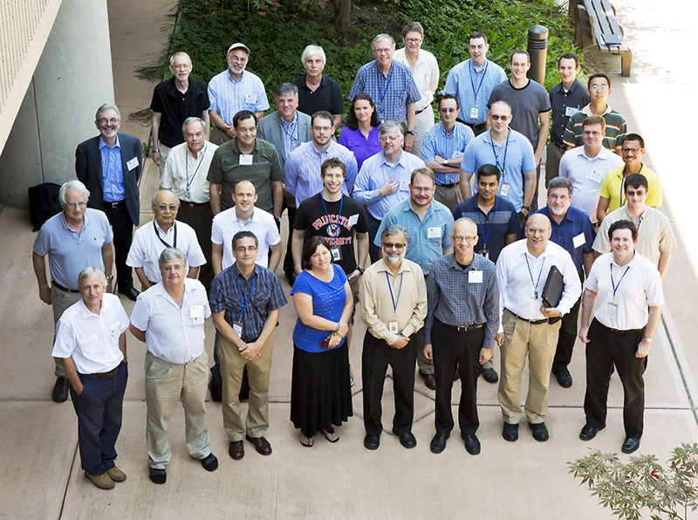
Theory and Simulation of Disruptions Workshop

Slide 6
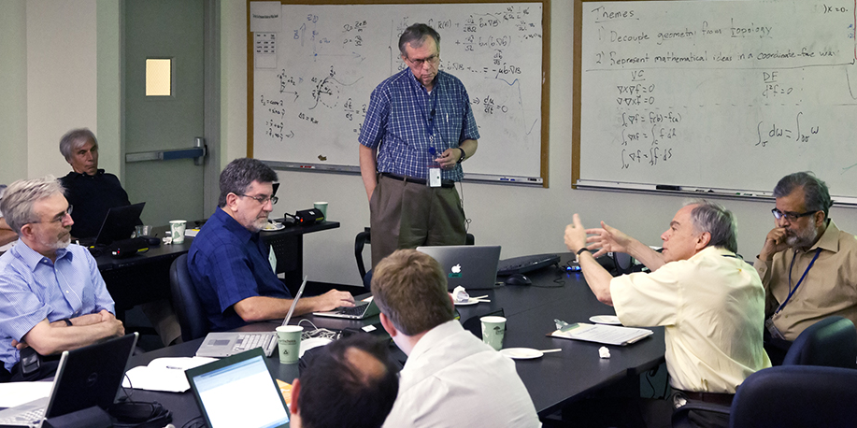
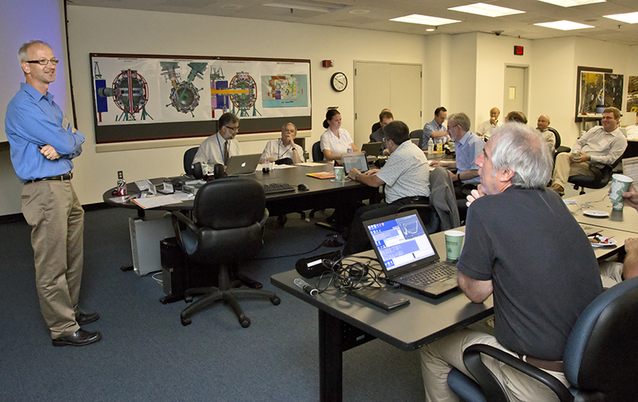
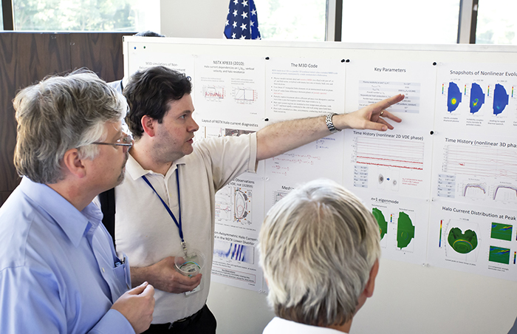
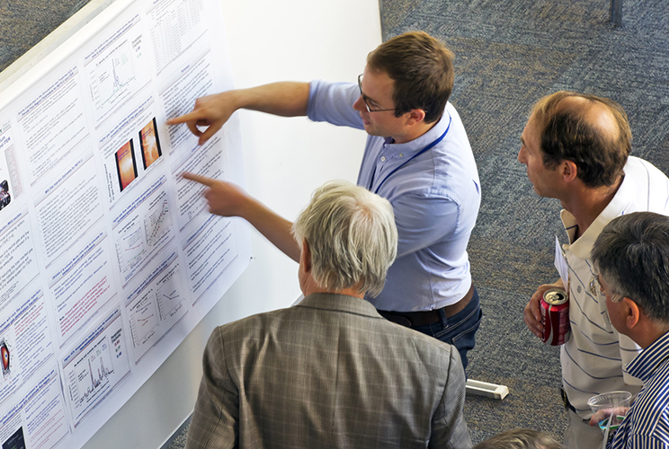
Theory and Simulation of Disruptions Workshop

Slide 7
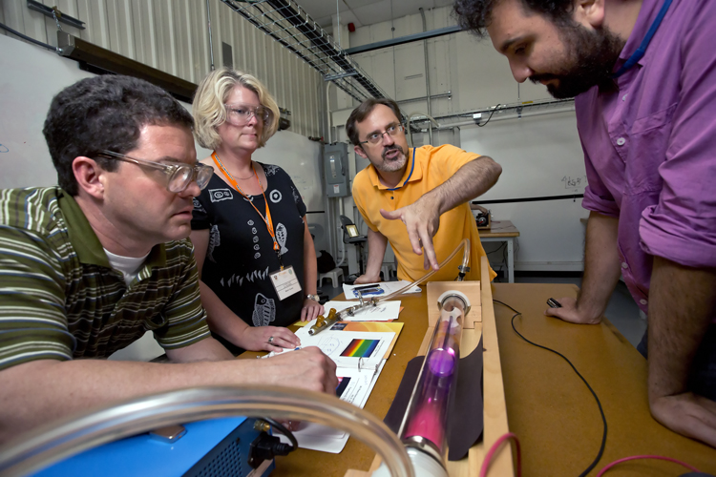
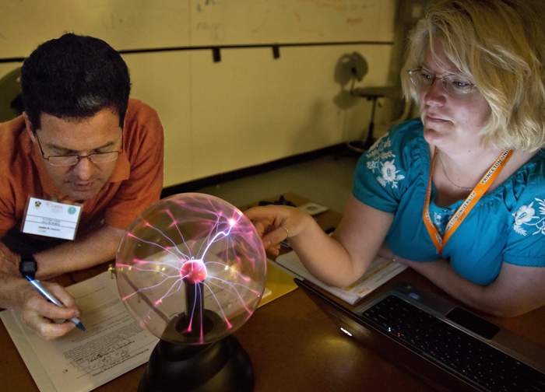
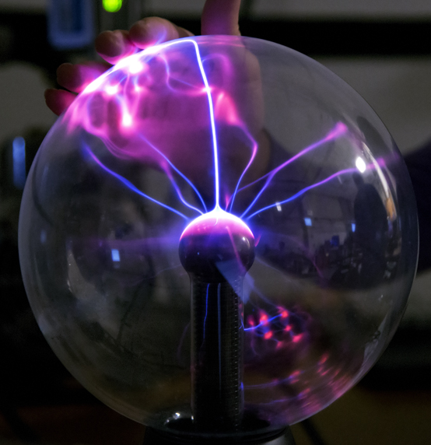
PLASMA CAMP at PPPL

Slide 8
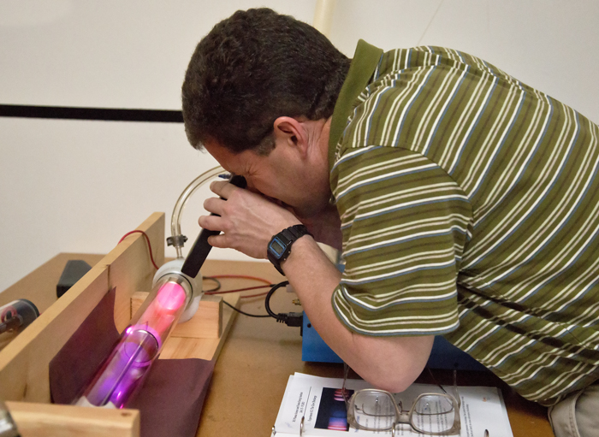
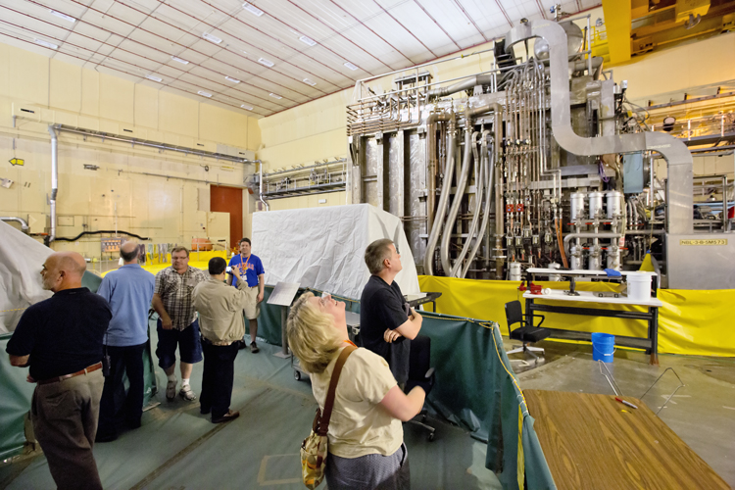
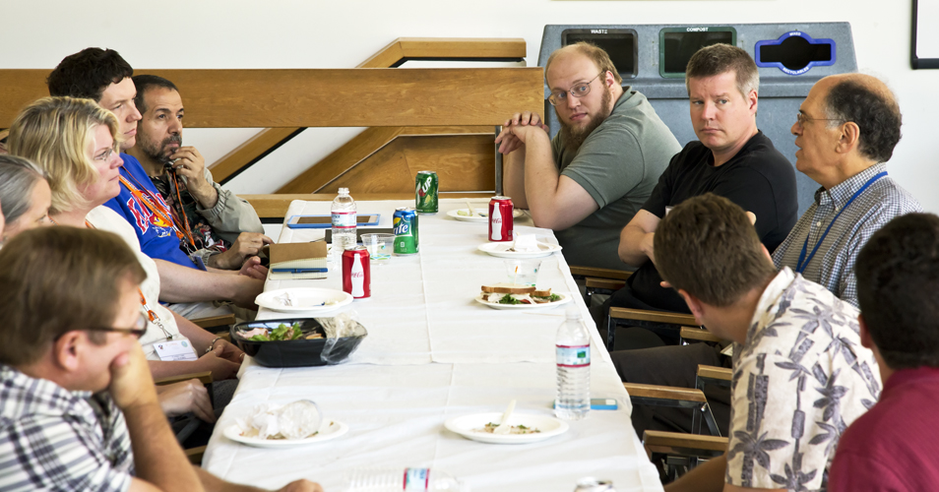
PLASMA CAMP at PPPL

Slide 9







FOLLOW PPPL ON…
twitter.com/PPPLab
www.facebook.com/PPPLab
www.youtube.com/PPPLab
www.flickr.com/photos/pppl/

Slide 10

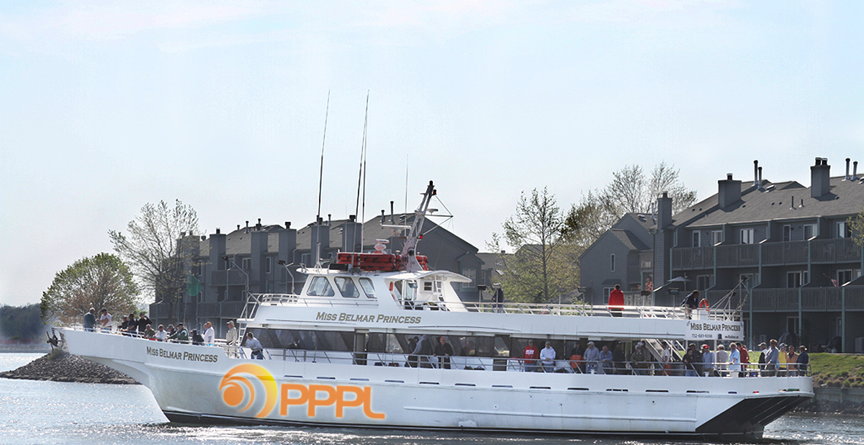
2013 PPPL Bluefishing Trip
FRIDAY, JULY 26
Aboard the 120’ Miss Belmar Princess
Departure: 5 p.m. SHARP!!! Belmar Marina, Hwy. 35, Belmar, N.J.
INFO: ANDY CARPE ext. 2118 acarpe@pppl.gov
BOB TUCKER JR. ext. 3190 rltucker@pppl.gov

Slide 11
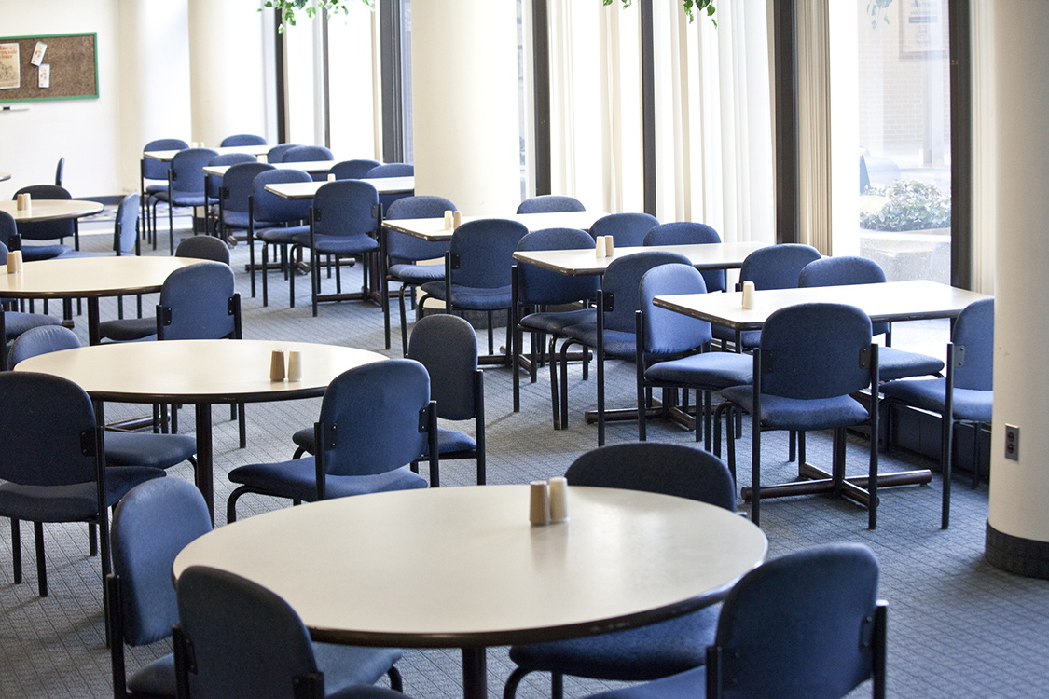

Menu subject to change without notice.

