Slide 1
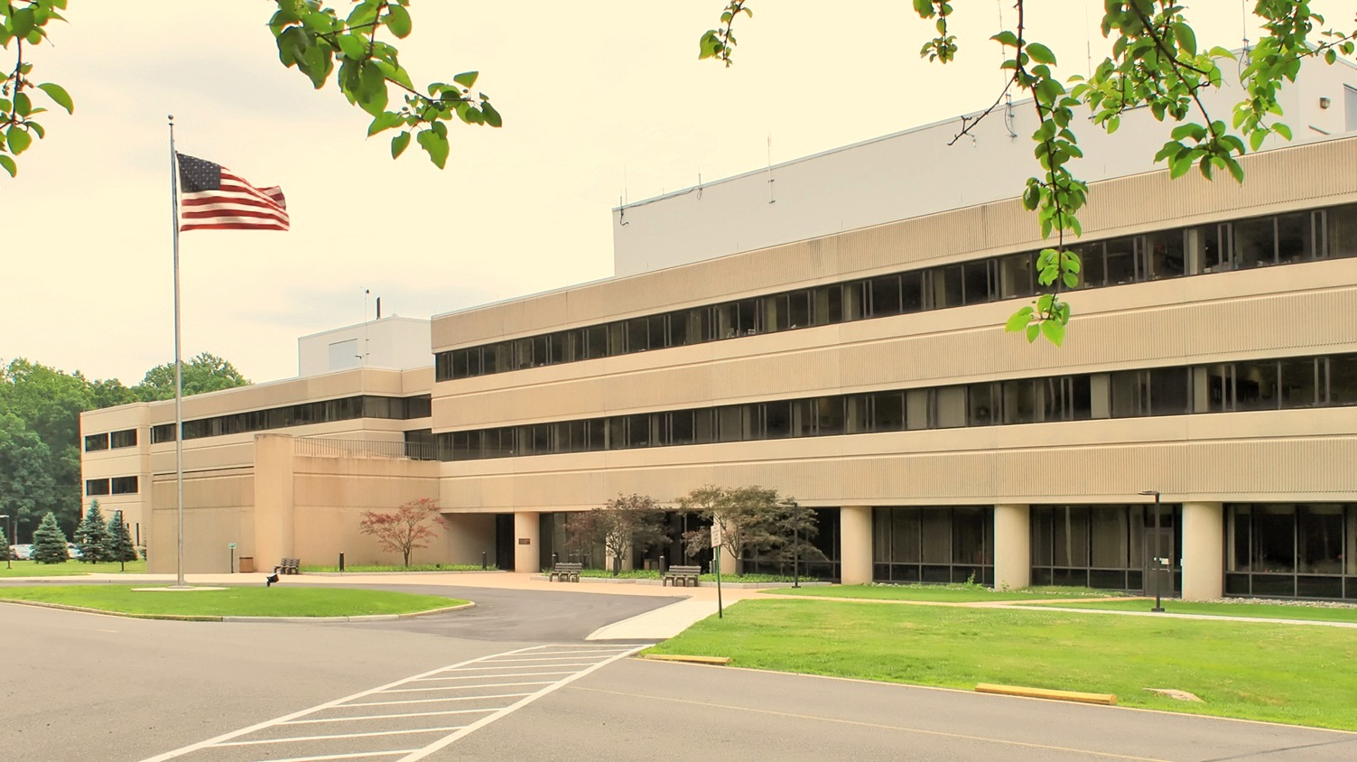
This Week @ PPPL
August 4 - 8, 2014
Brought to you by the PPPL Office of Communications

Slide 2
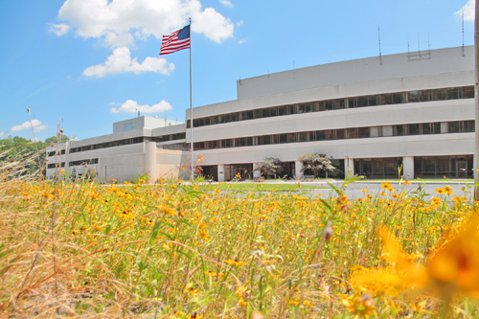


UPCOMING EVENTS
  Wednesday, August 6
  Farewell Cake for Maria Dikeakos – 10 a.m. – LSB Commons
  Wednesday, August 6
  Yoga Class at PPPL – Noon – LSB Commons
  Friday, August 8
  Annual PPPL Bluefishing Trip – 5 p.m. – Belmar Marina, Belmar, NJ
  Wednesday, August 13
  Poster Session for Summer Students – 10 a.m. – LSB Lobby
  Monday, September 1
  Lab Closed – Labor Day Holiday

Slide 3
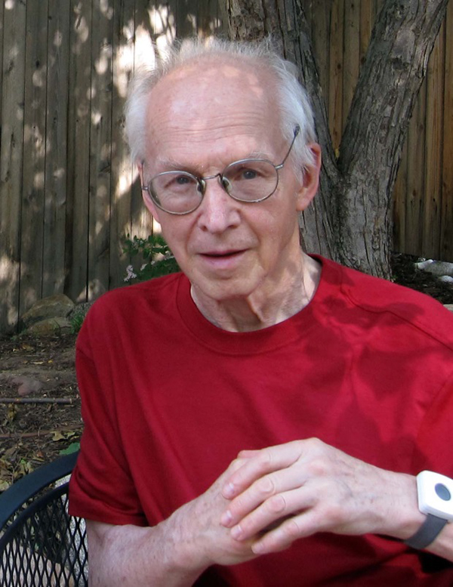
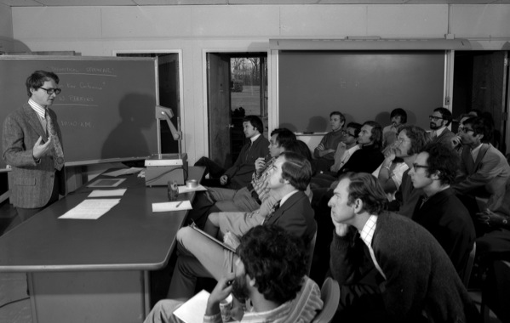
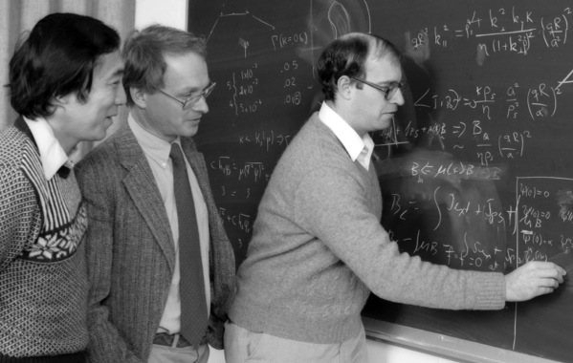
Francis “Rip” William Perkins, Jr.
1934 - 2014
Came to PPPL in 1966.
Head of PPPL Theory Division from 1980 to 1986.
Head of the Physics Integration Unit for ITER in San Diego from 1993 to 1998.
PPPL collaborator at General Atomics 1999-2000.

Slide 4
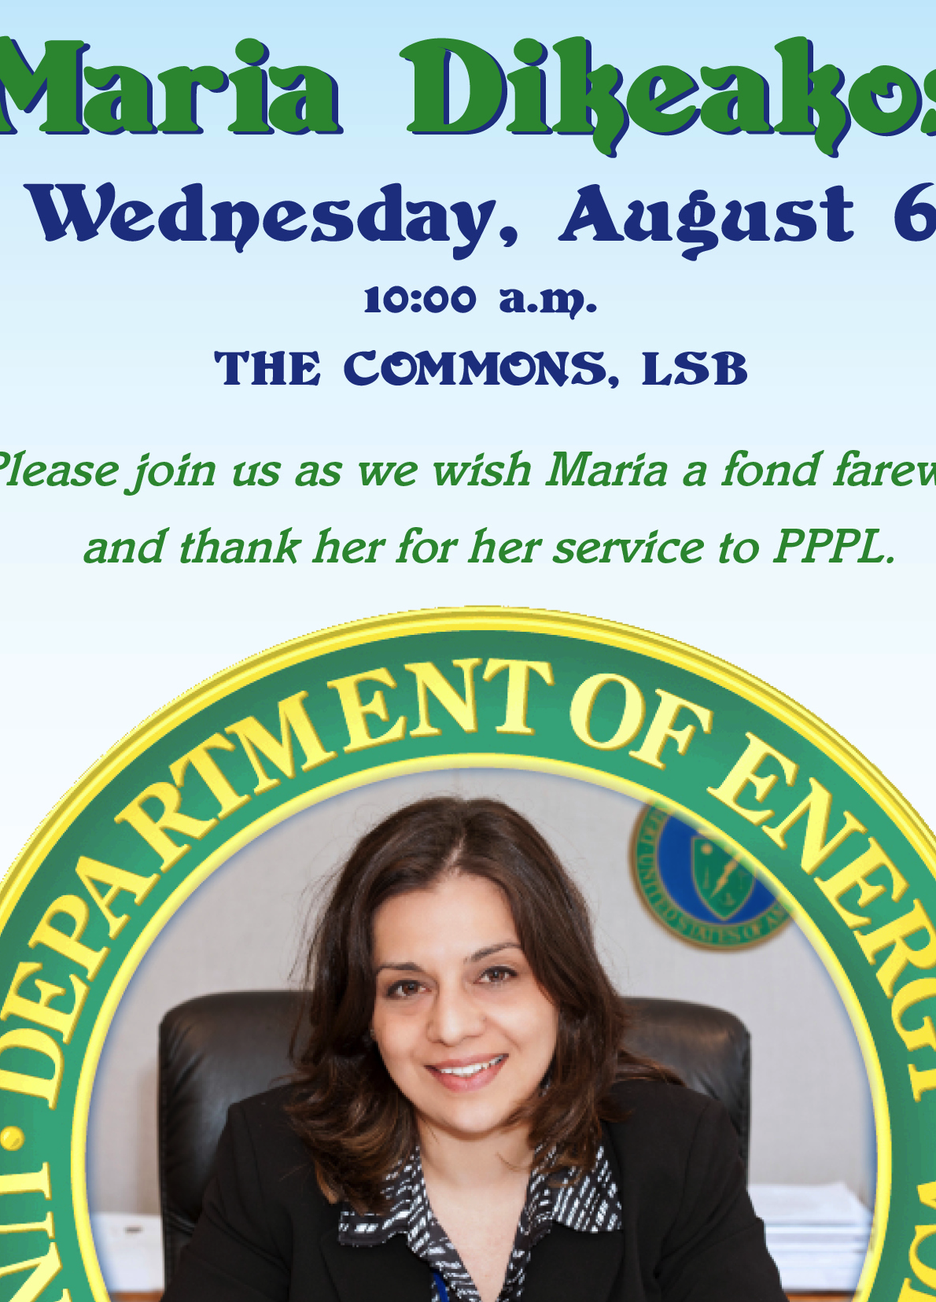


Slide 5

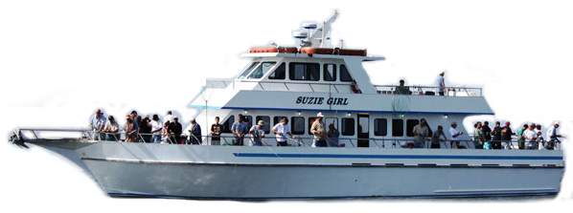
2014 PPPL Bluefishing Trip
THIS FRIDAY, AUGUST 8
Aboard the 80’ Suzie Girl
Departure: 5 p.m. SHARP!!! Belmar Marina, Hwy. 35, Belmar, N.J.
Info:
ANDY CARPE ext. 2118 acarpe@pppl.gov
or BOB TUCKER JR. ext. 3190 rltucker@pppl.gov

Slide 6
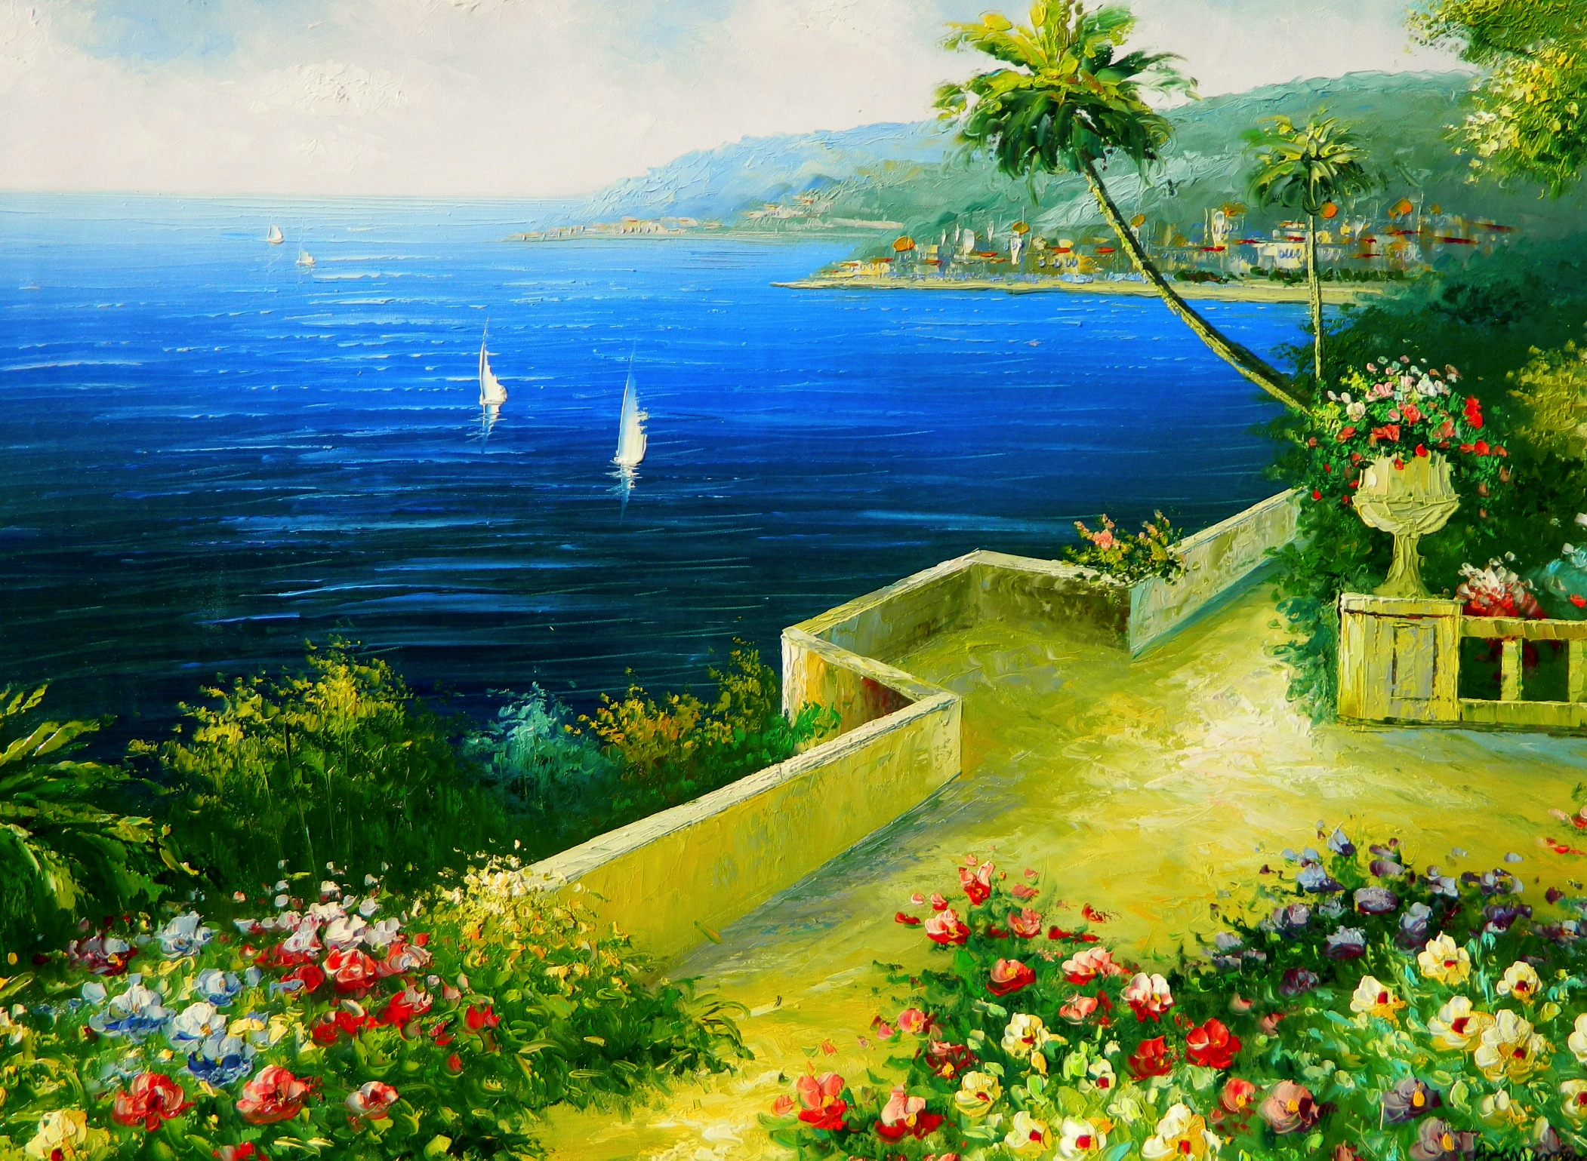
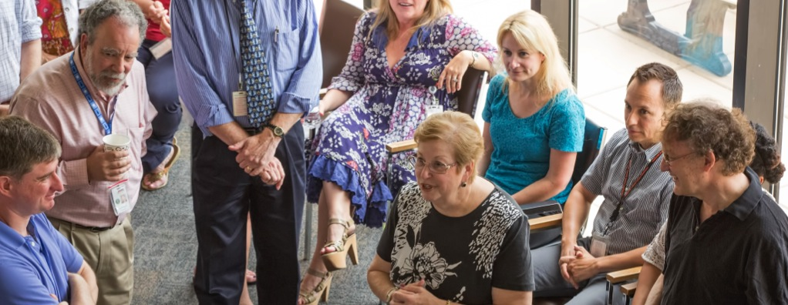
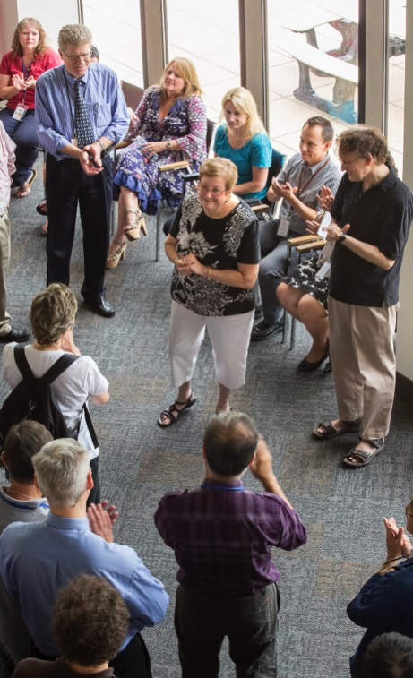
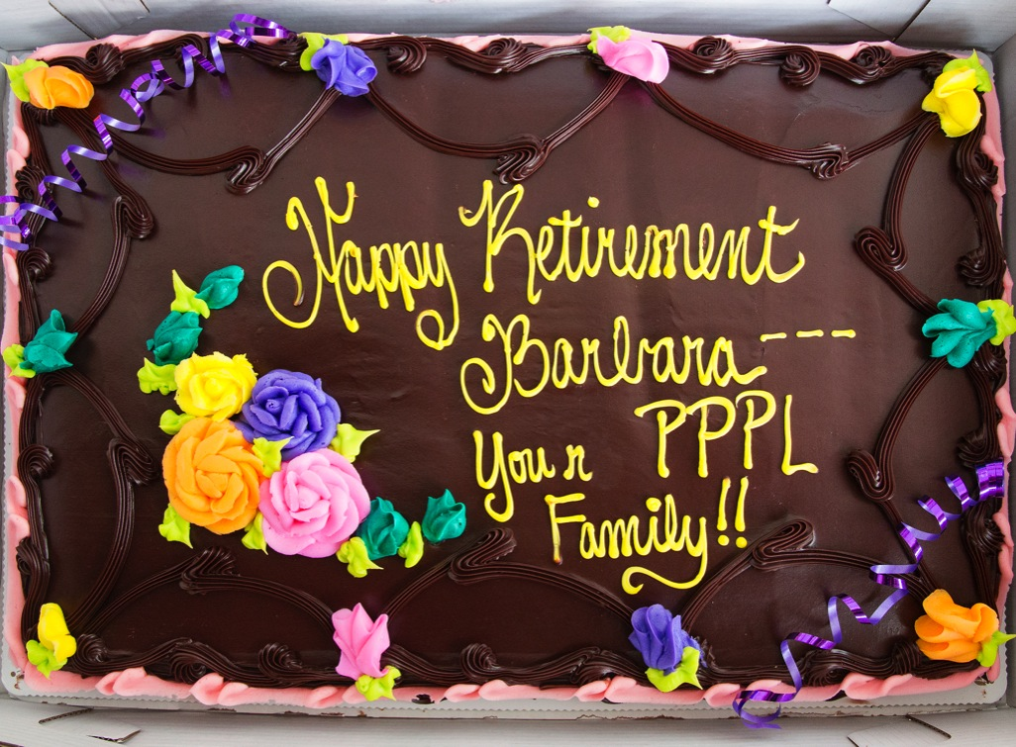
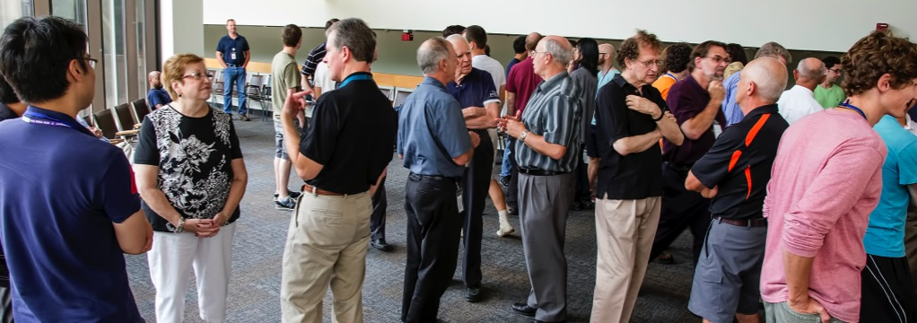
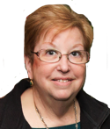
RETIREMENT FAREWELL FOR BARBARA SARFATY

Slide 7



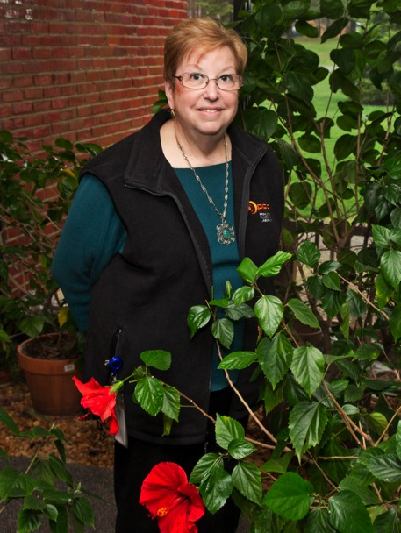

trivia
Barbara Sarfaty retired on Aug. 1 after how many years at PPPL?
a) 39
b) 33
c) 37
d) 31

Slide 8
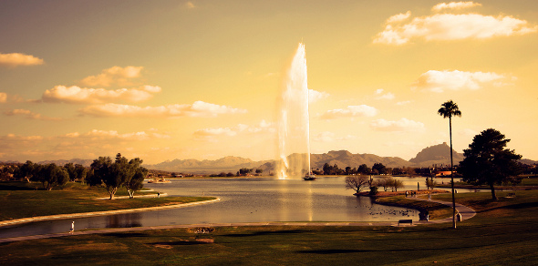
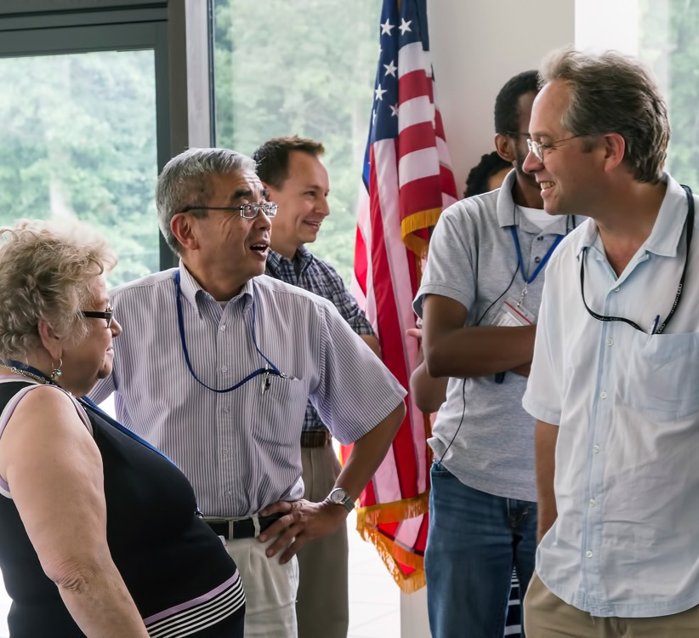
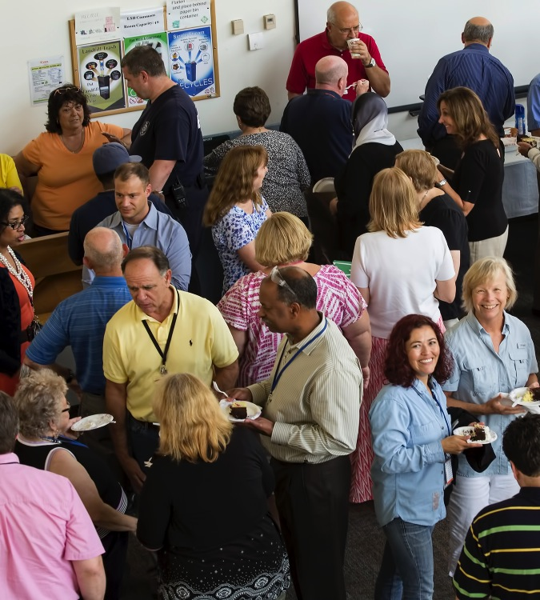
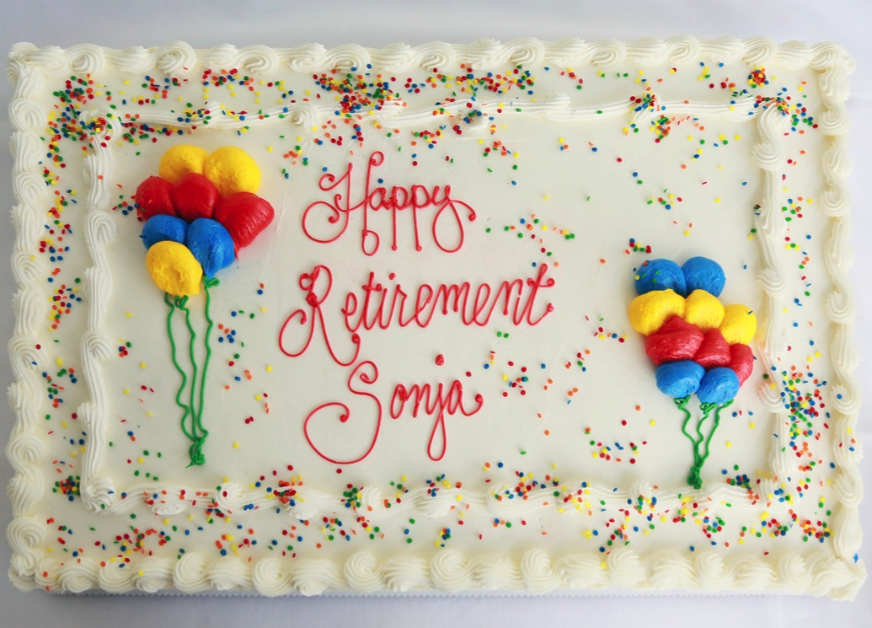
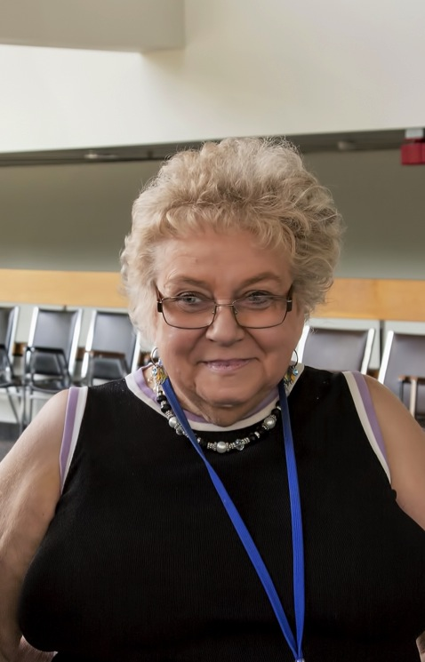

RETIREMENT FAREWELL FOR SONJA PATTERSON

Slide 9
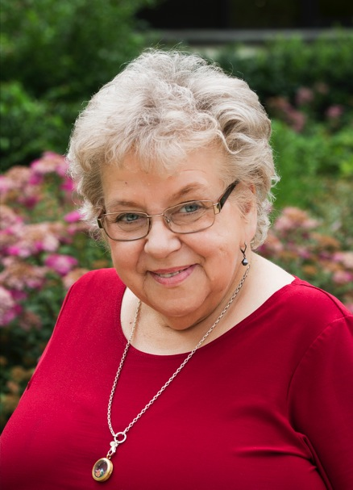

trivia
Sonja Patterson retired on Aug. 1 after how many years at PPPL?
a) 29
b) 37
c) 41
37
d) 33

Slide 10
