Slide 1
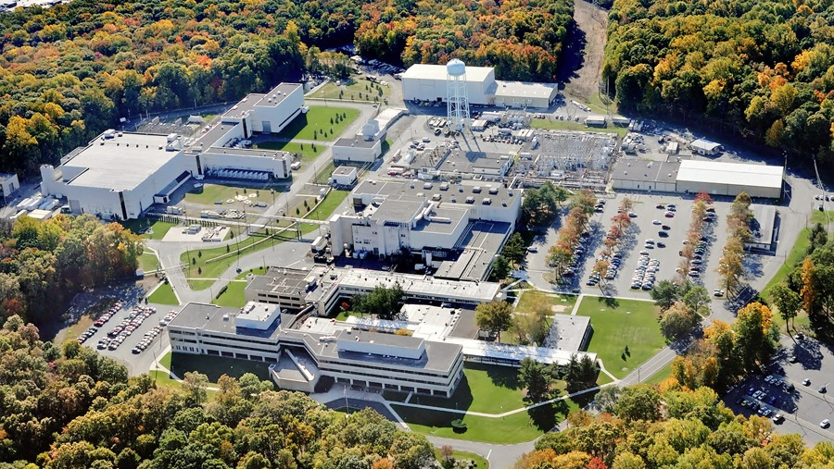
This Week @ PPPL
August 12 - 16, 2013
From the PPPL Office of Communications

Slide 2
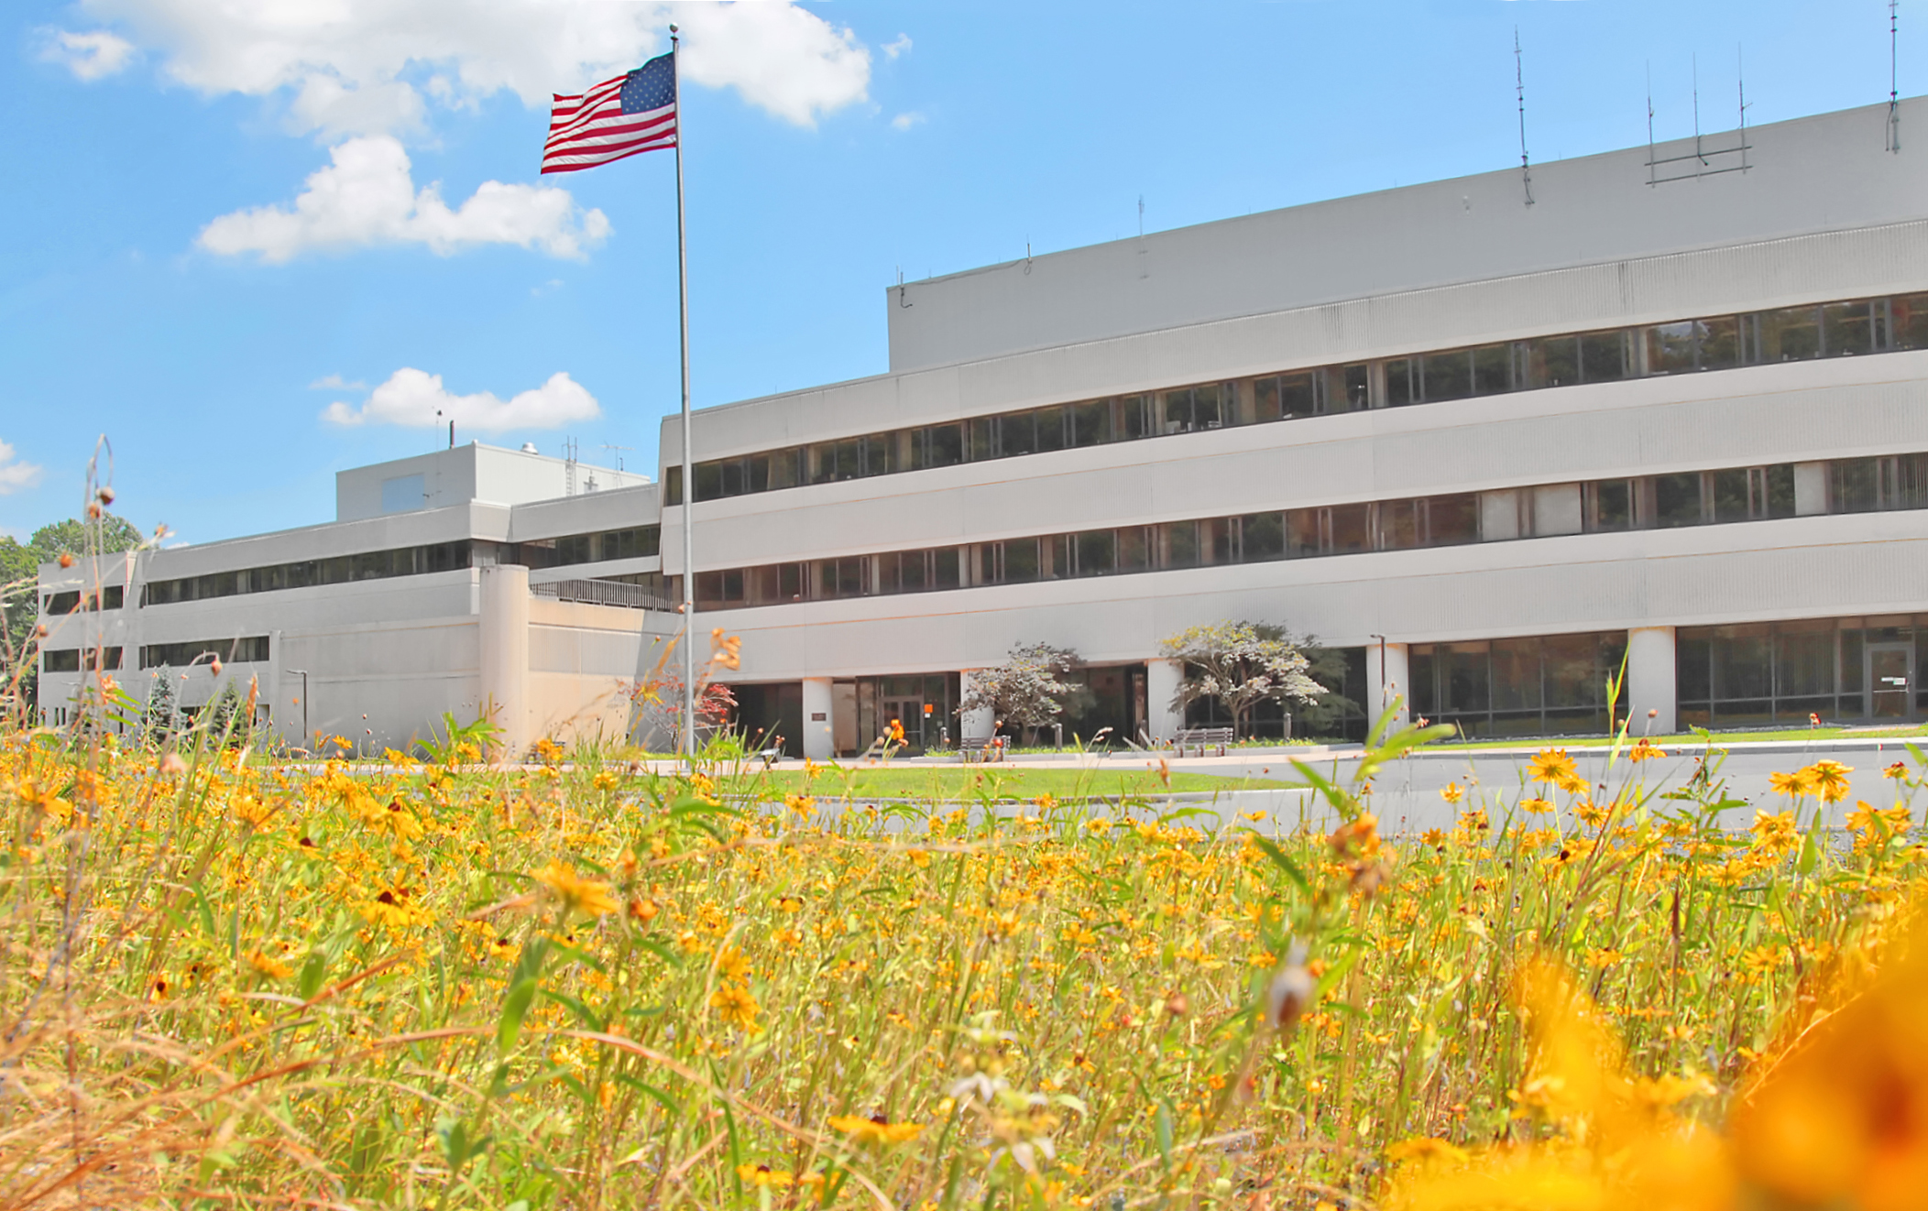
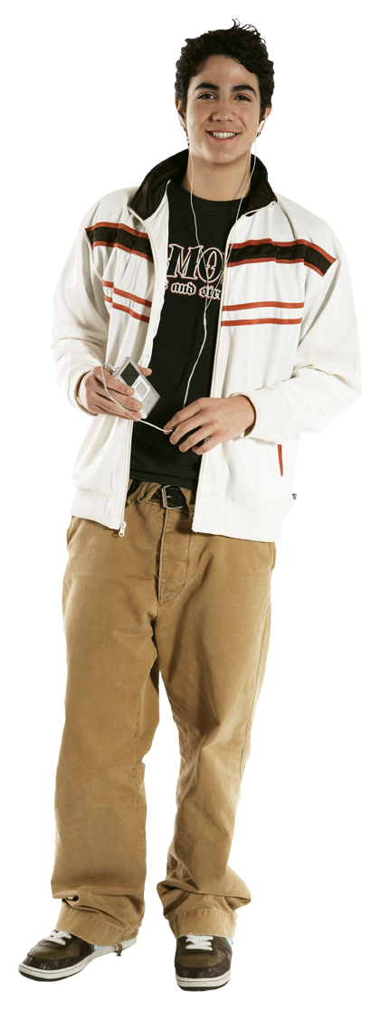


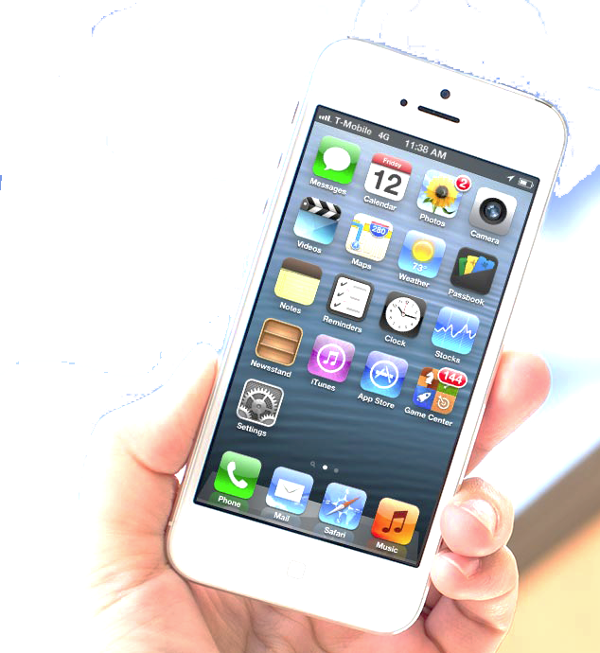


FOLLOW PPPL ON…
twitter.com/PPPLab
www.facebook.com/PPPLab
www.youtube.com/PPPLab
www.flickr.com/photos/pppl/

Slide 3
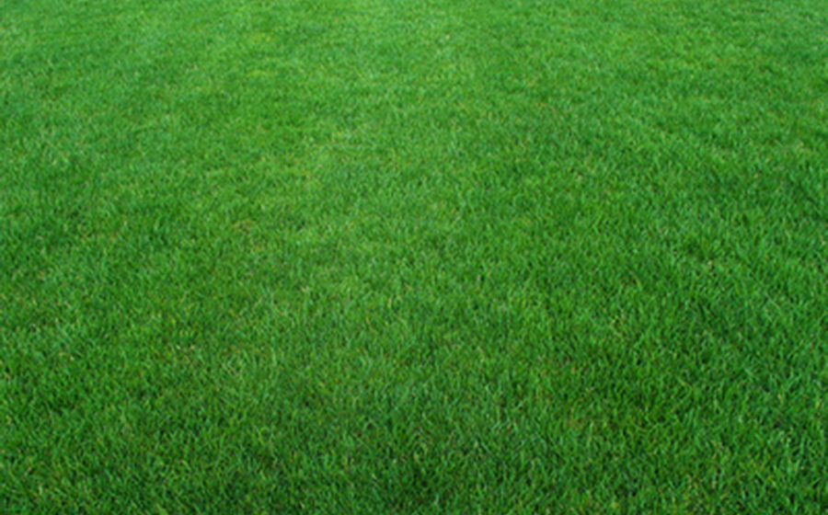
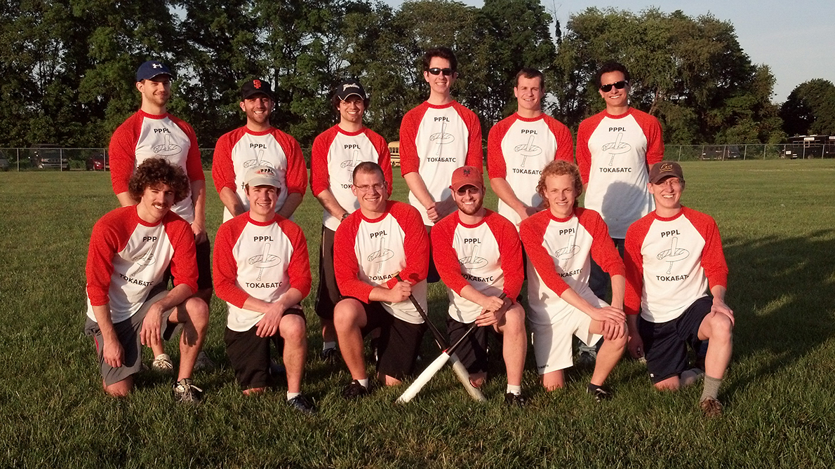

– CHAMPIONS –
Congratulations to THE TOKABATS, the PPPL grad student softball team,
winner of the Princeton University Summer Softball League championship.

Slide 4
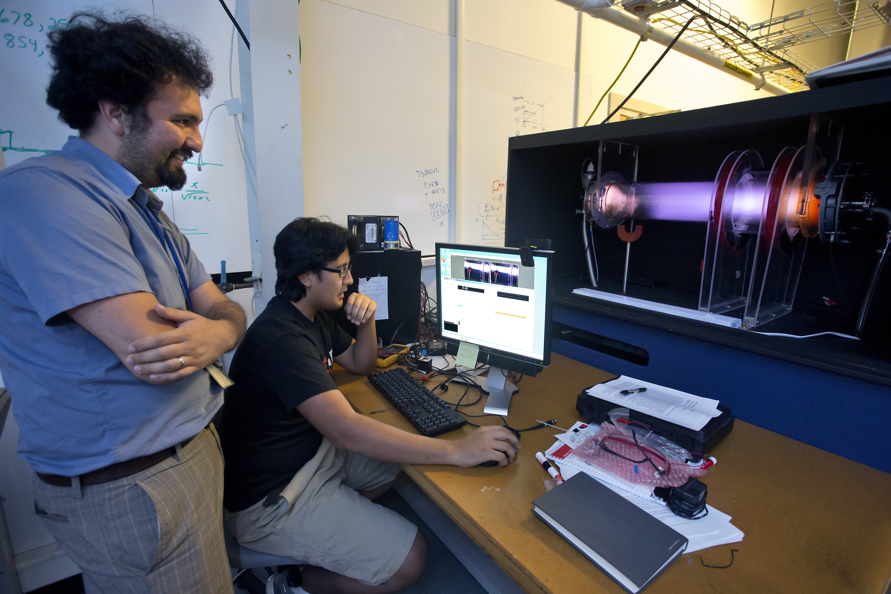
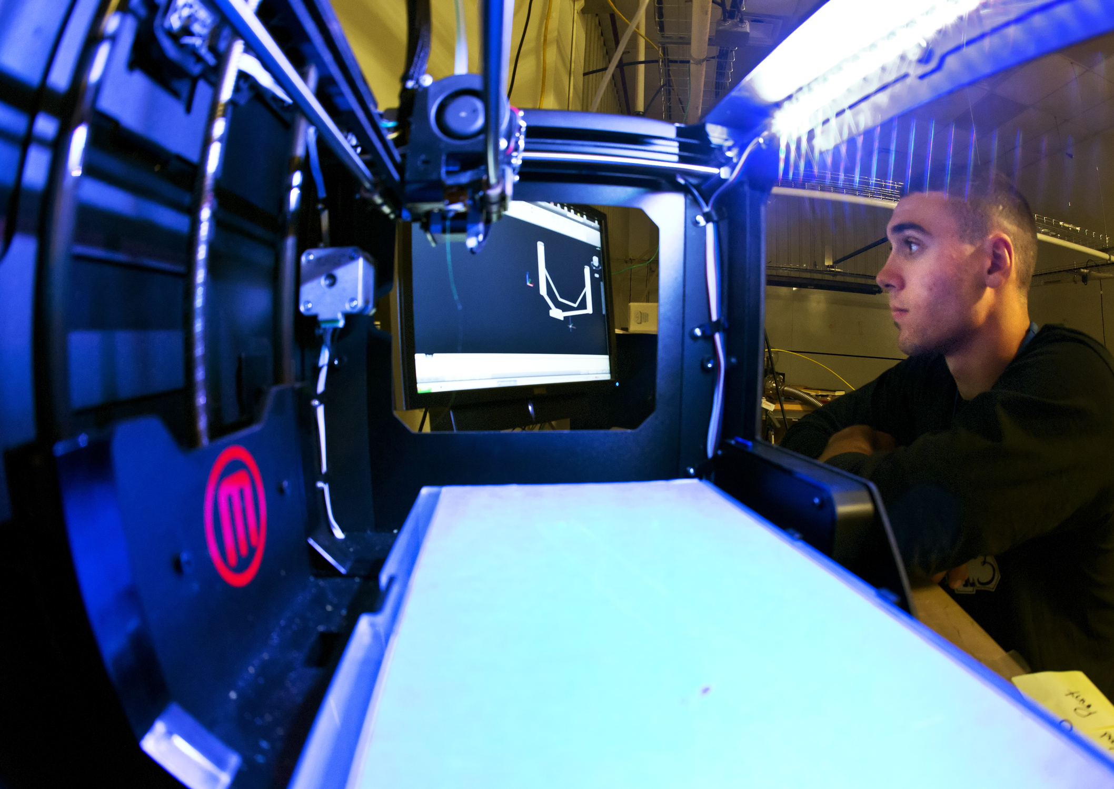
Summer Students at PPPL

Slide 5
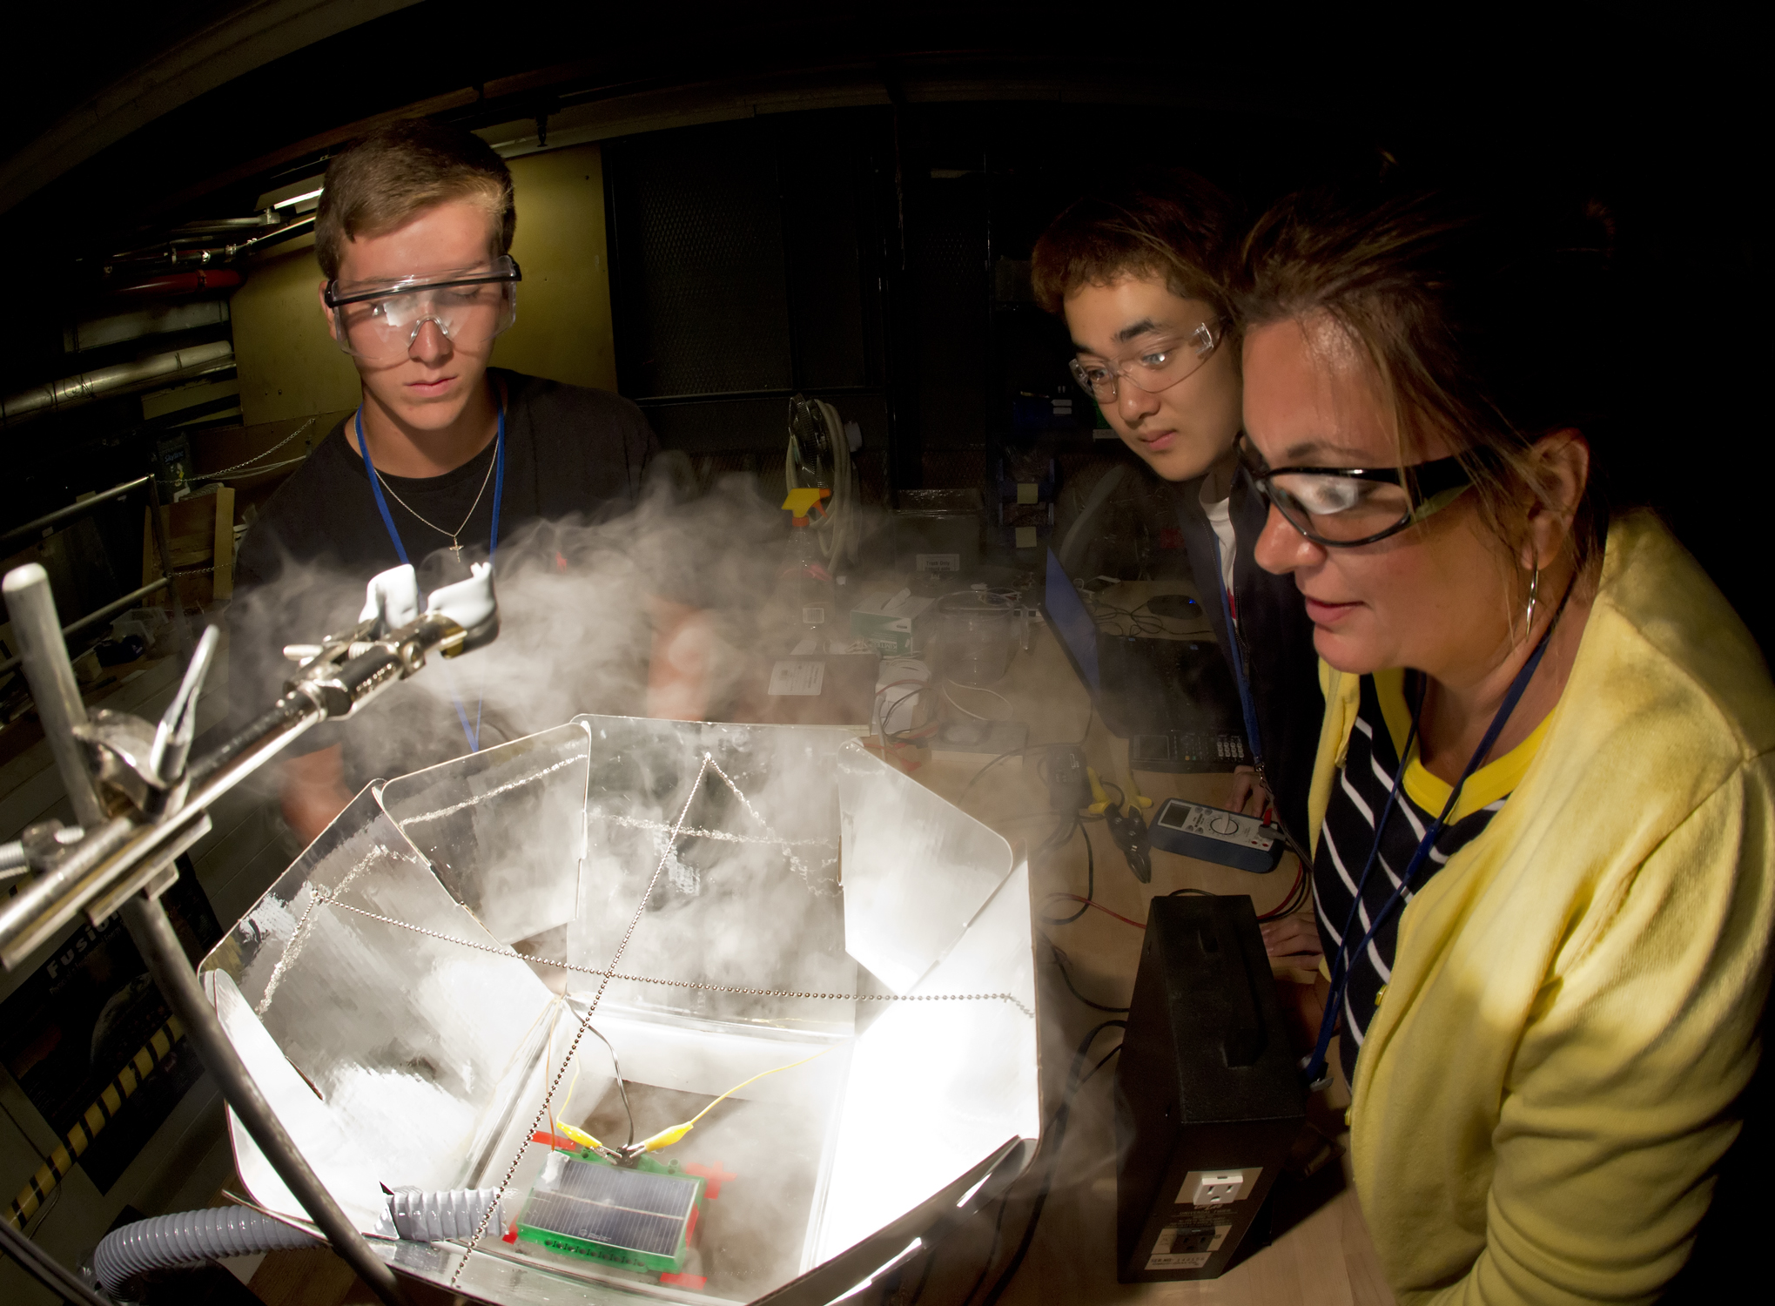
Summer Students at PPPL

Slide 6

COMING SOON

Slide 7

RED CARPET
*********
INTRODUCTIONS
*************
MEET THE STARS
********************
WORLD PREMIERE
SCREENING OF
THE NEW PPPL VIDEO
“STAR POWER”
****************************************
REFRESHMENTS – SOUVENIRS
**********************************************************
THU. AUG. 29 – 1 PM – MBG AUD.

Slide 8
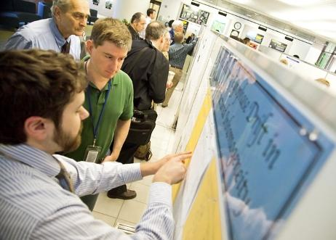
On behalf of the Science Education Department,
you are invited to attend the annual
STUDENT POSTER SESSION
on Wednesday, August 14
from 10 a.m. to 2 p.m.
in the LSB Lobby.
Students will be on-hand to present their
hard work during the summer.
Please stop by! We look forward to seeing you!

Slide 9
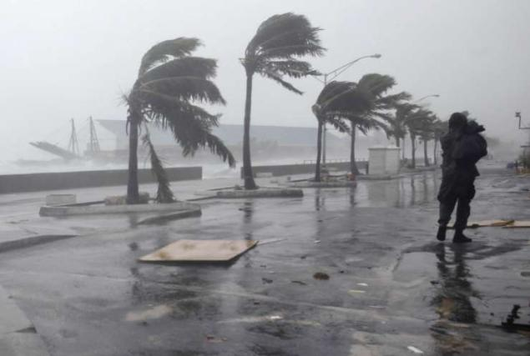
HURRICANE PREPAREDNESS
^{Before the storm:}
Map evacuation routes to higher ground. Leave promptly if directed to before roads become crowded or impassable.
^{Clean gutters and downspouts.}
^{Verify sump pumps work.}
^{Reinforce garage doors.}
Consider purchasing a generator. (Do not use indoors!)
Get your supervisor’s contact information.
^{During the storm:}
If in a high-rise, consult building management for guidance. Shelter below the 10th floor as a general precaution.
^{Close all interior doors.}
Stay away from doors and windows.
^{After the storm:}
Check your home for structural damage, loose power lines, and gas leaks.
Turn flashlights on outside the home – the battery could spark, igniting any gas fumes.
Keep an eye on pets and look out for wild animals, especially snakes. Poke through debris with a stick.

Slide 10
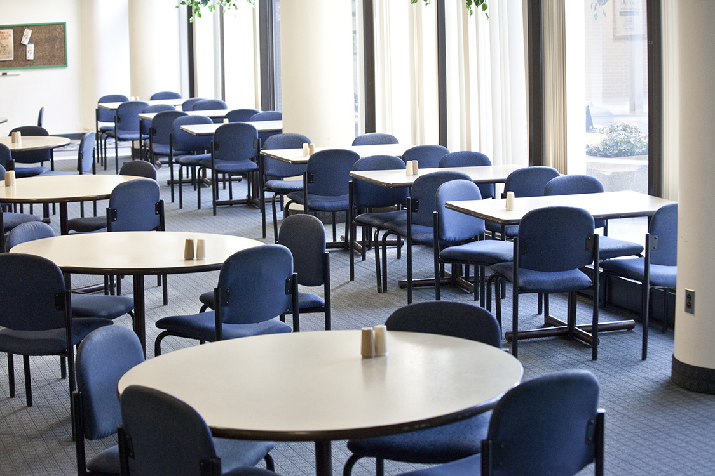
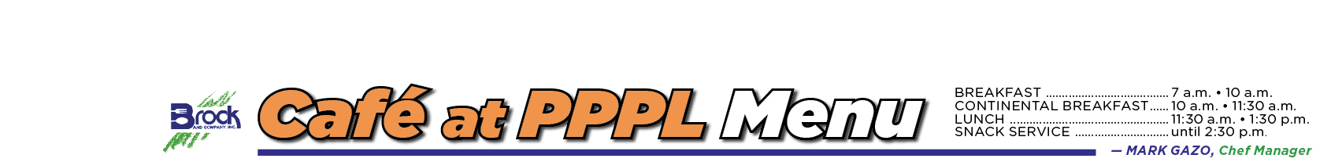
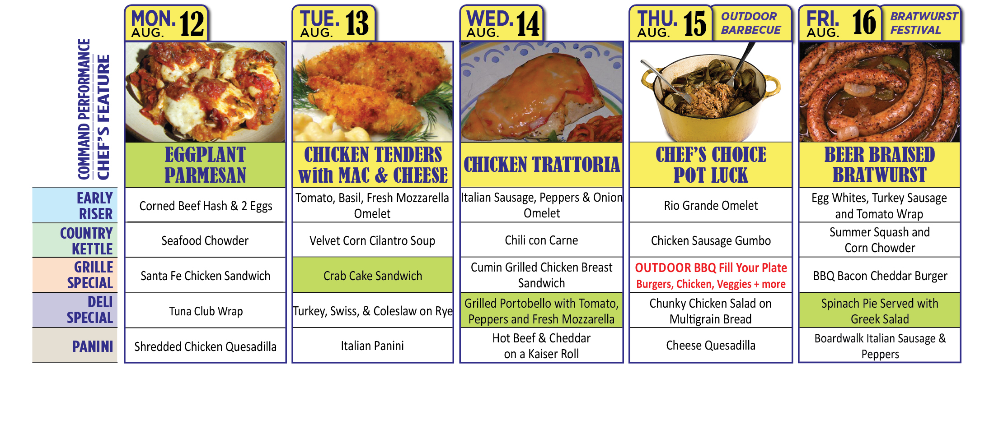
Menu subject to change without notice.

