Slide 1
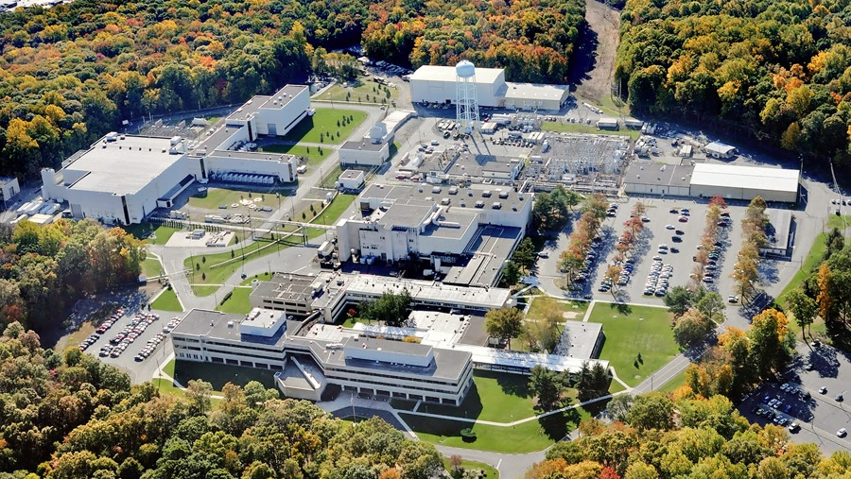
This Week @ PPPL
August 19 - 23, 2013
From the PPPL Office of Communications

Slide 2
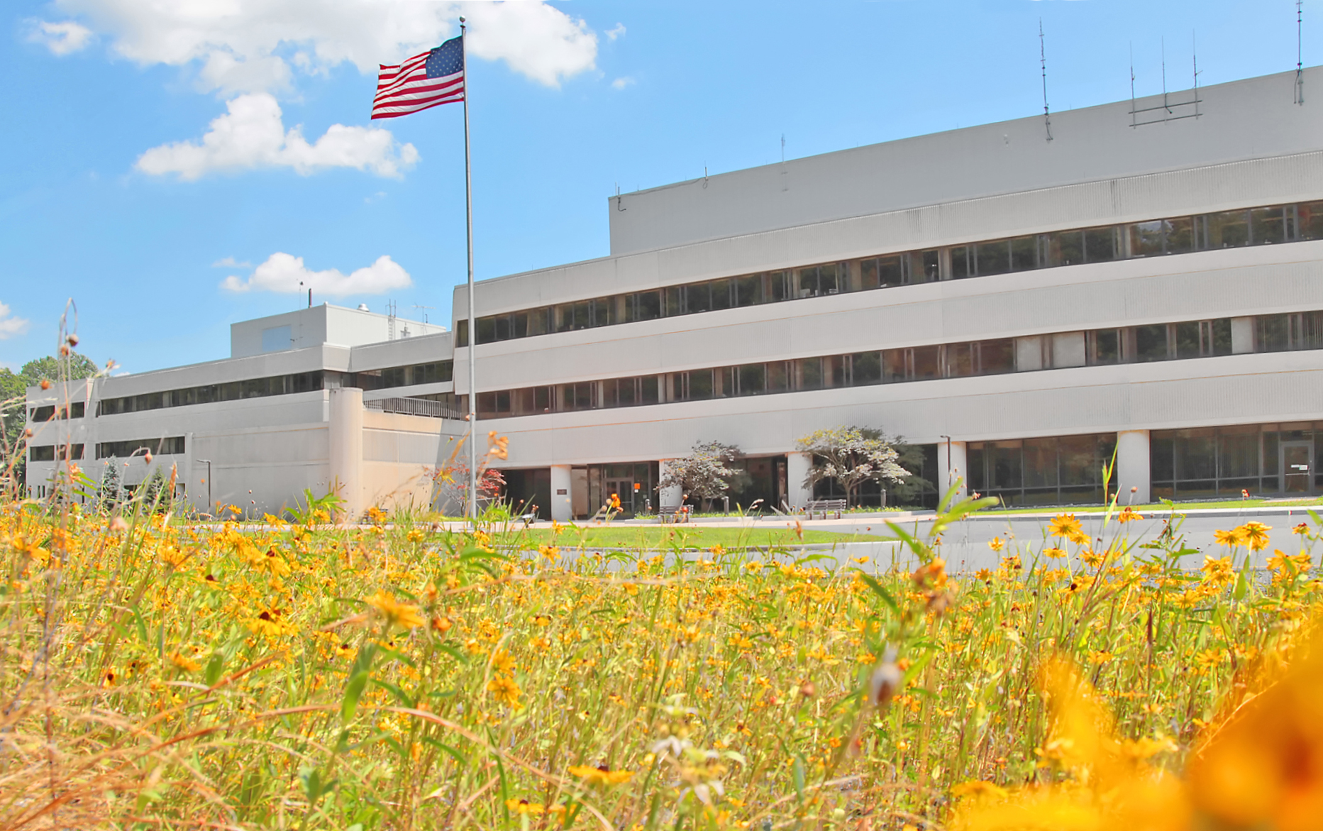



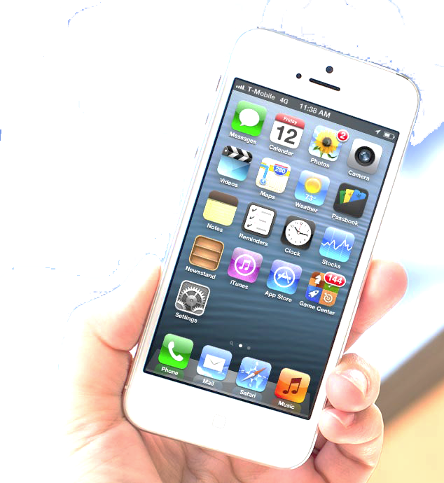


FOLLOW PPPL ON…
twitter.com/PPPLab
www.facebook.com/PPPLab
www.youtube.com/PPPLab
www.flickr.com/photos/pppl/

Slide 3
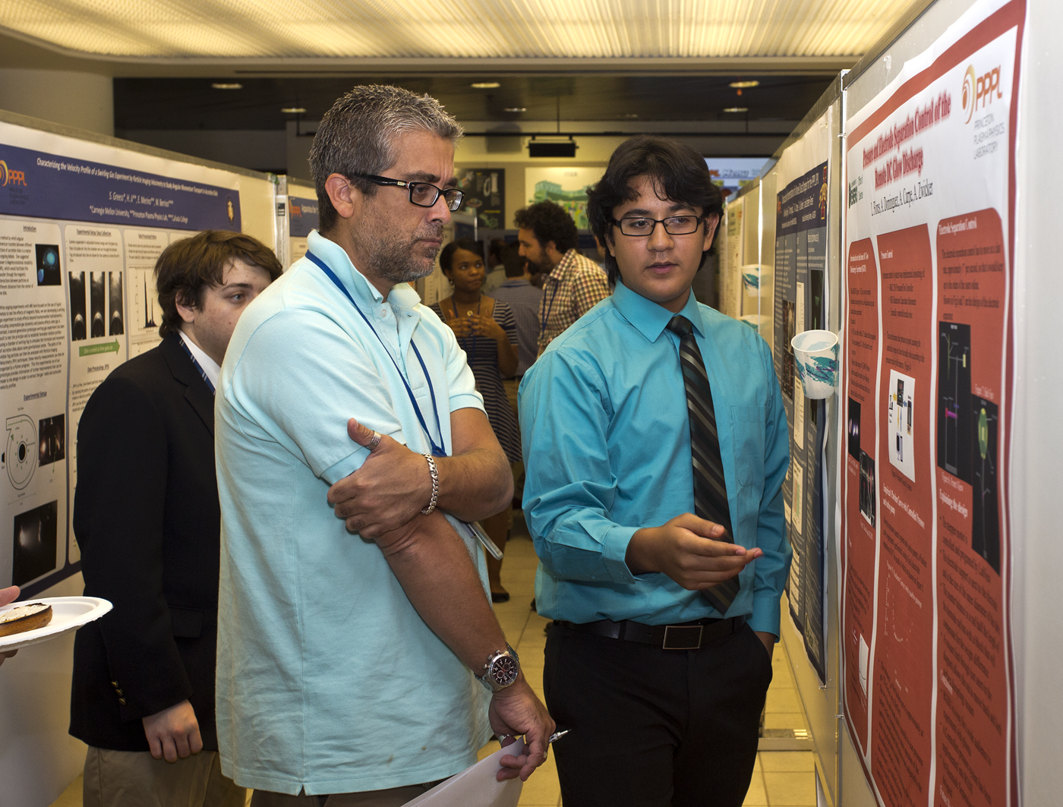
Summer Students Poster Session at PPPL

Slide 4
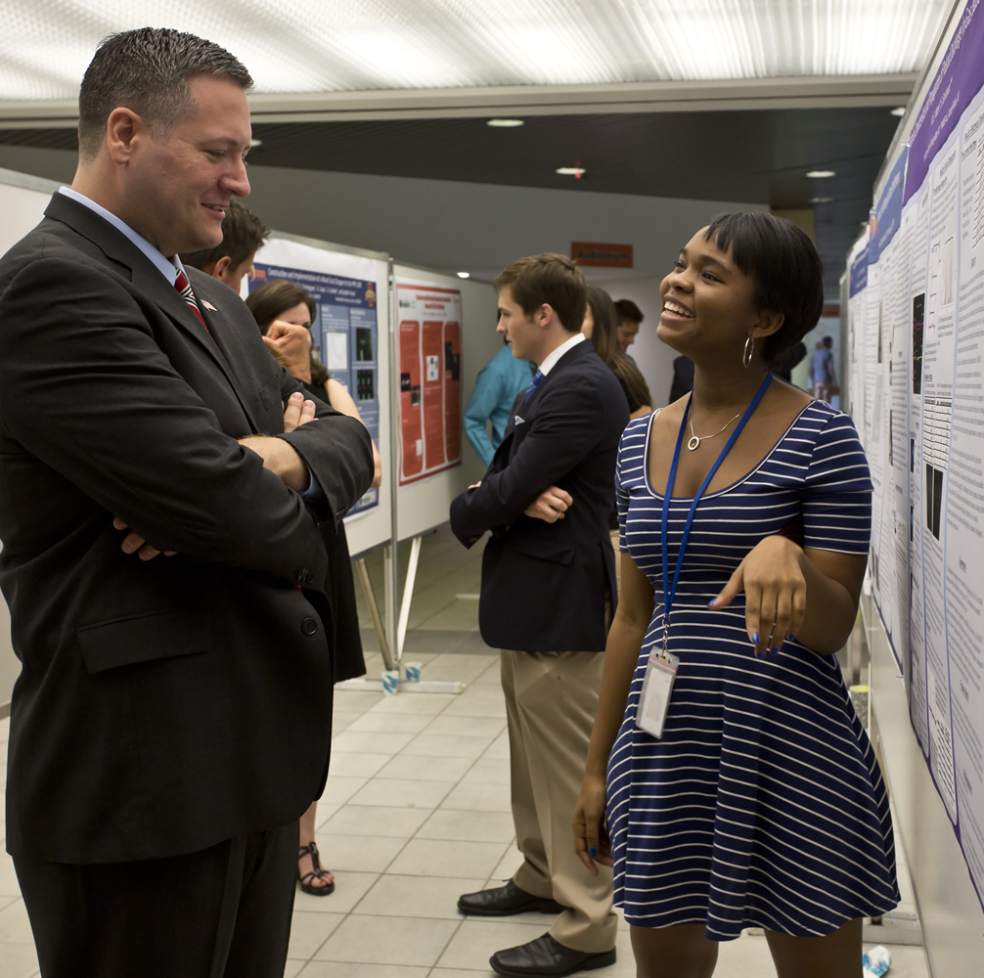
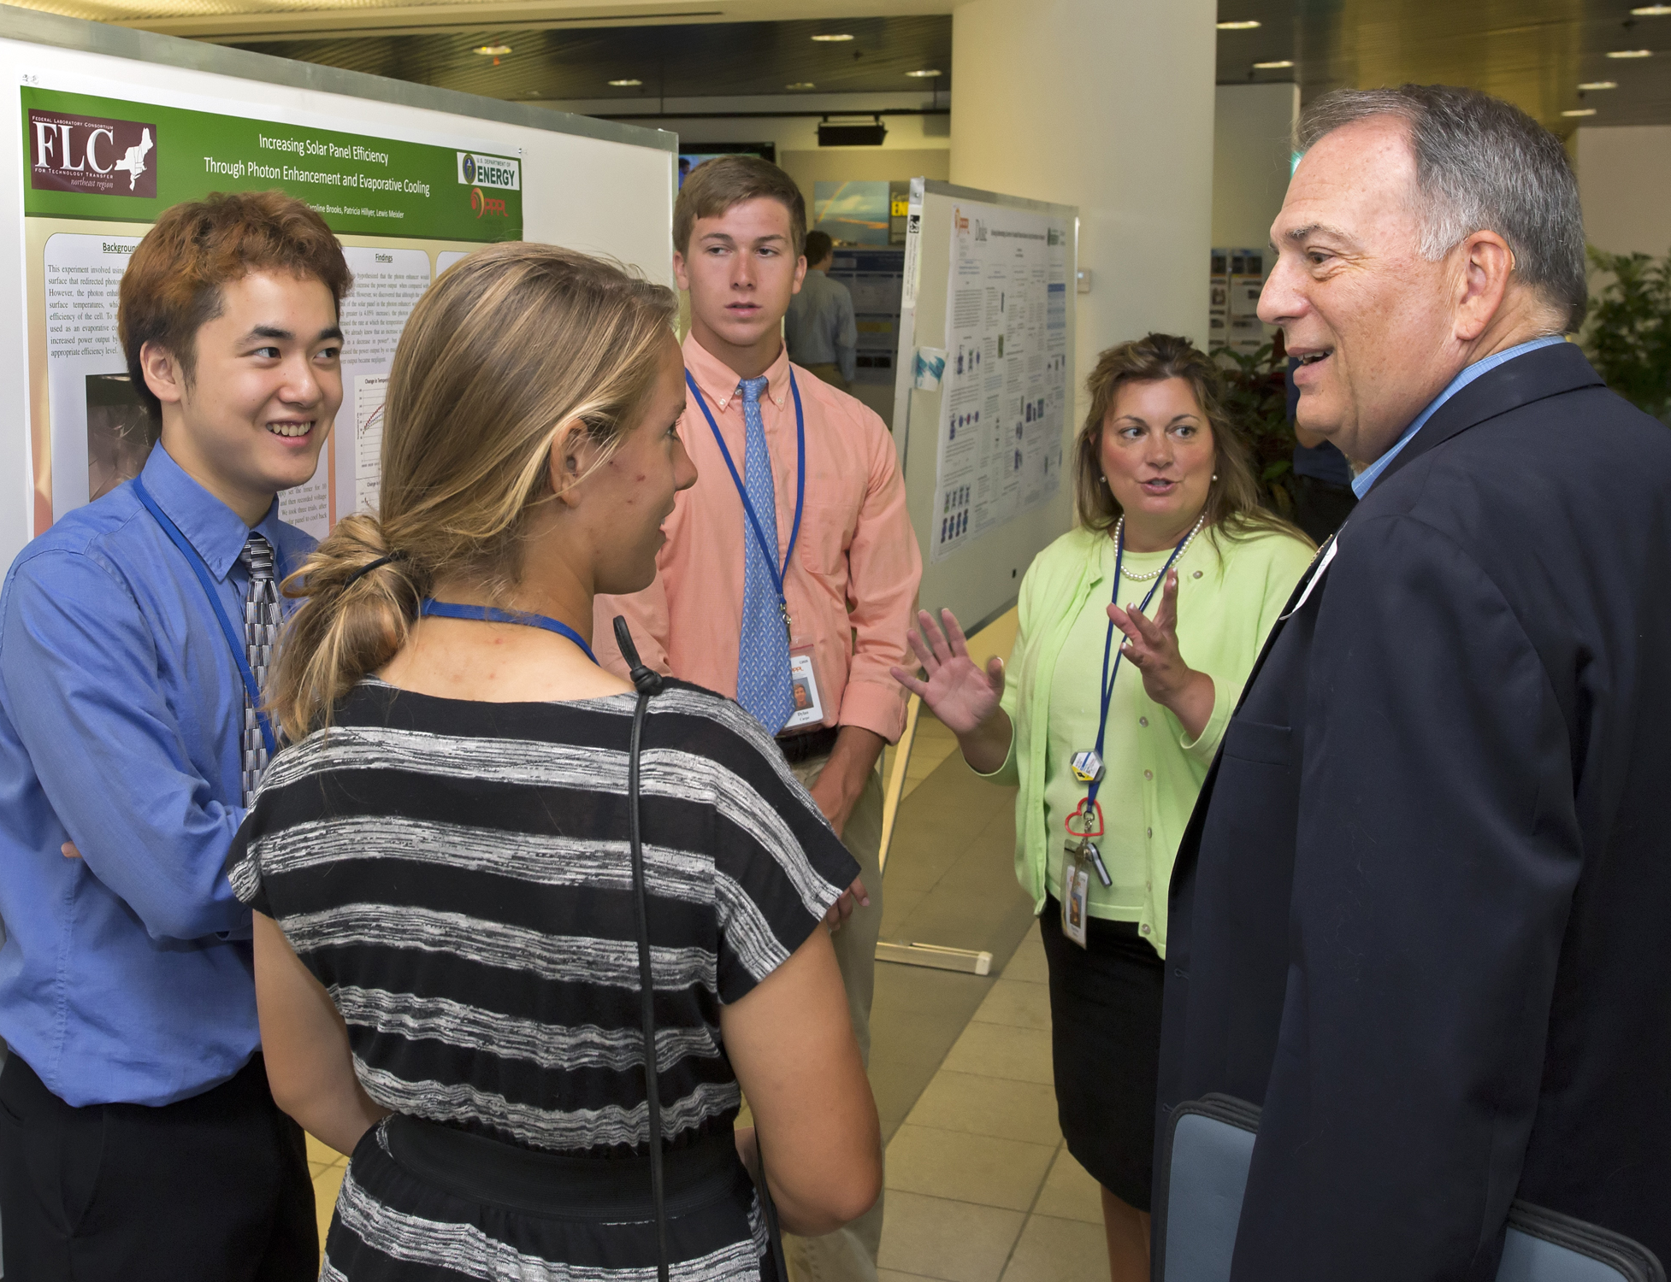
Summer Students Poster Session at PPPL

Slide 5

COMING SOON

Slide 6



Slide 7

RED CARPET
********************
INTRODUCTIONS
**************************
MEET THE STARS
********************************
WORLD PREMIERE
SCREENING OF
THE NEW PPPL VIDEO
“STAR POWER”
*******************************************************
REFRESHMENTS – SOUVENIRS
***************************************************************
THU. AUG. 29 – 1 PM – MBG AUD.

Slide 8
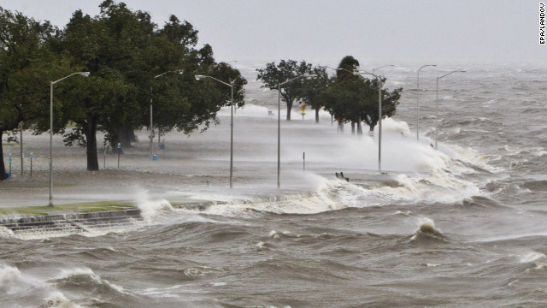
HURRICANE PREPAREDNESS
^{Before the storm:}
Map evacuation routes to higher ground. Leave promptly if directed to before roads become crowded or impassable.
^{Clean gutters and downspouts.}
^{Verify sump pumps work.}
^{Reinforce garage doors.}
Consider purchasing a generator. (Do not use indoors!)
Get your supervisor’s contact information.
^{During the storm:}
If in a high-rise, consult building management for guidance. Shelter below the 10th floor as a general precaution.
^{Close all interior doors.}
Stay away from doors and windows.
^{After the storm:}
Check your home for structural damage, loose power lines, and gas leaks.
Turn flashlights on outside the home – the battery could spark, igniting any gas fumes.
Keep an eye on pets and look out for wild animals, especially snakes. Poke through debris with a stick.

Slide 9
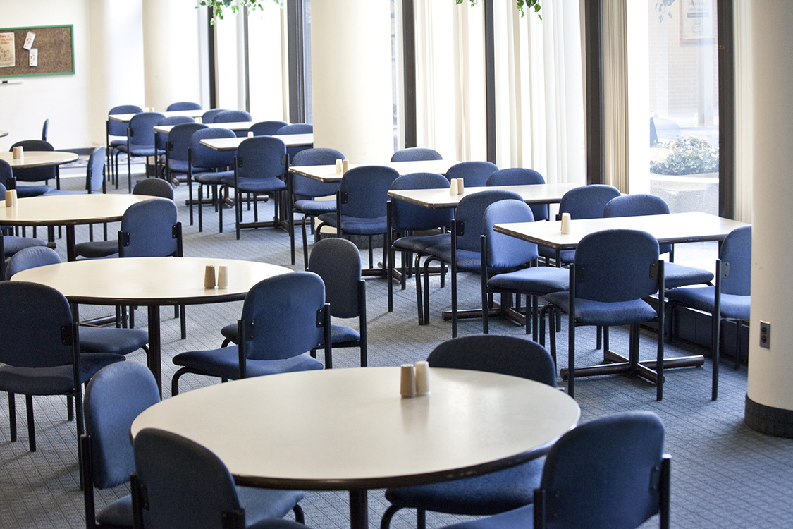

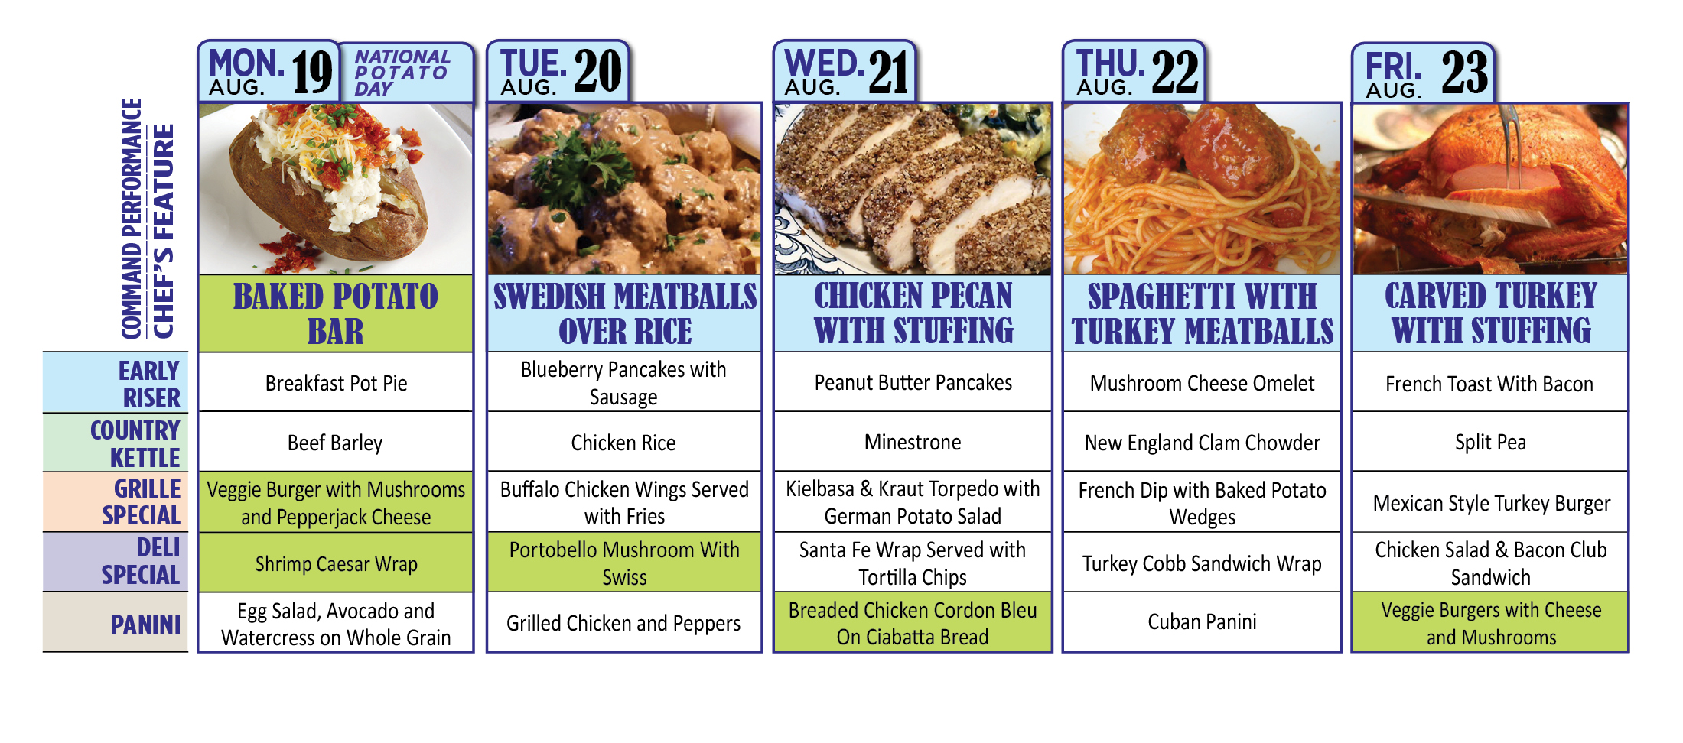
Menu subject to change without notice.

