Slide 1
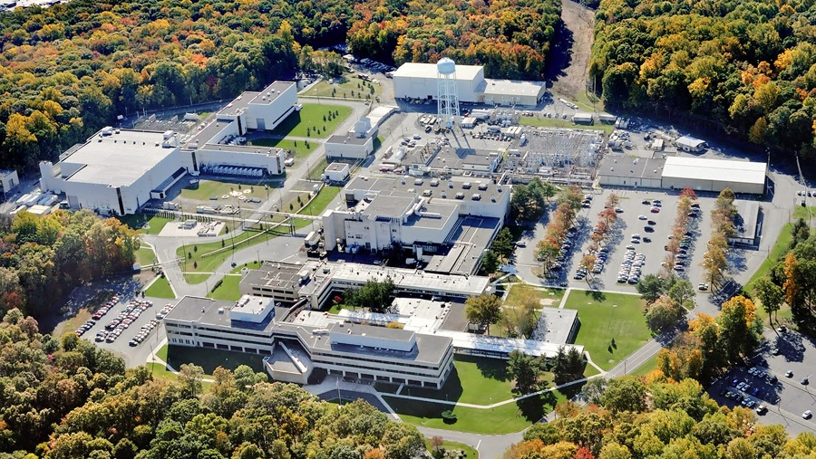
This Week @ PPPL
August 26 - 30, 2013
From the PPPL Office of Communications

Slide 2
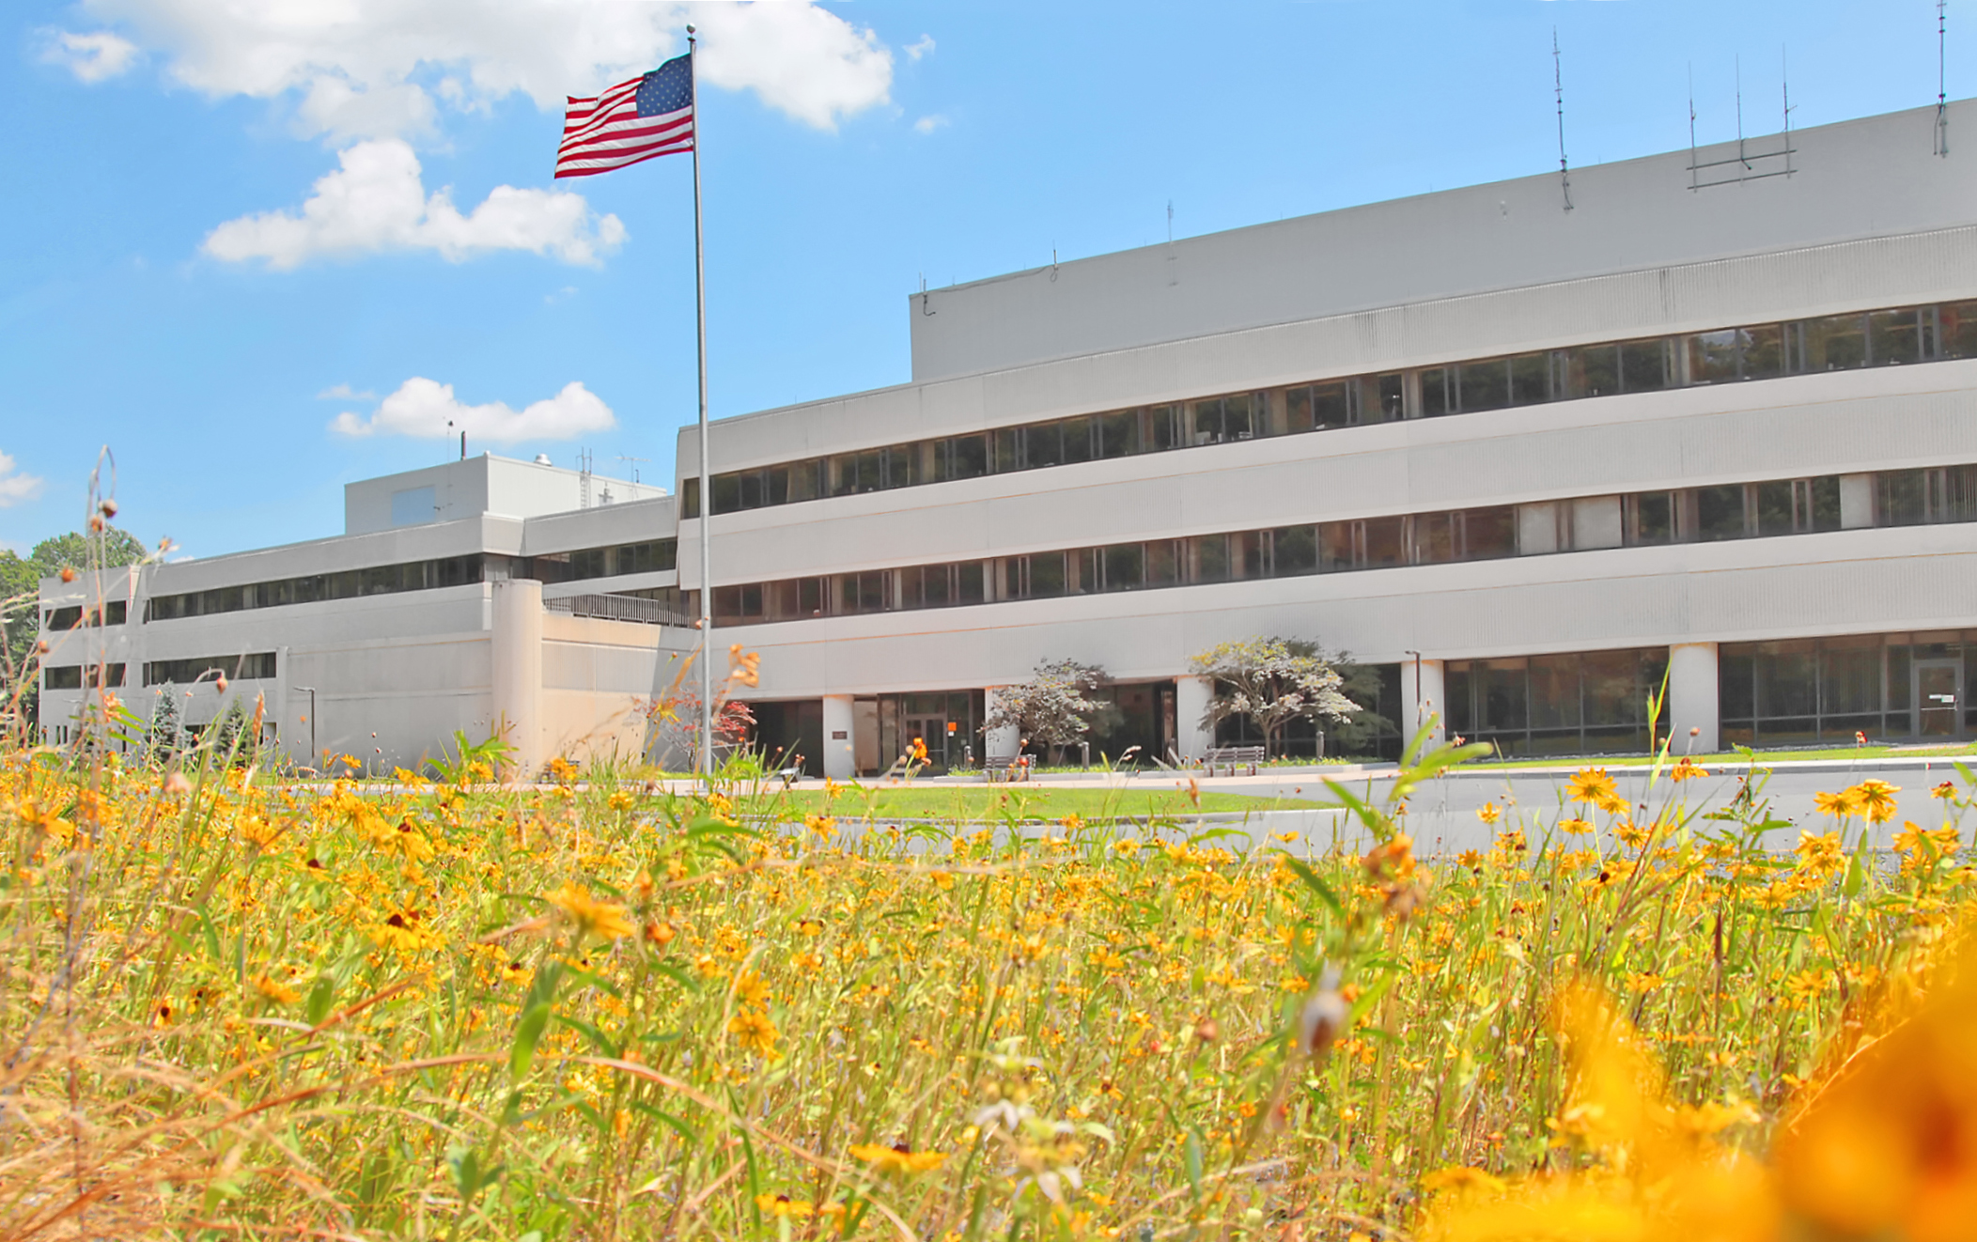






FOLLOW PPPL ON…
twitter.com/PPPLab
www.facebook.com/PPPLab
www.youtube.com/PPPLab
www.flickr.com/photos/pppl/

Slide 3

THIS THURSDAY

Slide 4



Slide 5

RED CARPET
********************
INTRODUCTIONS
**************************
MEET THE STARS
********************************
WORLD PREMIERE
SCREENING OF
THE NEW PPPL VIDEO
“STAR POWER”
*******************************************************
REFRESHMENTS•SOUVENIRS•DOOR PRIZES
***************************************************************
THU. AUG. 29 – 1 P.M. – MBG AUD.

Slide 6



Slide 7



The Future of Offshore Wind Energy and Transmission in New Jersey
Mrs. Kris Ohleth
The Atlantic Wind Connection
WEDNESDAY, SEPTEMBER 11
4:15 p.m. (Coffee/Tea at 3 p.m.) • M.B.G. Auditorium, Lyman Spitzer Building

Slide 8
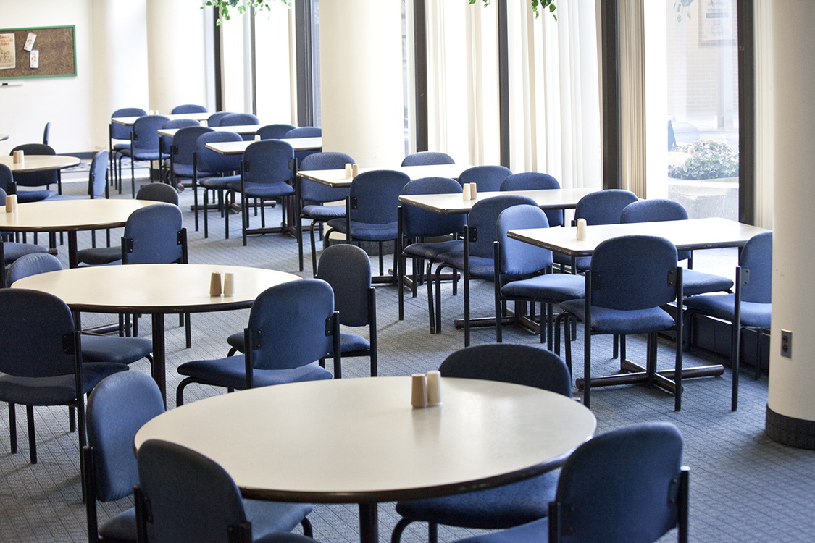



Menu subject to change without notice.

