Slide 1
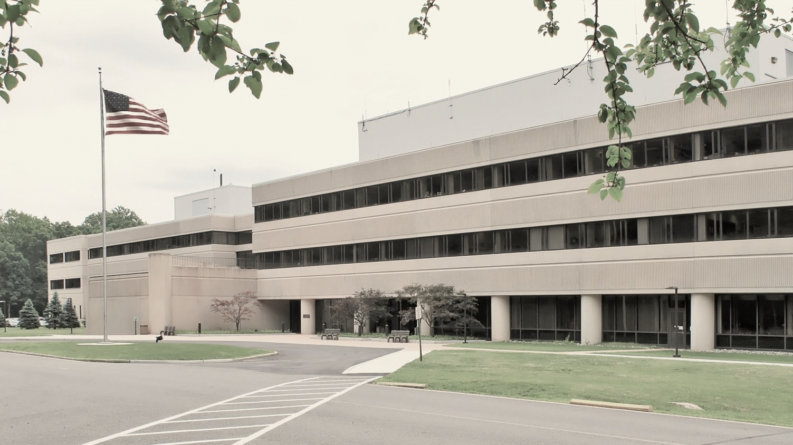
This Week @ PPPL
September 8 - 13, 2014
Brought to you by the PPPL Office of Communications

Slide 2
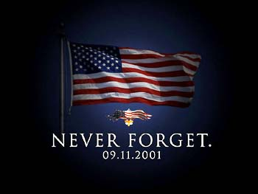
The Laboratory will be observing a moment of silence on Thursday, September 11 at 8:46 a.m. to honor those lost during the tragic events of Sept. 11, 2001. The time marks the moment when a plane struck the first of the two World Trade Center towers.

Slide 3
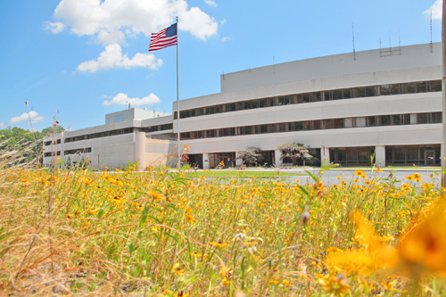


UPCOMING EVENTS
  Wednesday, September 10
  Princeton University – First Day of Classes
  Wednesday, September 24
  PPPL COLLOQUIUM - Evolution of Coil Design and Manufacturing at PPPL
  Wednesday, October 15
  PPPL COLLOQUIUM - Antibiotic Resistance: A Global Challenge
  Mon. – Fri., October 27 – 31
  56th Annual Meeting of the APS Division of Plasma Physics – New Orleans

Slide 4
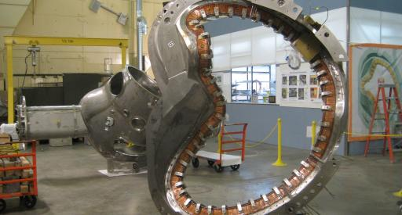

Evolution of Coil Design and Manufacturing at PPPL
James Chrzanowski – Princeton University
WEDNESDAY, SEPTEMBER 24
4:15 p.m. • M.B.G. Auditorium

Slide 5
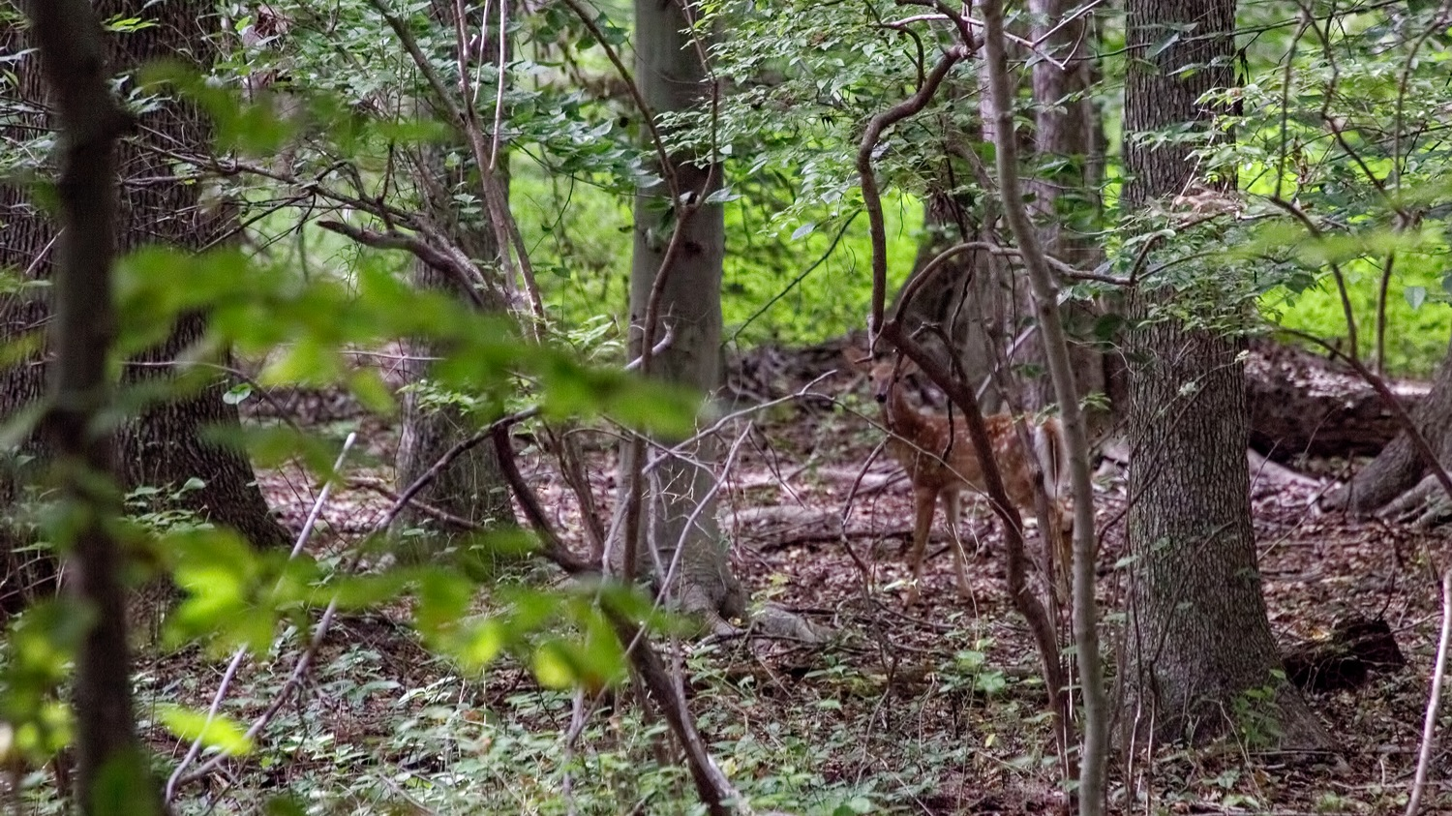
Photo by PPPL Photographer Elle Starkman
Nature at PPPL – Fawn in the woods

Slide 7




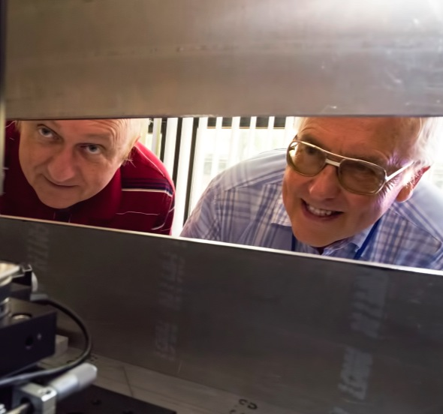
trivia
Who is the Dynamic Duo?
a) Batman & Robin
b) A Korean Hip Hop Twosome
c) Ken Hill & Manfred Bitter
PPPL’s scientific pioneers who have collaborated seamlessly for more than
35 years.
d) 1980’s Wrestling Tag Team

Slide 8
