Slide 1
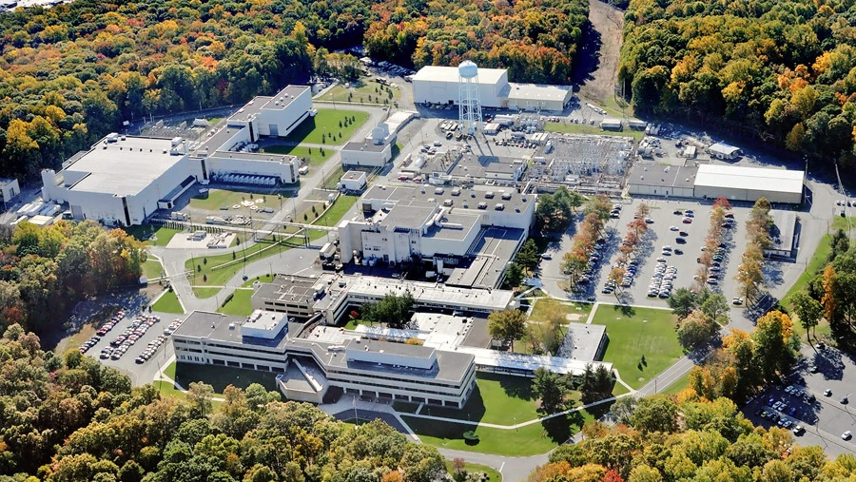
This Week @ PPPL
September 9 - 13, 2013
From the PPPL Office of Communications

Slide 2

The Laboratory will be observing a moment of silence on Wednesday at 8:46 a.m. to honor those lost during the tragic events of Sept. 11, 2001. The time marks the moment when a plane struck the first of the two World Trade Center towers.

Slide 3


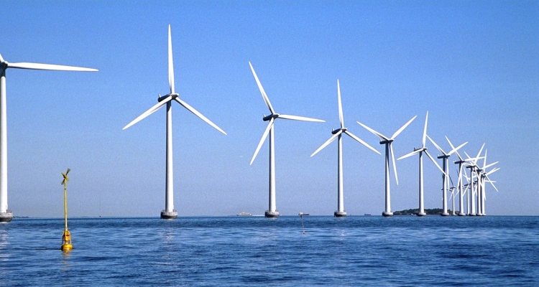
The Future of Offshore Wind Energy and Transmission in New Jersey
Mrs. Kris Ohleth
The Atlantic Wind Connection
WEDNESDAY, SEPTEMBER 11
4:15 p.m. (Coffee/Tea at 4 p.m.) • M.B.G. Auditorium, Lyman Spitzer Building

Slide 4
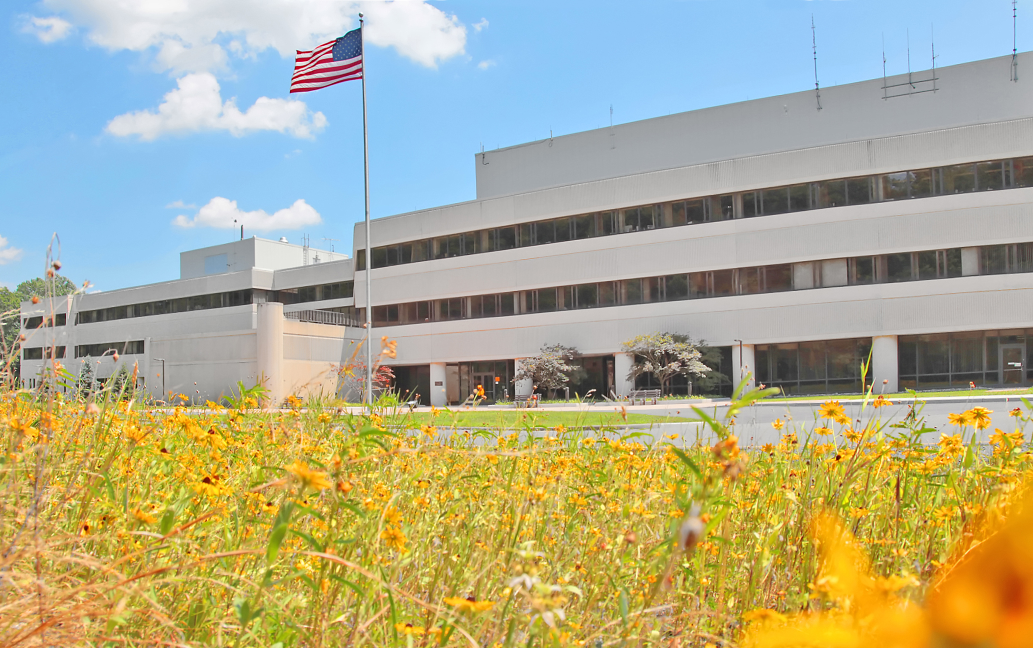






FOLLOW PPPL ON…
twitter.com/PPPLab
www.facebook.com/PPPLab
www.youtube.com/PPPLab
www.flickr.com/photos/pppl/

Slide 5

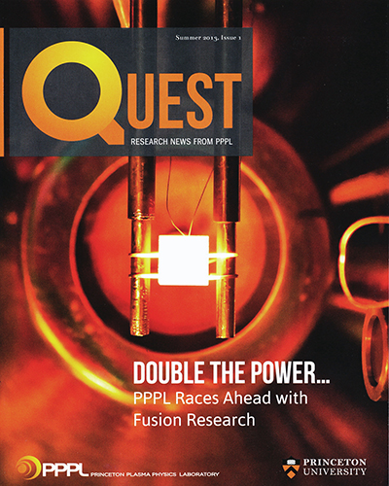
PPPL’s annual magazine QUEST is now available online at
www.pppl.gov/quest

Slide 6

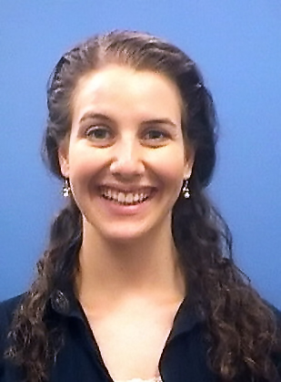
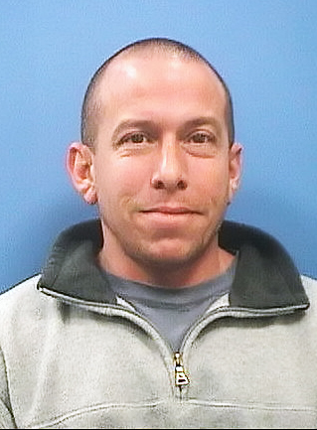
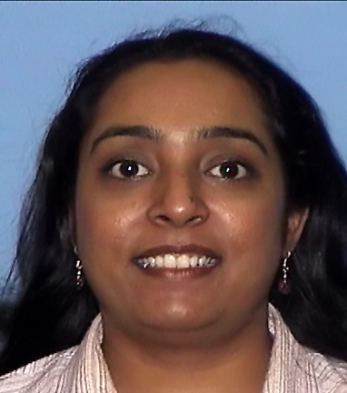
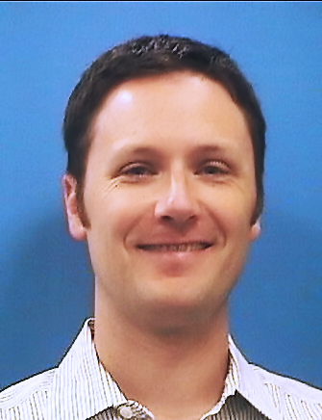
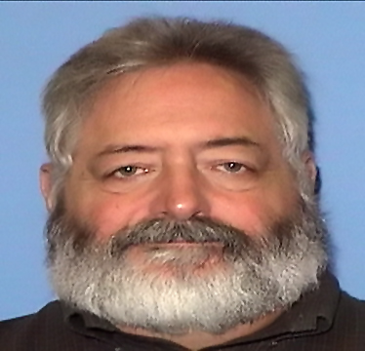
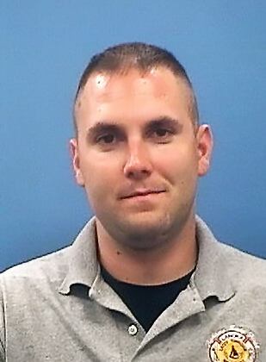

Welcome PPPL New Hires…

Slide 7
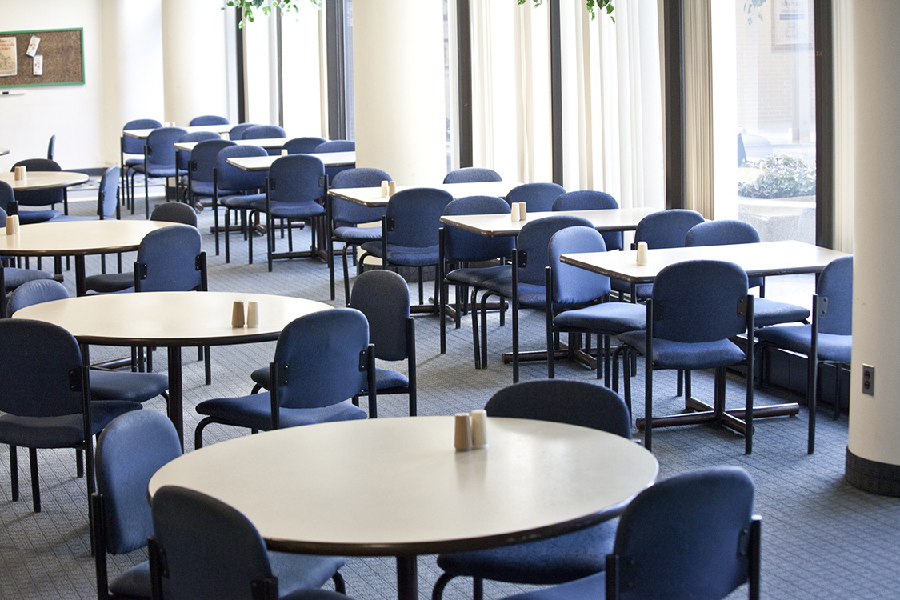

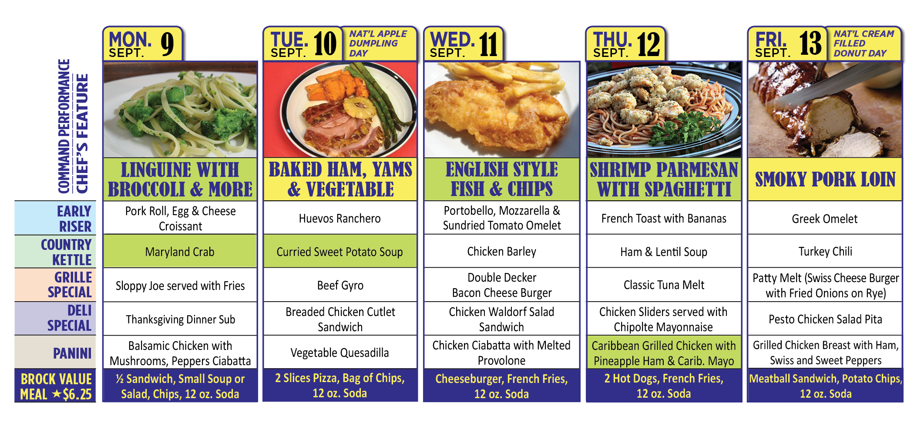
Menu subject to change without notice.

