Slide 1
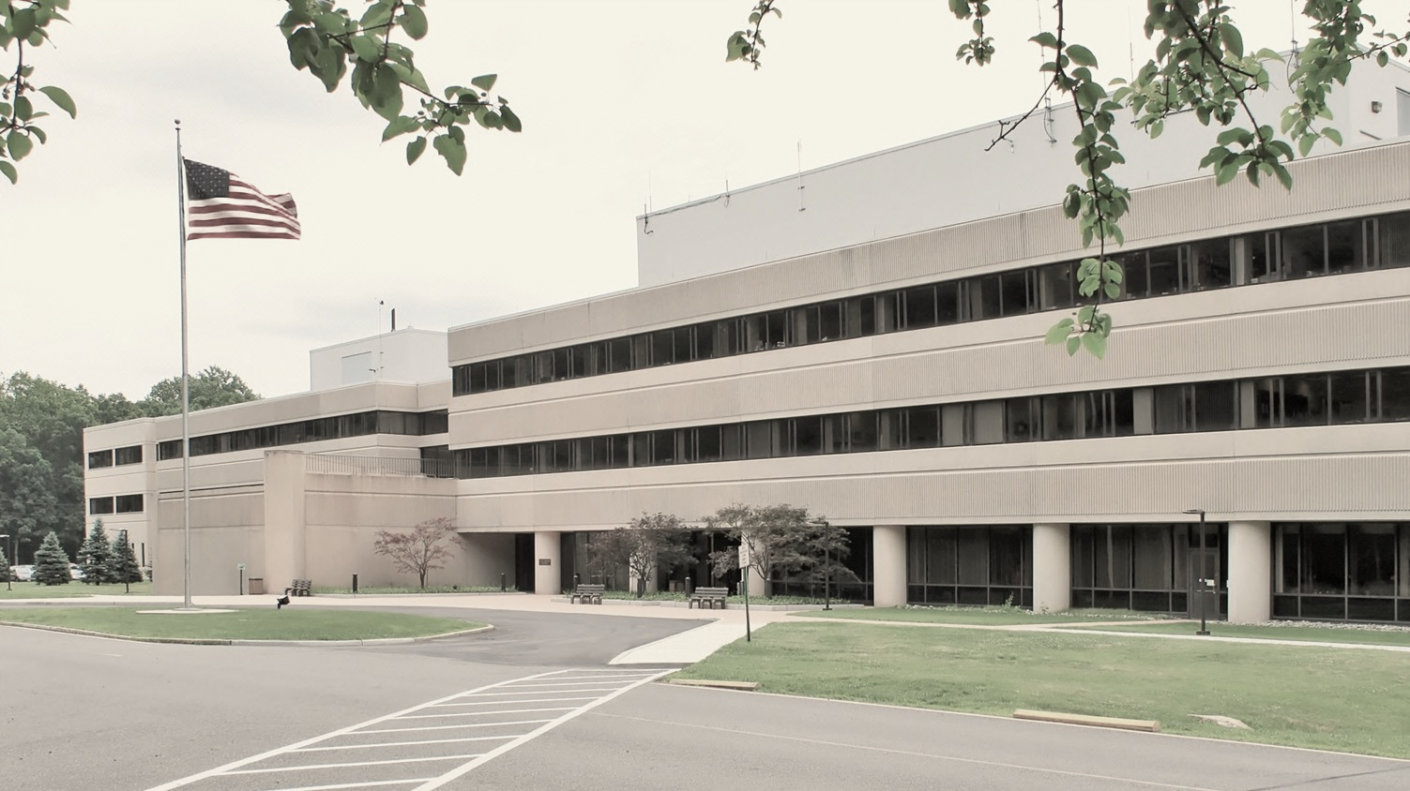
This Week @ PPPL
September 15 - 20, 2014
Brought to you by the PPPL Office of Communications

Slide 2

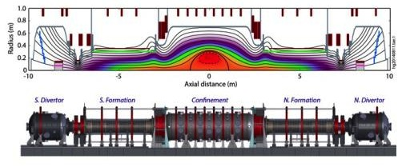
The Main Results from the C-2 Device
Michel Tuszewski – Tri Alpha Energy
WEDNESDAY, SEPTEMBER 17
4:15 p.m. • M.B.G. Auditorium

Slide 3


PPPL WELCOMES
The New Jersey Chamber of Commerce Cornerstone Members

Slide 4
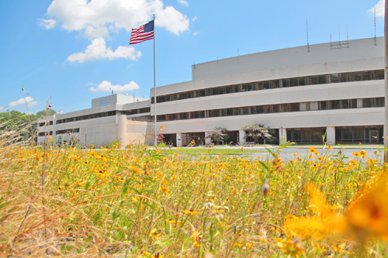


UPCOMING EVENTS
  Wednesday, September 17
  NJ Chamber of Commerce Meeting and Tour
  Wednesday, September 17
  PPPL COLLOQUIUM – The Main Results from the C-2 Device
  Wednesday, September 24
  PPPL COLLOQUIUM - Evolution of Coil Design and Manufacturing at PPPL
  Wednesday, October 15
  PPPL COLLOQUIUM - Antibiotic Resistance: A Global Challenge
  Mon. – Fri., October 27 – 31
  56th Annual Meeting of the APS Division of Plasma Physics – New Orleans

Slide 5
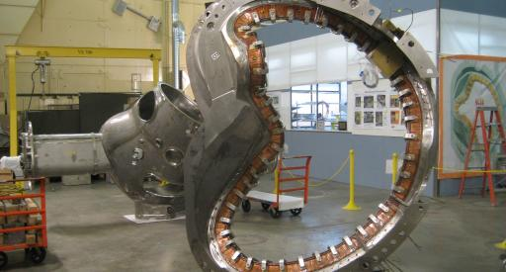
Evolution of Coil Design and Manufacturing at PPPL
James Chrzanowski – Princeton University
WEDNESDAY, SEPTEMBER 24
4:15 p.m. • M.B.G. Auditorium

Slide 6

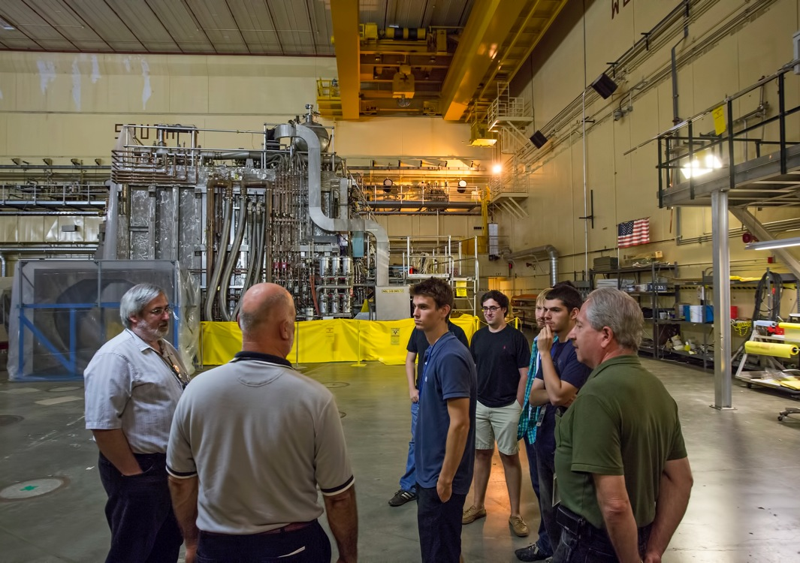
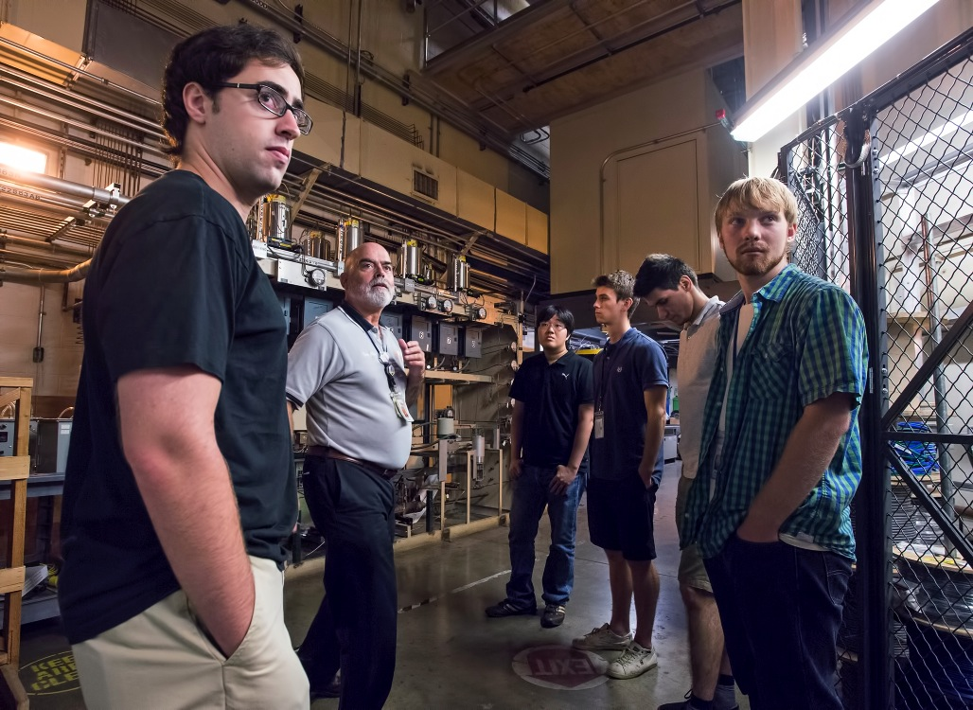
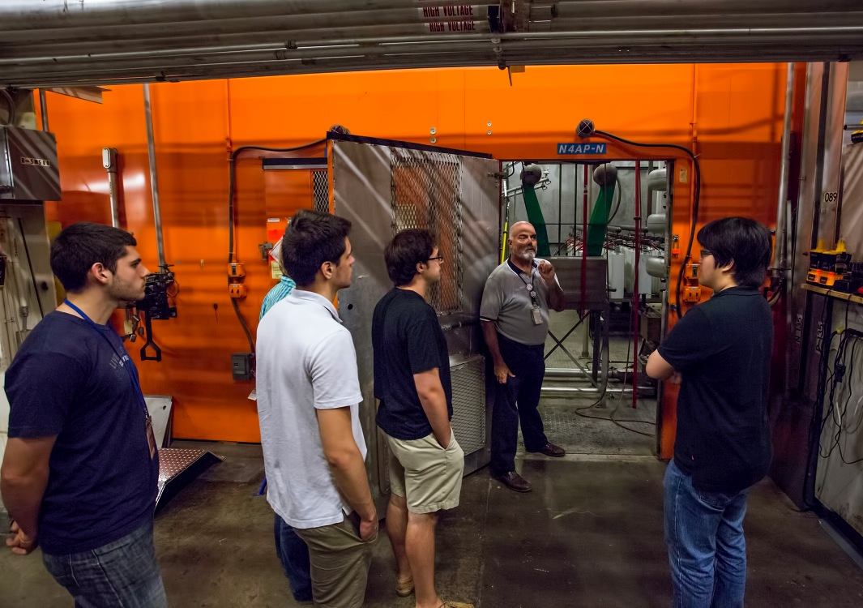
Graduate Students Safety Walk-Through

Slide 7



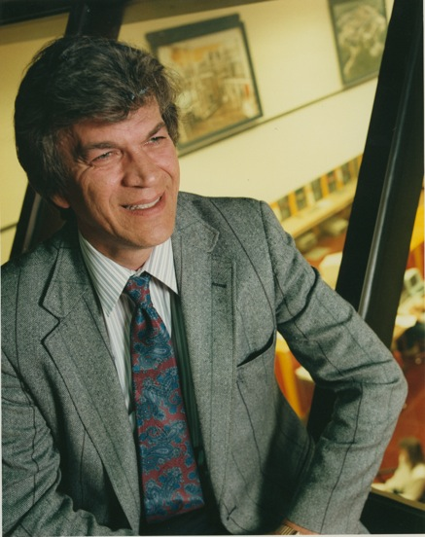
trivia
In what year did Ron Davidson become Director of PPPL?
a) 2001
b) 1991
c) 1999
1991
d) 1980

Slide 9
