Slide 1
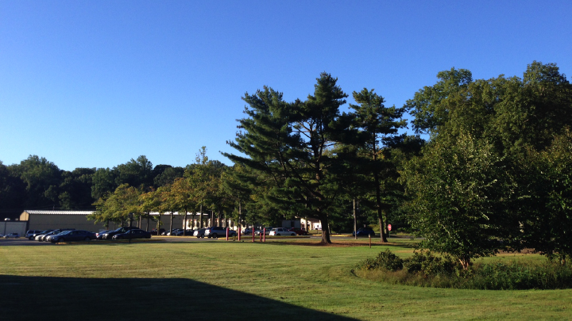
This Week @ PPPL
September 15 - 20, 2014
Brought to you by the PPPL Office of Communications

Slide 2
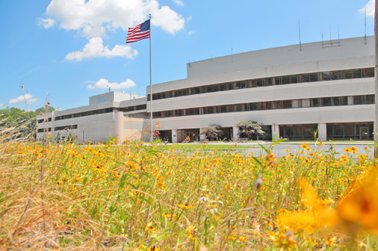


UPCOMING EVENTS
  Wednesday, September 24
  PPPL COLLOQUIUM - Evolution of Coil Design and Manufacturing at PPPL
  Wednesday, October 3
  American Red Cross BLOOD DRIVE – 8 a.m. – 1 p.m. – Lower End Parking Lot
  Wednesday, October 15
  PPPL GROUP PHOTO SHOOT – 11 a.m. – Meet in Lobby at 10:50 a.m.
  Wednesday, October 15
  PPPL COLLOQUIUM - Antibiotic Resistance: A Global Challenge
  Mon. – Fri., October 27 – 31
  56th Annual Meeting of the APS Division of Plasma Physics – New Orleans

Slide 3
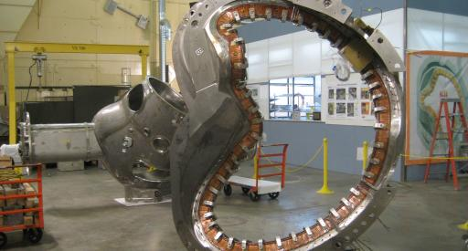

Evolution of Coil Design and Manufacturing at PPPL
James Chrzanowski – Princeton University
WEDNESDAY, SEPTEMBER 24
4:15 p.m. • M.B.G. Auditorium

Slide 4
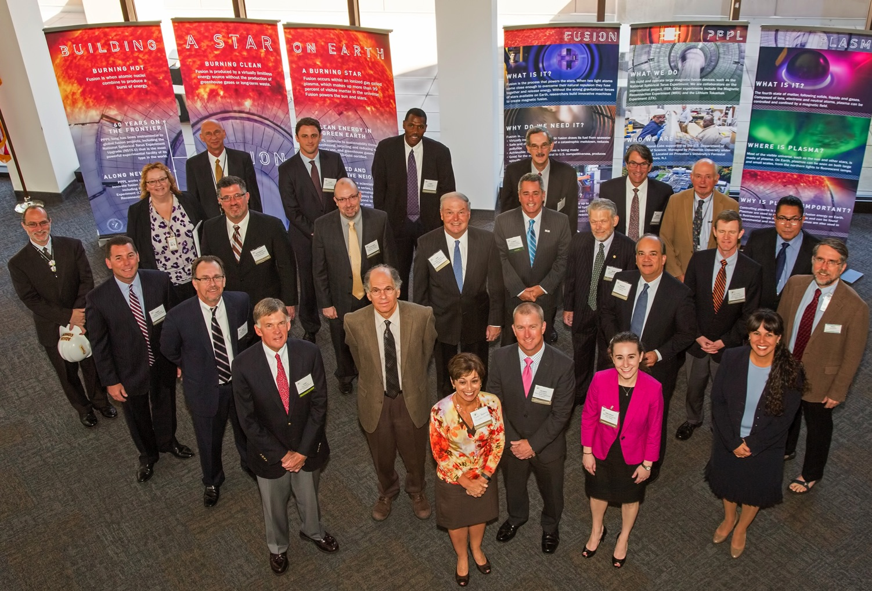
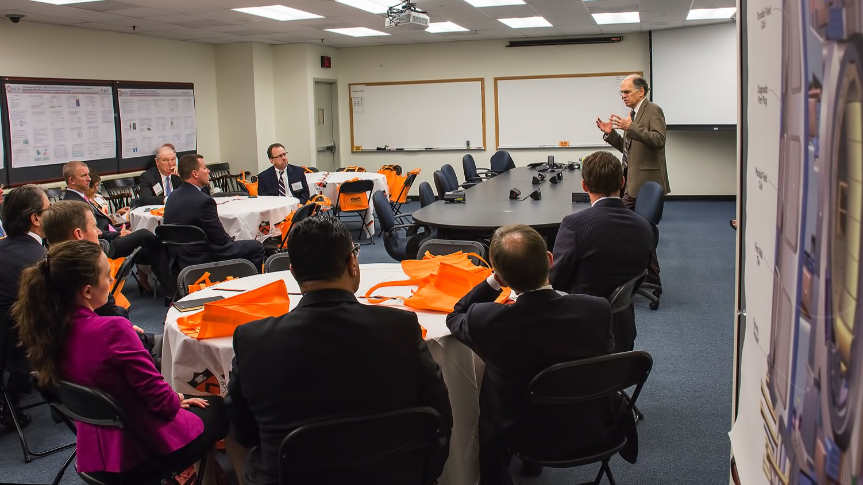
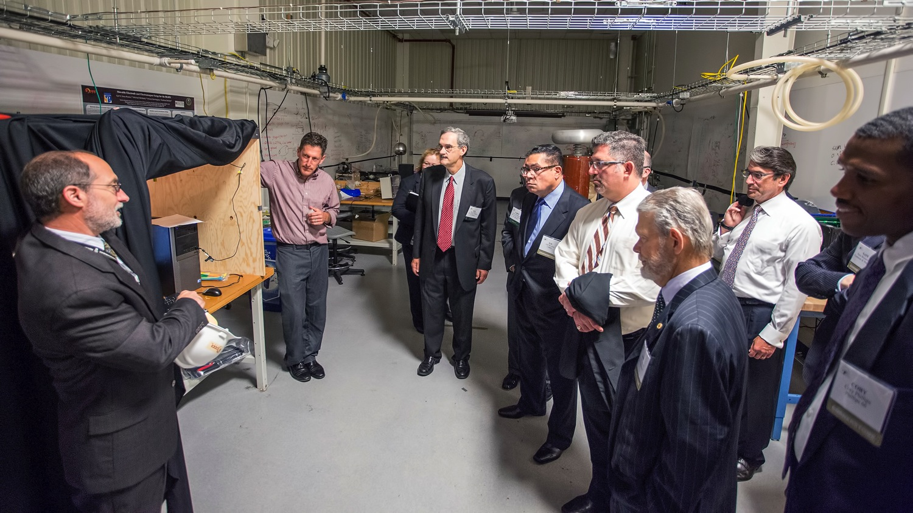
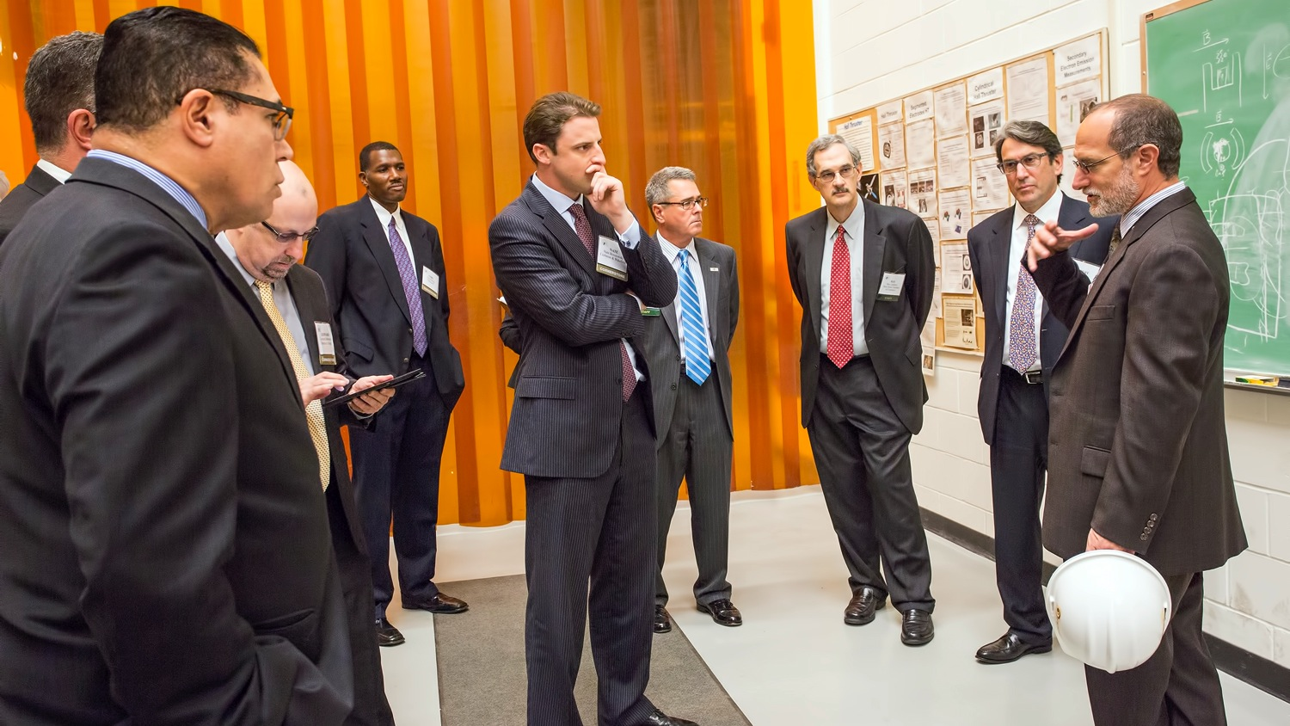
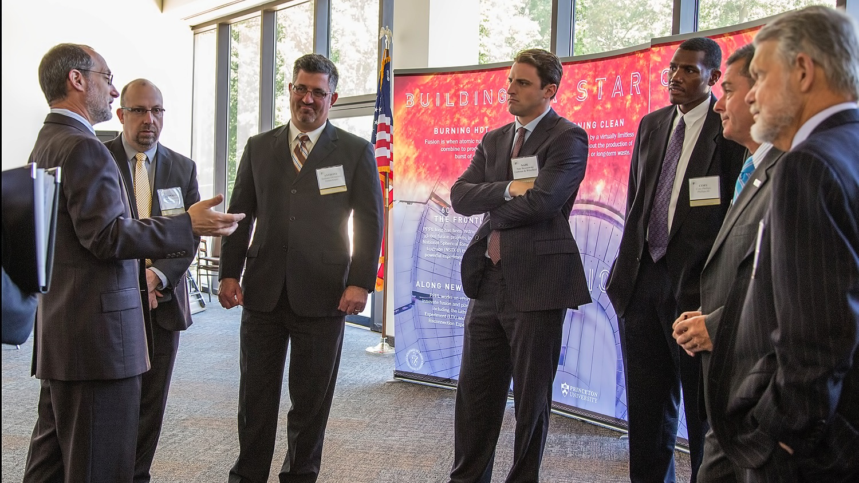
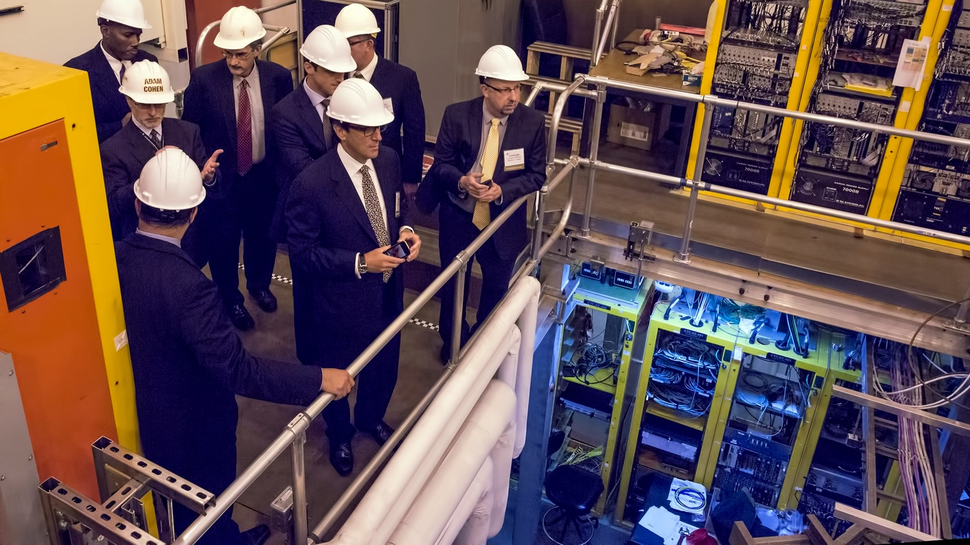

New Jersey Chamber of Commerce’s Cornerstone group visits PPPL

Slide 5




trivia
PPPL is helping General Electric develop a new…?
a) Dishwasher
b) Jet Engine
c) Light Bulb
d) Power Switch

Slide 7
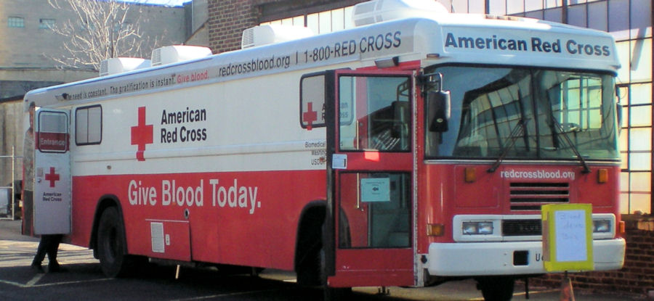
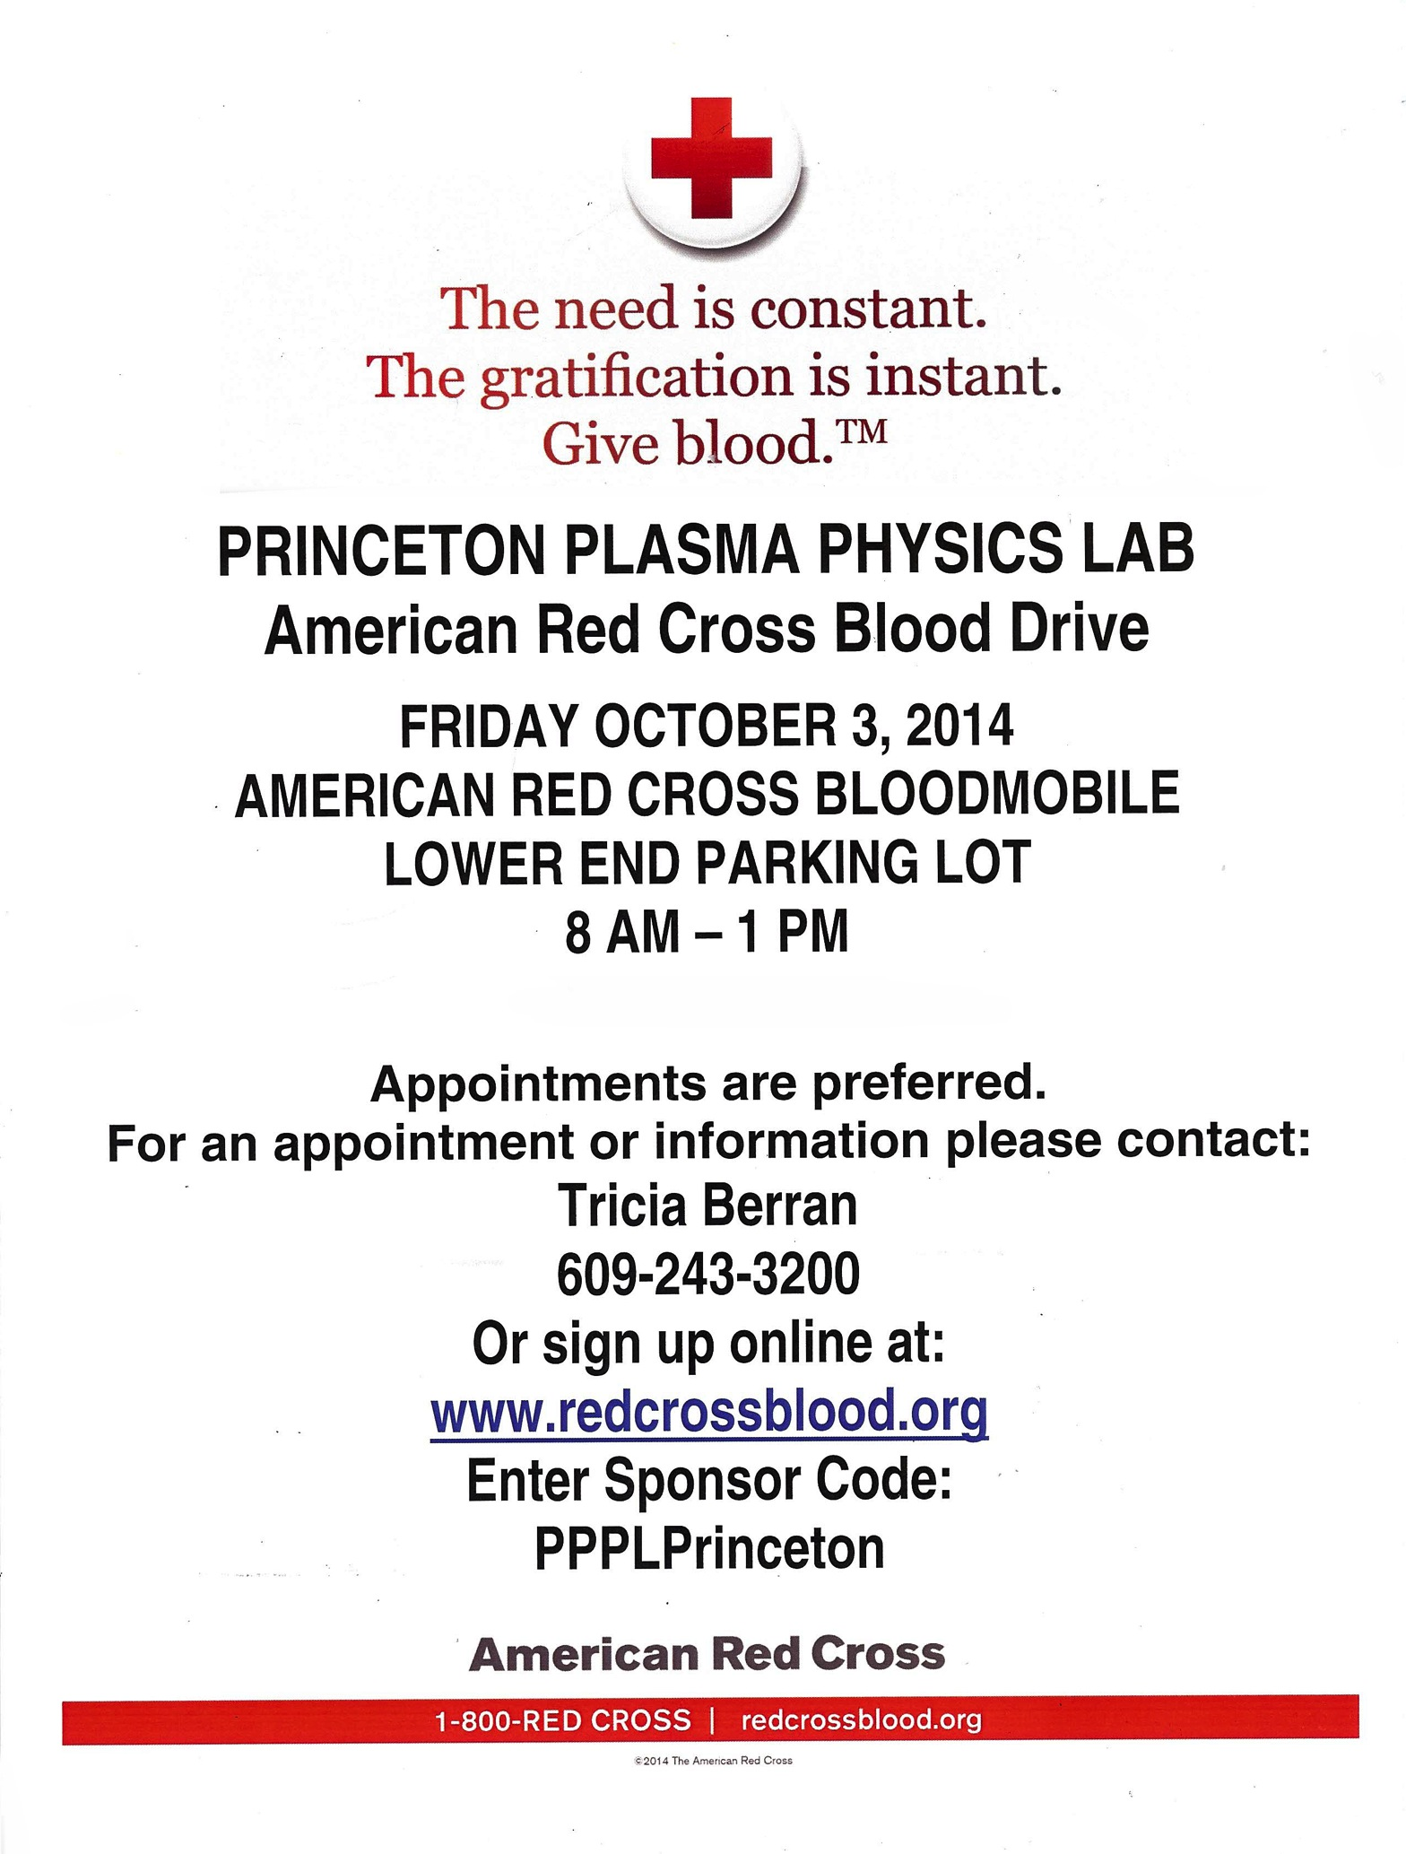

Slide 8
