Slide 1
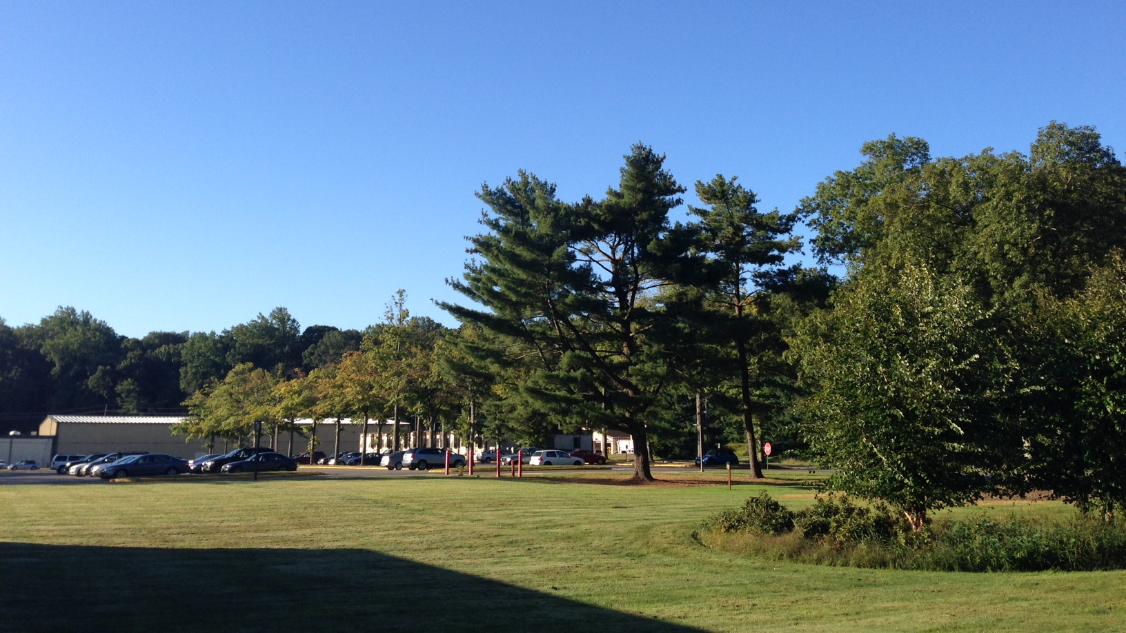
This Week @ PPPL
September 23 - 27, 2013
From the PPPL Office of Communications

Slide 2


Influenza is a contagious disease caused by a virus that can be spread by coughing, sneezing
or nasal secretions.
The best single way to prevent seasonal flu
is to get an annual influenza vaccination.
By getting vaccinated you can protect yourself from influenza and may also avoid spreading
this illness to others.
Flu vaccine appointments are available NOW. Please contact the OMO at extension 3200 for
an appointment.

Slide 3



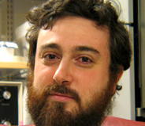
Consciousness and
the Social Brain
Michael Graziano
Princeton University
WEDNESDAY, SEPTEMBER 25
4:15 p.m. (Coffee/Tea at 4 p.m.) • M.B.G. Auditorium

Slide 4
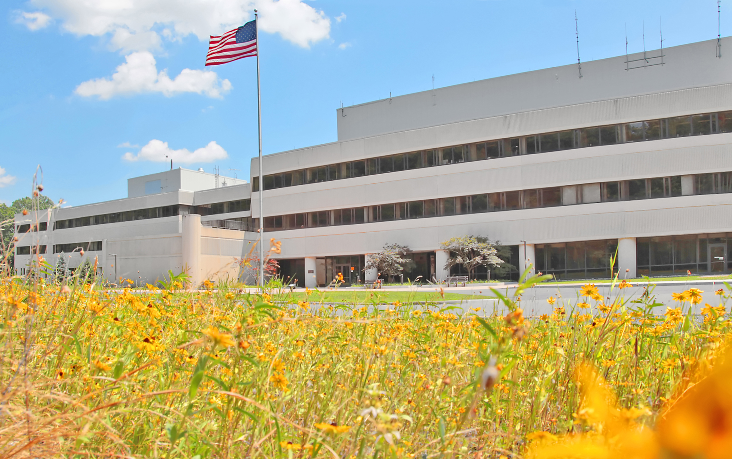






FOLLOW PPPL ON…
twitter.com/PPPLab
www.facebook.com/PPPLab
www.youtube.com/PPPLab
www.flickr.com/photos/pppl/

Slide 5


The Power of Neuroplasticity: Enhancing Human Potential
Paula Tallal
Rutgers University
Next Week • WEDNESDAY, OCTOBER 2
4:15 p.m. (Coffee/Tea at 4 p.m.) • M.B.G. Auditorium

Slide 6



Slide 7

This SLIDESHOW is also available
on the PPPL website for online viewing at:
http://www-local.pppl.gov/slideshow/

Slide 8
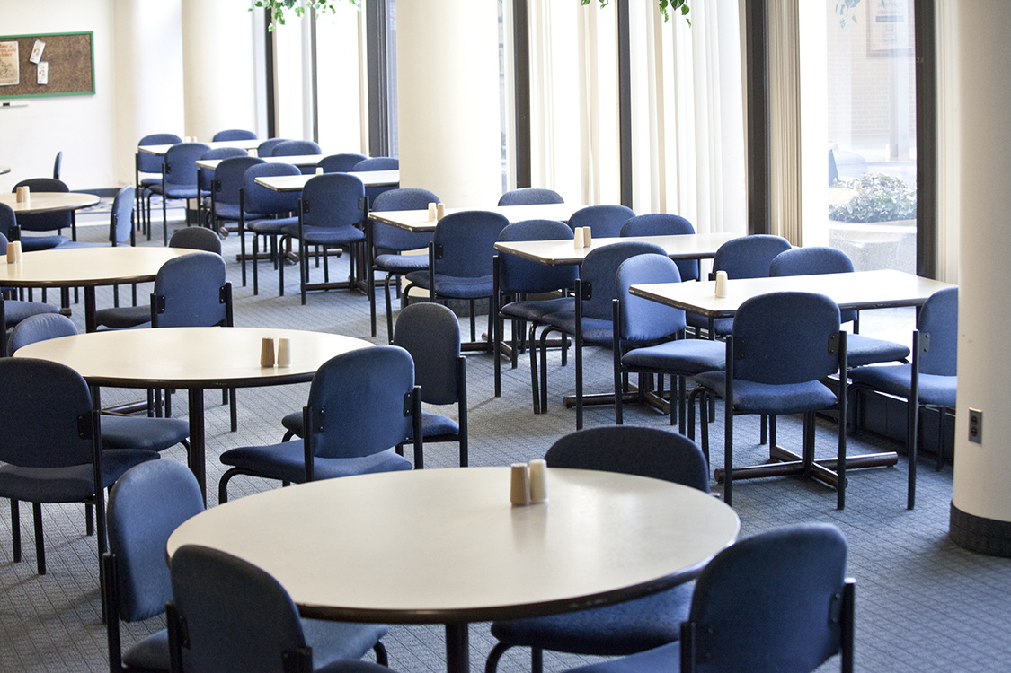


Menu subject to change without notice.

