Slide 1
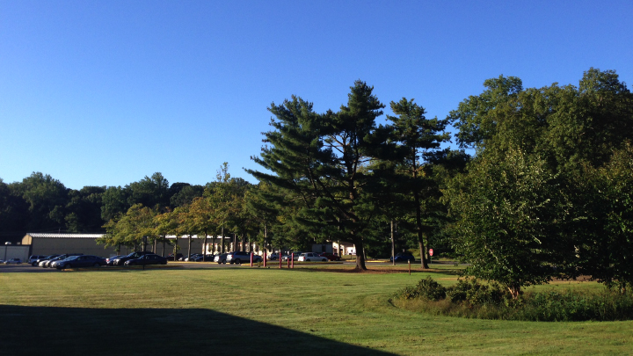
This Week @ PPPL
Sept. 29 – Oct. 3, 2014
Brought to you by the PPPL Office of Communications

Slide 2
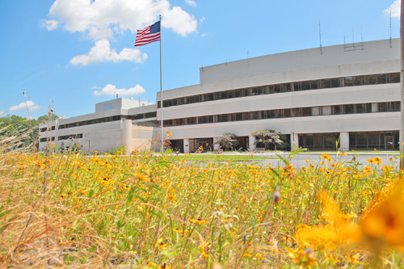


UPCOMING EVENTS
  Wednesday, October 1
  PPPL COLLOQUIUM - Superconductors for Fusion for the Next Ten Years
  Wednesday, October 3
  American Red Cross BLOOD DRIVE – 8 a.m. – 1 p.m. – Lower End Parking Lot
  Wednesday, October 15
  PPPL GROUP PHOTO SHOOT – 11 a.m. – Meet in Lobby at 10:50 a.m.
  Wednesday, October 15
  PPPL COLLOQUIUM - Antibiotic Resistance: A Global Challenge
  Mon. – Fri., October 27 – 31
  56th Annual Meeting of the APS Division of Plasma Physics – New Orleans

Slide 3
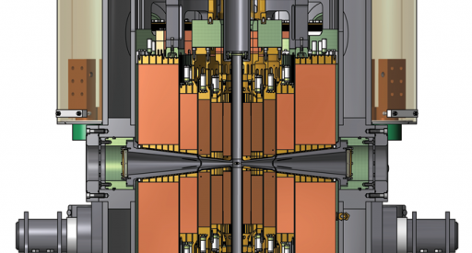

Superconductors for Fusion for the Next Ten Years
David Larbalestier – Florida State University - National High Magnetic Field Lab
WEDNESDAY, OCTOBER 1
4:15 p.m. • M.B.G. Auditorium

Slide 4
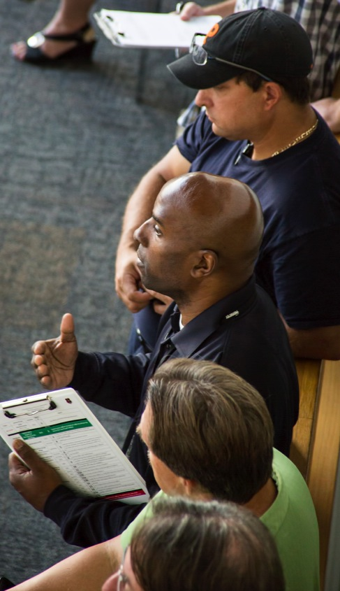
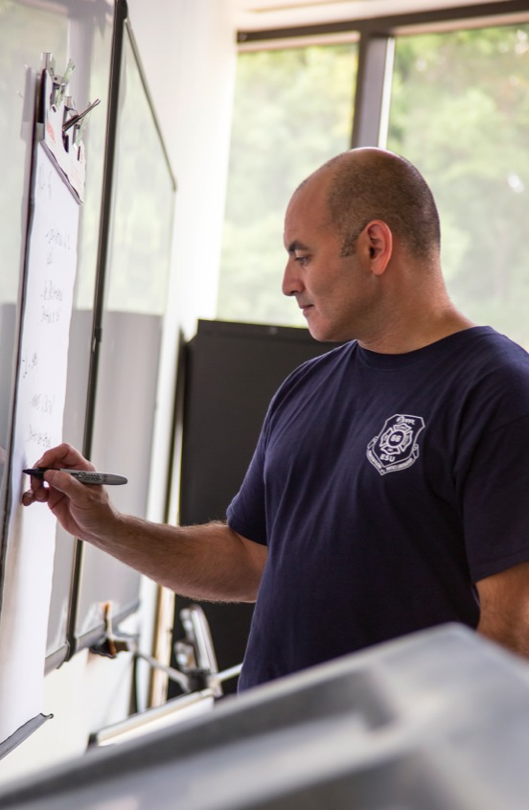
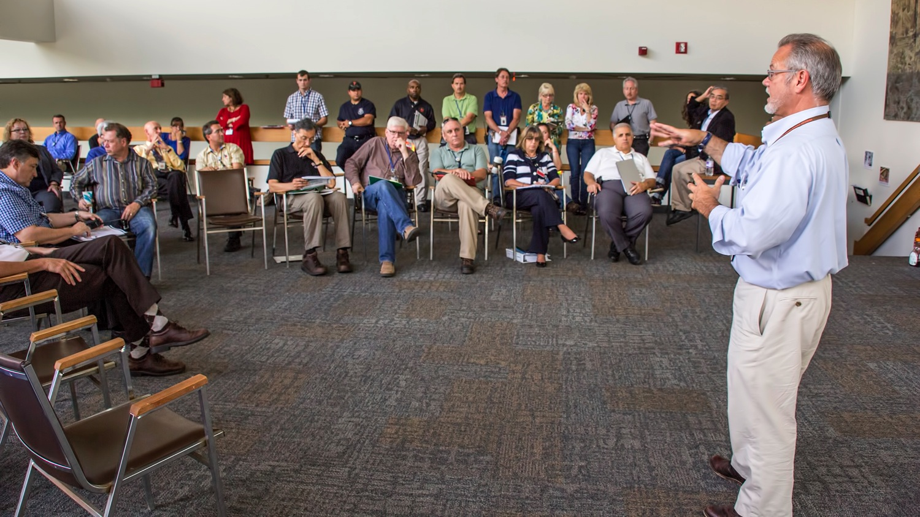
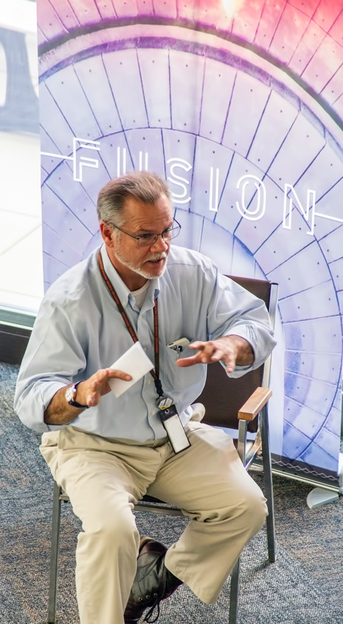
Emergency Response Organization Exercise at PPPL

Slide 5



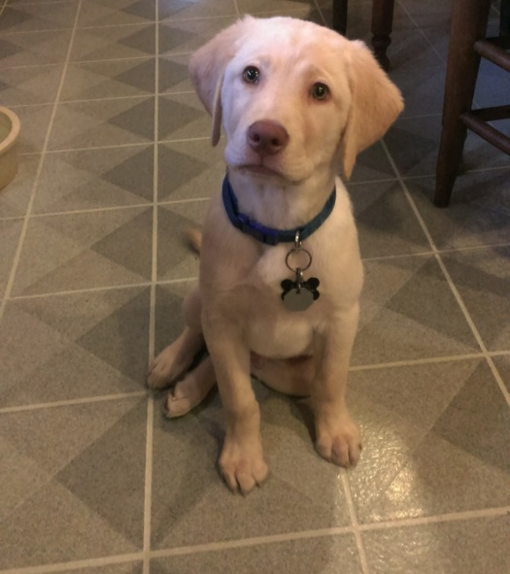
trivia
What is the name of this puppy?
a) Xongo
b) Avatar
c) Shen
d) Boomer

Slide 6



Please call the OMO at extension
3200 to make an appointment.

Slide 7

Please fill out the Diversity & Inclusion Survey!
The survey at https://www.surveymonkey.com/s/KJRT9TJ will take just five to ten minutes and will help the group learn more about diversity at PPPL and the work environment in general. The Diversity & Inclusion Group will use the survey to develop a strategic plan in this area.

Slide 8
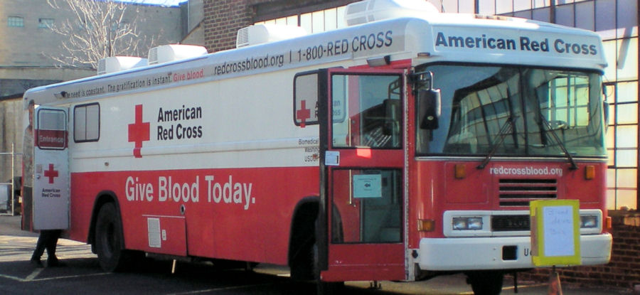
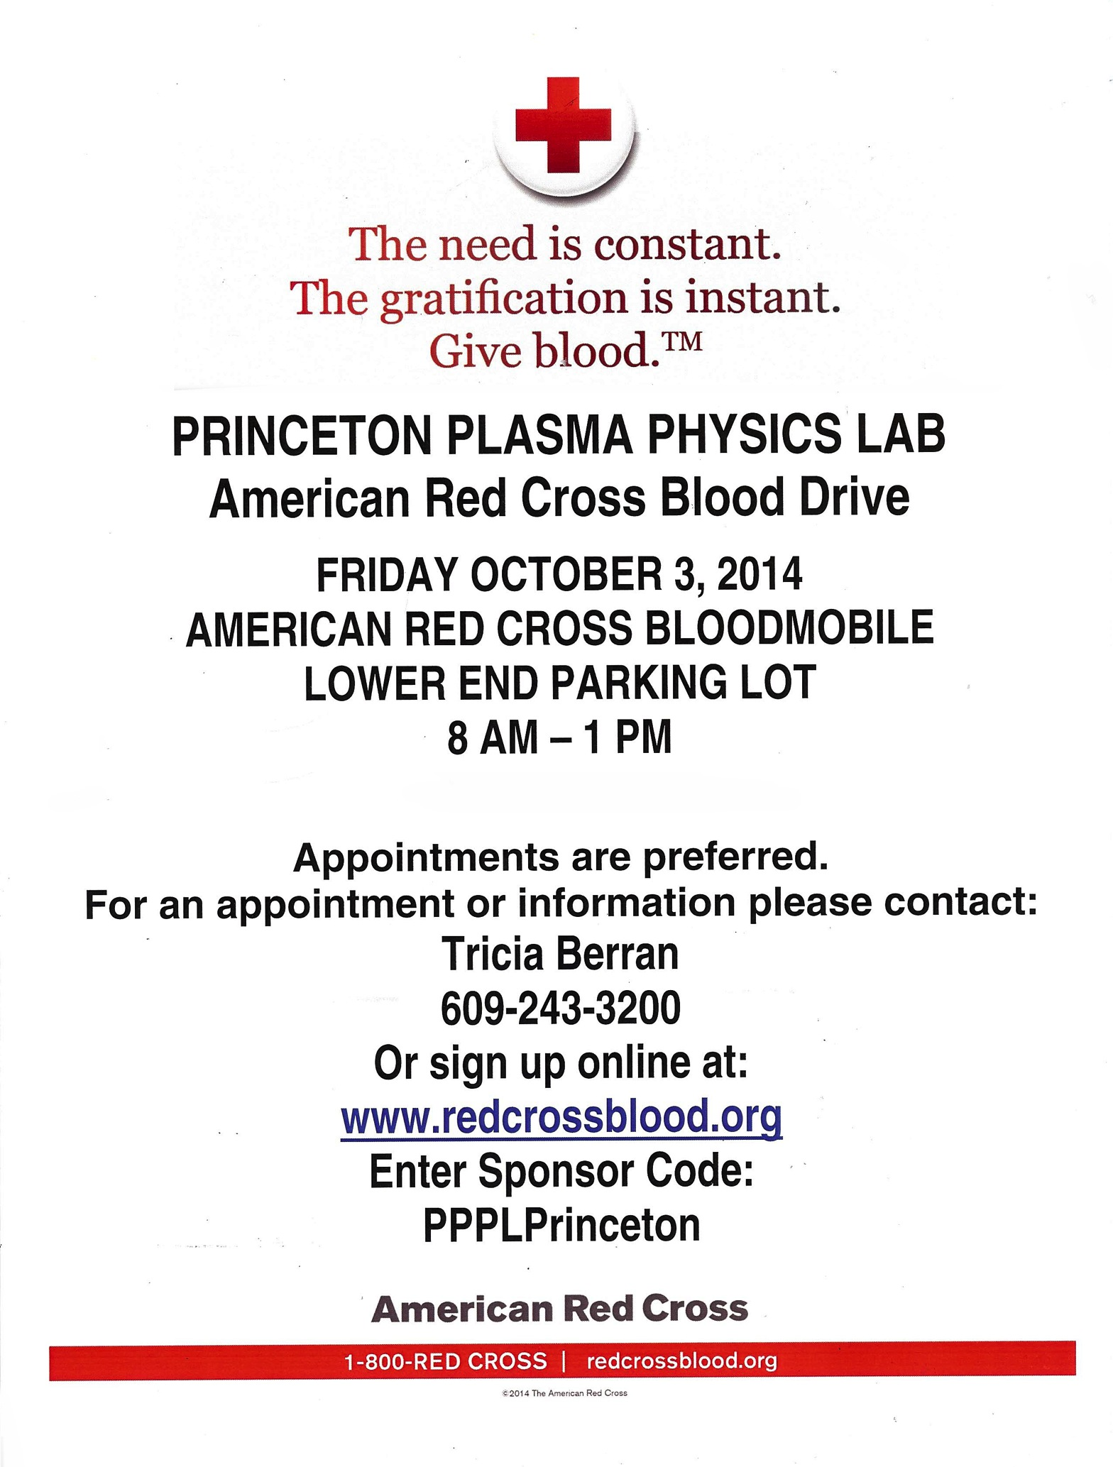

Slide 9
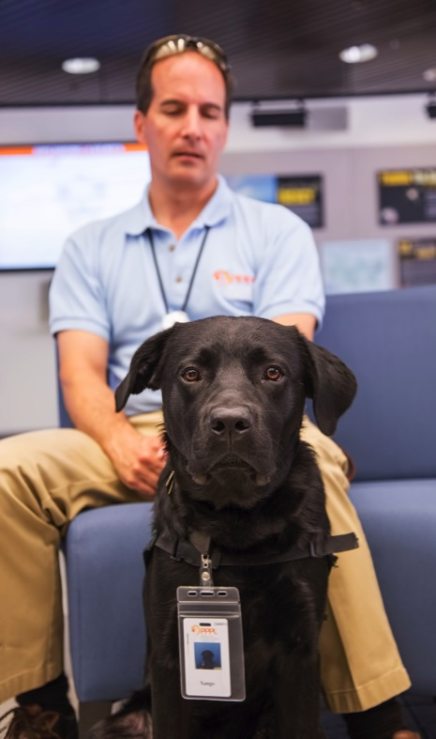
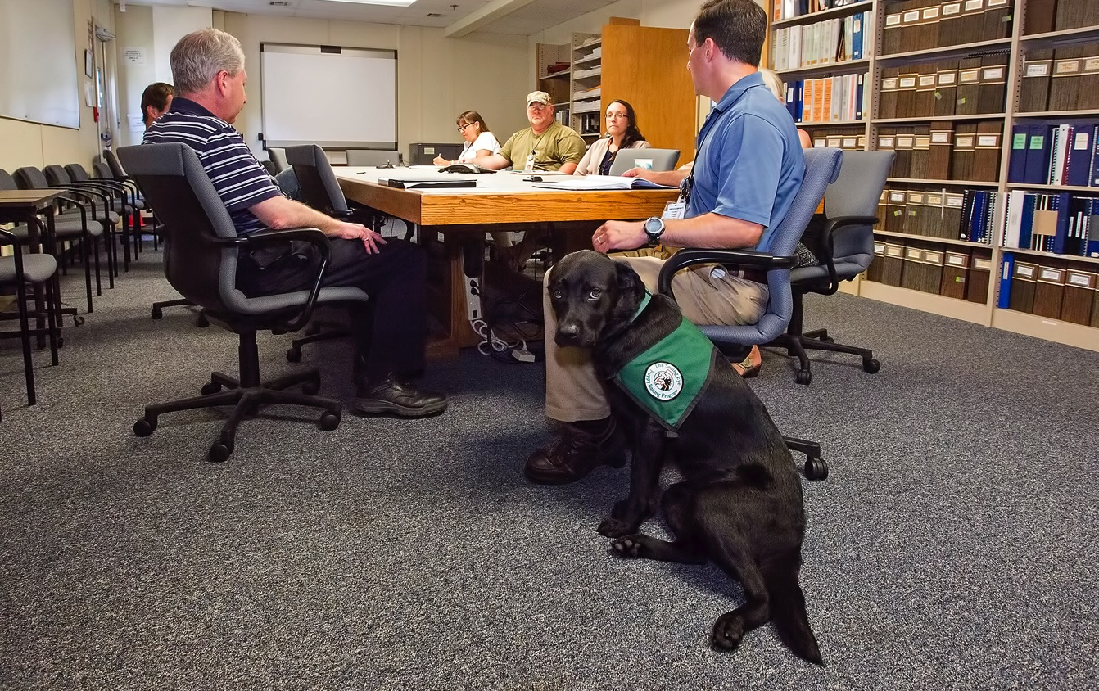
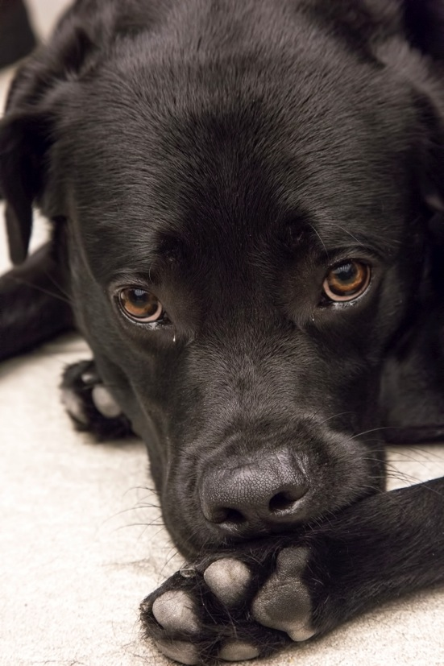
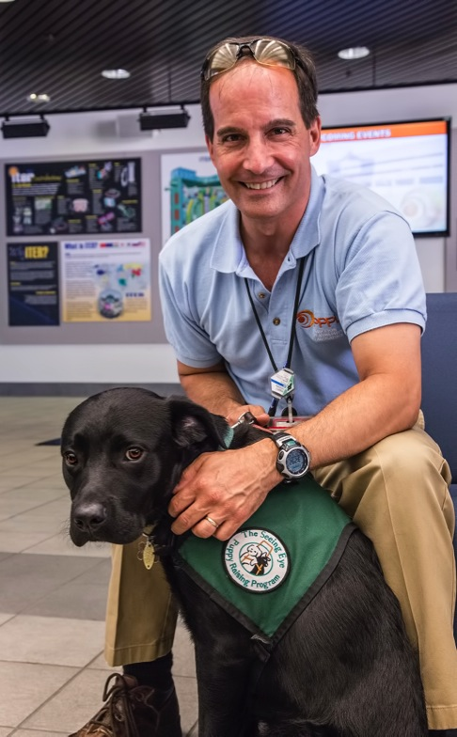
Lab at the Lab

Slide 10
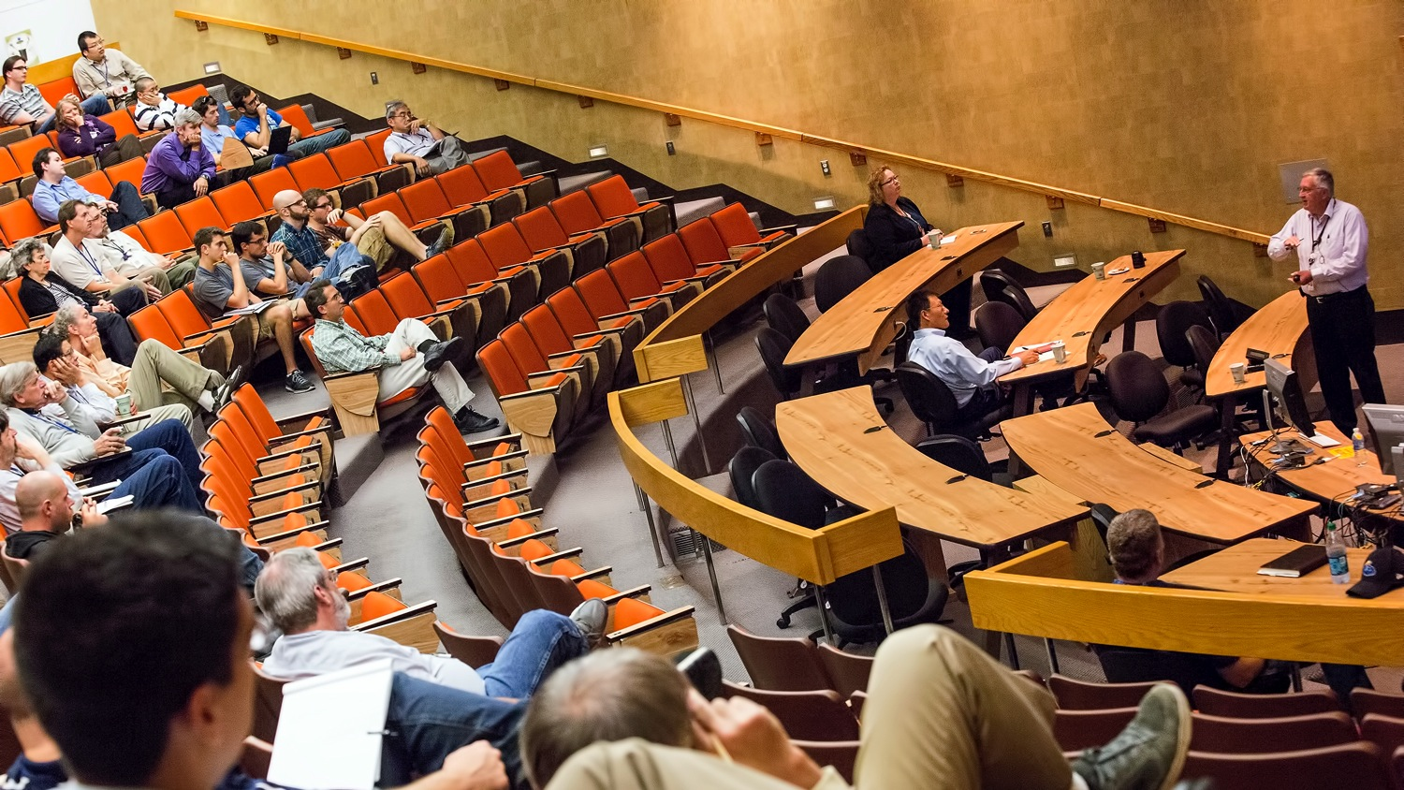
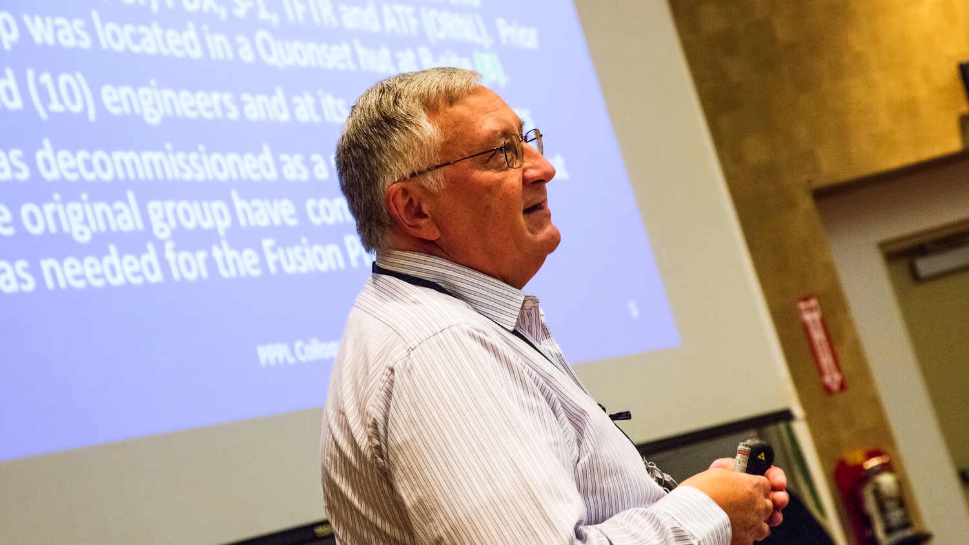
Evolution of Coil Design at PPPL Colloquium by Jim Chrzanowski

Slide 12
