Slide 1
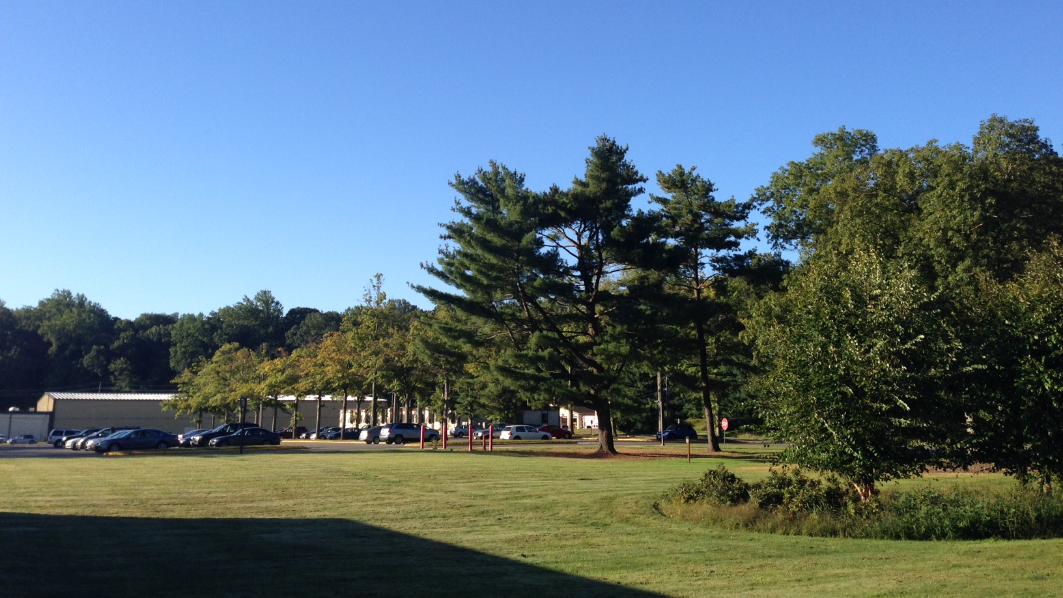
This Week @ PPPL
Sept. 30 – Oct. 4, 2013
From the PPPL Office of Communications

Slide 2


Influenza is a contagious disease caused by a virus that can be spread by coughing, sneezing
or nasal secretions.
The best single way to prevent seasonal flu
is to get an annual influenza vaccination.
By getting vaccinated you can protect yourself from influenza and may also avoid spreading
this illness to others.
Flu vaccine appointments are available NOW.
Contact the OMO at 3200 for an appointment.

Slide 3
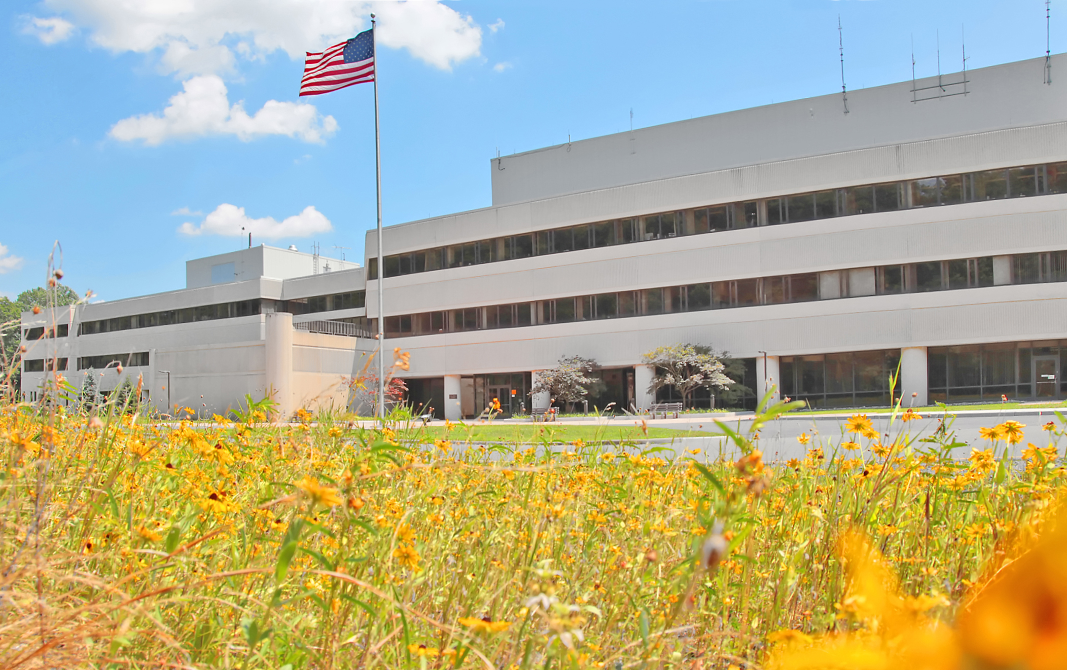






FOLLOW PPPL ON…
twitter.com/PPPLab
www.facebook.com/PPPLab
www.youtube.com/PPPLab
www.flickr.com/photos/pppl/

Slide 4



The Power of Neuroplasticity: Enhancing Human Potential
Paula Tallal
Rutgers University
WEDNESDAY, OCTOBER 2
4:15 p.m. (Coffee/Tea at 4 p.m.) • M.B.G. Auditorium

Slide 5



Slide 6

Convenience
is one of the most reported reasons behind unsafe behavior, per STOP Program data.
Don’t accept shortcuts for yourself or from others.
Consider the potential outcome of your actions - for yourself, your family, and your coworkers.
Analyze hazards and have protective measures in place before you begin to work.
Take the time to do it right!

Slide 7



NSTX-U
Center Stack bundle construction

Slide 8
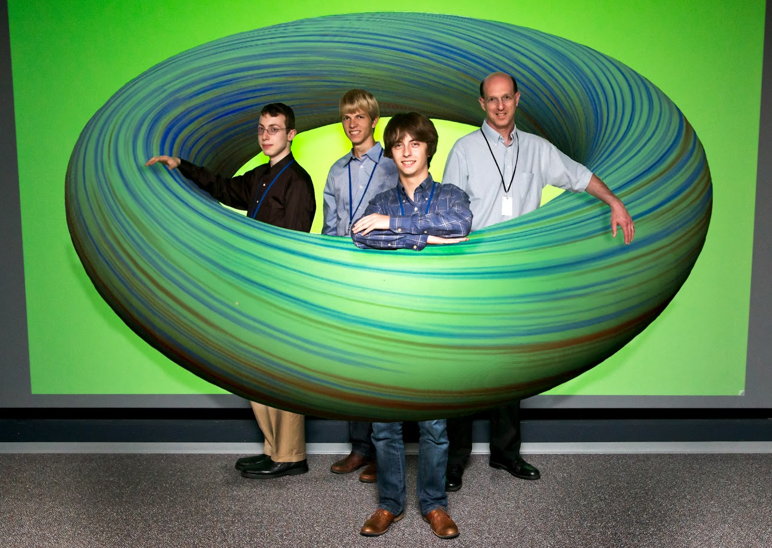
Feibush students
working to improve ElVis.

Slide 9
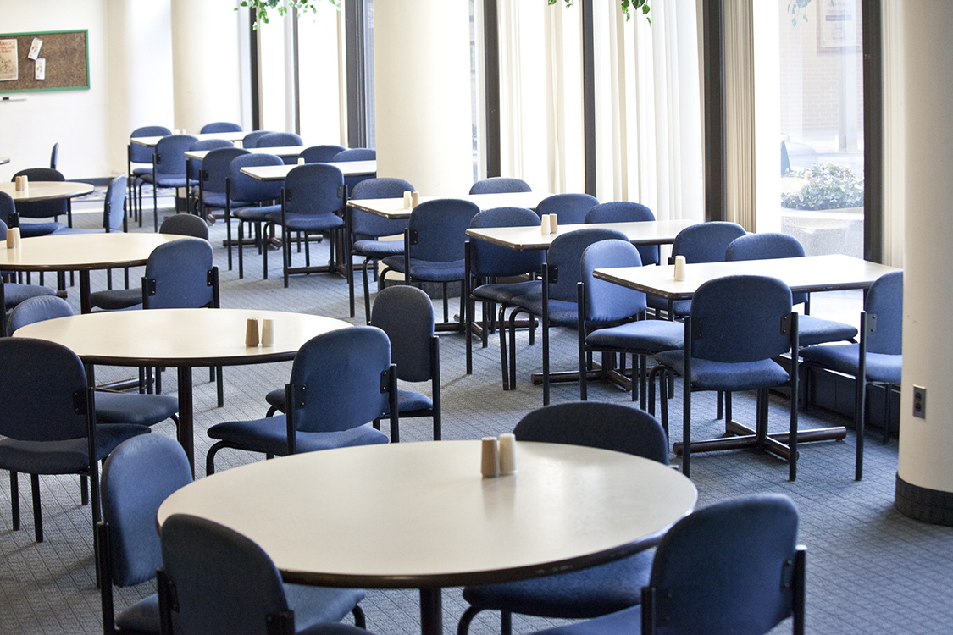

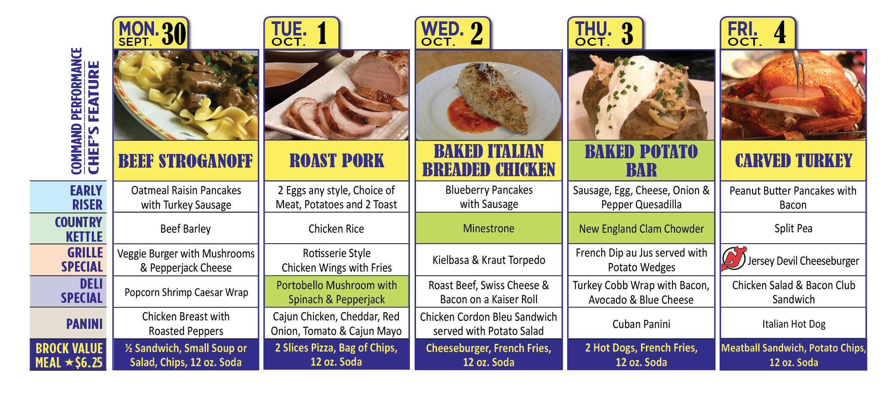
Menu subject to change without notice.

