Slide 1
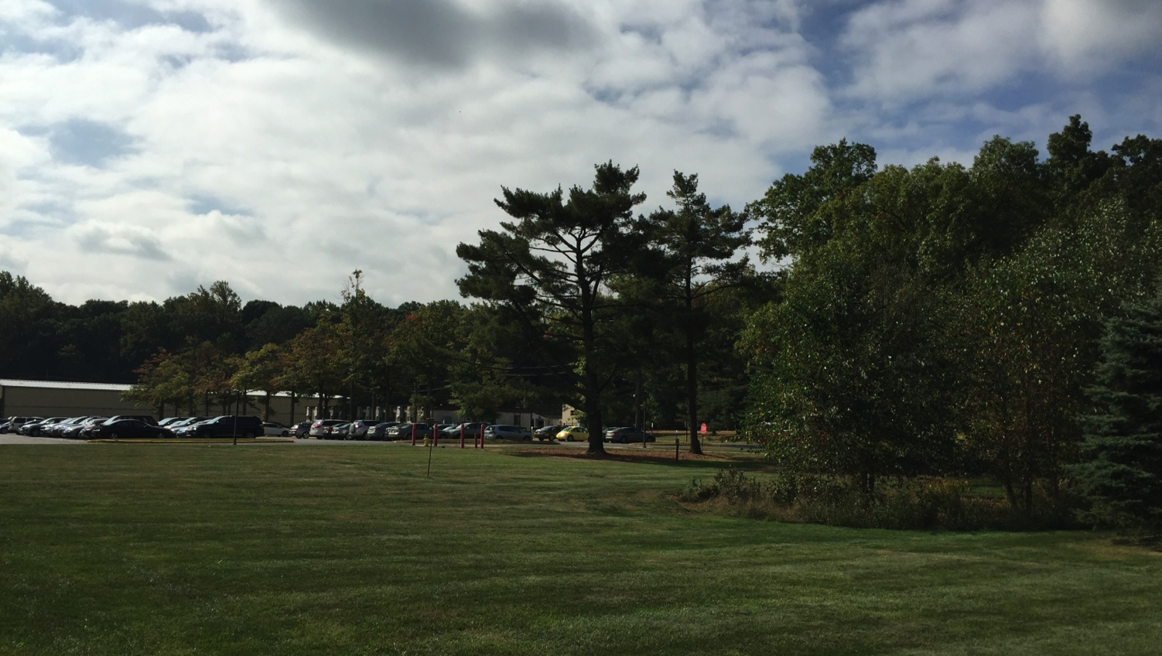
This Week @ PPPL
October 6 - 10, 2014
Brought to you by the PPPL Office of Communications

Slide 2
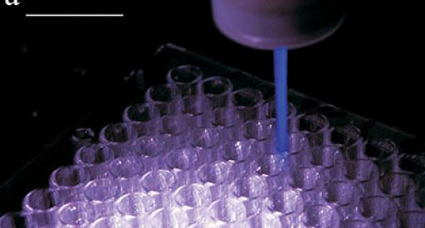

Plasma Mediated Effects on Biological Cells
Mounir Laroussi – Old Dominion University
WEDNESDAY, OCTOBER 8
4:15 p.m. • M.B.G. Auditorium

Slide 3
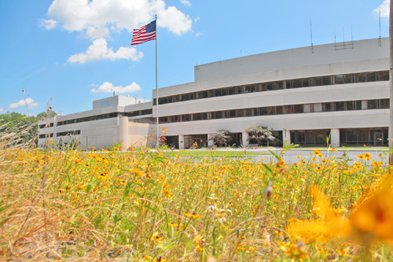


UPCOMING EVENTS
  Wednesday, October 8
  PPPL COLLOQUIUM - Plasma Mediated Effects on Biological Cells
  Wednesday, October 15
  PPPL GROUP PHOTO SHOOT – 11 a.m. – Meet in Lobby at 10:50 a.m.
  Wednesday, October 15
  PPPL COLLOQUIUM - Large Scale Superconducting Magnets
  Mon. – Fri., October 27 – 31
  56th Annual Meeting of the APS Division of Plasma Physics – New Orleans
  Wednesday, November 19
  PPPL COLLOQUIUM - Antibiotic Resistance: A Global Challenge

Slide 4
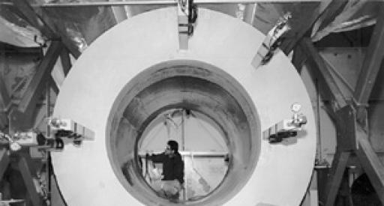
Large Scale Superconducting Magnets for a Variety of Applications
Joseph Minervini – Massachusetts Institute of Technology
WEDNESDAY, OCTOBER 15
4:15 p.m. • M.B.G. Auditorium

Slide 5
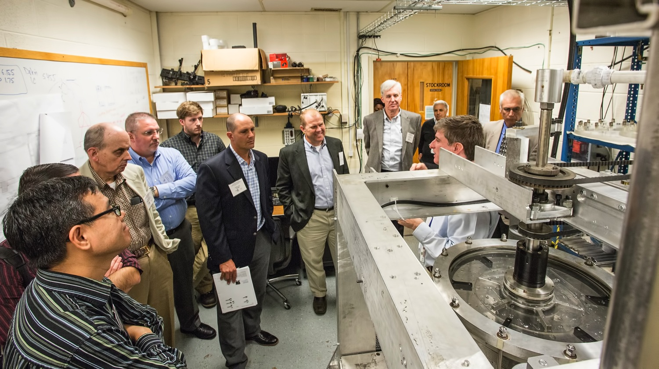
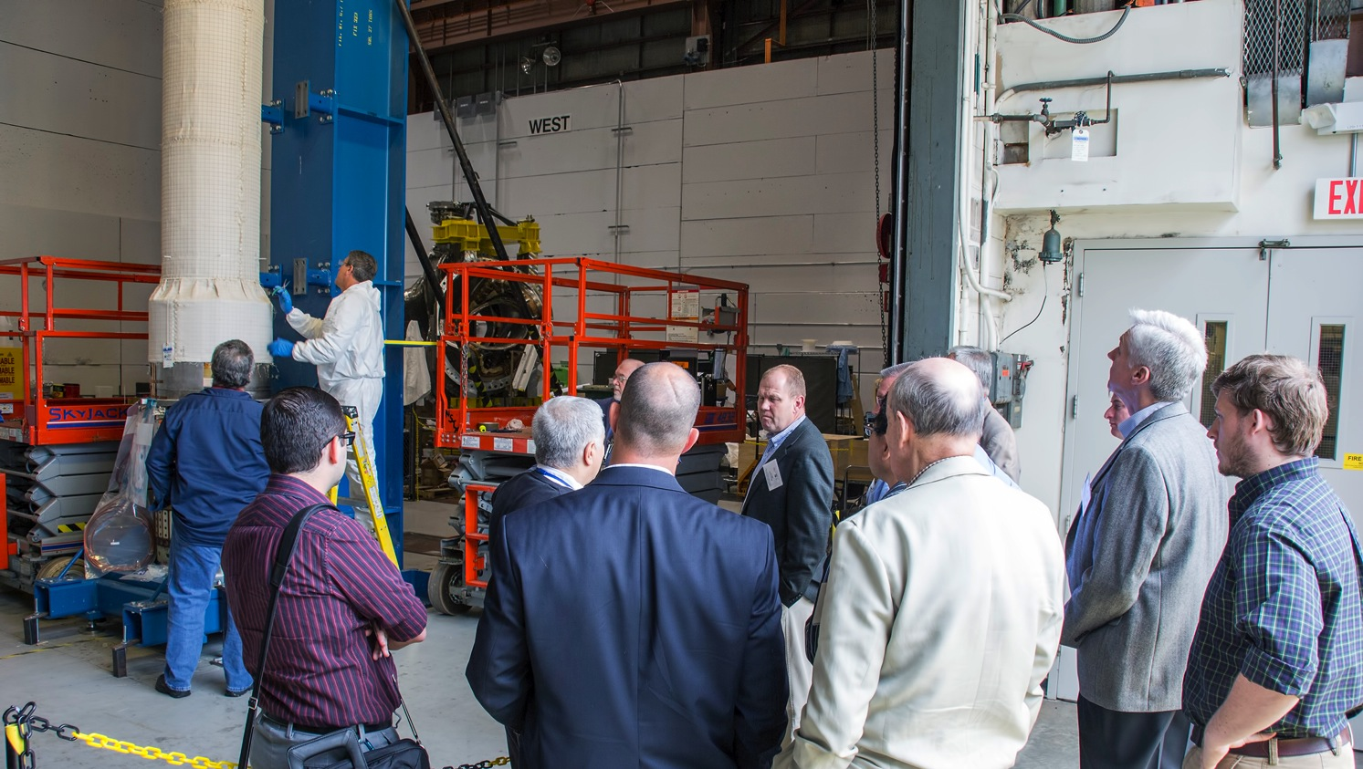
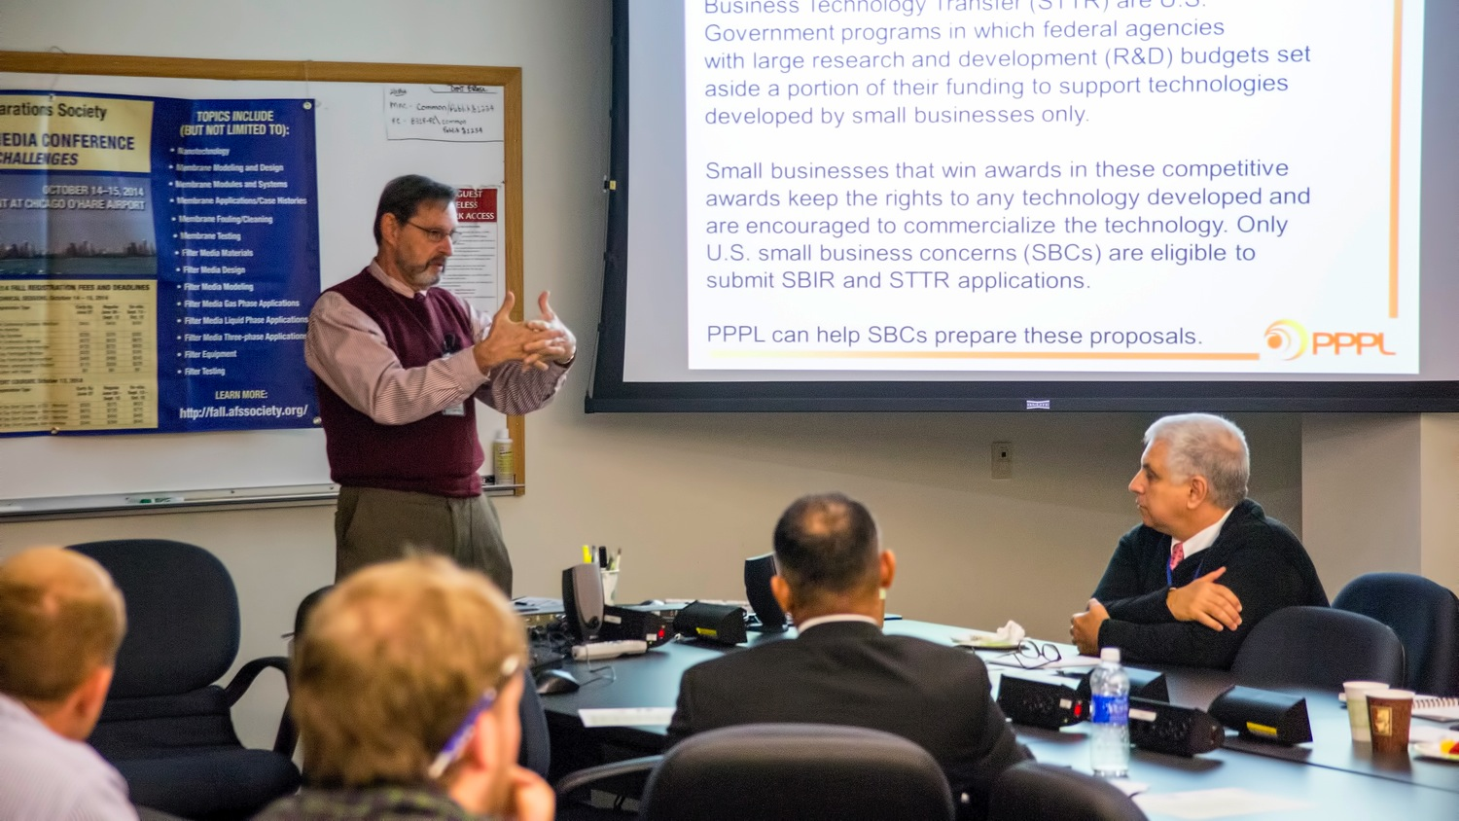
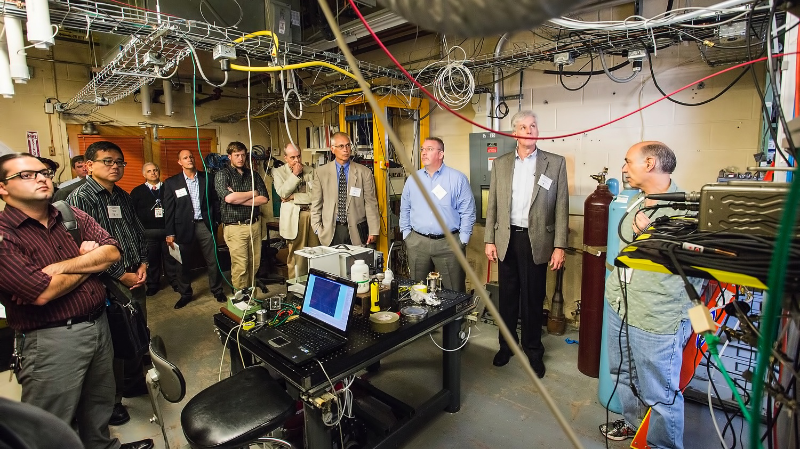
Technology Transfer Meeting at PPPL

Slide 6

Please fill out the Diversity & Inclusion Survey!
The survey at https://www.surveymonkey.com/s/KJRT9TJ will take just five to 10 minutes and will help the group learn more about diversity at PPPL and the work environment in general. The Diversity & Inclusion Group will use the survey to develop a strategic plan in this area.

Slide 7
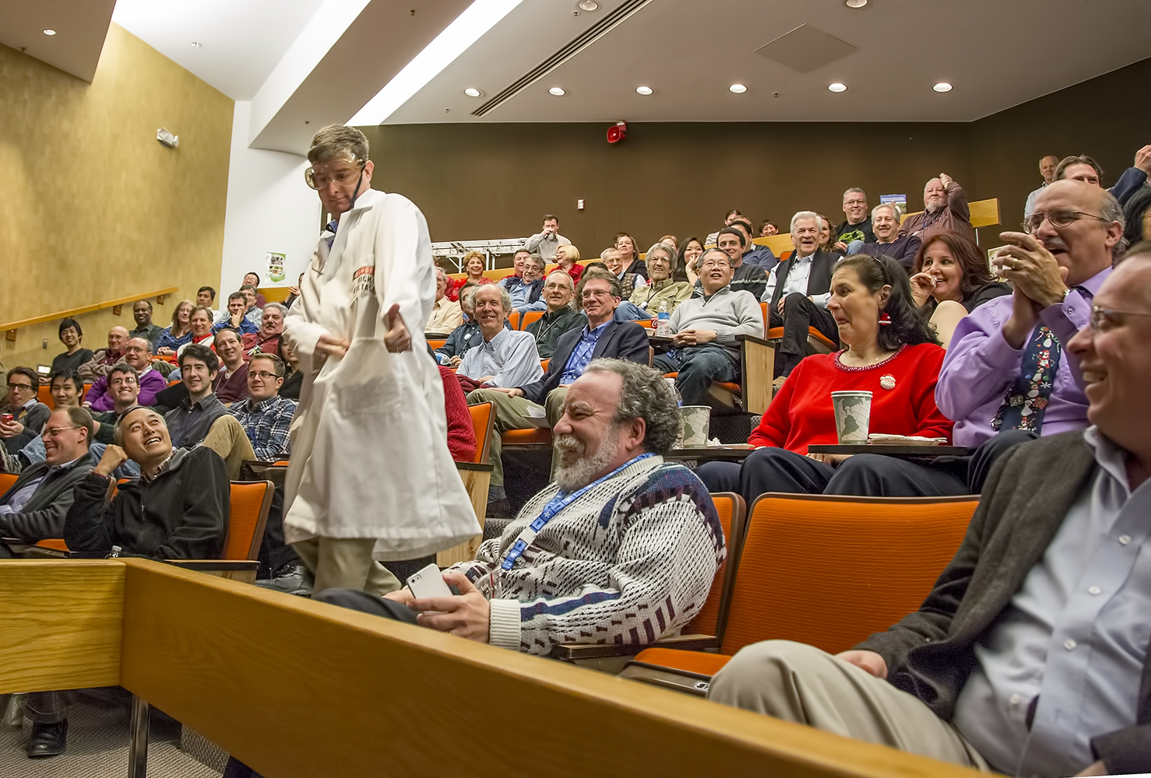


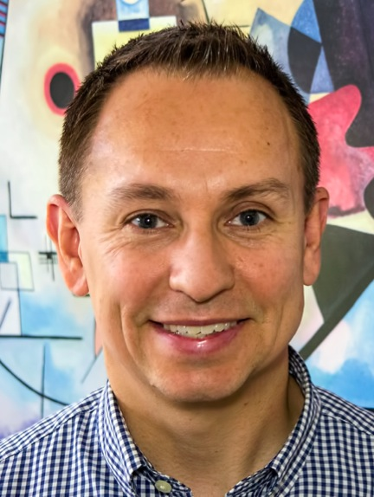
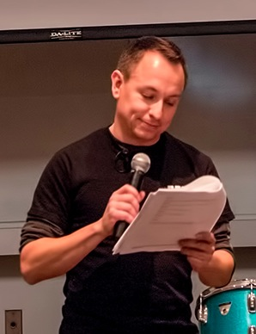
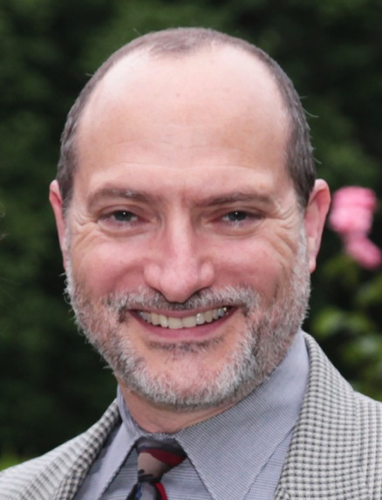
trivia
Who does Mike Gonzalez usually impersonate in the annual PPPL Holiday Skit?
a) Adam Cohen
b) Mike Williams
c) Stewart Prager
d) Mike Zarnstorff

Slide 8
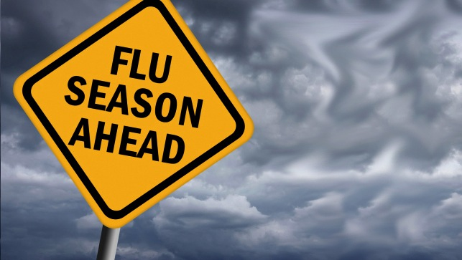


Please call the OMO at extension 3200 to make an appointment.

Slide 9
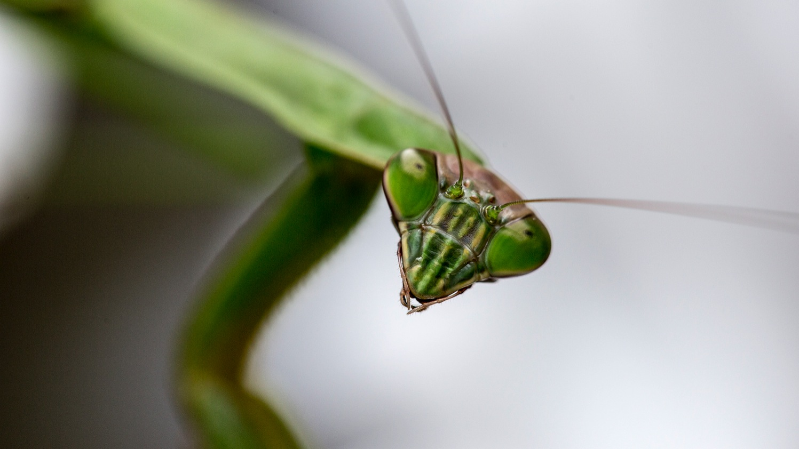
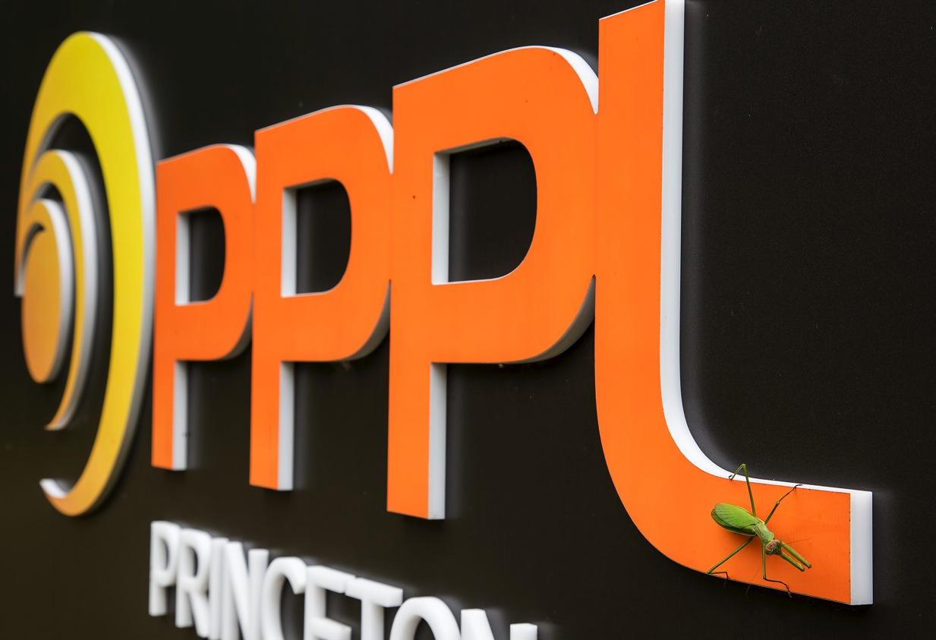
Nature at PPPL
Photos by Elle Starkman

Slide 10
